Slide 1
ESTER
Lección 01
Introducción a Ester

Slide 2
PERSONAJES
Ester
Mardoqueo
Amán
Asuero (Jerjes)
Notes:
More about Esther and Mordecai in next classes. For now, they are Jews
Haman is basically a cartoon character.
The bible is consistent in only revealing to us what we NEED to know. Huge chunks of history, people’s character, events….are left out because they’re not relevant to the story the bible is telling.
If Haman had any redeeming qualities, they are not mentioned
Today, the events of Esther are recounted every year by the Jewish community…and Haman is depicted as a complete buffoon.
But there is a key fact we need to remember about Haman…that he was an Agagite or an Amalekite.
He was a descendent of King Agag the Amalekite and King Saul had been told by God to completely exterminate those people. (read)
But Saul violated that order, and in doing so cost the lives of many. (read)
So remember this as we see Haman being a thorn in the side of the Jews throughout this narrative
Ahasuerus is Xerxes from secular history and he fits right in with the biblical narrative.

Slide 3
³ Ve ahora, y ataca a Amalec, y destruye por completo todo lo que tiene, y no te apiades de él; antes bien, da muerte tanto a hombres como a mujeres, a niños como a niños de pecho, a bueyes como a ovejas, a camellos como a asnos”».
1 Sam 15:3 (NBLA)
⁹ Pero Saúl y el pueblo perdonaron a Agag, y lo mejor de las ovejas, de los bueyes, de los animales engordados, de los corderos y de todo lo bueno. No lo quisieron destruir por completo; pero todo lo despreciable y sin valor lo destruyeron totalmente.
1 Sam 15:9 (NBLA)

Slide 4
PERSONAJES
Ester
Mardoqueo
Amán
Asuero (Jerjes)

Slide 5
Achaemenes
705 - 675
Teispes
675 - 640
Ariaramnes
Ciro I
640 - 600
Arsames
Cambyses I
600 - 559
Hystaspes
Ciro II
559 – 530/528
Darío I
522 - 486
Atossa
Cambyses II
530 - 522
Smerdis
522
Artystone
Jerjes I
485 - 465
Artajerjes I
465 - 424
Jerjes II
424
Sogdianus
424 - 423
Darío II
423 - 404
Arsites
Parysatis
Bagapaios
Notes:
This is Cyrus the Great, who made the decree that the temple be rebuilt and the Jews be allowed to return to Jerusalem:
Ezra 1:1-4
1 In the first year of Cyrus king of Persia, that the word of the Lord by the mouth of Jeremiah might be fulfilled, the Lord stirred up the spirit of Cyrus king of Persia, so that he made a proclamation throughout all his kingdom and also put it in writing:
2 “Thus says Cyrus king of Persia: The Lord, the God of heaven, has given me all the kingdoms of the earth, and he has charged me to build him a house at Jerusalem, which is in Judah. 3 Whoever is among you of all his people, may his God be with him, and let him go up to Jerusalem, which is in Judah, and rebuild the house of the Lord, the God of Israel—he is the God who is in Jerusalem. 4 And let each survivor, in whatever place he sojourns, be assisted by the men of his place with silver and gold, with goods and with beasts, besides freewill offerings for the house of God that is in Jerusalem.”
Then if you remember the story, some of Judah’s enemies spent years frustrating the attempts of the Jews to fulfill this decree…a letter is sent to Artaxerxes saying the Jews are a menace…he orders the work to stop…then eventually another letter is sent to Darius II, who searches the archives and finds Cyrus’s initial decree and…
Ezra 6, Darius tells the people frustrating the Jews to leave them alone, let the work restart.
Right in the middle of all of this is the events of Esther
And I want to notice a few things:
During this time:
The Persian empire is a large, mostly united kingdom
Different races, religions, and languages are represented
Conflict exists, in that the Persians didn’t care for Babylonia and their way of life, nor the Egyptians and there way of life…perhaps to a racist degree, not just culturally
Xerxes is known for separating the Persian government from the religion of Egypt and Babylon
Does any of this sound familiar?
Things today are not exactly as they were in the Persian empire, but there’s enough there to recognize. And that’s going to be one of the themes of this class…I want you to see yourself and your circumstances in Esther.
I think we can learn a lot if we do that…we’ll talk more about that in a second with our goals.

Slide 6
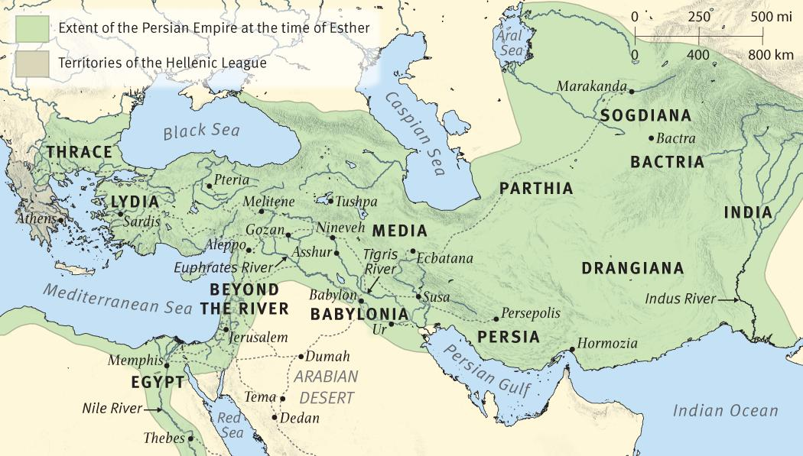
Imperio persa en el tiempo de Ester
Territorios de la liga helénica
Notes:
In history, this book is set in the time following the Babylonian exile when Persia was the ruling power. It’s set in Susa, the Persian capital, during the reign of King Ahasuerus, better known by his Greek name, Xerxes I (486-464). Some Jews had returned to Jerusalem (see Ezra, Nehemiah). Others, like Esther and Mordecai were still in exile and were looked down on as a minority group. Their situation was similar to that of Daniel and his friends around a century earlier.
Main history of Persia during this time comes from the Greek historian Herodotus, along with a limited amount of archaeological evidence from Susa and elsewhere.

Slide 7
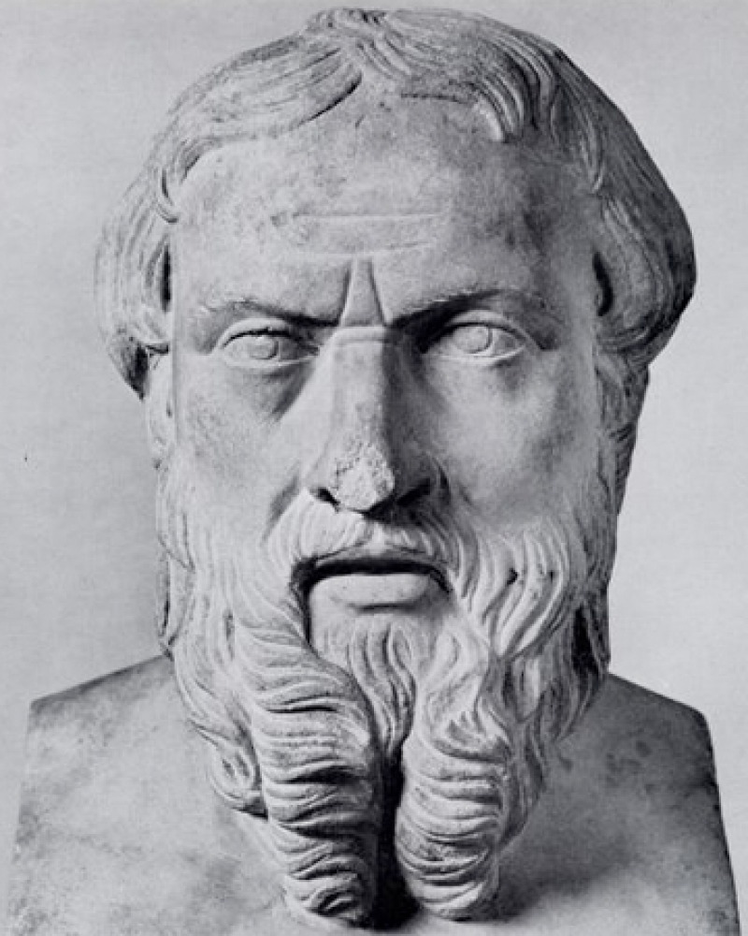

Slide 8
Referencia | Evento | Mes | Día | Año
1:3 | Asuero hace sus banquetes |  |  | 483 a.C.
2:16 | Ester va a Asuero | 10 |  | 479
3:7 | Amán echa sus suertes | 1 |  | 474
3:12 | Hamán hace su edicto | 1 | 13 | 474
3:13 | Fecha planificada para la aniquilación de los judíos | 12 | 13 | 473
8:9 | Mardoqueo hace su edicto | 3 | 23 | 473
8:12; 9:1 | Día en el cual los judíos se podrían defender | 12 | 13 | 473
9:6-10, 20-22 | Los diez hijos de Amán son ejecutados; la Fiesta de Purim | 12 | 14, 15 | 473

Slide 9
OBJETIVOS
Prepararnos para el crecimiento de carácter
Considerar la soberanía de Dios
“Procurar el bienestar de la ciudad…”

Slide 10
¿Es Ester un libro religioso?

Slide 11
¿Es Ester un libro religioso?
Nunca se le menciona a Dios
Tampoco hay mención de Jerusalén, el templo, la Ley, el pacto, amor ni perdón
Nadie ora, profetiza, tiene una vision ni hace un milagro
El Nuevo Testamento nunca cita ni alude a Ester

Slide 12
EL DIÁLOGO INTERBÍBLICO COMO PISTA A LA RELIGIÓN DE ESTER
Mardoqueo y Saúl
Nabal y Amnón
Asuero y Amán
Ester y Daniel
Mardoqueo y José
Ester, Jonás, y Joel
Moisés y Ester
Amán y José
Purim y Pascua
Purim y Sión
Ester y Cristo
Notes:
One of the biggest clues to Esther being a religious book is what we call interbiblical dialogue
And what this means is that the characters and events in Esther closely resemble other characters and events from the bible…so that when you read them it’s hard not to learn some of the same lessons
And we’re going to spend this class showing Esther as a wonderful piece of the biblical narrative, but not everyone feels the same way…including religious people
Consider some of these quotes:
“They are Jews who chose not to return to the Promised Land. Esther shows no concern for dietary laws when brought into the king’s court, and she conceals her Jewish identity during the search for a queen and continues to do so as queen. She then loses her virginity in the bed of an uncircumcised pagan king to whom she is not married. She only risks her life by going to the king after Mordecai points out that she will not escape harm if she refuses to act. Finally, when she finds out the Jews have killed 500 people in Susa, she asks that the massacre be permitted for yet another day and the bodies of Haman’s ten sons be impaled on the city gate.”
Another quote that I’ll pick up midway through:
“…Luther [Martin] is well known as expressing his hostility to Esther, wishing even that it did not exist as it “Judaize[s] too greatly and [has] much pagan rubbish.” Jewish scholar Samuel Sandmel echoes the sentiment: “I should not be grieved if the book of Esther were somehow dropped out of Scripture.” Pfeiffer goes on to say, “Such a secular book hardly deserves a place in the canon of Sacred Scriptures.” Eissfeldt says, “Christianity… has neither occasion nor justification for holding onto it,” and Morris calls it “a standing embarrassment to Christian expositors.” Anderson says, “One gains the impression that the author had an indifferent, if not cynical, attitude toward the Jewish religion. Not least of all, the book is inspired by a fierce nationalism and an unblushing vindictiveness which stand in glaring contradiction to the Sermon on the Mount. Surely this book is of the earth.” Anderson goes on to say it unveils the dark passions of the human heart—such as envy, hatred, fear, anger, vindictiveness, and pride—which are then blended into an intense nationalism. He ultimately concludes, “A more human book has never been written.”
Those are some tough words against the book, right? And some of the accusations are warranted…we SHOULD ask the question…is this a bible book?
I think it is, of course, and I want to look through this list of Interbiblical dialogue as a way to START answering this question
Group Activity
Pair off in 2-3
Use scriptures in lesson sheet
Try to find some similarity between the names given
Come together and share

Slide 13
ESTRUCTURA LITERARIA DE ESTER
A Fiesta orgullosa del rey (1:1-22)
B Ester alcanza el reinado (2:1-18)
C Se salva la vida del rey (2:19-23)
D El complot de Amán (3:1 – 4:17
E Ester invita al rey y a Amán al primer banquete (5:1-14)
F La suerte de Amán cambia (6:1-14)
E Ester invita al rey y a Amán al segundo banquete (7:1-10)
D El complot de Amán frustrado (8:1-17)
C Las vidas de los judíos son salvadas (9:1-10)
B Ester gana el segundo día para los judíos en Susa (9:11-19)
A Se establece la fiesta judía de Purim (9:20 – 10:3)

Slide 14
REVESES EN ESTER
3:1-2
Haman’s high rank
3:10
Amán le dio un anillo de sello
4:1
El luto de Mardoqueo
4:3
Ayuno y llanto entre los judíos
5:14
Zeres sugiere una horca para Mardoqueo
5:14
Zeres advierte a Amán acerca de Mardoqueo
6:6-9
Amán busca honra para sí mismo
6:11-12
Amán obligado a honrar a Mardoqueo
6:13b-14
Zeres advierte a Amán acerca de Mardoqueo
7:9-10
Harbona sugiere que Amán sea colgado de su propia horca
8:17a
Banquete y celebración entre los judíos
8:15a
La exaltación de Mardoqueo
8:2a
Mardoqueo recibió un anillo de sello
9:3-4; 10:3
El alto rango de Mardoqueo

Slide 15
ESTER
Lección 02
ESTER 1-2

Slide 16
OBJETIVOS
Prepararnos para crecer en nuestro carácter
Considerar la soberanía de Dios
“Procurar el bienestar de la ciudad…”

Slide 17
CASUALIDADES
Vasti debe rehusar presentarse ante Asuero
Asuero debe despedir a Vasti para hacer espacio para Ester
Ester debe ser traída a la competencia del rey
Hagai debe fijarse en Ester y avanzarla
Ester debe ser escogida por Asuero
Mardoqueo debe estar en el lugar correcto para oír sobre la conspiración para asesinar al rey
Asuero debe anotar la buena obra de Mardoqueo sin recompensarle
Esther debe esconder con éxito su raza
Debe salir de la suerte una fecha tarde en el año
Ester debe ser convencida por Mardoqueo a arriesgar su vida
Asuero debe aceptar a Ester cuando entra sin que ésta sea llamada
Ester no debe hacer su petición de inmediato, así permitiendo los sucesos del capítulo 6
Asuero debe tener insomnio
Asuero debe decidir que le lean las crónicas reales en su insomnio
La sección debe ser leída que se trata de Mardoqueo
Asuero debe decidir recompensar a Mardoqueo
Amán debe presentarse en el patio del rey en el momento adecuado
Asuero debe hablar antes de Amán, siendo lo suficientemente ambiguo como para permitir una interpretación equivocada de parte de Amán
Amán debe malinterpretar al rey, pensando que está hablando de él
Asuero debe volver del huerto en el momento preciso cuando Amán se está cayendo sobre el lecho de Ester
Notes:
The last thing I want to mention about the book as a whole to illustrate it’s religious nature, is the number of “coincidences” that take place for the ending result to occur.
None of the things on this list are unbelievable on their own.
And you could argue that most of them could be altered in some way and the end result still could have been accomplished…especially if we believe God played a role in this…
But when taken all together, I think it’s powerful evidence that God plays a role in the affairs of man…I don’t know how or to what degree, but the evidence piles up.
With it all on the screen it will feel redundant to read all of these but I think that’s the thing to do here…partly because this serves as a way of outlining the total book before we start going through chapter and verse in the next classes.
(read through slide)
When all of these things come together, you feel God’s hand, right?
It’s like when you look at nature…and I can’t lay out a scientific argument for how it was clearly designed by an intelligent being…but the evidence is there, right?
I never want to use my “feelings” as a way to prove things, but our ability to look at large swaths of evidence and lean towards a conclusion can’t be discounted.
I think Esther is a beautiful book, that will challenge us all to think about our own character, or own relationship with God, and how we can use those things to do good in this world.

Slide 18
Notes:
Read 1-9
First lets use what we see in these first 9 verses to frame the setting and get a little background.
3rd year of reign was 483, since Xerxes came to the throne in 486.
How many days was this great festival?
This great festival that lasted 180 days, capped by a 7 day feast, was in preparation for the invasion of Greece…something we learn from Herodotus (advance to black when finished). It’s likely that all of the nobles, governors, princes, etc. came in succession sometime during the 180 day period, being entertained and shown off to, but also to receive their instructions for the coming war.
In the time of these events there were at least 3 great men called Ahasuerus. Daniel mentions one in 9:1 as the father of Darius, but he was not a king. Ezra mentions another in 4:6 (Xerxes II), but the distinction is made in the size of the kingdom…being much larger than at the time of Ezra.
What is another name for Ahasuerus?
Names will be used interchangeably.
Structure of Power: This is kind of an aside…not very important…but it helps me understand the time they were living in a little better
127 provinces (Esther 1:1)
27 Satraps (Ezra and Nehemiah) (over taxation districts) (4-5 provinces per Satrap)
Nobles
Governors
King
Queen
Eunuchs (7 serving the King)
Princes (7 over Persia and Media) (3-4 Satraps per Prince)
This was a large empire. This was an organized empire.
Susa (now called Shush, in the southwestern part of modern Iran), was one of four capitals of Persia. The others were Babylon, Ecbatana, and Persepolis.
What do y’all think about the description of the king’s palace? What kind of place was it?
The beautiful description of the king’s palace provides a fitting setting for the disaster that, no doubt, took place there. It would be hard to find a better image of man’s flaws than this scene. The edict that anyone should drink whatever they want, however little or much as they pleased, gives us an image of a drunken wasteland by day 7.
“Merry with wine” (drunk)
So that sets the scene

Slide 21
¹ En el año primero de Darío, hijo de Asuero, descendiente de los medos, que fue constituido rey sobre el reino de los caldeos,
Daniel 9:1 (NBLA)
⁶ En el reinado de Asuero, al principio de su reinado, sus enemigos escribieron una acusación contra los habitantes de Judá y de Jerusalén.
Esdras 4:6 (NBLA)

Slide 22
Imperio persa en el tiempo de Ester
Territorios de la liga helénica
Notes:
In history, this book is set in the time following the Babylonian exile when Persia was the ruling power. It’s set in Susa, the Persian capital, during the reign of King Ahasuerus, better known by his Greek name, Xerxes I (486-464). Some Jews had returned to Jerusalem (see Ezra, Nehemiah). Others, like Esther and Mordecai were still in exile and were looked down on as a minority group. Their situation was similar to that of Daniel and his friends around a century earlier.
Main history of Persia during this time comes from the Greek historian Herodotus, along with a limited amount of archaeological evidence from Susa and elsewhere.

Slide 23
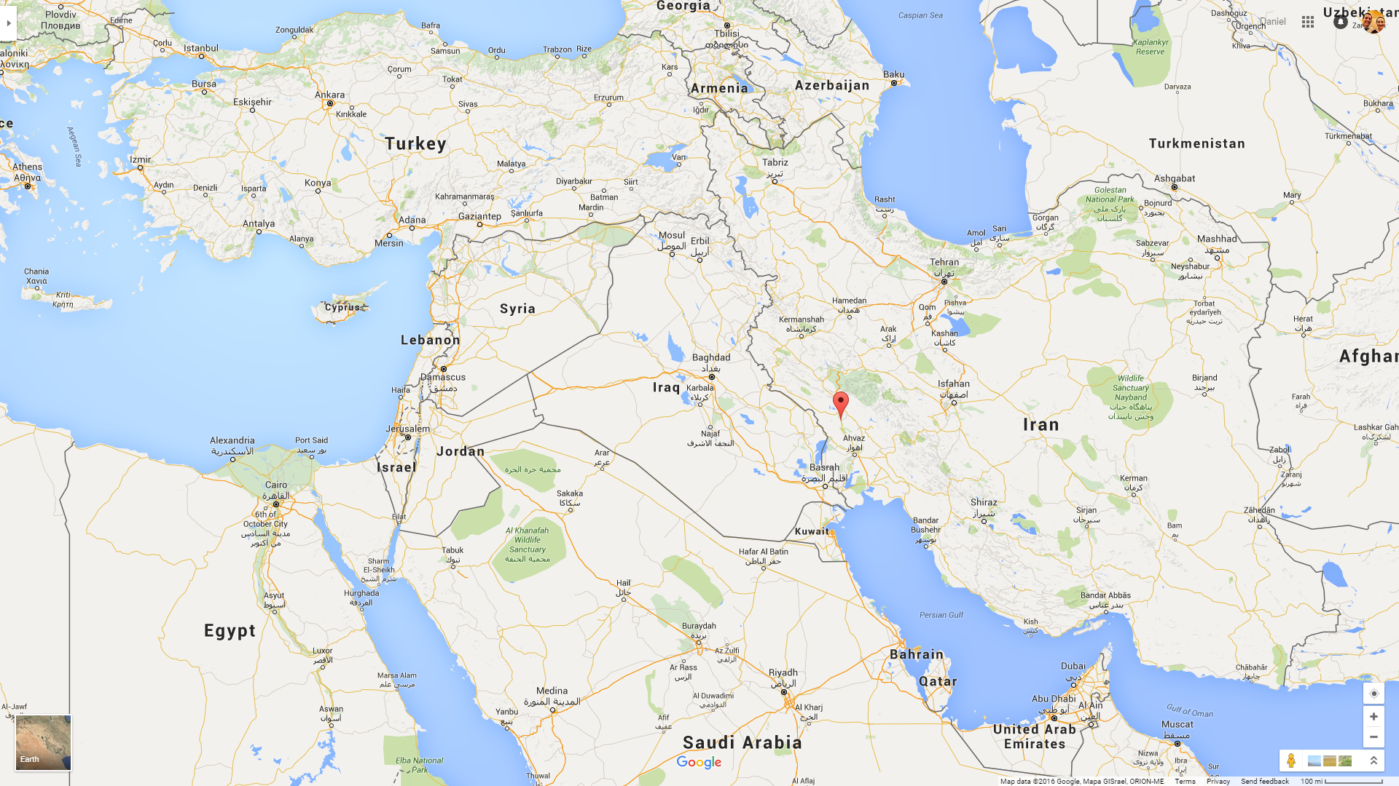

Slide 24
Imperio persa en el tiempo de Ester
Territorios de la liga helénica
c. 479 B.C.
Notes:
In history, this book is set in the time following the Babylonian exile when Persia was the ruling power. It’s set in Susa, the Persian capital, during the reign of King Ahasuerus, better known by his Greek name, Xerxes I (486-464). Some Jews had returned to Jerusalem (see Ezra, Nehemiah). Others, like Esther and Mordecai were still in exile and were looked down on as a minority group. Their situation was similar to that of Daniel and his friends around a century earlier.
Main history of Persia during this time comes from the Greek historian Herodotus, along with a limited amount of archaeological evidence from Susa and elsewhere.

Slide 25
Notes:
Read 10-22
Why do you think Vashti disobeyed?
Theories for why Vashti disobeyed:
Most likely…she was pregnant with Artaxerxes I…didn’t feel good, look good, whatever…to expose herself to the king’s drunken request
She knew the dangers of the request (physical danger, sexual exploitation, embarrassment to the kingdom…kind of like being at a bar at 2am…hard to see a good outcome)
She was drunk too, and made a decision she might not have otherwise made
What do you think this says about the status of women in Persian culture?
Perhaps more than any of Ahasuerus’s other decisions, this one shows what a poor man that he was, and what a poor culture he was a part of. Whether Vashti was pregnant or not, she should be respected and protected above anyone else in his kingdom, but he instead wanted to parade her around in front of all the drunken people. We don’t know the exact nature of the request, I think the bible wisely omits some of the details of this feast and exactly what he wanted Vashti to do by appearing before everyone…but we know that this request was shameful…and reveals the character of Ahasuerus.
Vs 13-22 – The events in these verses show the low estate given to women in the ancient world, which provides a heavy reminder to look to and follow the teachings of Jesus on women.
Men, read this passage carefully…don’ t gloss over it as something that only happened in B.C. times. Do you ever think of women like this? Do you ever lead your household like this? Do you ever think of women as an object instead of someone to lift up in honor?
Women, also read this passage carefully and be careful not to get carried away in your reactions toward it. It’s not the difference in roles that’s at issue here, it’s how they fulfill their roles. Ahasuerus is doing a poor job in his role as king, in his role as head of his wife…the world’s reaction to this is “equality”. Women should be treated as equal in all things…but that is a specious equality, and one that denies the teachings of Christ.
Everyone, look to Jesus here. Examine yourself in this passage, and then look to Jesus for the answers.
A quick note about Persia and Media. We sometimes hear it called the Medo-Persian empire…sometimes just the Persian empire. In Daniel you see the phrase “the law of the Medes and the Persians” while in Esther you see “The law of the Persians and the Medes”. Just to be clear, Persians and Medes were the two principal races that formed the Medo-Persian empire, but it’s not two empires…it’s one…made up primarily of two racially different peoples. Daniel mentions Media first because at that time, Darius a Mede was king. Now in Esther it’s Xerxes, a Persian, so they’re mentioned first.

Slide 26
En los versículos 1-18, el escritor describe el proceso implementado por Asuero para reemplazar a Vasti como reina de Persia. Identifique un versículo o grupo de versículos que usted considera que mejor resuma la naturaleza de este proceso. Explique.
What nationality were they? (5)
Jewish
How did they come to Susa? (6)
Exile
What was Esther’s Hebrew name? (7)
Hadassah
How were Esther and Mordecai related biologically? (7)
Cousins
What did she look like? (7)
Beautiful
What was the nature of their relationship? (7)
Father/Daughter
Notes:
We’re about to go through the first 18 verses of chapter 2, but before we do…a few things to know:
Verse 16 tells us that Esther became queen in Xerxes’ seventh year; and, as the great feast mentioned in the previous chapter was in this third year (1:3), we understand that a lapse of 4 years has occurred between these two chapters. During this period, Xerxes fought the Grecian war, which was a complete disaster for him. He was consistently defeated by troops of far fewer numbers and resources. A movie that came out several years ago details one of those occasions. The movie of course embellishes the story, but it’s based on fact where a group of, perhaps 300 men, dealt a great deal of damage to Xerxes gigantic army.
The Greek historian Herodotus tells us that when Xerxes returned from the campaign he consoled himself with indulgences from his harem. So I think that will help frame what we’re about to read a bit.
Read Slide, then read 1-18
What verse or passage did you come up with…which one best encapsulates this process?
I want to make a note about this plan before we go through the rest of this chapter…it would be easy to dance around some of the ugly parts of what was going on here…the language used is as tasteful as it can be while describing things, but we need to recognize exactly what was going on so that we understand Xerxes, Ahasuerus the way we need to…as a rotten person…whom God was still able to use to advance His purposes.
The harem was a place reserved for wives, concubines, and female servants. So this plan would mean that all of the beautiful women in the land would be taken from their homes, and gathered into this harem, where they would spend at least a year, as we see in verse 12, getting as beautiful and desirable as possible for the king, who would then take them one at a time, one night at a time…try them out…see if he liked them, and then return them the next morning, verse 14.
This was rape. This was human slavery. And I’m sure there were varying degrees of thought among the women on their consent to what was going on, but I just don’t want to reduce this situation to what I’ve heard it called a hundred times…a beauty contest. This was not a beauty contest, this was a dirty old man, enslaving young women, taking them to bed, taking their virginity, and then discarding them when finished. This means that Ahasuerus wasn’t just stupid, as we like to think of him for his decision making, or how we think of him when considering a beauty contest, what a stupid way to get a new queen…he was disgusting. He was an abomination of what God created, when he created man…and we need to understand that as we go through this story. Sometimes he looks like a good guy because he responds to Esther favorably, orders the execution of Haman, the villain of the story. These actions were simply God using him as a tool, nothing more.
Vs 5-7 introduces us to the people that the rest of this story is going to revolve around, Mordecai and Esther. (Read)
In these next two passages I just want to note a verse from each that is really sad to me. From 8-11, vs 11. “And every day Mordecai walked in front of the court to the harem to learn how Esther was and what was happening to her.”
Do you think Mordecai knew what was going on? Of course he did. What did we say his relationship was to Esther? How many fathers do we have in here who cringe at that thought. I get this picture of Mordecai standing outside, getting as close as he could…I can see the concern on his face, his body language probably showed his anxiety…and I feel bad for him. I’m not sure exactly how he felt towards Xerxes…this was a different time…and while we would all recoil in horror at what was going on, I don’t think it was way out of the ordinary for them. Or at least it wasn’t completely unexpected…it seemed like something that a Persian king would do. And so your expectations of reality sort of guides how you react towards it. It wasn’t that outlandish of an idea, so he may not have been that upset with Xerxes. Or maybe he was, I don’t know. But we can circle back to this at the end of the chapter.
The next, from 12-15, is verse 14. “In the evening she would go in, and in the morning she would return to the second harem in custody of Shaashgaz, the king’s eunuch, who was in charge of the concubines. She would not go into the king again, unless the king delighted in her and she was summoned by name.”
The women entered the king’s chamber a virgin from the first harem, and left a concubine, mostly forgotten about. Remember, this was not a beauty contest.
This chapter is just really depressing to me…the things going on. But this is really important, I want us to remember this…
There is not a situation in this world that God cannot use to exert His will. Out of the deepest, darkest, ashes of our sin….God can bring glory, and honor, and salvation. That’s the God that we serve.
Everyone in here will face, or has already faced some very difficult…some very disturbing situations. For those of you who don’t know I work at CNN, and I sit there and watch some of the most horrific things you can imagine scroll across the screen daily. Grizzly murders, rape, human trafficking, beheadings, children suffering from chemical attacks in war-torn countries…..there is no good to be found in these things. Sometimes no good ever comes from these things. But there is only One who can use these for good and that is God, and we praise him for that.
When we go through these things, when we see these things, remember who you serve….it can be a tremendous comfort.
It’s hard not to see God’s providence in verses 16-18. You have this Jewish orphan, dependent on her cousin’s charity for her livelihood – becomes the first woman of Persia, the wife of the most powerful monarch on earth, the queen of an empire comprised of more than half of the known world. And this isn’t even a unique thing that God has done…remember Joseph, seated next to the throne in Egypt. Moses in the palace of Pharaoh; Daniel third in command in Babylon; now Esther; later Ezra and Nehemiah given great influence…this is God working…God providing for His people, providing a way for His son the Christ. And we’ll see even more of that influence in the chapters to come.
And good ol’ Xerxes is so happy he gives everyone a big holiday in verse 18. Something like tax free weekend and some government handouts…so it looks like Esther is already helping people out in the kingdom.

Slide 27
MARDOQUEO Y ESTER
¿Qué nacionalidad tenían? (5)
Judía
¿Cómo llegaron a Susa? (6)
Exilio
¿Cuál era el nombre hebreo de Ester? (7)
Hadasa
¿Qué parentesco biológico tenían Ester y Mardoqueo? (7)
Primos
¿Cómo era el aspecto de Ester?
Hermosa
¿Cómo era su relación?
Padre/Hija

Slide 28
Notes:
Read 19-23
Verse 19 talking about the virgins gathering for a second time is kind of strange, seeing that Esther has already been made queen…why would he be gathering them again. One guess that I read was that they were gathered in some sort of celebration gathering for Esther’s coronation. Either way, the real point of this passage is Mordecai being in the right place at the right time, by no strategy of his own, to hear about the plot against the king.
This is where I want to return to Mordecai’s thoughts towards Xerxes.
Advance to activity
He’s just found out about a plot against him...and you may think, if he really didn’t like the guy, and for all of the things that he’s done…Mordecai might certainly be justified in letting that plot play itself out. Let him be killed, he deserves it. But that’s not what Mordecai does. “Seek the welfare of the city where I have sent you into exile”. I guess it could be argued that Mordecai would have been seeking the welfare of the city by allowing the murder to happen, but that wasn’t Mordecai’s choice to make. Remember our goals of character growth, and seeking the welfare of the city. Mordecai was responsible for upholding the law, and the 6th commandment tells him not to kill, which he would have been guilty of if he had not alerted someone to this plot. It’s just like we see in court today, the person who pulls the trigger isn’t the only one who can be convicted of murder.
Mordecai did the right thing. And I don’t know if it tormented him to do so, but he did. And through it, some of the events of the rest of the story are staged.
Now, in these first two chapters we’re already seeing passages that are leading towards our goals. What I want to do the rest of this class is look through the first two chapters, let’s do this in groups, and look for passages that help with our goals.
Remember, some overlap can and does occur. Some verses hit on multiple goals.
Let’s look for them and then come back together and talk.

Slide 29
Al descubrir el complot contra Asuero, Mardoqueo tenía que decidir si iba a contarlo a alguien que conocía, o guardar la información para si mismo. Sin el beneficio de la objetividad, la perspectiva, y saber cómo resultó su decisión…nosotros sabemos que Mardoqueo tomó la decisión correcta al revelar el complot a Ester. Sin embargo, a lo mejor esta decisión no fue tan fácil como parece ser en la historia.
¿Cuáles son unas razones posibles por las que Mardoqueo no hubiera querido revelar el complot a Ester?
¿Por qué era correcta su decisión?

Slide 30
“Y busquen el bienestar de la ciudad adonde los he desterrado”
Jeremías 29:7 (NBLA)
What nationality were they? (5)
Jewish
How did they come to Susa? (6)
Exile
What was Esther’s Hebrew name? (7)
Hadassah
How were Esther and Mordecai related biologically? (7)
Cousins
What did she look like? (7)
Beautiful
What was the nature of their relationship? (7)
Father/Daughter

Slide 31
CRECIMIENTO DE CARÁCTER
¿QUIÉN SABE?
BUSQUEN EL BIENESTAR…

Slide 32
CRECIMIENTO DE CARÁCTER
¿QUIÉN SABE?
BUSQUEN EL BIENESTAR…

Slide 33
CRECIMIENTO DE CARÁCTER
¿QUIÉN SABE?
BUSQUEN EL BIENESTAR…

Slide 34
CRECIMIENTO DE CARÁCTER
¿QUIÉN SABE?
BUSQUEN EL BIENESTAR…

Slide 35
CRECIMIENTO DE CARÁCTER
¿QUIÉN SABE?
BUSQUEN EL BIENESTAR…

Slide 36
CRECIMIENTO DE CARÁCTER
¿QUIÉN SABE?
BUSQUEN EL BIENESTAR…

Slide 37
CRECIMIENTO DE CARÁCTER
¿QUIÉN SABE?
BUSQUEN EL BIENESTAR…

Slide 38
ESTER
Lección 03
ESTER 3-4

Slide 39
OBJETIVOS
Prepararnos para crecer en nuestro carácter
Considerar la soberanía de Dios
“Procurar el bienestar de la ciudad…”

Slide 40
Notes:
Read Chapter 3
Who are we introduced to in this chapter?
Haman the……Agagite
Where does this name come from?
King Agag….who was king of…..the Amalekites
And what had God declared would happen to this nation?
Utterly blot out
So with that as a little background…Why would Mordecai have not bowed down to pay homage to Haman?
There’s really nothing in the text that would indicate the command was to worship Haman, simply to “pay homage”. The best guess would be because of Haman’s ancestry, being an Agagite, a descendant of King Agag, an ancient enemy of Israel. Agag was king of the Amalekites (Ex 17:8-16) and was defeated by King Saul and killed by Samuel (1 Sam 15:1-33). The text says that when asked, Mordecai’s reason for not bowing was because he was a Jew. Of course there could have been more to the bowing than is revealed. It may have been commanded as homage but practiced as worship among the people, but that is speculation.
One more thing before we get into the real theme of this chapter…
The whole idea of Haman casting lots describes the process by which Haman decided the best time to destroy the Jews. Casting lots was usually a method for obtaining divine guidance (Josh 18:6; Prov 16:33)… Joshua did it when dividing the land among the tribes….Solomon describes it as a process that men do…but is controlled by God…so who knows if Haman looked for divinity in this process…if so…perhaps he received it from God himself…giving him the ridiculous date of 1 year out.
So that’s just to understand that process a bit in case you’re unfamiliar.

Slide 41
¹ Después de esto el rey Asuero engrandeció a Amán, hijo de Hamedata el agagueo, y lo ensalzó y estableció su autoridad sobre todos los príncipes que estaban con él.
Ester 3:1 (NBLA)

Slide 42
⁸ Capturó vivo a Agag, rey de los amalecitas, y destruyó por completo a todo el pueblo a filo de espada.
1 Samuel 15:8 (NBLA)

Slide 43
¹⁴ Entonces dijo el Señor a Moisés: «Escribe esto en un libro para que sirva de memorial, y haz saber a Josué que Yo borraré por completo la memoria de Amalec de debajo del cielo».
Éxodo 17:14 (NBLA)

Slide 44
⁴ Después que ellos le estuvieron hablando día tras día y él se había negado a escucharlos, se lo informaron a Amán para ver si la palabra de Mardoqueo era firme, porque él les había declarado que era judío.
Ester 3:4 (NBLA)

Slide 45
⁷ En el mes primero, que es el mes de Nisán, el año doce del rey Asuero, se echó el Pur, es decir la suerte, delante de Amán para cada día y cada mes hasta el mes doce, que es el mes de Adar.
Ester 3:7 (NBLA)

Slide 46
⁶ »Describirán la tierra en siete partes, y me traerán aquí la descripción, y yo les echaré suertes aquí delante del Señor nuestro Dios.
Josué 18:6 (NBLA)
³³ La suerte se echa en el regazo,
Pero del Señor viene toda decisión.
Proverbios 16:33 (NBLA)

Slide 47
ACTIVIDAD DURANTE LA CLASE
List the things we read in this chapter that seem absurd
What about each of the things you listed makes them absurd?
Haga una lista de las cosas que leemos en este capítulo que parecen absurdas.
¿Qué hace que cada elemento de tu lista sea absurdo?
List the things we read of in this chapter that seem absurd
What about each of the things you listed makes them absurd?
Notes:
Find the absurdity in this chapter
The point of this activity is that we don’t just want to see things that are ridiculous….label it as something stupid….and just move on……we want to identify why there is something wrong with it. How are we going to be able to influence others if we’re not able to articulate why we think the way we do.
Two examples:
You’re talking to someone about the church they go to….and they say….”Yeah this place is really great, they have this amazing youth group that my kids go to…they really love it”. Now….you know nothing else about this church yet…what they believe…anything. But when you hear the phrase “youth group”, what sort of things do you think about? (Write on board)
Activity driven fellowship
More focused on “life lessons” than bible teaching
Misuse of church funds
Fun supersedes usefulness
And all of those ideas get wrapped up into that one phrase “youth group”…so you hear this person you’re talking to say that and you immediately are thinking, wrong…sin…that’s stupid. And right as you think that they’re like “How about you let your kids come by next Thursday…they’re meeting down the road for a bible study”.
“What…a bible study?” You weren’t thinking that. So you ask questions…(Go to board and explain everything away)
What is wrong with youth group? Nothing. Embry Hills has a youth group. They meet an hour before worship on Sunday’s, split up by age group and learn about the bible. Some of them sing songs and color and play PowerPoint Jeopardy. Then on some days parts of the youth group meet at different people’s houses and talk about the bible together and then have a potluck. Some of the youth group have become really good friends and go to the movies together, and play basketball, or go to the mall or whatever (do kids still do that).
But what’s the difference?
Church funds are used solely for bible teaching
Anything done in class is focused primarily on bible teaching, from which life lessons are derived from
Usefulness supersedes fun, though fun can be a by-product
Nothing is wrong with “youth group”, only in the way that we usually see it practiced…and we have to be able to articulate that to people.
Found right here in Esther 3
I read one person’s opinion about how the people telling on Mordecai was ridiculous and he equated it to gossip. I don’t really agree, seeing that under their system of beliefs, they were doing the right thing. The idea of making known the wrongs of others isn’t bad in itself…we just praised Mordecai for doing the same thing. Their only fault would be in not respecting the God of Israel, who they surely knew about, and had heard what He was capable of, but decided that their governments system was more important.
So the example here is that some of us may read this verse, like the commentator I was reading did…who by the way has a ton of other great ideas and good things to say, but he read this and was like, oh…stupid, wrong…and he assigned a lesson to this verse that was not there. We all do that sometimes. It would have been better to look at this action taken by the people, and think why was it wrong. Did they disobey some part of the law, did they lie about what happened, what was their motivation for what they did? And I think it would be hard to call what they did gossip. There may be something else but it needs to be articulated better, so that others can understand.
Do Activity
First question individually
Second question in groups, then all together
Haman deciding to kill the entire Jewish race instead of punishing only Mordecai – the absurdity of Haman’s wrath
Haman casting lots to decide on such a matter – the absurdity of Haman’s lack of decision making. Perhaps it would have seemed good that his casting lots revealed a time in the first month, which would have been during the Passover. What a great way to stick it to the Jews. But of course he doesn’t factor in any of the other problems, like the year of advance notice.
The absurdity of Ahasuerus’s agreement. It would seem that Haman perhaps thought he would not agree, therefore he threw in the 10,000 talents of silver (8-9 digits of money today). The absurdity of greed.

Slide 48
³ Entonces los siervos del rey, que estaban a la puerta del rey, dijeron a Mardoqueo: «¿Por qué traspasas el mandato del rey?». ⁴ Después que ellos le estuvieron hablando día tras día y él se había negado a escucharlos, se lo informaron a Amán para ver si la palabra de Mardoqueo era firme, porque él les había declarado que era judío.
Ester 3:3-4 (NBLA)

Slide 49
ACTIVIDAD DURANTE LA CLASE
List the things we read in this chapter that seem absurd
What about each of the things you listed makes them absurd?
Haga una lista de las cosas que leemos en este capítulo que parecen absurdas.
¿Qué hace que cada elemento de tu lista sea absurdo?
List the things we read of in this chapter that seem absurd
What about each of the things you listed makes them absurd?
Notes:
Find the absurdity in this chapter
The point of this activity is that we don’t just want to see things that are ridiculous….label it as something stupid….and just move on……we want to identify why there is something wrong with it. How are we going to be able to influence others if we’re not able to articulate why we think the way we do.
Two examples:
You’re talking to someone about the church they go to….and they say….”Yeah this place is really great, they have this amazing youth group that my kids go to…they really love it”. Now….you know nothing else about this church yet…what they believe…anything. But when you hear the phrase “youth group”, what sort of things do you think about? (Write on board)
Activity driven fellowship
More focused on “life lessons” than bible teaching
Misuse of church funds
Fun supersedes usefulness
And all of those ideas get wrapped up into that one phrase “youth group”…so you hear this person you’re talking to say that and you immediately are thinking, wrong…sin…that’s stupid. And right as you think that they’re like “How about you let your kids come by next Thursday…they’re meeting down the road for a bible study”.
“What…a bible study?” You weren’t thinking that. So you ask questions…(Go to board and explain everything away)
What is wrong with youth group? Nothing. Embry Hills has a youth group. They meet an hour before worship on Sunday’s, split up by age group and learn about the bible. Some of them sing songs and color and play PowerPoint Jeopardy. Then on some days parts of the youth group meet at different people’s houses and talk about the bible together and then have a potluck. Some of the youth group have become really good friends and go to the movies together, and play basketball, or go to the mall or whatever (do kids still do that).
But what’s the difference?
Church funds are used solely for bible teaching
Anything done in class is focused primarily on bible teaching, from which life lessons are derived from
Usefulness supersedes fun, though fun can be a by-product
Nothing is wrong with “youth group”, only in the way that we usually see it practiced…and we have to be able to articulate that to people.
Found right here in Esther 3
I read one person’s opinion about how the people telling on Mordecai was ridiculous and he equated it to gossip. I don’t really agree, seeing that under their system of beliefs, they were doing the right thing. The idea of making known the wrongs of others isn’t bad in itself…we just praised Mordecai for doing the same thing. Their only fault would be in not respecting the God of Israel, who they surely knew about, and had heard what He was capable of, but decided that their governments system was more important.
So the example here is that some of us may read this verse, like the commentator I was reading did…who by the way has a ton of other great ideas and good things to say, but he read this and was like, oh…stupid, wrong…and he assigned a lesson to this verse that was not there. We all do that sometimes. It would have been better to look at this action taken by the people, and think why was it wrong. Did they disobey some part of the law, did they lie about what happened, what was their motivation for what they did? And I think it would be hard to call what they did gossip. There may be something else but it needs to be articulated better, so that others can understand.
Do Activity
First question individually
Second question in groups, then all together
Haman deciding to kill the entire Jewish race instead of punishing only Mordecai – the absurdity of Haman’s wrath
Haman casting lots to decide on such a matter – the absurdity of Haman’s lack of decision making. Perhaps it would have seemed good that his casting lots revealed a time in the first month, which would have been during the Passover. What a great way to stick it to the Jews. But of course he doesn’t factor in any of the other problems, like the year of advance notice.
The absurdity of Ahasuerus’s agreement. It would seem that Haman perhaps thought he would not agree, therefore he threw in the 10,000 talents of silver (8-9 digits of money today). The absurdity of greed.

Slide 50
Notes:
Read chapter 4
Let me back up real quick and mention something about the last verse from the previous chapter…
…it mentions that the city of Susa was perplexed. Although the Jews certainly had enemies in Susa, the majority of Persians were Zoroastrians (a highly ethical religion that put great importance on good vs evil, and it was monotheistic…not God, but a god), and were likely to sympathize with the Jews. There might also have been other national groups in Persia who would be fearful that their group was next.
So that may provide a bit of an idea of what the mood or thoughts of the city as a whole were…but as we enter chapter 4 we see Mordecai spending sometime in sackcloth and ashes…
What was the purpose of sackcloth and ashes?
Either one of them was a sign of mourning; but both together indicated the most distressing grief possible. E.g. gen 37:34; 2 sam 1:11; Job 1:20; Isa 15:1-3; Jonah 3:6). It also was an appeal to God. It’s like stripping away anything that makes you seem like a respectable human, and laying yourself bare before God…I am not worthy, your will be done. The same can be said for fasting.
Now I want to mention a quick aside about this before we go on. This has nothing to do with Esther particularly…I just want to expand on this idea of sackcloth and ashes for a second…because we’ve read it a hundred times and are kind of used to it now…we understand what they’re doing…what it means…but it is a little strange…and doesn’t make much sense in today’s world. Or does it?
I think the best way to understand it is by observing how different cultures today grieve…and mourn.
South Korean Ferry disaster
American’s much more conserved mourning
It’s a learned response
End aside.
So Mordecai is mourning, and word reaches Esther so she sends out one of the Eunechs to find out what’s going on. He finds out and brings this report back to her…including some instructions from Mordecai…what does he tell her to do?
Why do you think Mordecai was able to make that request of Esther, what enabled him to be able to boldly tell the queen to put her life at risk?
His relationship to her as her father
Who was Mordecai to command the queen to take this kind of risk, if they did not have the type of relationship that would merit this request. Perhaps God was already working when Esther’s parents passed away, by placing Mordecai in her life. His wise council would be imperative to her as queen.
And so by this point we’re beginning to see a very clear pattern of God’s providence in this story AND its connection with our responsibility. God has a Will, and that will will be accomplished. But he often, not all the time but often, does it through the free-will actions and choices of men.
Read slide
God is at work, and we’re starting to see it in the first few chapters.

Slide 51
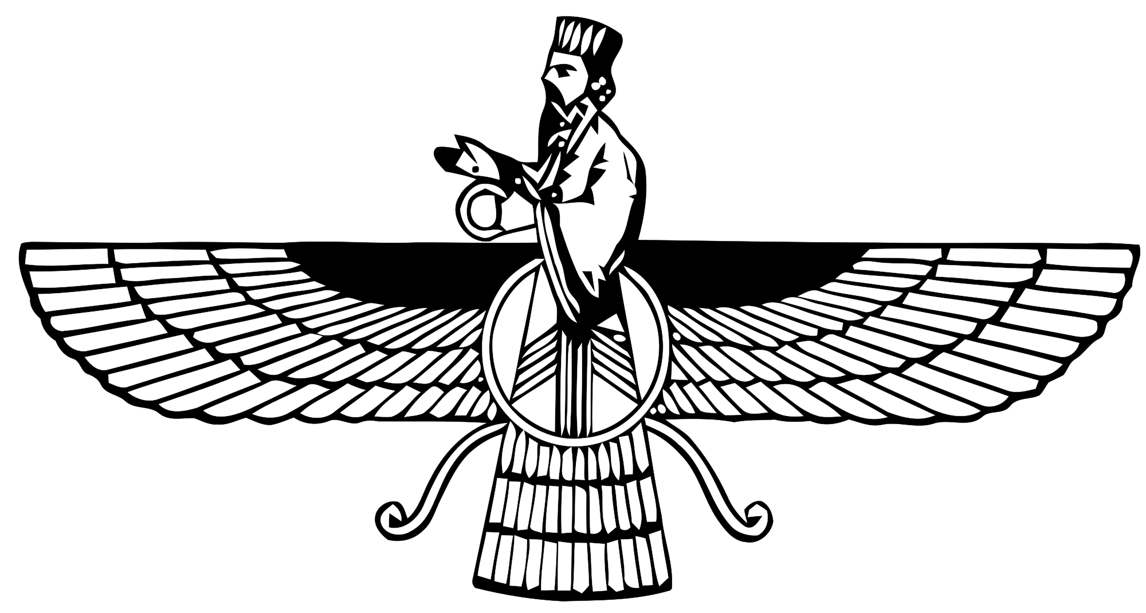

Slide 52
³⁴ Jacob rasgó sus vestidos, puso cilicio sobre sus lomos y estuvo de duelo por su hijo muchos días.
Génesis 37:34 (NBLA)
²⁰ Entonces Job se levantó, rasgó su manto, se rasuró la cabeza, y postrándose en tierra, adoró,
Job 1:20 (NBLA)
¹¹ Entonces Job se levantó, rasgó su manto, se rasuró la cabeza, y postrándose en tierra, adoró,
2 Samuel 1:11 (NBLA)
⁶ Cuando llegó la noticia al rey de Nínive, se levantó de su trono, se despojó de su manto, se cubrió de cilicio y se sentó sobre ceniza.
Jonás 3:6 (NBLA)

Slide 53
Después de la derrota original de los amalecitas, Dios declara que los borrará por completo
Éxodo 17
Dios le ordena a Saúl que destruya por completo a los amalecitas, pero no lo hace
1 Samuel 15
Ester
Mardoqueo se convierte en una figura paterna para Ester cuando fallecen sus padres
2:7
Dios usa el pedido de Jerjes cuando éste estaba borracho para degradar a Vasti y hacer ascender a una reina judía al trono
Capítulos 1-2
Plantó el nombre de Mardoqueo en las crónicas del rey
2:23
A Jerjes se le recuerda a Mardoqueo precisamente en el momento adecuado
6:1

Slide 54
ACTIVIDAD DURANTE LA CLASE
Lea los versículos 12-16 y elija el que más te llame la atención.
¿Por qué te llama la atención?
¿Qué lecciones podemos aprender de su versículo?
List the things we read of in this chapter that seem absurd
What about each of the things you listed makes them absurd?
Notes:
End with 14 – “For if you keep silent at this time, relief and deliverance will rise for the Jews from another place, but you and your father’s house will perish. And who knows whether you have not come to the kingdom for such a time as this?” This verse highlights providence and responsibility. (What two themes do you see in this verse, and why).
Backup to verse 11. Why is it mentioned that the king hasn’t summoned Esther for 30 days? Perhaps his love for her was waning, meaning that this task was even more dangerous.
What do you think about Mordecai’s faith that the Jews will be delivered, one way or another? Is that how we think of things sometimes? I think most of the time I don’t look past the immediate decision; all I can see is how disastrous it would be if that one decision is made incorrectly. Mordecai certainly saw the disaster coming, but he still had the clarity of mind to know who was ultimately in control. That is a practiced faith. He didn’t just learn that by reading a few manuscripts and hearing some stories passed down from his father. That is a practiced faith, to be able to see God and have faith in Him, even in the worst of circumstances. I really hope to be like that when the worst things happen to me. Would I see and know that God was in control if Page passed away in childbirth? If we lost all three babies somehow? What things in your life would shake your faith? Look to this example of Mordecai.

Slide 55
CRECIMIENTO DE CARÁCTER
¿QUIÉN SABE?
BUSQUEN EL BIENESTAR…

Slide 56
CRECIMIENTO DE CARÁCTER
¿QUIÉN SABE?
BUSQUEN EL BIENESTAR…

Slide 57
CRECIMIENTO DE CARÁCTER
¿QUIÉN SABE?
BUSQUEN EL BIENESTAR…

Slide 58
CRECIMIENTO DE CARÁCTER
¿QUIÉN SABE?
BUSQUEN EL BIENESTAR…

Slide 59
CRECIMIENTO DE CARÁCTER
¿QUIÉN SABE?
BUSQUEN EL BIENESTAR…

Slide 60
CRECIMIENTO DE CARÁCTER
¿QUIÉN SABE?
BUSQUEN EL BIENESTAR…

Slide 61
ESTER
Lección 04
ESTER 5

Slide 62
OBJETIVOS
Prepararnos para crecer en nuestro carácter
Considerar la soberanía de Dios
“Procurar el bienestar de la ciudad…”

Slide 63
Notes:
Read 1-8
Let’s go through some of the questions from your lesson…
What kind of emotions do you think Esther was feeling while standing in the court waiting on the king?
Remember this was the third day of her fasting. That certainly played into the way she felt physically. I think she certainly would have been nervous, first for her life, if the king had simply failed to notice her she would have been dragged out and killed per law….but also generally the way any of us would when doing something important.
The LXX has more text in this passage where it says “the king kissed his wife tenderly and restored her when she fainted through excitement”. I don’t know why that was in that text and not the other translations but it at least seems plausible….and even lends to the character of Ahasuerus.
But either way, we’re seeing character growth here…she’s going and doing the hard thing. She has a plan…she’s not throwing her hands up and saying “let’s get this over with”…she’s doing it with purpose.
It says in verse 1 that the king was sitting on his royal throne…and there’s actually archeological evidence of that type of scene. This is Darius I sitting on the throne with a scepter, and Xerxes standing behind him carved into limestone and dates to about 490 B.C….so just a few years before Xerxes ascended to the throne.
No point to be made I just thought this was interesting.
Let’s look at the 3rd question from your lesson, “A similar oath to the one made inverse 3 is made by Herod the tetrarch many years later. What was the result of that similar oath (Matt 14:1-12)?”
The death of John the Baptist. And really what this highlights is that, even if his language of “half the kingdom” was hyperbole, this offer was big…and she probably could have taken a shortcut here to whatever she was trying to accomplish.
Which brings us to the first “In class” question from the lesson. (read). Talk to your neighbor for just a minute or two and then let’s float some theories.
What do you think? Why did Esther wait?
It’s possible that she simply panicked. This is perhaps not what she was expecting. And if you’ve got something all planned out in your mind it’s hard to change course (tell story of asking Page to marry me).
My opinion is somewhere between wisdom and folly. On the folly side…I think that there was a certain lack of trust in God here. It would be pretty easy to imagine the story of Esther WITHOUT most of chapter 6 and 7. Haman not celebrating and building the gallows, none of the shaming of Haman as his honor is taken by Mordecai, none of the dramatic reversal with Haman on the gallows instead of Mordecai…all of that could have been skipped had Esther made her request here.
It would be reasonable to think that Ahasuerus would have been just as angry had he learned Haman’s plan here as he is later, and killed Haman and granted Esther’s request to reverse the edict. You could make the argument that Ahasuerus’s demeanor here WAS God’s hand…setting the table for Esther…”here you go…he’s putty…make your request…I’ve given you salvation”.
But then on the wisdom side…what Esther was asking for here kind of WAS half the kingdom. Not in the way Ahasuerus meant it, but to reverse an edict that was made in the King’s name was a sign of weakness, of error, it hurt his credibility. Even if he could blame it all on Haman….Haman was HIS appointment. This request was a big deal politically, and personally embarrassing to the king. There was perhaps wisdom in letting natural events play out.
A natural result of more time here is an accentuation of what was in the inner heart of those involved. Ahasuerus’s curiosity and, what looks like, infatuation with Esther would grow. Haman’s pride and mismanagement as a ruler would fester. You can almost see Esther saying, I may only need to sit back and let Haman destroy HIMSELF.
Whatever the case, it really looks like God seized the opportunity..as we’ll read over the next couple of classes.

Slide 64
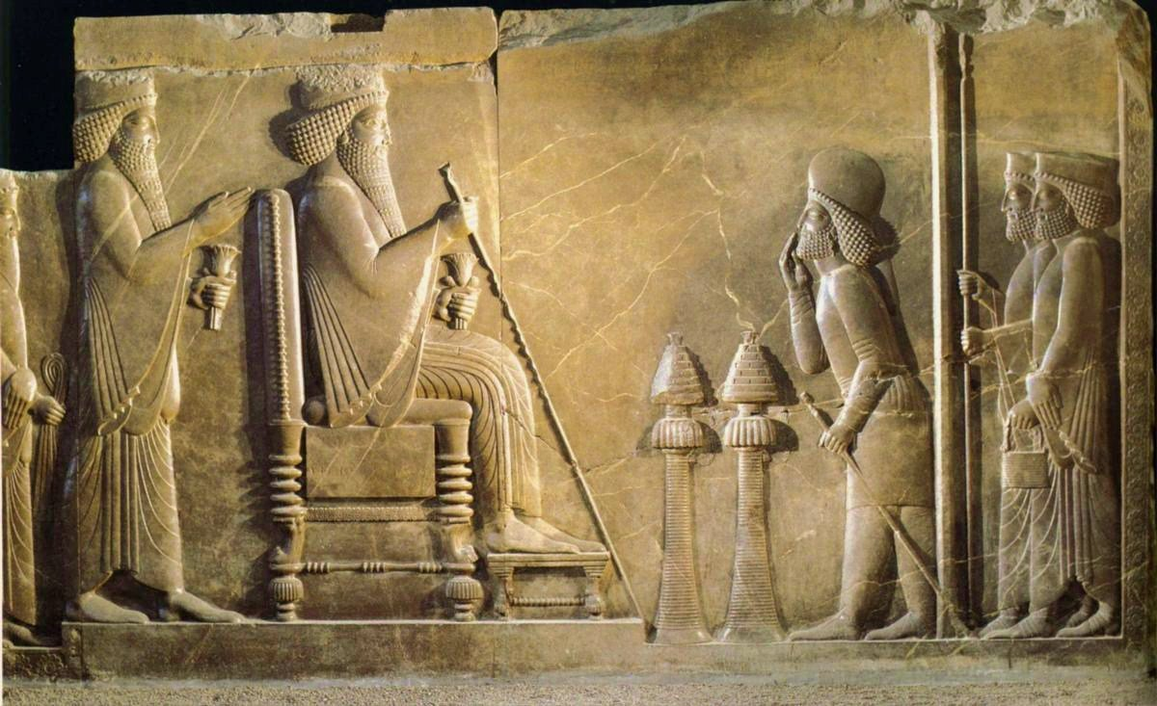
Darío [sentado] y Jerjes dando audiencia - Relieve de piedra caliza del complejo palaciego de Darío y Jerjes, Persépolis c. 490 a.C.

Slide 65
⁷ Por lo cual le prometió con juramento darle lo que ella pidiera. ⁸ Ella, instigada por su madre, dijo*: «Dame aquí, en una bandeja la cabeza de Juan el Bautista».
⁹ Y aunque el rey se entristeció, a causa de sus juramentos y de sus invitados, ordenó que se la dieran;
Mateo 14:7-9 (NBLA)

Slide 66
ACTIVIDAD DURANTE LA CLASE
¿Por qué cree que Ester no hace su petición inmediatamente cuando se le pide? ¿Por qué la deja hasta un segundo banquete al día siguiente?
List the things we read of in this chapter that seem absurd
What about each of the things you listed makes them absurd?

Slide 67
Notes:
Let’s read 9-14 and as we do, look for all of the absurd things that Haman does.
In a previous iteration of this class we highlighted “absurdity” as a theme of the class. It was literally a theme we looked for in every class. I pulled that out of main focus this time, but it’s still here and I can’t help but highlight it a few times.
(read)
Joy and gladness of heart is tied to his perceived honor
Filled with wrath because someone doesn’t show him honor he believes he is due
Boasts of all of his stuff
As high as he regards his stuff, he disdains Mordecai more
Likes idea of gallows
Actually follows through with idea of gallows
Haman, here, is something that I still see today…he is a child in a man’s body. How sad for us if we make it to adulthood, middle-age, and even our senior years, yet are still children on the inside.
My 6 year olds right now are proud of their stuff. They’ll show people when they come over….look at this it’s mine. But they don’t have much to call their own, they’re still excited by that feeling of ownership…that something in this big world they live in could actually belong to them…but we expect them to grow past this over time. We expect them to learn the true value of “stuff”, and that it’s actually pretty worthless overall.
We expect children to learn to control their emotions, not to lash out in wrath over small slights. Yet I see children in men’s bodies in all sorts of road rage incidents. People shooting people because they got cut off.
I still feel that little devil inside of me that likes an idea that really is not good, not righteous
As I mature, shouldn’t I be able to control that, though? Stamp that down?
Everything we just read of Haman SOUNDS ridiculous…yet we still see it all around us today, and COULD be all of us if we do not GROW as Christians.
I expect everyone in this room to grow to be patriarchs and matriarchs of your respective families. You should all be wise and in control of yourselves as you age.
So as we look at Esther and her character growth through this book, let’s also remember the poor example we have in Haman..and resign not to be like that.

Slide 68
CITA A
“Era un hombre rudo e indisciplinado, poco mejor que un salvaje; y, sin embargo, era el primer ministro del monarca más grande del mundo en ese momento. La prominencia y el poder mundanos no son prueba de bondad o grandeza de alma”.
A- Comentario del púlpito, op. cit., pág. 110
---
Notes:
What I want to do for the rest of class is to look at ourselves next to Haman. And I want to do this with a couple of quotes about him that I think are very apt.
Read Quote A
We’re going to go through the questions in your lesson 1 at a time. For each one, talk with someone around you for 1-2 minutes…come up with some answers and then we’ll share together.
Quote A
List some situations where we often mistakenly equate wordly prominence and power with someone’s success as a human
High position at work must mean they’re smart, wise, make good decisions
Drive a nice vehicle = rich = good at something
Speaking ability equated with bible knowledge
I write computer code for a living, and for whatever reason that stuff makes sense to me. I did nothing for that ability…I was born with a brain that was capable of learning this type of thing. My brain struggles tremendously with learning another language…I struggled tremendously with the sciences during school…but other people get that stuff really well. Should we hang our pride on those things? Are we BETTER because we’re good at certain things?
Worldy prominence is often more proof of someones FAILURE as a human than their success. That’s when we measure human success by God’s standards.
There are some monetarily poor people in this congregation who are RICH in faith and righteousness.
We always need to remember the true measure of success, which is our adherence to the teachings of Jesus
List the most effective ways you can think of for measuring the “goodness or greatness of soul”
The things that are said during bible class
Temperament, mannerisms, non-verbal communication
Acts of service
Acts of submission
Acts of restraint
Anything that SHOWS love for God or love for people
Let’s recognize THAT greatness in others and elevate it. There are people in this congregation that I look up to tremendously. And their qualities are often unnoticed by others because they don’t flaunt it. I like that and want to be like that.
Quote B
What characteristic are you showing about yourself when you “magnify and exaggerate slights”?
Pride.
Being unable to withstand any perceived blemish to your stature. This is the opposite of being humble, turning the other cheek, forgiving, forebearing
List some of the “slights” that bother you the most
This question is all about trying to openly identify what it is we struggle with. You don’t have to share but there is some value in admitting your weaknesses if you’re willing.
Mine are:
When I’m falsely accused (of small things)
When I’m interrupted
When someone gives me the finger in traffic. Because there’s nothing I can do about it.
When I think someone’s reasoning for a decision is poor
Anything that slows me down
When I’m not in control of my time
I want everyone to keep some of these in mind for a minute as we look at the next question because they relate to one another
How would you define “overlook[ing]” a slight? Are there times you should address it, rather than overlook it? What elements would factor into your decision?
Most people overlook being interrupted by a baby. You understand their lack of understanding, that there was no ill intent. But it’s harder to overlook when it’s an adult that SHOULD understand, or who we know is doing it to be mean. But do you know what changes on your end between the baby and the actively mean adult?
Nothing. Your words or your activity was usurped by someone else. You can almost certainly resume if it’s critical you do so. The truthfulness of what you were saying doesn’t change, the importance of your activity doesn’t change. That can be overlooked.
There are tons of caveats to what I’m saying, I hope everyone understands that and sees these statements as truisms….usually true.
Someone giving me the finger doesn’t change my worth as a human or physically harm me or force me into anything, it’s literally someone’s sign of disapproval. I can withstand that, I can overlook.
But I think we all noticed as we were making our lists, there ARE times when we shouldn’t overlook.
Being falsely accused of tracking in mud from outside is very different from being falsely accused of murder, right? I can let the mud thing go, it was the dog, but I get why they thought it was me. The murder thing has long-lasting devasting implications though. I would no longer be able to be an effective husband to my wife or father to my children. I would certainly face severe challenges to the way I want to worship God.
What elements factor into our decision to overlook or not overlook?
God
Does overlooking help or hurt someones relationship with God? Does it help or hurt someone’s ability to live as a Christian. Do I have a righteous anger against sin? Or do I have an unrighteous anger against inconvenience?
Haman did a poor job with all of this. And I’ll admit that it’s pretty difficult to master the types of things that Haman faltered at if you don’t have good guidance. But we don’t have that excuse…we know better…and we should use these examples to sharpen ourselves and grow.

Slide 69
CITA A
“Era un hombre rudo e indisciplinado, poco mejor que un salvaje; y, sin embargo, era el primer ministro del monarca más grande del mundo en ese momento. La prominencia y el poder mundanos no son prueba de bondad o grandeza de alma”.
A- Comentario del púlpito, op. cit., pág. 110
Enumere algunas situaciones en las que a menudo equiparamos erróneamente la prominencia y el poder mundanos con el éxito de alguien como ser humano

Slide 70
CITA A
“Era un hombre rudo e indisciplinado, poco mejor que un salvaje; y, sin embargo, era el primer ministro del monarca más grande del mundo en ese momento. La prominencia y el poder mundanos no son prueba de bondad o grandeza de alma”.
A- Comentario del púlpito, op. cit., pág. 110
Enumere las formas más efectivas que se le ocurran para medir la “bondad o grandeza del alma”

Slide 71
CITA B
“La infelicidad de Amán por la negativa de Mardoqueo a honrarlo es fiel al tipo; porque son los hombres inferiores los que magnifican y exageran los desaires; los grandes pueden pasarlos por alto.”
B- Nuevo Comentario Bíblico Revisado, p. 418

Slide 72
“La infelicidad de Amán por la negativa de Mardoqueo a honrarlo es fiel al tipo; porque son los hombres inferiores los que magnifican y exageran los desaires; los grandes pueden pasarlos por alto.”
B- Nuevo Comentario Bíblico Revisado, p. 418
CITA B
¿Qué característica está mostrando ud. sobre si mismo cuando “magnifica y exagera los desaires”?

Slide 73
“La infelicidad de Amán por la negativa de Mardoqueo a honrarlo es fiel al tipo; porque son los hombres inferiores los que magnifican y exageran los desaires; los grandes pueden pasarlos por alto.”
B- Nuevo Comentario Bíblico Revisado, p. 418
CITA B
Enumere algunos de los "desaires" que más le molestan:

Slide 74
“La infelicidad de Amán por la negativa de Mardoqueo a honrarlo es fiel al tipo; porque son los hombres inferiores los que magnifican y exageran los desaires; los grandes pueden pasarlos por alto.”
B- Nuevo Comentario Bíblico Revisado, p. 418
CITA B
¿Cómo definiría "pasar por alto" un desaire? ¿Hay momentos en los que debería tratarlo, en lugar de pasarlo por alto? ¿Qué elementos influirían en su decisión?

Slide 75
ESTER
Lección 05
ESTER 6-7

Slide 76
OBJETIVOS
Prepararnos para crecer en nuestro carácter
Considerar la soberanía de Dios
“Procurar el bienestar de la ciudad…”

Slide 77
Notes:
We’re going to start by going through the questions on the first page of your lesson (lesson 5). So if you didn’t do that, try to think through it as we read…
Read chapter 6
Why do you think Ahasuerus couldn’t sleep?
There’s speculation it could have been because of Esther’s impending request, or the fact that Haman had been invited to join them. All of us have probably had trouble sleeping when something unknown is on our minds.
You could also point back to the “Interbiblical dialogue” that we pointed out in our first class. I read a quote “God accomplishes some of his deepest work in the hearts of men as they lay awake on their beds at night”. There are examples in Job 4:12-16, Psalm 4:4, Acts 18:9 and 23:11
A Jewish audience would probably pick up on this idea of God being at work here.
We’re taking the “Who Knows” approach. Did God use the king’s insomnia or was the insomnia caused by God. Who knows, but it leads to all of the reversals we’re about to see.
What compelled him to have the “book of memorable deeds” read?
Maybe he enjoys hearing about history that probably casts him in the best possible light. That would fit with his character.
Maybe the book was known for being long and boring and he’s trying to be put to sleep.
But here’s another of our “sovereignty of God” goals. Who knows.
A couple comments before we move to our next question:
The question the king asks about whether Mordecai had been honored was as much about himself as it was Mordecai. I read that Persian culture put heavy emphasis on matters of honor or shame, these were core values of their culture. Good deeds were supposed to be honored quickly, to reward the person but also to show the character of the one doing the honoring.
So this apparent oversight was an actual problem for the king…it lowered HIS honor. So what he did here mattered…and it needed to be public.
So then you see here in vs4-5 Ahasuerus and Haman come together with opposite objectives trying to serve the same goal…honoring themselves. Ahasuerus wants to honor Mordecai and therefore restore his own honor, and Haman wants to kill Mordecai and restore his own honor. These verses are the apex of our chiasm. The story pivots here.
And again we have to draw attention to the “who knows” God’s sovereignty question….the timing of all of this is spectacular.
And Haman must feel at this moment like he’s unstoppable. Invitations from the queen, great advice from his wife, his nemesis about to die, the king inviting him in…what could go wrong?
So he goes in, the king asks what should be done “to the man whom the king delights to honor”, and Haman asks to himself “whom would the king delight to honor more than me?”
What does this reveal about Haman? Question 3.
This bares his soul for all to see. Haman cared about his own honor above all else, even more than revenge, more than wealth and power which he could have asked for here. And he answers quick…it sounds like he’s thought about this before because he’s got a well thought out answer immediately.
And I think us as readers immediately pick up on the contrast of Haman’s answer to Esther’s earlier plea. He doesn’t speak in formal language as an inferior addressing a superior. He gets right to the point like he’s speaking to an equal.
And everything he asks for his granted to his enemy Mordecai. What a reversal. If God orchestrated this, remember who knows, He could not have done it any better.
We’re going to skip the next question, it’s a hold over from a line of thought we pursued the last time I taught this class but I’d rather move past it here, sorry about that.
Which takes us to the last question on page 1, why do Haman’s wife and friends suddenly change from instigating his plan, to declaring his ultimate defeat?
They were probably drunk the first time…so maybe they have more sense now.
But to me it feels like we see a common pattern of the advisers in this story to simply react to what they saw. It’s not real advice, it’s saying what you think SHOULD be said in the situation.
The king’s advisers see his wrath and say we should get rid of Vashti.
Haman’s wife and friends see his glee and say you should hang Mordecai.
Now they see what is happening and they’re like “yeah this is the end for you”.
It’s possible they were aware of the connection between the Jews and Amelekites and knew that God had foretold their destruction.
Who knows?
And with that, Haman is whisked off to the feast prepared by Esther…and he has lost ALL of the control that he once had.

Slide 78
ACTIVIDAD DURANTE LA CLASE
Enumere las formas en que Ester presenta su petición al rey. Describa cómo cada elemento contribuyó a la aceptación final de su petición.
List the things we read of in this chapter that seem absurd
What about each of the things you listed makes them absurd?
Notes:
We’re going to handle chapter 7 with two separate activities. The first is going to cover the first 6 verses.
Scan through 7:1-6 and (read slide)
Starts with respect and submissiveness to the king’s position
Shows that she is respectful
Immediately asks for her own life, and the life of her people
Surely not the request he thought was coming. This would disarm him from his heightened state of preparation for whatever request was coming. Would be met with “of course I’ll do that”
Esther protested that if the Jews had merely been sold as slaves, she would have held her peace
Highlights her own reasonableness, plus the egregiousness of the edict
Demonstrates her knowledge of being “sold”, and that her request results in a monetary loss to the king, DIRECTLY IN THE CONTEXT OF HER OWN LIFE
Highlights the innate human understanding that lives are worth more than money, by saying the opposite “our affliction is not to be compared with the loss to the king”
Puts all of the blame on Haman (and not the king)
Wisely does not highlight his own role in the issue
Labels Haman in terms that were highly troubling (foe, enemy, wicked)
Puts the king in a position of having to defend him if he’s going to disagree with those terms, otherwise agree with them
All of this together forms a nearly perfect request. She has revealed what she needs to reveal, and only that. She has been humble, submissive, reasonable, acknowledging the king’s difficulty, and has placed all of the blame and problem squarely on Haman.
And that’s why we see in vs 6, Haman was terrified before the king and the queen.

Slide 79
ACTIVIDAD DURANTE LA CLASE
¿Debería Ester haber intercedido a favor de Amán? Enumere algunas razones por las que debería o no debería hablerlo hecho.
List the things we read of in this chapter that seem absurd
What about each of the things you listed makes them absurd?
Notes:
Now let’s flip our mindset a bit. Read through vs 7-10 and answer (read slide)
This one is hard for me because I feel that I have no say in the judgment of someone’s life, that’s all up to God.
What I will say is that I don’t believe God values physical life the same way we do. I hope that statement isn’t shocking. Which part of you is God concerned with?
Your spirit, your soul. So I don’t think we can equate Esther interceding here with mercy… because the only positive outcome for all involved is that Haman’s physical body keeps on going.
Now I can’t give an answer on where the line is between mercy and righteous judgment….that’s up to God…but if we do have decisions to make, like intercede or don’t intercede…let the soul’s involved be your guide.
In this case, Haman’s soul is probably not saved through intercession. Many more souls are at risk with him still alive. Esther’s positive influence as queen is at risk if she tries to steer the king away from his wrath here.
So the rest of this chapter tells how Haman pleads for his life, does something ambiguous “falling on the couch where Esther was”, that the king sees as an assault. And he is hanged on the gallows that he built for Mordecai.
I’ll mention one interesting thing about this last passage, vs 8 says “as the word” singular, “left the mouth of the king. And that’s a correct translation, THE WORD. It could also be translated as judgment. This perhaps lends more evidence towards Esther being correct in not interceding. The king was very angry and pronounced judgment quickly.
But the edict is still active to kill the Jews. So we’ll get into that with the next chapter.

Slide 80
ESTER
Lección 06
ESTER 8-10

Slide 81
OBJETIVOS
Prepararnos para crecer en nuestro carácter
Considerar la soberanía de Dios
“Procurar el bienestar de la ciudad…”

Slide 82
¿Quién suplanta a Amán en riqueza y prosperidad?
Mardoqueo
Notes:
For these last few chapters we’re going to move fairly quick to wrap up the story of Esther, but we’re going to do more of the application portion in our next class. Some today, but more next time. So please excuse the speed.
First, a summary:
This is the chapter that deals with Haman’s property, and how Esther deals with the edict to kill the Jews.
So let’s look at the questions: the first (read)
…Mordecai supplants Haman in wealth and prosperity, in every way.
Remember our chiasm of reversals. (read reversals)
So with Mordecai now over the house of Haman, he’s out of the way, they now have to deal with edict to kill the Jews
What did Esther request of the king in vs 5?
Revoke the edict. Is this possible in Persian law?
No, when the king made a decree in Persian law it could not be revoked. I’m sure that made some type of sense in their political climate, but this meant the decree to kill all Jews had to stand.
But Ahasuerus does grant her request in a way. How does he do it?
He allows a new edict to be written in his name, that could effectively counteract the previous edict. This is kind of a loophole.
So what is the new edict that gets written?
The Jews are allowed to defend themselves, kill anyone who tries to kill them, and plunder their goods.
So let’s look at the timeline. When was the first edict written?
13th day of first month
What about the second edict?
23rd day of the 3rd month
When did they both go into effect?
13th day of 12th month
Which gives the Jews how much time to prepare?
Just under 9 months
(look at timeline)
So the Jews are very happy with this new edict. They understood Persian law and how this was a big win for them. It even says in the last verse of the chapter that other people wer edeclaring themselves Jews “for fear of the Jews had fallen on them”.
I think this is the same fear that we read about Haman’s wife warning him about. They knew Jewish history…and anyone who was religious…which was a lot of people…even if they weren’t for Jehovah God…understood that the Jews had a powerful god on their side.
So fasting and weeping has turned to feasting and celebration

Slide 83
REVESES EN ESTER
3:1-2
Haman’s high rank
3:10
Amán le dio un anillo de sello
4:1
El luto de Mardoqueo
4:3
Ayuno y llanto entre los judíos
5:14
Zeres sugiere una horca para Mardoqueo
5:14
Zeres advierte a Amán acerca de Mardoqueo
6:6-9
Amán busca honra para sí mismo
6:11-12
Amán obligado a honrar a Mardoqueo
6:13b-14
Zeres advierte a Amán acerca de Mardoqueo
7:9-10
Harbona sugiere que Amán sea colgado de su propia horca
8:17a
Banquete y celebración entre los judíos
8:15a
La exaltación de Mardoqueo
8:2a
Mardoqueo recibió un anillo de sello
9:3-4; 10:3
El alto rango de Mardoqueo

Slide 84
¿Qué le pidió Ester al rey
(v 5)?
Revocar el edicto

Slide 85
¿Cómo concede Asuero su petición?
Permite que un nuevo edicto sea escrito en su nombre

Slide 86
¿Cuándo se escribió el primer edicto (3:12)?
“El día trece del mes primero”

Slide 87
¿Cuándo fue escrito el segundo edicto (v 9)?
“…el mes tercero… Siván… en el día veintitrés”

Slide 88
¿Cuándo debían ejecutarse ambos edictos (3:13, 8:12)?
“El día trece del mes doce”

Slide 89
¿Cuánto tiempo le dio eso a los judíos para prepararse?
Un poco menos de 9 meses

Slide 90
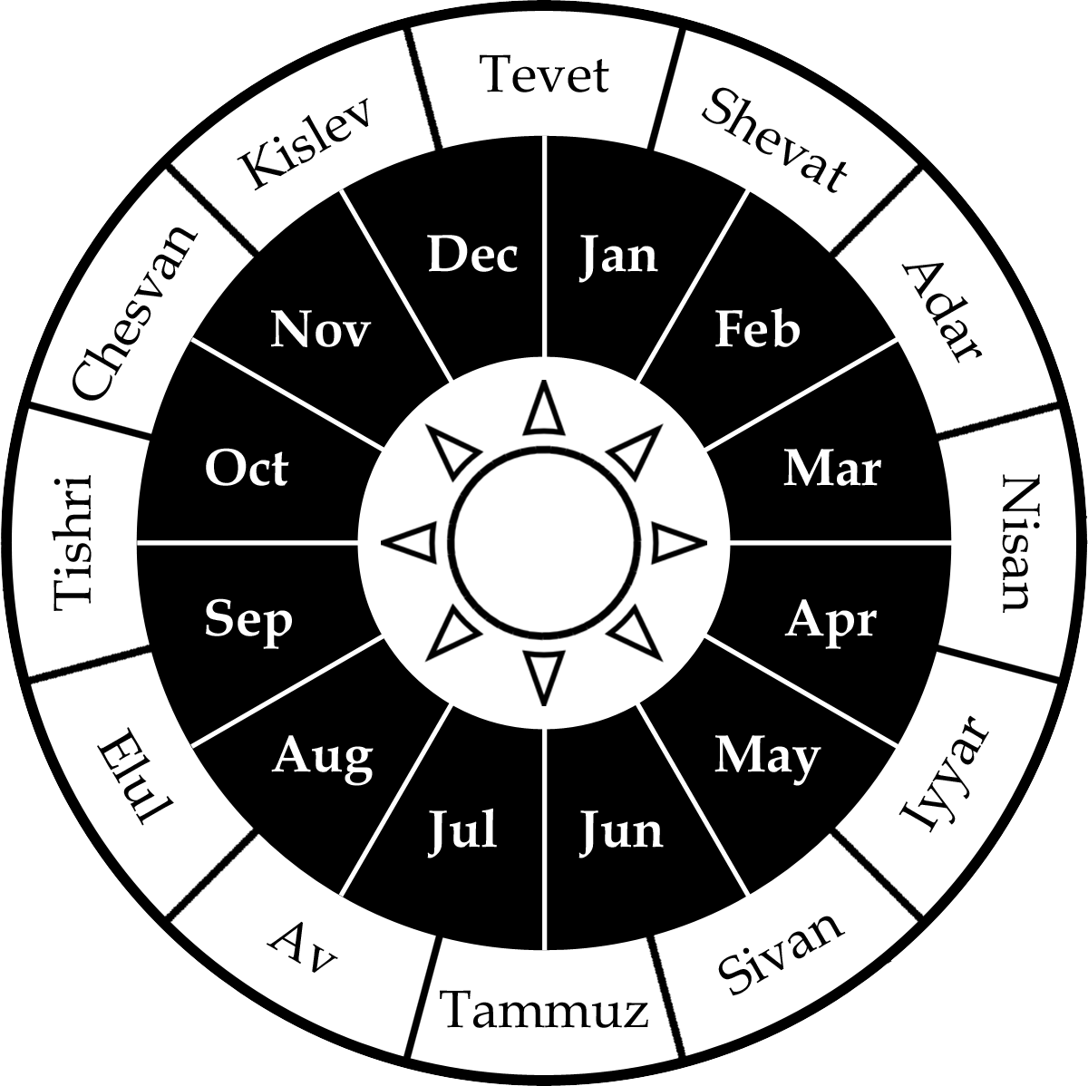
Día de ejecución
Edicto de Amán
Edicto de Ester

Slide 91
Notes:
Moving into chapter 9, the first 19 verses detail the account of the Jews destroying their enemies.
On the day the edicts when into effect, the Jews killed 500 men in Susa, including the 10 sons of Haman.
Ahasuerus is astonished by this number from such a small sample size and wonders what’s going on in the rest of the kingdom
It also seems that he has a certain amount of fear of the Jews, like the rest of the nation, as he asks, what else do you want Esther?
Esther asks that her edict be allowed to stand for another day, which seems to be a military move….there were still more enemies
Then she also asks that the sons of Haman be hanged, which was a symbolic move, and common in war
The king allows that and by the end of everything 75,000 of the Jews’ enemies had been killed, and the Jews had rest
From this section, something important happened that I want to focus on for just a bit…this will be the application portion of this class

Slide 92
ACTIVIDAD DURANTE LA CLASE
El final del v. 10 dice: “…pero no tocaron sus bienes”. Esta es la primera de tres instancias de esta frase y sugiere que se tomó una decisión consciente de no ejercer plenamente los derechos.
List the things we read of in this chapter that seem absurd
What about each of the things you listed makes them absurd?
Notes:
(read slide)
Why do you think this is mentioned?
In 1 Sam 15, Saul is told to exterminate literally every breathing Amalekite, and to destroy all of their possessions. The Amalekites were the first group to oppose Israel on their way to Canaan and so they became a sort of paradigm for the enemies of God’s people.
As part of that extermination, they were explicitly told NOT to take any plunder. It was acceptable in other battles with other enemies, but not with the Amalekites. God has assigned a special value to the Amalekites as enemies.
Saul, as we know, disobeyed that command. He took some plunder and left some Amalekites alive.
The writer here repeats 3 times that the Jews did NOT take plunder. The Jews in the story of Esther are completing a task left unfinished, and it seems to prove that their motivations were correct, they were in control of themselves, and were REMEMBERING God in this process. Remember this is the diaspora, the Jews who had been spread out over foreign lands…they were, in this instance, returning to God.
But I also want us to remember, this was harder than it sounds. Hard choices were made by some of these Jews because in this case, it was LEGAL for them to take plunder. It was part of the edict. And you can imagine someone telling you now to make right the sins of people from hundreds of years ago.
But this highlights a very important part of Christianity that I think Paul summarized nicely when he said “All things are lawful for me, but not all things are helpful”. There are things that are legal for us to do, but are not helpful in our pursuit of Jesus.
I want to spend a few minutes, talk to those around you, and let’s get a list of things that are LEGAL for us, but are not helpful as Christians
Pornography
MOST media aimed at adults
Alcohol
Only the ABUSE of alcohol is condemned in scripture, but I would point you towards Russ’ most recent lesson on alcohol as a way to understand that, even when not abused, it’s not helpful
Loopholes
Any time you are able to obey the law, but you violate the spirit of the law
The question we should be asking ourselves as Christians is, why do we do what we do? Here the Jews were given full legal right to take from their enemies, but they chose not to. Why? Because God asked them not to a long time ago, and they wanted to honor that.
Pick one item from your list…how would you explain your choice to abstain from said activity to a non-Christian?
One of the most impactful statements I’ve ever heard someone say was “If Jesus was simply your friend, and politely asked you to do certain things or not to do certain things…wouldn’t you want to do that?” How much more should we want to obey since he DIED for us, and tells us there are ETERNAL consequences to what we do?
You could sum that up, I believe the bible is real, that Jesus is real, and he has asked me not to.

Slide 93
“…que celebrasen el día décimicuarto del mes de Adar, y el decimoquinto del mismo, cada año…Que los hiciesen días de banquete y de gozo, y para enviar porciones cada uno a su vecino, y dádivas a los pobres”.
Ester 9:21-22 (RV60)
Notes:
The rest of chapter 9 is about the inauguration of the feast of Purim.
We won’t say much about this holiday except for a few things that you’ll find in your lesson.
(read facts from lesson)
On paper, could you think of a better holiday? Sharing meals with friends. Giving to the poor. Reading scripture, praying. I think we would do well to incorporate all of these elements into our holidays. Thanksgiving, Christmas.
Unfortunately I’m told that Purim has devolved into a holiday based around drinking now. My sister is a proselytized Jew and she says that while all of these elements still exist today…most of them are only observed by orthodox Jews, and the meal parts put heavy emphasis on alcohol.
But the origin, which wasn’t ordained by God, but also wasn’t opposed by God…was such a good holiday. When we hear of it today we can think back to the character growth, God’s sovereignty, and the examples we get of living in this world that we’ve learned through this book.

Slide 94
“Porque Mardoqueo el judío fue el segundo después del rey Asuero, y grande entre los judíos, y estimado por la multitud de sus hermanos, porque procuró el bienestar de su pueblo y habló paz para todo su linaje”.
Ester 10:3 (RV60)
Notes:
Chapter 10 closes out the book with only 3 verses, but they have a very powerful message.
Mordecai has proven that a Jew in the Diaspora can serve his king and his people well. That is something we can do as well, be good citizens of heaven and of this earth while we’re here.
In our next class we’re going to close out with some activities that really focus on that.
Everyone be ready for plenty of discussion in our next and final class on Esther.

Slide 95
ESTER
Lección 07
LECCIONES EN ESTER
Notes:
What we’re going to do in this last class on Esther is step through our 3 goals one at a time and draw out some application.
We’ve done some of that throughout the class but today brings it all together.
Your lesson material will be a framework for the class and will come in handy for anything you want to jot down.
This class will also feature an unusual amount of interaction time amongst yourselves. I think that will be the best way for all of us to generate and share ideas.

Slide 96
EL CRECIMIENTO DEL CARÁCTER MEDIANTE EL VALOR
Notes:
So let’s get into our first goal…character growth. As we tried to highlight throughout the class, Esther grows from the beginning of the book to the end. It’s not perfectly linear and it’s not complete, she clearly already had some good qualities from the start and certainly doesn’t finish as a perfect human, but we SEE growth.
And we expect that same kind of growth in our lives, right?
So we’re going to break this up. Scan through 2:5-19 and try to summarize Esther’s character in 1 or 2 words. Take 1 minute.
(write answers on board)
Passive
She’s introduced incidentally during Mordecai’s introduction, and as the object of his action. He “was bringing” her up and “took her as his own daughter”.
She’s described here mainly by her looks, and by an event that happened to her (her parents dying)
Throughout Esther 2 she is 100% compliant with everyone
She obeys Mordecai
She takes Hegai’s advise
Presumably to Ahasuerus himself, whatever happened on her night with him
She’s always presented as the object of someone else’s action in chapter 2
Taken to the harem
Hegai advances her
Taken to the king
Made queen
The one exception is her “winning favor”, which could be more of a negative than a positive depending on how she was doing that
Okay let’s move on to 4:4-17. Same thing…summarize her character in 1 or 2 words. Take 1 minute.
(write answers on board)
Active
Sends Mordecai clothes
When the clothes are refused, she initiates conversation with him through Hathach, one of the king’s eunuchs.
Inquires of Mordecai…again commands Hatach
These actions may not seem like much, especially for a queen, but they mark a difference in the Esther we saw 2 chapters earlier. She’s initiating now. She’s not only the object of other activities.
She expresses fear for her own safety at the prospect of going to the king unbidden. This is in contrast to the writer conveying NO feelings at the activities from chapter 2.
The way Mordecai addresses her also shows a difference:
He argues with her, gives her evidence, tries to persuade her
He’s starting to treat her not just as a ward but as a partner, and adult, an equal who must be persuaded
Then you really see a kind of higher tier of activity once she resolves to take action against the edict
She commands Mordecai and he obeys her
She organizes a community-wide fast
She works out the plan of the two banquets
And so by this point, Esther is a long way away from the passive person we met two chapters ago. She’s initiating action, showing concern, making decisions.
Let’s look at the last phase, which admittedly is not as important to our purposes in this class…but we should still identify. Summarize in 1-2 words. Take 1 minute.
(write answers on board)
Authoritative
She takes control of Haman’s property and everything that comes with that
She reveals her relationship with Mordecai, something she was once fearful to do, but now is more of a “let me tell you this” rather than meekly reveal.
Now that she is the source of wealth and power for Mordecai, that elevates her status in that relationship. The same way a child that grows into a respectable adult changes that relationship.
She is effectively the commander-in-chief of the killing of the Jews enemies.
She orchestrates the symbolic hanging of Haman’s sons
It’s her letters that validate the new feast of Purim.
Look at this progression. What I want to highlight…is that not all characters in the Bible are great heroes and pillars of faith. Both Esther and Mordecai’s morality is, at the very least, questionable at points in this book. They are depicted as ordinary people trying to get by in a pagan world, and who sometimes allow themselves to blend in with the crowd.
But I think the lesson here is that ordinary people can do remarkable things. Her role in helping deliver the Jews was not the result of some miraculous event, or a deep inner faith…she instead rose to the moment by becoming a better person. We can aspire to that right?
We too can adapt…use the resources that God gives us…get out of our comfort zone at times…and become someone that we used to not be.
Rapid fire before we move to the next goal, what are some ways that we can build our own character?
Serve
Deny yourself something, build contentment
Pick 1 gospel and make it yours
Teach, it forces you to harden your faith
There are millions more, pick something and work at it
So that’s our goal of character growth.

Slide 97
FASE 1
2:5-19

Slide 98
FASE 2
4:4-17

Slide 99
FASE 3
8:1; 9:12-13; 9:29-32

Slide 100
Pregunta de reflexión
¿Cuáles son algunas maneras en que podemos construir nuestro propio carácter?

Slide 101
LA SOBERANÍA DE DIOS
Notes:
Our second goal of the class was to consider God’s sovereignty. Where do we see God? Where do we not see him? What can we learn about his absence in this book? What role does God play in man’s affairs?
The chart we included in the lesson shows that most people lean towards one of the two extremes. He’s controls everything, or controls nothing. And we think the bible is hard evidence that He’s somewhere between those two.
So remember, what was our big question that we focused on from the text that Mordecai asks?
Who knows whether you have not come to the kingdom for such a time as this? Who knows?
Now, we pulled this question out of immediate context during the class and used it consider God’s sovereignty in different characters and actions throughout the text.
But IN context, I think we have to at least consider that he may not have asked this question the way we’ve been reading it. Remember, there are a lot of people, religious people, that don’t think Esther belongs in biblical cannon…and many of them believe this question was asked rhetorically…more negatively.
Like, who knows why you’re here. Stop whining and save us. Save me. Some critics call this intense nationalism…that the book focuses too heavily on Jews as a race…almost the way a white nationalist would or any hate group that elevates race above other things.
I think that idea only make sense if you discredit all of Esther as non-religious. It’s totally out of character with Mordecai if you consider his other actions as a faithful Jew. So, please stop me if you’d like to consider the possibility of him asking this rhetorically, but otherwise we’re going to skip this thought question from the lesson and move into the thought question on the last page.
(pause)
Okay so Mordecai is not the only person in the OT who asks this “who knows” question. What I want you guys to do is scan each of these passages and come up with a short sentence that summarizes the conclusion each of these men were expressing. When they asked who knows, what were they saying, in effect?
David
He has sinned with Bathsheba, God, through Nathan, tells him the son they have together is going to die, so David fasts and prays while the child is sick, then returns to his normal self after he dies. No one understands his conduct, and he says “While the child was still alive, I fasted an dwept, for I said, ‘Who knows whether the LORD will be gracious to me, that the child may live?’ But now he is dead. (and here’s the conclusion he came to). Why should I fast? Can I bring him back again?
David doesn’t accept Nathan’s message as unchangeable, as if God were impervious to human pleas, but at the same time he doesn’t presume that his special covenant relationship with God, or his status as Israel’s king, or being “the man after God’s own heart” earns him any favors.
He simply expresses hope, and admits that he doesn’t know what God will do.
Joel
Joes is a very typical prophet…he’s telling the people how they’ve broken their covenant, he declares their coming judgment, but he also gives brief glimpses of hope of restoration. He says, “Return to the Lord your God, for he is gracious and merciful, slow to anger, and abounding in steadfast love; and he relents over disaster. Who knows whether he will not turn and relent, and leave a blessing behind him.”
Again, Joel is showing hope, but not presuming God’s relenting…he only acknowledges the possibility. This shows that he understands the freedom and sovereignty of God, and he knows that while people can hope for his compassion, they cannot command it.
Jonah passage (king of Ninevah)
Here, Jonah announces “yet forty days, and Nineveh shall be overthrown”. And the king listens! And he makes a decree that everyone fast, repent, humble themselves..for “who knows? God may turn and relent and turn from his fierce anger, so that we may not perish”.
Again, they show that God is under no obligation to pardon…but there is still hope that he may look on them with mercy if they commit themselves to him.
The conclusion here is that, remember our chart, God is not completely hands off…just setting the world in motion and letting go…but he’s also not a micro-manager who opens up parking places and turns traffic lights green.
What the bible shows us, is that we just cannot definitely know what God is doing.
Scripture allows for human evil, but also shows that God is in control of the outcome.
It acknowledges that some events come from Satan, while others come directly from God.
Ecclesiastes says there is “time and chance”, while still saying God has them in his hands.
God can certainly work through miracles, but more often I think he works through far simpler means. perhaps we need to develop the skill of seeing those things and remember Him.
But also, we have to hesitate to speak for God. The reality is that, without some kind of special revelation, we simply don’t know what God did, and there should be some humility in our regard for this. There can be plausible guesses, based on observation and experience, but certainty is impossible..and dangerously presumptuous.
Getting a great job offer may be from God or Satan…only time will tell.
And so you see these great people of faith in the scriptures speak more hesitantly about God, but it clearly doesn’t distract from their faith. They clearly believed God was active and demonstrated their belief in it…just without nailing down the specifics.
But just like Mordecai expressed uncertainty about God’s working, the best human response is not to claim knowledge of God’s working but to trust in Him and His sovereignty.
And that’s our God’s Sovereignty goal

Slide 102
No involucrado en los asuntos del hombre
Control total sobre los asuntos del hombre
¿Y quién sabe si para una ocasión como esta tú habrás llegado a ser reina?
Ester 4:14b

Slide 103
¿Quién Sabe?
2 Sam 12:22-23
Joel 2:12-14
Jonás 3:7-9

Slide 104
UNA VIDA BÍBLICA EN UN MUNDO PAGANO
Notes:
We had one more goal “to seek the welfare of the city…” or rephrased here…a biblical life in a pagan world. How do we live as Christians inside of a mostly non-Christian world.
I started this section off in your lesson with a kind of baseline question….is it okay that Mordecai and Esther did not return to Jerusalem... as they were allowed to?
This is a difficult question, perhaps unanswerable now because we don’t know enough about life at that time
But it’s a good question to ponder. What factors do we consider in where we live? Are some places better or worse to live as a Christian? We should always consider that.
But for the purposes of this lesson, Mordecai and Esther ARE in Susa, and so we want to consider how to live faithfully in a foreign land.
I’m going to suggest there are 2 key components to doing this successfully
First is to do something called “living critically”. Let me explain what this means…
The book of Esther shows us both the critical acceptance of some cultural and political traditions AND the critical rejection of others.
When you read this book, on one hand, you have this almost satirical description of the Persian government. Ahasuerus is a fool, Haman is a fool, their laws are foolish…and as a Jew at this time or a Christian now…we have an understanding of where kingship is rooted. Back in Deut 17 God says that kings should lead well, not be super rich, not have a bunch of wives, write a copy of the book of the law, fear God keep his commandments.
And so this shapes what we expect of a ruler, it defines what “the state” should be…and this Persian government hast lost all touch with this expectation and it is therefore critically rejected by Mordecai first, then Esther and others.
But on the other hand there are some elements of the government system that are critically accepted.
Esther functions within the royal court system
Mordecai plays an active role in the state
He saves the kings life
Receives public honor
And both Mordecai and Esther use those systems that function for the good of the people
But, and here’s the critical point, that does not mean a wholesale adoption or acceptance of the system, but rather a process of critical acceptance of the elements that allow them to live as God’s people.
So the question for us is, how do we live critically? What types of things do we do, to critically reject sin…anything that separates us from God, but then critically accept the parts of this world that are helpful.
I understand this may be hard to think of right now but give it 1-2 minutes, talk if you want, or sit silently and think…what types of things do we do to live critically
The country that we live in is important. Our burden for living critically increases if we decide to live in China.
The jobs that we do. Do you serve food at McDonald’s or a casino? We critically reject some places but accept others.
Some of us work at places that are led by morally deficient people. We work at companies that do 9 things fine and 1 thing that we cannot be a part of. It is critical that we choose wisely what we accept, and what we reject.
Does this concept make sense?
This is the first thing I think we need to do to live a biblical life in a pagan world….live critically.

Slide 105
Pregunta de reflexión
¿Está bien que Mardoqueo y Ester no regresaran a Jerusalén? ¿Por qué o por qué no?

Slide 106
Vivir críticamente

Slide 107
Buscar la paz
Notes:
The second thing, is to seek the peace.
More than 100 years before Ahasuerus took the throne in Persia, Jeremiah wrote a letter to the exiles in Babylonian captivity. And these Jewish exiles were the ones who heard about Hananiah’s false prophecies in Jer 28, some of them boasted in the Temple as a reason for security in Jer 7, and some of them simply believed that Jews were better than the unclean Gentiles.
And so Jeremiah’s letter was, at best, counterintuitive to some of them. Because the basic message was to settle in and prepare for a long life in captivity. But even more shocking was his statement “seek the welfare of the city”.
But him saying that shows us, that it is possible to be part of a complex social, political, and rich environment in a foreign land, AND remain a devoted and loyal follower of God.
So the main principle for us is to recognize the INTERDEPENDENCE of the Christian, and the Christian’s host environment. They are interdependent.
And within out host environment, we can affect, for good, those around us. We are supposed to be salt…making the things around us better.
So let’s think for a minute as a group how do we “seek the peace”. What are things we can do to promote peace and shine a light in this world.
Let me say one thing that we DON’T want to do. We don’t want to abdicate good deeds to formless, faceless welfare programs or organized charities. They have their purposes, but they’re no substitute for individual, personal service to others.
I read a quote that said, “When God walked, he went where people hurt and he healed; when God talked, he spoke words of comfort and hope; when God relaxed, he played with the children”. The idea there is that goodness pours out of God in every part of life.
We CANNOT box off our Christianity into this building. It follows us everywhere. It starts (heart) right here and radiates out.
And if we do that right, we are going to “seek the peace” we’re going to influence the world around us for good, and show others who God is.
So there’s our goal of living a biblical life in a pagan world.

