Slide 1
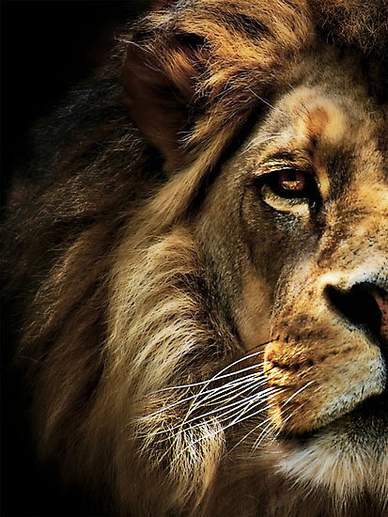
The Book of Daniel

Slide 2
Daniel
Law
History
Wisdom
Old Testament – 39
New Testament – 27
Total – 66
Major Prophets
Minor Prophets
Gospels
Acts
Letters
Rev

Slide 3
Daniel
Creation & Fall
Exodus & Conquest
Kings & Prophets
Life of Jesus
The Patriarchs
The
Judges
Exile & Return
Early Church
Law
History
Gospels
Acts
Wisdom
Letters
Prophets
Rev

Slide 4
“And your house and your kingdom shall be made sure forever before me. Your throne shall be established forever.” 2 Samuel 7:16
931 BC
722 BC
Northern Kingdom:
ISRAEL
586 BC
597 BC
Saul
David
Solomon
605 BC
Southern Kingdom:
JUDAH

Slide 5
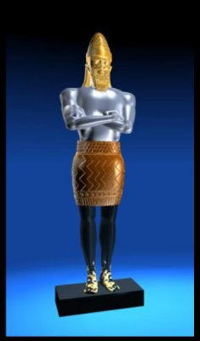
1 2 3 4 5 6 7 8 9 10 11 12
The Book of Daniel
Four empires will rise & fall before the everlasting kingdom.
Babylonian
Medo-Persian
Grecian
Roman
God rescues & exalts those who are faithful.
2
3
4
5
6
7
God humbles the proud.
Fiery Furnace
Lion’s Den
Aramaic
Nebuchad-nezzar
Belshazzar
2
3
4
5
6
7

Slide 6
Preparing for the Lions

Slide 7
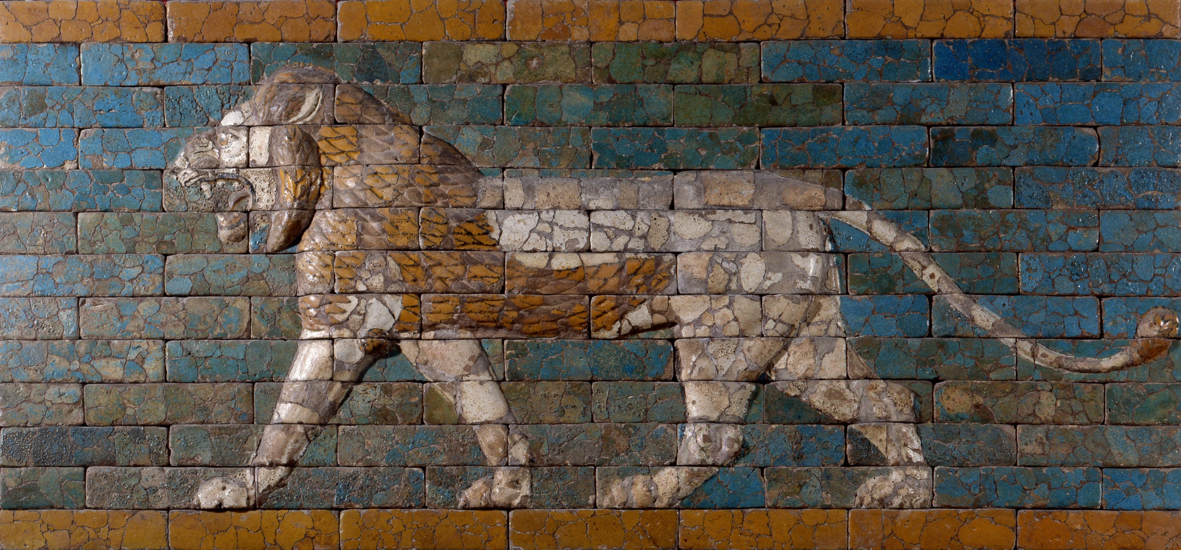
Consistent conduct before God.

Slide 8
1 Peter 2:12
Keep your conduct among the Gentiles honorable, so that when they speak against you as evildoers, they may see your good deeds and glorify God on the day of visitation.

Slide 9
A consistent prayer life before God.

Slide 10
Daniel 6:10
When Daniel knew that the document had been signed, he went to his house where he had windows in his upper chamber open toward Jerusalem. He got down on his knees three times a day and prayed and gave thanks before his God, as he had done previously.

Slide 11
Daniel 6:10
When Daniel knew that the document had been signed, he went to his house where he had windows in his upper chamber open toward Jerusalem. He got down on his knees three times a day and prayed and gave thanks before his God, as he had done previously.

Slide 12
1 Thess 5:17
…pray without ceasing…

Slide 13
Ephesians 5:20
…giving thanks always and for everything to God the Father in the name of our Lord Jesus Christ.

Slide 14
Consistent faith in God.

Slide 15
Daniel 6:16
The king declared to Daniel, “May your God, whom you serve continually, deliver you!”

Slide 16
Daniel 1:8
Daniel resolved that he would not defile himself…

Slide 17
Jeremiah 12:5
“If you have raced with men on foot, and they have wearied you, how will you compete with horses? And if in a safe land you are so trusting, what will you do in the thickets of the Jordan?”

Slide 18
But our citizenship is in heaven, and from it we await a Savior, the Lord Jesus Christ…
Philippians 3:20

