Slide 1
Acts 21:1-4
Scripture Reading

Slide 2
Anywhere with Jesus

Slide 3
The Chorus
Anywhere, anywhere!
Fear I cannot know;
Anywhere with Jesus
I can safely go.

Slide 4
1st Verse
Anywhere with Jesus I can safely go,
Anywhere He leads me in this world below;
Anywhere without dearest joys would fade;
Anywhere with Jesus I am not afraid.

Slide 5
2nd Verse
Anywhere with Jesus I am not alone;
Other friends may fail me, He is still my own;
Tho’ His hand may lead me over drearest ways;
Anywhere with Jesus is a house of praise.

Slide 6
3rd Verse
Anywhere with Jesus, over land and sea,
Telling souls in darkness of salvation free;
Ready as He summons me to go or stay,
Anywhere with Jesus when He points the way.

Slide 7
4th Verse
Anywhere with Jesus, I can go to sleep,
When the dark’ning shadows round about me creep,
Knowing I shall waken never more to roam;
Anywhere with Jesus will be home, sweet home.

Slide 8
Paul on his way to Jerusalem
An illustration of this song

Slide 9
1 Now it came to pass, that when we had departed from them and set sail, running a straight course we came to Cos, the following day to Rhodes, and from there to Patara.
2 And finding a ship sailing over to Phoenicia, we went aboard and set sail.
3 When we had sighted Cyprus, we passed it on the left, sailed to Syria, and landed at Tyre; for there the ship was to unload her cargo.
4 And finding disciples, we stayed there seven days. They told Paul through the Spirit not to go up to Jerusalem.
Acts 21:1-6

Slide 10
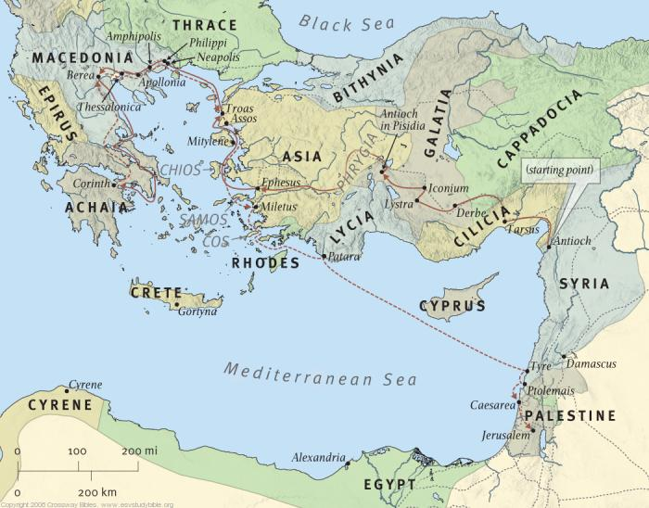
1 Now it came to pass, that when we had departed from them and set sail, running a straight course we came to Cos, the following day to Rhodes, and from there to Patara.
2 And finding a ship sailing over to Phoenicia, we went aboard and set sail.
3 When we had sighted Cyprus, we passed it on the left, sailed to Syria, and landed at Tyre; for there the ship was to unload her cargo.
4 And finding disciples, we stayed there seven days. They told Paul through the Spirit not to go up to Jerusalem.
Acts 21:1-6

Slide 11
Paul landed at Tyre.
1 Now it came to pass, that when we had departed from them and set sail, running a straight course we came to Cos, the following day to Rhodes, and from there to Patara.
2 And finding a ship sailing over to Phoenicia, we went aboard and set sail.
3 When we had sighted Cyprus, we passed it on the left, sailed to Syria, and landed at Tyre; for there the ship was to unload her cargo.
4 And finding disciples, we stayed there seven days. They told Paul through the Spirit not to go up to Jerusalem.
Acts 21:1-6

Slide 12
Paul landed at Tyre.
1 Now it came to pass, that when we had departed from them and set sail, running a straight course we came to Cos, the following day to Rhodes, and from there to Patara.
2 And finding a ship sailing over to Phoenicia, we went aboard and set sail.
3 When we had sighted Cyprus, we passed it on the left, sailed to Syria, and landed at Tyre; for there the ship was to unload her cargo.
4 And finding disciples, we stayed there seven days. They told Paul through the Spirit not to go up to Jerusalem.
Acts 21:1-6

Slide 13
He went to Caesarea.
5 When we had come to the end of those days, we departed and went on our way; and they all accompanied us, with wives and children, till we were out of the city. And we knelt down on the shore and prayed.
6 When we had taken our leave of one another, we boarded the ship, and they returned home.
7 And when we had finished our voyage from Tyre, we came to Ptolemais, greeted the brethren, and stayed with them one day.
8 On the next day we who were Paul's companions departed and came to Caesarea, and entered the house of Philip the evangelist, who was one of the seven, and stayed with him.
Acts 21:5-8

Slide 14
Agabus warned him.
9 Now this man had four virgin daughters who prophesied.
10 And as we stayed many days, a certain prophet named Agabus came down from Judea.
11 When he had come to us, he took Paul's belt, bound his own hands and feet, and said, "Thus says the Holy Spirit, 'So shall the Jews at Jerusalem bind the man who owns this belt, and deliver him into the hands of the Gentiles.'"
12 Now when we heard these things, both we and those from that place pleaded with him not to go up to Jerusalem.
Acts 21:9-13

Slide 15
Paul was determined.
9 Now this man had four virgin daughters who prophesied.
10 And as we stayed many days, a certain prophet named Agabus came down from Judea.
11 When he had come to us, he took Paul's belt, bound his own hands and feet, and said, "Thus says the Holy Spirit, 'So shall the Jews at Jerusalem bind the man who owns this belt, and deliver him into the hands of the Gentiles.'"
12 Now when we heard these things, both we and those from that place pleaded with him not to go up to Jerusalem.
13 Then Paul answered, "What do you mean by weeping and breaking my heart? For I am ready not only to be bound, but also to die at Jerusalem for the name of the Lord Jesus."
Acts 21:9-13

Slide 16
Why was Paul so determined?
To help the saints

Slide 17
There was a chronic need among the saints in Jerusalem.
Started at Pentecost, Acts 2:43,44
Continued in Jerusalem, Acts 4:32-35
Arose among widows, Acts 6:1-7
Need existed later, Acts 11:27-30

Slide 18
Paul determined to help.

Slide 19
Paul was asked to help.
9 And when James, Cephas, and John, who seemed to be pillars, perceived the grace that had been given to me, they gave me and Barnabas the right had of fellowship, that we should go to the Gentiles and they to the circumcised.
10 They desired only that we should remember the poor, the very thing which I also was eager to do.

Slide 20
Paul was asked to help.
9 And when James, Cephas, and John, who seemed to be pillars, perceived the grace that had been given to me, they gave me and Barnabas the right had of fellowship, that we should go to the Gentiles and they to the circumcised.
10 They desired only that we should remember the poor, the very thing which I also was eager to do.

Slide 21
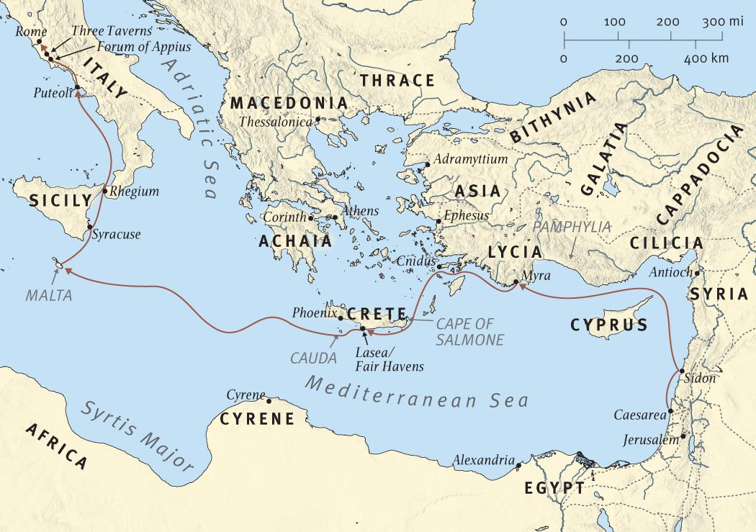

Slide 22
It was for the saints.
1 Now concerning the collection for the saints, as I have given orders to the churches of Galatia, so you must do also:
2 On the first day of the week let each one of you lay something aside, storing up as he may prosper, that there be no collections when I come.
3 And when I come, whomever you approve by your letters I will send to bear your gift to Jerusalem.
4 But if it is fitting that I go also, they will go with me.
1 Corinthians 16:1-4

Slide 23
He gave orders to the Corinthians.
1 Now concerning the collection for the saints, as I have given orders to the churches of Galatia, so you must do also:
2 On the first day of the week let each one of you lay something aside, storing up as he may prosper, that there be no collections when I come.
3 And when I come, whomever you approve by your letters I will send to bear your gift to Jerusalem.
4 But if it is fitting that I go also, they will go with me.
1 Corinthians 16:1-4

Slide 24
The gift would be taken to Jerusalem.
1 Now concerning the collection for the saints, as I have given orders to the churches of Galatia, so you must do also:
2 On the first day of the week let each one of you lay something aside, storing up as he may prosper, that there be no collections when I come.
3 And when I come, whomever you approve by your letters I will send to bear your gift to Jerusalem.
4 But if it is fitting that I go also, they will go with me.
1 Corinthians 16:1-4

Slide 25
Paul wanted to go.
1 Now concerning the collection for the saints, as I have given orders to the churches of Galatia, so you must do also:
2 On the first day of the week let each one of you lay something aside, storing up as he may prosper, that there be no collections when I come.
3 And when I come, whomever you approve by your letters I will send to bear your gift to Jerusalem.
4 But if it is fitting that I go also, they will go with me.
1 Corinthians 16:1-4

Slide 26
Later, he reminds them.

Slide 28
Later, he reminds them.
1 Now concerning the ministering to the saints, it is superfluous for me to write to you;
5 Therefore I thought it necessary to exhort the brethren to go to you ahead of time, and prepare your generous gift beforehand, which you had previously promised, that it may be ready as a matter of generosity and not as a grudging obligation.
2 Corinthians 9:1,5

Slide 29
He wants them to be ready.
1 Now concerning the ministering to the saints, it is superfluous for me to write to you;
5 Therefore I thought it necessary to exhort the brethren to go to you ahead of time, and prepare your generous gift beforehand, which you had previously promised, that it may be ready as a matter of generosity and not as a grudging obligation.
2 Corinthians 9:1,5

Slide 30
Paul hopes for a “win-win” result.
12 For the administration of this service not only supplies the needs of the saints, but also is abounding through many thanksgivings to God,
13 while, through the proof of this ministry, they glorify God for the obedience of your confession to the gospel of Christ, and for your liberal sharing with them and all men,
14 and by their prayer for you, who long for you because of the exceeding grace of God in you.
15 Thanks be to God for His indescribable gift!
2 Corinthians 9:12-15

Slide 31
It would help needy saints.
12 For the administration of this service not only supplies the needs of the saints, but also is abounding through many thanksgivings to God,
13 while, through the proof of this ministry, they glorify God for the obedience of your confession to the gospel of Christ, and for your liberal sharing with them and all men,
14 and by their prayer for you, who long for you because of the exceeding grace of God in you.
15 Thanks be to God for His indescribable gift!
2 Corinthians 9:12-15

Slide 32
The Jews would be thankful for their obedience.
12 For the administration of this service not only supplies the needs of the saints, but also is abounding through many thanksgivings to God,
13 while, through the proof of this ministry, they glorify God for the obedience of your confession to the gospel of Christ, and for your liberal sharing with them and all men,
14 and by their prayer for you, who long for you because of the exceeding grace of God in you.
15 Thanks be to God for His indescribable gift!
2 Corinthians 9:12-15

Slide 33
God would be glorified.
12 For the administration of this service not only supplies the needs of the saints, but also is abounding through many thanksgivings to God,
13 while, through the proof of this ministry, they glorify God for the obedience of your confession to the gospel of Christ, and for your liberal sharing with them and all men,
14 and by their prayer for you, who long for you because of the exceeding grace of God in you.
15 Thanks be to God for His indescribable gift!
2 Corinthians 9:12-15

Slide 34
Paul reaches Corinth and writes to Rome.

Slide 35
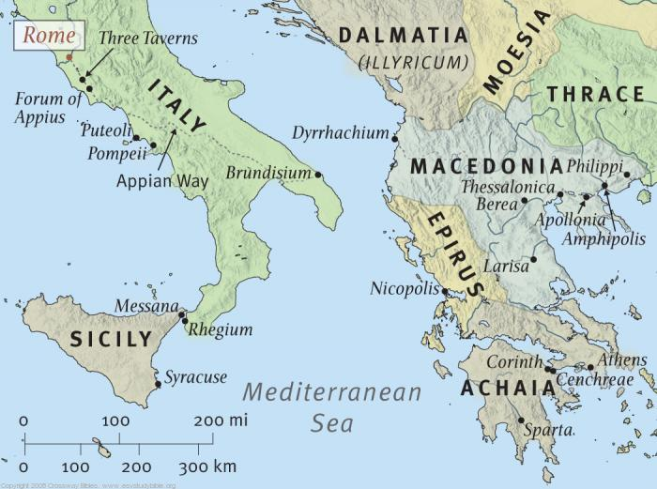

Slide 36
Paul planned to visit Rome …
25 But now I am going to Jerusalem to minister to the saints.
26 For it pleased those from Macedonia and Achaia to make a certain contribution for the poor among the saints who are in Jerusalem.
27 It pleased them indeed, and they are their debtors. For if the Gentiles have been partakers of their spiritual things, their duty is also to minister to them in material things.
28 Therefore, when I have performed this and have sealed to them this fruit, I shall go by way of you to Spain.
29 But I know that when I come to you, I shall come in the fullness of the blessing of the gospel of Christ.
Romans 15:25-32

Slide 37
… on his way to Spain.
25 But now I am going to Jerusalem to minister to the saints.
26 For it pleased those from Macedonia and Achaia to make a certain contribution for the poor among the saints who are in Jerusalem.
27 It pleased them indeed, and they are their debtors. For if the Gentiles have been partakers of their spiritual things, their duty is also to minister to them in material things.
28 Therefore, when I have performed this and have sealed to them this fruit, I shall go by way of you to Spain.
29 But I know that when I come to you, I shall come in the fullness of the blessing of the gospel of Christ.
Romans 15:25-32

Slide 38
First he would go to Jerusalem.
25 But now I am going to Jerusalem to minister to the saints.
26 For it pleased those from Macedonia and Achaia to make a certain contribution for the poor among the saints who are in Jerusalem.
27 It pleased them indeed, and they are their debtors. For if the Gentiles have been partakers of their spiritual things, their duty is also to minister to them in material things.
28 Therefore, when I have performed this and have sealed to them this fruit, I shall go by way of you to Spain.
29 But I know that when I come to you, I shall come in the fullness of the blessing of the gospel of Christ.
Romans 15:25-32

Slide 39
He was ministering to the saints.
25 But now I am going to Jerusalem to minister to the saints.
26 For it pleased those from Macedonia and Achaia to make a certain contribution for the poor among the saints who are in Jerusalem.
27 It pleased them indeed, and they are their debtors. For if the Gentiles have been partakers of their spiritual things, their duty is also to minister to them in material things.
28 Therefore, when I have performed this and have sealed to them this fruit, I shall go by way of you to Spain.
29 But I know that when I come to you, I shall come in the fullness of the blessing of the gospel of Christ.
Romans 15:25-32

Slide 40
…and explains the added benefit.
25 But now I am going to Jerusalem to minister to the saints.
26 For it pleased those from Macedonia and Achaia to make a certain contribution for the poor among the saints who are in Jerusalem.
27 It pleased them indeed, and they are their debtors. For if the Gentiles have been partakers of their spiritual things, their duty is also to minister to them in material things.
28 Therefore, when I have performed this and have sealed to them this fruit, I shall go by way of you to Spain.
29 But I know that when I come to you, I shall come in the fullness of the blessing of the gospel of Christ.
Romans 15:25-32

Slide 41
…and explains the added benefit.
25 But now I am going to Jerusalem to minister to the saints.
26 For it pleased those from Macedonia and Achaia to make a certain contribution for the poor among the saints who are in Jerusalem.
27 It pleased them indeed, and they are their debtors. For if the Gentiles have been partakers of their spiritual things, their duty is also to minister to them in material things.
28 Therefore, when I have performed this and have sealed to them this fruit, I shall go by way of you to Spain.
29 But I know that when I come to you, I shall come in the fullness of the blessing of the gospel of Christ.
Romans 15:25-32

Slide 42
… but he is apprehensive.
30 Now I beg you, brethren, through the Lord Jesus Christ, and through the love of the Spirit, that you strive together with me in prayers to God for me,
31 that I may be delivered from those in Judea who do not believe, and that my service for Jerusalem may be acceptable to the saints,
32 that I may come to you with joy by the will of God, and may be refreshed together with you.
Romans 15:25-32

Slide 43
He wants others to pray for his deliverance.
30 Now I beg you, brethren, through the Lord Jesus Christ, and through the love of the Spirit, that you strive together with me in prayers to God for me,
31 that I may be delivered from those in Judea who do not believe, and that my service for Jerusalem may be acceptable to the saints,
32 that I may come to you with joy by the will of God, and may be refreshed together with you.
Romans 15:25-32

Slide 44
He wants his “service” to be acceptable.
30 Now I beg you, brethren, through the Lord Jesus Christ, and through the love of the Spirit, that you strive together with me in prayers to God for me,
31 that I may be delivered from those in Judea who do not believe, and that my service for Jerusalem may be acceptable to the saints,
32 that I may come to you with joy by the will of God, and may be refreshed together with you.
Romans 15:25-32

Slide 45
He is ready for what awaits him.
9 Now this man had four virgin daughters who prophesied.
10 And as we stayed many days, a certain prophet named Agabus came down from Judea.
11 When he had come to us, he took Paul's belt, bound his own hands and feet, and said, "Thus says the Holy Spirit, 'So shall the Jews at Jerusalem bind the man who owns this belt, and deliver him into the hands of the Gentiles.'"
12 Now when we heard these things, both we and those from that place pleaded with him not to go up to Jerusalem.
13 Then Paul answered, "What do you mean by weeping and breaking my heart? For I am ready not only to be bound, but also to die at Jerusalem for the name of the Lord Jesus."
Acts 21:9-13

Slide 46
He could go anywhere with Jesus because:
He knew Him.
He had a relationship with Him.
He trusted Him.
We can go anywhere with Jesus!

