Slide 2
Going through Samaria
John 4:1-42 – A Narrative

Slide 3
Jesus was heading home.
3 He left Judea and departed again to Galilee.
John 4:3

Slide 4
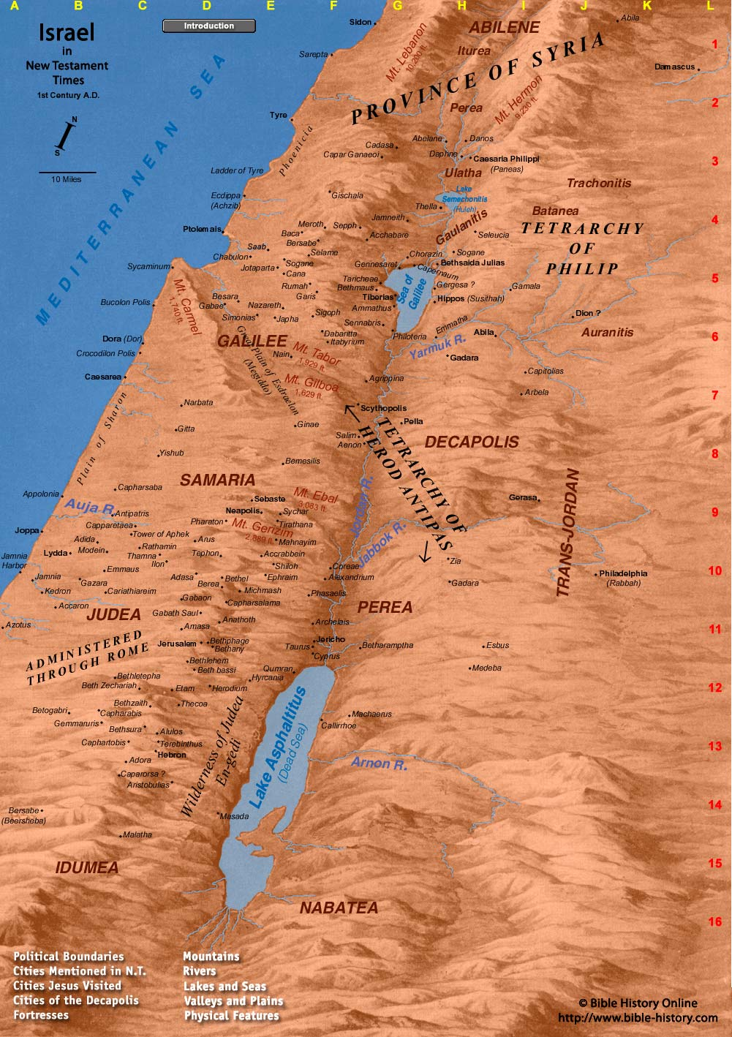
4 But He needed to go through Samaria.
John 4:4

Slide 5
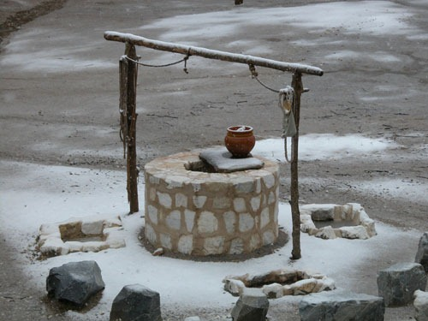
Jesus asks for water.
… Jesus said to her, "Give Me a drink”
John 4:7

Slide 6
Jesus offers her water.
… He would have given you living water”
John 4:10

Slide 7
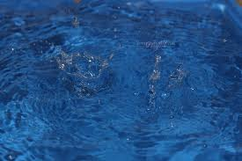
It is different.
“… But the water that I shall give him will become in him a fountain of water springing up into everlasting life.”
4:14

Slide 8
He probes into her past.
“ … you have had five husbands …”
4:18

Slide 9
He seeks true worship.
“ …the true worshippers will worship the Father in spirit and truth: …”
4:23

Slide 10
Messiah has come.
“ I who speak to you am He.”
4:26

Slide 11
A Telling “Pattern”
Jesus “intrudes” into our busy lives
He offers us living water
He probes into our past
He wants true worship
Messiah has come

Slide 12
What about us?
Will we drink?
Will we go and tell others?

