Slide 2
What should I do?

Slide 3
It is at the heart of excellence.
Excellence
Approve the best
Desire the best
Give our best

Slide 4
We make careful choices.
9 And this I pray, that your love may abound still more and more in knowledge and all discernment,
10 that you may approve the things that are excellent, that you may be sincere and without offense till the day of Christ,
11 being filled with the fruits of righteousness which are by Jesus Christ, to the glory and praise of God.
Philippians 1:9-11

Slide 5
Corinthians:
Attend feasts? Eat meat sacrificed to idols?
1 Corinthians 8:1-13

Slide 6
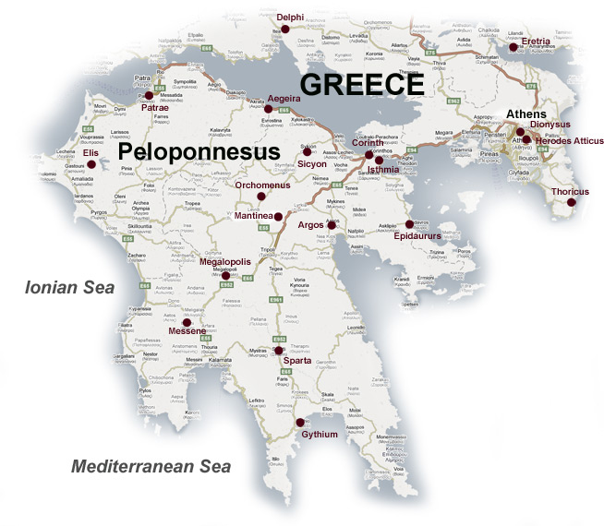

Slide 7
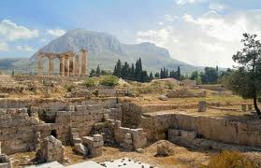

Slide 8
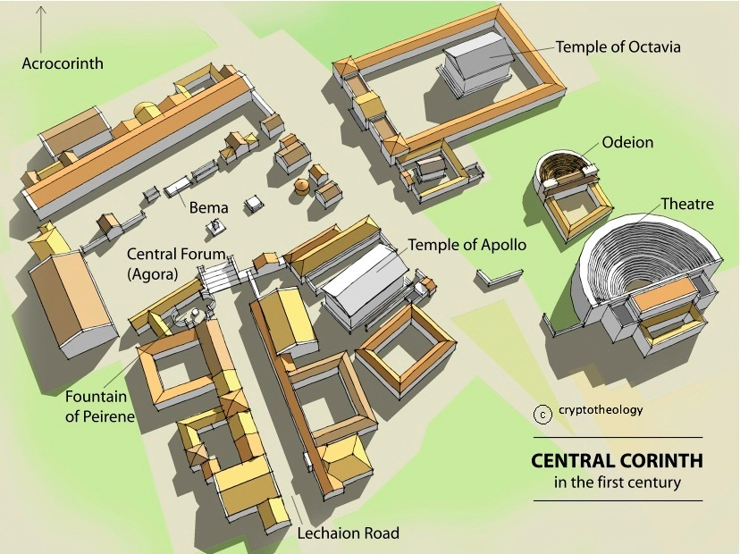

Slide 9
Corinthians:
Attend feasts? Eat meat sacrificed to idols?
1 Corinthians 8:1-13

Slide 10
Consider:
Know idol is nothing, 4
All don’t “know” it, 7
Food = neutral, 8
Weaken others? Cause to stumble?
If necessary, I’ll never eat meat again!

Slide 11
Paul (evangelist):
Eat and drink? 4
Take a wife? 5
Refrain from working? 6
1 Corinthians 9:1-27

Slide 12
Basis for answer:
Soldier? Planter? Shepherd? 7
The Law:
Don’t muzzle ox, 10
(Sow spiritual, reap material?)
Priests partake of offering, 13
Preach gospel – live of gospel?, 14

Slide 13
Paul: Exercise “right”?
Preach gospel w/o charge, 18
All things to all men – win them, 22
Discipline self – lest disqualified, 27
1 Corinthians 9:1-27

Slide 14
By the way:
Israelites:
Favored by God, 1-4
But God not pleased, 5
Our Examples:
Lust, 6
Idolatry, 7
Sexual immorality, 8
Tempted God, 9
Complained, 10
1 Corinthians 10:1-11

Slide 15
12 Therefore let him who thinks he stands take heed lest he fall.
13 No temptation has overtaken you except such as is common to man; but God is faithful, who will not allow you to be tempted beyond what you are able, but with the temptation will also make the way of escape, that you may be able to bear it.
1 Corinthians 10:12,13

Slide 16
12 Therefore let him who thinks he stands take heed lest he fall.
13 No temptation has overtaken you except such as is common to man; but God is faithful, who will not allow you to be tempted beyond what you are able, but with the temptation will also make the way of escape, that you may be able to bear it.
1 Corinthians 10:12,13

Slide 17
Why would I think that?
I know
I’m strong
I’ve been a Christian a long time
God has blessed me
It’s my business, not theirs
I’m not like them (others)

Slide 18
12 Therefore let him who thinks he stands take heed lest he fall.
13 No temptation has overtaken you except such as is common to man; but God is faithful, who will not allow you to be tempted beyond what you are able, but with the temptation will also make the way of escape, that you may be able to bear it.
1 Corinthians 10:12,13

Slide 19
By the way:
Israelites:
Favored by God, 1-4
But God not pleased, 5
Our Examples:
Lust, 6
Idolatry, 7
Sexual immorality, 8
Tempted God, 9
Complained, 10
1 Corinthians 10:1-11

Slide 20
Paul’s “final” answer:
Flee idolatry! 14
Cup of Lord/demons don’t mix, 22
Lawful, helpful, edifies, 23
Do all to glory of God, 31
1 Corinthians 10:14-33

Slide 21
We can stand!
By trusting in God, not self

