Slide 1
Please turn off or silence all cell phones and PDAs before the worship service begins

Slide 2
Order of Evening Services
Scripture Reading
Song 200 – Hallelujah, Praise Jehovah
Prayer
Song 666 – The Spacious Firmament
Psalm 19
Song 10 (PHSS) – The Law of the LORD
Psalm 121
Song 712 – Unto the Hills
Psalm 8
Song 3 (PHSS) – O How Glorious, Full of Wonder
Psalm 95
Inv. Song 517 – O Why Not Tonight
Closing Prayer

Slide 3
Psalm 148
Scripture Reading

Slide 4
Hallelujah, Praise Jehovah (Psalm 148)
200
Praise for the Lord

Slide 5
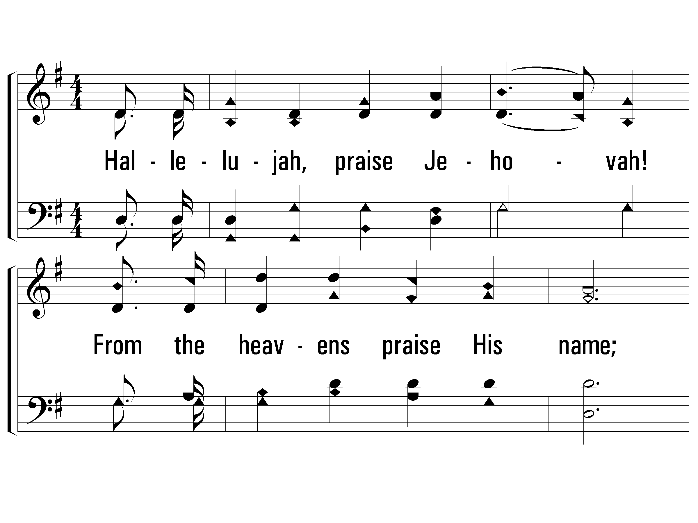
1 – Hallelujah, Praise Jehovah
200
1.
Hallelujah, praise Jehovah!
From the heavens praise His name;
Praise Jehovah in the highest;
All His angels praise proclaim,
All His hosts together praise Him,
Sun and moon and stars on high;
Praise Him, O ye heaven of heavens,
And ye floods above the sky.
Words and Music by: William J. Kirkpatrick
© 2001 The Paperless Hymnal™

Slide 6
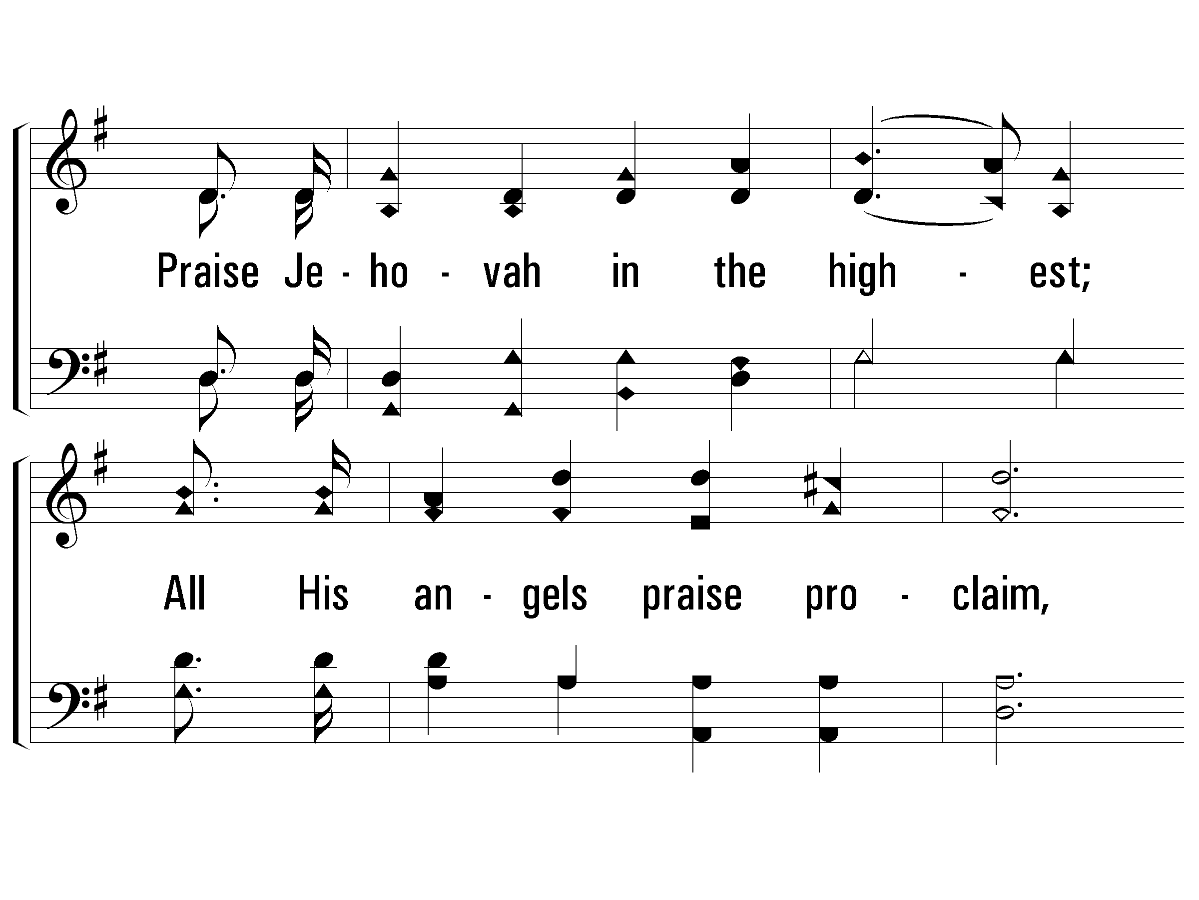
1 – Hallelujah, Praise Jehovah
200
© 2001 The Paperless Hymnal™

Slide 7
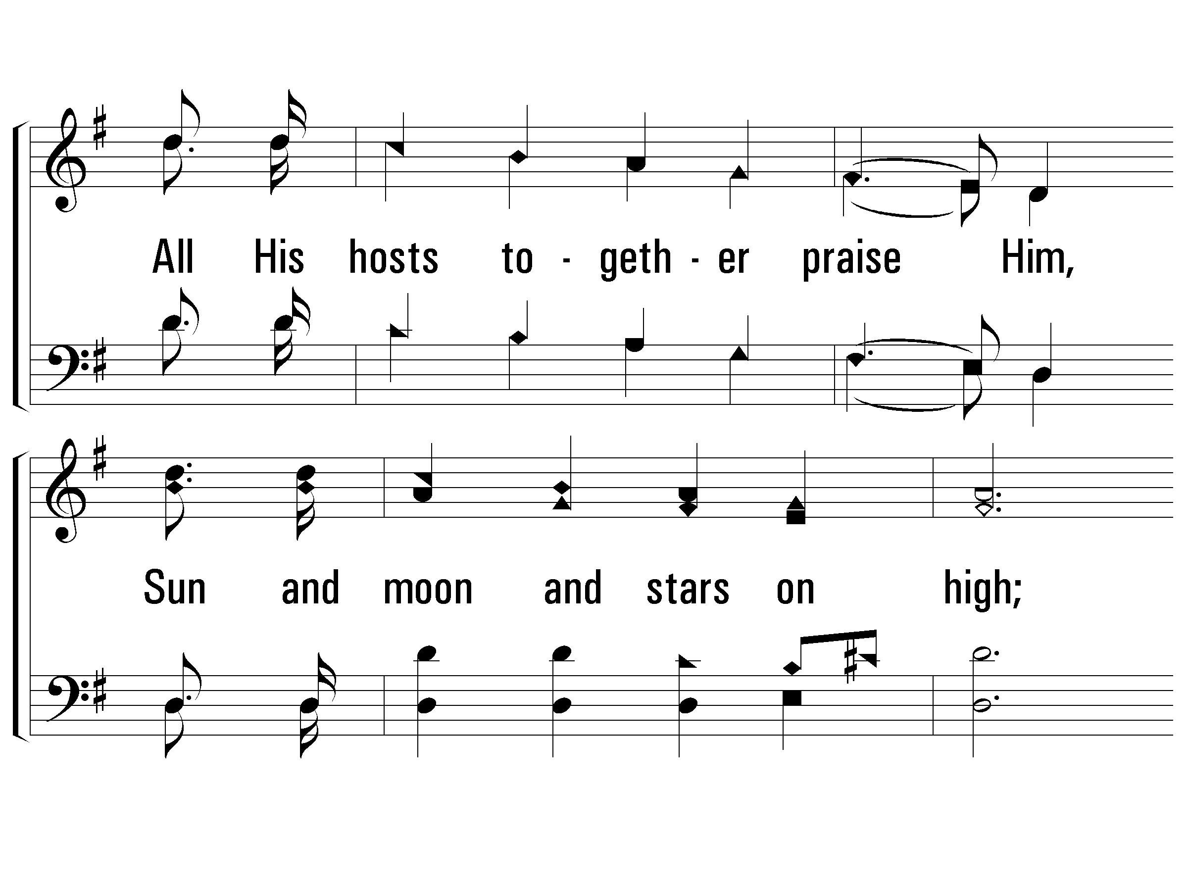
1 – Hallelujah, Praise Jehovah
200
© 2001 The Paperless Hymnal™

Slide 8
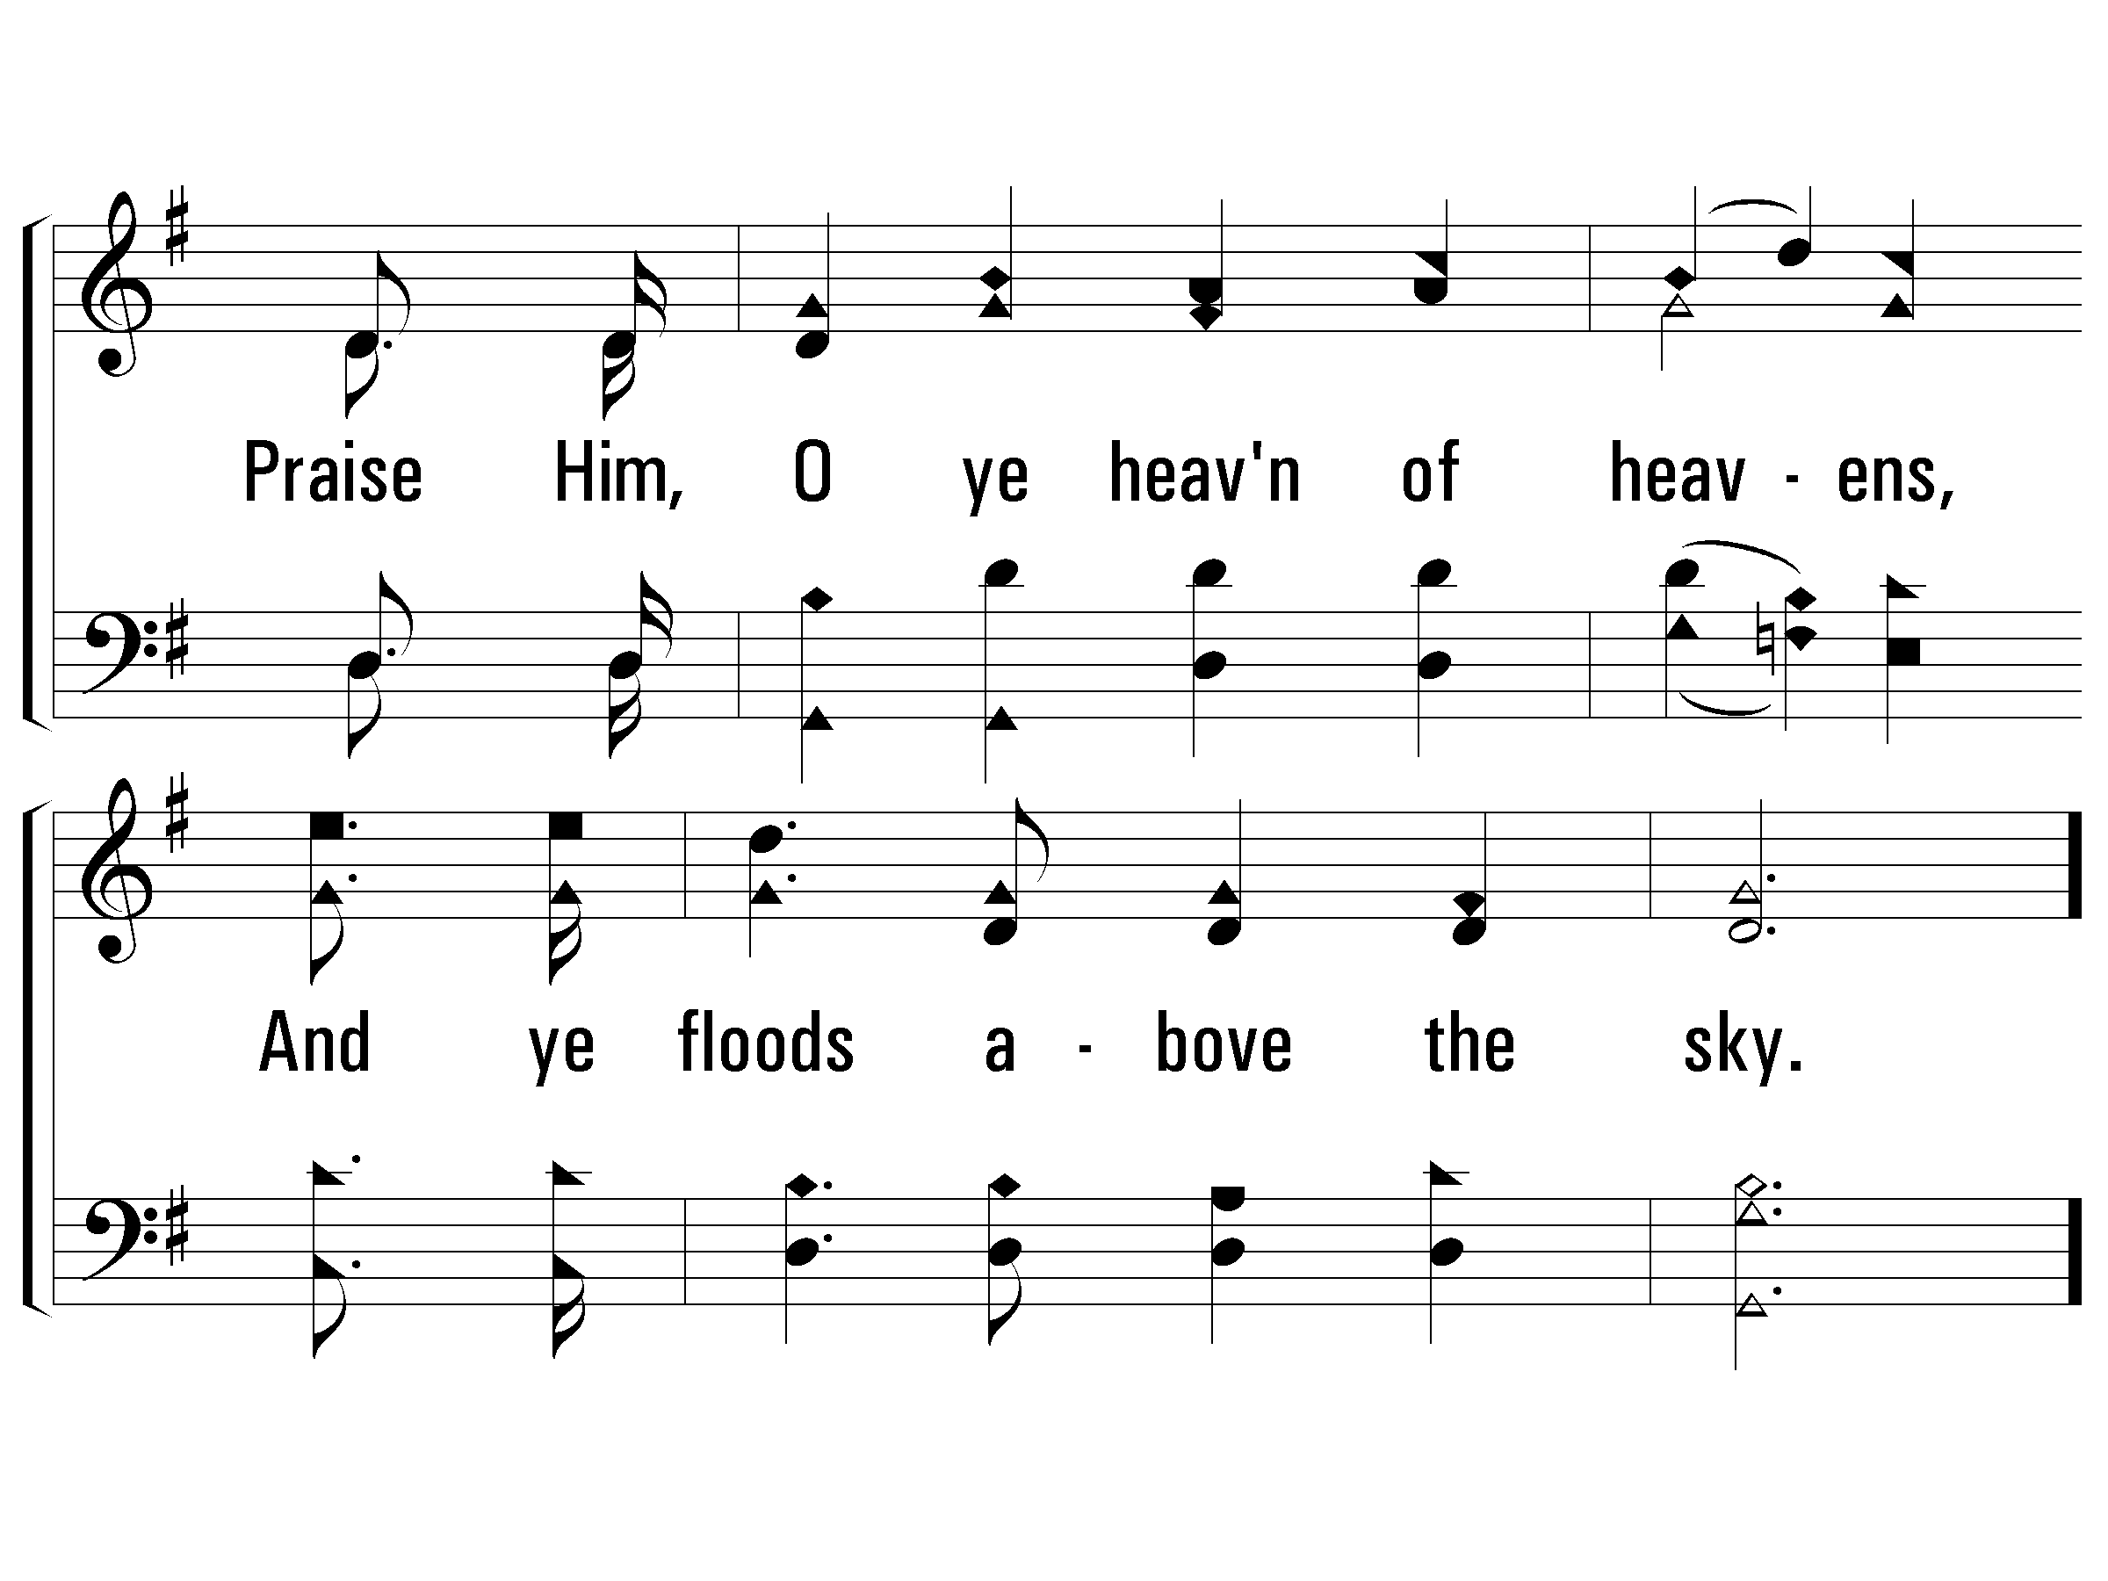
1 – Hallelujah, Praise Jehovah
200
© 2001 The Paperless Hymnal™

Slide 9
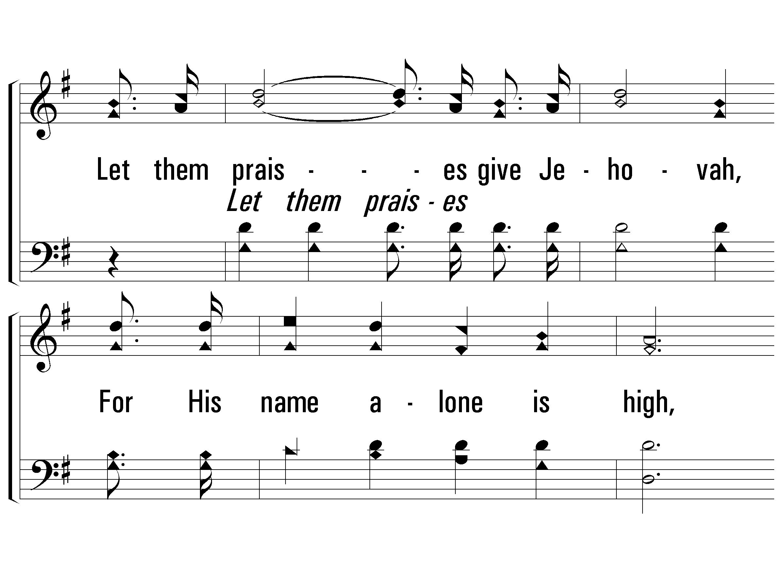
c – Hallelujah, Praise Jehovah
200
Let them praises give Jehovah,
For His name alone is high,
And His glory is exalted,
And His glory is exalted,
And His glory is exalted,
Far above the earth and sky.
© 2001 The Paperless Hymnal™

Slide 10
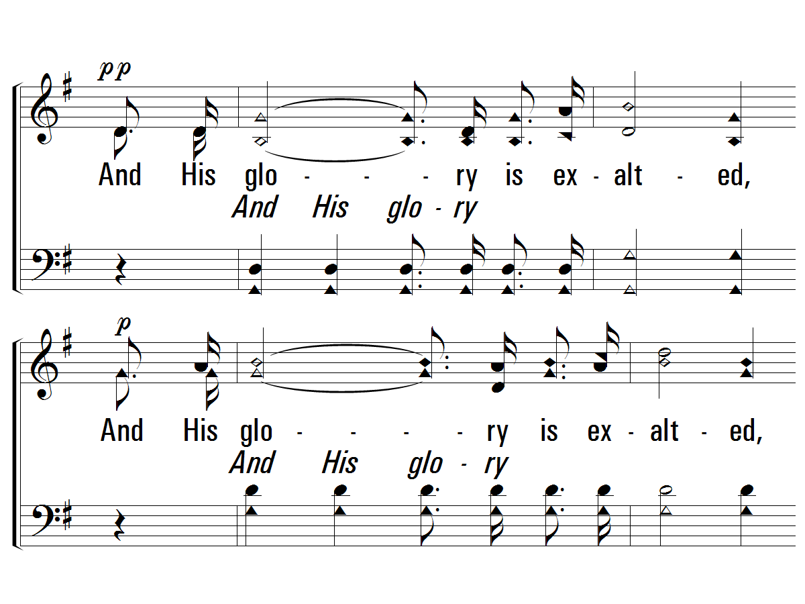
c – Hallelujah, Praise Jehovah
200
© 2001 The Paperless Hymnal™

Slide 11
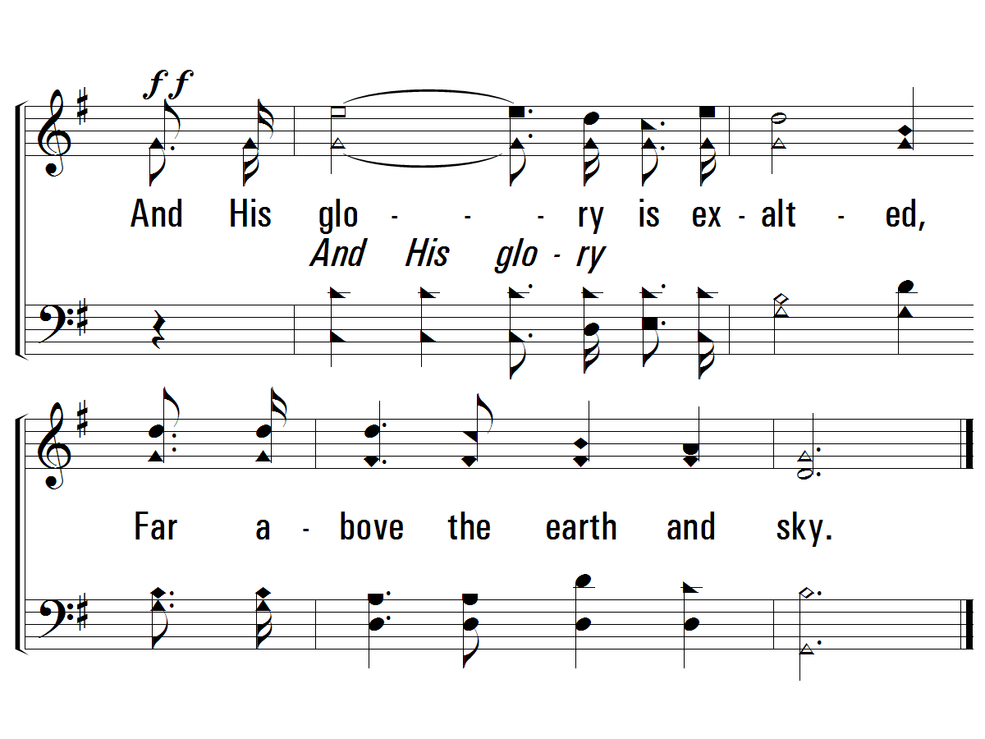
c – Hallelujah, Praise Jehovah
200
© 2001 The Paperless Hymnal™

Slide 12
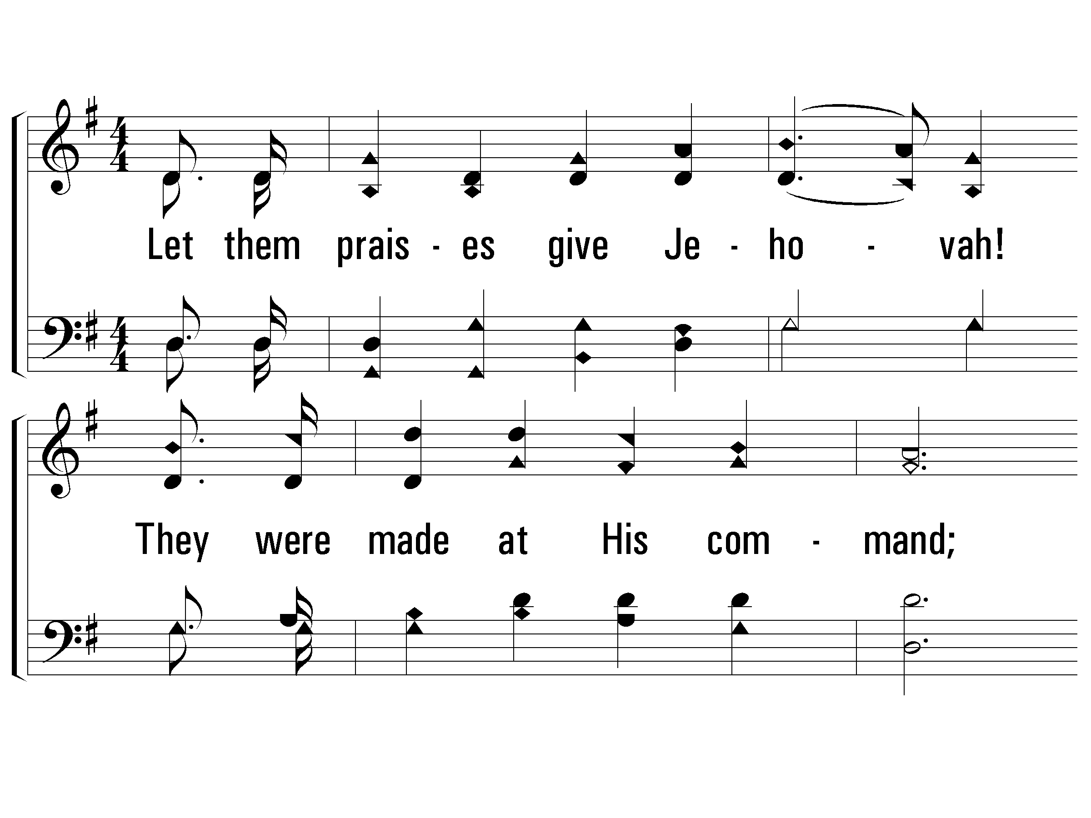
2 – Hallelujah, Praise Jehovah
200
2.
Let them praises give Jehovah!
They were made at His command;
Them for ever He established:
His decree shall ever stand,
From the earth, O praise Jehovah,
All ye floods, ye dragons all,
Fire and hail and snow and vapors,
Stormy winds that hear Him call.
Words and Music by: William J. Kirkpatrick
© 2001 The Paperless Hymnal™

Slide 13
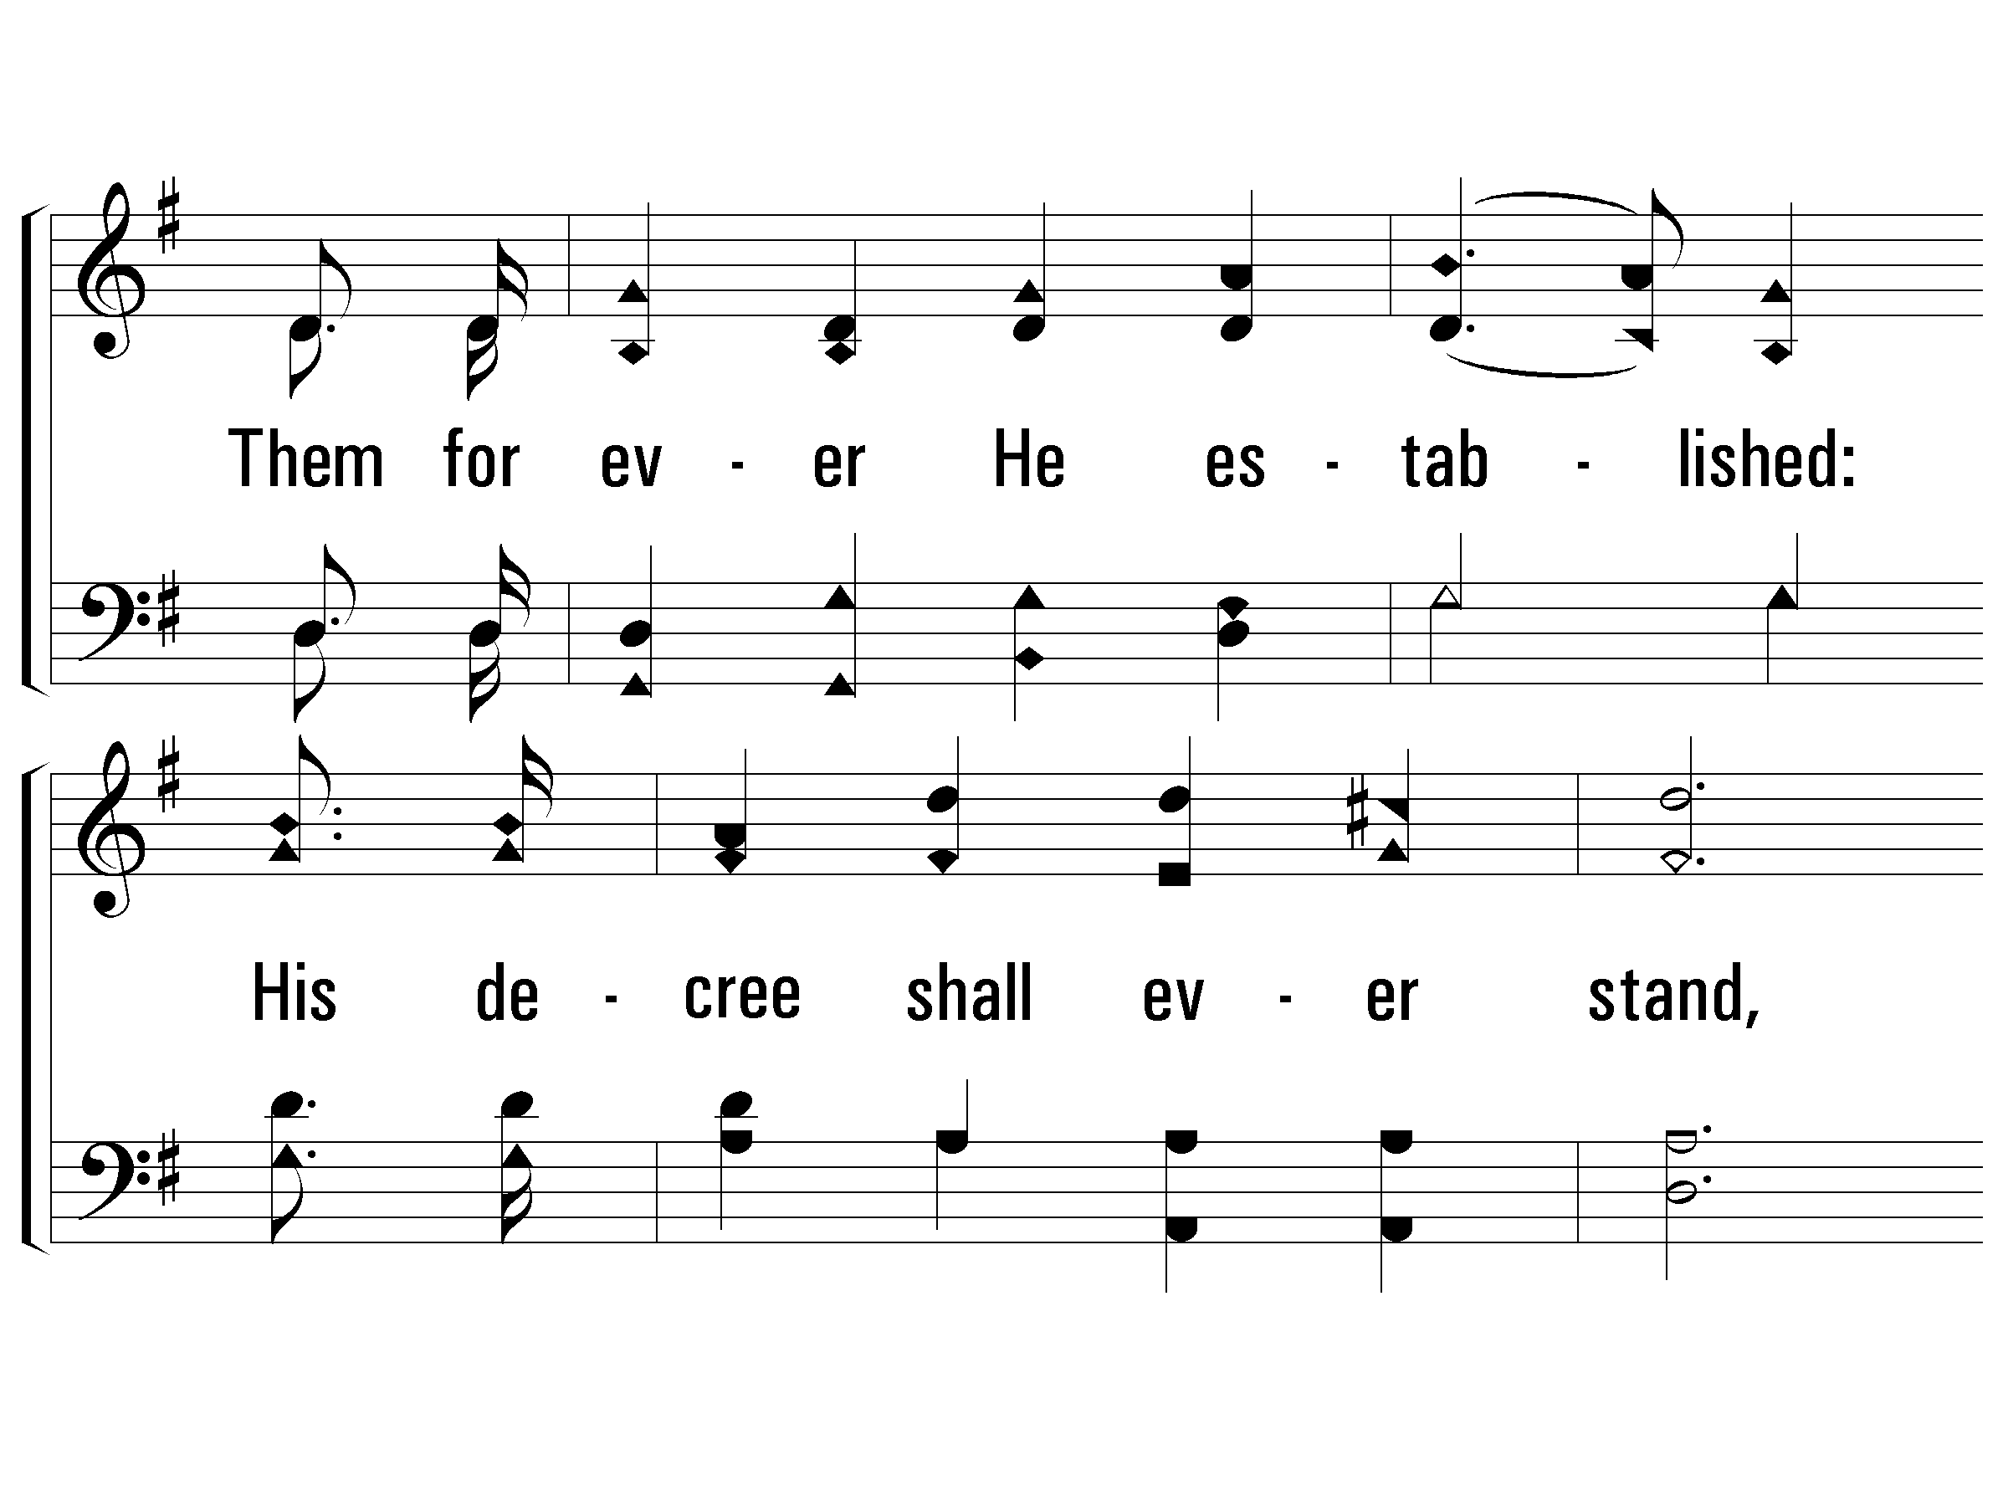
2 – Hallelujah, Praise Jehovah
200
© 2001 The Paperless Hymnal™

Slide 14
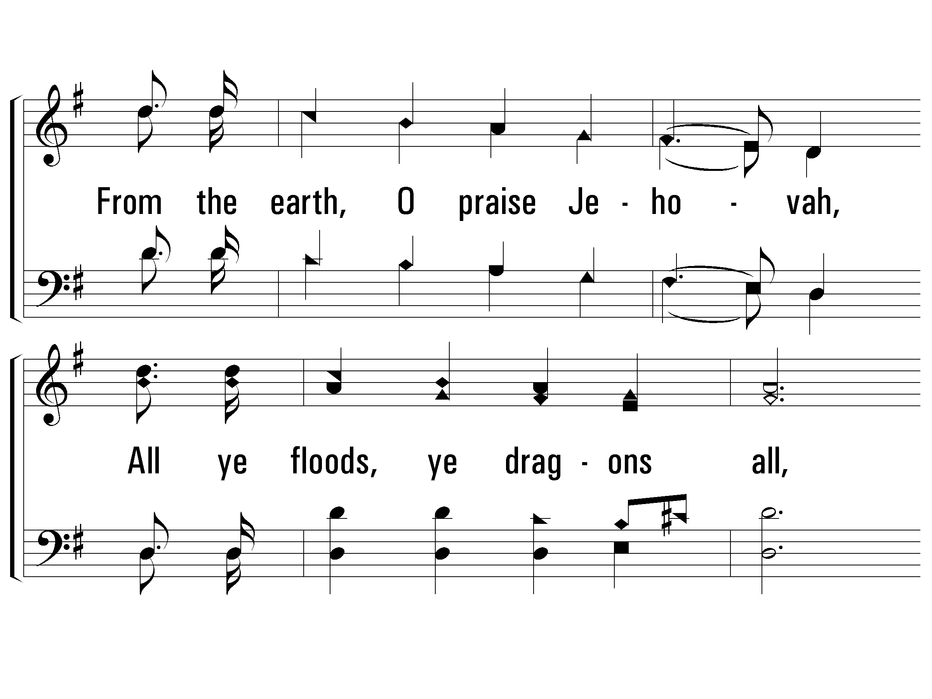
2 – Hallelujah, Praise Jehovah
200
© 2001 The Paperless Hymnal™

Slide 15
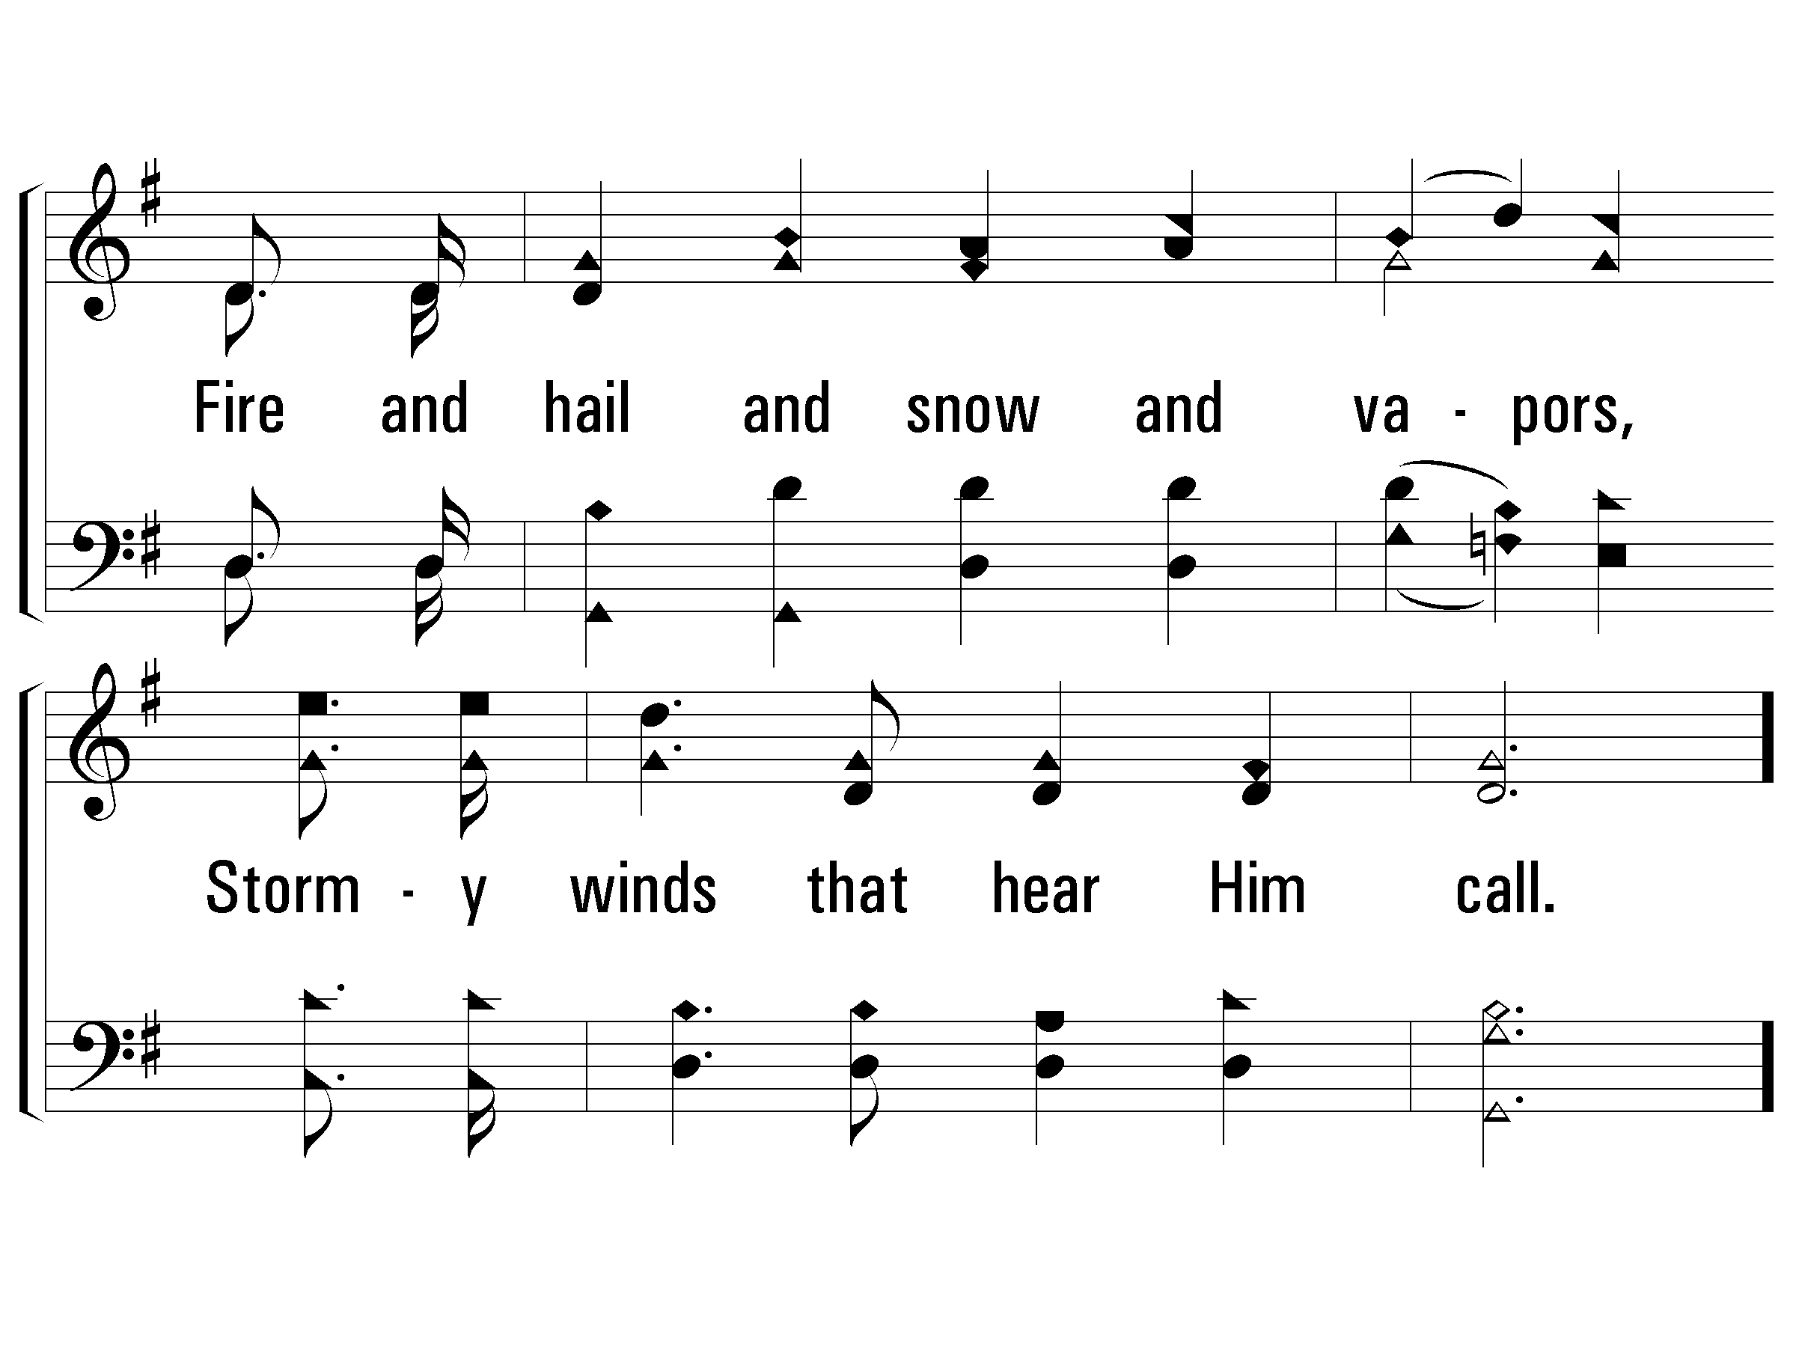
2 – Hallelujah, Praise Jehovah
200
© 2001 The Paperless Hymnal™

Slide 16
c – Hallelujah, Praise Jehovah
200
Let them praises give Jehovah,
For His name alone is high,
And His glory is exalted,
And His glory is exalted,
And His glory is exalted,
Far above the earth and sky.
© 2001 The Paperless Hymnal™

Slide 17
c – Hallelujah, Praise Jehovah
200
© 2001 The Paperless Hymnal™

Slide 18
c – Hallelujah, Praise Jehovah
200
© 2001 The Paperless Hymnal™

Slide 19
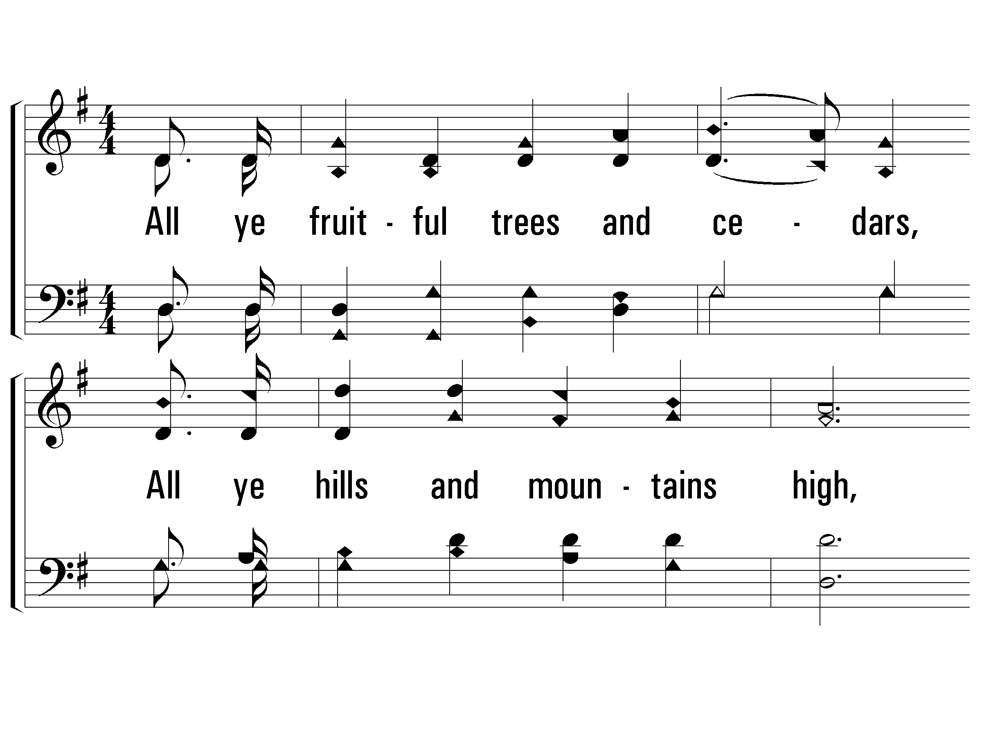
3 – Hallelujah, Praise Jehovah
200
3.
All ye fruitful trees and cedars,
All ye hills and mountains high,
Creeping things and beasts and cattle,
Birds that in the heavens fly,
Kings of earth, and all ye people,
Princes great, earth's judges all;
Praise His name, young men and maidens,
Aged men, and children small.
Words and Music by: William J. Kirkpatrick
© 2001 The Paperless Hymnal™

Slide 20
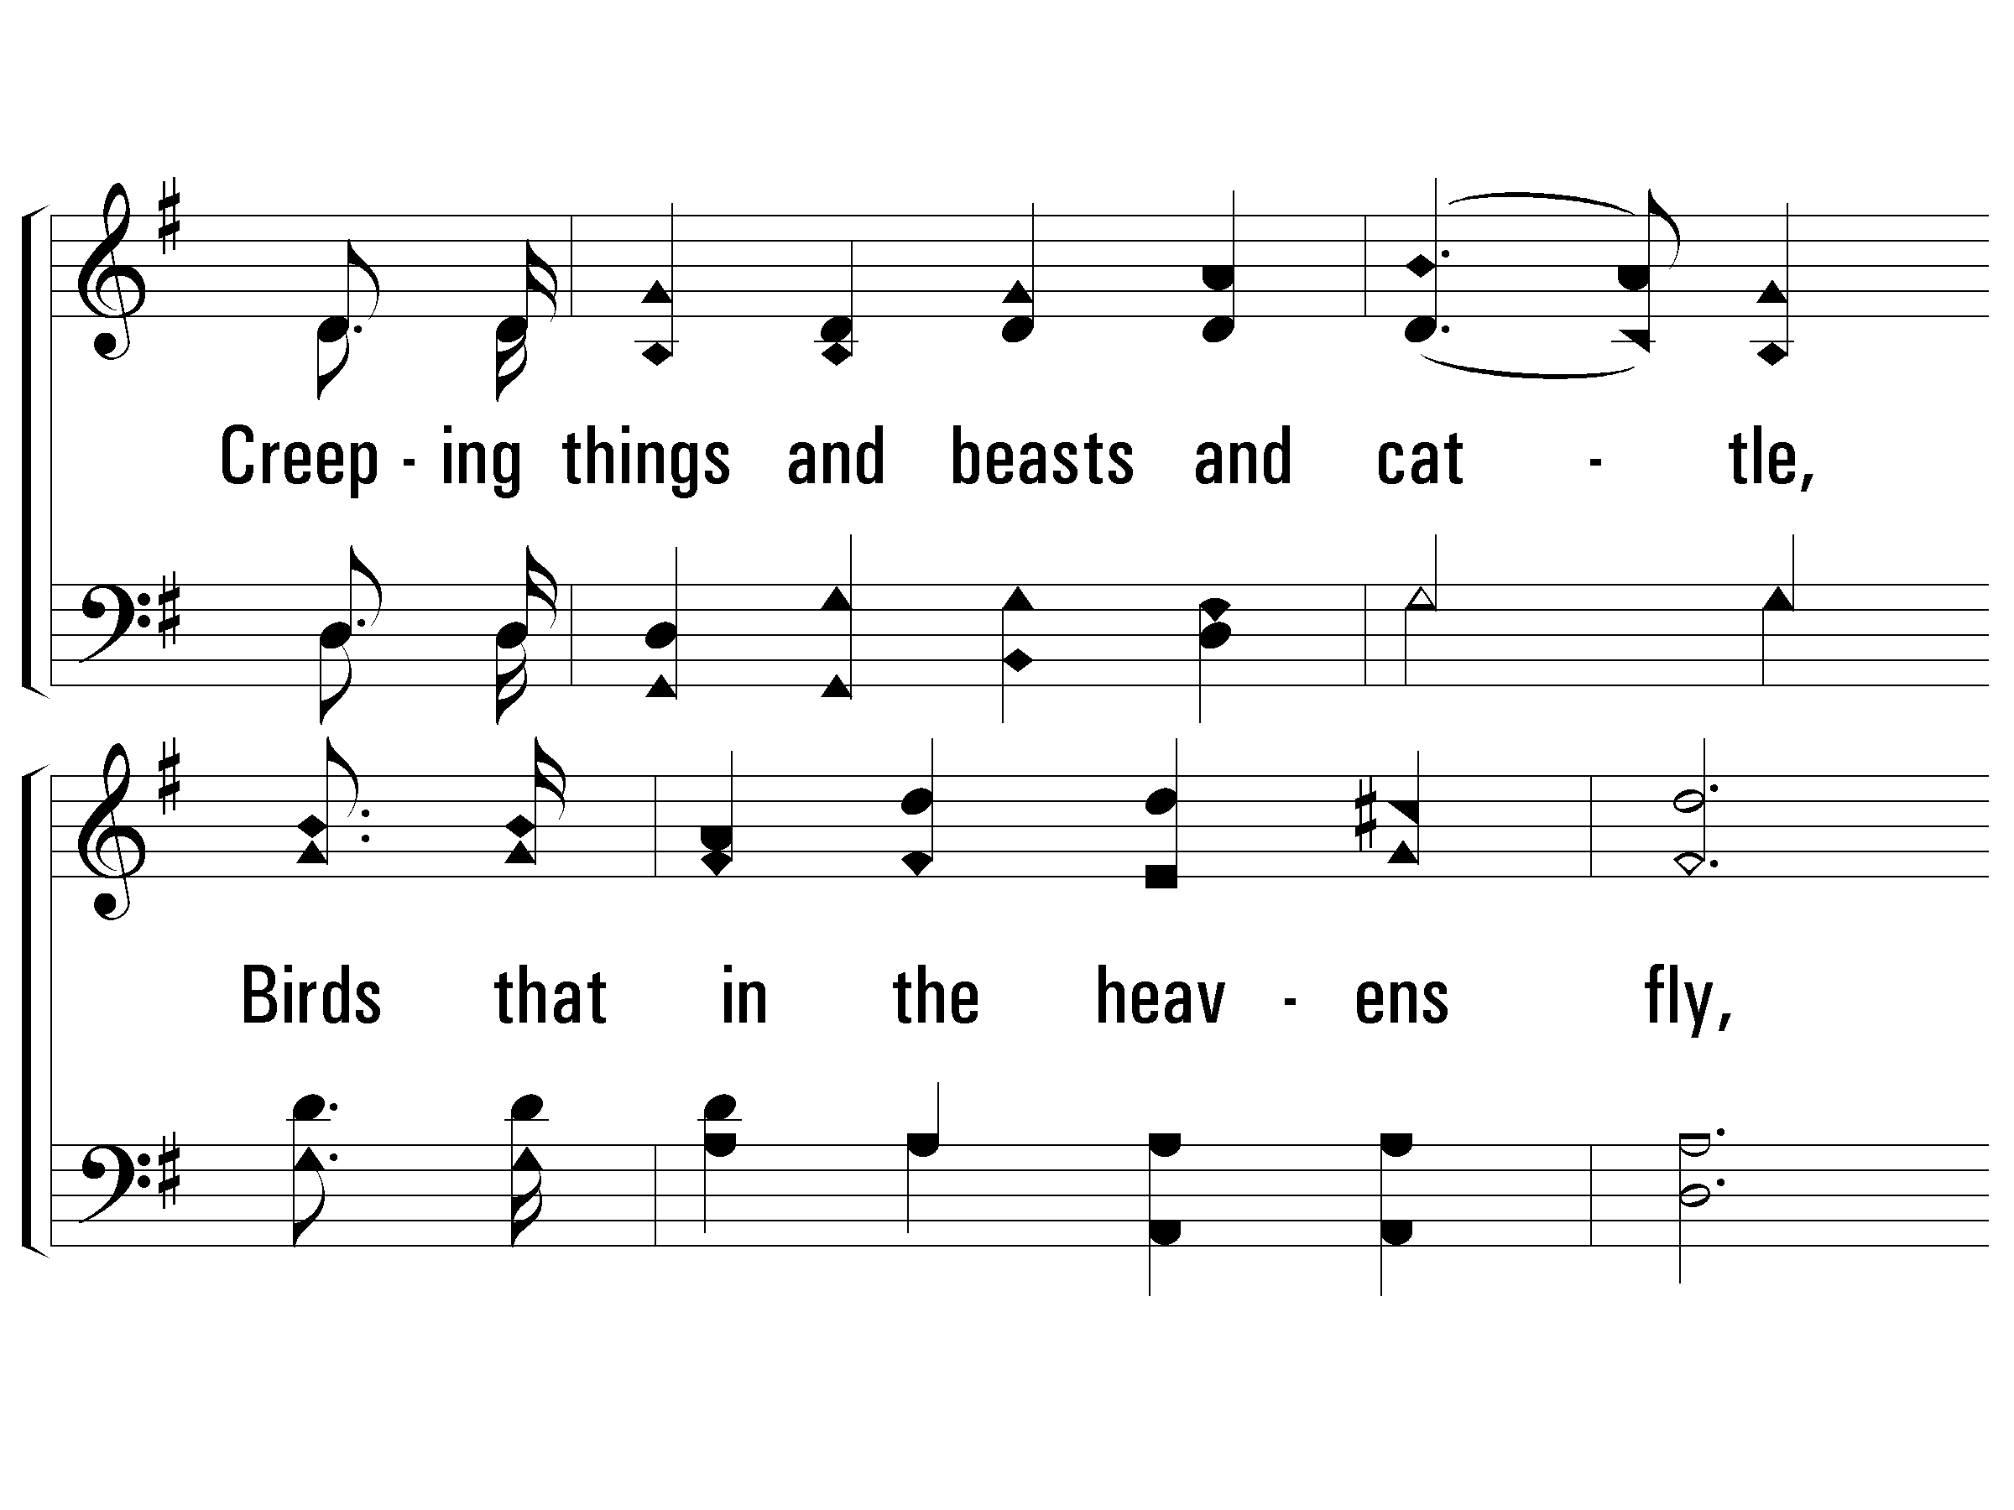
3 – Hallelujah, Praise Jehovah
200
© 2001 The Paperless Hymnal™

Slide 21
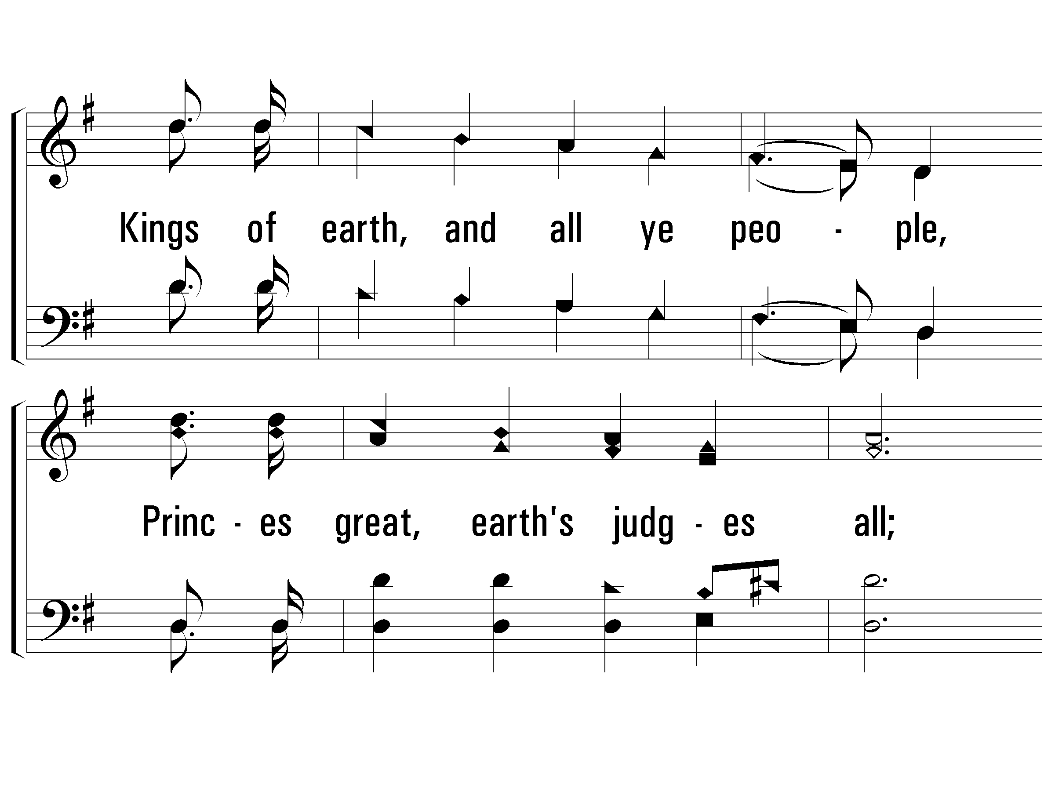
3 – Hallelujah, Praise Jehovah
200
© 2001 The Paperless Hymnal™

Slide 22
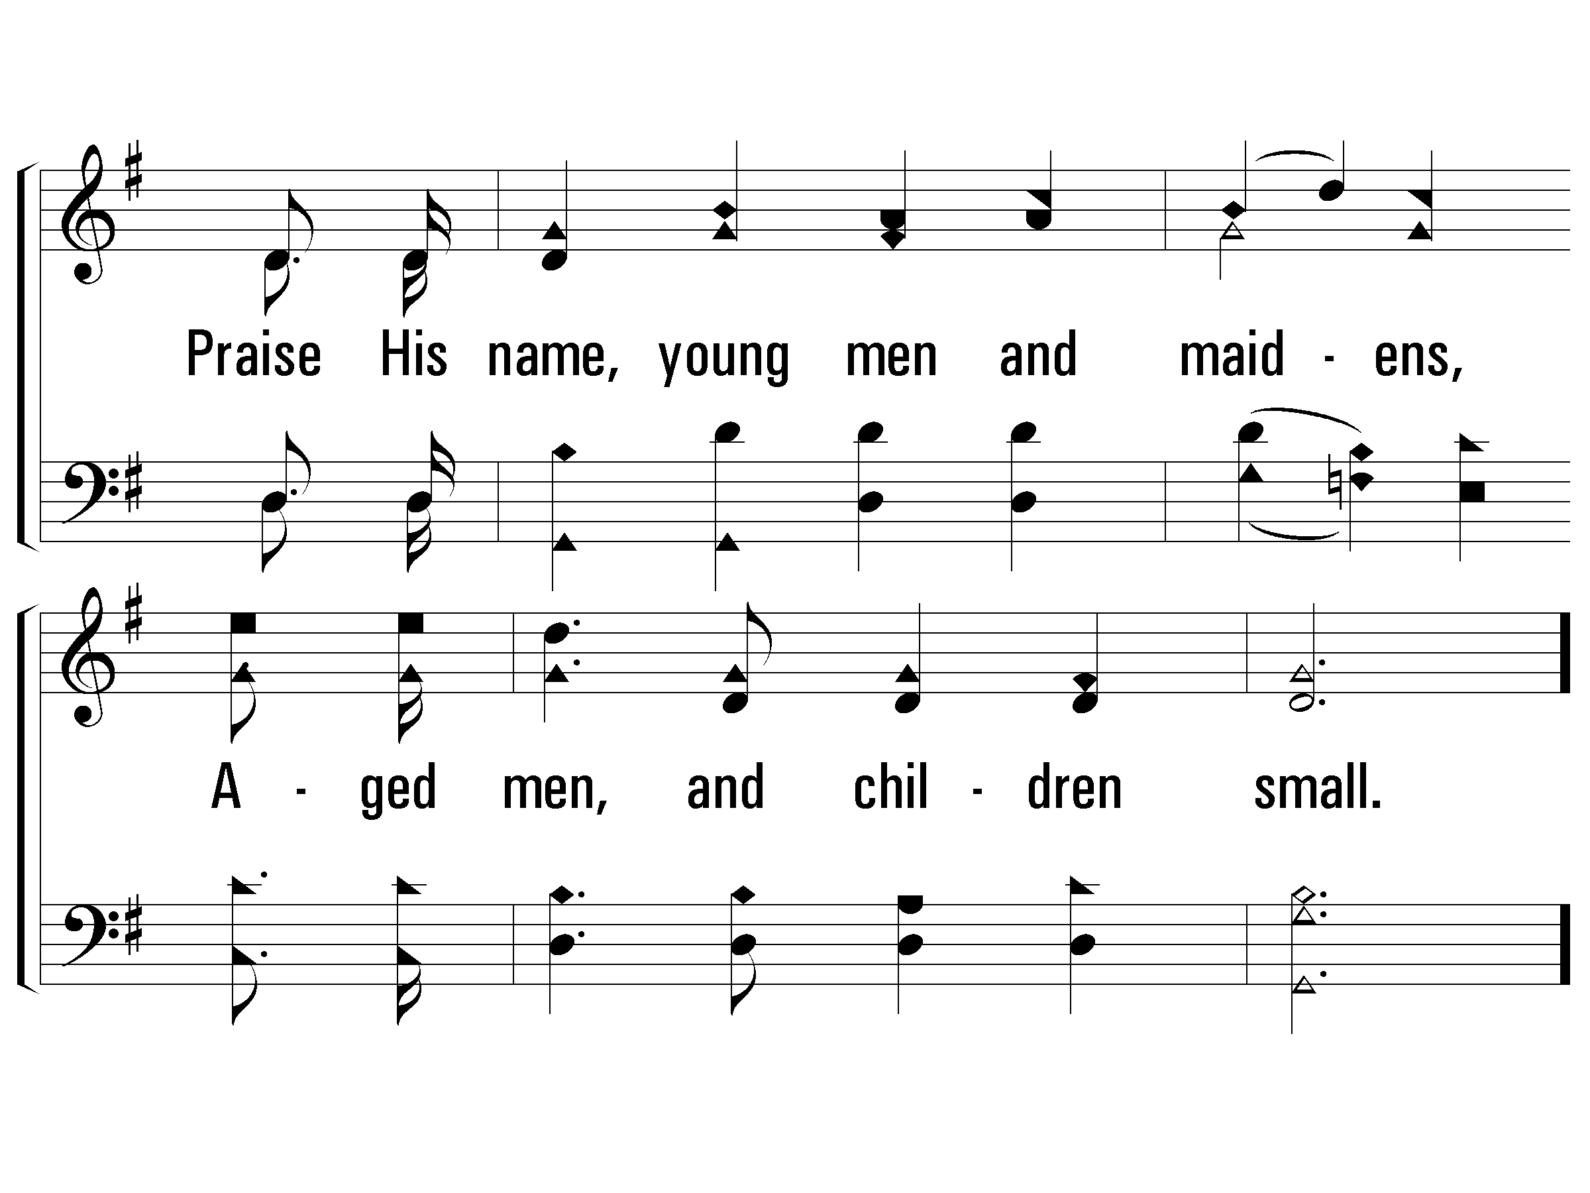
3 – Hallelujah, Praise Jehovah
200
© 2001 The Paperless Hymnal™

Slide 23
c – Hallelujah, Praise Jehovah
200
Let them praises give Jehovah,
For His name alone is high,
And His glory is exalted,
And His glory is exalted,
And His glory is exalted,
Far above the earth and sky.
© 2001 The Paperless Hymnal™

Slide 24
c – Hallelujah, Praise Jehovah
200
© 2001 The Paperless Hymnal™

Slide 25
c – Hallelujah, Praise Jehovah
200
End
© 2001 The Paperless Hymnal™

Slide 26
Order of Evening Services
Scripture Reading
Song 200 – Hallelujah, Praise Jehovah
Prayer
Song 666 – The Spacious Firmament
Psalm 19
Song 10 (PHSS) – The Law of the LORD
Psalm 121
Song 712 – Unto the Hills
Psalm 8
Song 3 (PHSS) – O How Glorious, Full of Wonder
Psalm 95
Inv. Song 517 – O Why Not Tonight
Closing Prayer

Slide 28
The Spacious Firmament (Psalm 19:1-7)
666
Praise for the Lord

Slide 29
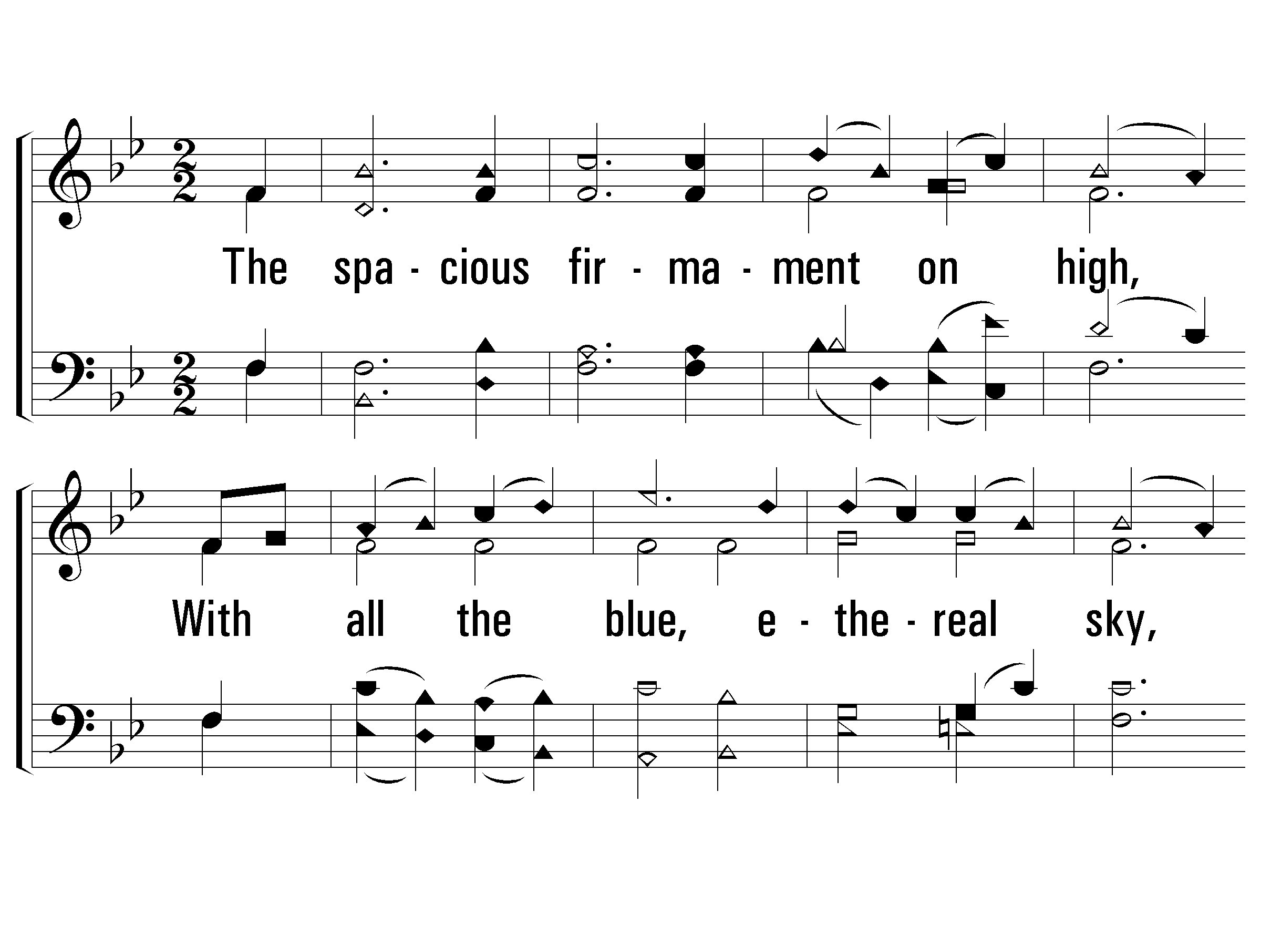
1 – The Spacious Firmament on High
666
1.
The spacious firmament on high,
With all the blue, ethereal sky,
And spangled heavens, a shining frame,
Their great Original proclaim:
The unwearied sun from day to day
Does his Creator's power display,
And publishes to every land
The work of an almighty hand.
Words: Joseph Addison
Music: Franz J. Haydn
© 2005 The Paperless Hymnal™

Slide 30
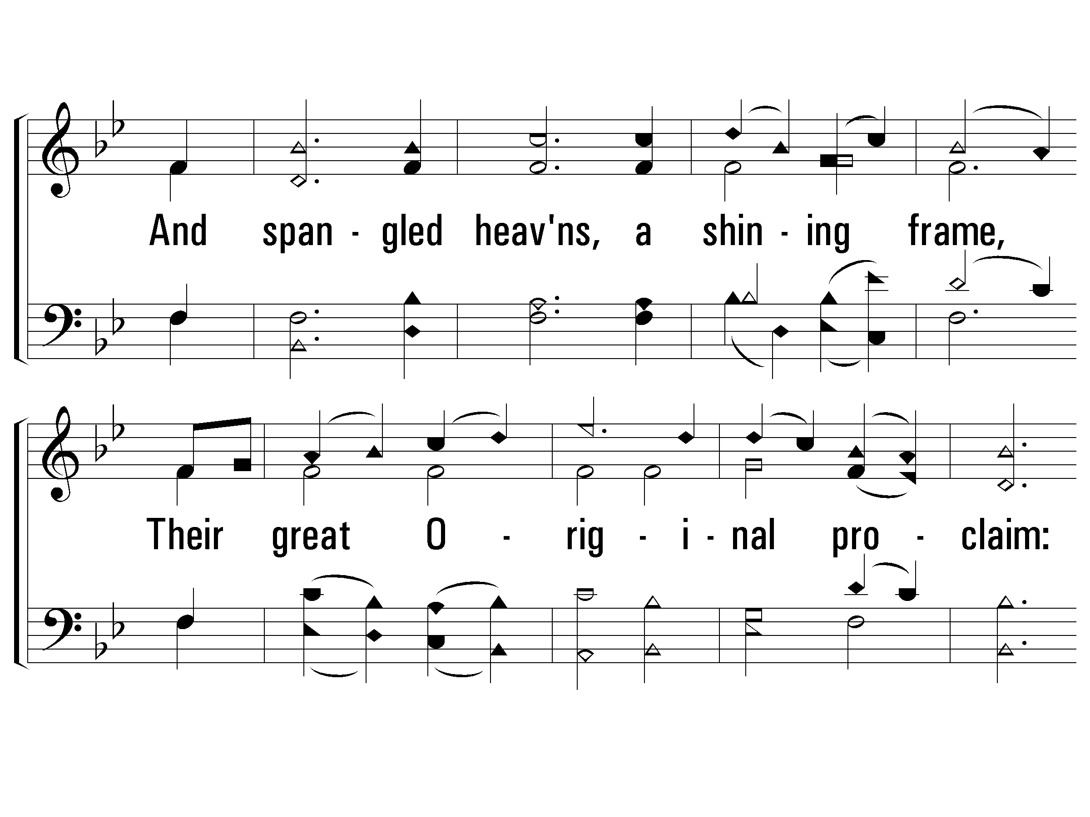
1 – The Spacious Firmament on High
666
© 2005 The Paperless Hymnal™

Slide 31
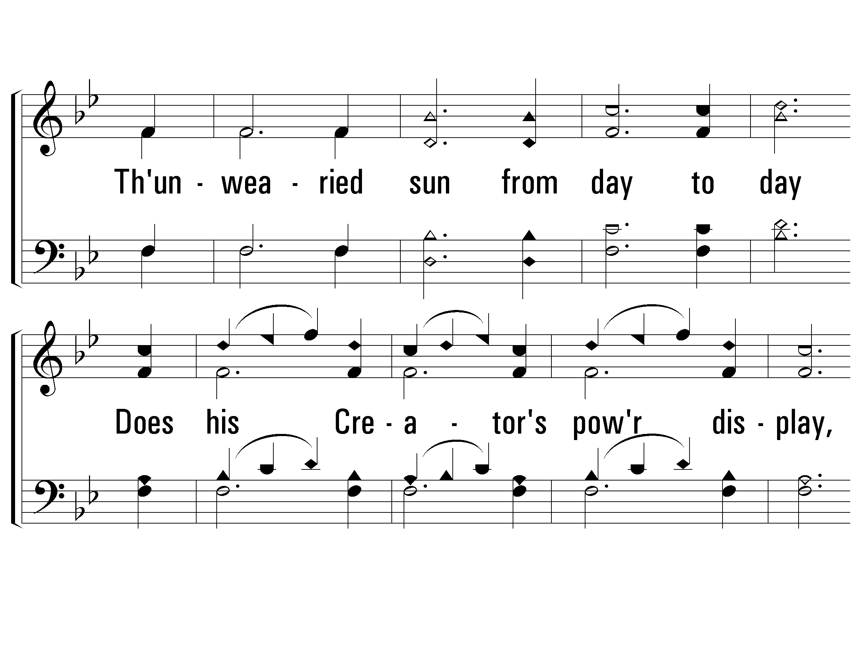
1 – The Spacious Firmament on High
666
© 2005 The Paperless Hymnal™

Slide 32
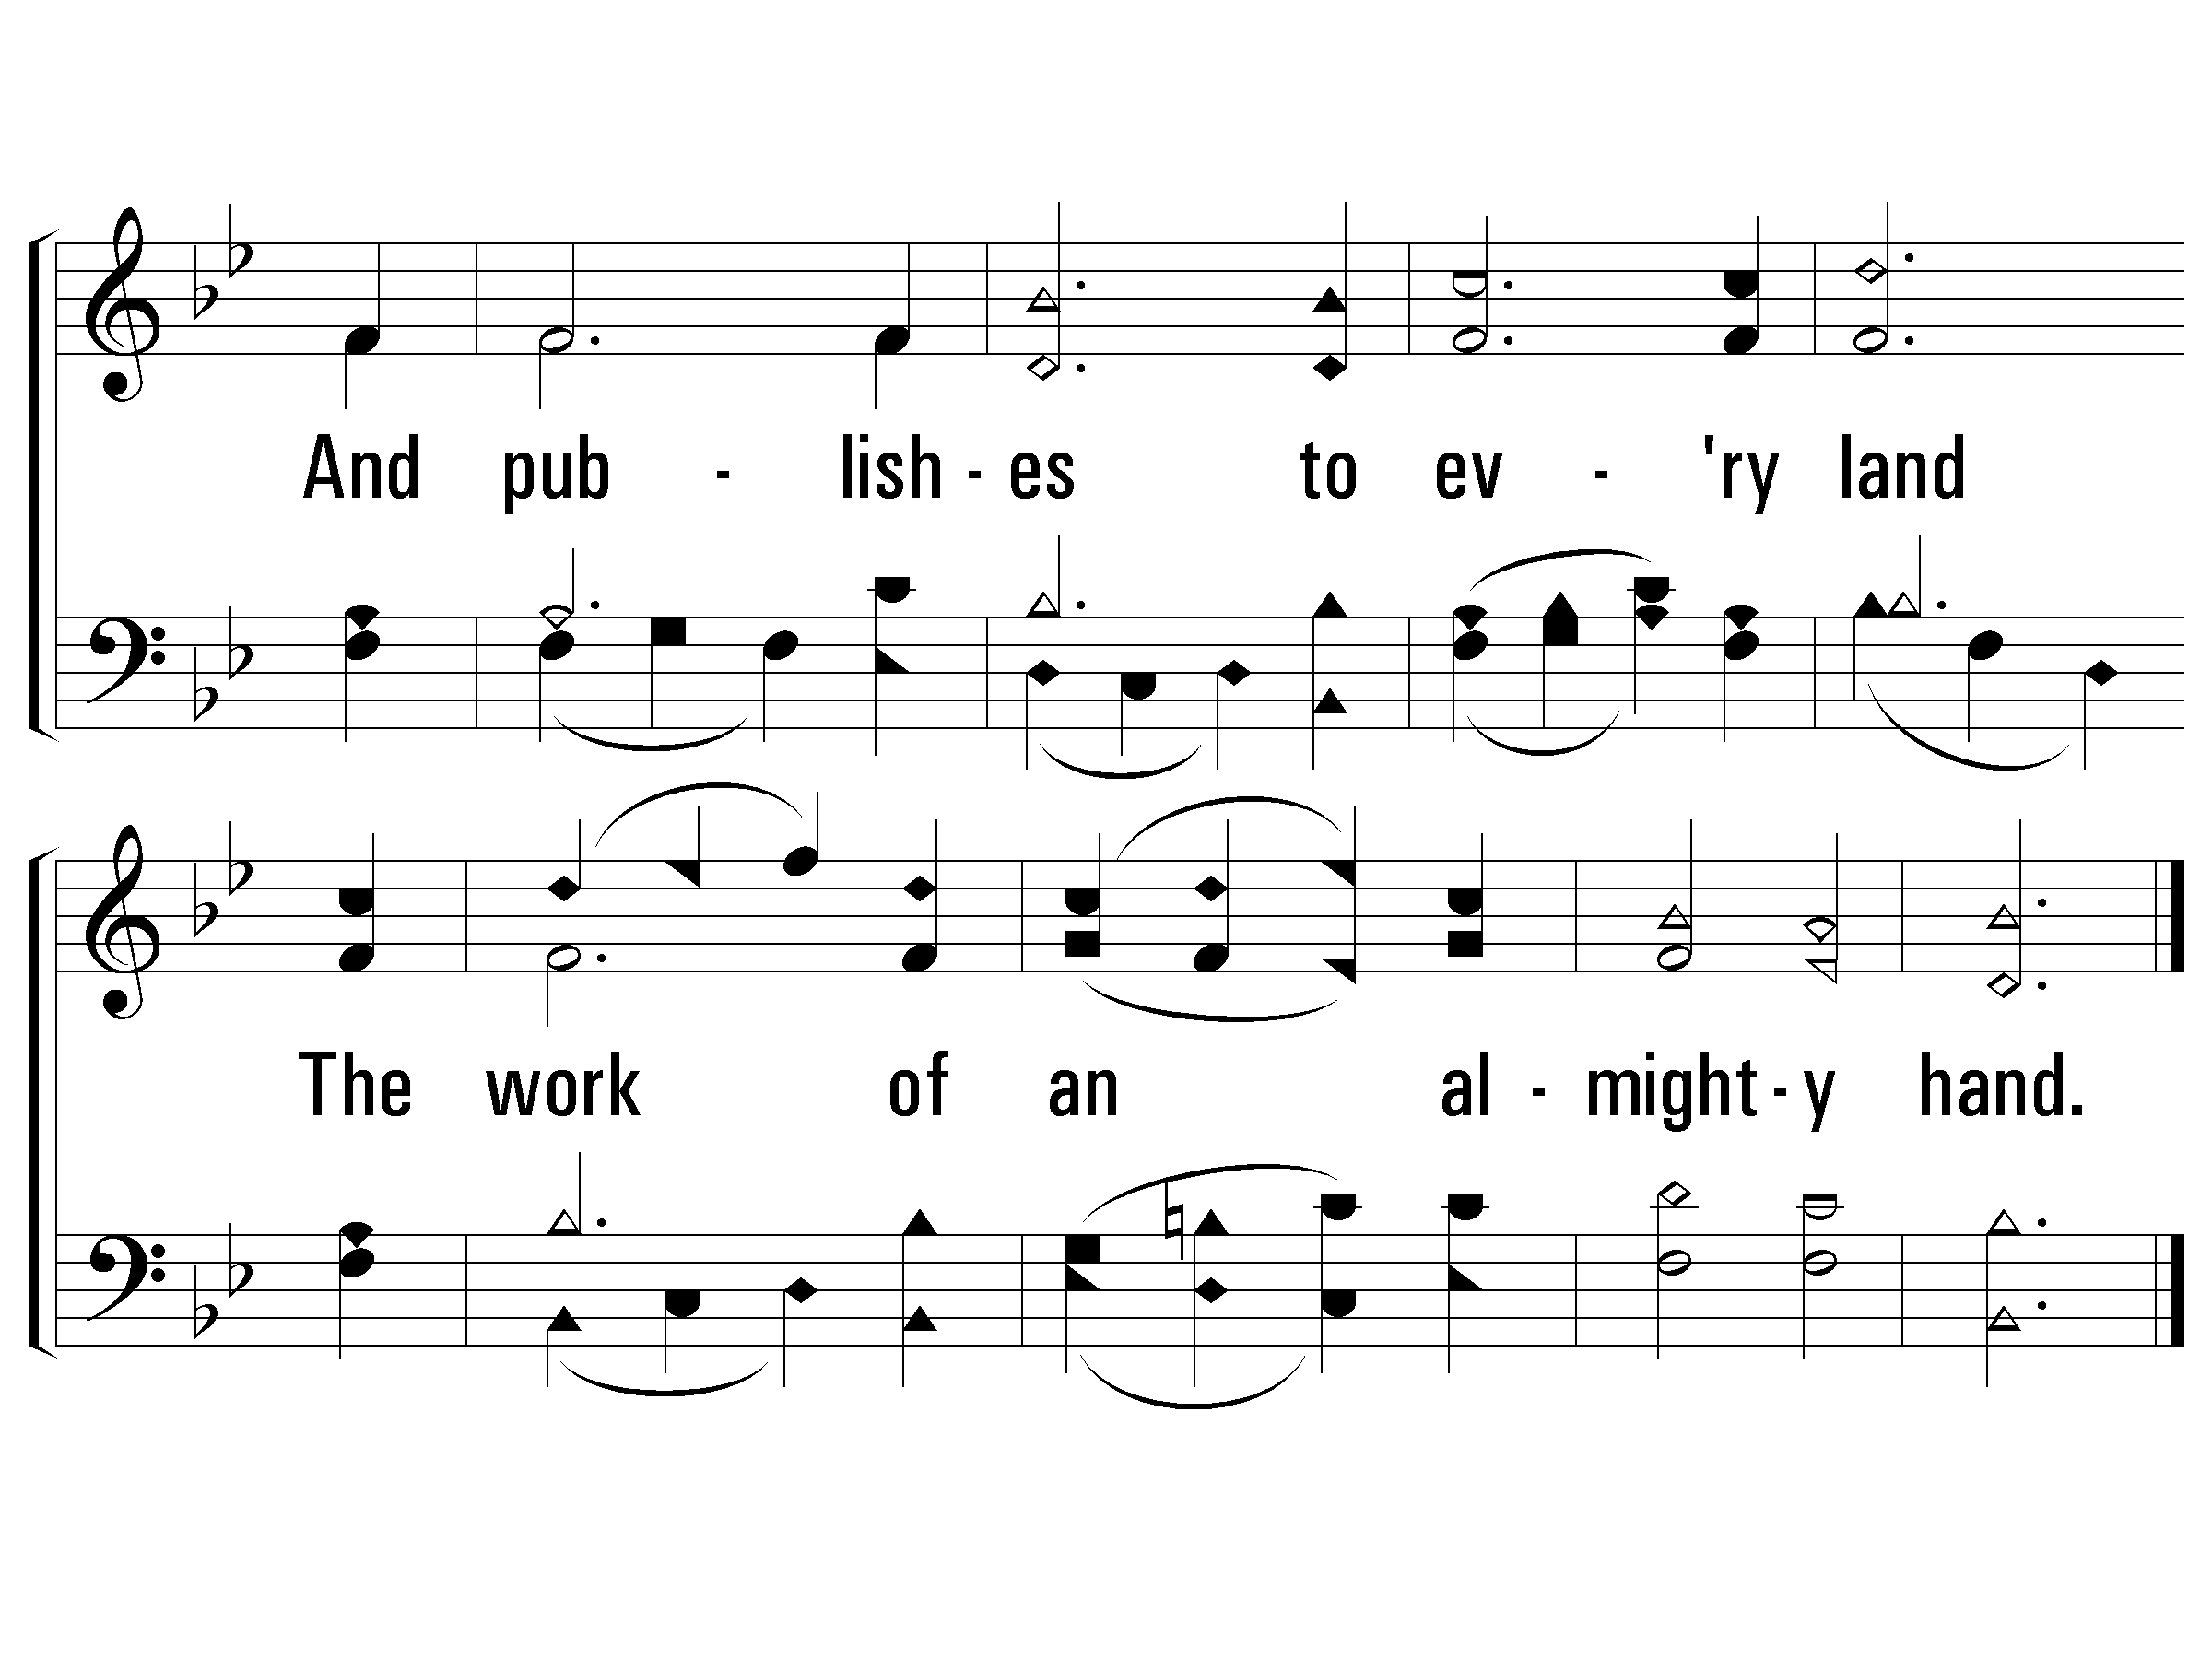
1 – The Spacious Firmament on High
666
© 2005 The Paperless Hymnal™

Slide 33
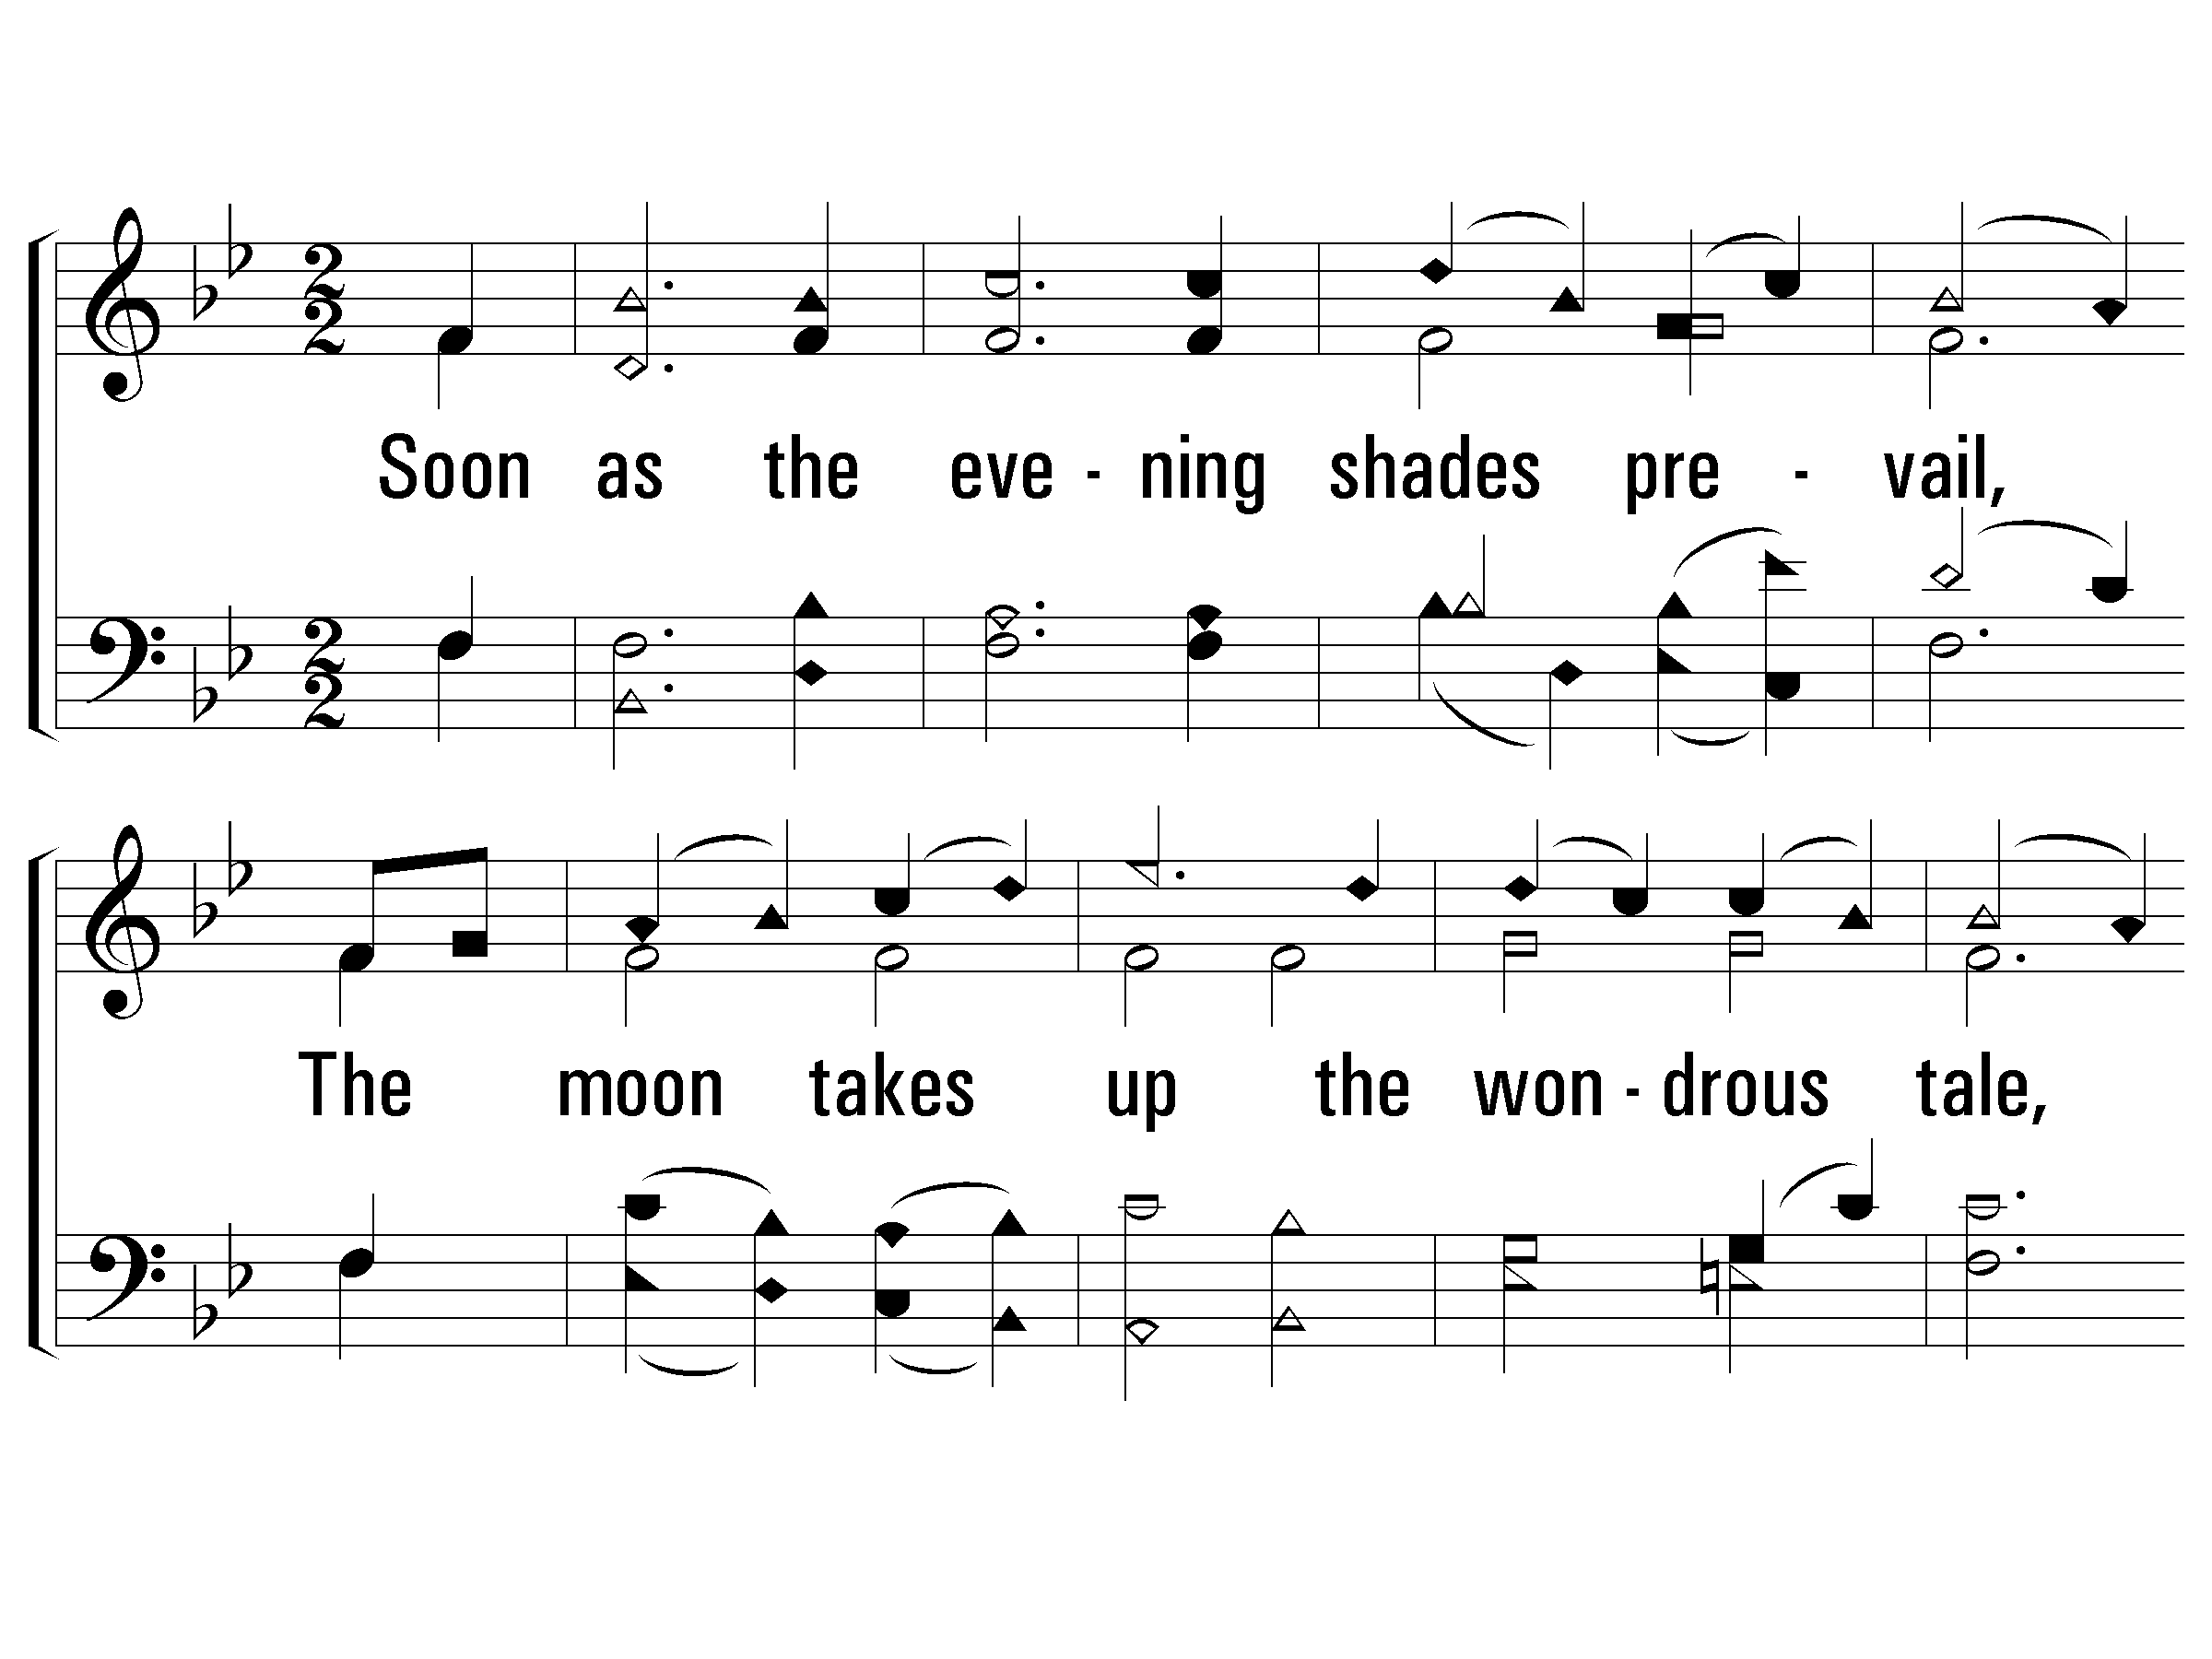
2 – The Spacious Firmament on High
666
2.
Soon as the evening shades prevail,
The moon takes up the wondrous tale,
And nightly to the listening earth
Repeats the story of her birth;
While all the stars that round her burn,
And all the planets in their turn,
Confirm the tidings as they roll,
And spread the truth from pole to pole.
Words: Joseph Addison
Music: Franz J. Haydn
© 2005 The Paperless Hymnal™

Slide 34
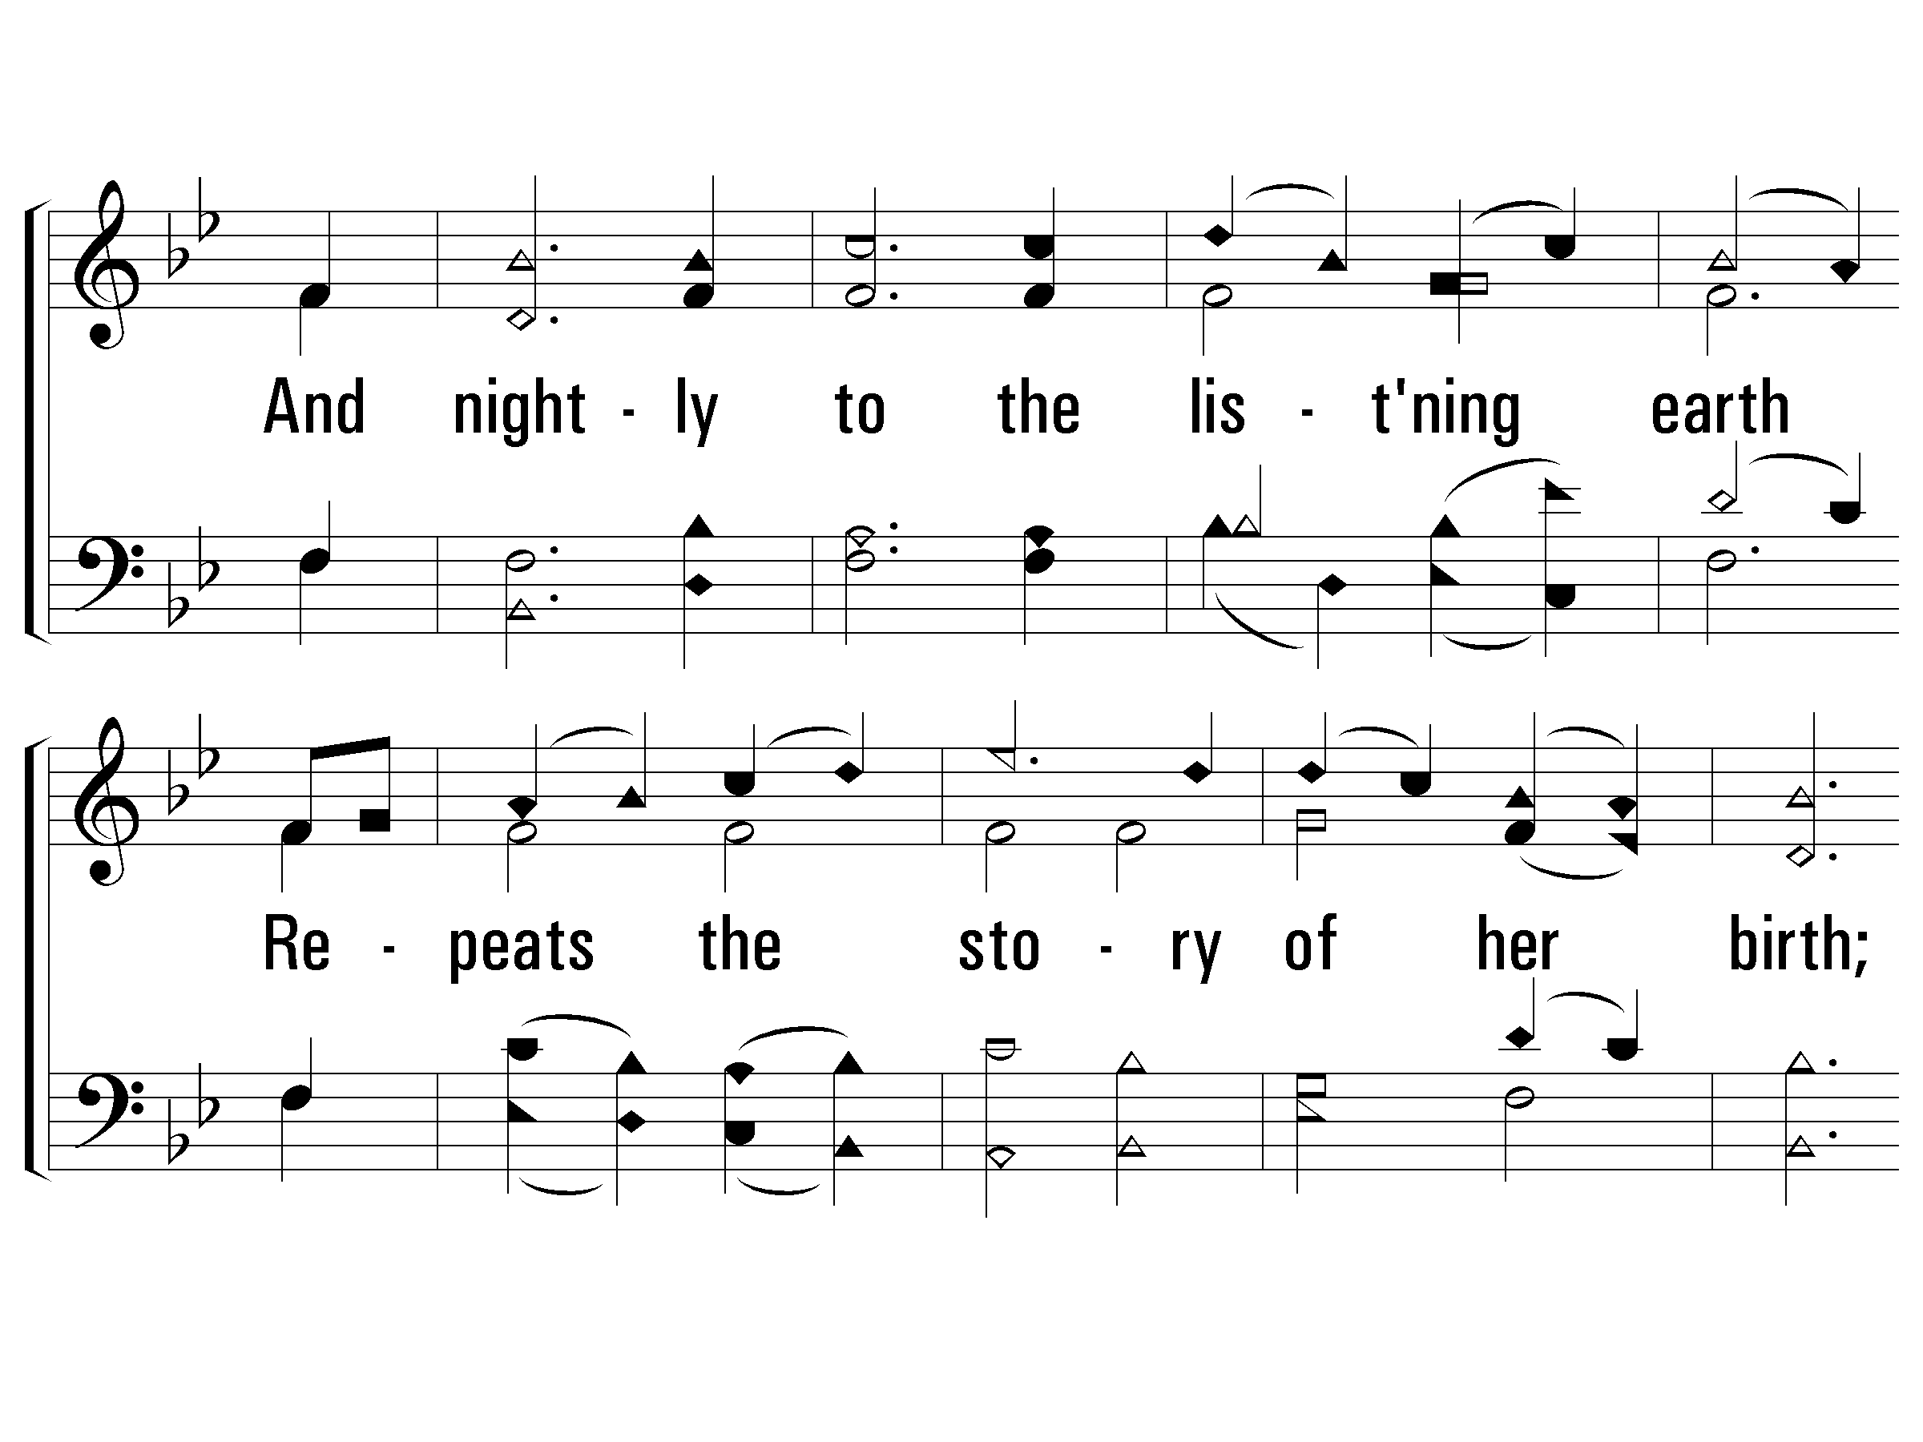
2 – The Spacious Firmament on High
666
© 2005 The Paperless Hymnal™

Slide 35
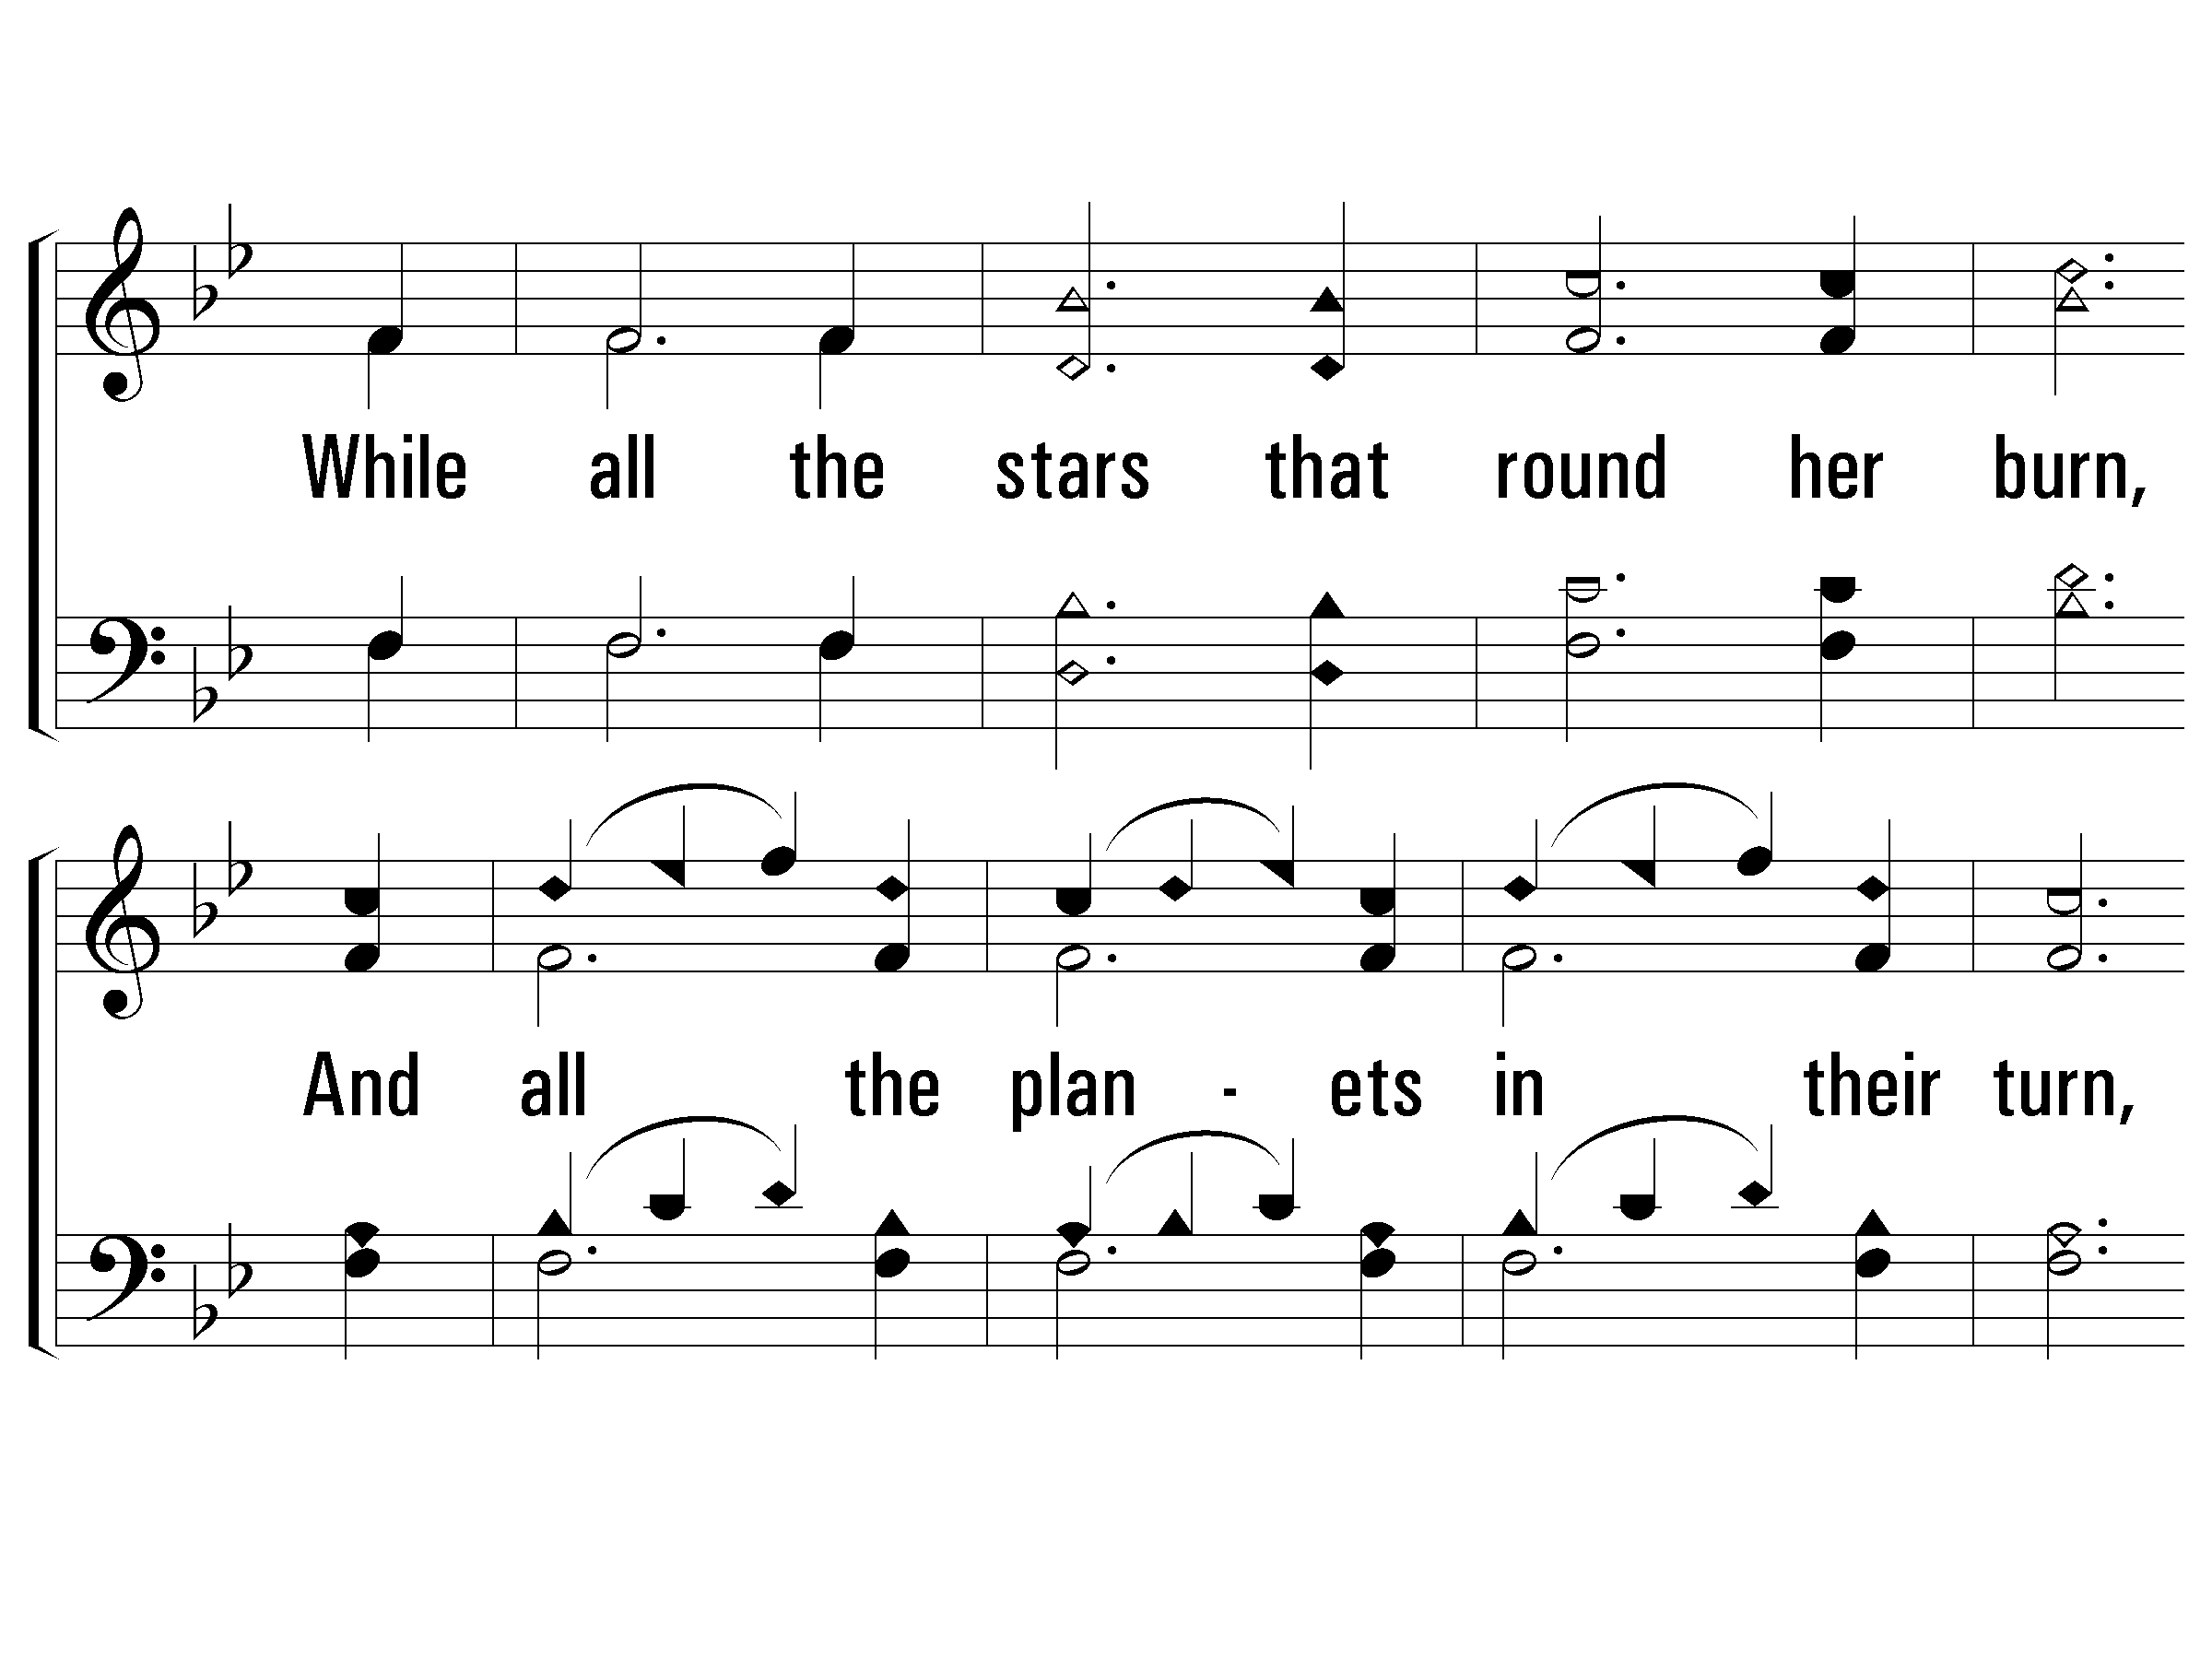
2 – The Spacious Firmament on High
666
© 2005 The Paperless Hymnal™

Slide 36
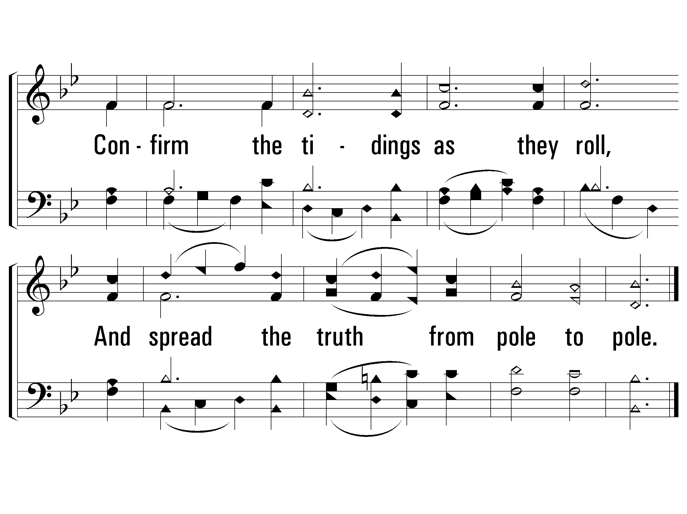
2 – The Spacious Firmament on High
666
© 2005 The Paperless Hymnal™

Slide 37
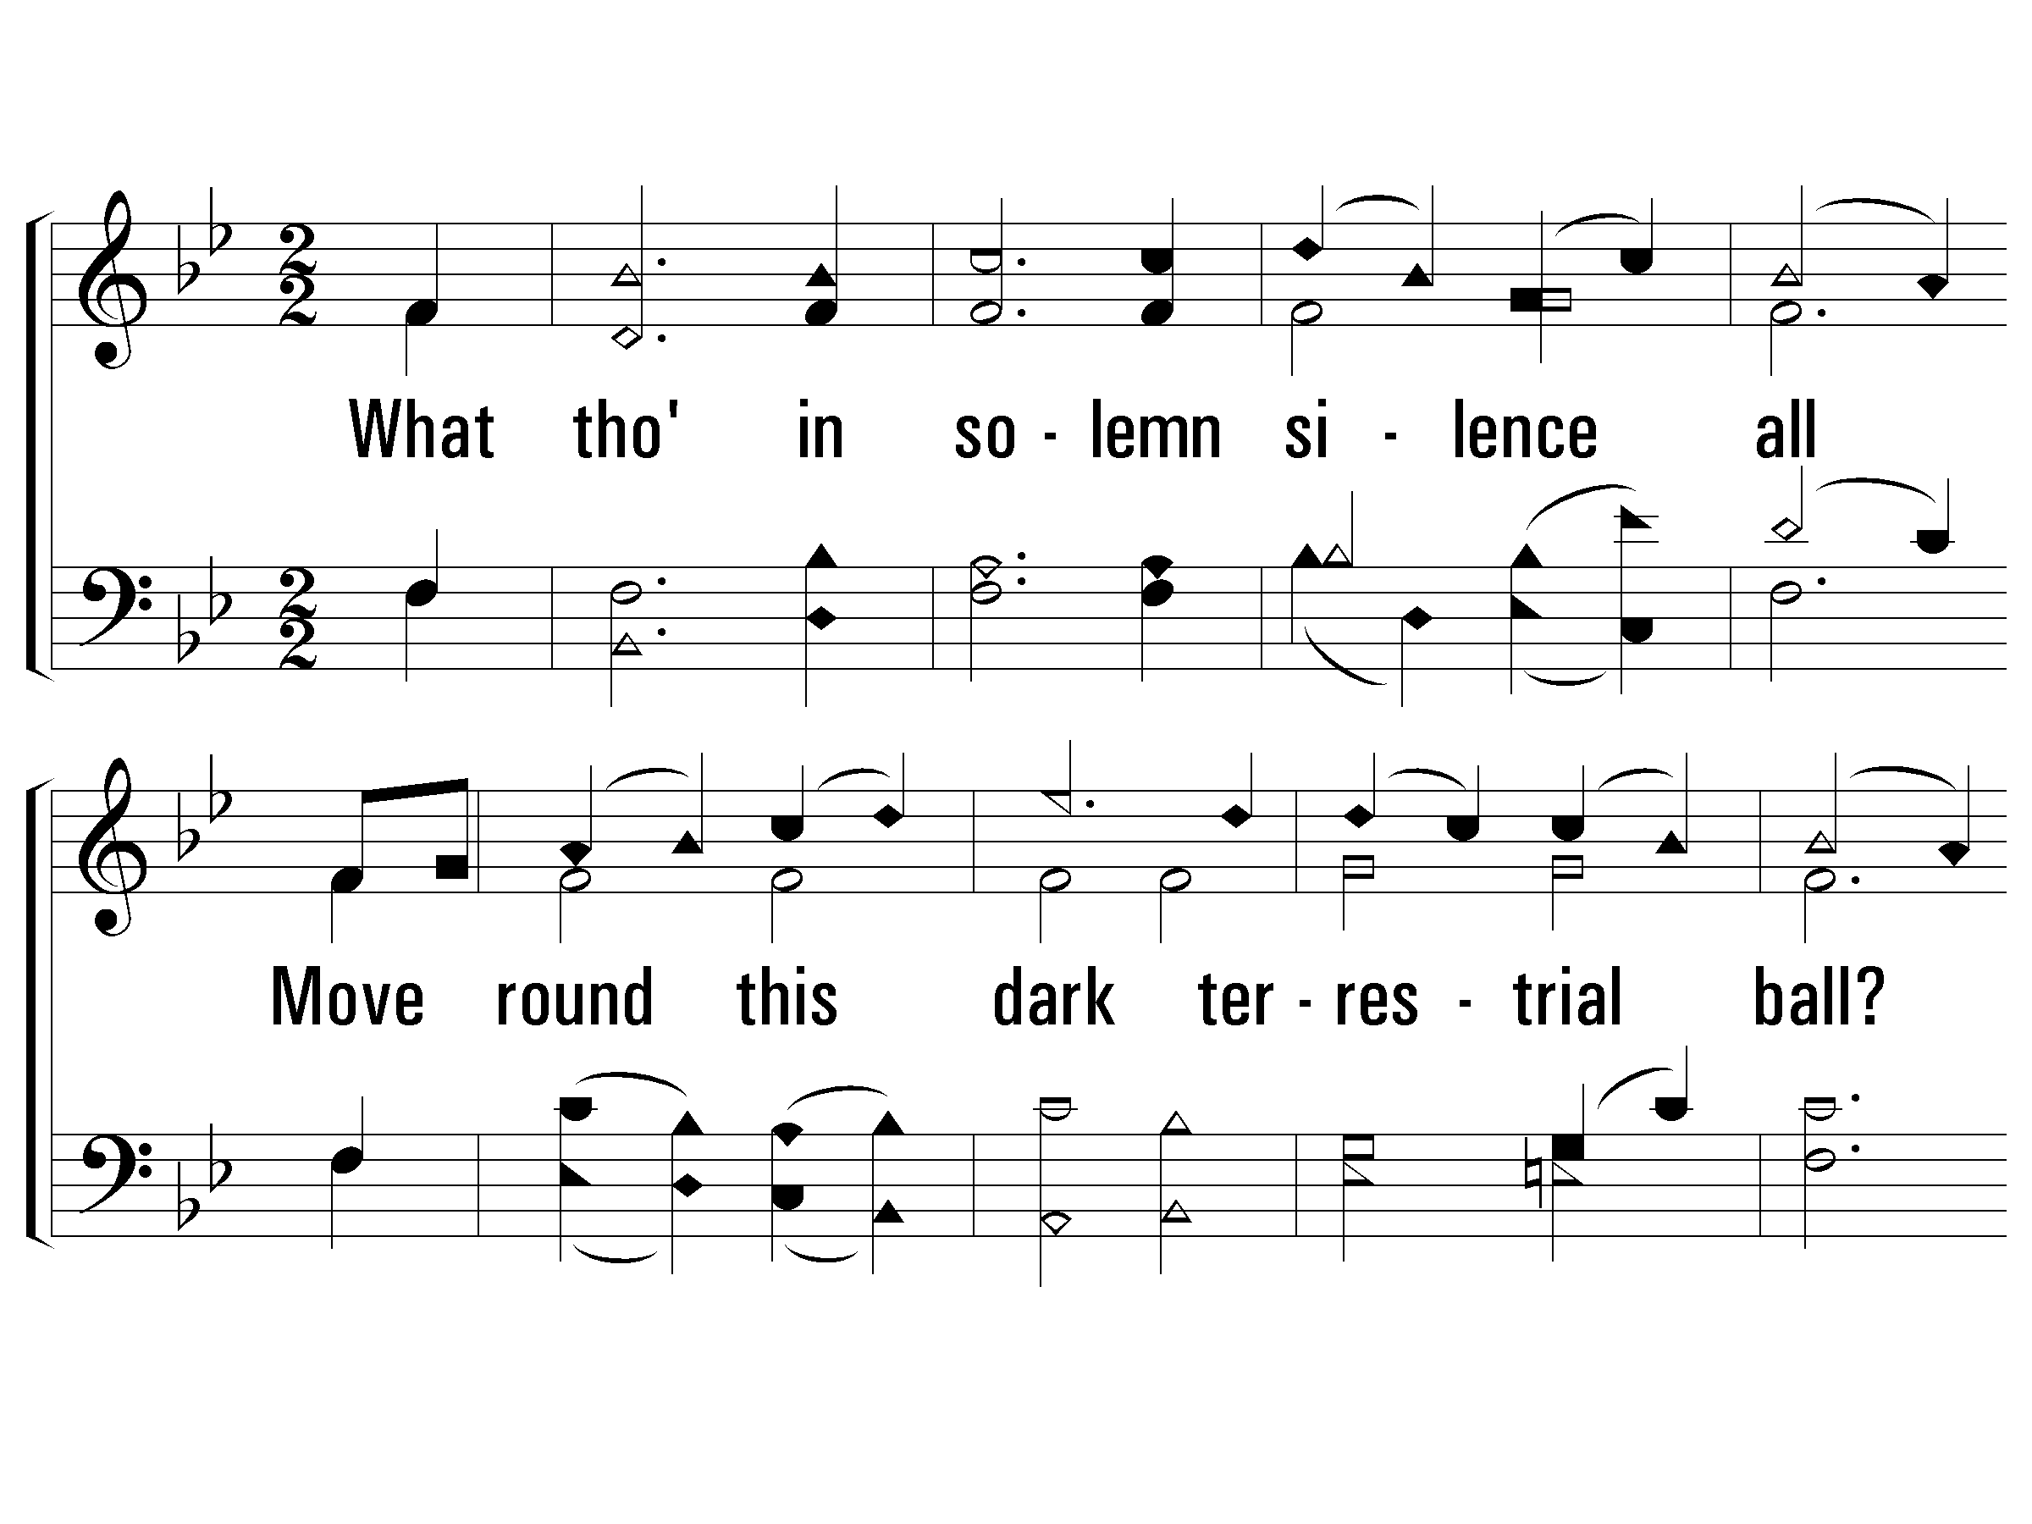
3 – The Spacious Firmament on High
666
3.
What though in solemn silence all
Move round this dark terrestrial ball?
What though no real voice nor sound
Amid their radiant orbs be found?
In reason's ear they all rejoice,
And utter forth a glorious voice,
For ever singing as they shine,
"The hand that made us is divine."
Words: Joseph Addison
Music: Franz J. Haydn
© 2005 The Paperless Hymnal™

Slide 38
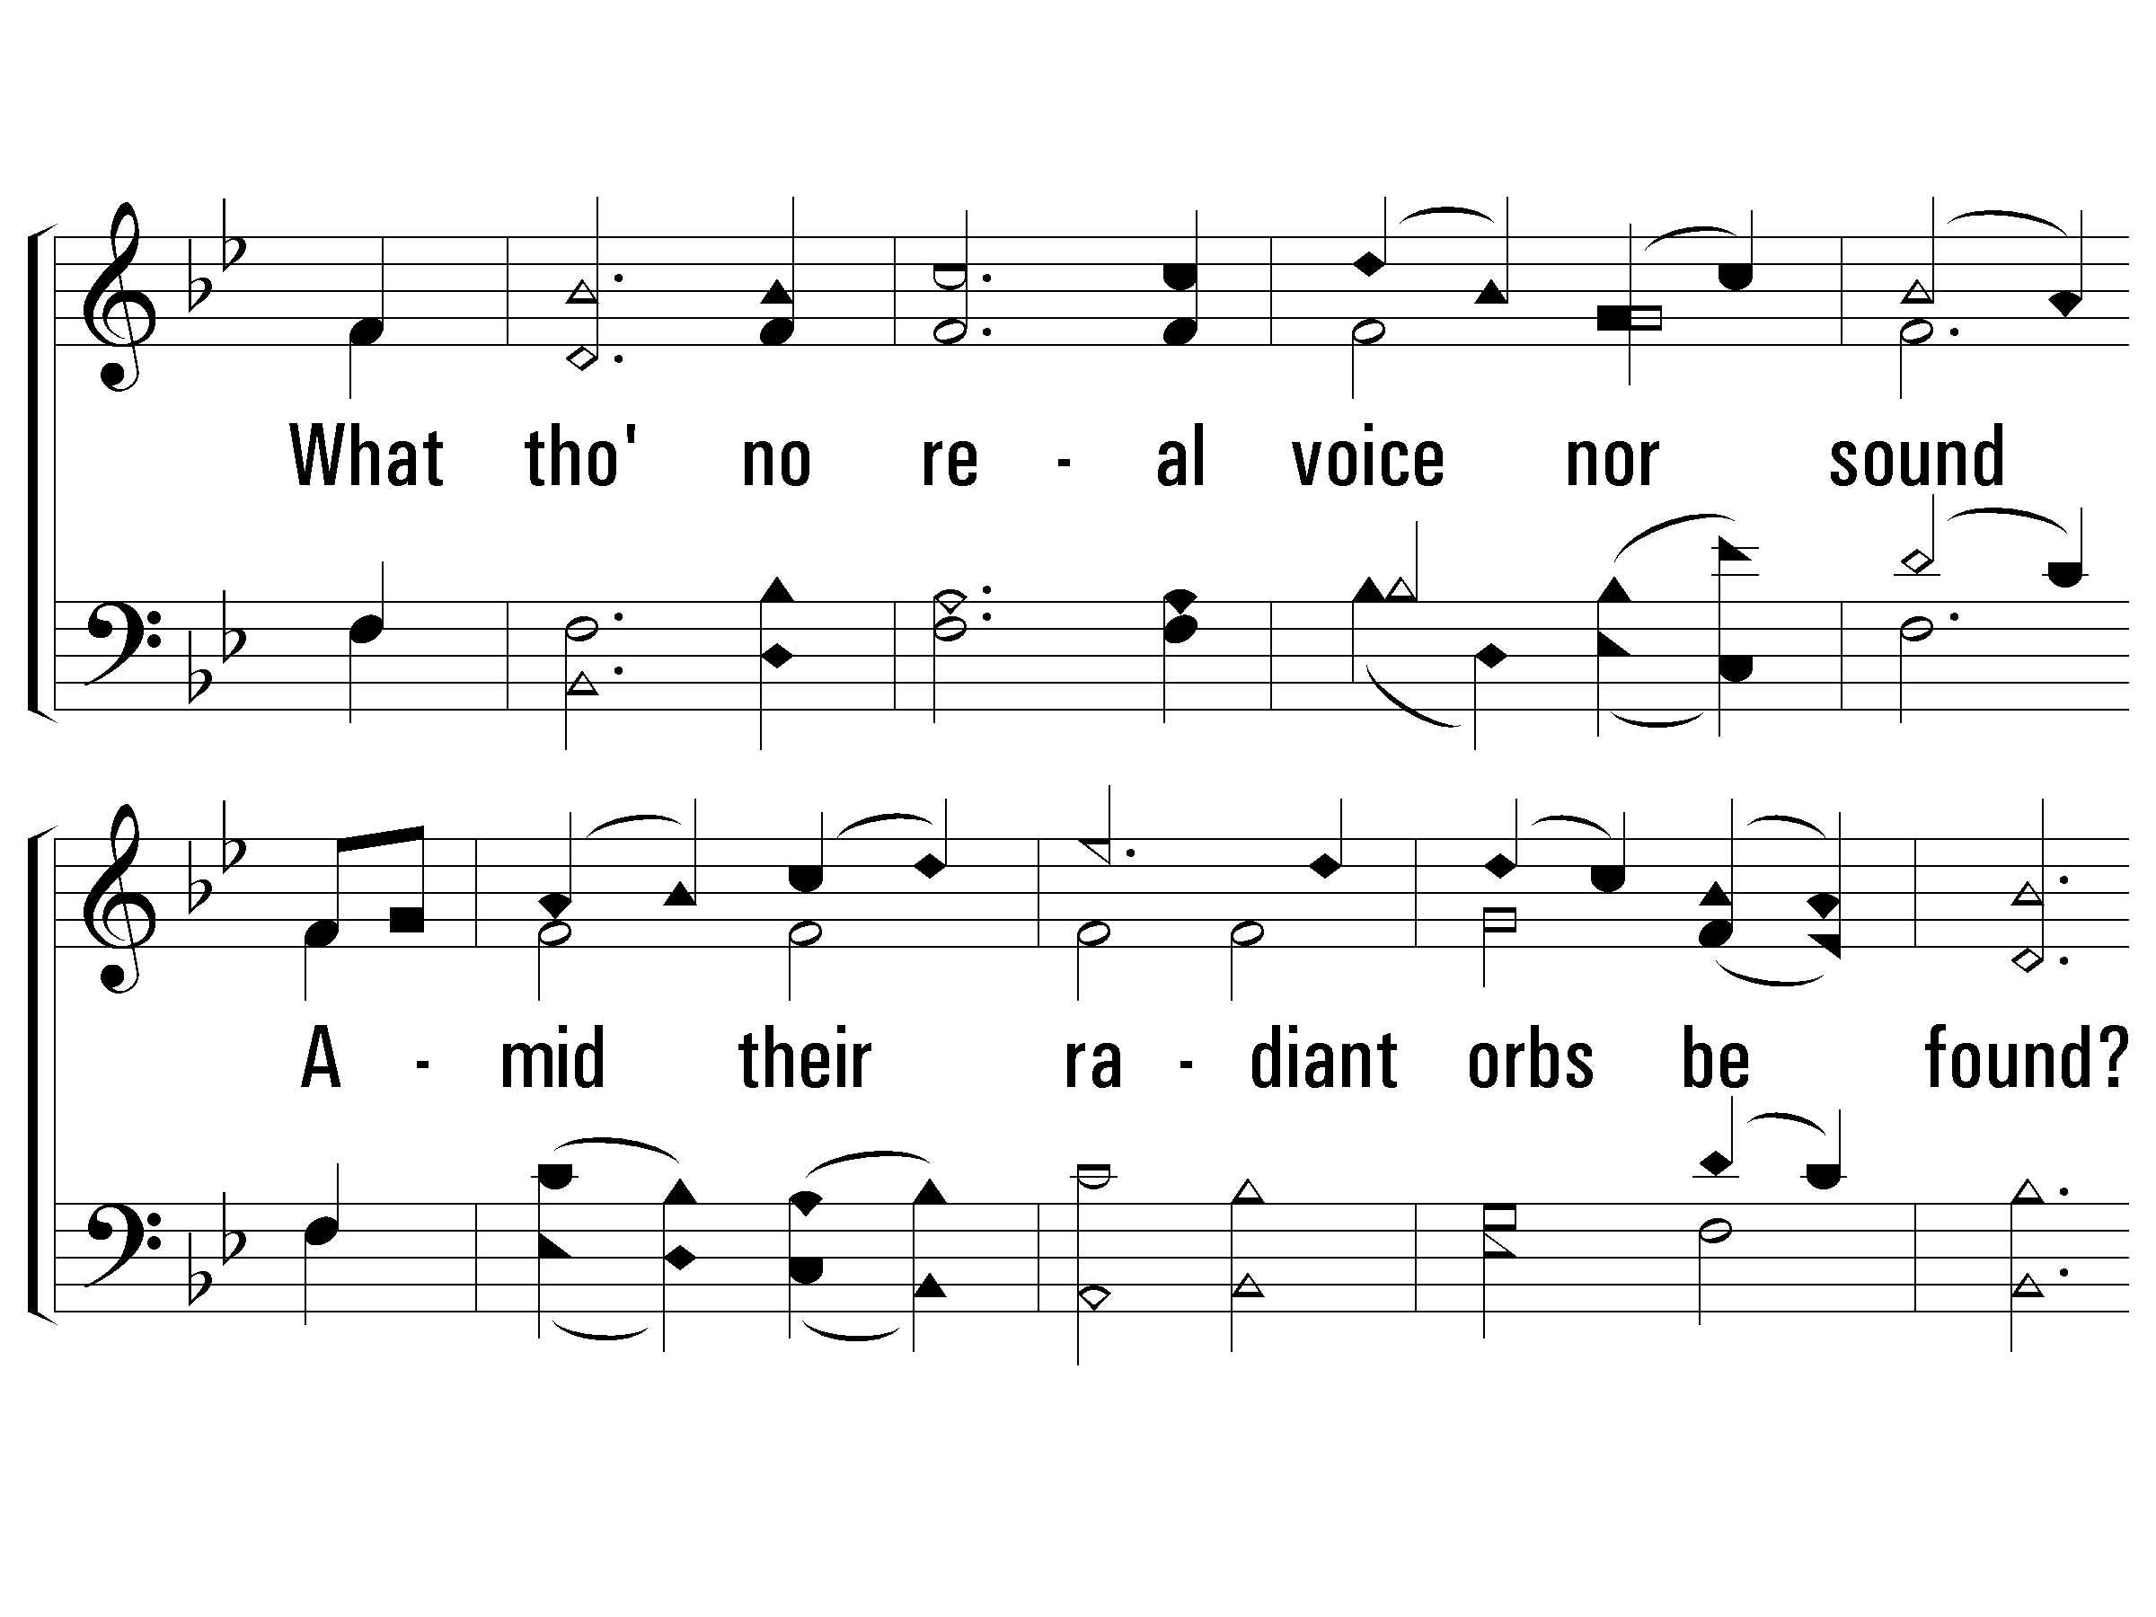
3 – The Spacious Firmament on High
666
© 2005 The Paperless Hymnal™

Slide 39
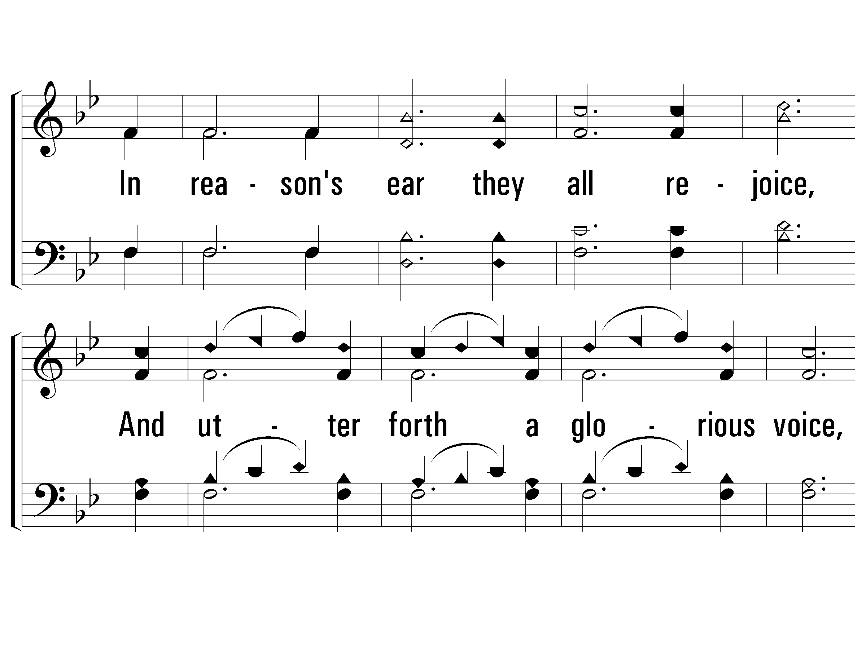
3 – The Spacious Firmament on High
666
© 2005 The Paperless Hymnal™

Slide 40
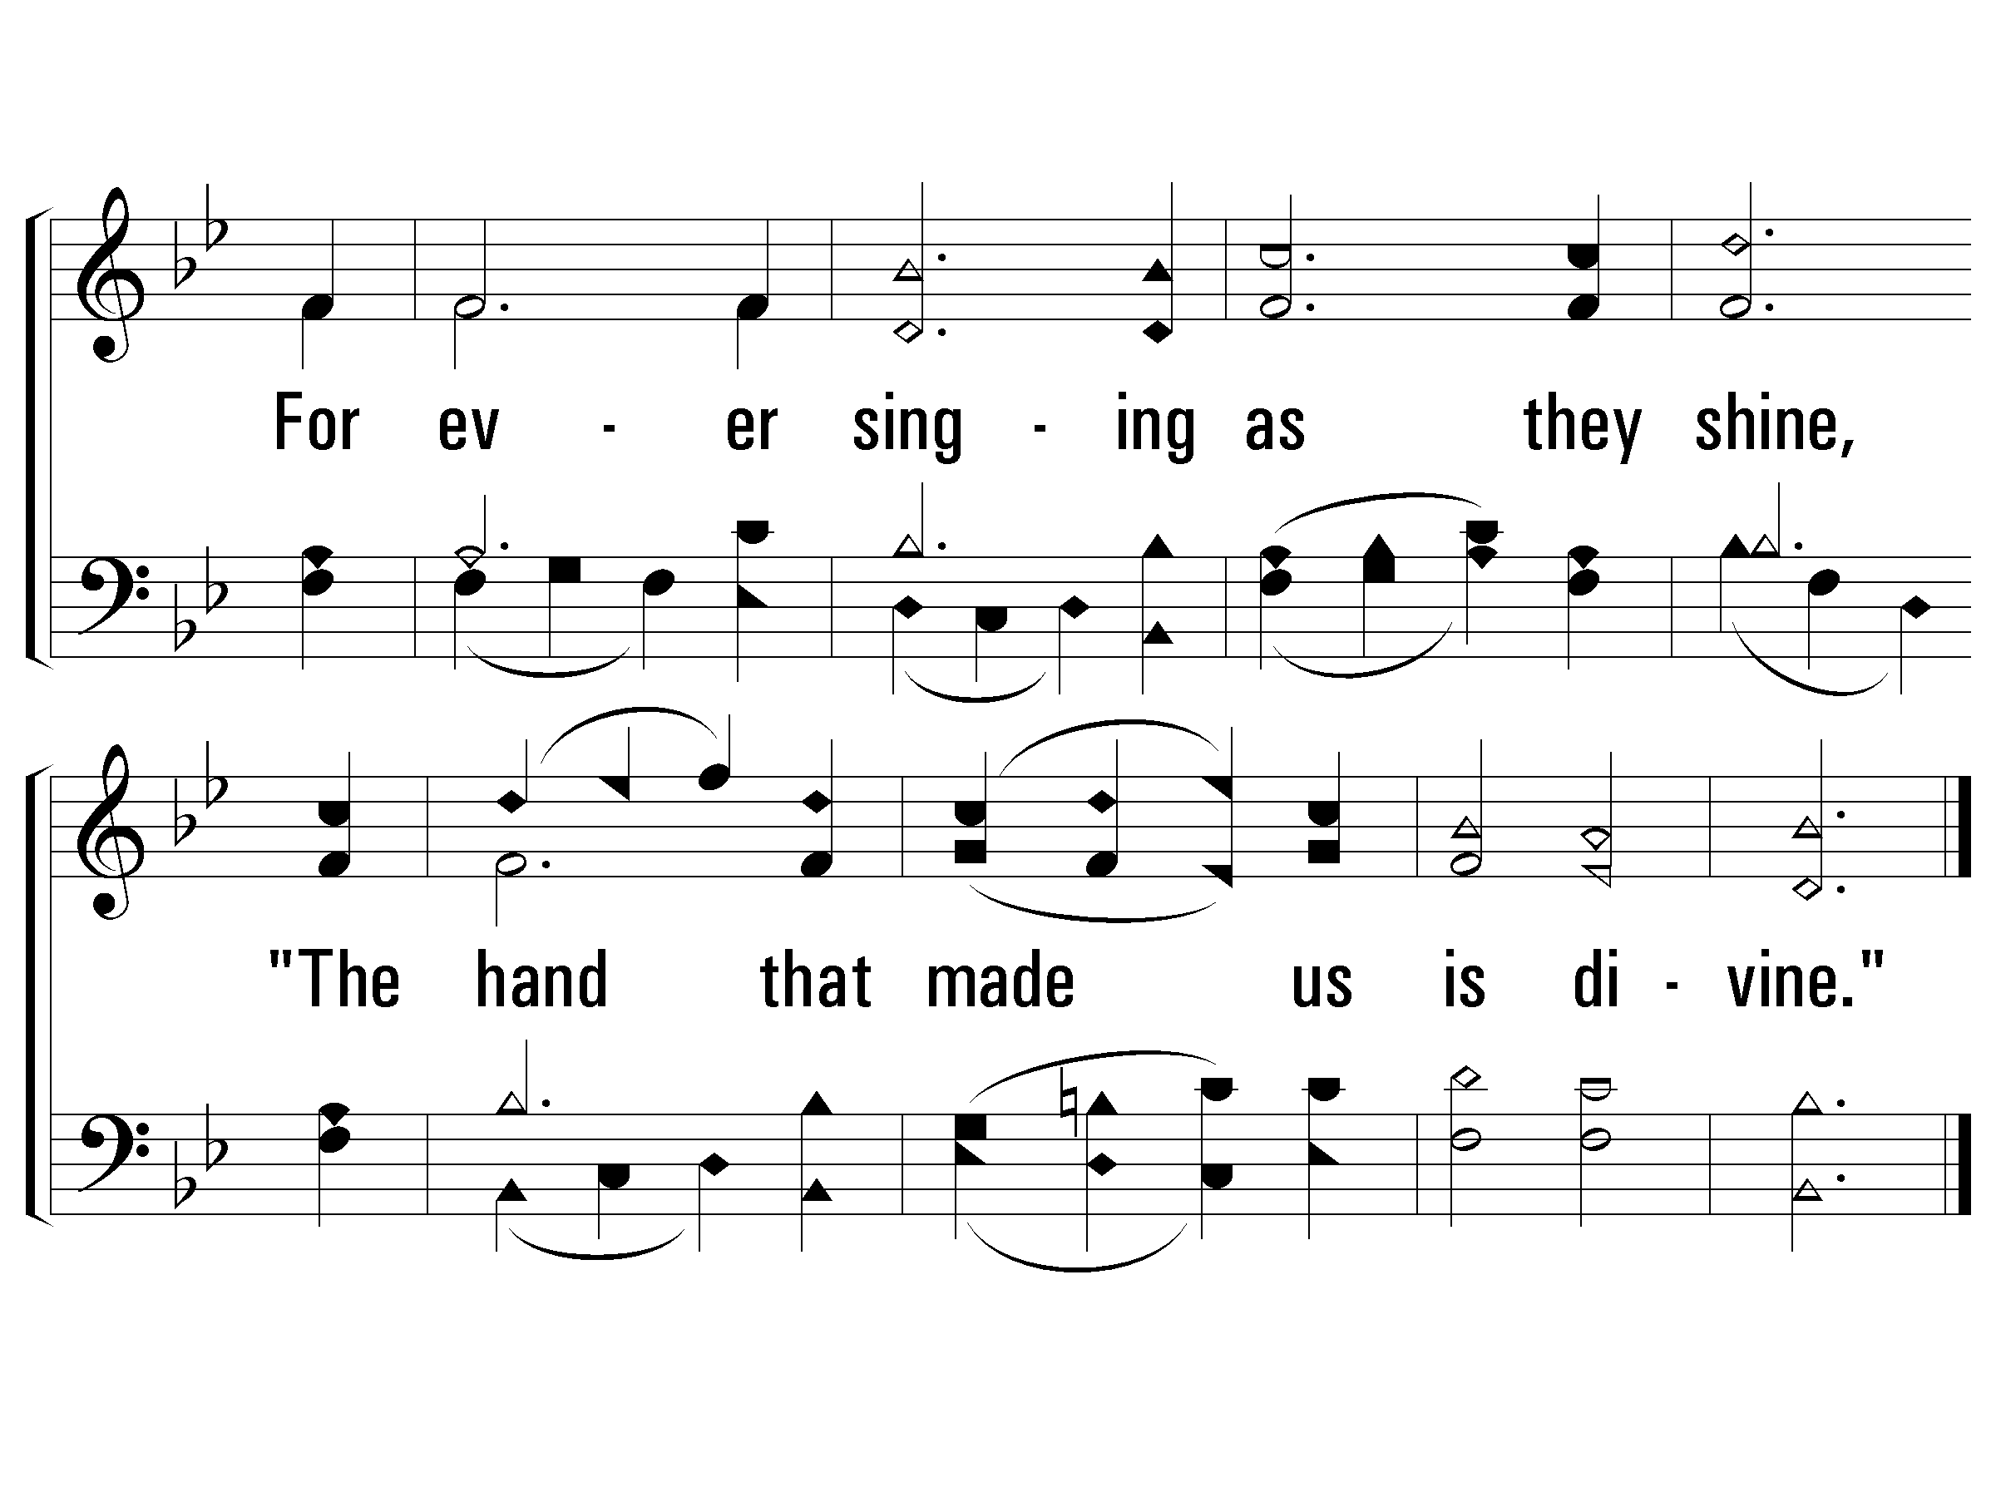
3 – The Spacious Firmament on High
666
End
© 2005 The Paperless Hymnal™

Slide 42
The Law of the LORD (Psalm 19:7-14)
10
Psalms, Hymns, and Spiritual Songs

Slide 43
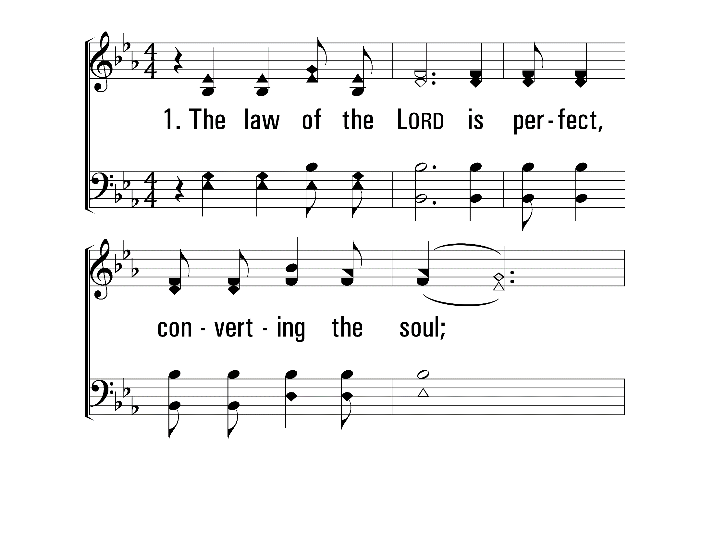
TheLawOfTheLord_st1_a
Vs 1
© 2014 Sumphonia Productions, LLC

Slide 44
TheLawOfTheLord_st1_b
Vs 1
© 2014 Sumphonia Productions, LLC

Slide 45
TheLawOfTheLord_cho_a
Chorus
© 2014 Sumphonia Productions, LLC

Slide 46
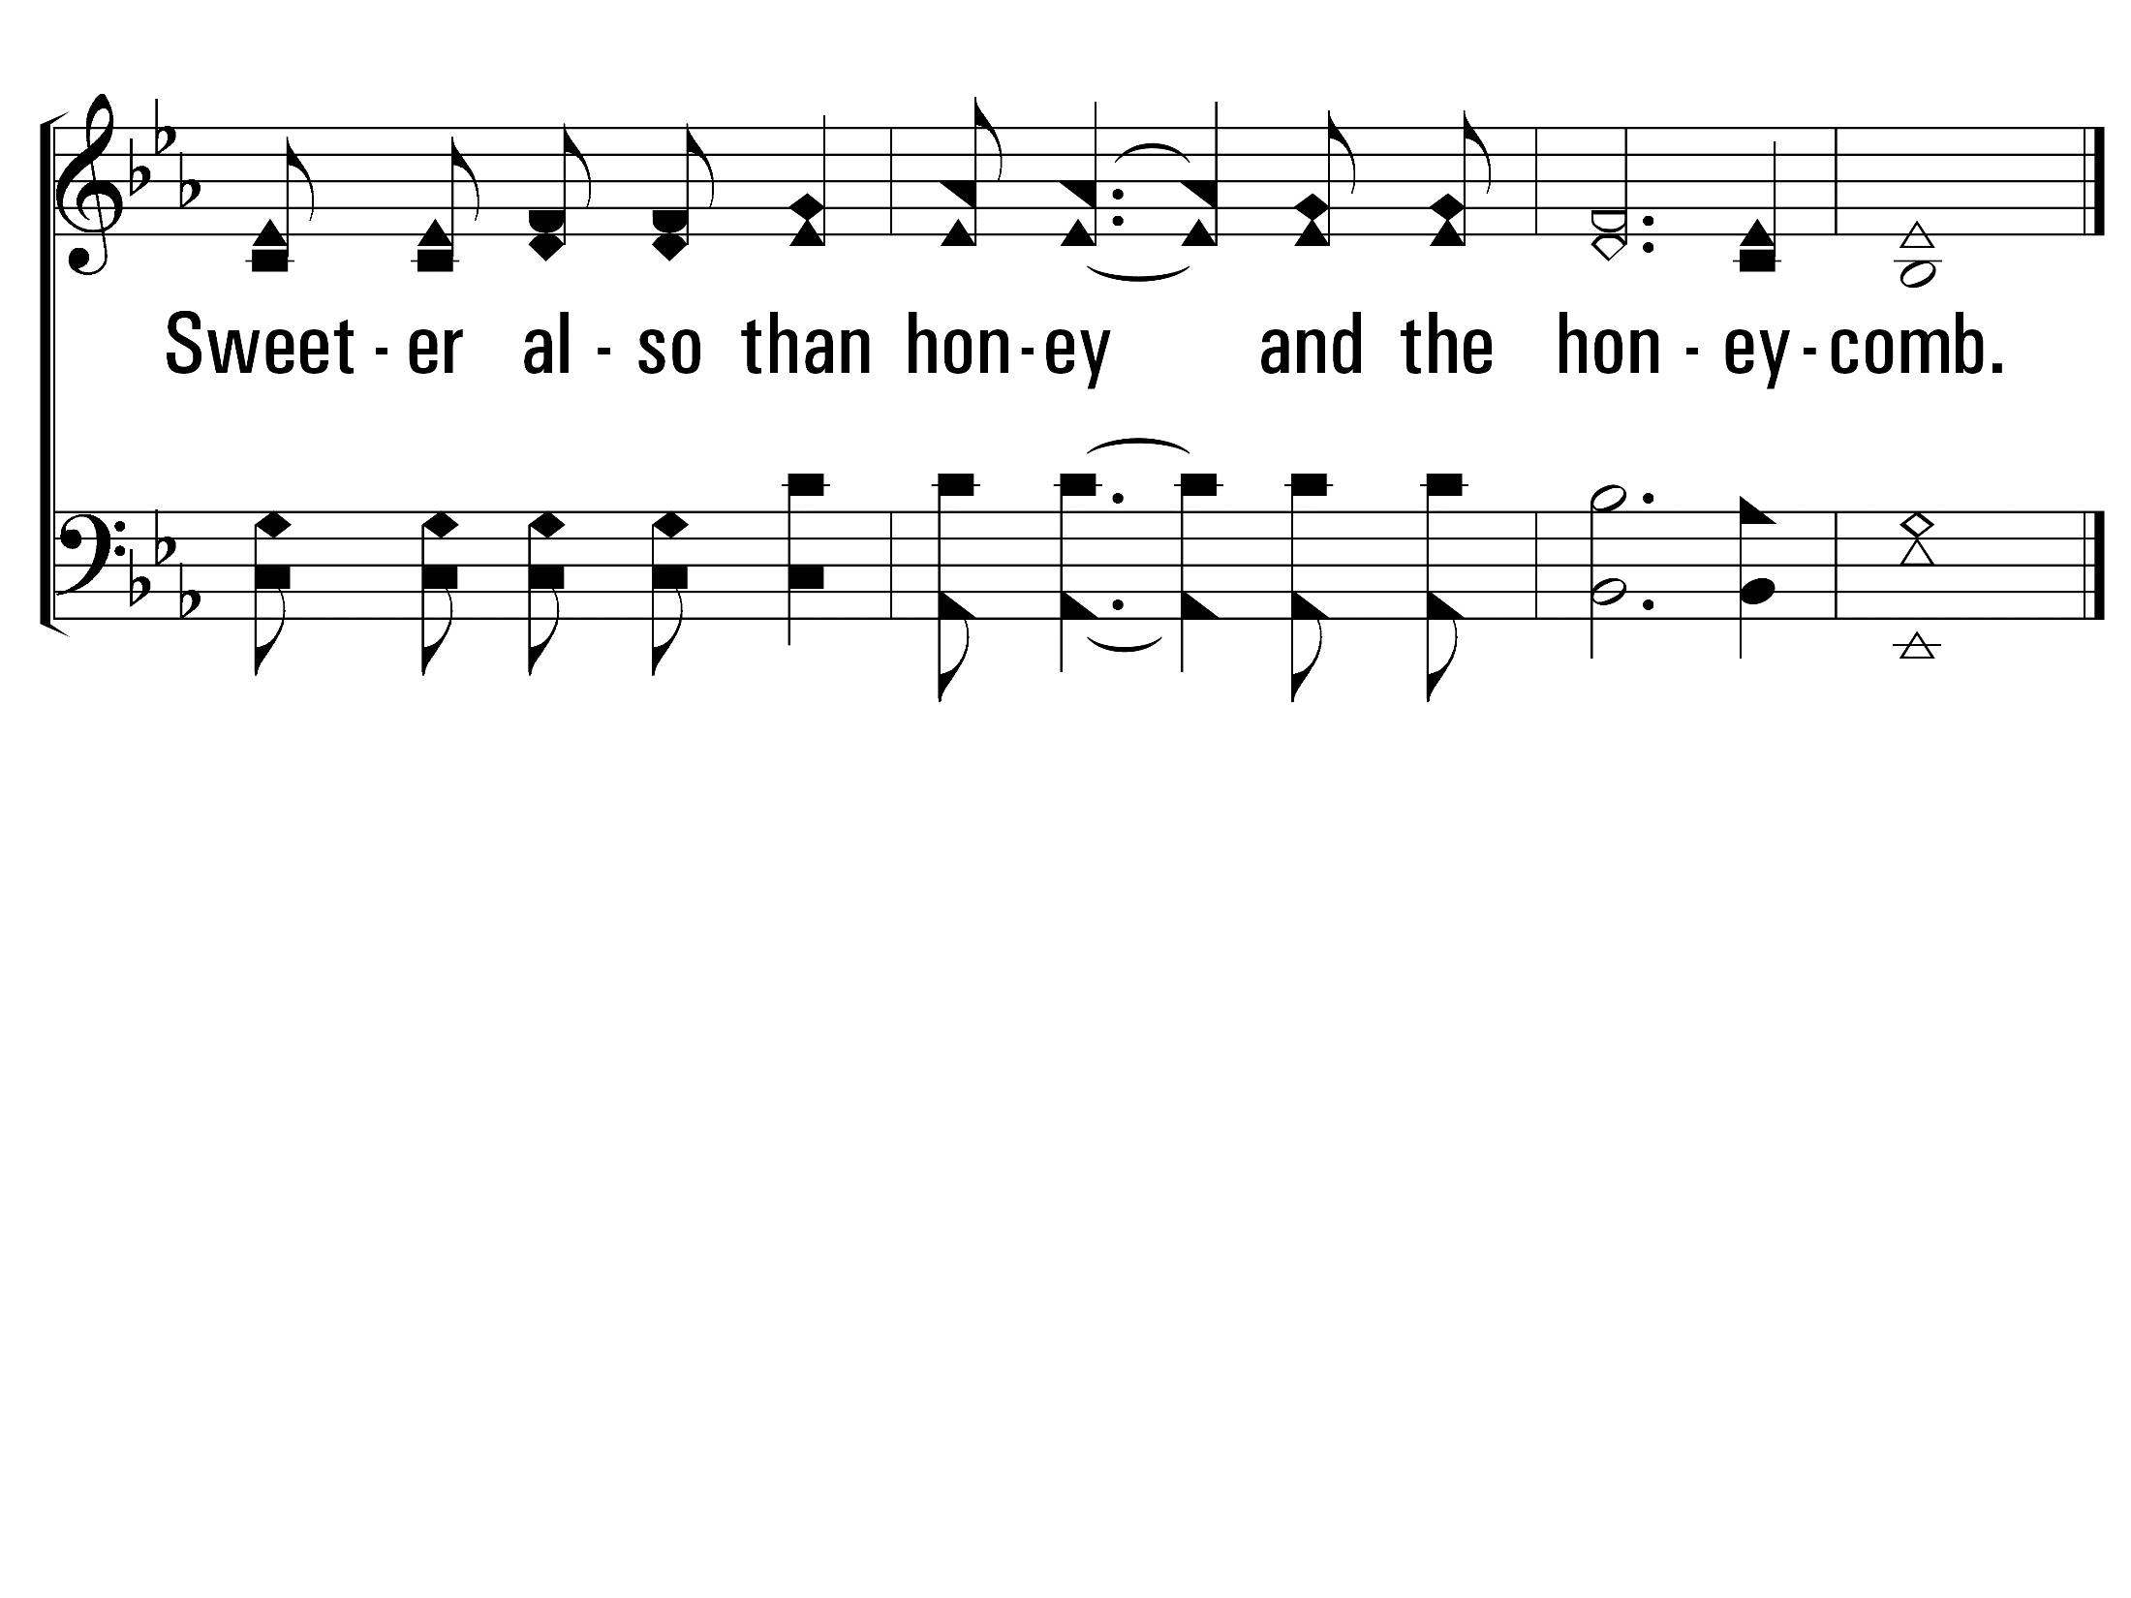
TheLawOfTheLord_cho_b
Chorus
© 2014 Sumphonia Productions, LLC

Slide 47
TheLawOfTheLord_st2_a
Vs 2
© 2014 Sumphonia Productions, LLC

Slide 48
TheLawOfTheLord_st2_b
Vs 2
© 2014 Sumphonia Productions, LLC

Slide 49
TheLawOfTheLord_cho_a
Chorus
© 2014 Sumphonia Productions, LLC

Slide 50
TheLawOfTheLord_cho_b
Chorus
© 2014 Sumphonia Productions, LLC

Slide 51
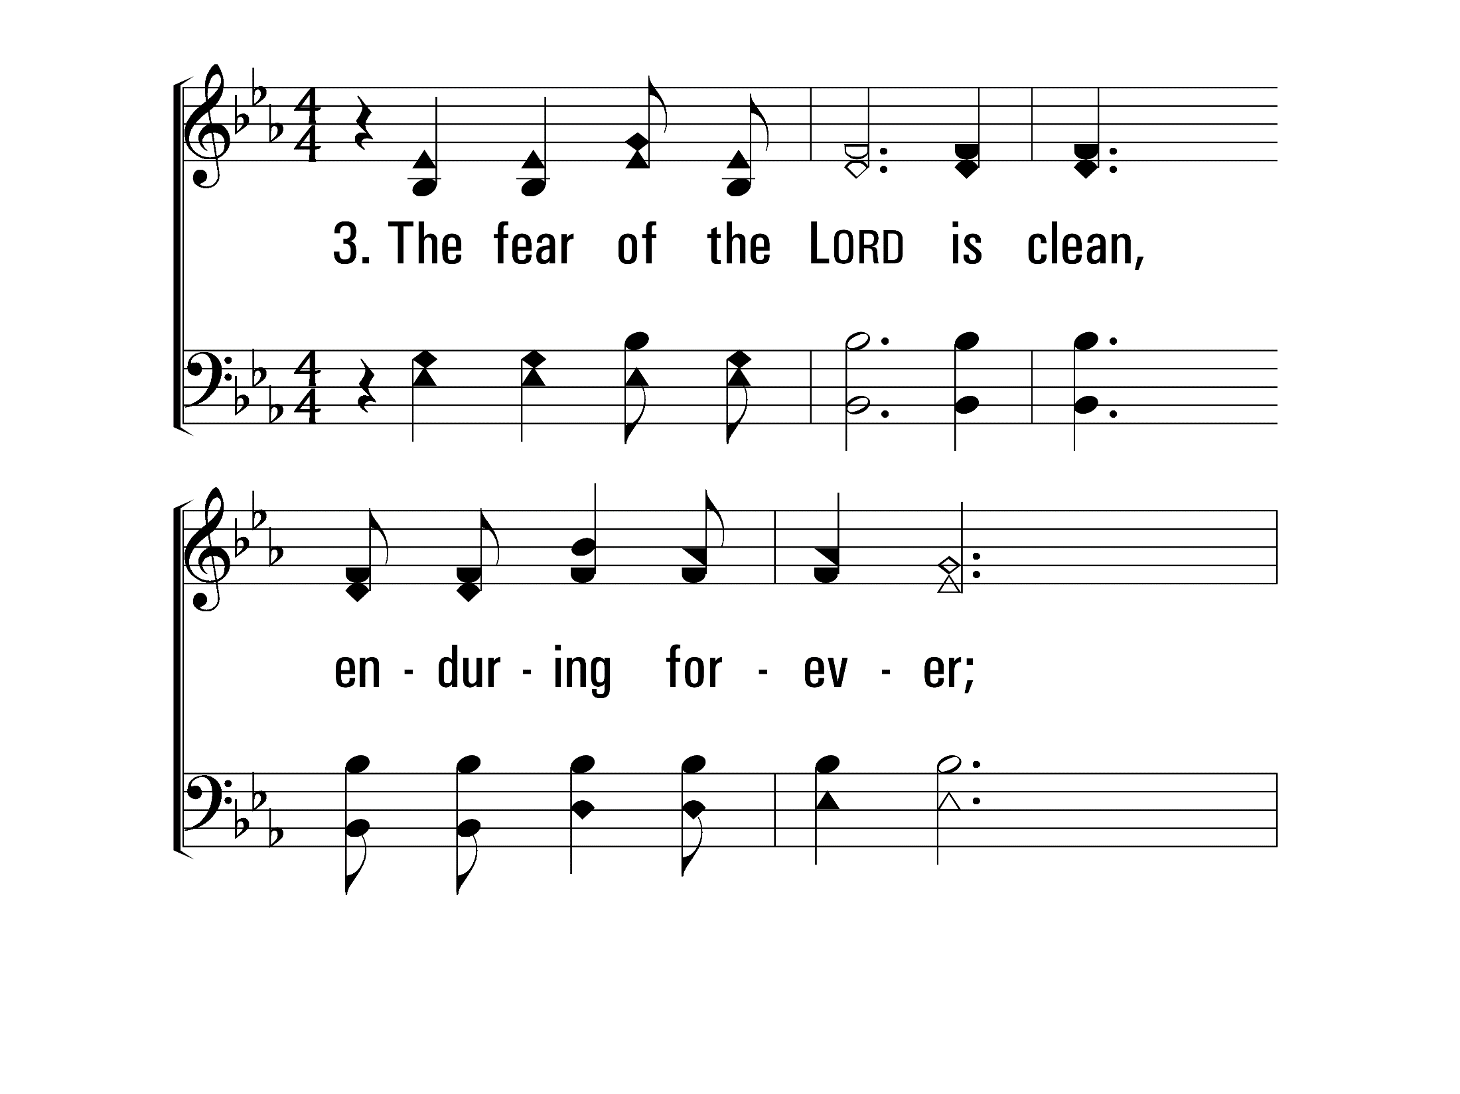
TheLawOfTheLord_st3_a
Vs 3
© 2014 Sumphonia Productions, LLC

Slide 52
TheLawOfTheLord_st3_b
Vs 3
© 2014 Sumphonia Productions, LLC

Slide 53
TheLawOfTheLord_cho_a
Chorus
© 2014 Sumphonia Productions, LLC

Slide 54
TheLawOfTheLord_cho_b
Chorus
© 2014 Sumphonia Productions, LLC
End

Slide 56
Unto the Hills (Psalm 121)
712
Praise for the Lord

Slide 57
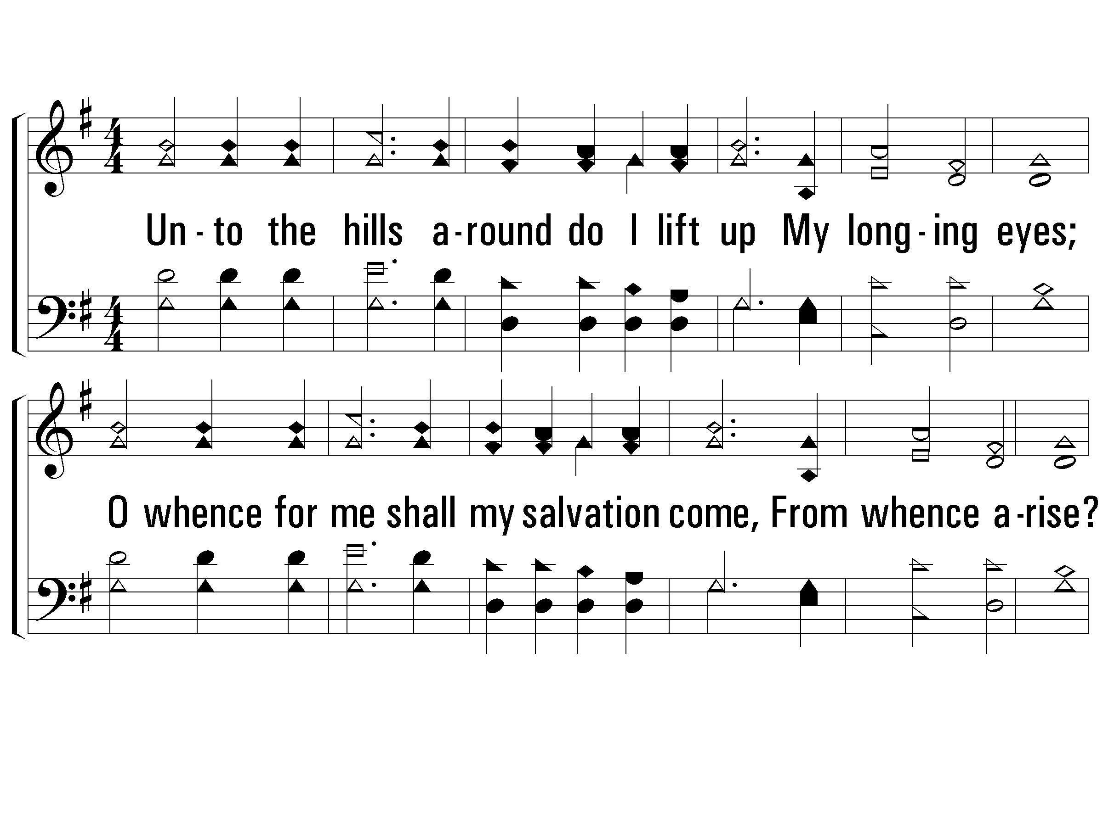
1 – Unto the Hills
712
1.
Unto the hills around do I lift up
My longing eyes;
O whence for me shall my salvation come,
From whence arise?
From God the Lord doth come my certain aid,
From God the Lord, who heaven and earth hath made.
Words by: Psalm 121 / Arr.: John D. S. Campbell
Music by: Charles H. Purday
© 2001 The Paperless Hymnal™

Slide 58
1 – Unto the Hills
712
© 2001 The Paperless Hymnal™

Slide 59
2 – Unto the Hills
712
2.
He will not suffer that thy foot be moved:
Safe shalt thou be;
No careless slumber shall His eyelids close,
Who keepeth thee;
Behold, He sleepeth not, He slumbereth never,
Who keepeth Israel in His holy care.
Words by: Ninth Duke of Argyll
Music by: C. H. Purday
© 2001 The Paperless Hymnal™

Slide 60
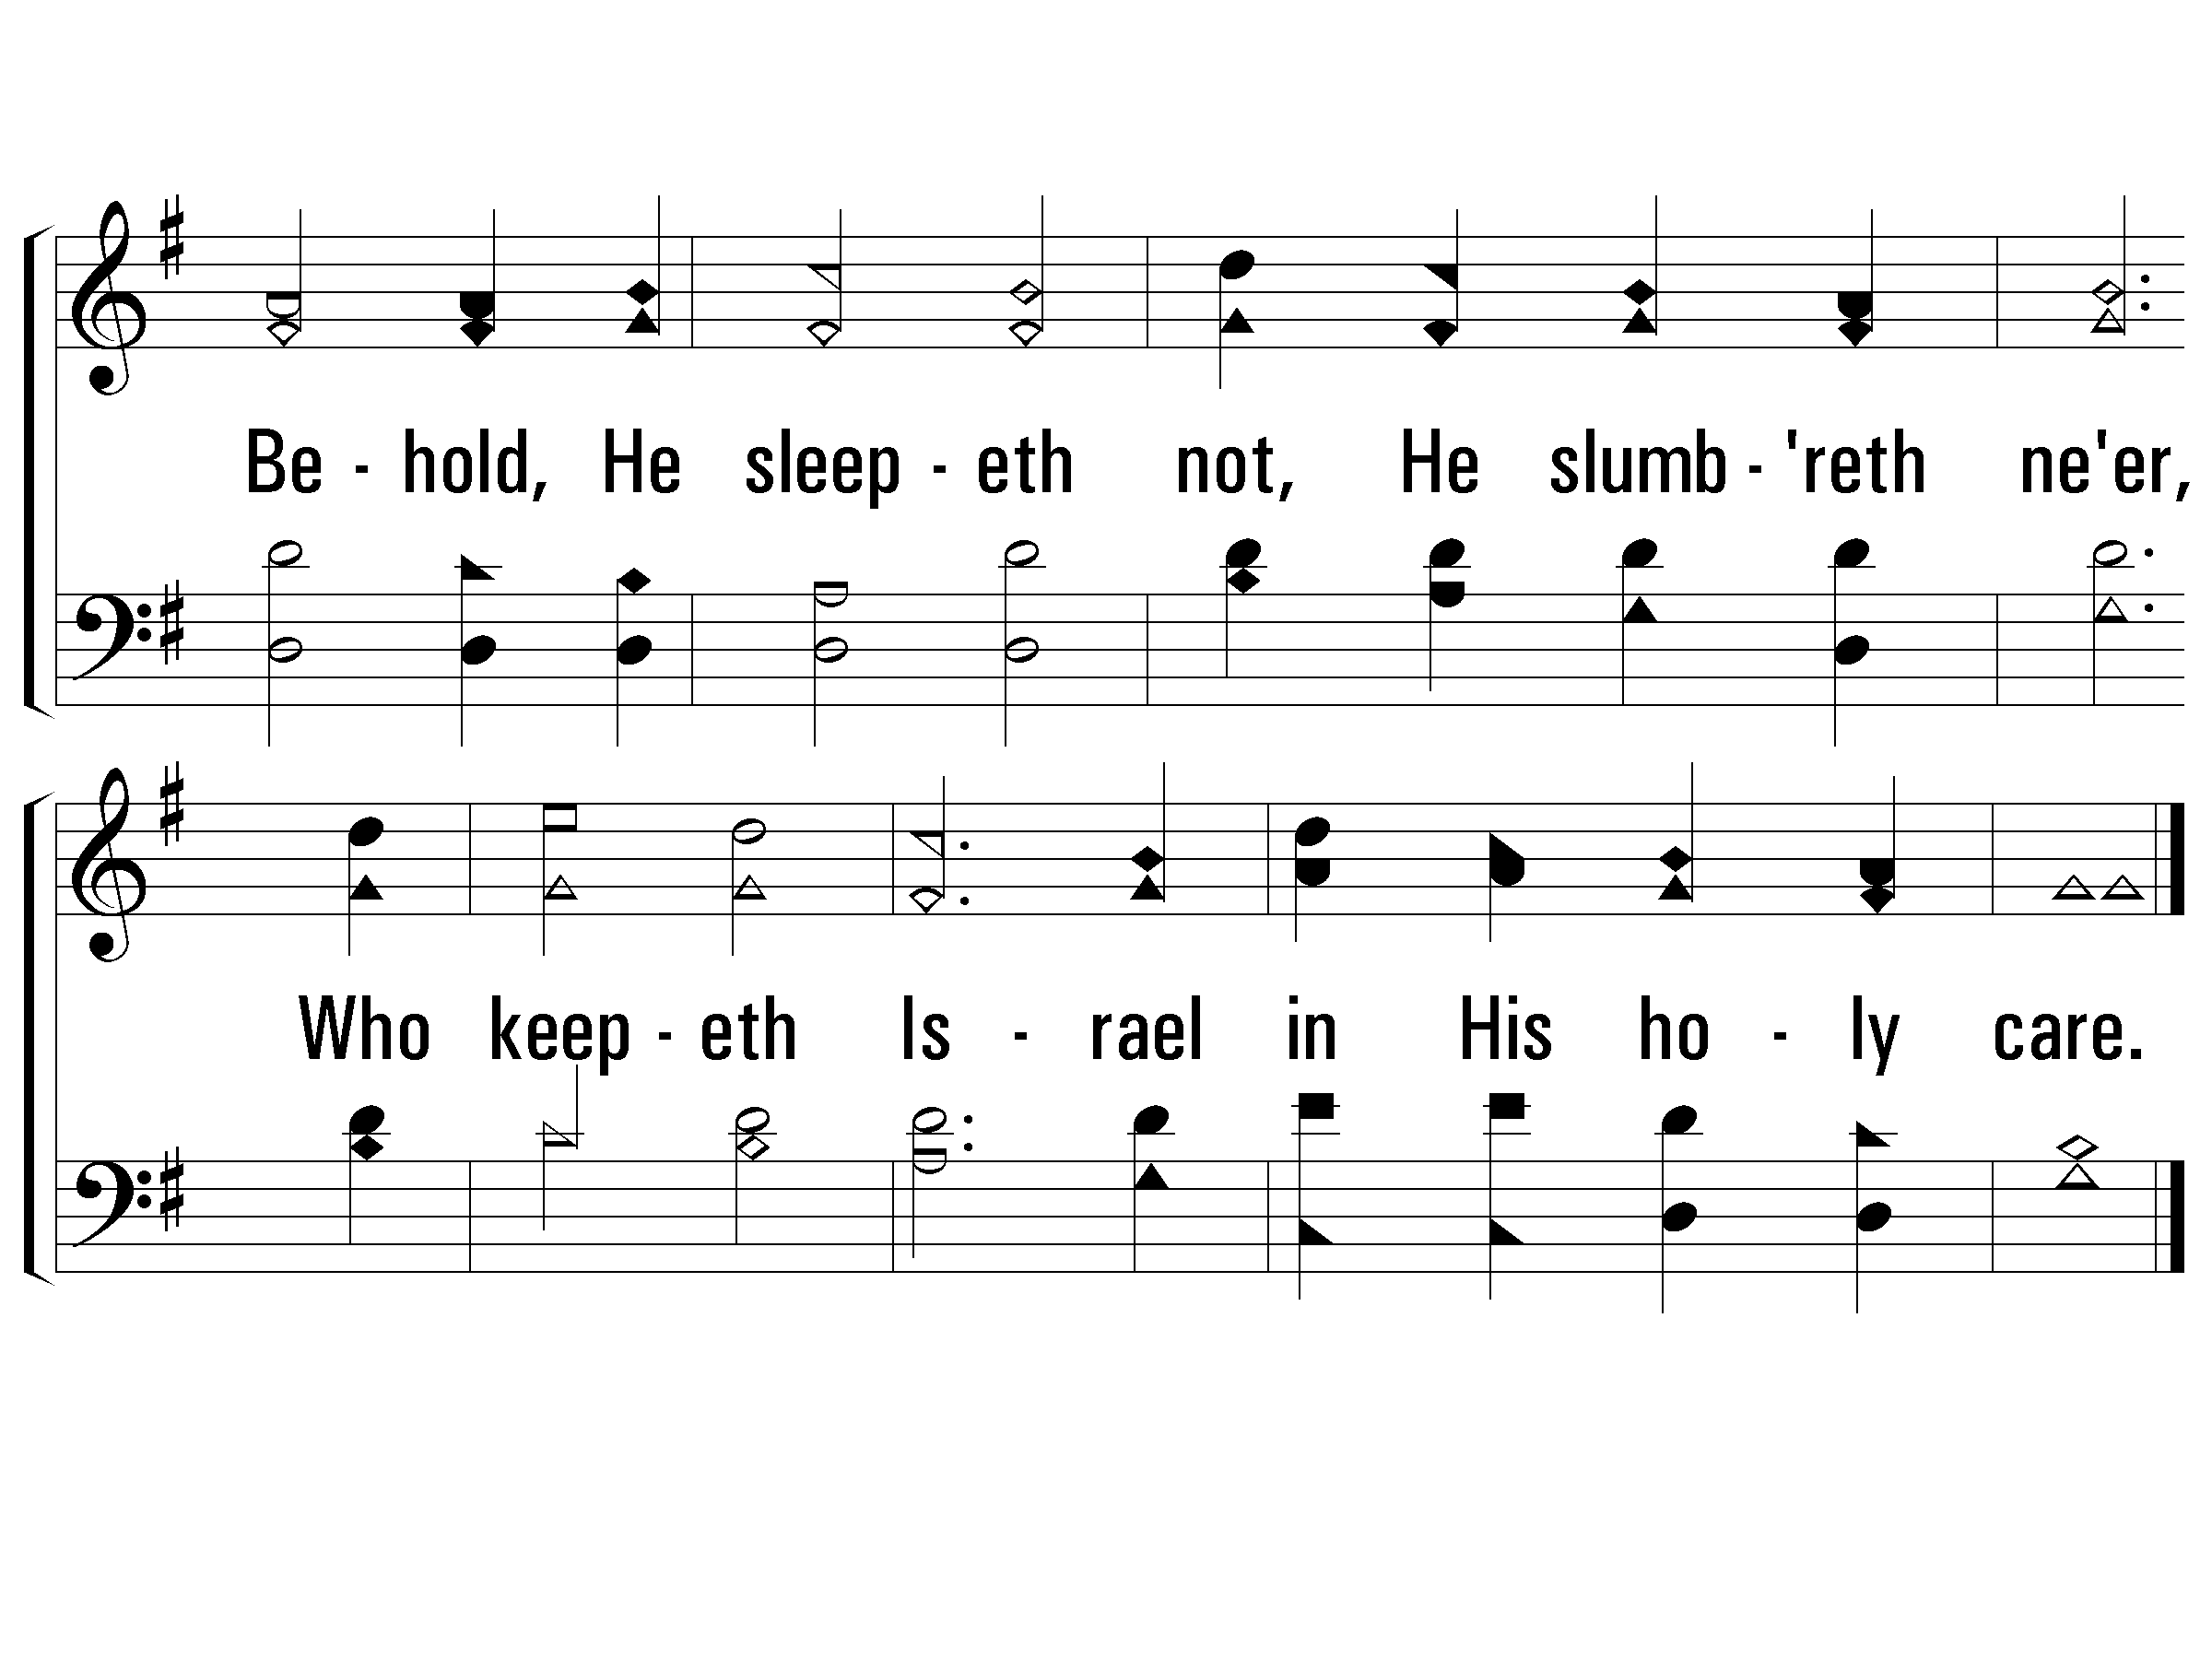
2 – Unto the Hills
712
© 2001 The Paperless Hymnal™

Slide 61
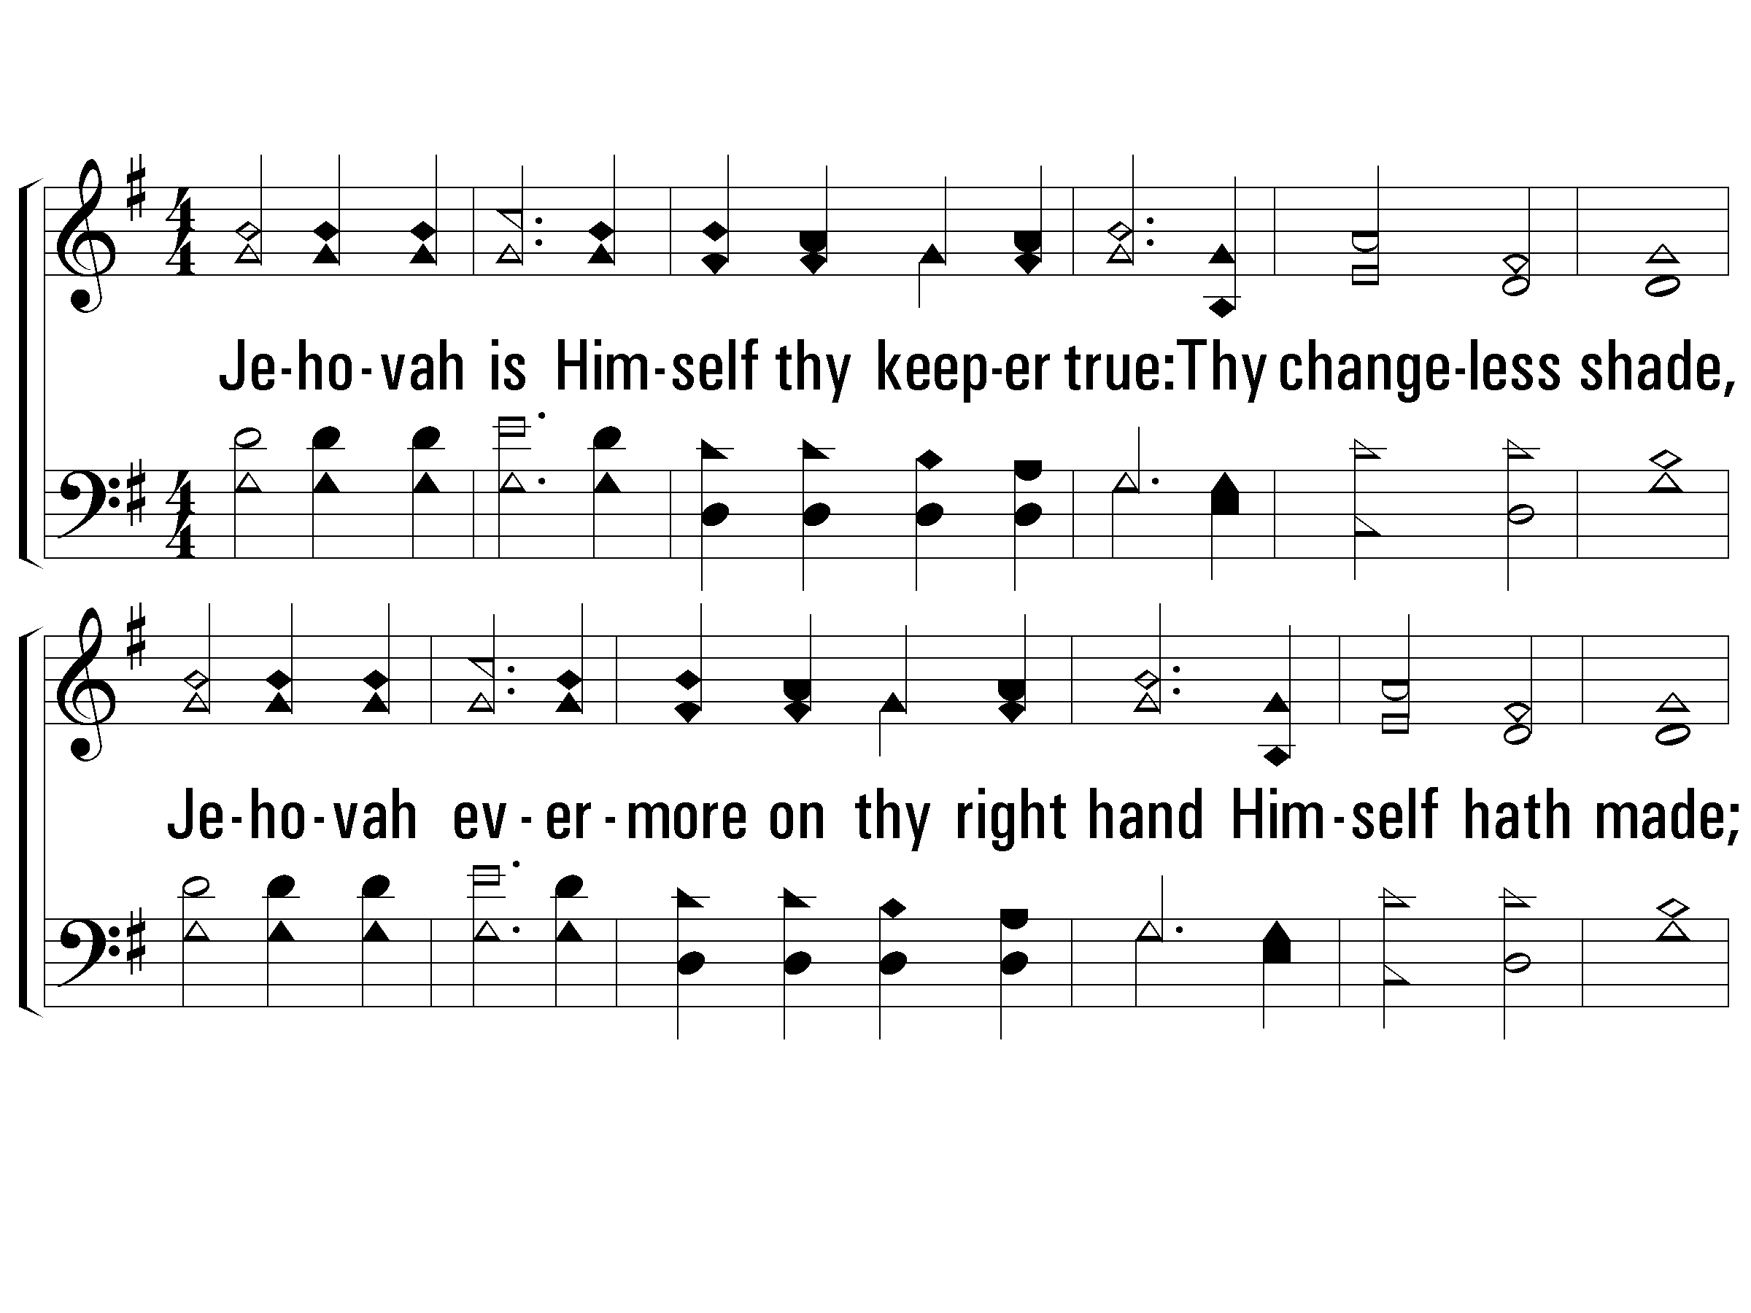
3 – Unto the Hills
712
3.
Jehovah is Himself thy keeper true:
Thy changeless shade,
Jehovah evermore on thy right hand
Himself hath made;
And thee no sun by day shall ever smite,
No moon shall harm thee in the silent night.
Words by: Ninth Duke of Argyll
Music by: C. H. Purday
© 2001 The Paperless Hymnal™

Slide 62
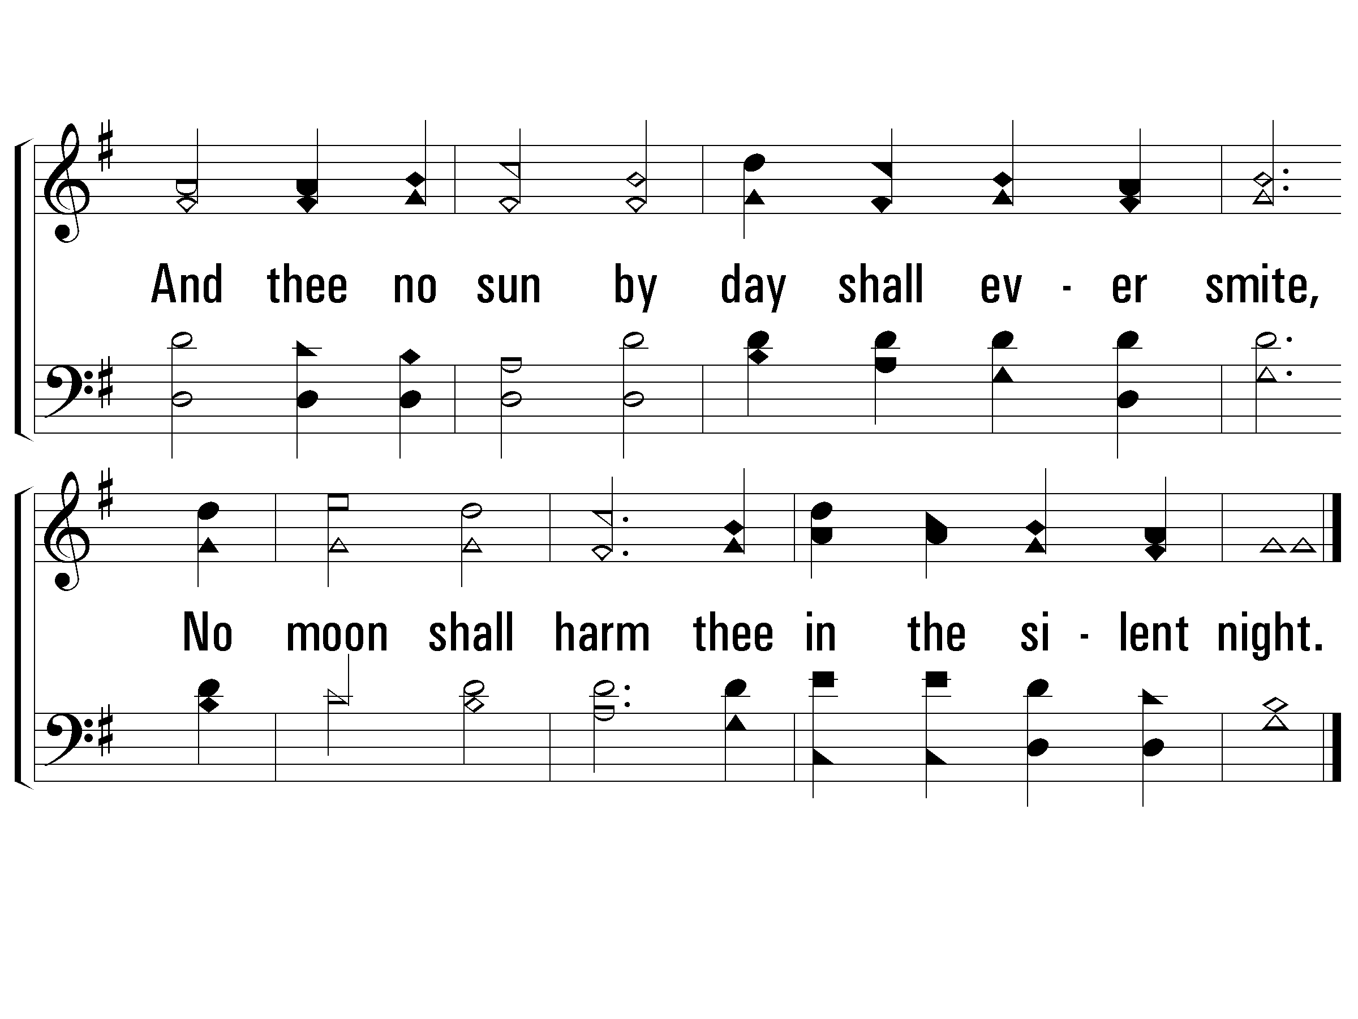
3 – Unto the Hills
712
© 2001 The Paperless Hymnal™

Slide 63
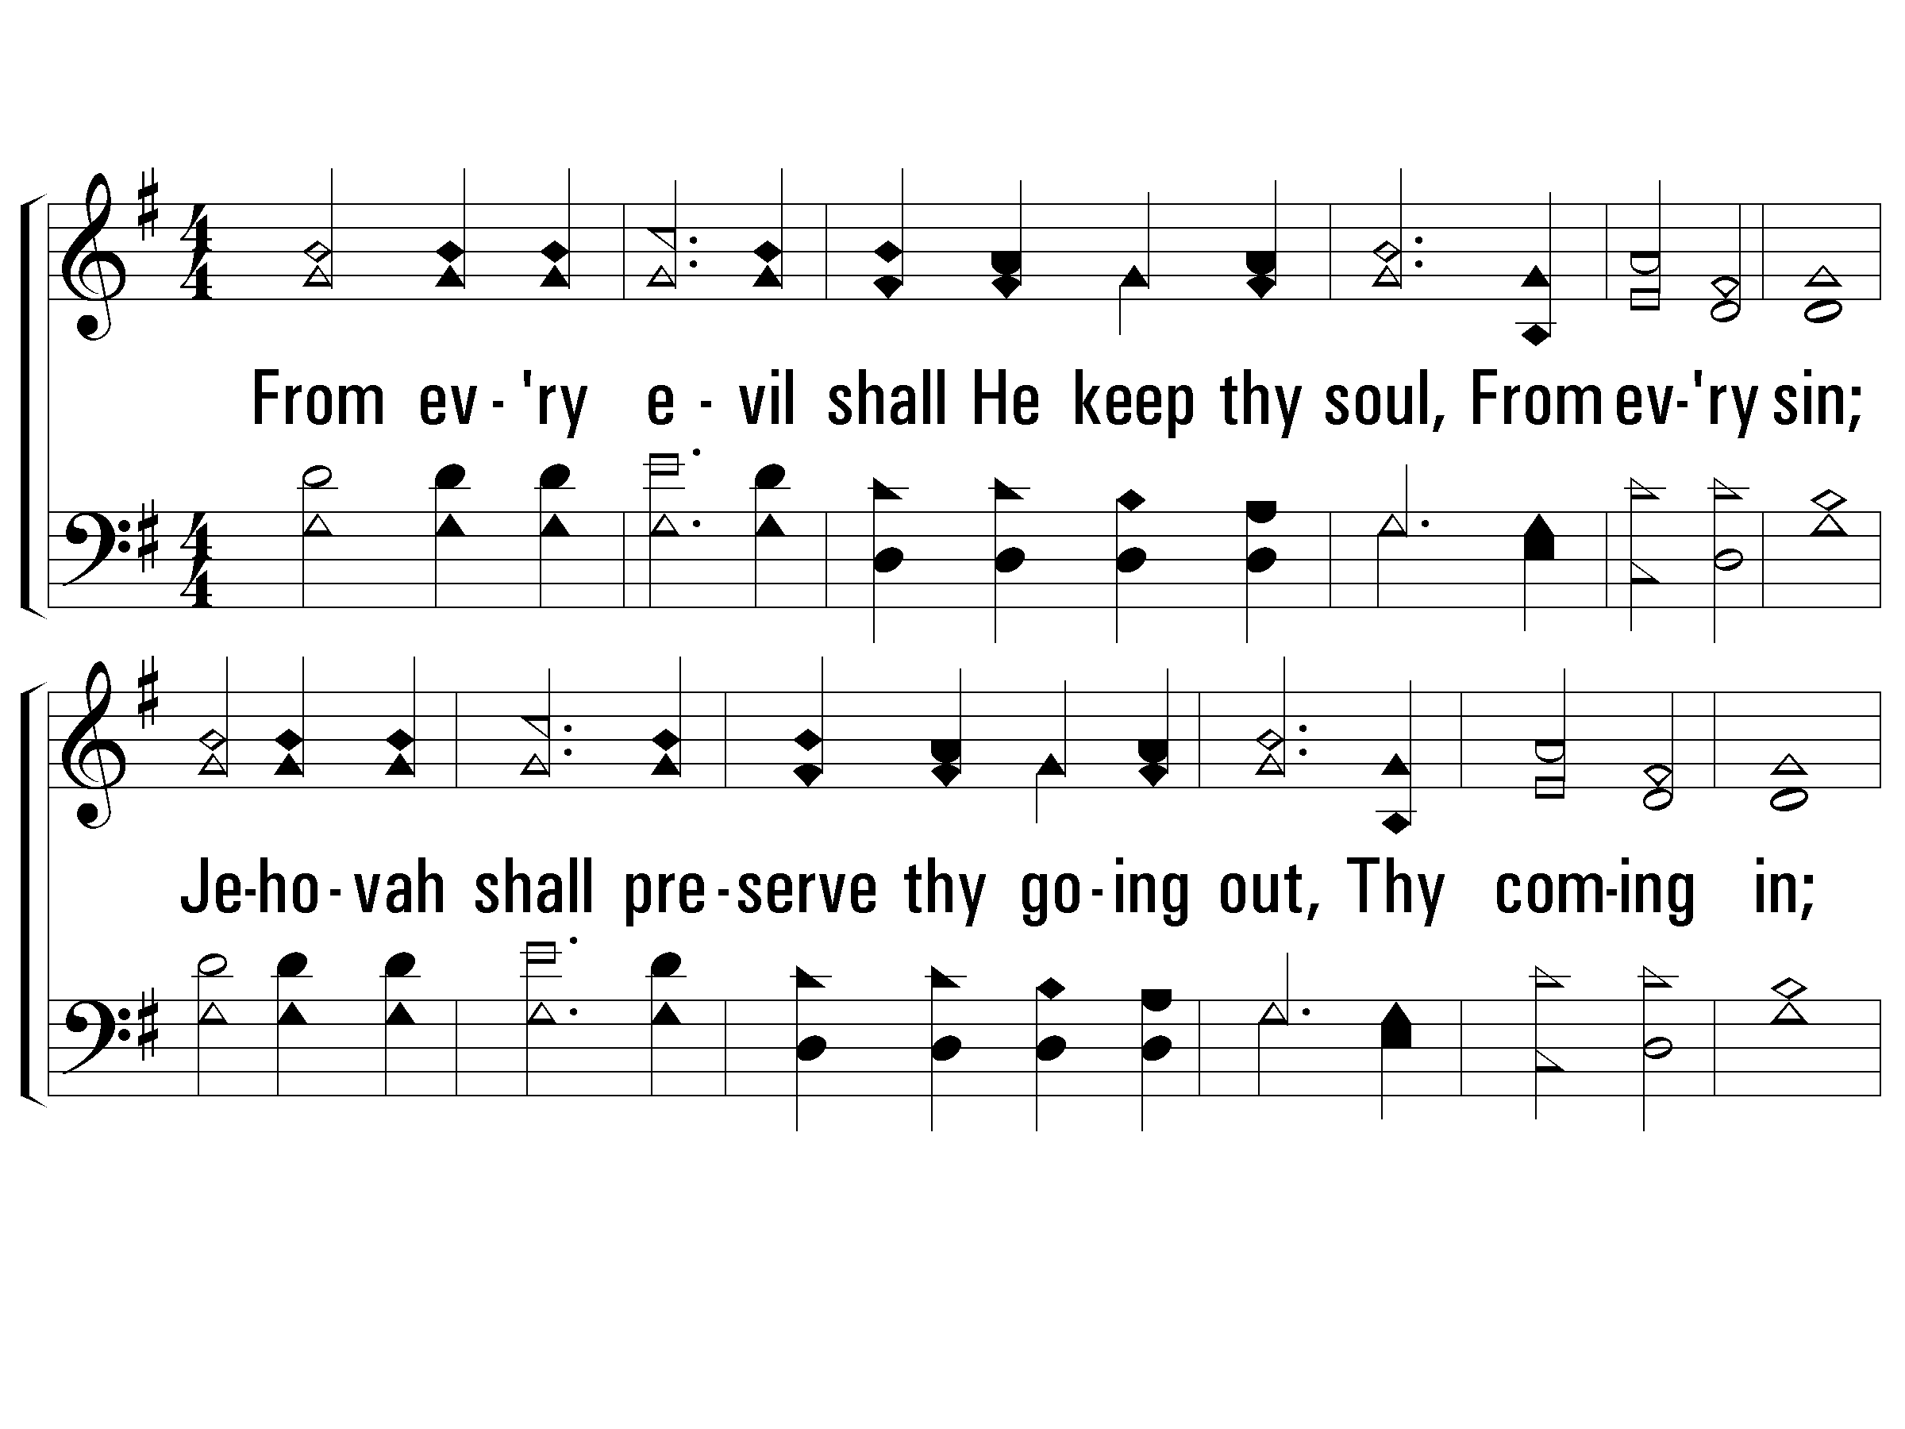
4 – Unto the Hills
712
4.
From every evil shall He keep thy soul,
From every sin;
Jehovah shall preserve thy going out,
Thy coming in;
Above thee watching, He whom we adore
Shall keep thee henceforth, yea, for evermore.
Words by: Ninth Duke of Argyll
Music by: C. H. Purday
© 2001 The Paperless Hymnal™

Slide 64
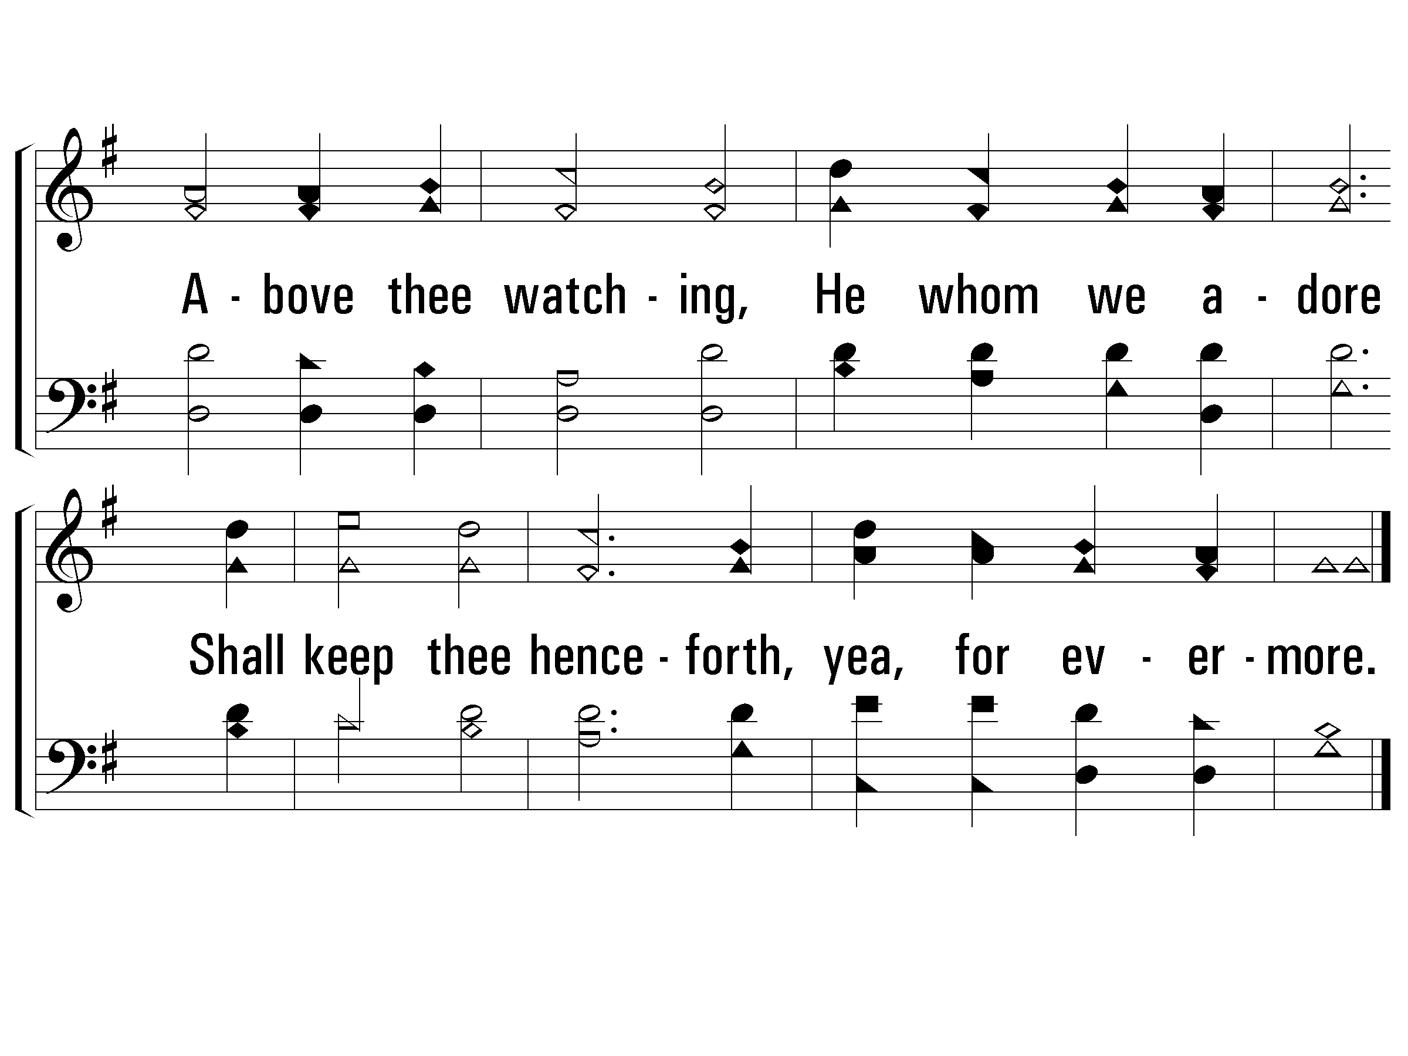
4 – Unto the Hills
712
End
© 2001 The Paperless Hymnal™

Slide 66
O How Glorious, Full of Wonder (Psalm 8)
3
Psalms, Hymns, and Spiritual Songs

Slide 67
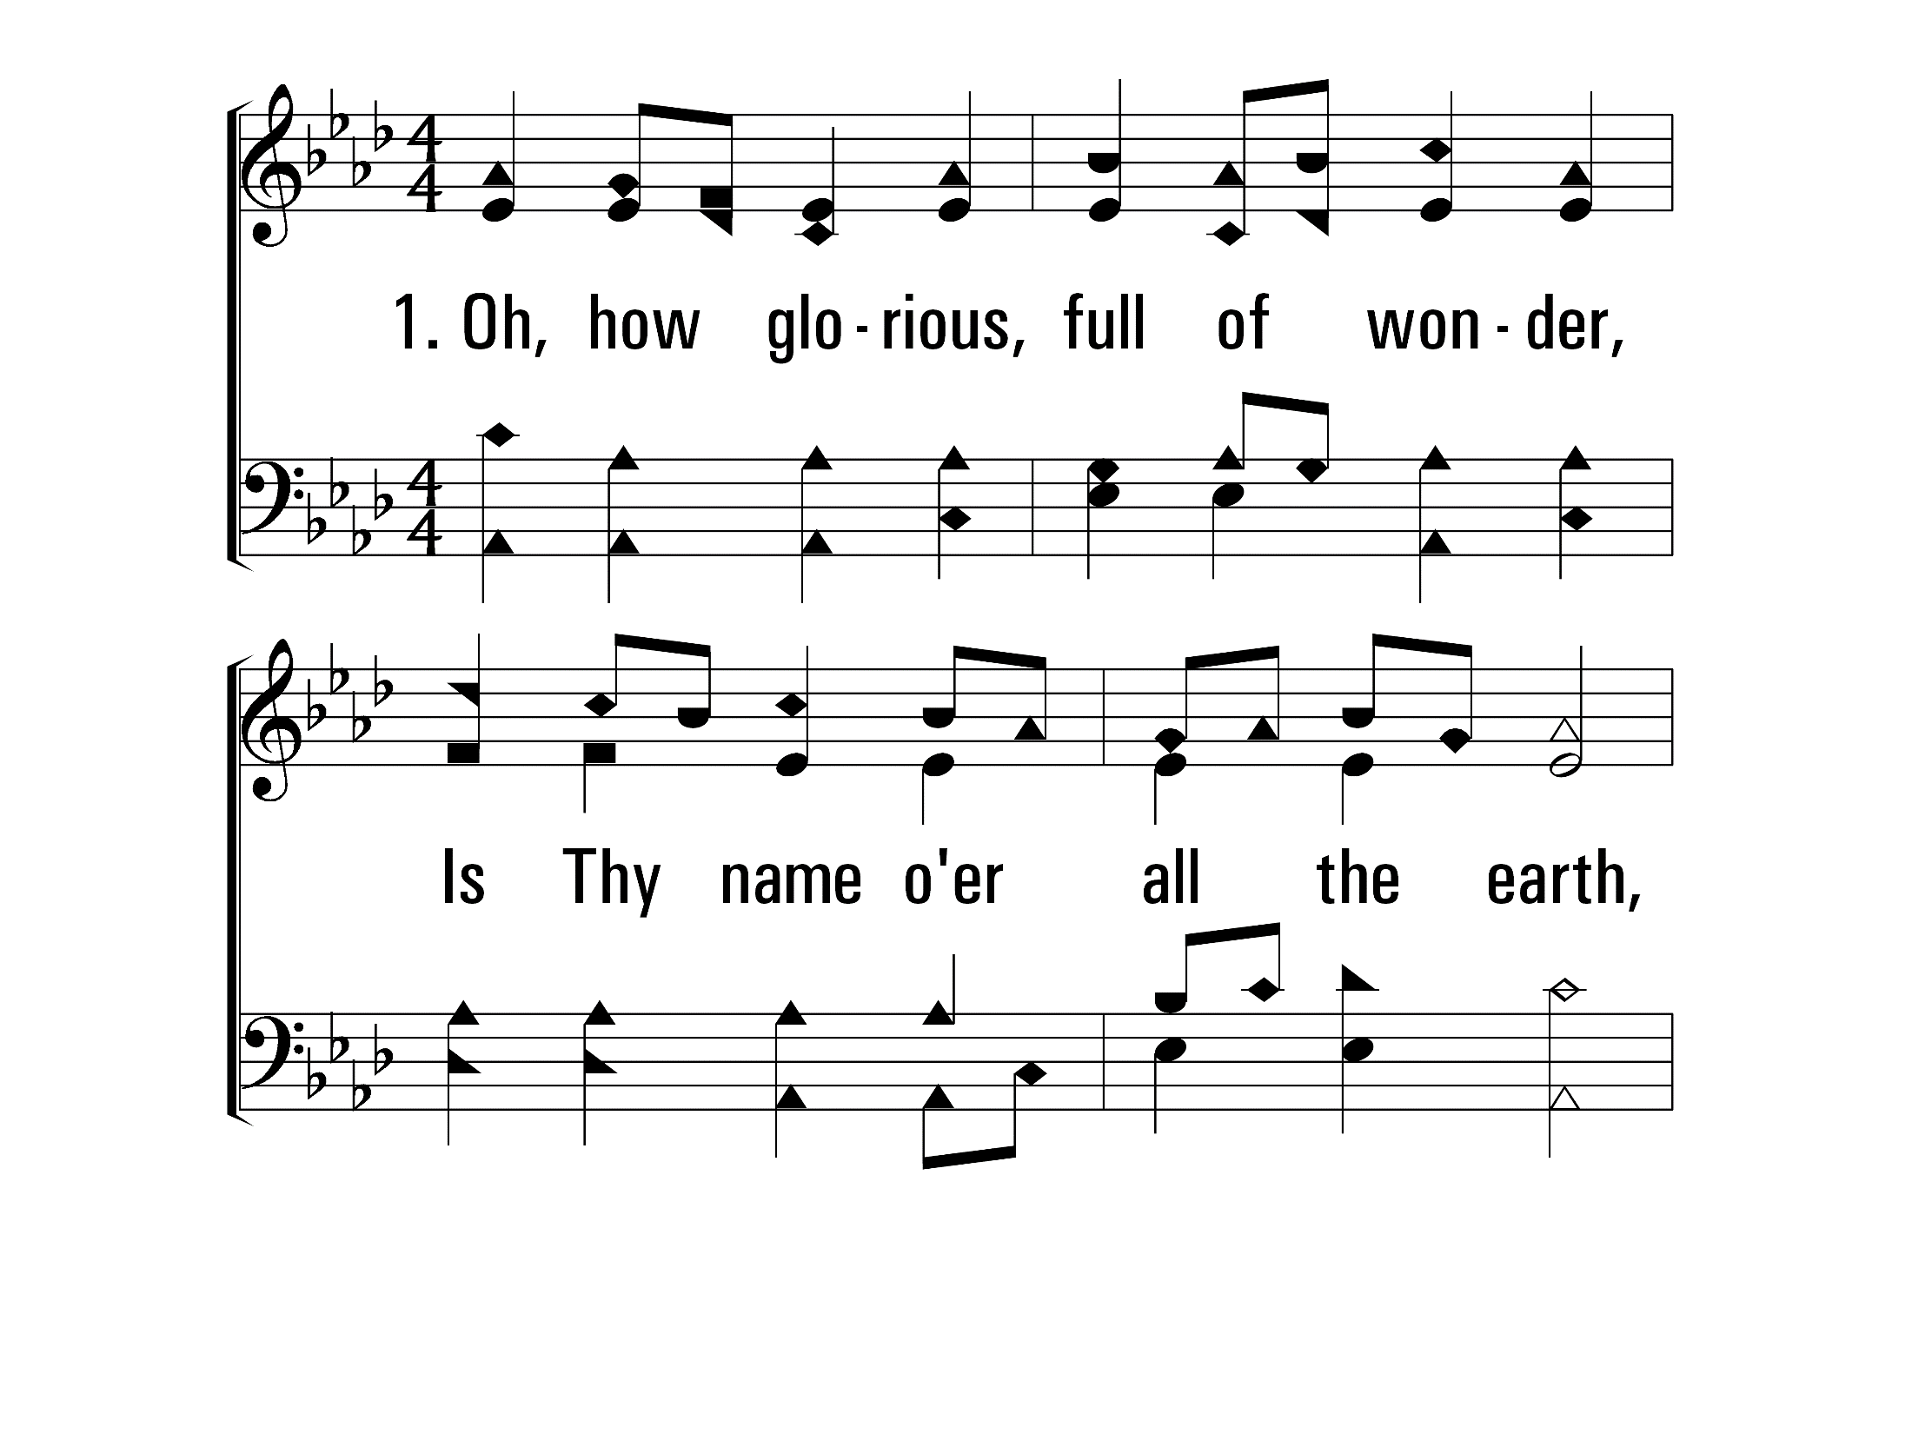
OhHowGloriousFullOfWonder_st1_a
Vs 1
© 2014 Sumphonia Productions, LLC

Slide 68
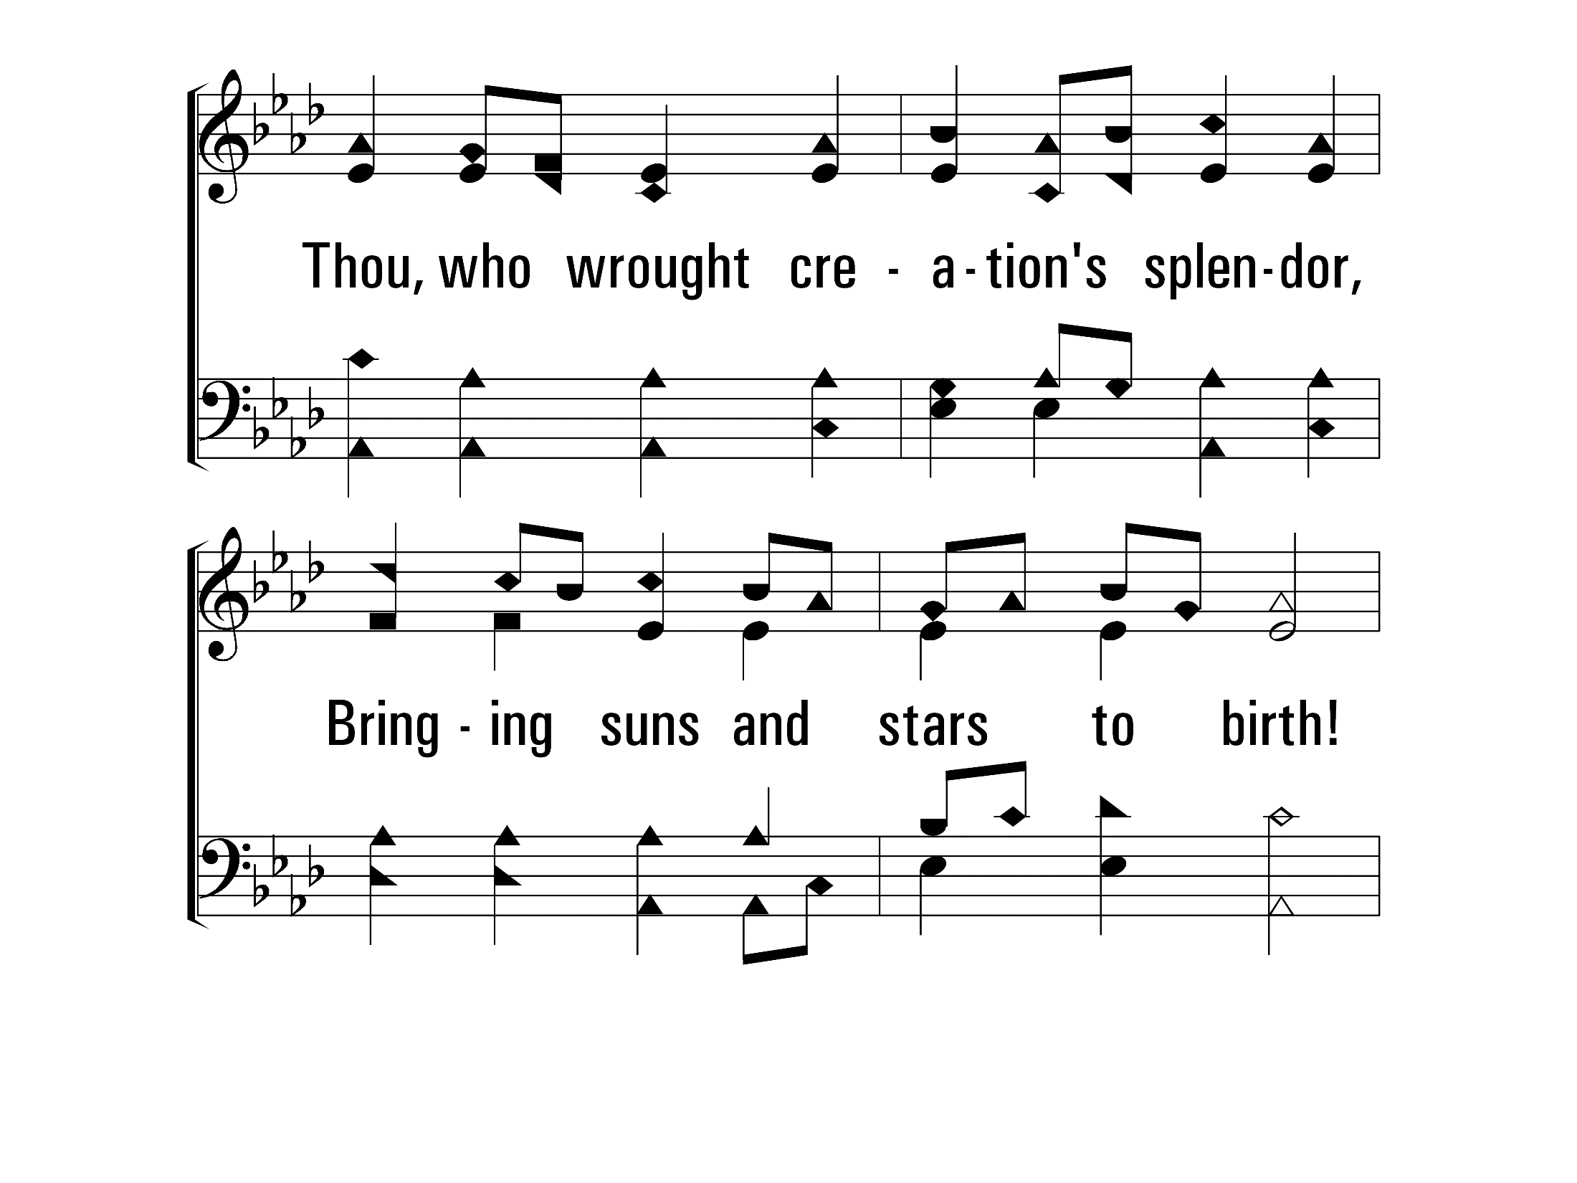
OhHowGloriousFullOfWonder_st1_b
Vs 1
© 2014 Sumphonia Productions, LLC

Slide 69
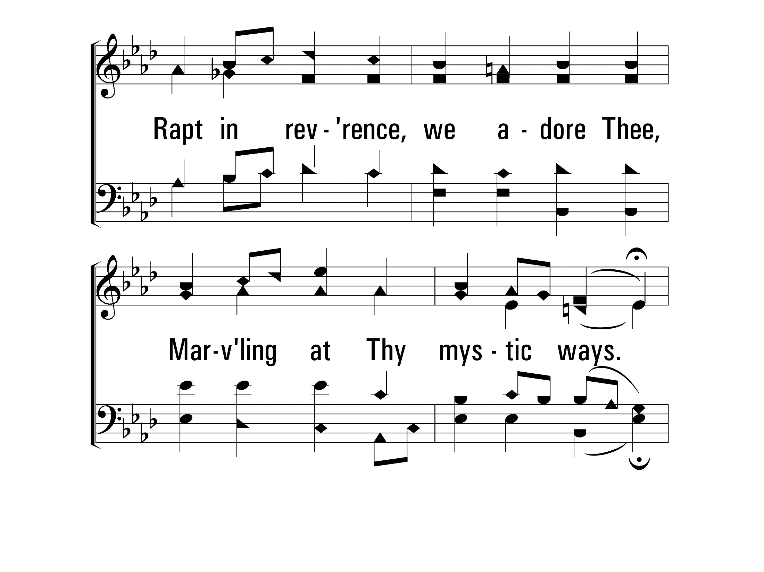
OhHowGloriousFullOfWonder_st1_c
Vs 1
© 2014 Sumphonia Productions, LLC

Slide 70
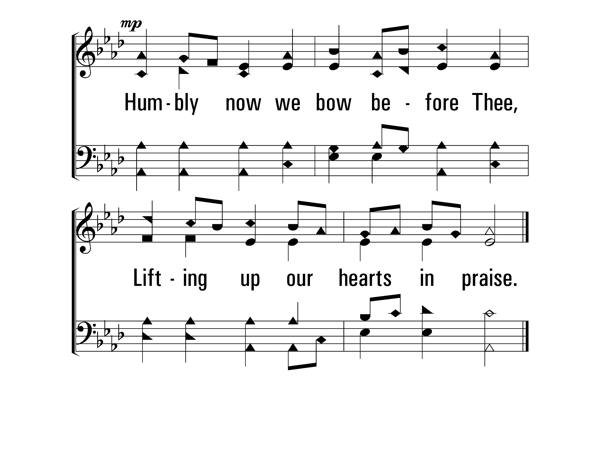
OhHowGloriousFullOfWonder_st1_d
Vs 1
© 2014 Sumphonia Productions, LLC

Slide 71
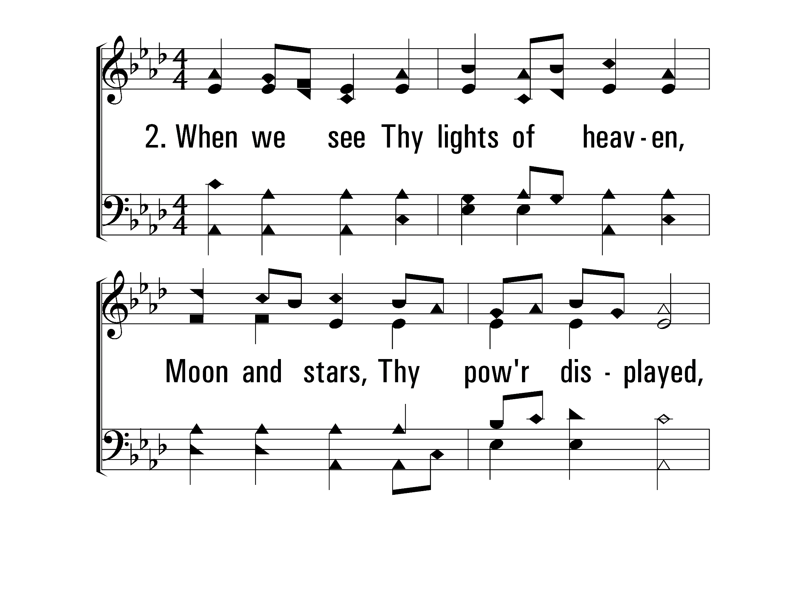
OhHowGloriousFullOfWonder_st2_a
Vs 2
© 2014 Sumphonia Productions, LLC

Slide 72
OhHowGloriousFullOfWonder_st2_b
Vs 2
© 2014 Sumphonia Productions, LLC

Slide 73
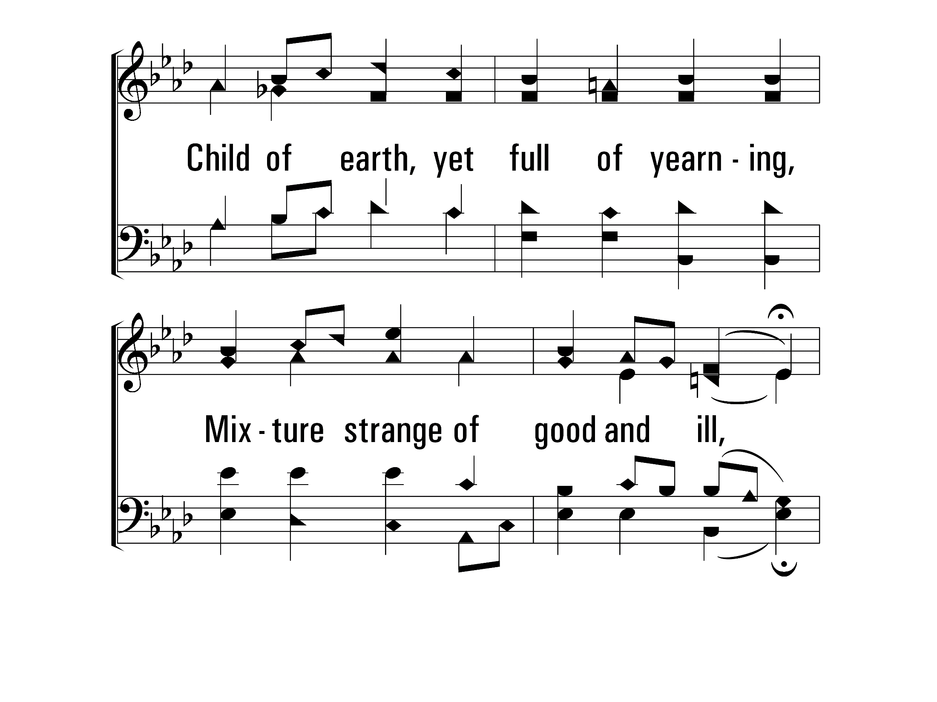
OhHowGloriousFullOfWonder_st2_c
Vs 2
© 2014 Sumphonia Productions, LLC

Slide 74
OhHowGloriousFullOfWonder_st2_d
Vs 2
© 2014 Sumphonia Productions, LLC

Slide 75
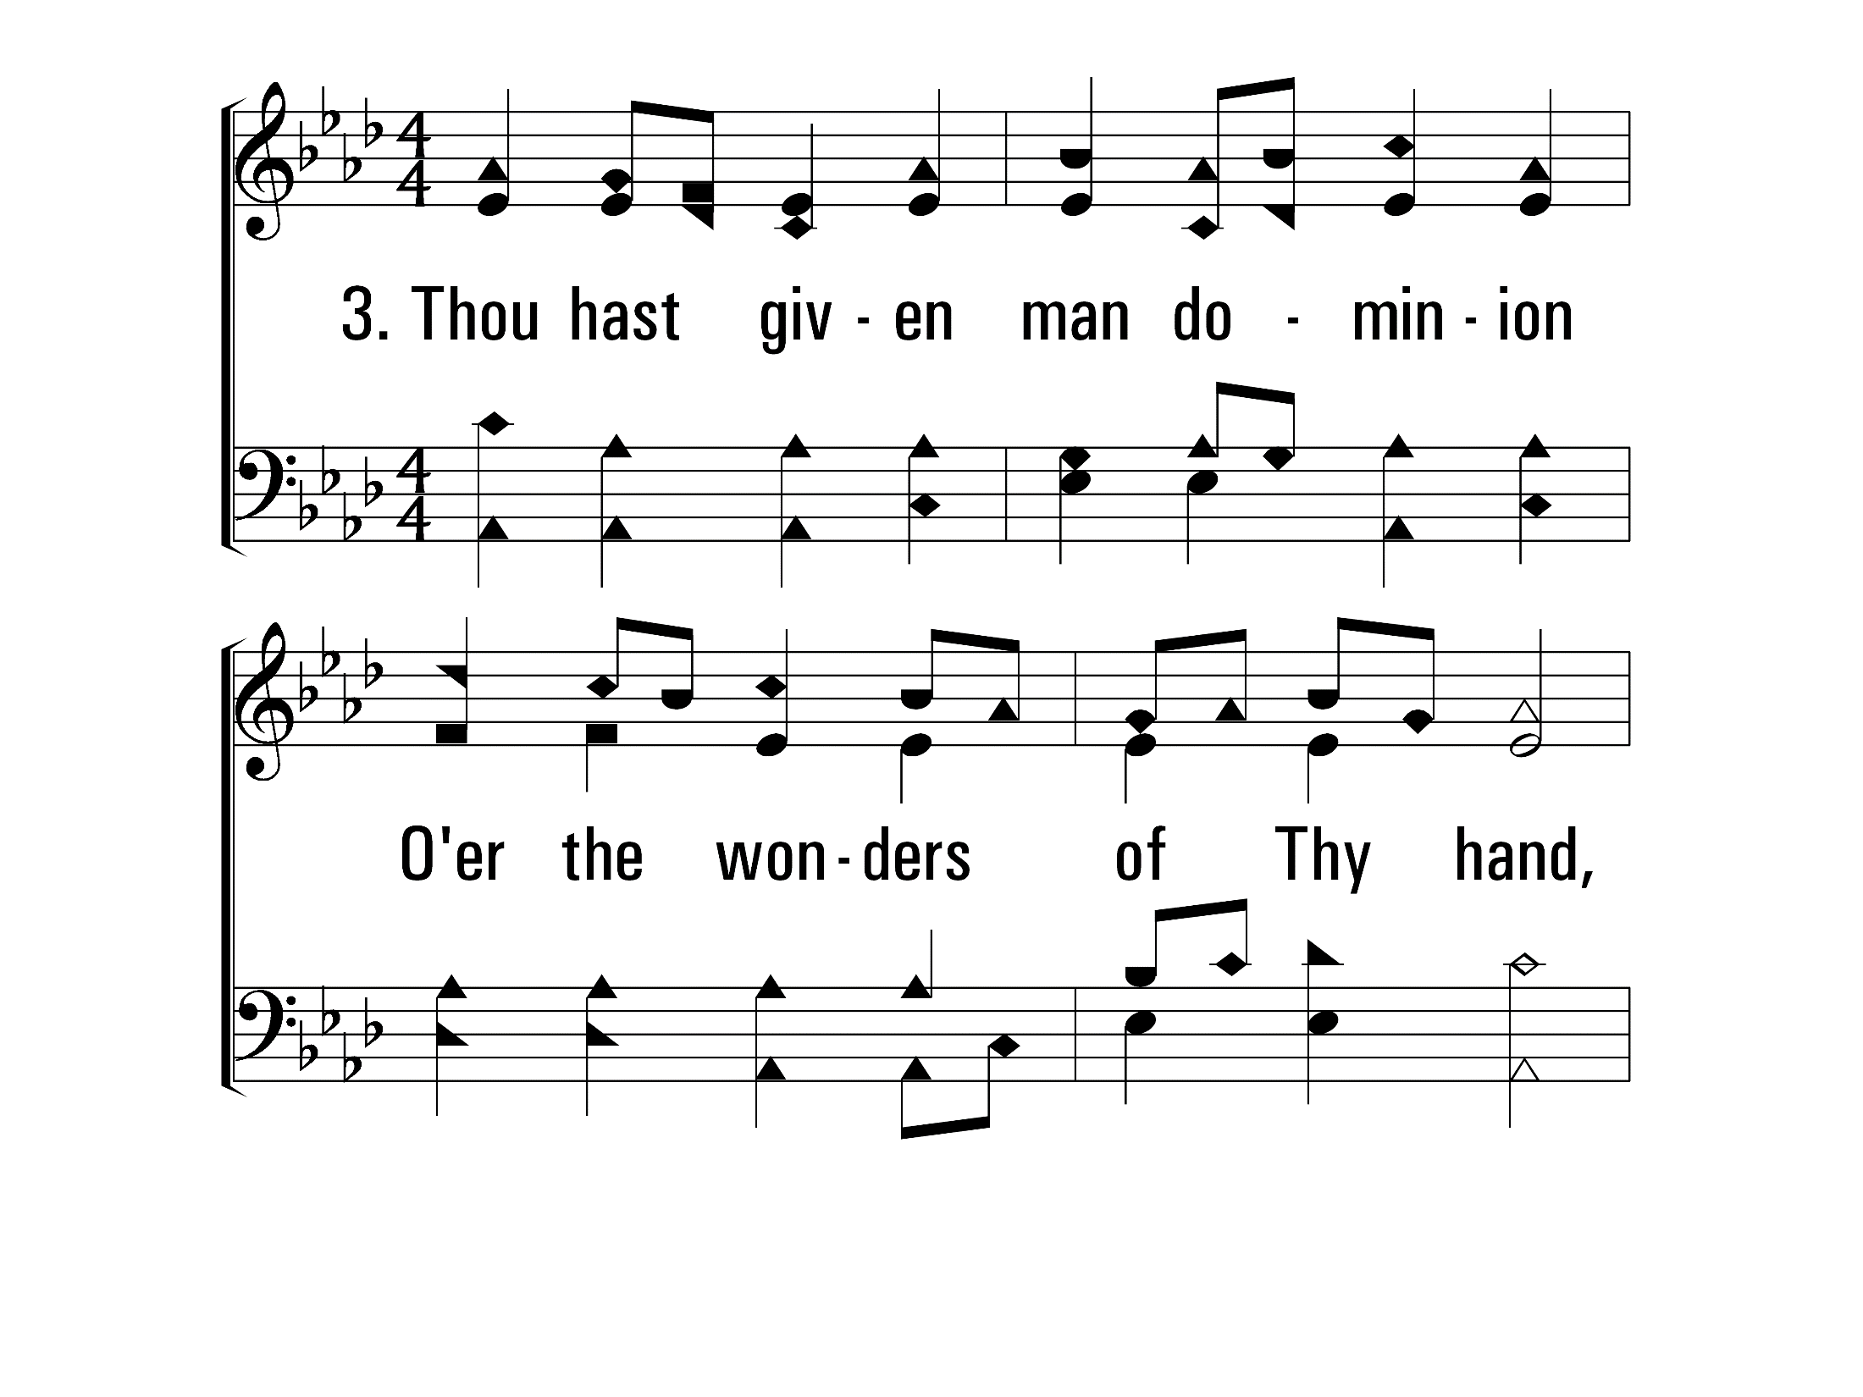
OhHowGloriousFullOfWonder_st3_a
Vs 3
© 2014 Sumphonia Productions, LLC

Slide 76
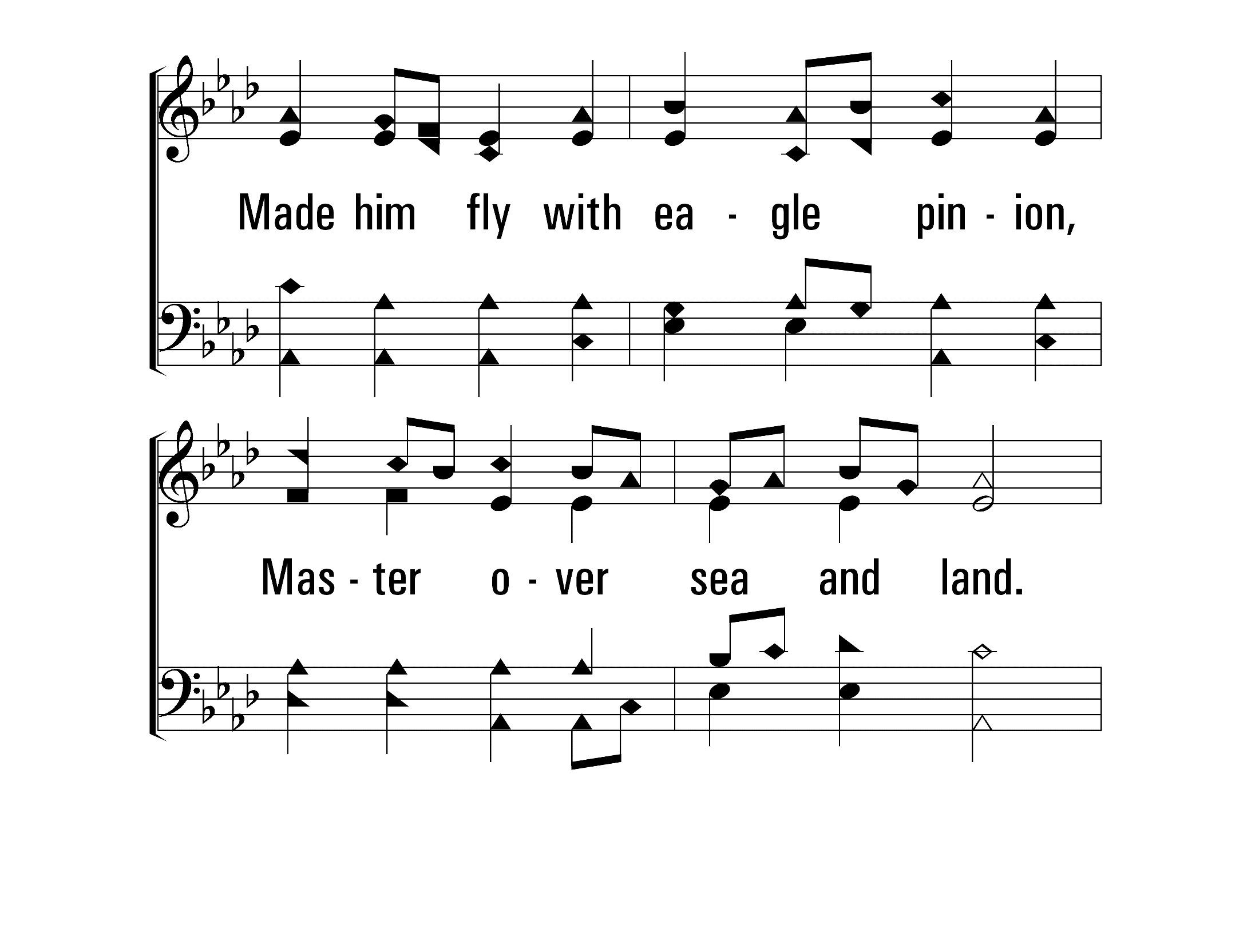
OhHowGloriousFullOfWonder_st3_b
Vs 3
© 2014 Sumphonia Productions, LLC

Slide 77
OhHowGloriousFullOfWonder_st3_c
Vs 3
© 2014 Sumphonia Productions, LLC

Slide 78
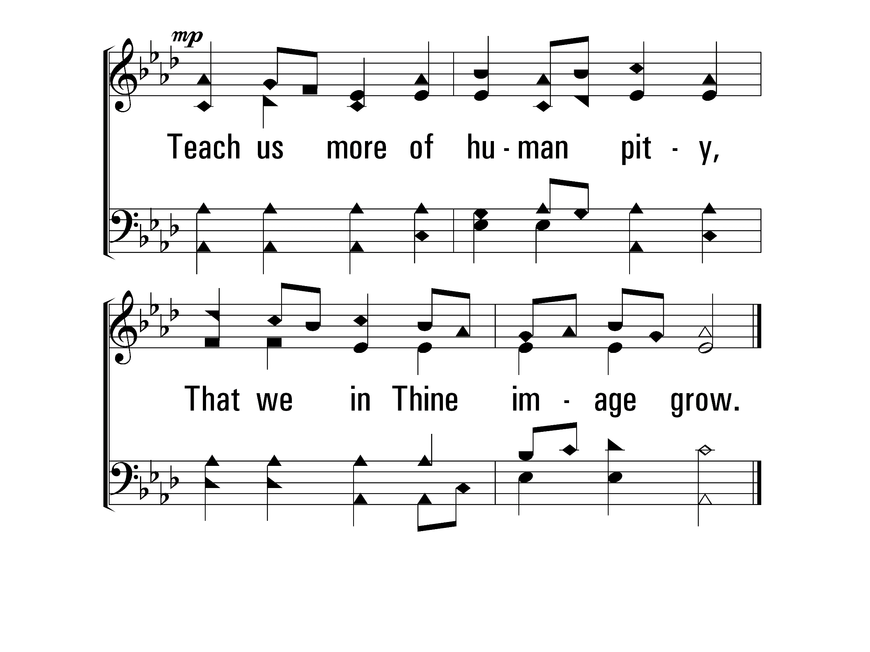
OhHowGloriousFullOfWonder_st3_d
Vs 3
© 2014 Sumphonia Productions, LLC
End

Slide 80
O Why Not Tonight? (Psalm 95)
517
Praise for the Lord

Slide 81
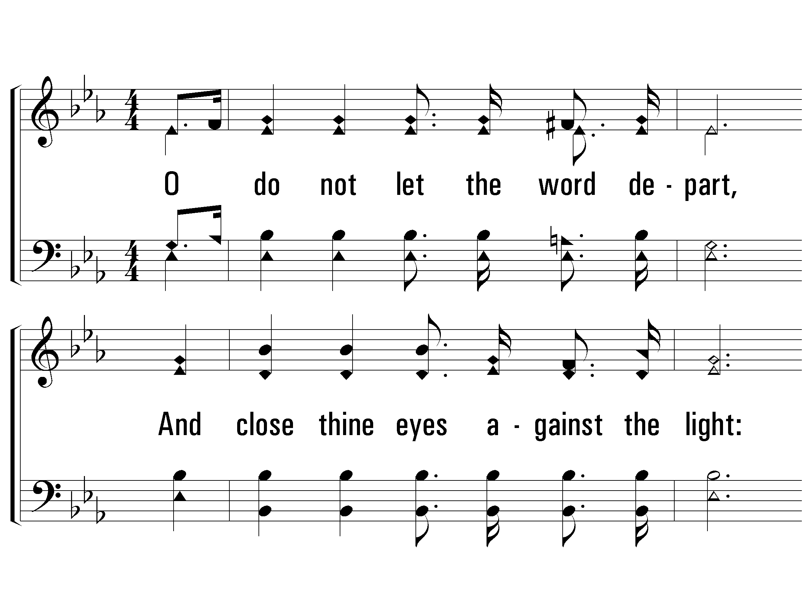
1 - O Why Not Tonight
517
1.
O do not let the word depart,
And close thine eyes against the light:
Poor sinner, harden not thy heart:
Be saved, O tonight.
Words: Eliza Holmes Reed
Music: J. Calvin Bushey
© 2008 The Paperless Hymnal®

Slide 82
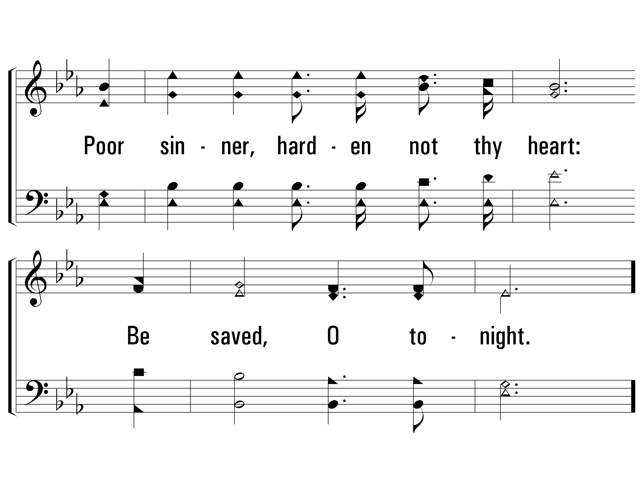
1 - O Why Not Tonight
517
© 2008 The Paperless Hymnal®

Slide 83
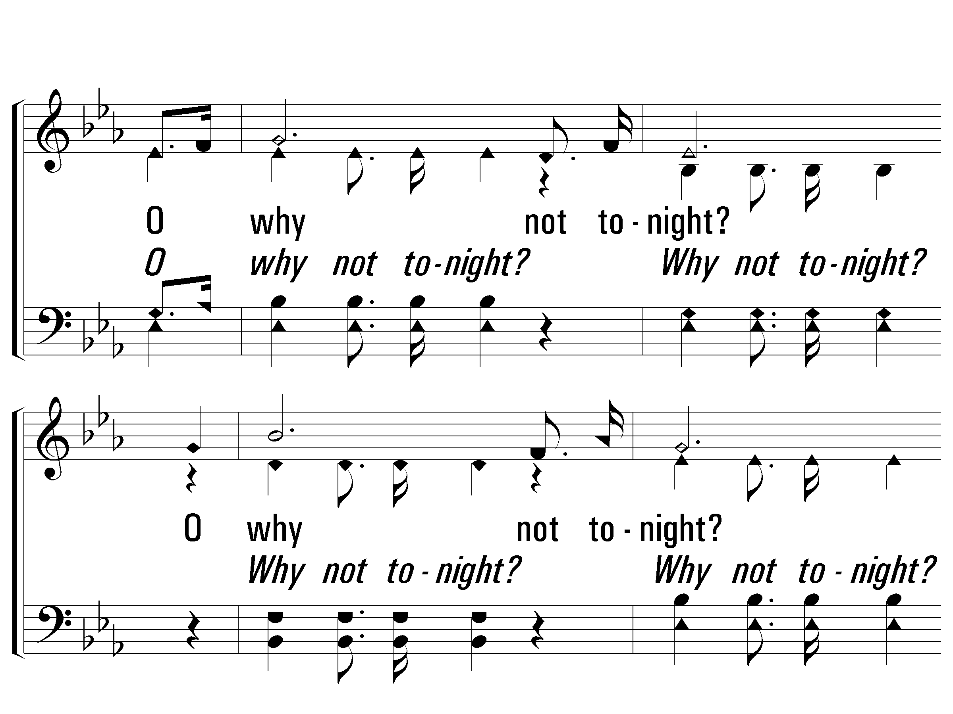
c - O Why Not Tonight
517
O why not tonight?
O why not tonight?
Wilt thou be saved?
Then why not tonight?
© 2008 The Paperless Hymnal®

Slide 84
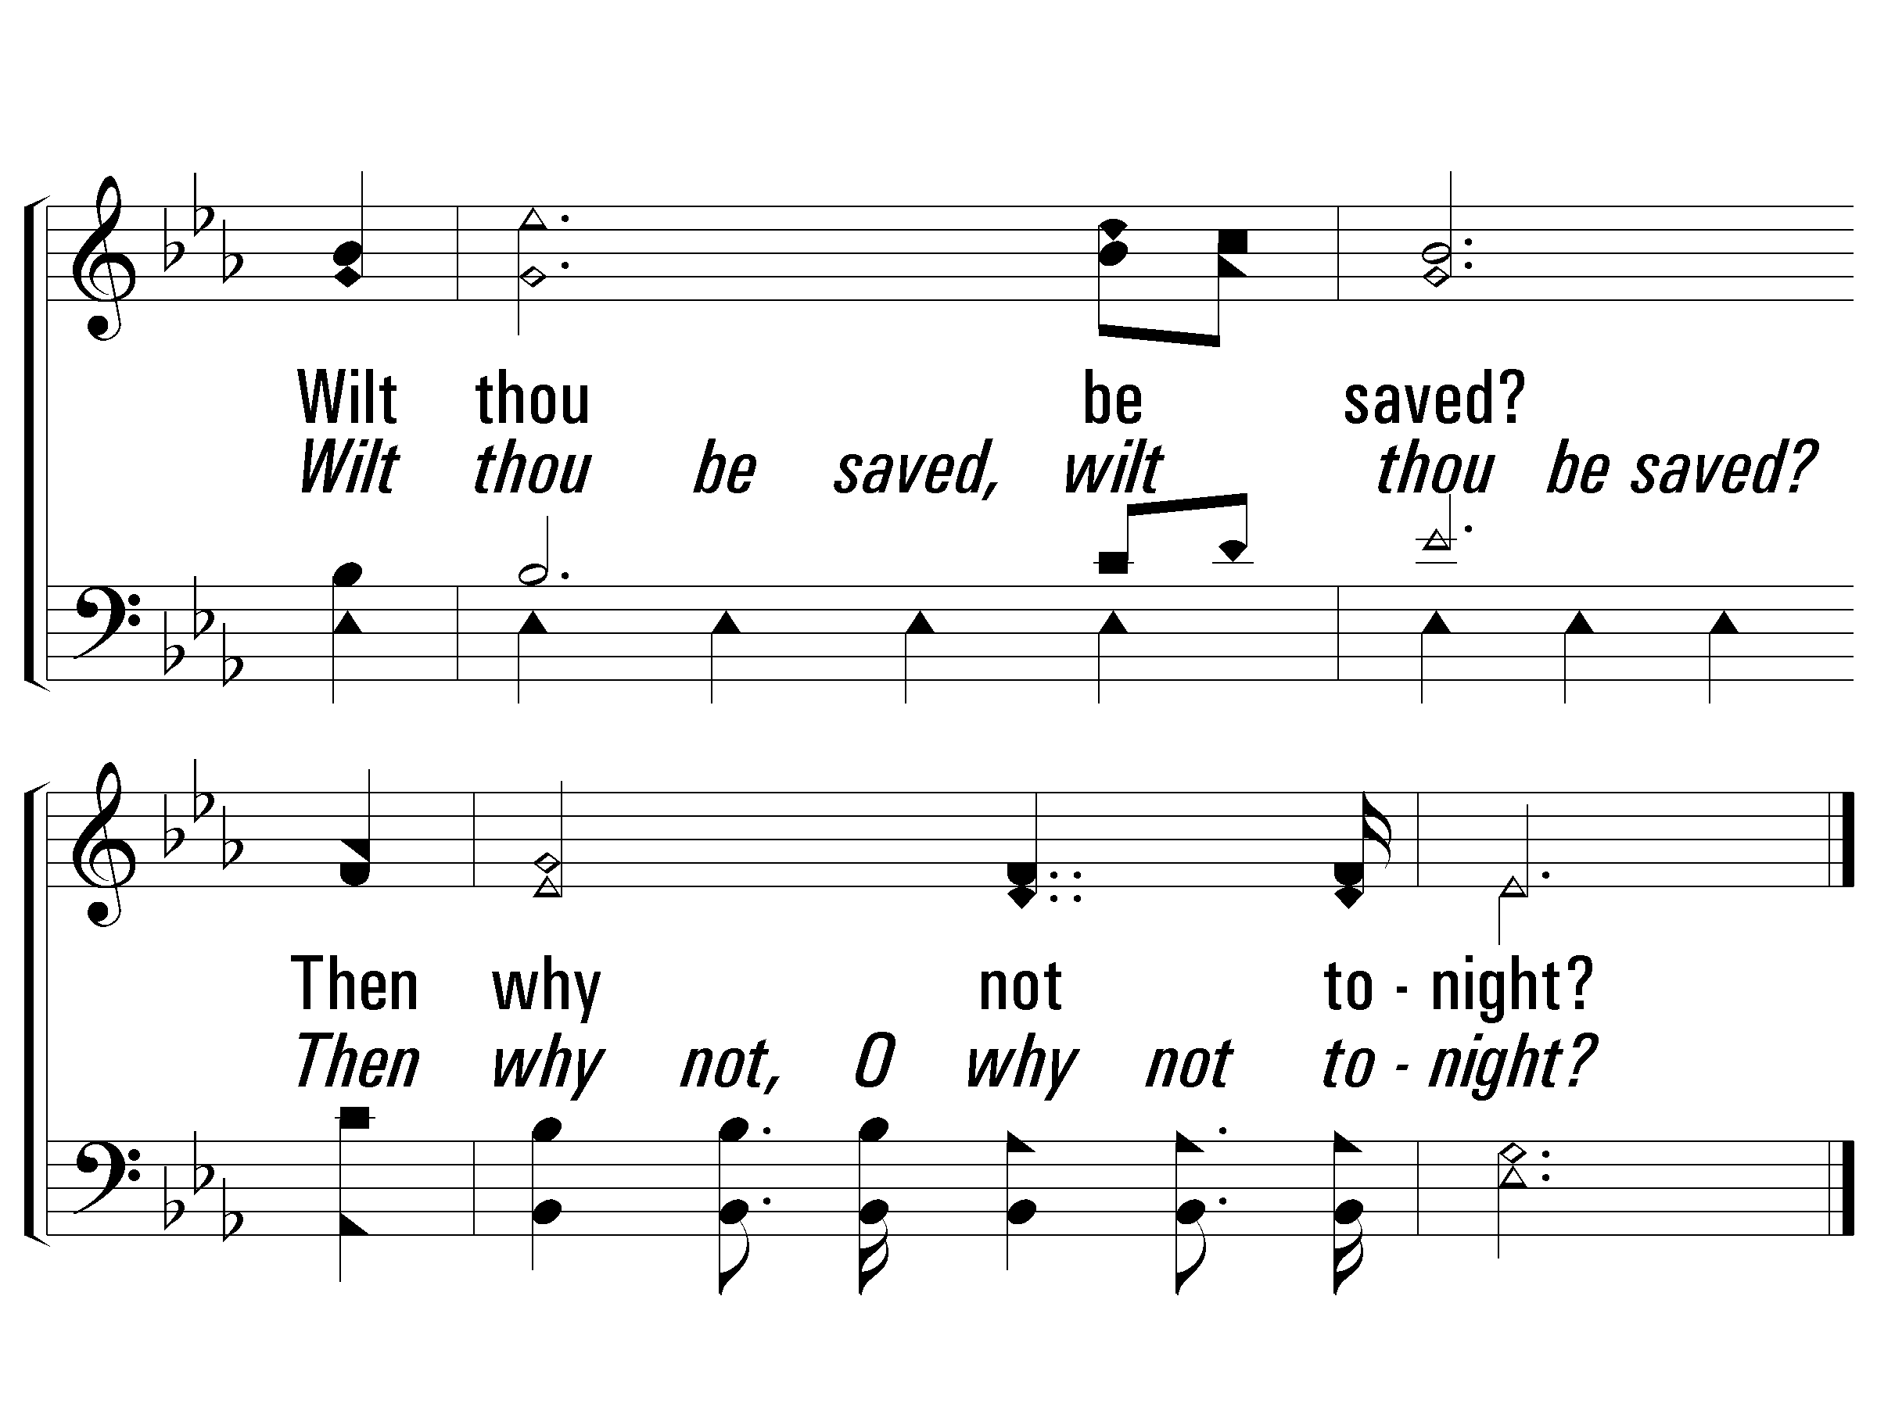
c - O Why Not Tonight
517
© 2008 The Paperless Hymnal®

Slide 85
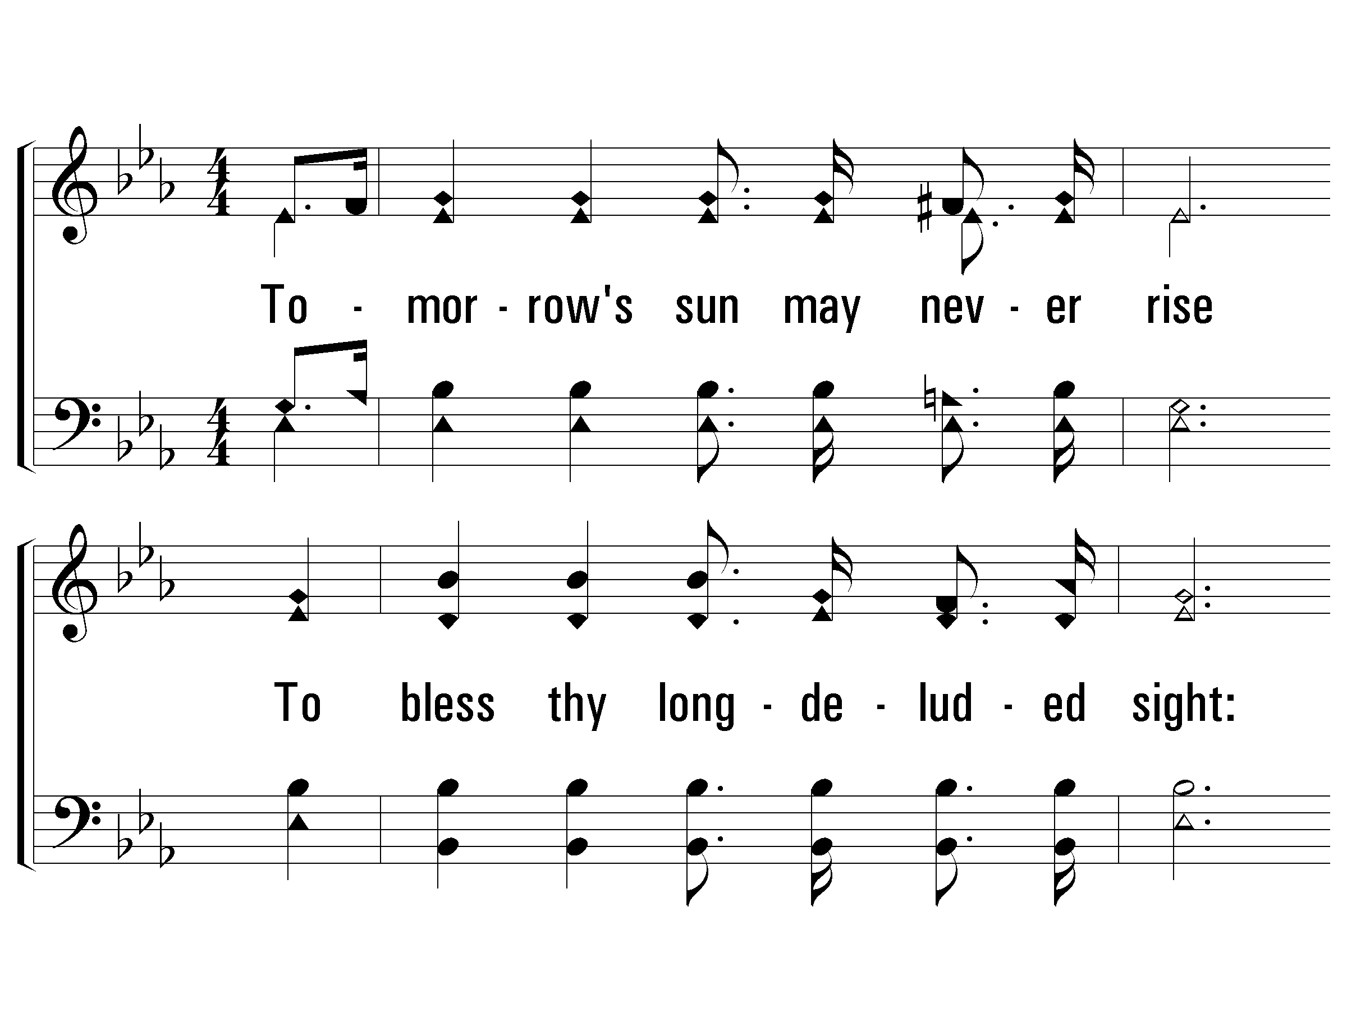
2 - O Why Not Tonight
517
2.
Tomorrow's sun may never rise
To bless thy long-deluded sight:
This is the time, O then be wise:
Be saved, O tonight.
Words: Eliza Holmes Reed
Music: J. Calvin Bushey
© 2008 The Paperless Hymnal®

Slide 86
2 - O Why Not Tonight
517
© 2008 The Paperless Hymnal®

Slide 87
c - O Why Not Tonight
517
O why not tonight?
O why not tonight?
Wilt thou be saved?
Then why not tonight?
© 2008 The Paperless Hymnal®

Slide 88
c - O Why Not Tonight
517
© 2008 The Paperless Hymnal®

Slide 89
3 - O Why Not Tonight
517
3.
Our God in pity lingers still,
And wilt thou thus His love requite?
Renounce at once thy stubborn will:
Be saved, O tonight.
Words: Eliza Holmes Reed
Music: J. Calvin Bushey
© 2008 The Paperless Hymnal®

Slide 90
3 - O Why Not Tonight
517
© 2008 The Paperless Hymnal®

Slide 91
c - O Why Not Tonight
517
O why not tonight?
O why not tonight?
Wilt thou be saved?
Then why not tonight?
© 2008 The Paperless Hymnal®

Slide 92
c - O Why Not Tonight
517
© 2008 The Paperless Hymnal®

Slide 93
5 - O Why Not Tonight
517
5.
Our blessed Lord refuses none
Who would to Him their souls unite;
Believe, obey, the work is done:
Be saved, O tonight.
Words: Eliza Holmes Reed
Music: J. Calvin Bushey
© 2008 The Paperless Hymnal®

Slide 94
5 - O Why Not Tonight
517
© 2008 The Paperless Hymnal®

Slide 95
c - O Why Not Tonight
517
O why not tonight?
O why not tonight?
Wilt thou be saved?
Then why not tonight?
© 2008 The Paperless Hymnal®

Slide 96
c - O Why Not Tonight
517
End
© 2008 The Paperless Hymnal®

