Slide 1
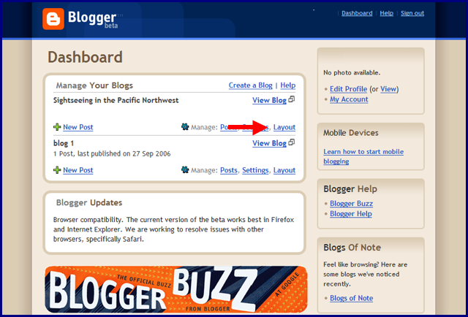

Slide 2
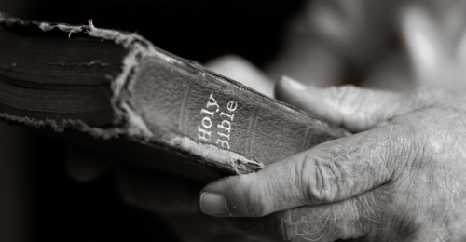
Have I Been Told the Truth?
Messages which challenge today’s conventional thinking about…
The Origins of the
The Bible
Writings from God or Men?

Slide 3
The Origins of
The Bible
God’s fingerprints?
Unifying theme
Harmony of content though multiple writers
Historically accurate
Noble doctrines and ethics

Slide 4
The Origins of
The Bible
The crux of the evidence – prophecies, particularly the Messianic prophecies
Luke 24:44-46
Acts 17:1-4
O. T. Prophecies > N.T. Fulfillment
Micah 5:2
Jesus born in Bethlehem
Psalm 22:1-21
Jesus’ execution on the cross
Isaiah 53:3-12
Jesus’ rejection, suffering, death

Slide 5
The Origins of
The Bible
O. T. Prophecies > N.T. Fulfillment
Micah – 750-700 BC Jesus – 0-33 AD
Psalm (David) – 1000-961 BC
Isaiah – 740-700 BC
Humans cannot write documents centuries before a person lives and describe the details of their life, or death
These documents have a divine source, they are of God

Slide 6
The Origins of
The Bible
O. T. Prophecies > N.T. Fulfillment
QUESTION:
How do we know the Old Testament we have today is the same as what was originally written?

Slide 7
The Origins of
The Bible
Evidence to consider:
The dates of the completed O.T.?
Manuscripts – O.T. and N.T.?
Hand copies for
distribution and preservation

Slide 8
The Origins of
The Bible
O.T. Book | Date of completion (believing scholars)
Exodus | 15th century B.C. (possibly as late as the 13th c.)
Psalms of David | 1000-961 B.C.
Isaiah | 740-700 B.C.
Micah | 750-700 B.C.
Jeremiah | 627-586 B.C.
Most unbelieving critics of the Bible would date these books a few centuries later

Slide 9
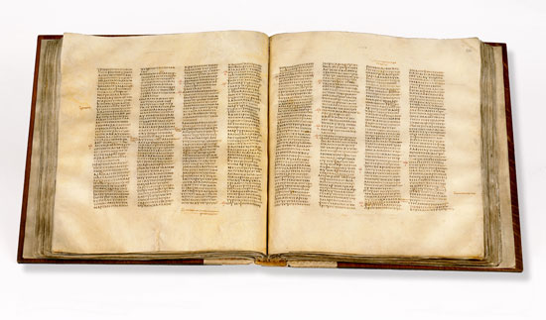
The Origins of
The Bible
The Origins of
The Septuagint
This Greek translation of the Hebrew scriptures was completed no later than the 2nd century B.C.
The Hebrew Scriptures had been in circulation long before that
Codex Sinaiticus, a 4th-century manuscript of the Septuagint

Slide 10
The Origins of
The Bible
The Origins of
Isaiah and Micah
700 BC
The Septuagint
200 BC
Jesus
1st century AD
No one can reasonably dispute that centuries separate the writing of the O.T. prophecies and the time of Jesus on earth

Slide 11
The Origins of
The Bible
O. T. Prophecies > N.T. Fulfillment
QUESTION:
How do we know the O.T. we have today is the same as what was originally written?

Slide 12
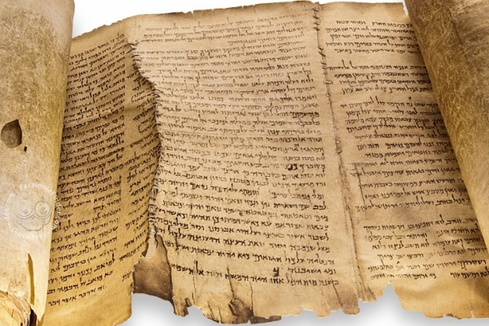
The Origins of
The Bible
The Dead Sea Scrolls
Ancient Jewish community
Initial find 1946/47
Dated from between 2nd century B.C. and 2nd century A.D.

Slide 13
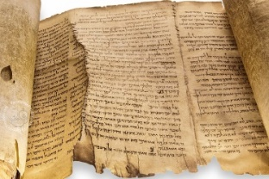
The Origins of
The Bible
The Origins of
Jesus
1st century AD
Modern English O.T.
The Dead Sea Scrolls
200 BC – 200 AD
DSS harmonize with the earliest Hebrew manuscripts available before the find and with our modern English O.T.

Slide 14
The Origins of
The Bible
O. T. Prophecies > N.T. Fulfillment
How do we know the O.T. documents were written and completed centuries before Jesus?
Many pieces of evidence and the clincher is the Septuagint
How do we know the O.T. we have today is the same as what was originally written?
Many pieces of evidence and the clincher is the collection of the Dead Sea Scrolls

Slide 15
Have I Been Told the Truth?
Messages which challenge today’s conventional thinking about…
The Origins of the
The Bible
And Paul went in as was his custom, and on three Sabbath days reasoned with them from the scriptures…
Acts 17:2
Writings from God or Men?

