Slide 1
Have I Been Told the Truth?
Messages which challenge today’s conventional thinking about…
Camel bone found in the High Arctic

Slide 2
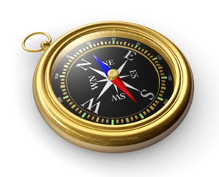
“Each person has to determine right and wrong for himself or herself. We should not judge how other people live. It is their business to do what they think is good and proper for them. You must seek and do what is right for you, and I must do the same for me.”
A sacred value in our culture
Essence: There are no moral absolutes

Slide 3
Have I Been Told the Truth?
Messages which challenge today’s conventional thinking about…
Morality
Do you have a compass?

Slide 4
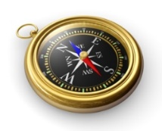
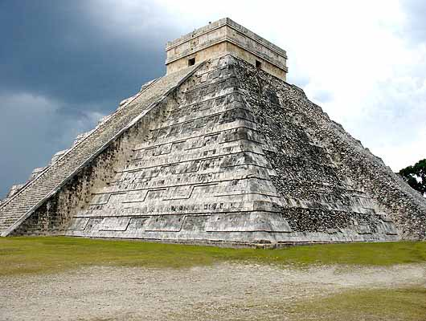
Do you have a compass?
Is morality relative or is there a standard?
A case study:
Aztec human sacrifice

Slide 5
Do you have a compass?
Jeremiah 10:23
I know, O Lord, that the way of man is not in himself,
that it is not in man who walks to direct his steps.
ESV
What should the standard be?
God
speaking in His Word
vs. 24
Correct me, O Lord, but in justice;
not in your anger, lest you bring me to nothing.

Slide 6
Do you have a compass?
God speaking in His Word is the moral standard which can guide our way
Ps 119:97-100
Oh how I love your law!
It is my meditation all the day.
Your commandment makes me wiser than my enemies,
for it is ever with me.
I have more understanding than all my teachers,
for your testimonies are my meditation.
I understand more than the aged,
for I keep your precepts.

Slide 7
Do you have a compass?
God speaking in His Word is the moral standard which can guide our way
Psalm 119:101-105
I hold back my feet from every evil way,
in order to keep your word.
I do not turn aside from your rules,
for you have taught me.
How sweet are your words to my taste,
sweeter than honey to my mouth!
Through your precepts I get understanding;
therefore I hate every false way.
Your word is a lamp to my feet
and a light to my path.

Slide 8
Do you have a compass?
1 Corinthians 6:8-11
Do you not know that the unrighteous will not inherit the kingdom of God? Do not be deceived: neither the sexually immoral, nor idolaters, nor adulterers, nor men who practice homosexuality, nor thieves, nor the greedy, nor drunkards, nor revilers, nor swindlers will inherit the kingdom of God. And such were some of you. But you were washed, you were sanctified, you were justified in the name of the Lord Jesus Christ and by the Spirit of our God.
The emphasis is on the word of God and following it is within the framework of a relationship with Him
It is His word which is the standard, not our own
What culture, the experts, or personal conscience says should not change God’s absolute moral standard

Slide 9
Do you have a compass?
Why turn to God and His Word?
Psalm 1
Blessed is the man
who walks not in the counsel of the wicked,
nor stands in the way of sinners,
nor sits in the seat of scoffers;
but his delight is in the law of the Lord,
and on his law he meditates day and night.
He is like a tree
planted by streams of water
that yields its fruit in its season,
and its leaf does not wither.

Slide 10
Do you have a compass?
Why turn to God and His Word?
Psalm 1
In all that he does, he prospers.
The wicked are not so,
but are like chaff that the wind drives away.
Therefore the wicked will not stand in the judgment,
nor sinners in the congregation of the righteous;
for the Lord knows the way of the righteous,
but the way of the wicked will perish.
You have security and stability
You will find inner peace
It leads to better outcomes for this life in the long run

Slide 11
Have I Been Told the Truth?
Messages which challenge today’s conventional thinking about…
Morality
Do you have a compass?

