Slide 2
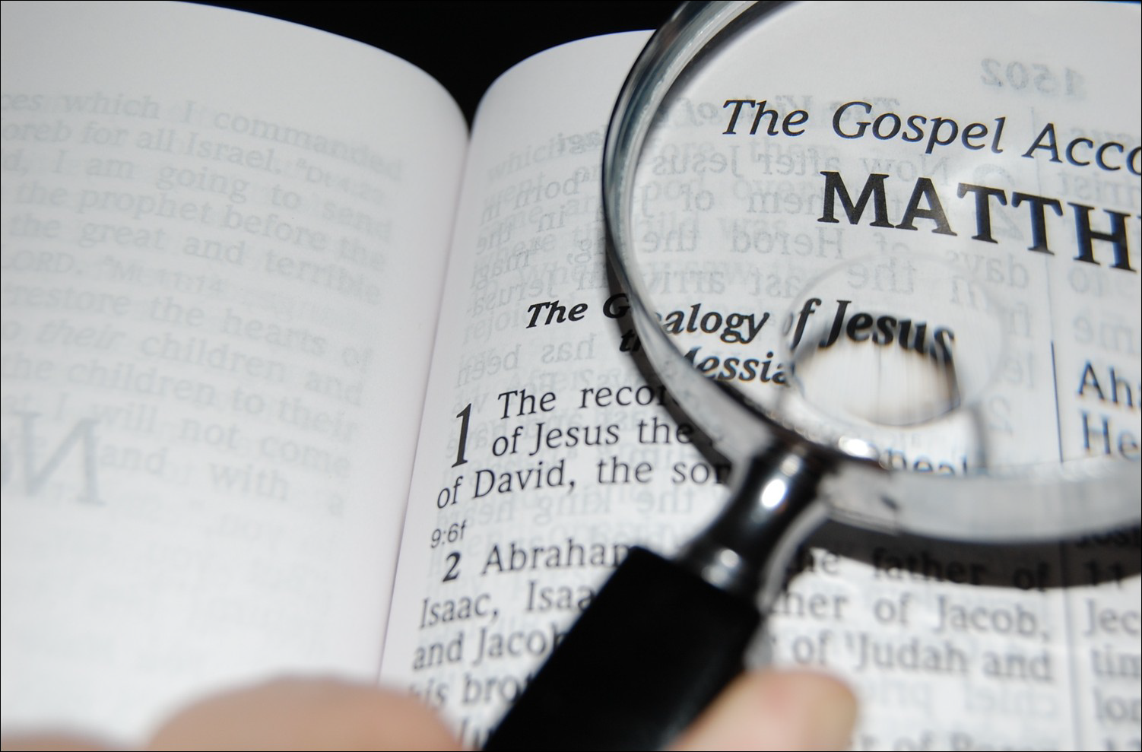
Have I Been Told the Truth?
Messages which challenge today’s conventional thinking about…
Who
Really Was
Jesus

Slide 3
How to know who JESUS really was?
The Believable New Testament

Slide 4
How to know who JESUS really was?
Mark 1:1
The beginning of the gospel of Jesus Christ, the Son of God.
The Believable New Testament
Gospel = “good news”
- Jesus’ message of salvation
- the account of Jesus’ life

Slide 5
How to know who JESUS really was?
Mark 1:19-20
And going a little farther, he saw James the son of Zebedee and John his brother, who were in their boats mending their nets. And immediately he called them, and they left their father Zebedee in the boat with the hired servants and followed him.
The Believable New Testament
Matthew and John
- apostles, companions of Jesus
Mark 2:14-15
And as he passed by, he saw Levi* the son of Alphaeus sitting at the tax booth, and he said to him, “Follow me”. And he rose and followed him. And he reclined at table in his house… (*Matthew 10:3 – “Matthew the tax collector”)

Slide 6
How to know who JESUS really was?
Luke 1:1-4
Inasmuch as many have undertaken to compile an account of the things accomplished among us, just as they were handed down to us by those who from the beginning were eyewitnesses and servants of the word, it seemed fitting for me as well, having investigated everything carefully from the beginning, to write it out for you in consecutive order, most excellent Theophilus; so that you may know the exact truth about the things you have been taught.
The Believable New Testament
Mark and Luke
- companions to the witnesses of Jesus

Slide 7
How to know who JESUS really was?
Their message –
Jesus of Nazareth was the fulfillment of Hebrew prophecy, the Son of God in human flesh, who came to show the way to God and die to pay for our sins
The Believable New Testament
John 20:30-31
Now Jesus did many other signs in the presence of the disciples, which are not written in this book; but these are written so that you may believe that Jesus is the Christ, the Son of God, and that by believing you may have life in his name.

Slide 8
How to know who JESUS really was?
Why are their accounts so important?
Their access to the people and events (primary sources)
The Believable New Testament
I John 1:1-3
What was from the beginning, what we have heard, what we have seen with our eyes, what we have looked at and touched with our hands, concerning the Word of Life — and the life was manifested, and we have seen and testify and proclaim to you the eternal life, which was with the Father and was manifested to us — what we have seen and heard we proclaim to you also, so that you too may have fellowship with us; and indeed our fellowship is with the Father, and with His Son Jesus Christ.

Slide 9
How to know who JESUS really was?
Why are their accounts so important?
Their access to the people and events (primary sources)
The Believable New Testament
II Peter 1:16
For we did not follow cleverly devised tales when we made known to you the power and coming of our Lord Jesus Christ, but we were eyewitnesses of His majesty.

Slide 10
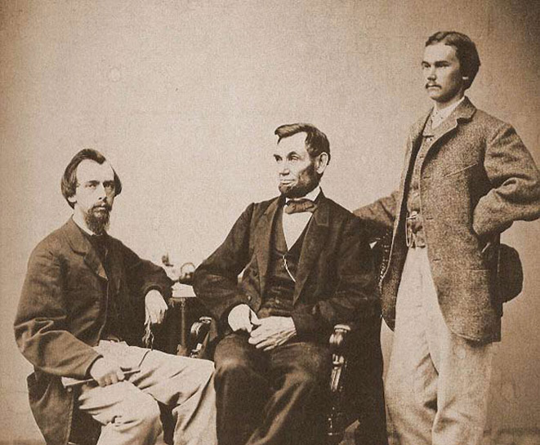
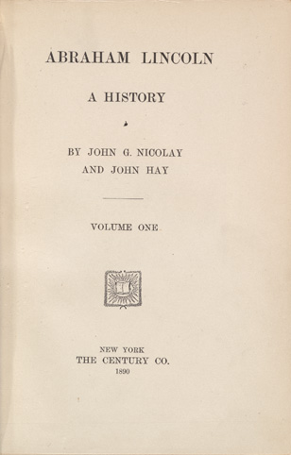
How to know who JESUS really was?
The Believable New Testament
John Nicolay
John Hay
(personal secretaries to A. Lincoln 1861-1865)
Authored
“Abraham Lincoln
– A History”
1890 10 Volumes

Slide 11
How to know who JESUS really was?
Why are their accounts so important?
Their access to the people and events (primary sources)
The Believable New Testament
The “Jesus of History” (the moral teacher, inspiring leader, merely human)
- Those who make this distinction often disregard Matthew, Mark, Luke, and John as legitimate sources and draw heavily from documents 150 to 300 years later

Slide 12
How to know who JESUS really was?
Haven’t their accounts been corrupted?
The manuscript evidence
The Believable New Testament
manuscript = hand-written copy
- no printing press copies in the ancient world
- fragile writing material (papyrus, animal skin) required frequent copying by scribes
Have the gospels been altered to create a legend?
Gospel Writings
2012 A.D.

Slide 13
How to know who JESUS really was?
Haven’t their accounts been corrupted? The manuscript evidence
The Believable New Testament
Author | Date Written | Earliest copy | No. of copies
Herodotus | 488-428.B.C. | 900 A.D. | 8
Thucydides | 460-400 B.C. | 900 A.D. | 8
Julius Caesar | 58-50 B.C. | 900 A.D. | 10
Tacitus | 100 A.D. | 900-1100 A.D. | 20

Slide 14
How to know who JESUS really was?
Haven’t their accounts been corrupted?
The manuscript evidence
The Believable New Testament
Author | Date Written | Earliest copy | No. of copies
Herodotus | 488-428.B.C. | 900 A.D. | 8
Thucydides | 460-400 B.C. | 900 A.D. | 8
Julius Caesar | 58-50 B.C. | 900 A.D. | 10
Tacitus | 100 A.D. | 900-1100 A.D. | 20
New Testament | 50 – 100 A.D. | 125 A.D. | 5,600

Slide 15
How to know who JESUS really was?
Haven’t their accounts been corrupted?
The manuscript evidence
The Believable New Testament

Slide 16
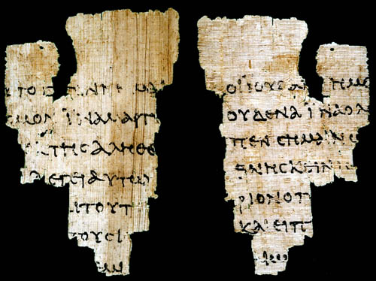
How to know who JESUS really was?
Haven’t their accounts been corrupted?
The manuscript evidence
The Believable New Testament
If we have confidence in any ancient documents being transmitted to us accurately, we must have confidence in the accuracy of the New Testament
Isn’t it only fair that Matthew, Mark, Luke, and John be treated as other ancient historians and writers?
John Rylands Fragment
of the gospel of John (120 A.D.)

Slide 17
How to know who JESUS really was?
What was in it for them?
The selfless and sacrificial nature of their work
The Believable New Testament
Acts 5:40-42
They took his advice; and after calling the apostles in, they flogged them and ordered them not to speak in the name of Jesus, and then released them. So they went on their way from the presence of the Council, rejoicing that they had been considered worthy to suffer shame for His name. And every day, in the temple and from house to house, they kept right on teaching and preaching Jesus as the Christ.

Slide 18
How to know who JESUS really was?
What was in it for them?
The selfless and sacrificial nature of their work
The Believable New Testament
Hebrews 10:32-34
But remember the former days, when, after being enlightened, you endured a great conflict of sufferings, partly by being made a public spectacle through reproaches and tribulations, and partly by becoming sharers with those who were so treated. For you showed sympathy to the prisoners and accepted joyfully the seizure of your property, knowing that you have for yourselves a better possession and a lasting one.

Slide 19
How to know who JESUS really was?
The Believable New Testament

