Slide 1
Welcome. Thank You for leaving the front 5 center pews empty so everyone will have a clear view of the screen tonight.

Slide 2
Order of Worship
Welcome - Phillip Shumake
Scripture Reading – Qiliang He (Ex. 1:5-14)
3 Songs – Mason Broadwell
God Is Holy - Justin Reynolds
God Is The Deliverer – Dwight Alleyne
2 Songs – Mason Broadwell
God The Provider – Dan Blimline
God The Ruler – Phillip Shumake
Invitation Song – Mason Broadwell
Closing Prayer – Corey Dutra

Slide 3
Exploring Exodus

Slide 4
Exploring Exodus
Day 1: God Is Holy I will listen to Him!
Day 2: God The Deliverer I will follow Him!
Day 3: God The Provider I will trust Him!
Day 4: God The Ruler I will obey Him!

Slide 5
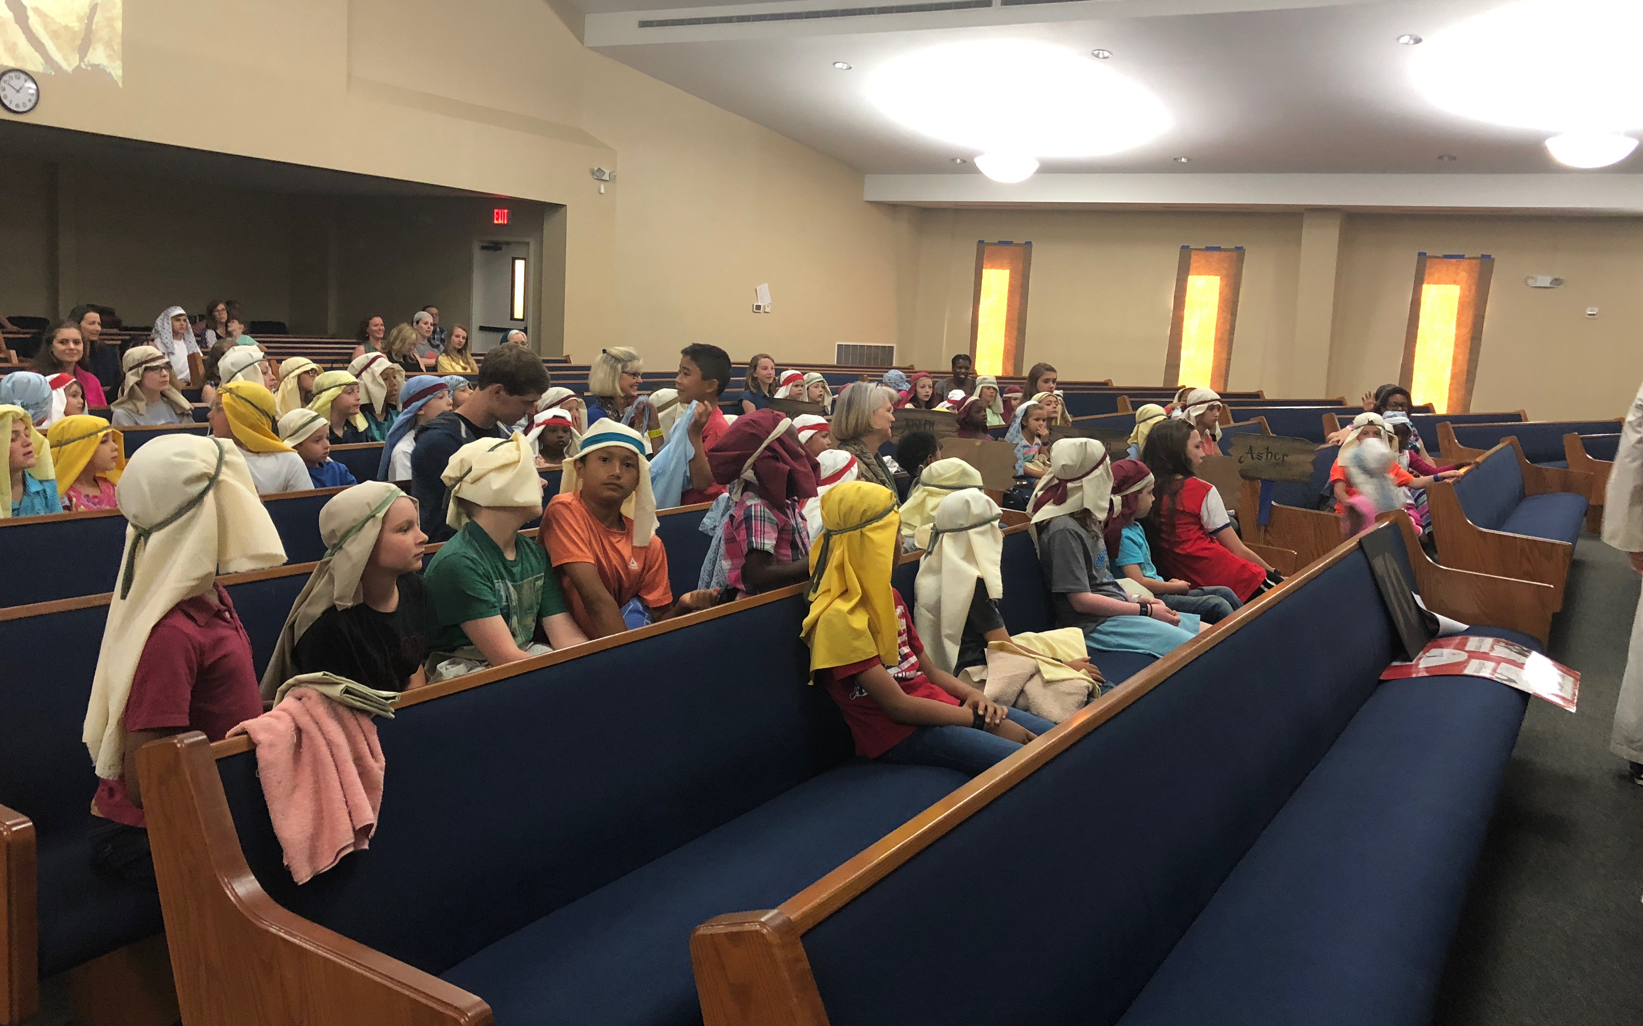

Slide 6
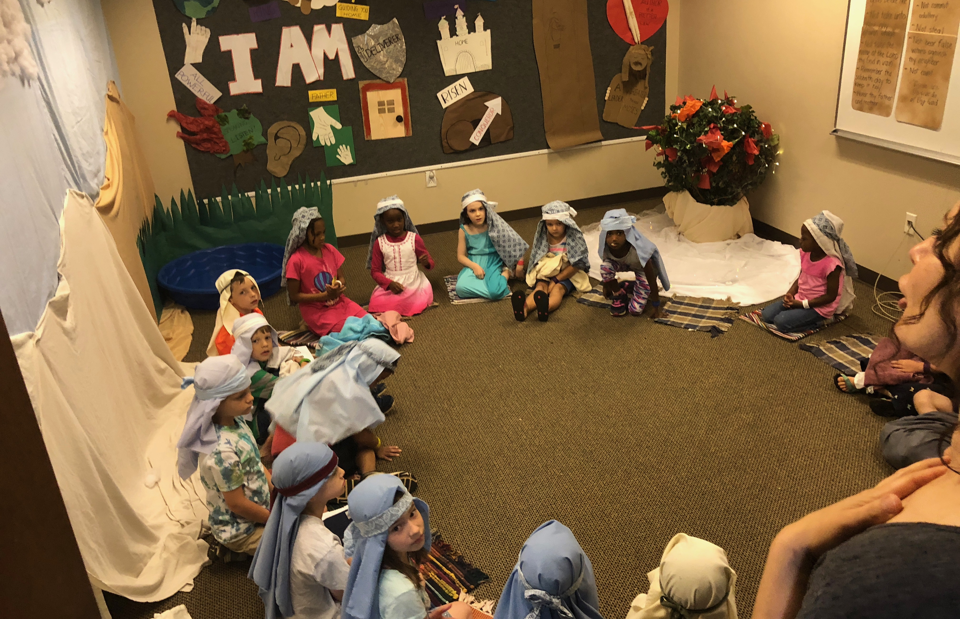

Slide 7
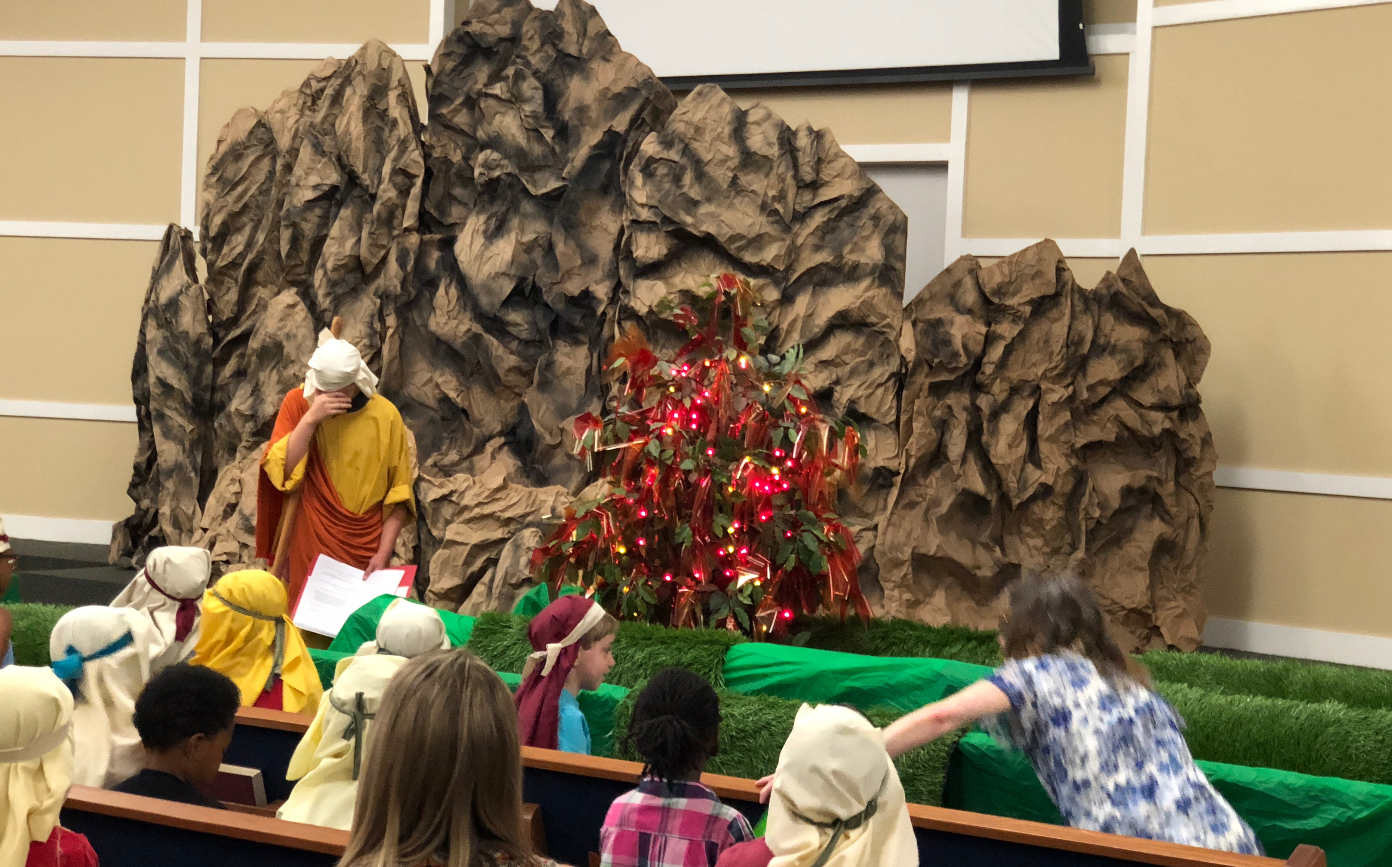

Slide 8
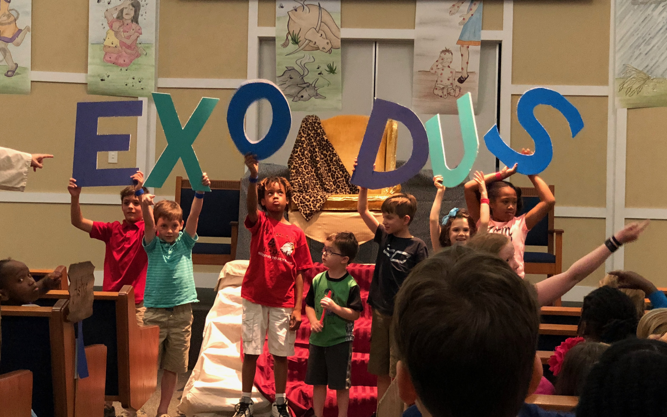

Slide 9
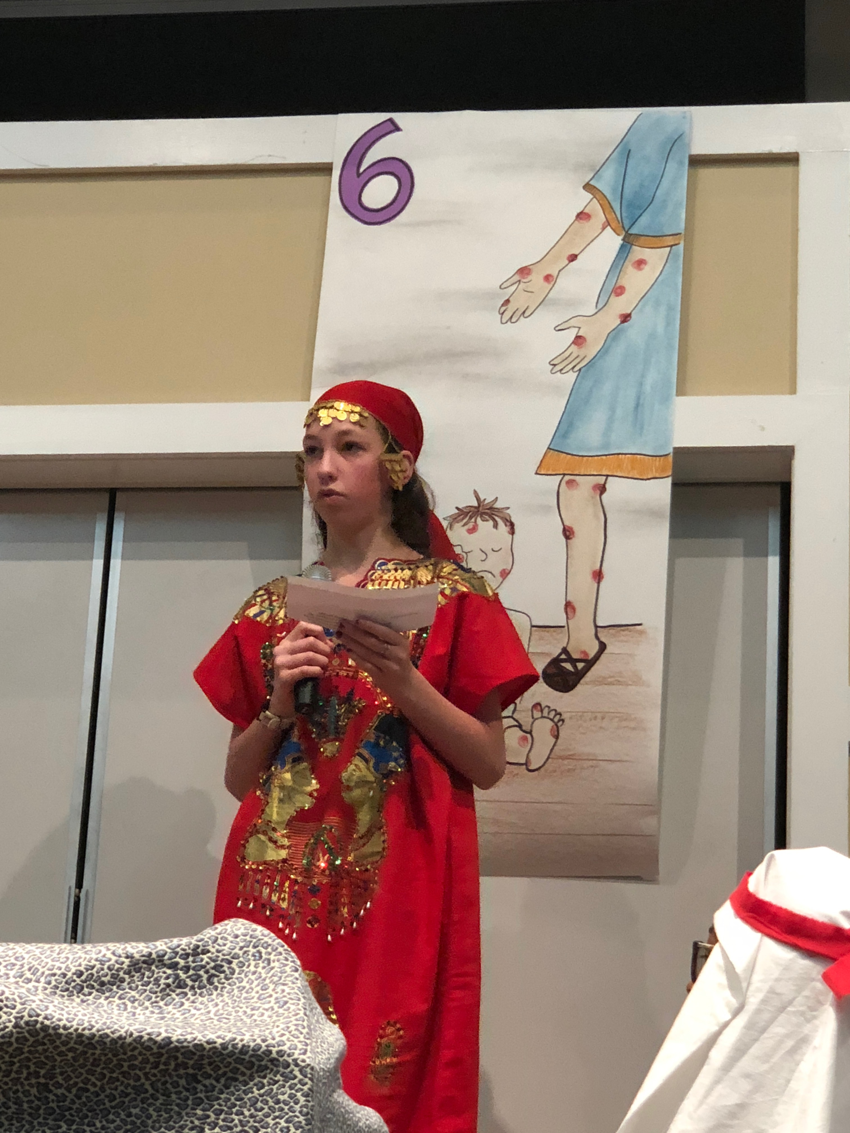
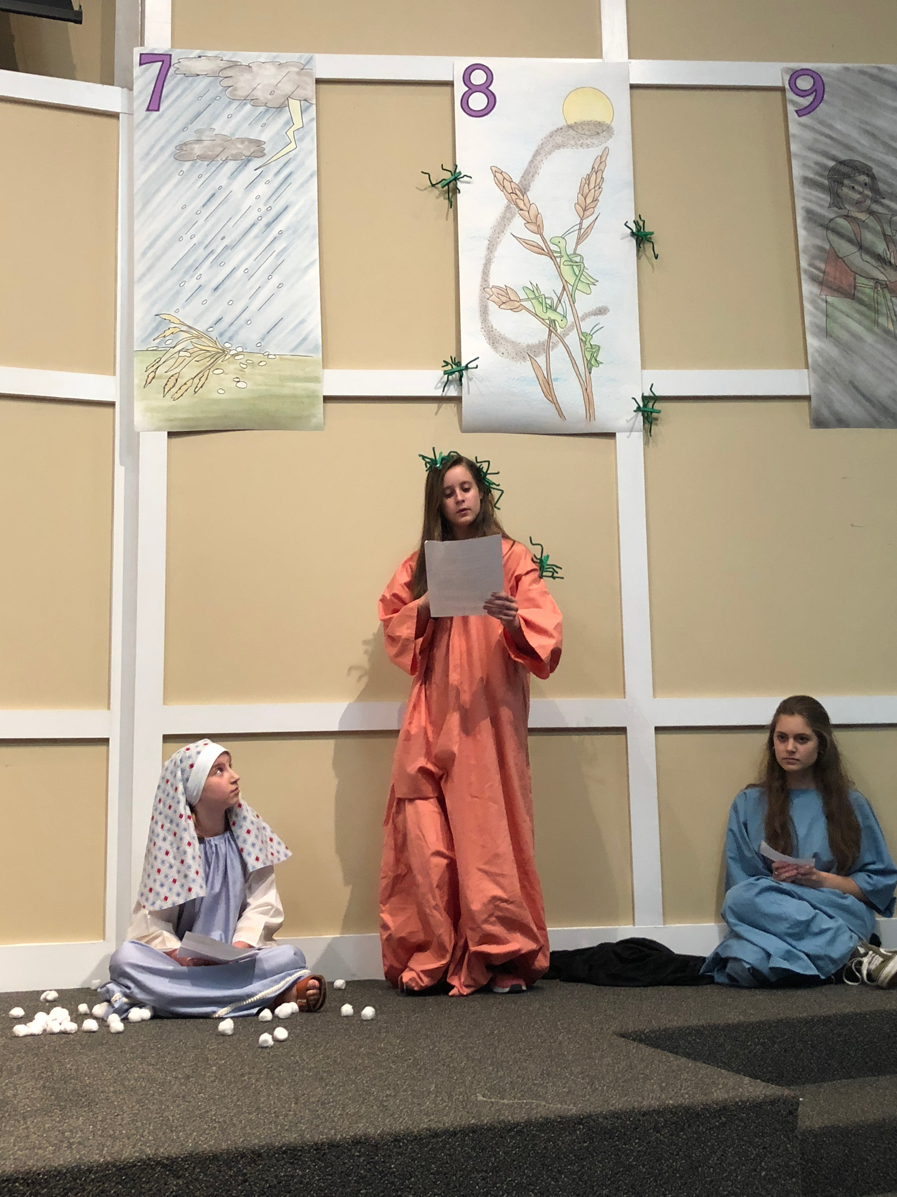

Slide 11
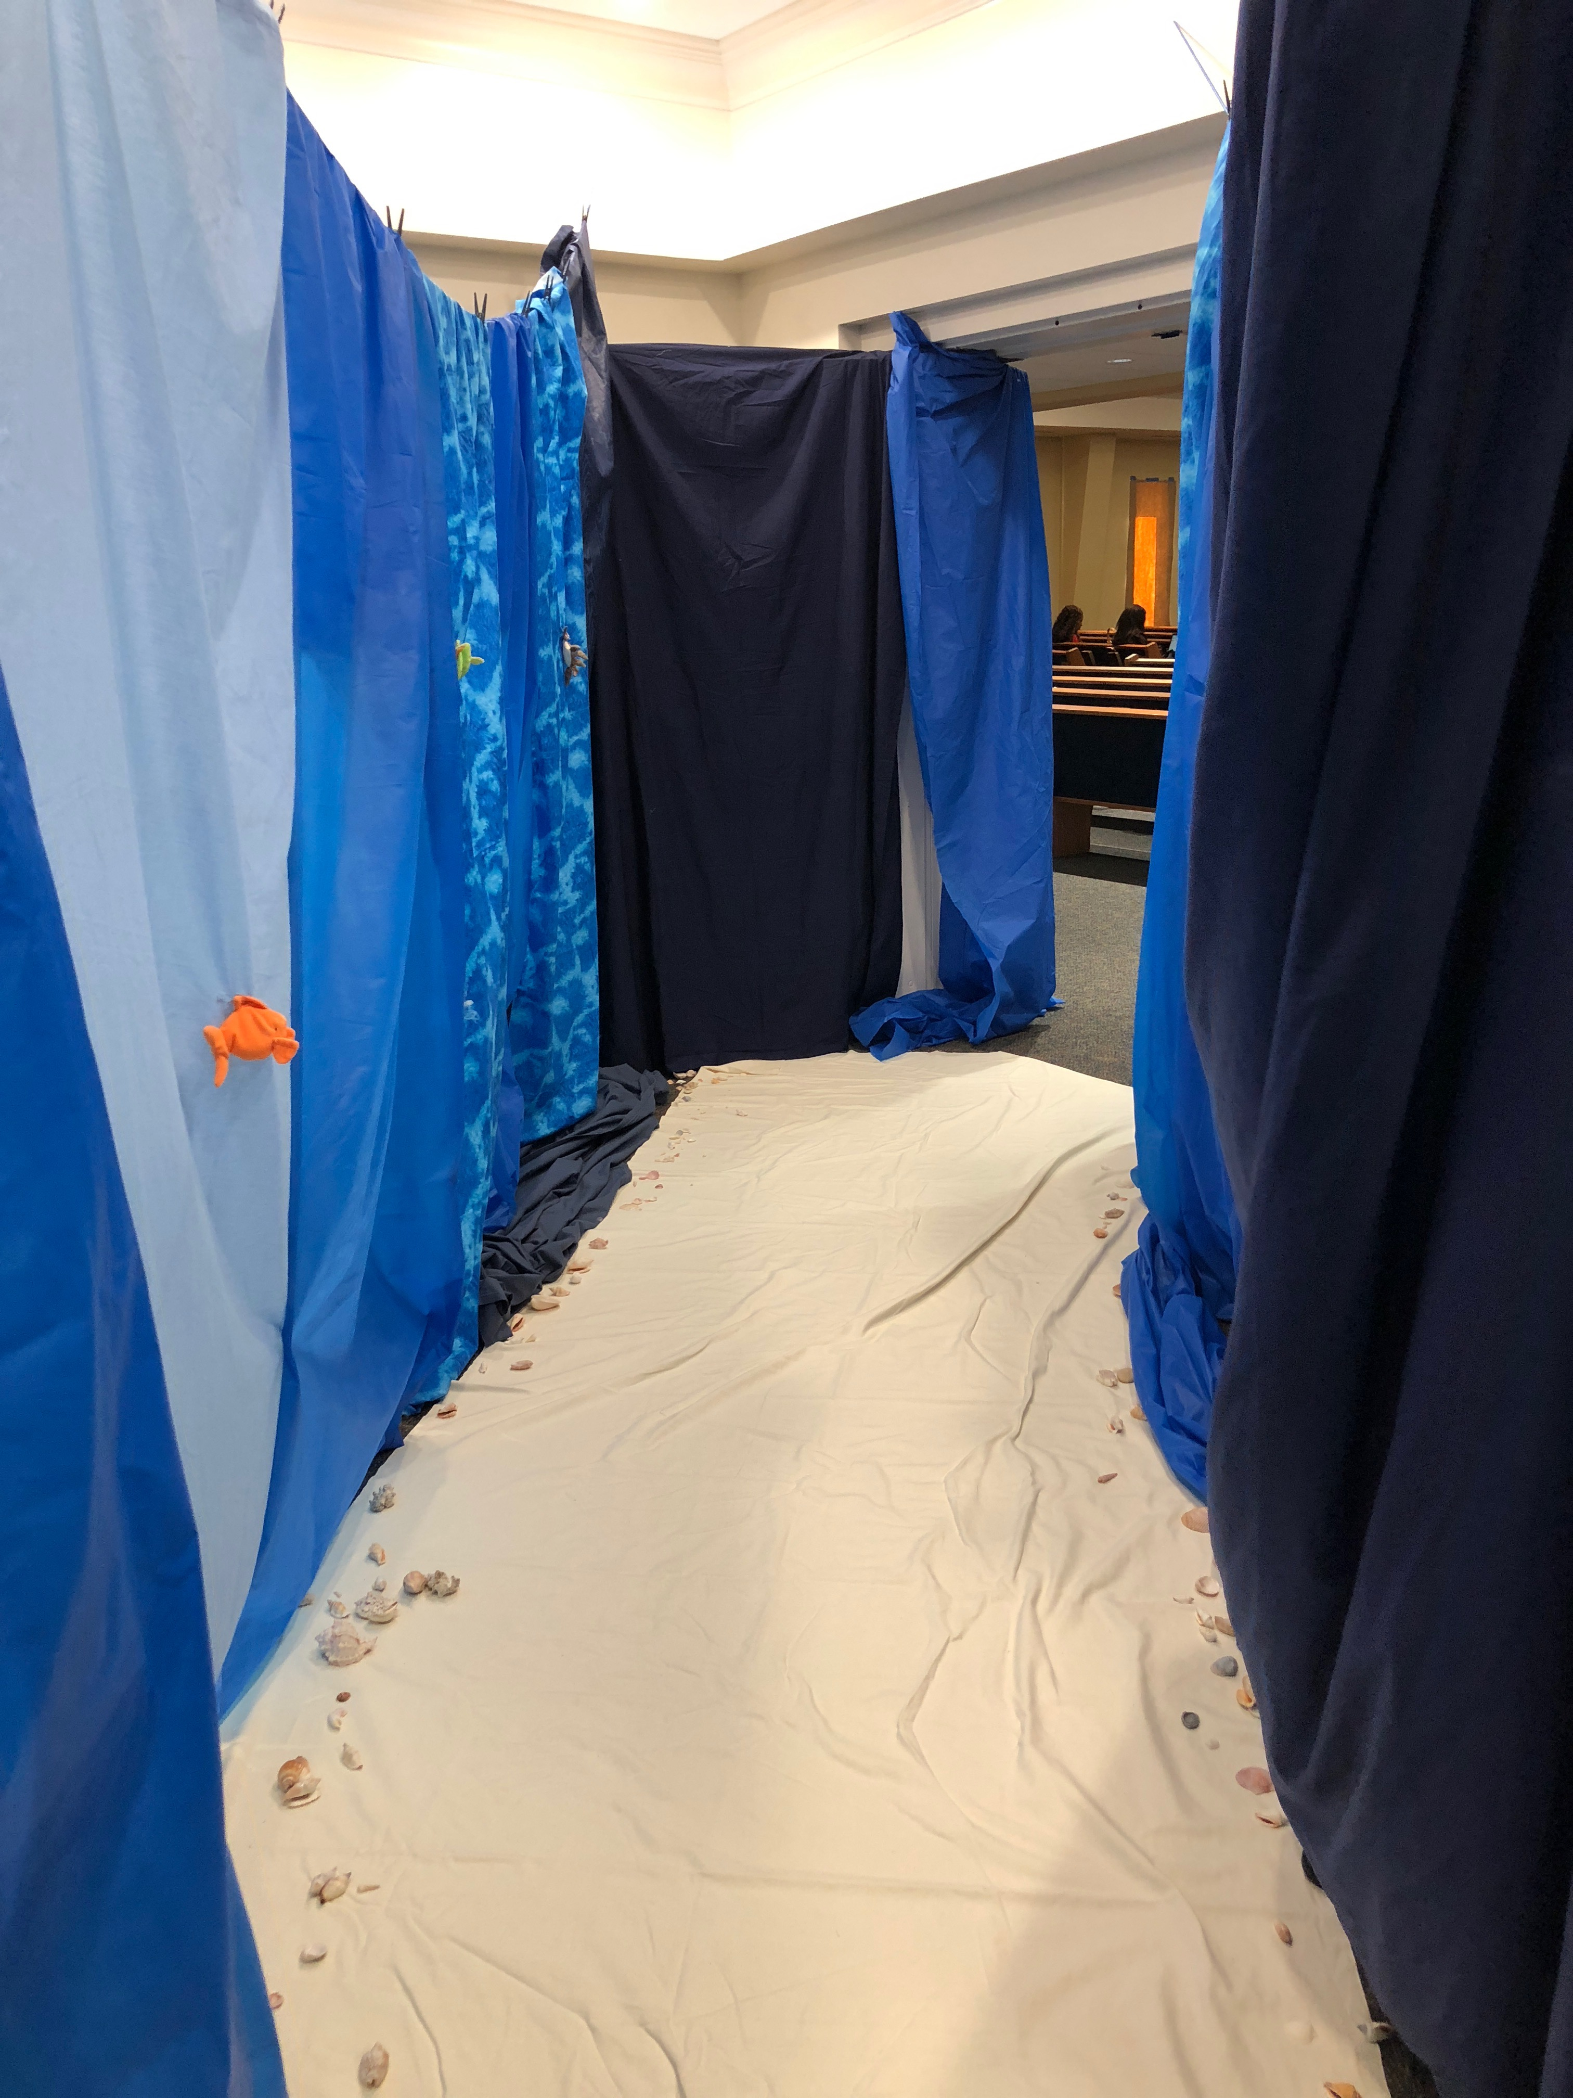
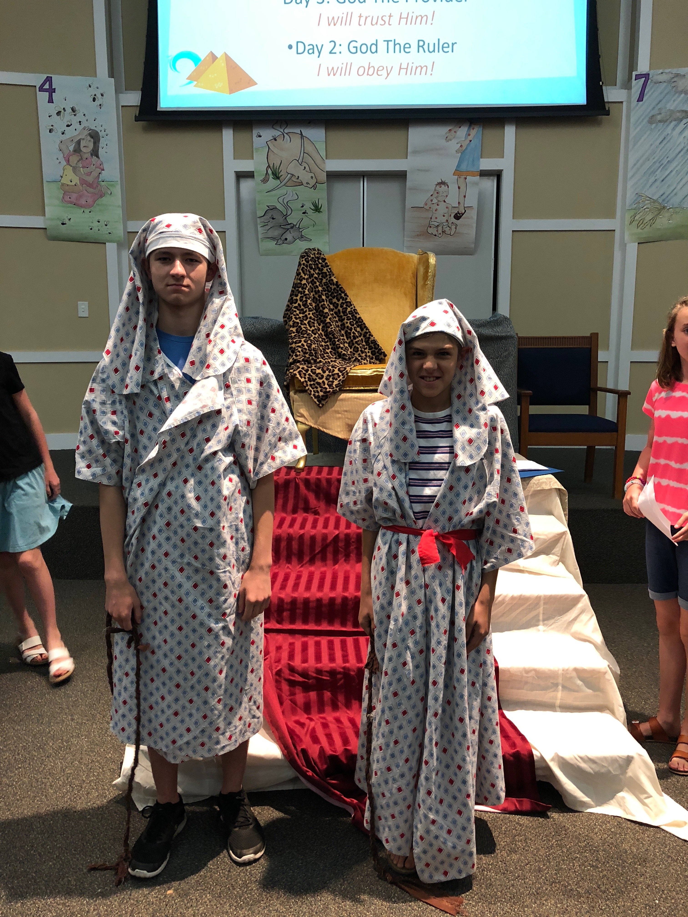

Slide 12
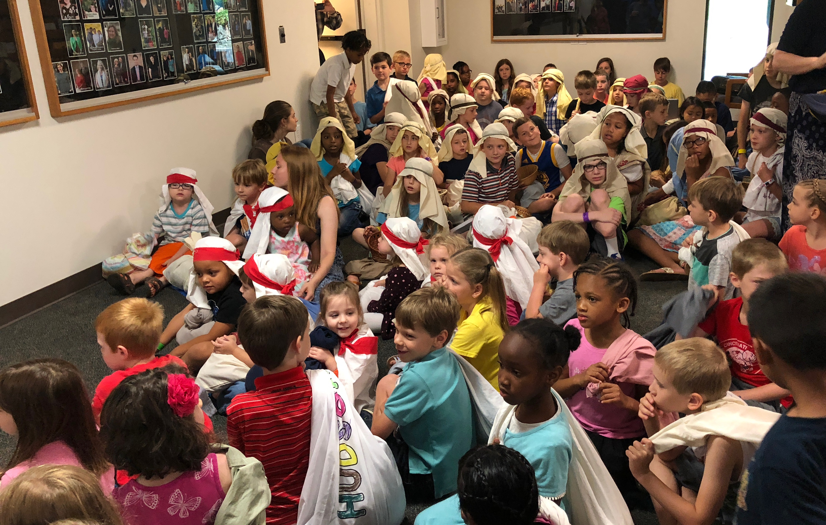

Slide 13
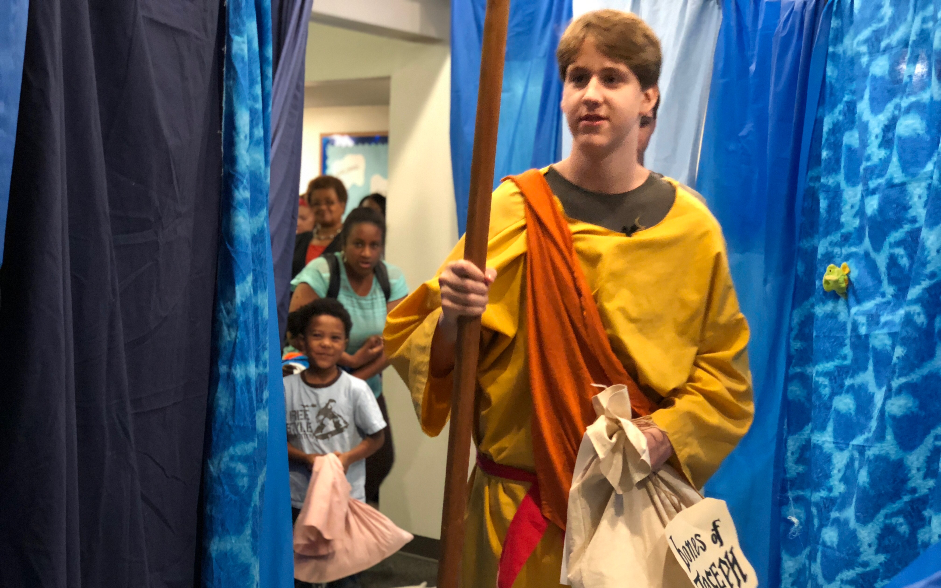

Slide 14
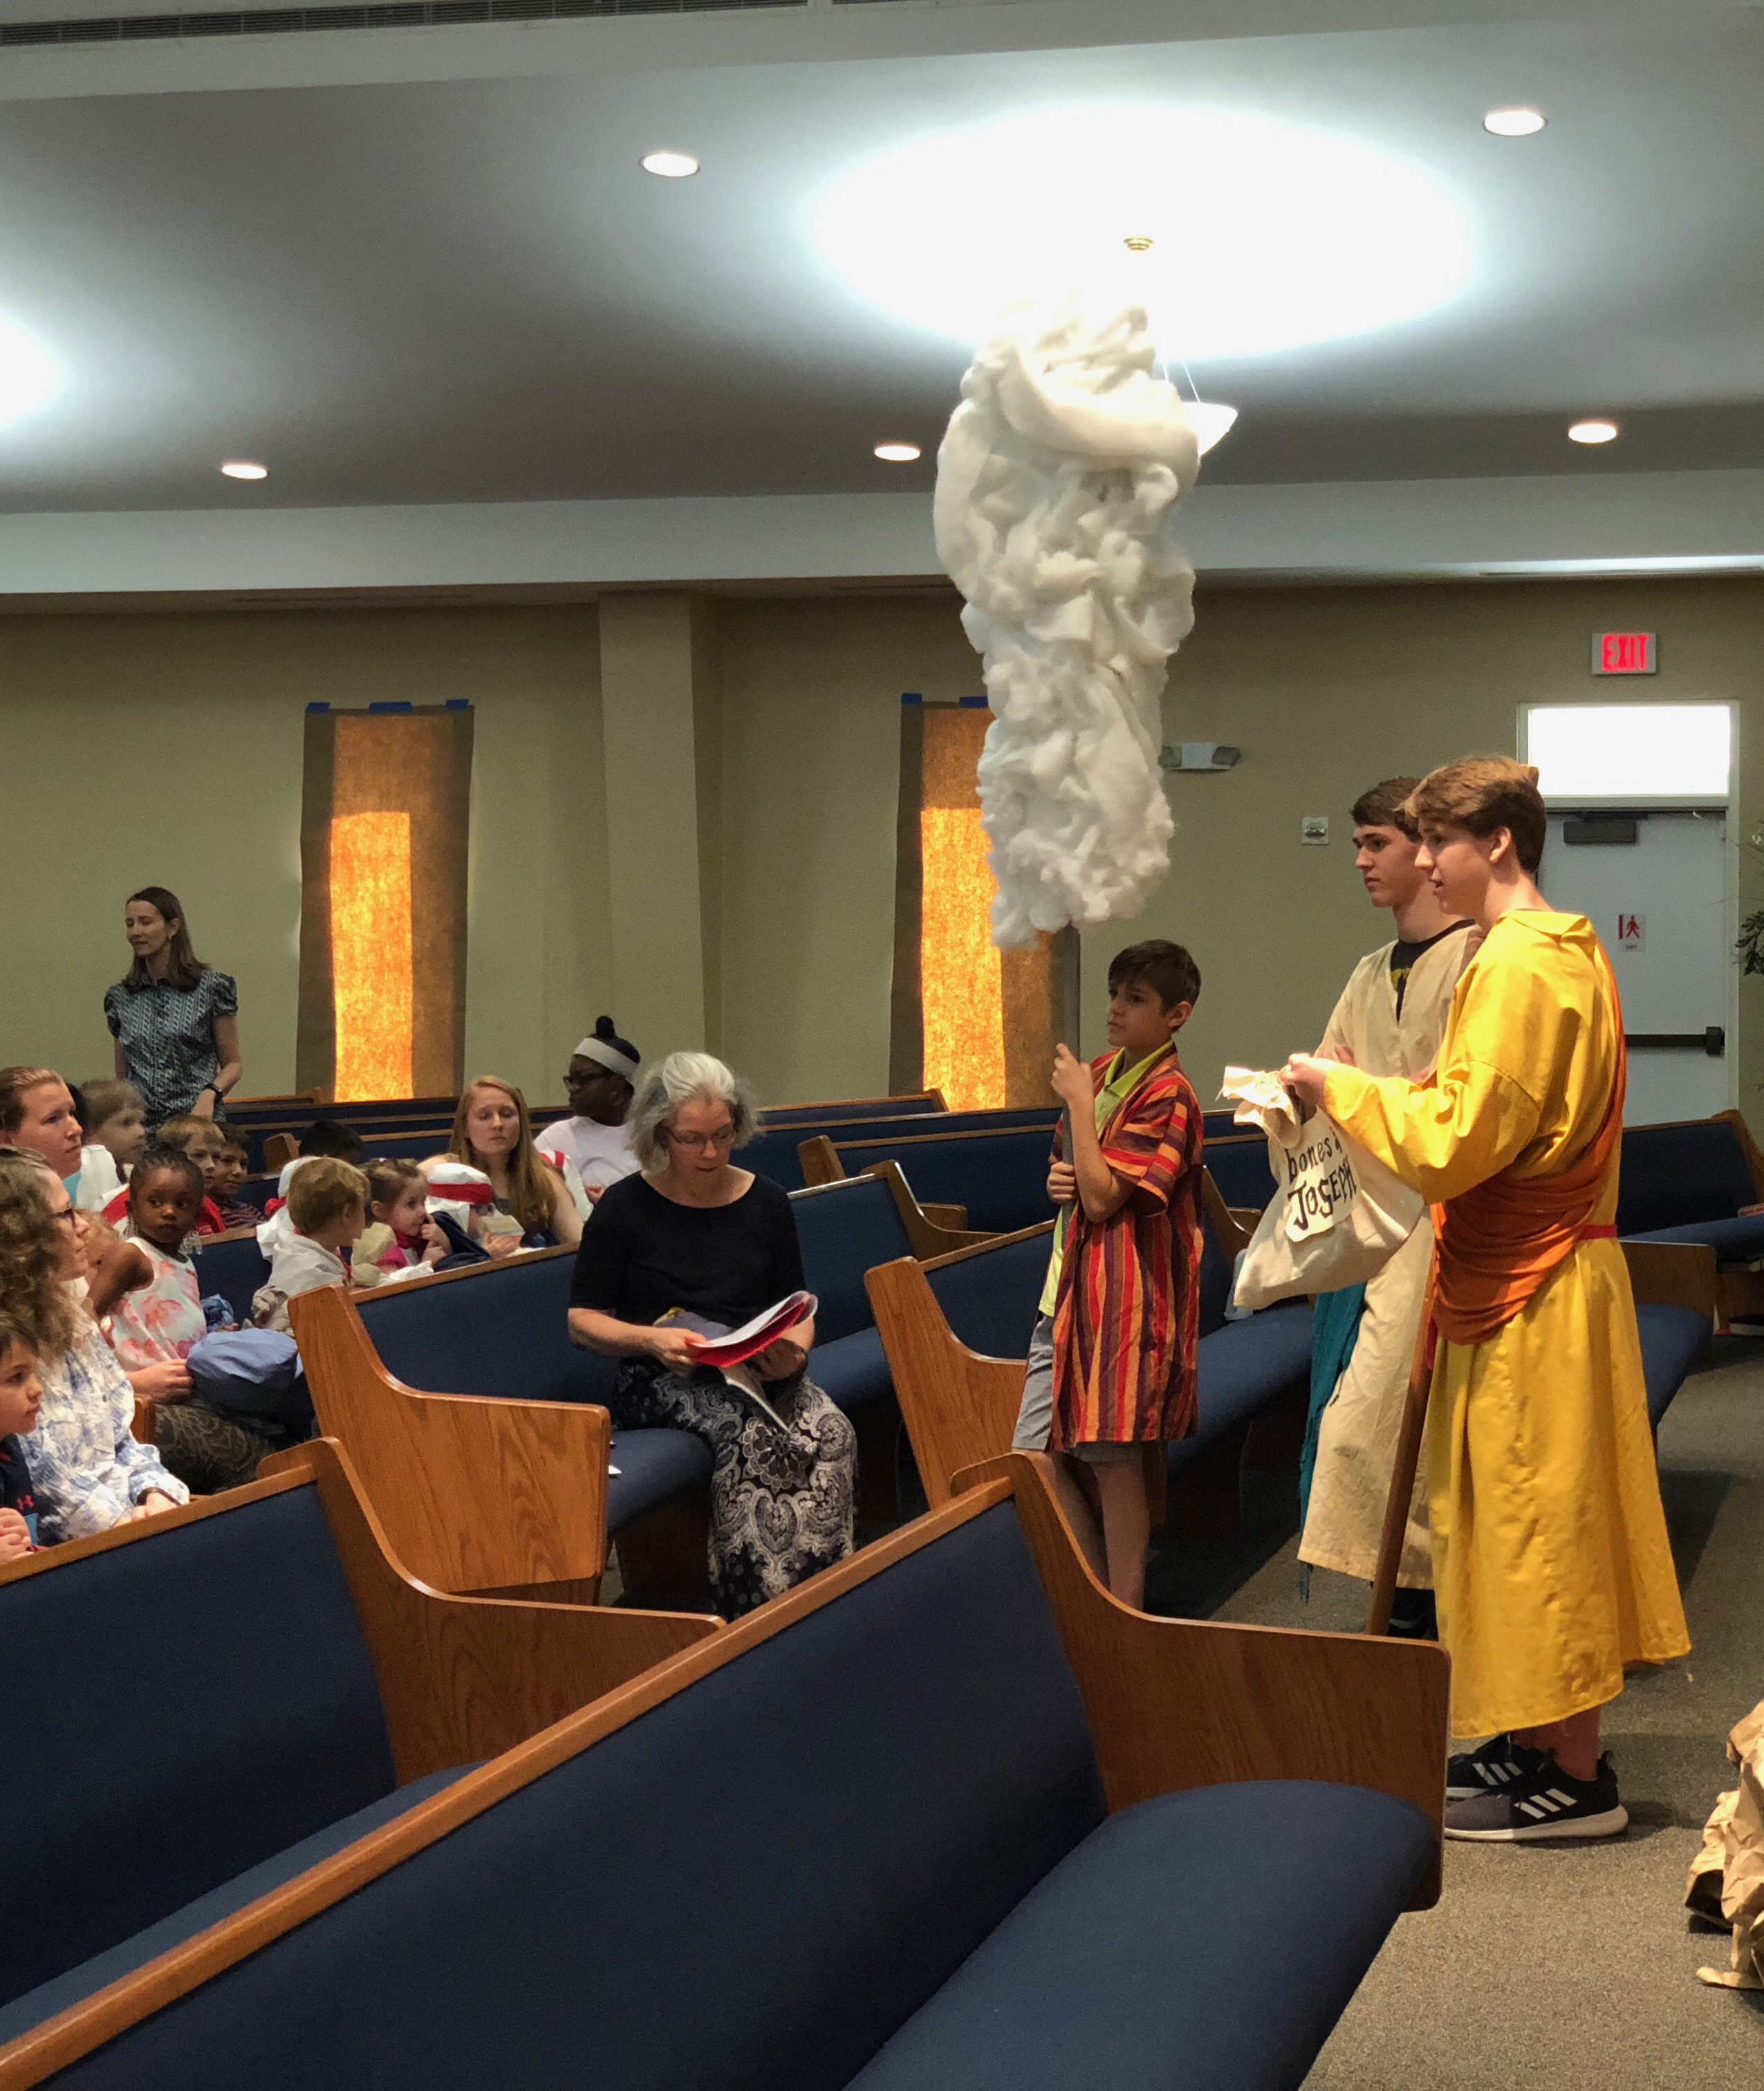
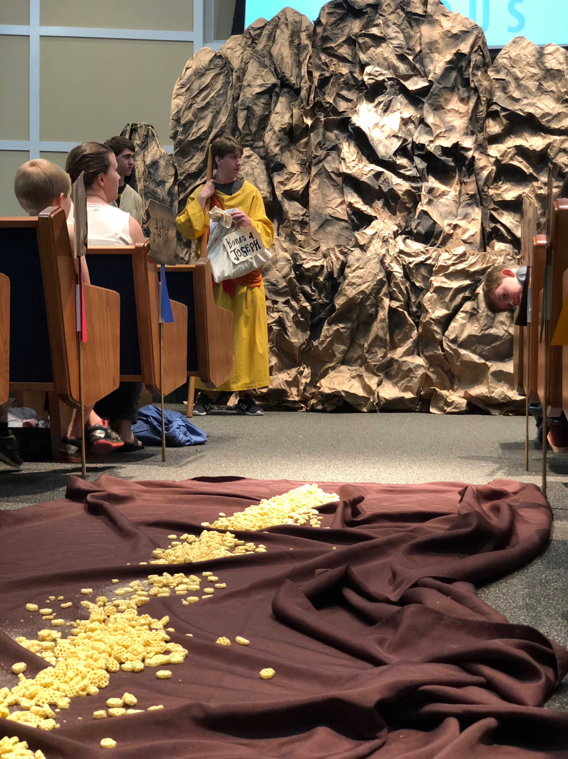

Slide 15
Exploring Exodus

Slide 16
Exodus 1:5-14
Scripture Reading

Slide 17
The Exodus Song
tune: The Gospel Is For All

Slide 18
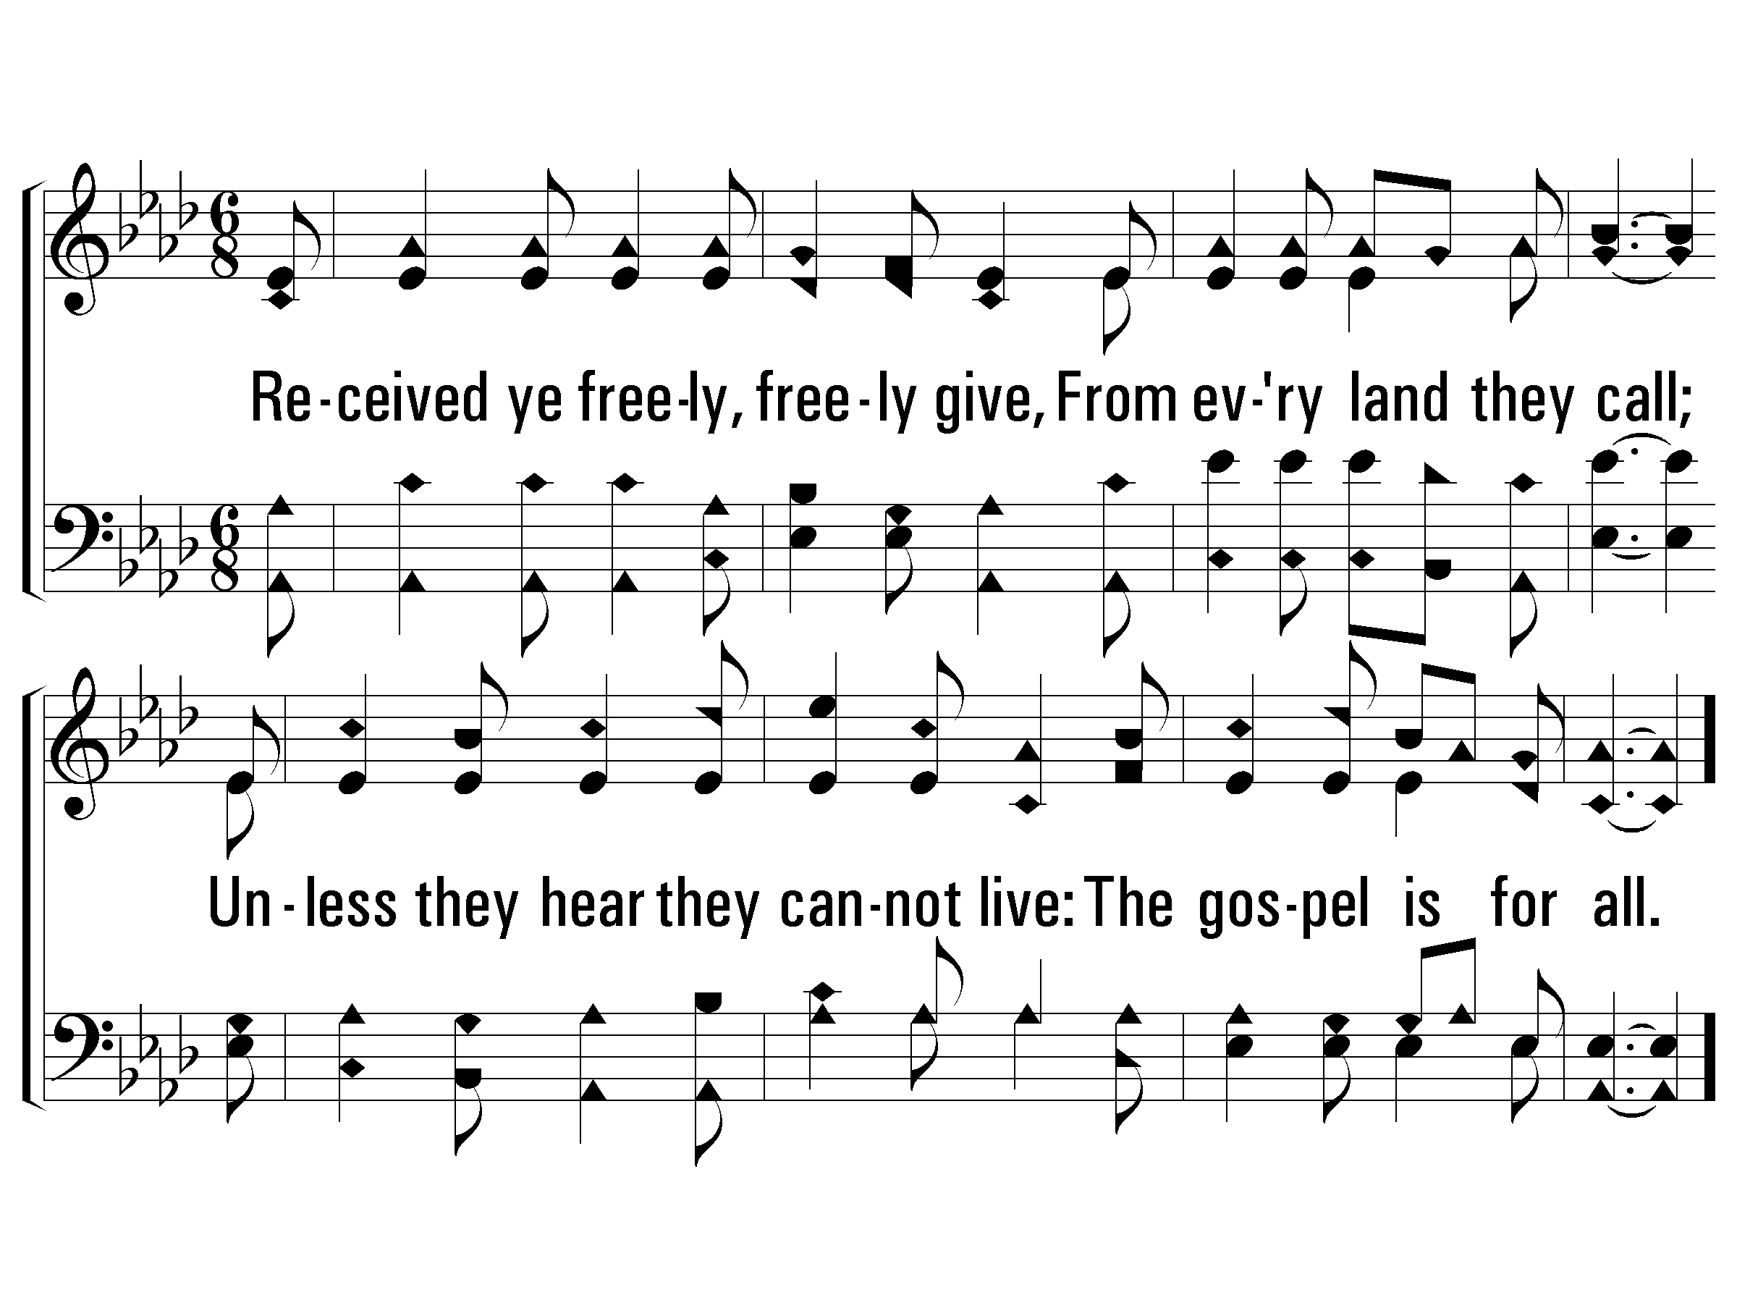
1 - The Exodus Song
When Mo - ses found the burn-ing bush, God said, “Take off your shoes.
3.
Received ye freely, freely give,
From every land they call;
Unless they hear they cannot live:
The gospel is for all.
The ground is ho - ly where I am, and I have work for you.”
Music: McIntosh’s Good News / Arr.: Rigdon M. McIntosh

Slide 19
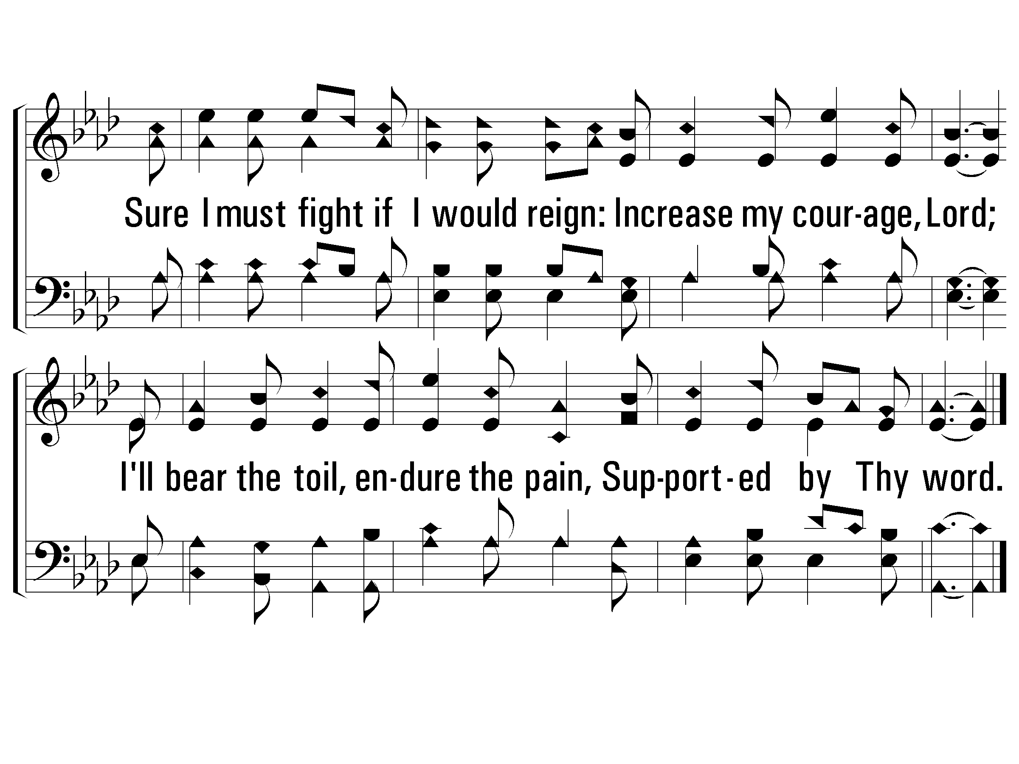
c – The Exodus Song
Je - ho - vah hears His peo-ple cry: He loves, and guides, and helps.
He res - cues them from sla - ve - ry And brings them to Him - self.

Slide 20
2 - The Exodus Song
When God killed E - gypt’s first-born, He pre-pared the Is - rael - ites:
3.
Received ye freely, freely give,
From every land they call;
Unless they hear they cannot live:
The gospel is for all.
“If I see blood on your door-post, I’ll spare that house to-night.
Music: McIntosh’s Good News / Arr.: Rigdon M. McIntosh

Slide 21
c – The Exodus Song
Je - ho - vah hears His peo-ple cry: He loves, and guides, and helps.
He res - cues them from sla - ve - ry And brings them to Him - self.

Slide 22
3 - The Exodus Song
When Is - rael had no food to eat, God said, “You will not die!
3.
Received ye freely, freely give,
From every land they call;
Unless they hear they cannot live:
The gospel is for all.
I’ll give you food and wa - ter If you trust me to pro-vide.”
Music: McIntosh’s Good News / Arr.: Rigdon M. McIntosh

Slide 23
c – The Exodus Song
Je - ho - vah hears His peo-ple cry: He loves, and guides, and helps.
He res - cues them from sla - ve - ry And brings them to Him - self.

Slide 24
4 - The Exodus Song
At Si - nai, God re - vealed Him-self in smoke and fire to say:
3.
Received ye freely, freely give,
From every land they call;
Unless they hear they cannot live:
The gospel is for all.
“O - bey My laws, and wor - ship Me, and do not dis - o - bey!”
Music: McIntosh’s Good News / Arr.: Rigdon M. McIntosh

Slide 25
c – The Exodus Song
Je - ho - vah hears His peo-ple cry: He loves, and guides, and helps.
He res - cues them from sla - ve - ry And brings them to Him - self.
END

Slide 26
We Are Called To Be God’s People
706
verses 2 & 3

Slide 27
2 - We Are Called to Be God’s People
706
2.
We are called to be God's servants,
Working in His world today;
Taking His own task upon us,
All His sacred words obey.
Let us rise, then, to His summons,
Dedicate to Him our all,
That we may be faithful servants,
Quick to answer now His call.
Words: Thomas A. Jackson / Music: Franz J. Haydn
Words Copyright © 1973, Ren. 2001 by Broadman Press (SESAC) (adm. by LifeWay Worship)
All rights reserved. Used by permission.
© 2010 The Paperless Hymnal®

Slide 28
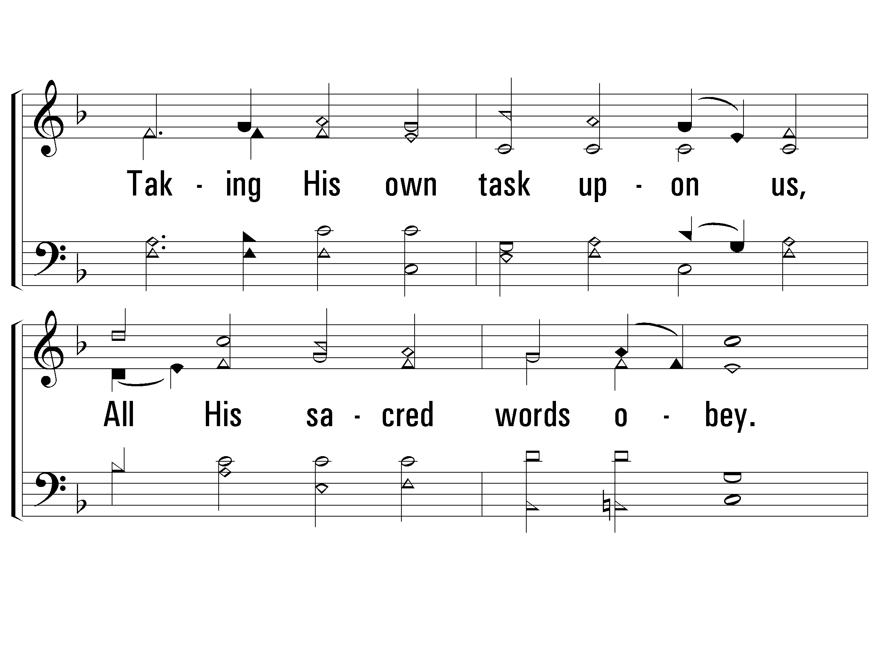
2 - We Are Called to Be God’s People
706
© 2010 The Paperless Hymnal®

Slide 29
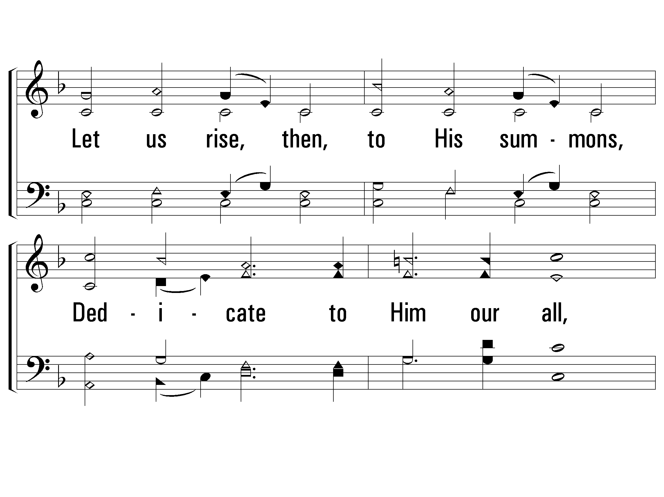
2 - We Are Called to Be God’s People
706
© 2010 The Paperless Hymnal®

Slide 30
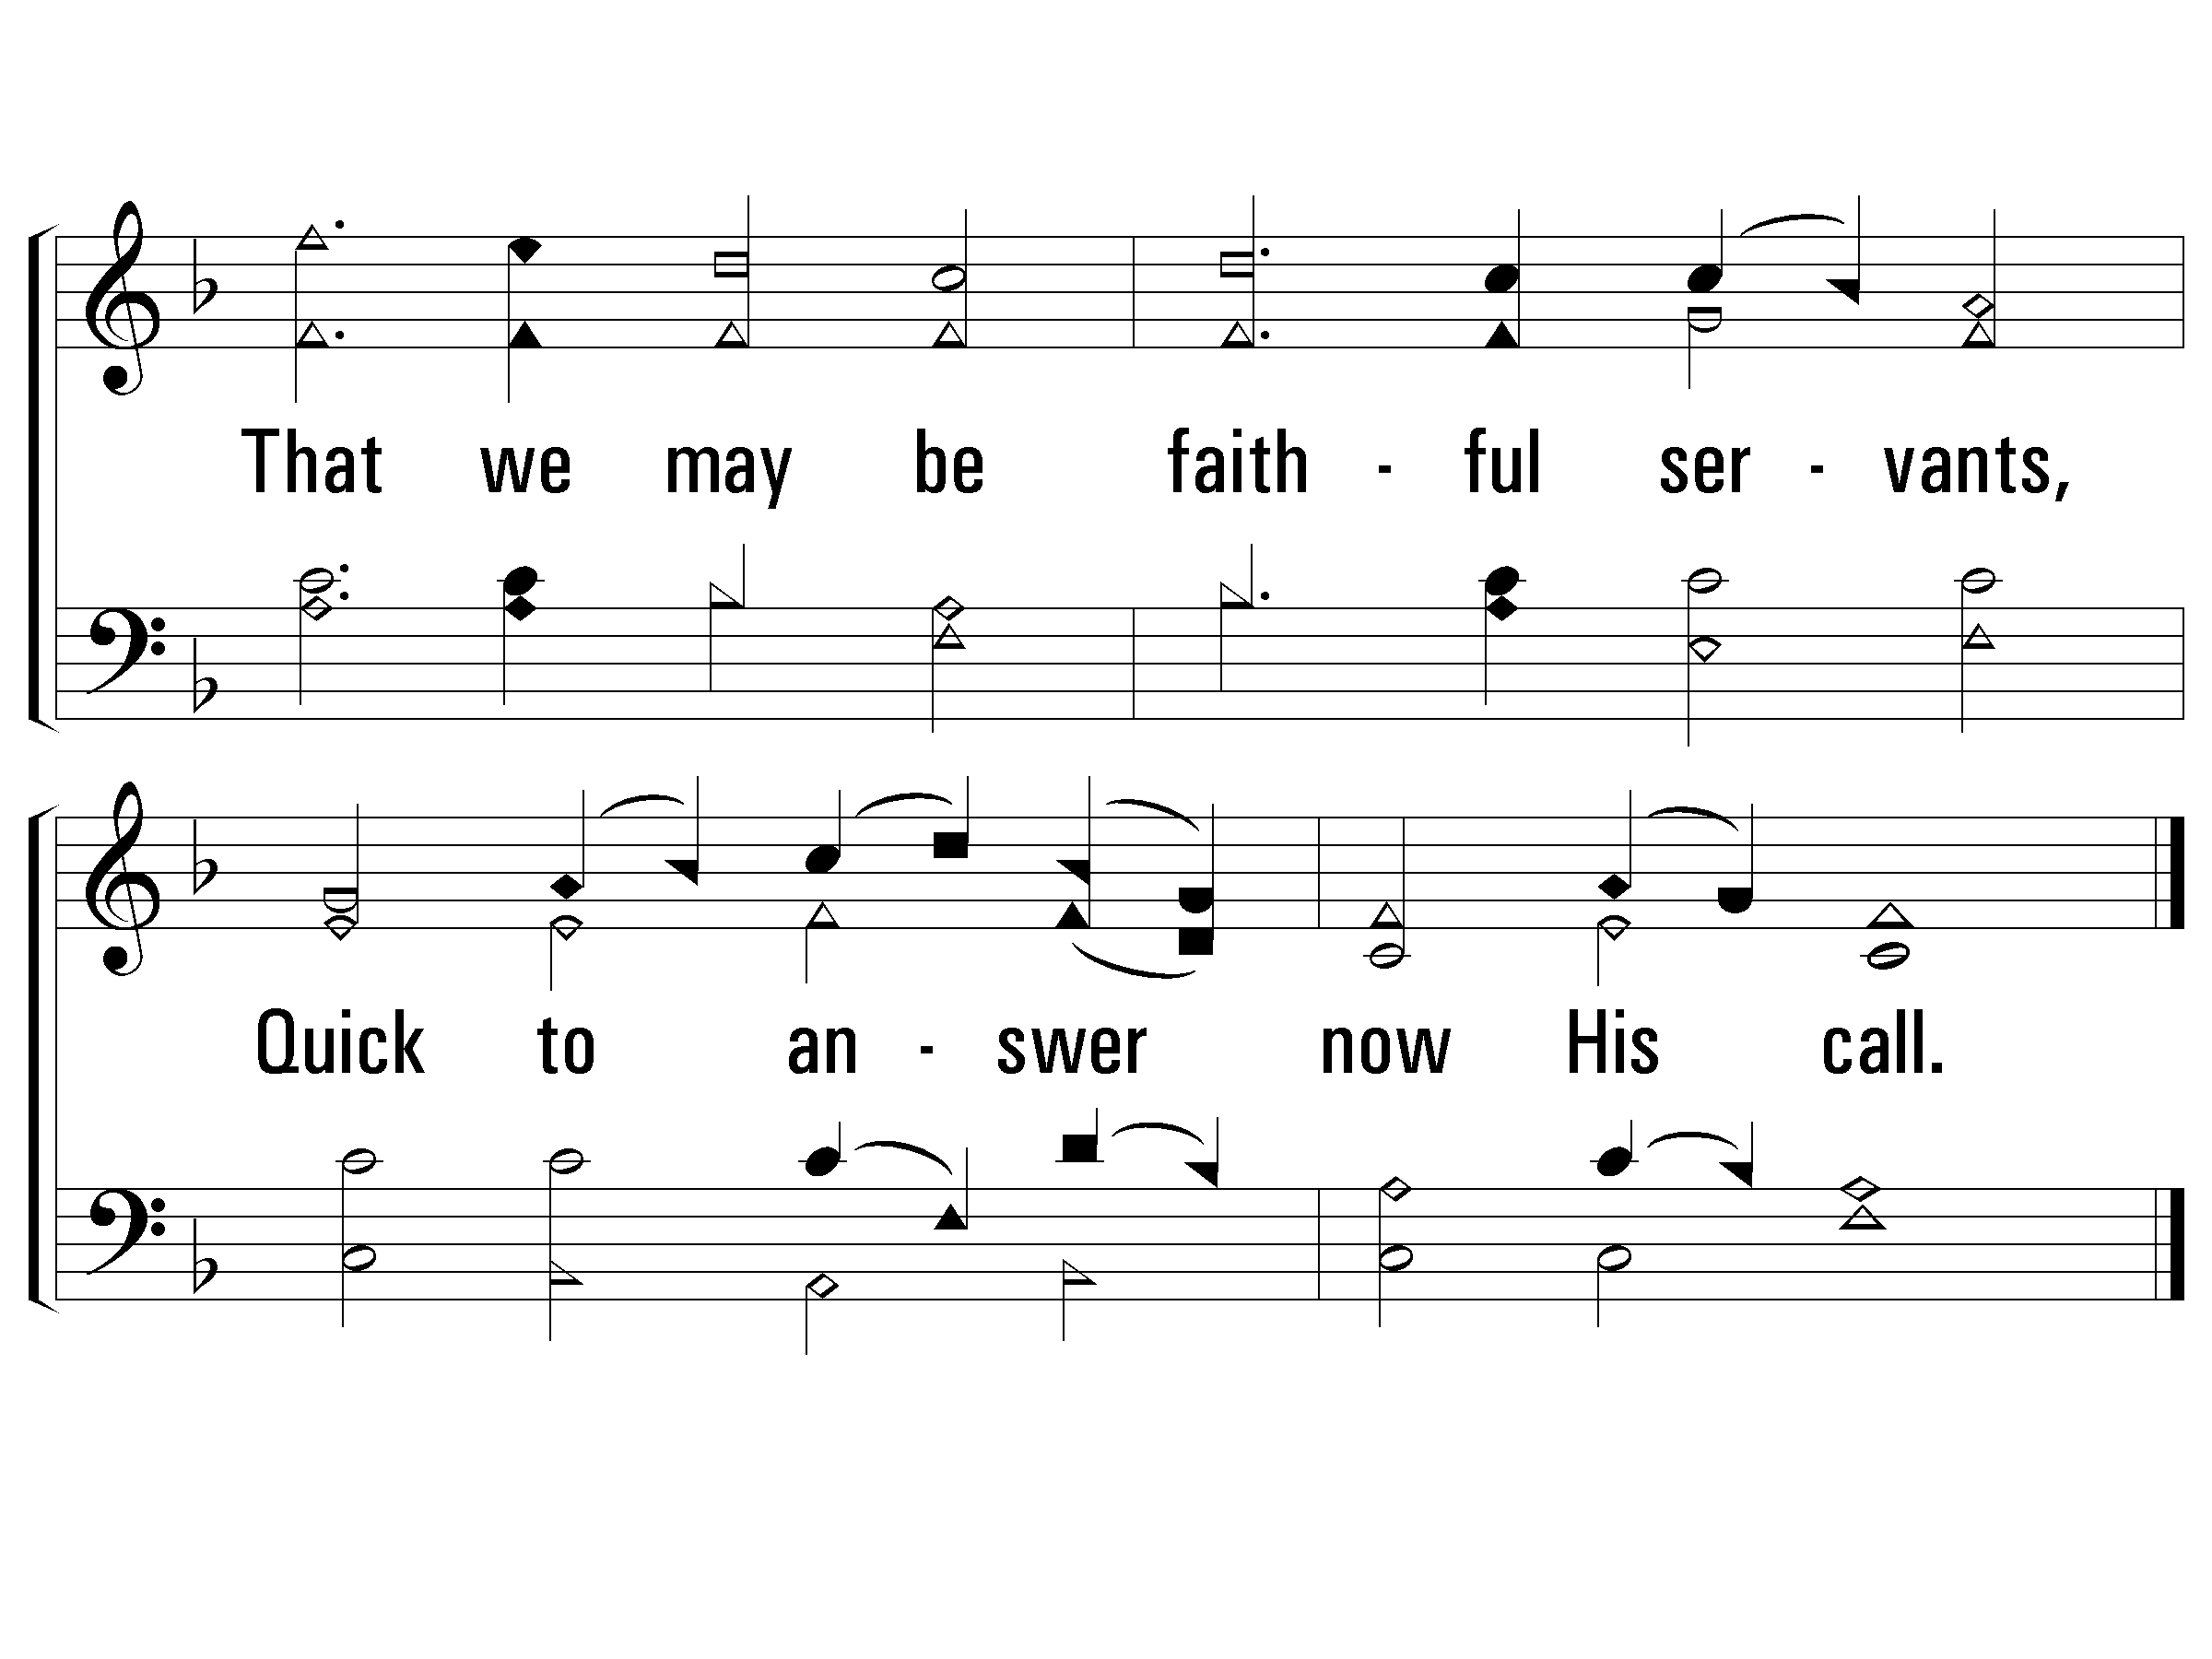
2 - We Are Called to Be God’s People
706
© 2010 The Paperless Hymnal®

Slide 31
3 - We Are Called to Be God’s People
706
3.
We are called to be God's prophets,
Spokesmen for the truth and right;
Standing firm for godly justice,
Bringing evil into light.
Let us seek the courage needed,
Our high calling to fulfill,
That mankind may know the blessing
Of the doing of God's will.
Words: Thomas A. Jackson / Music: Franz J. Haydn
Words Copyright © 1973, Ren. 2001 by Broadman Press (SESAC) (adm. by LifeWay Worship)
All rights reserved. Used by permission.
© 2010 The Paperless Hymnal®

Slide 32
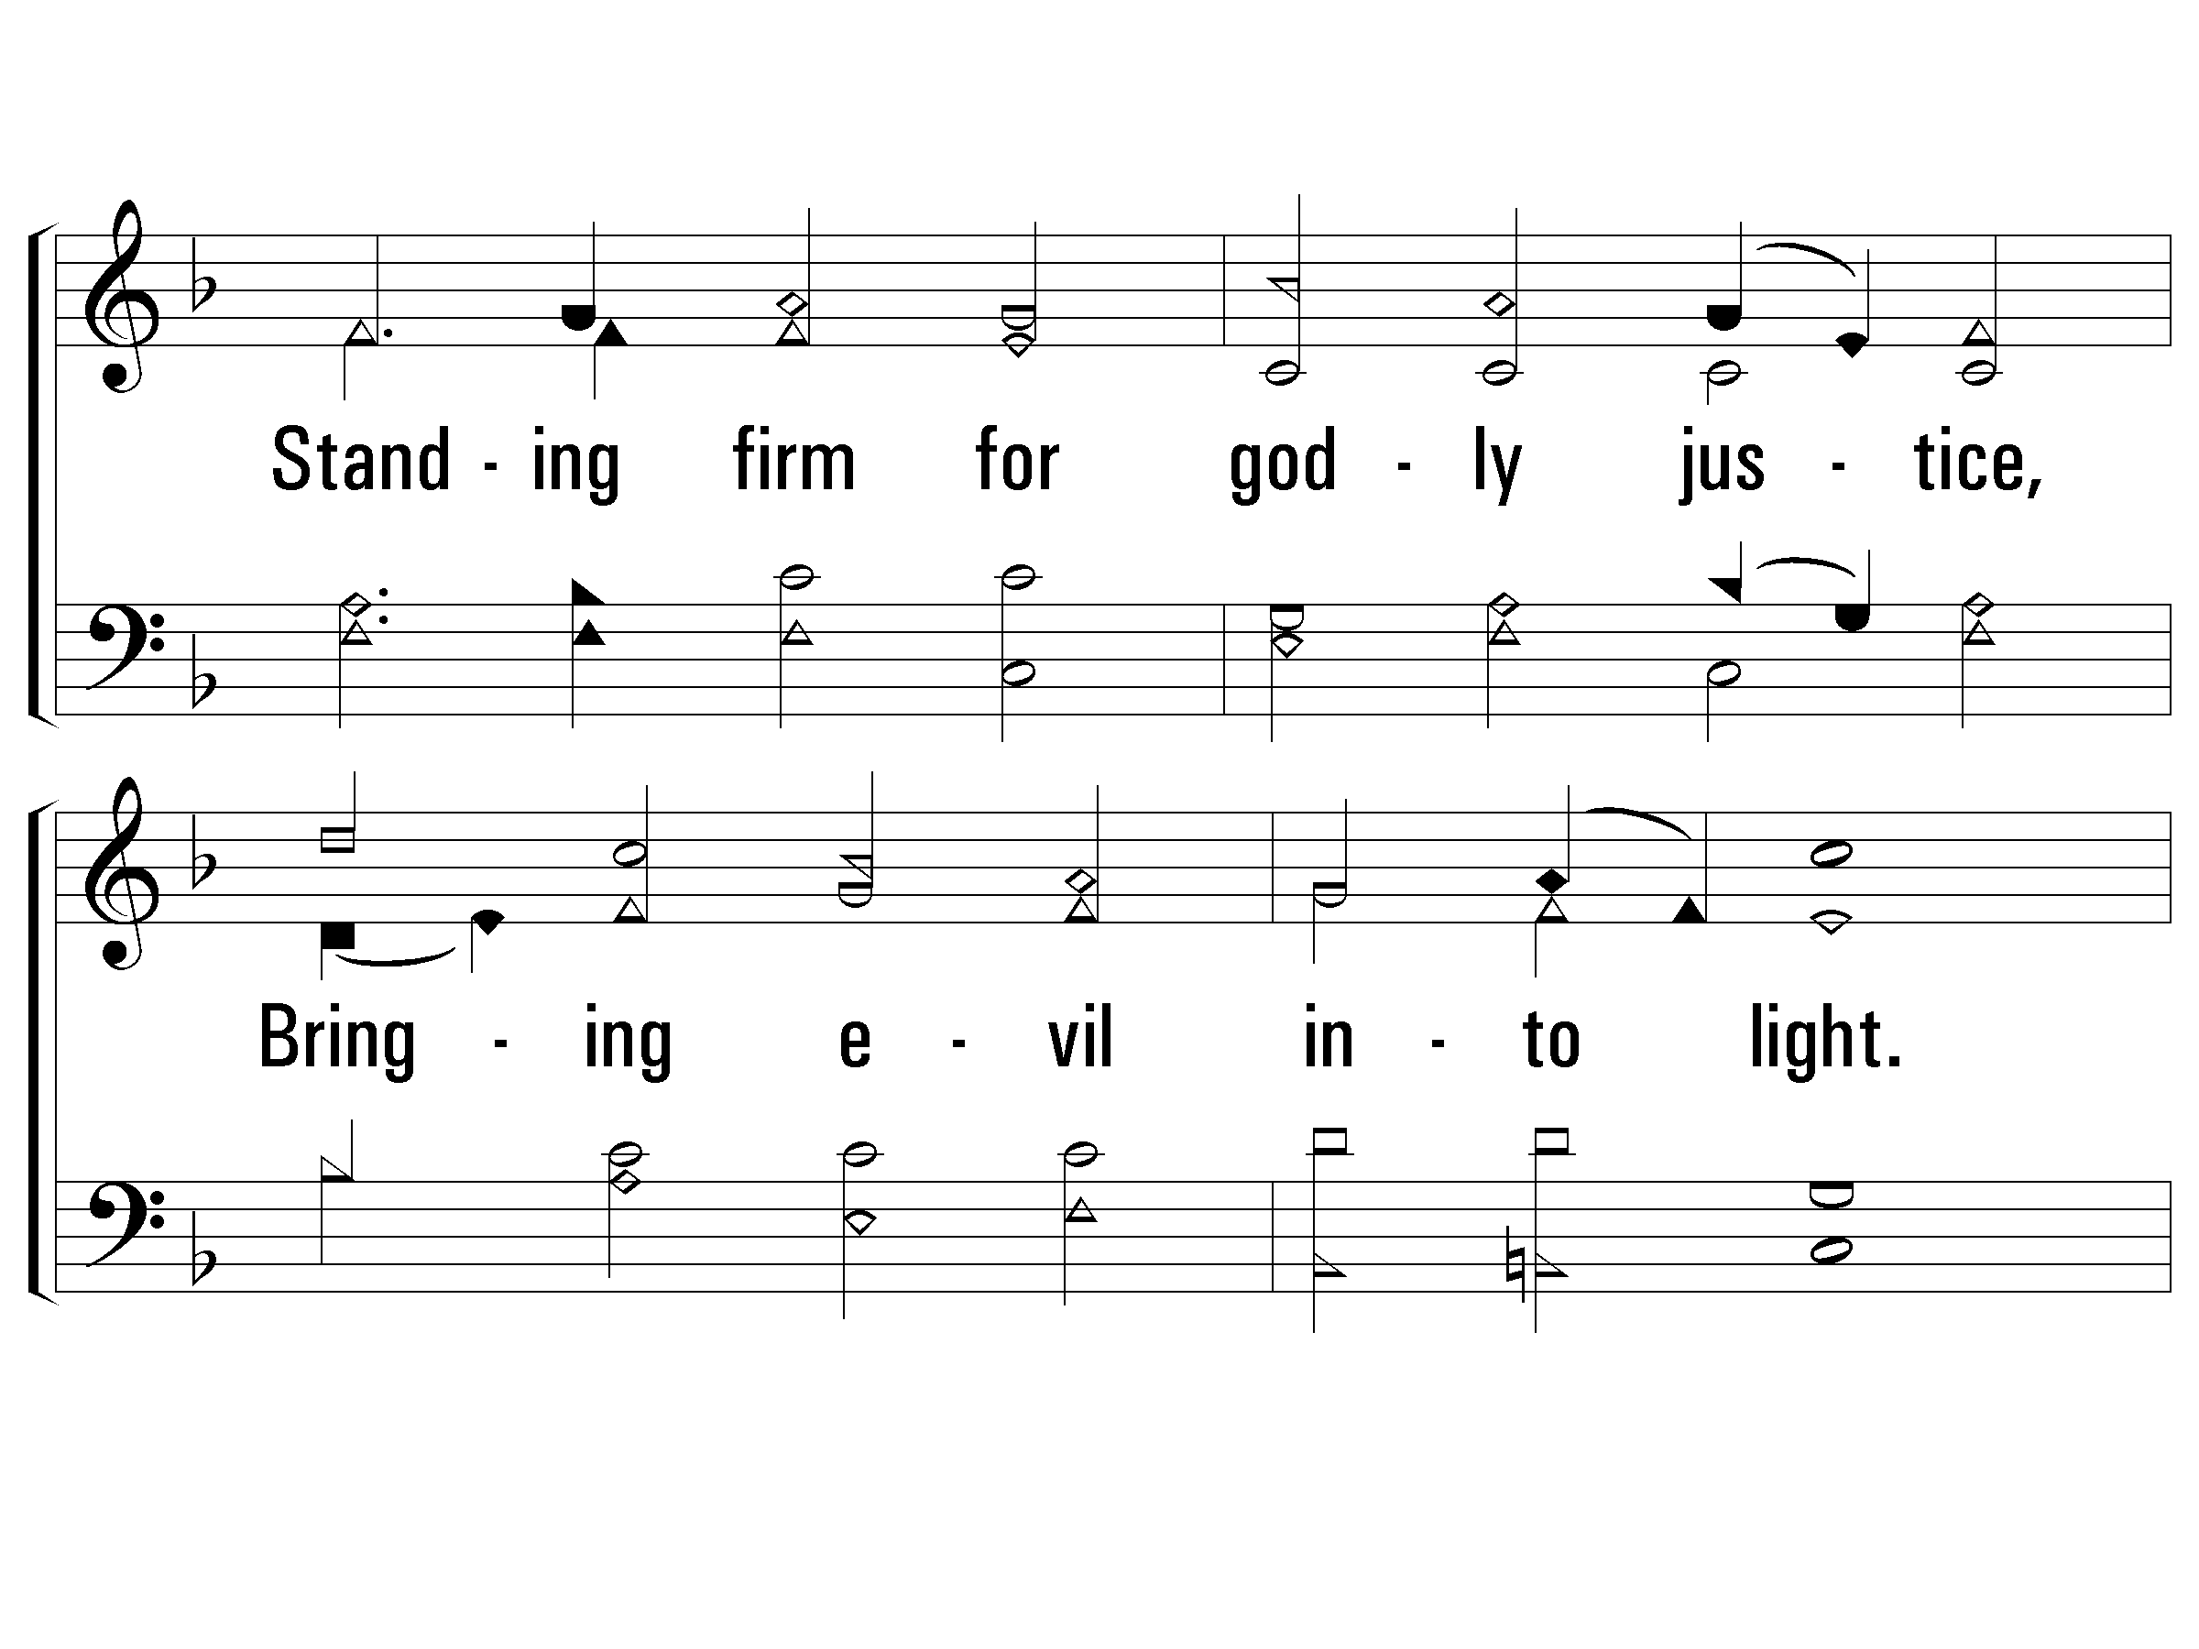
3 - We Are Called to Be God’s People
706
© 2010 The Paperless Hymnal®

Slide 33
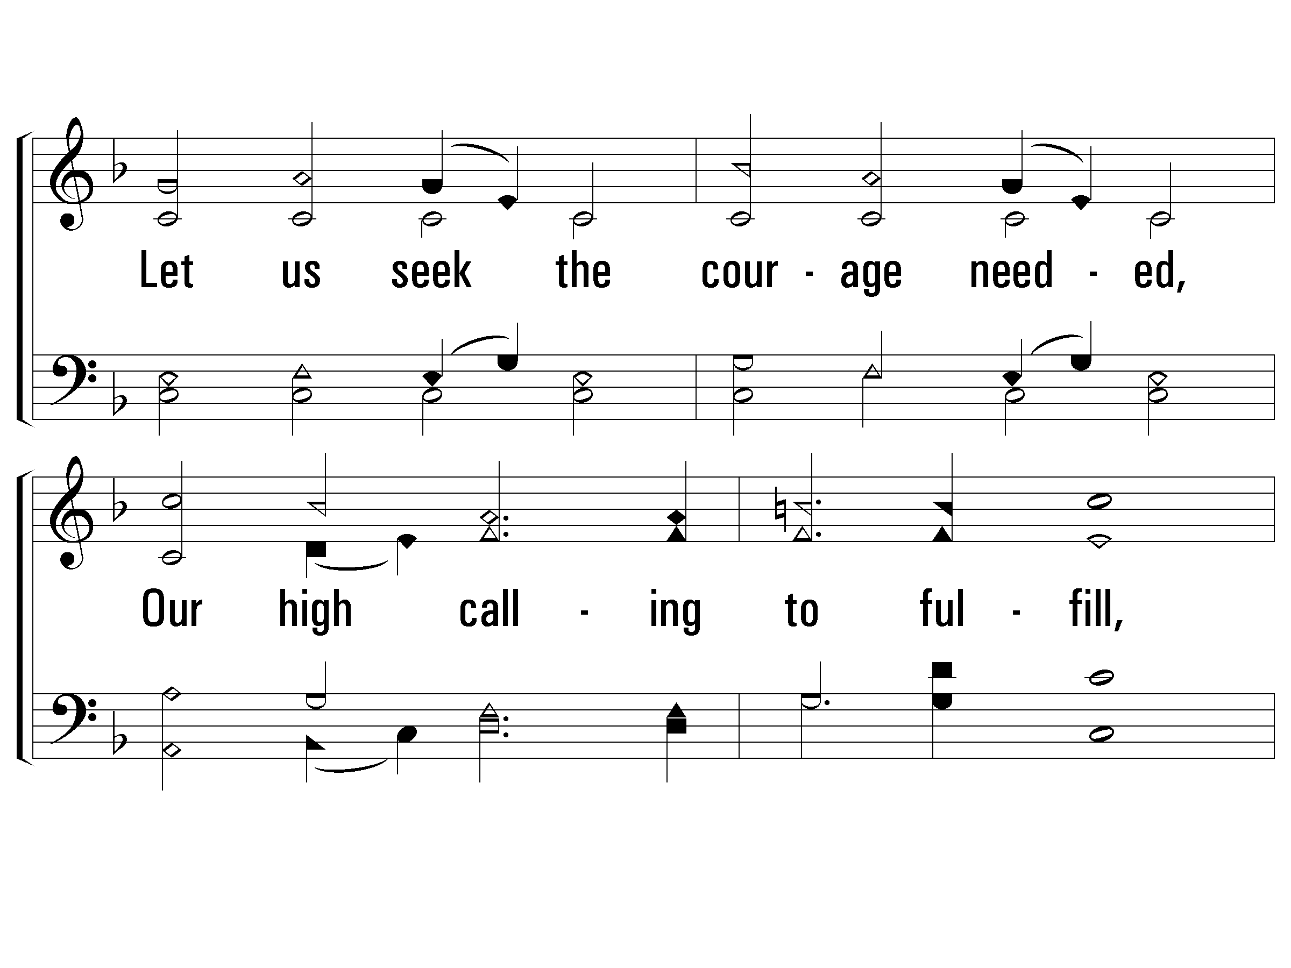
3 - We Are Called to Be God’s People
706
© 2010 The Paperless Hymnal®

Slide 34
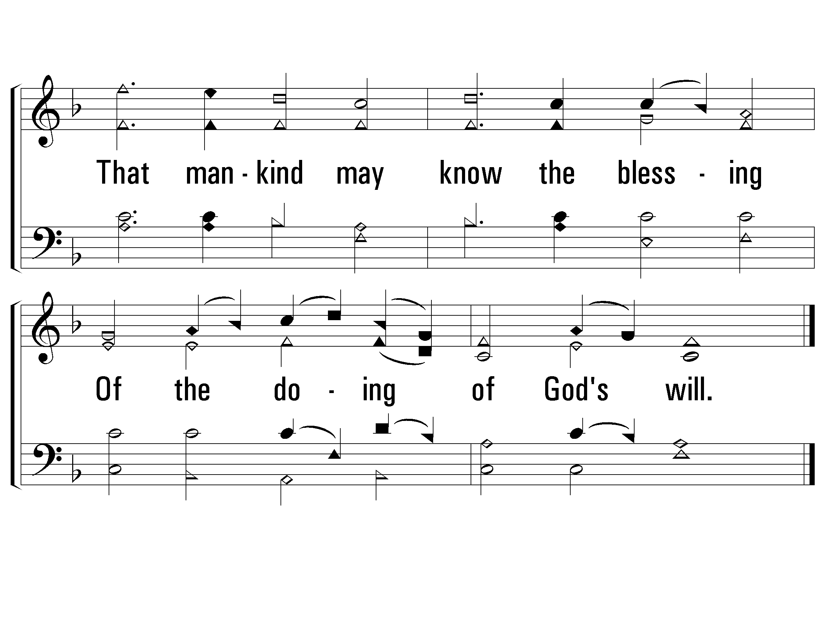
3 - We Are Called to Be God’s People
706
END
© 2010 The Paperless Hymnal®

Slide 35
He Is Able to Deliver Thee
208
verses 1 & 3, then chorus

Slide 36
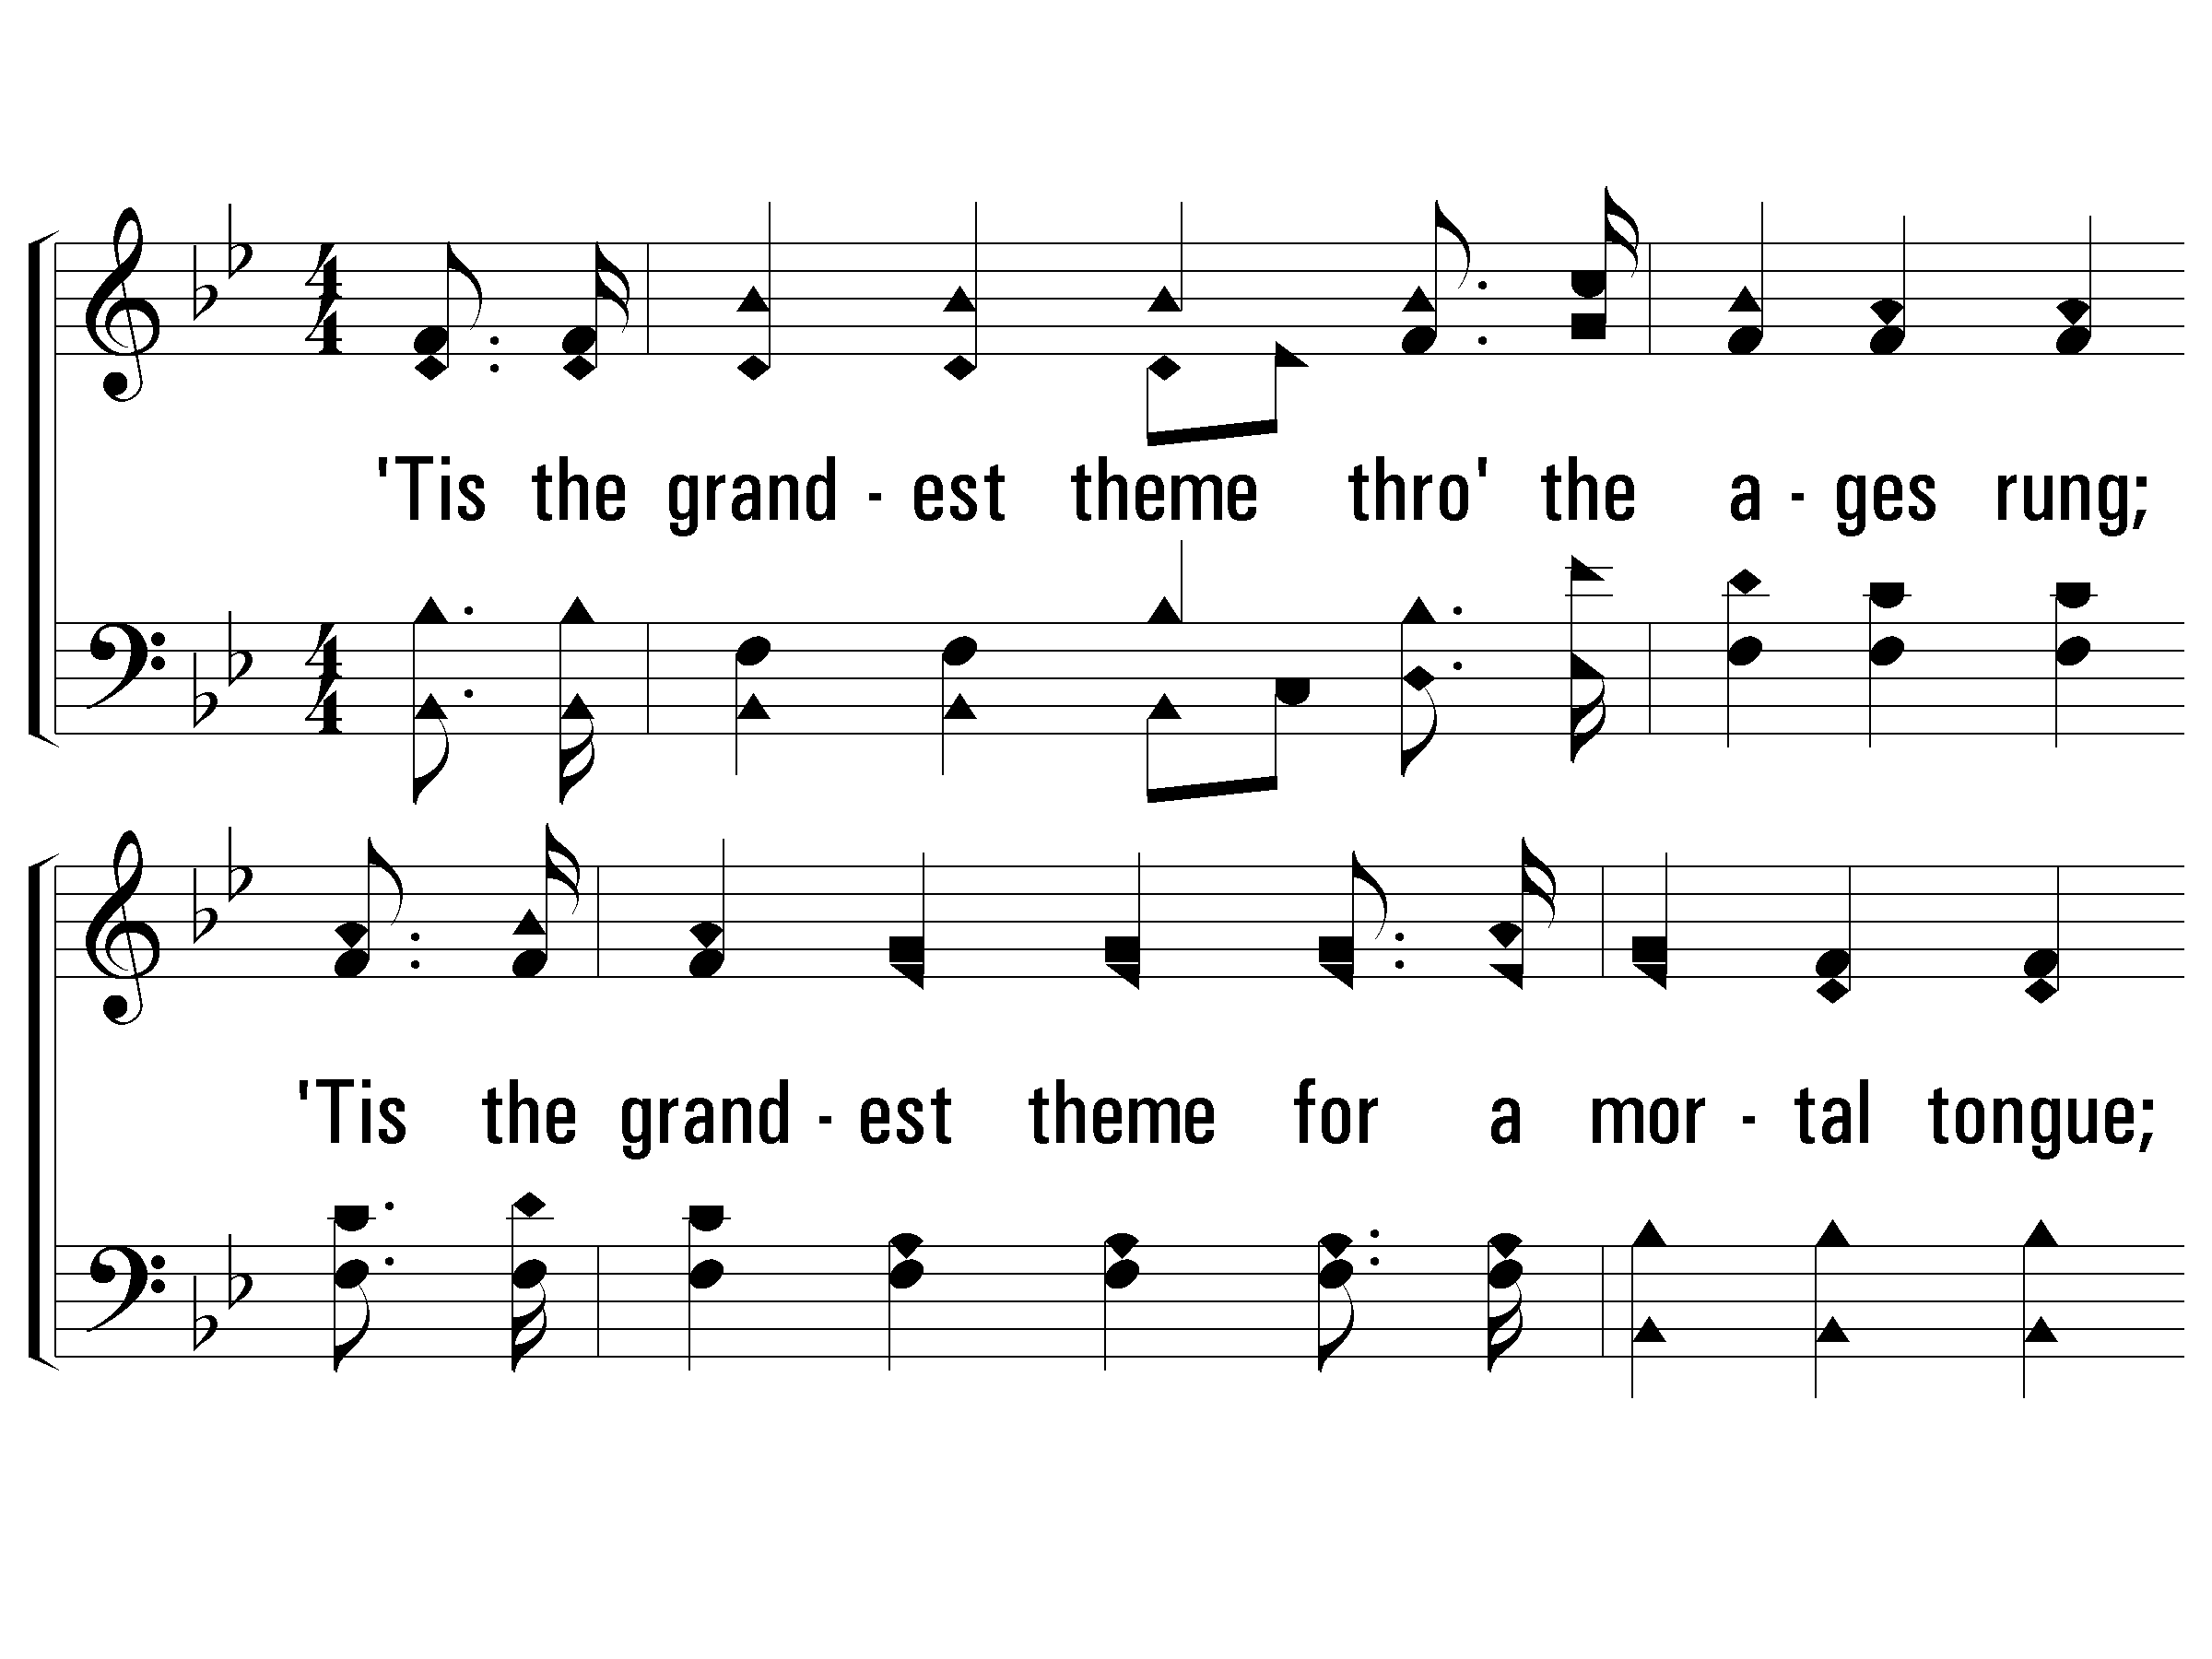
1 - He Is Able to Deliver Thee
208
1.
'Tis the grandest theme through the ages rung;
'Tis the grandest theme for a mortal tongue;
'Tis the grandest theme that the world ever sung,
"Our God is able to deliver thee."
Words & Music: William A. Ogden
© 2007 The Paperless Hymnal®

Slide 37
1 - He Is Able to Deliver Thee
208
to v.3
© 2007 The Paperless Hymnal®

Slide 38
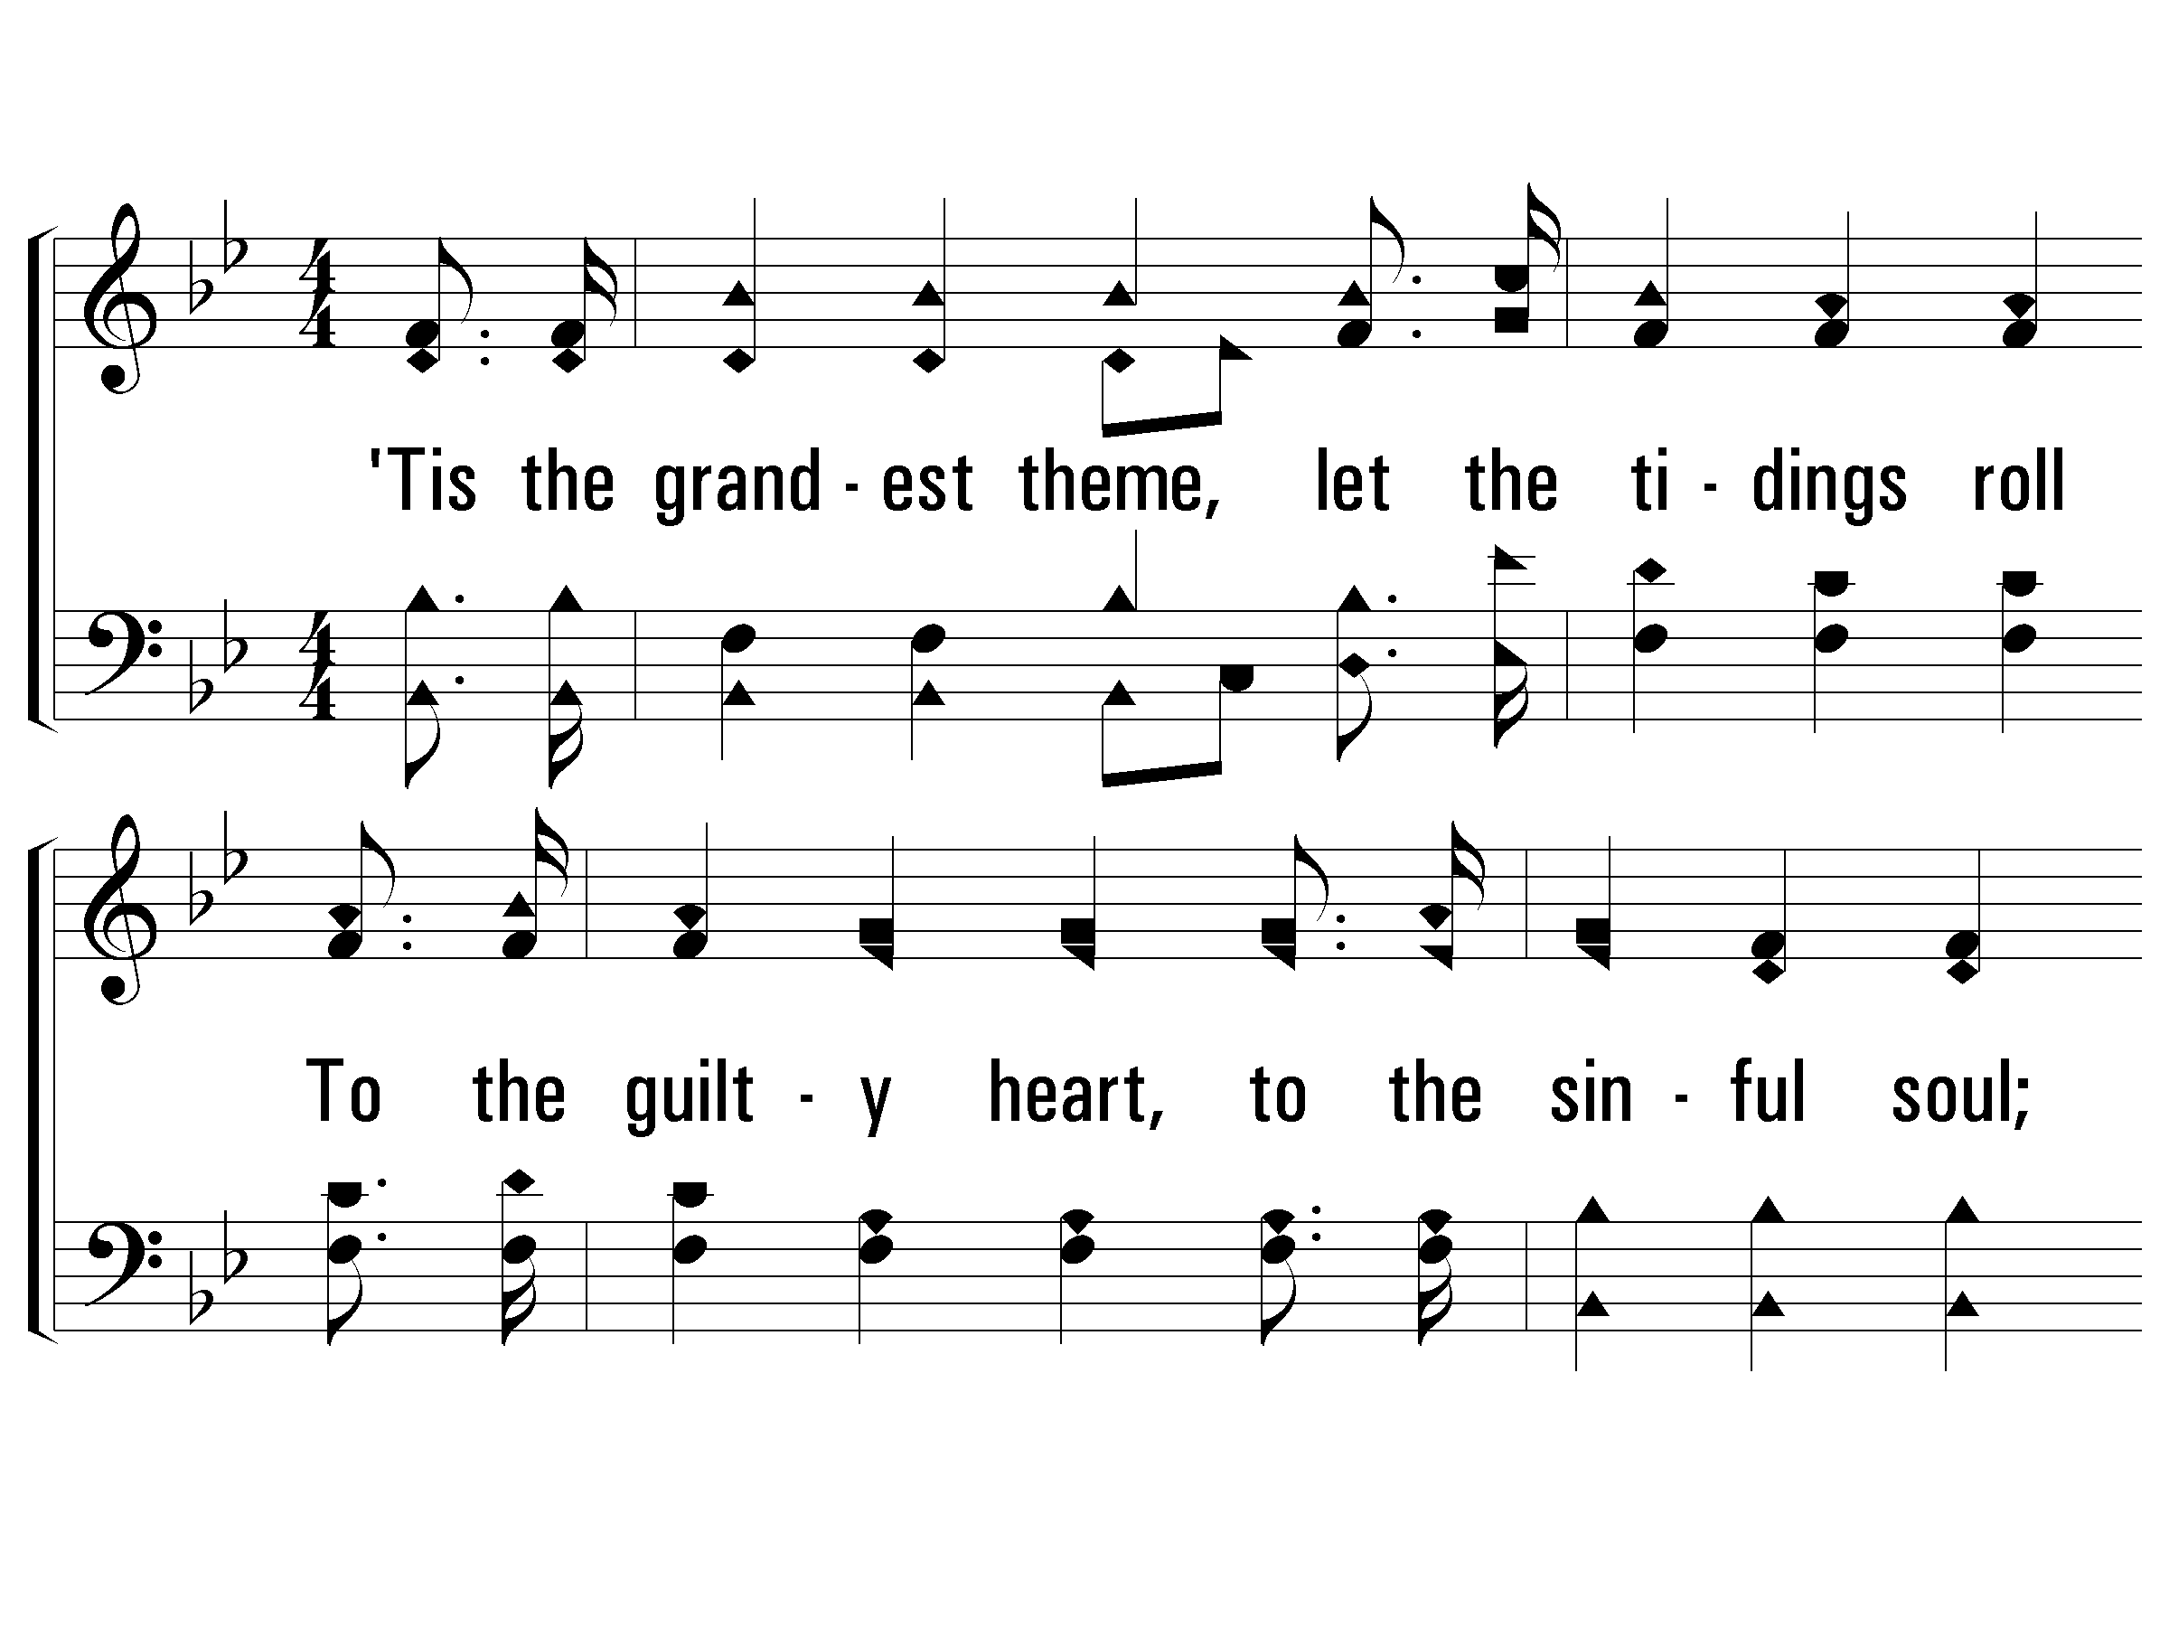
3 - He Is Able to Deliver Thee
208
3.
'Tis the grandest theme, let the tidings roll
To the guilty heart, to the sinful soul;
Look to God in faith, He will make thee whole;
"Our God is able to deliver thee."
Words & Music: William A. Ogden
© 2007 The Paperless Hymnal®

Slide 39
3 - He Is Able to Deliver Thee
208
© 2007 The Paperless Hymnal®

Slide 40
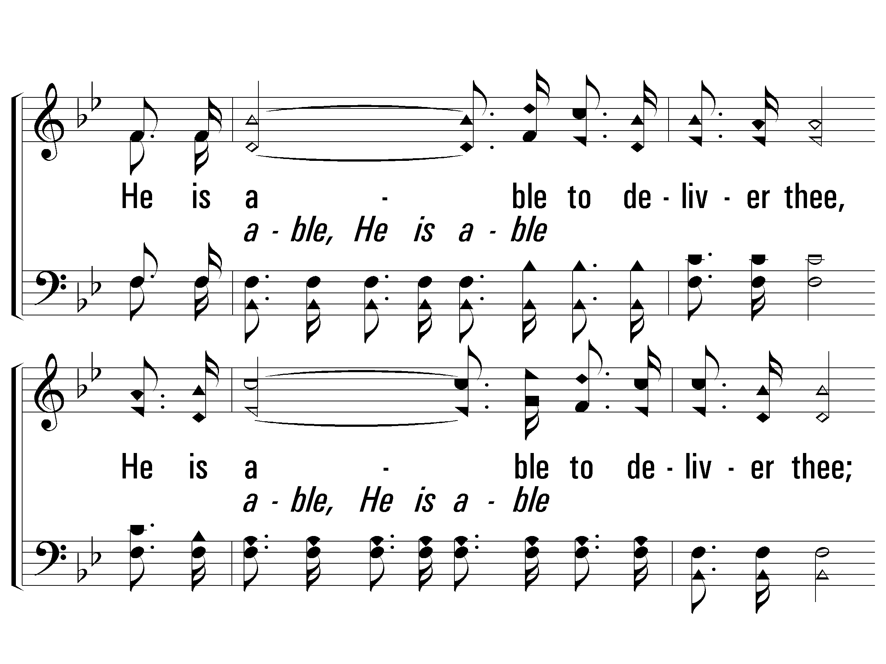
c - He Is Able to Deliver Thee
208
He is able to deliver thee,
He is able to deliver thee;
Though by sin oppressed, Go to Him for rest;
"Our God is able to de-liver thee."
© 2007 The Paperless Hymnal®

Slide 41
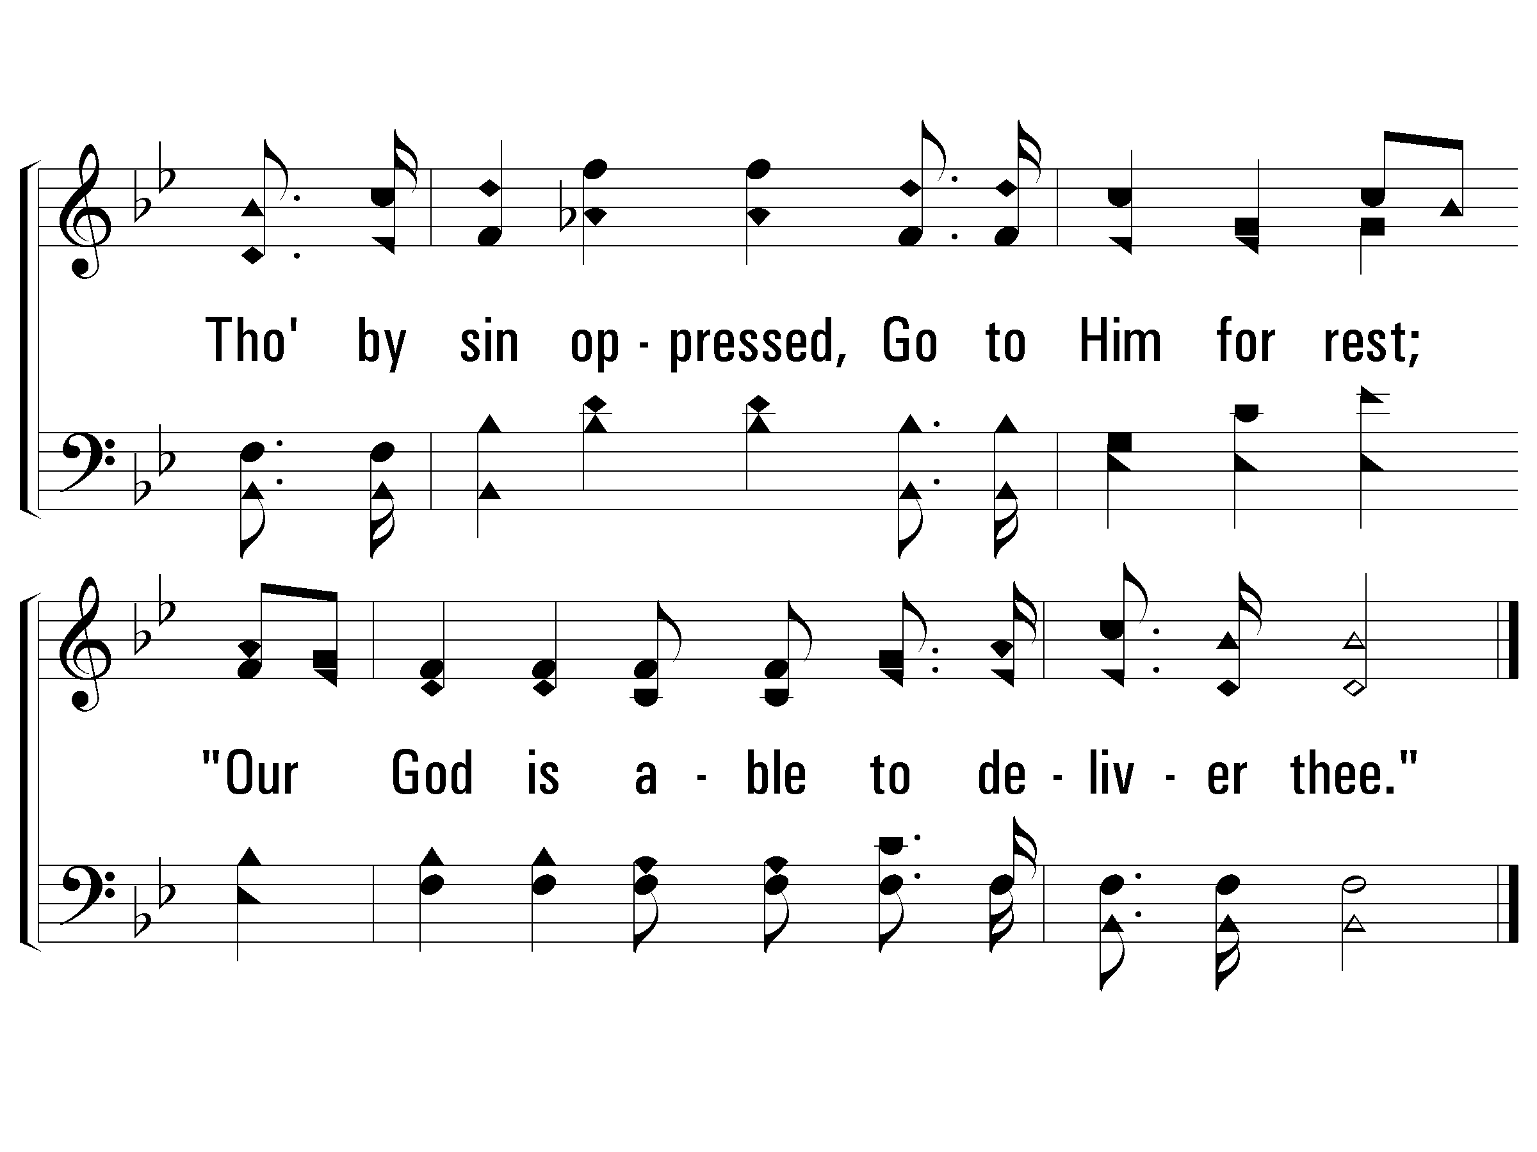
c - He Is Able to Deliver Thee
208
END
© 2007 The Paperless Hymnal®

Slide 42
God Is Holy

Slide 43
God Is The Deliverer

Slide 44
Guide Me, O Thou Great Jehovah
193
verses 1 & 2

Slide 45
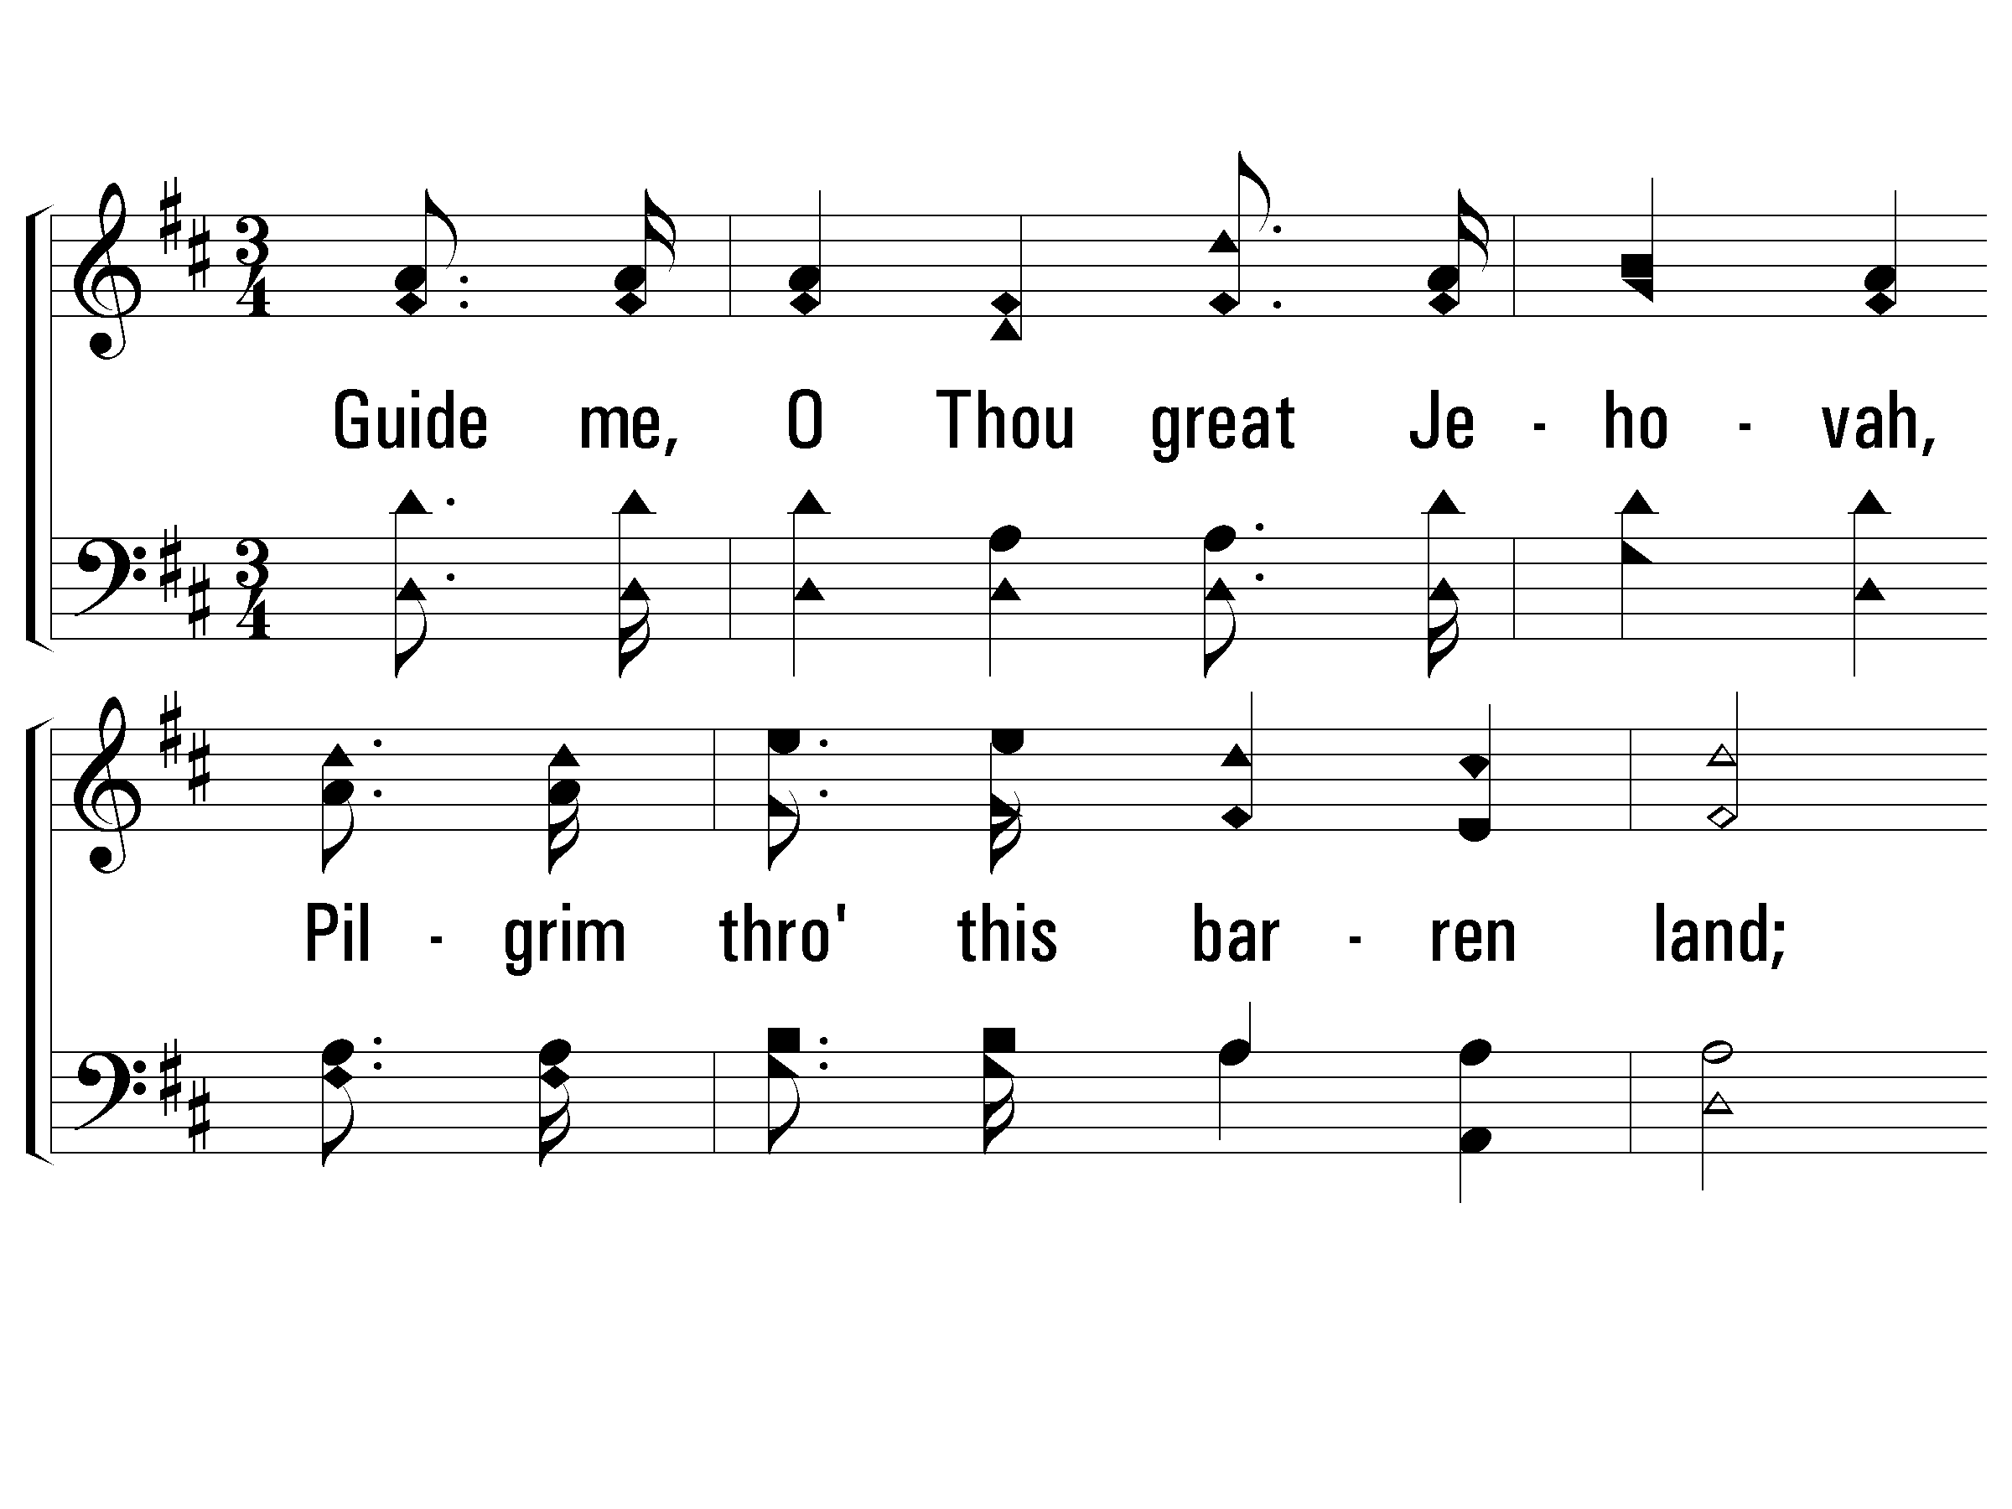
1 - Guide Me, O Thou Great Jehovah
193
1.
Guide me, O Thou great Jehovah,
Pilgrim through this barren land;
I am weak, but Thou art mighty,
Hold me with Thy powerful hand;
Bread of heaven,
Feed me till I want no more:
Bread of heaven,
Feed me till I want no more.
Words: William Williams / tr. Peter Williams
Music: Thomas Hastings
© 2001 The Paperless Hymnal™

Slide 46
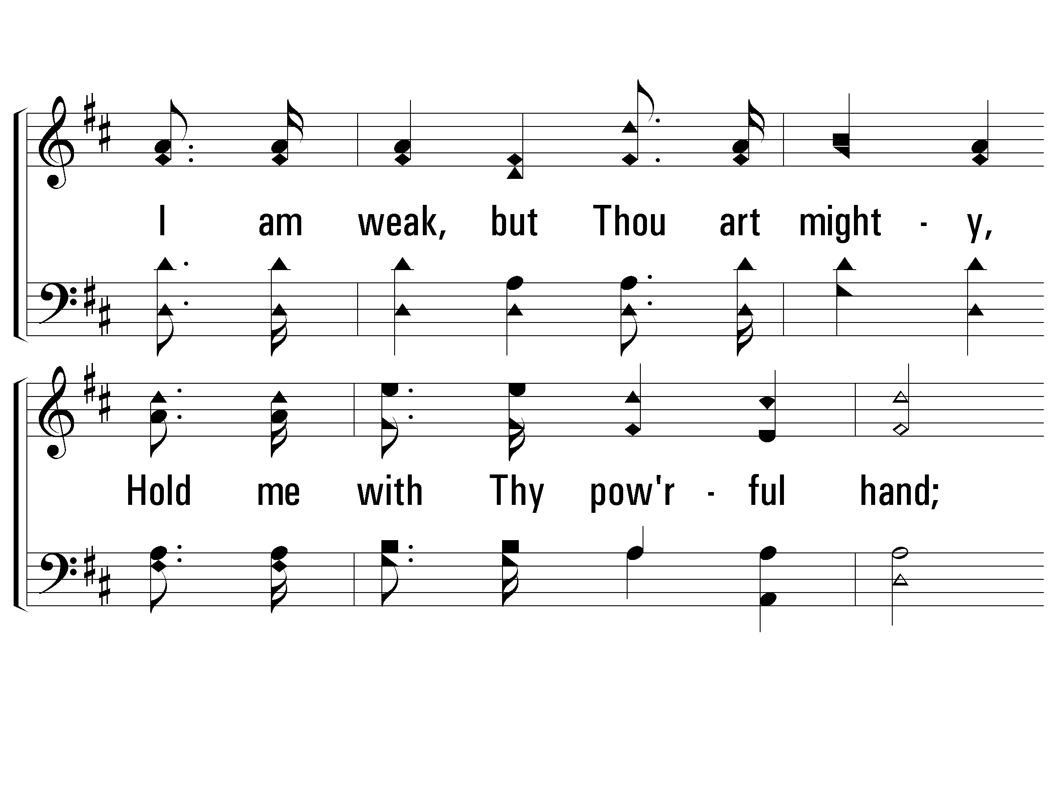
1 - Guide Me, O Thou Great Jehovah
193
© 2001 The Paperless Hymnal™

Slide 47
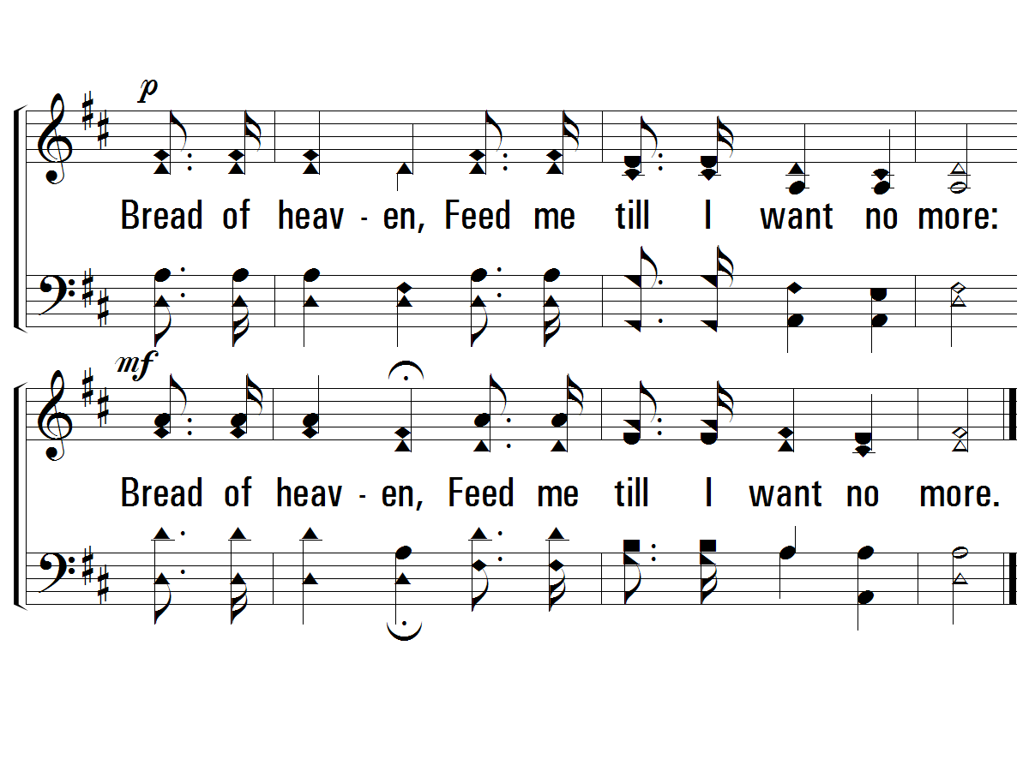
1 - Guide Me, O Thou Great Jehovah
193
© 2001 The Paperless Hymnal™

Slide 48
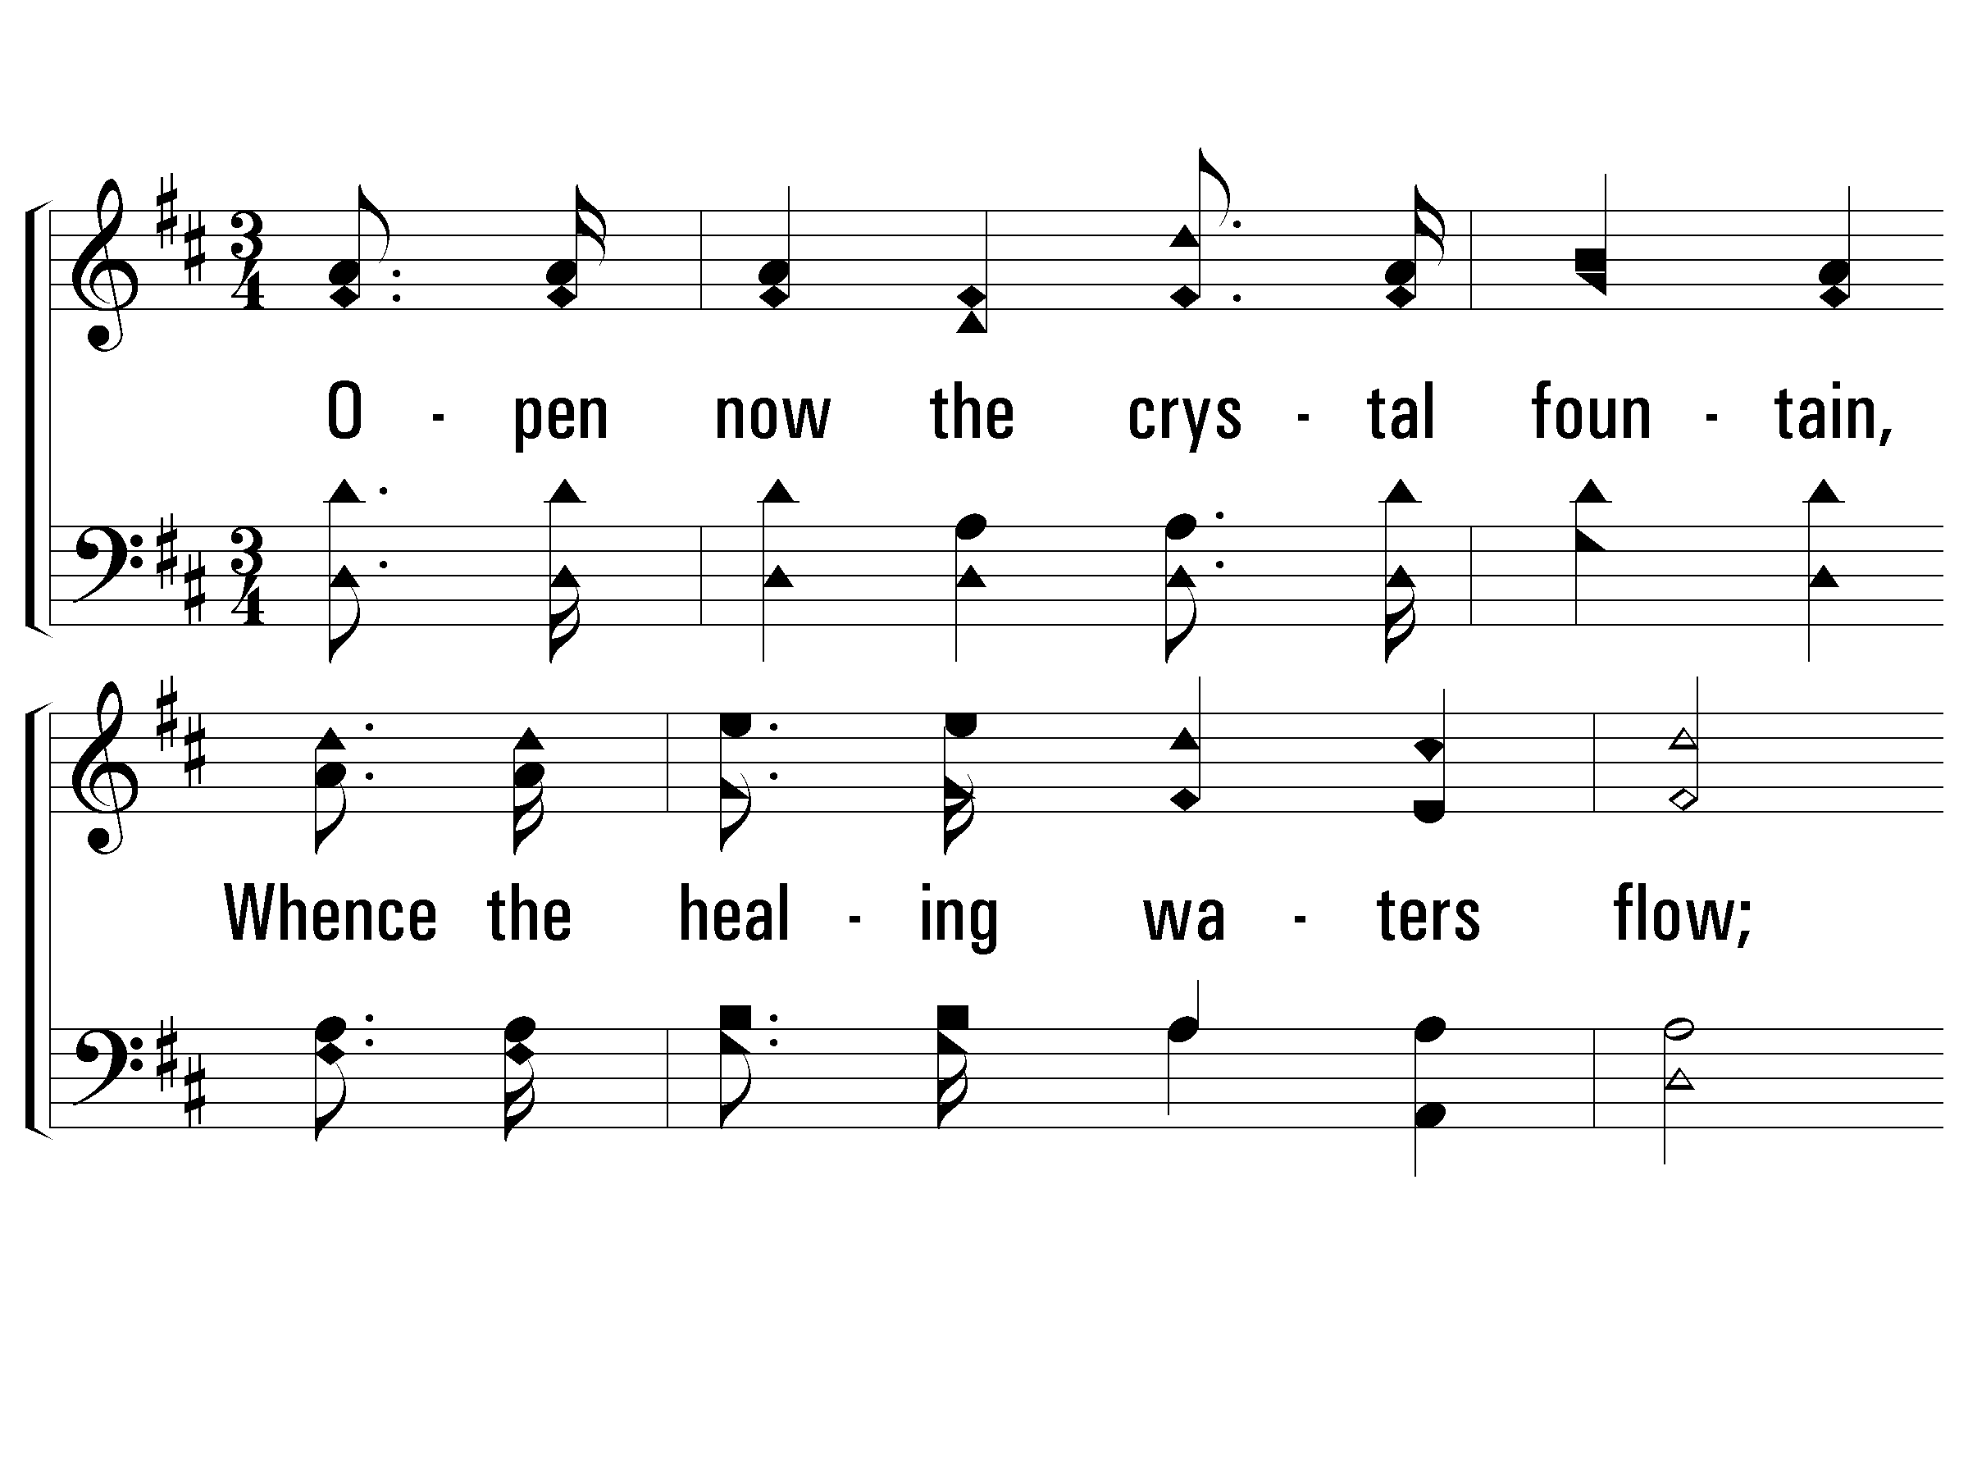
2 - Guide Me, O Thou Great Jehovah
193
2.
Open now the crystal fountain,
Whence the healing waters flow;
Let the fiery, cloudy pillar,
Lead me all my journey thro';
Strong Deliverer,
Be Thou still my strength and shield:
Strong Deliverer,
Be Thou still my strength and shield.
Words: William Williams
Music: Thomas Hastings
© 2001 The Paperless Hymnal™

Slide 49
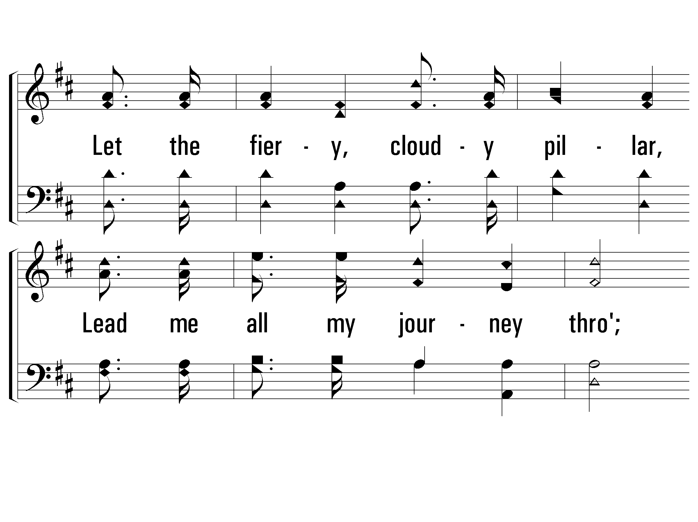
2 - Guide Me, O Thou Great Jehovah
193
© 2001 The Paperless Hymnal™

Slide 50
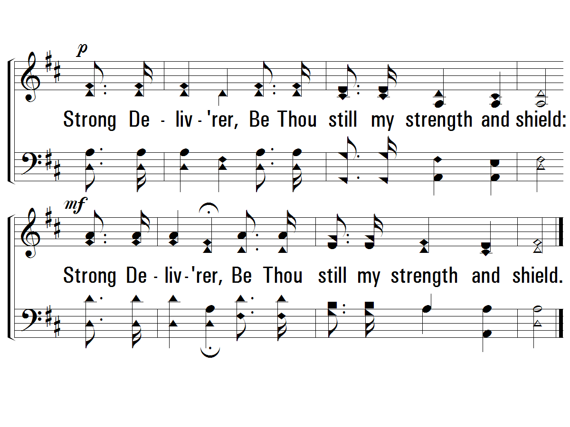
2 - Guide Me, O Thou Great Jehovah
193
END
© 2001 The Paperless Hymnal™

Slide 51
Trust and Obey
714
verses 1, 4, & 5

Slide 52
1 – Trust and Obey
714
1.
When we walk with the Lord
In the light of His Word,
What a glory He sheds on our way!
While we do His good will,
He abides with us still,
And with all who will trust and obey.
Words by: J. H. Sammis
Music by: D. B. Towner
© 2001 The Paperless Hymnal™

Slide 53
1 – Trust and Obey
714
© 2001 The Paperless Hymnal™

Slide 54
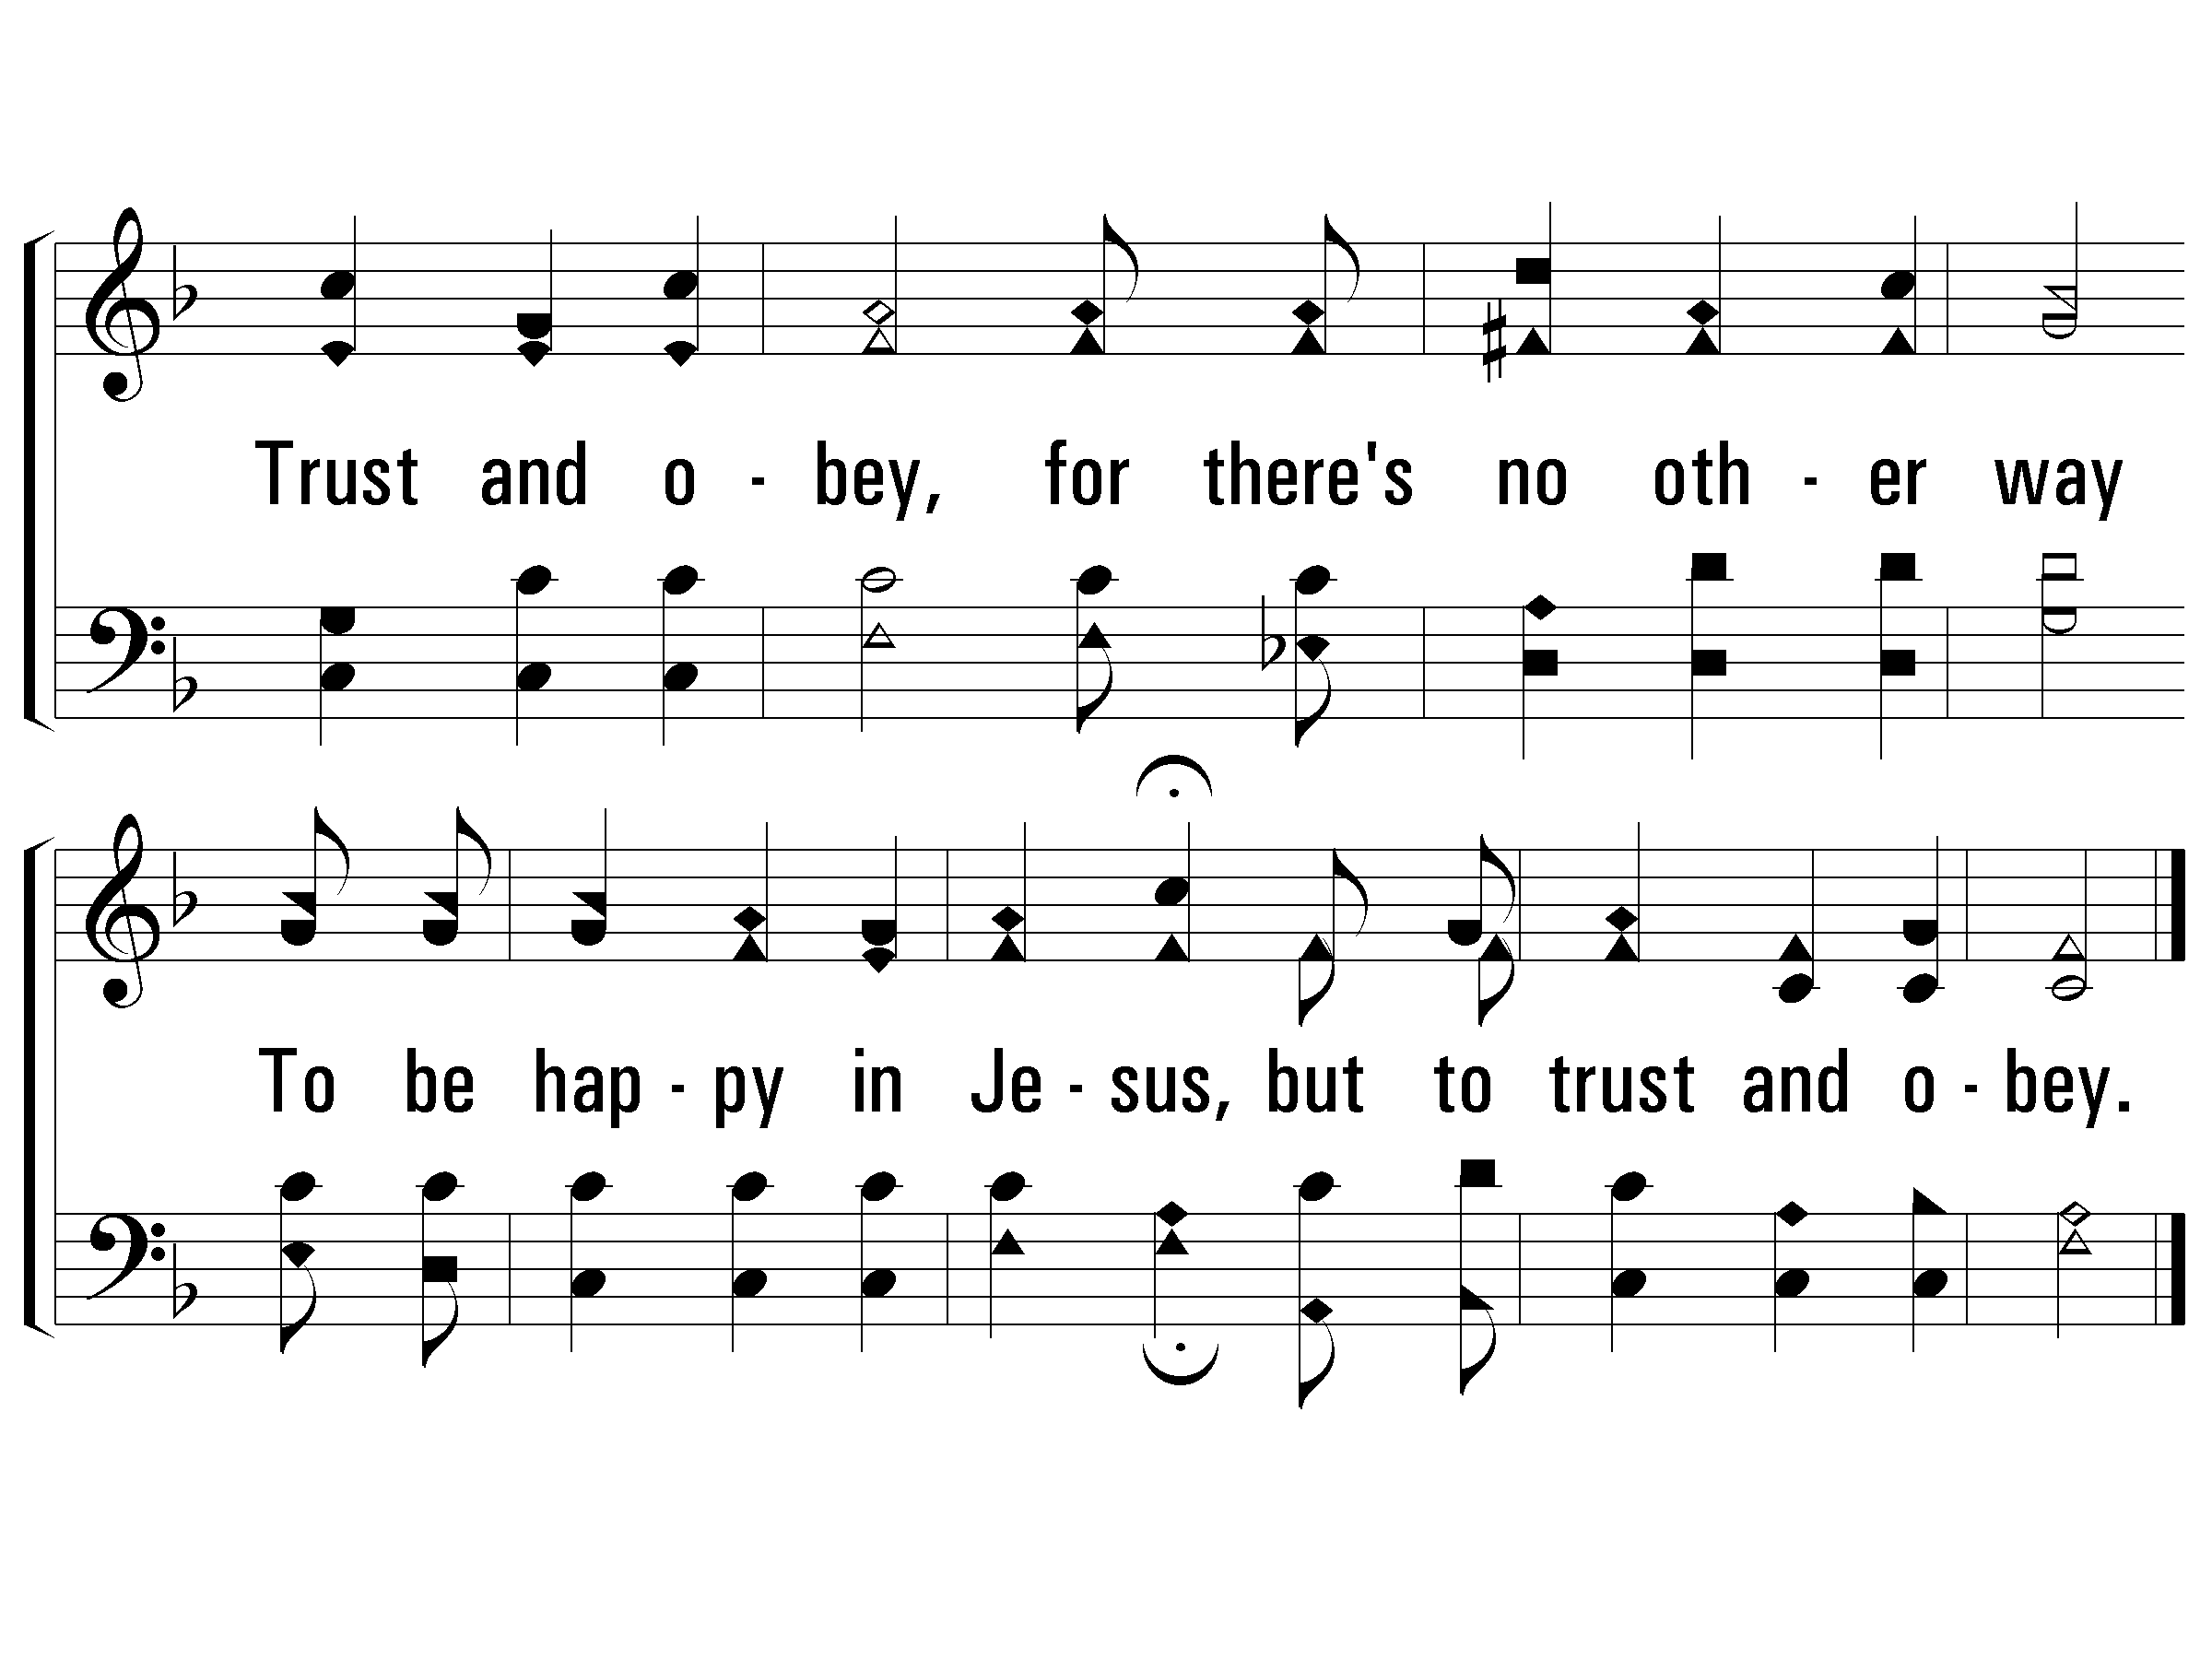
c – Trust and Obey
714
Trust and obey,
for there's no other way
To be happy in Jesus,
but to trust and obey.
© 2001 The Paperless Hymnal™

Slide 55
4 – Trust and Obey
714
4.
But we never can prove
The delights of His love
Until all on the altar we lay;
For the favor He shows,
And the joy He bestows,
Are for those who will trust and obey.
Words by: J. H. Sammis
Music by: D. B. Towner
© 2001 The Paperless Hymnal™

Slide 56
4 – Trust and Obey
714
© 2001 The Paperless Hymnal™

Slide 57
c – Trust and Obey
714
Trust and obey,
for there's no other way
To be happy in Jesus,
but to trust and obey.
© 2001 The Paperless Hymnal™

Slide 58
5 – Trust and Obey
714
5.
Then in fellowship sweet,
We will sit at His feet,
Or we'll walk by His side in the way;
What He says we will do,
Where He sends we will go
Never fear, only trust and obey.
Words by: J. H. Sammis
Music by: D. B. Towner
© 2001 The Paperless Hymnal™

Slide 59
5 – Trust and Obey
714
© 2001 The Paperless Hymnal™

Slide 60
c – Trust and Obey
714
Trust and obey,
for there's no other way
To be happy in Jesus,
but to trust and obey.
END
© 2001 The Paperless Hymnal™

Slide 61
Invitation Song Out of My Bondage
529
verses 1 & 2

Slide 62
God The Provider

Slide 63
God The Ruler

Slide 64
Invitation Song Out of My Bondage
529
verses 1 & 2

Slide 65
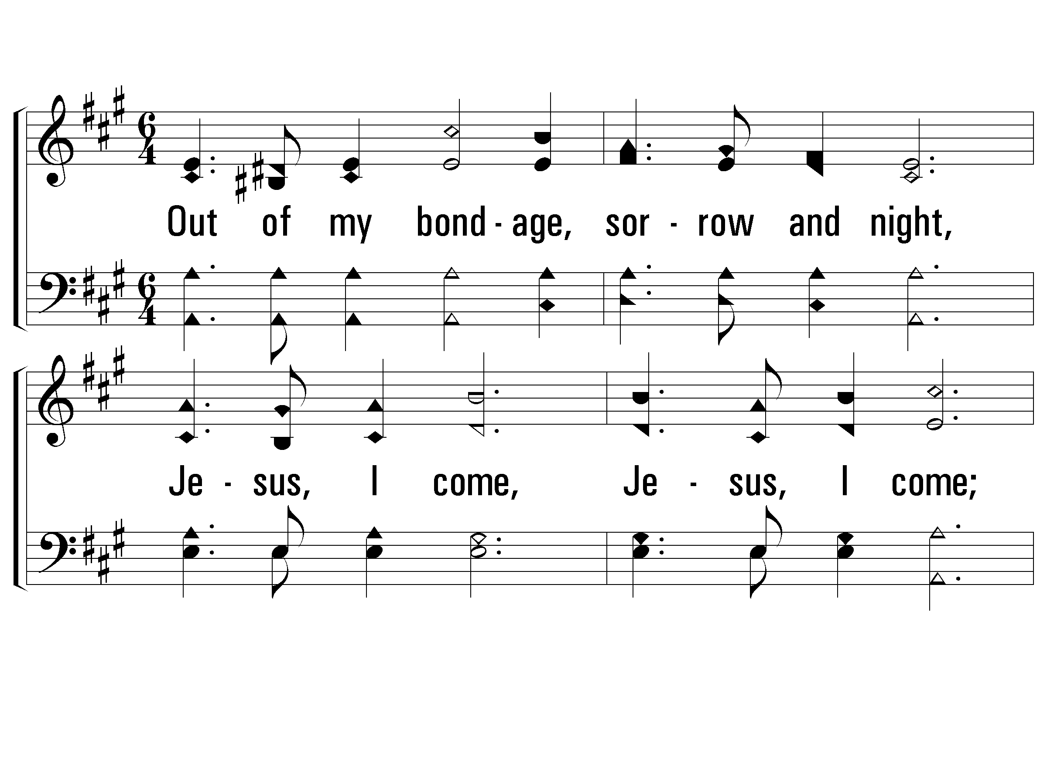
1 – Out of My Bondage
529
1.
Out of my bondage, sorrow and night,
Jesus, I come, Jesus, I come;
Into Thy freedom, gladness and light,
Jesus, I come to Thee;
Out of my sickness, into Thy health,
Out of my want and into Thy wealth,
Out of my sin and into Thyself,
Jesus, I come to Thee.
Words: W. T. Sleeper
Music: George C. Stebbins
© 2003 The Paperless Hymnal™

Slide 66
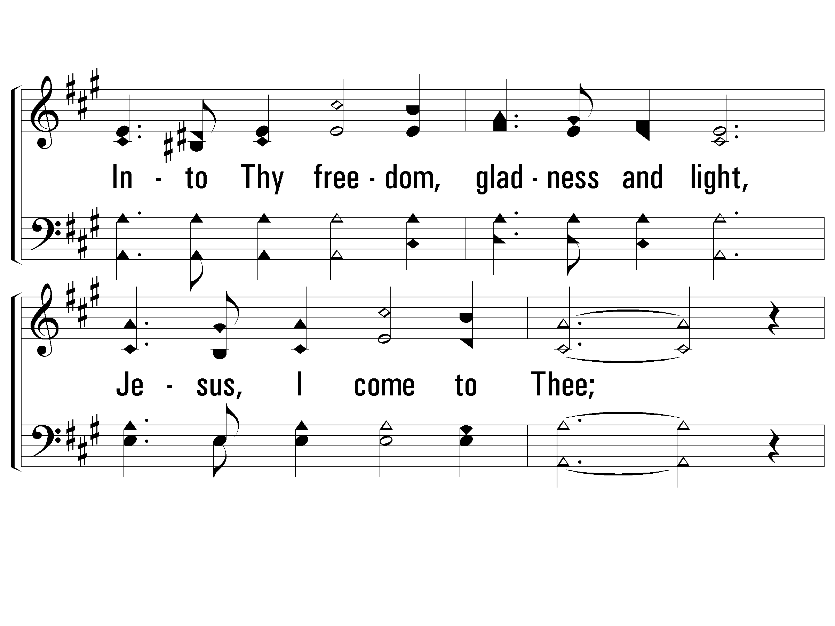
1 – Out of My Bondage
529
© 2003 The Paperless Hymnal™

Slide 67
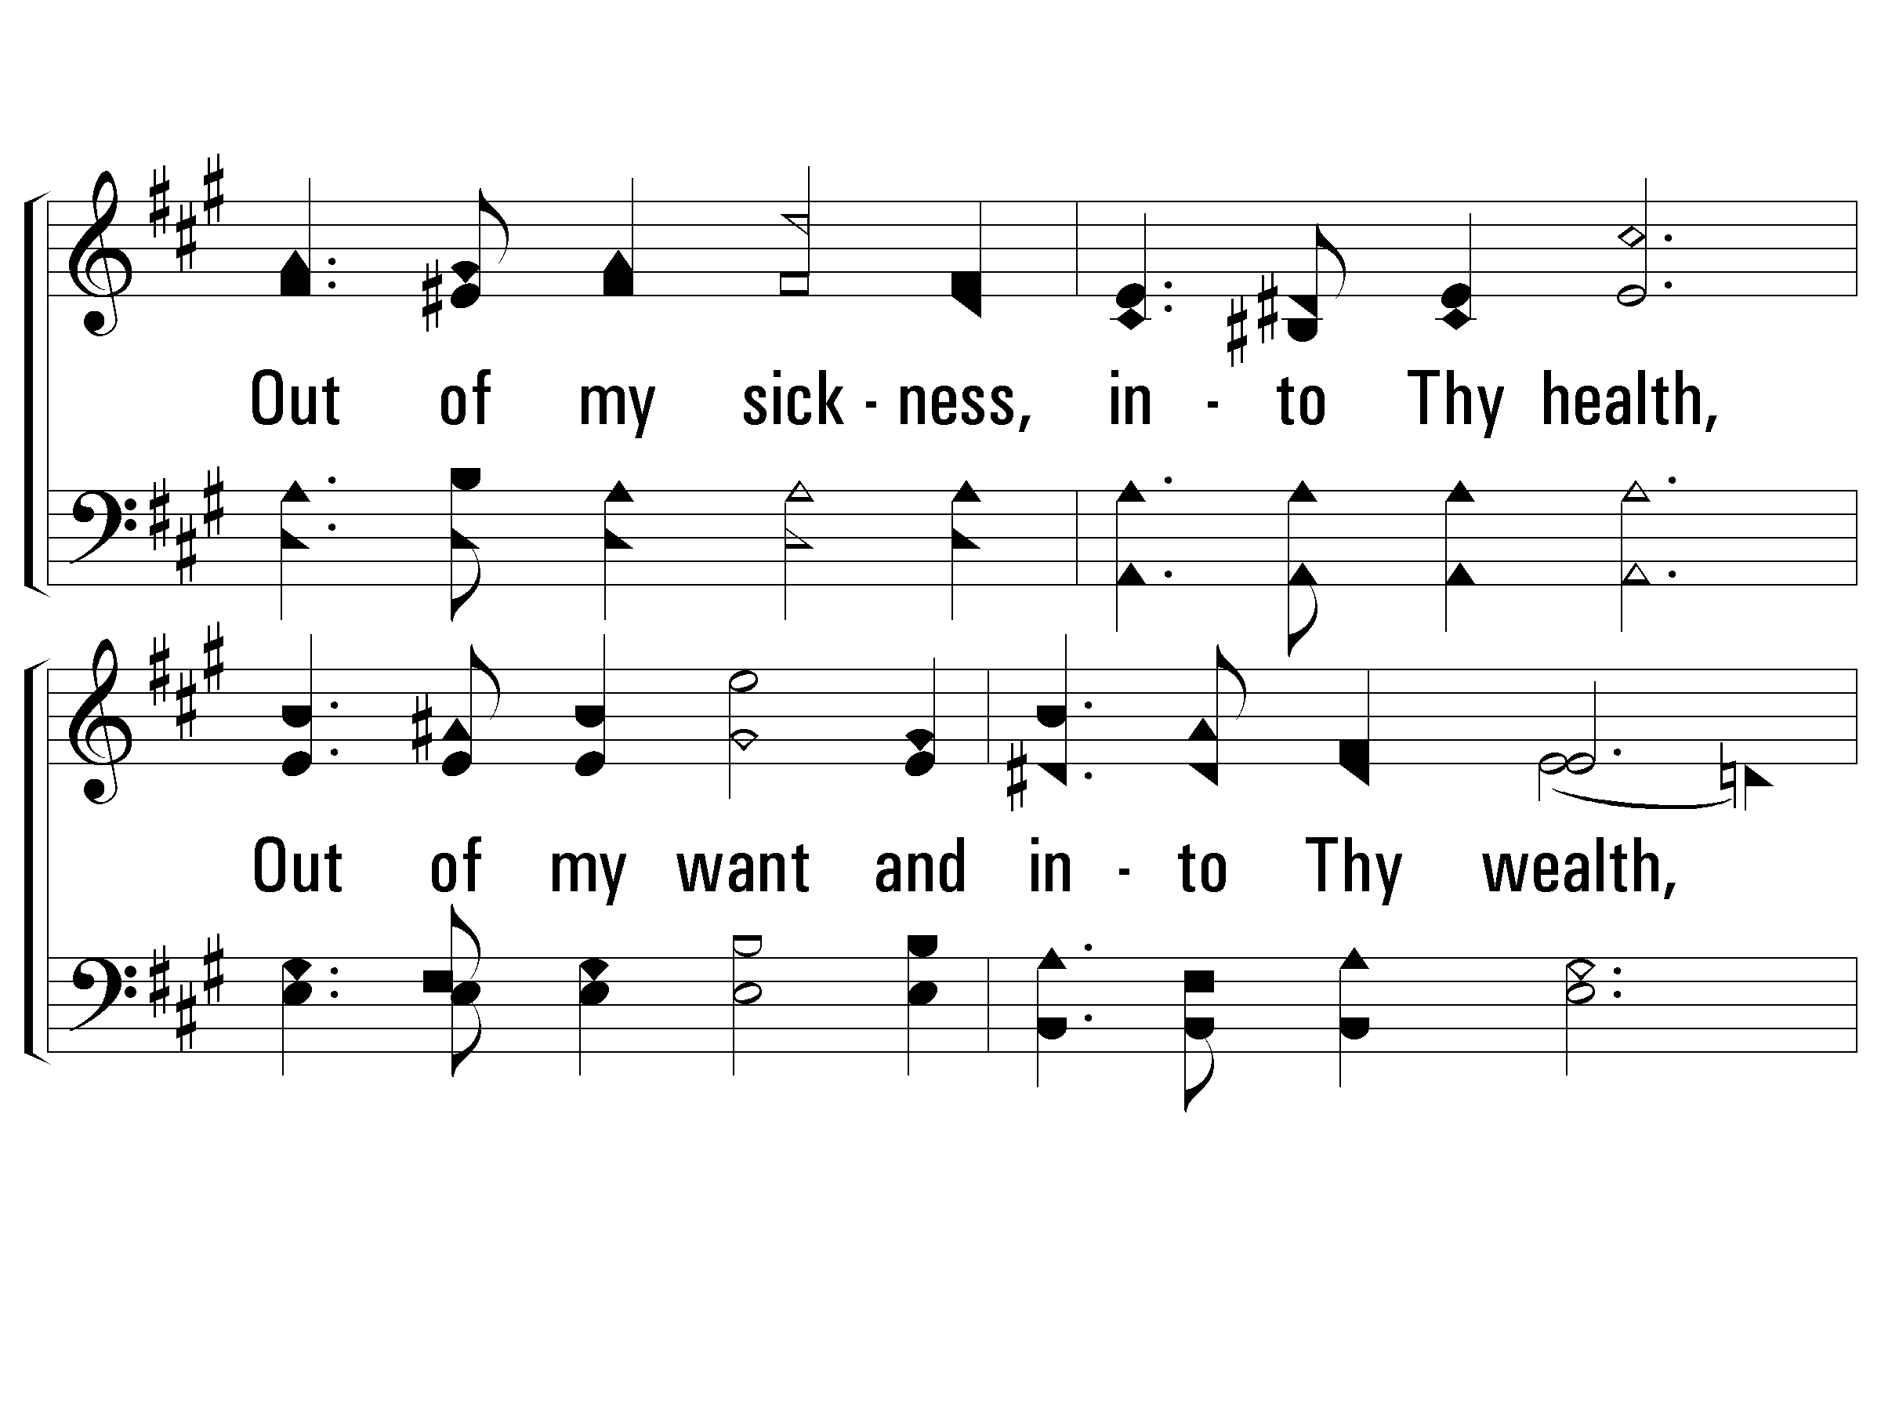
1 – Out of My Bondage
529
© 2003 The Paperless Hymnal™

Slide 68
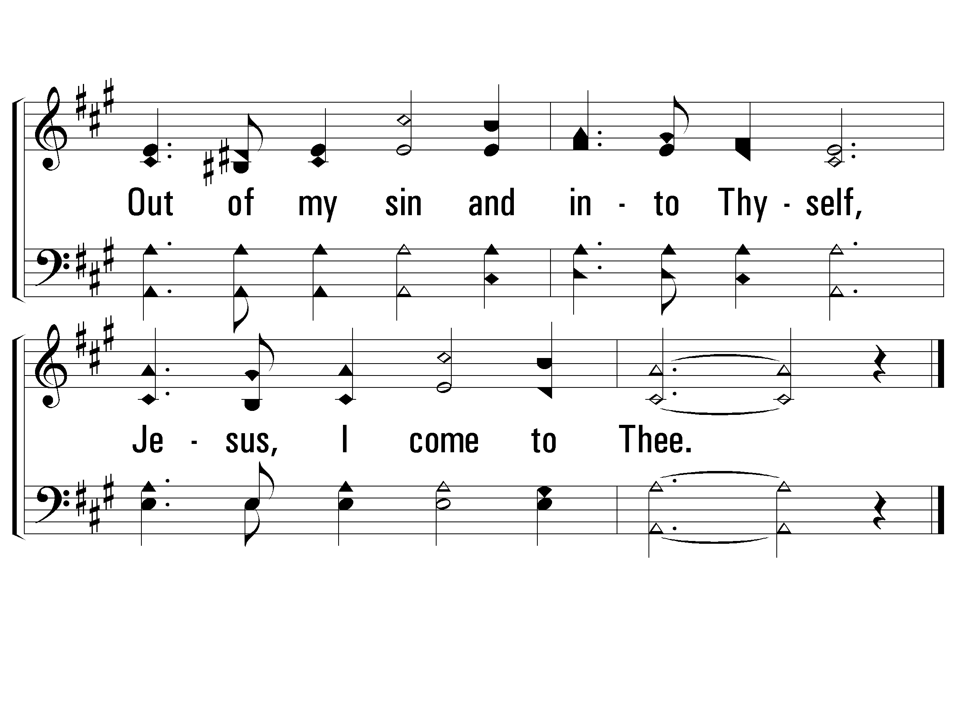
1 – Out of My Bondage
529
© 2003 The Paperless Hymnal™

Slide 69
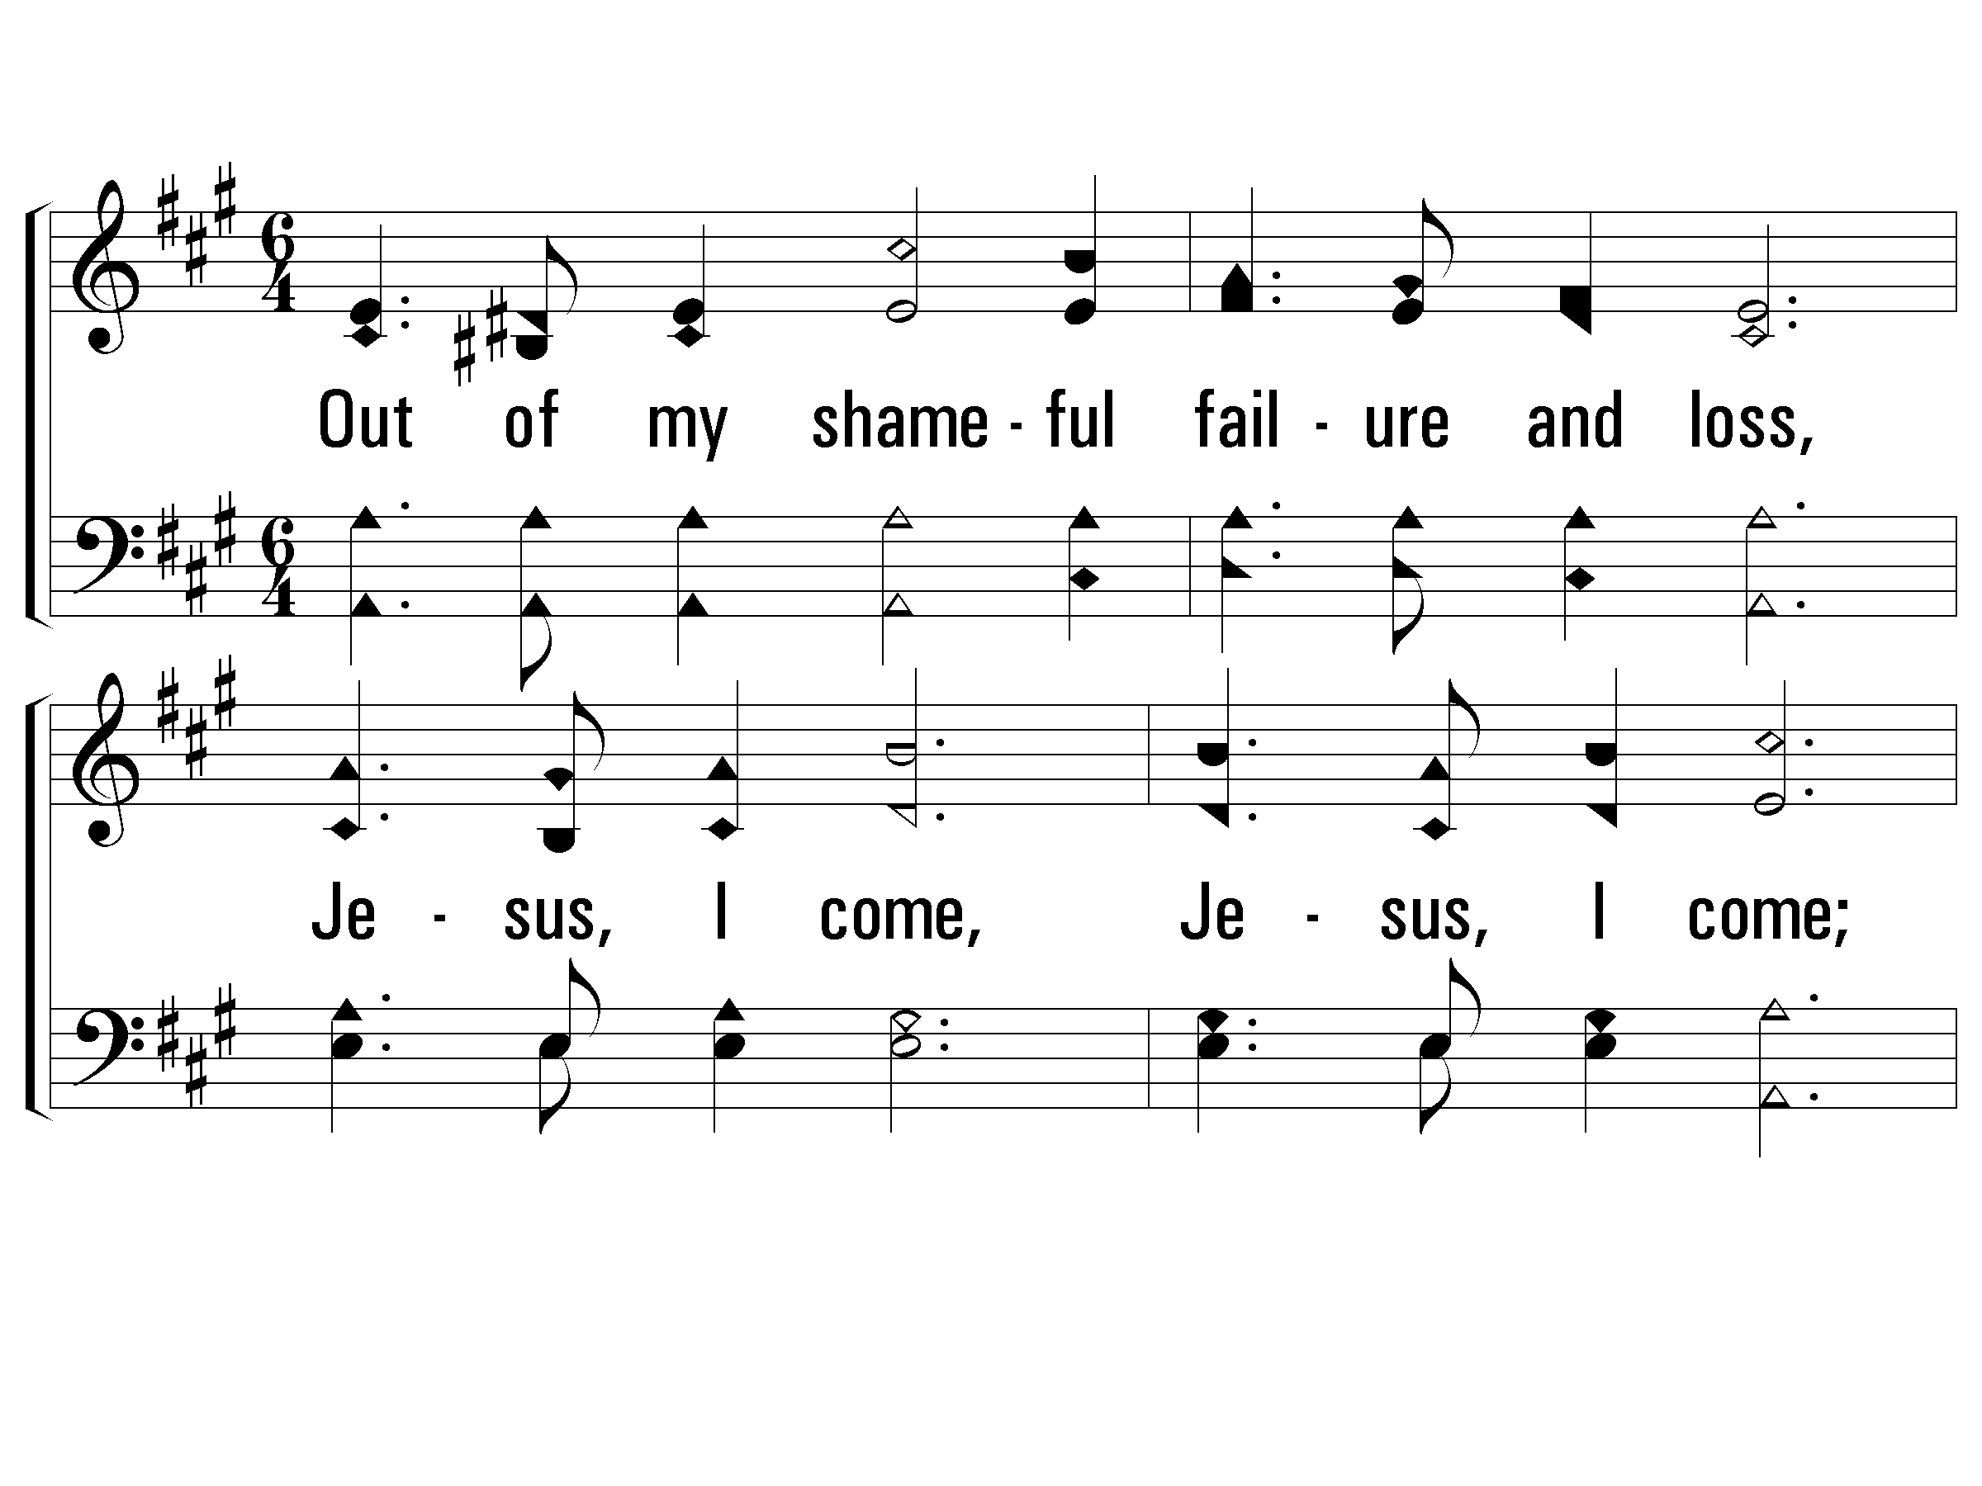
2 – Out of My Bondage
529
2.
Out of my shameful failure and loss,
Jesus, I come, Jesus, I come;
Into the glorious gain of Thy cross,
Jesus, I come to Thee;
Out of earth's sorrows, into Thy balm,
Out of life's storms and into Thy calm,
Out of distress to jubilant psalm,
Jesus, I come to Thee.
Words: W. T. Sleeper
Music: George C. Stebbins
© 2003 The Paperless Hymnal™

Slide 70
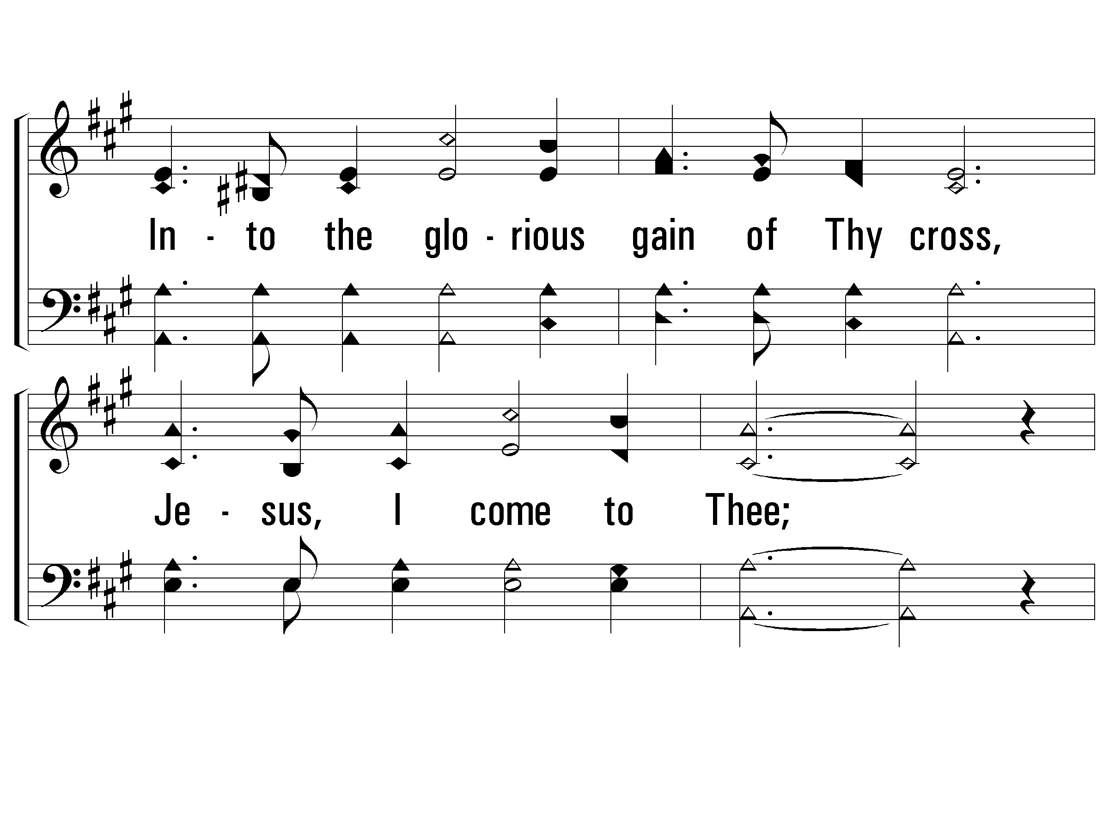
2 – Out of My Bondage
529
© 2003 The Paperless Hymnal™

Slide 71
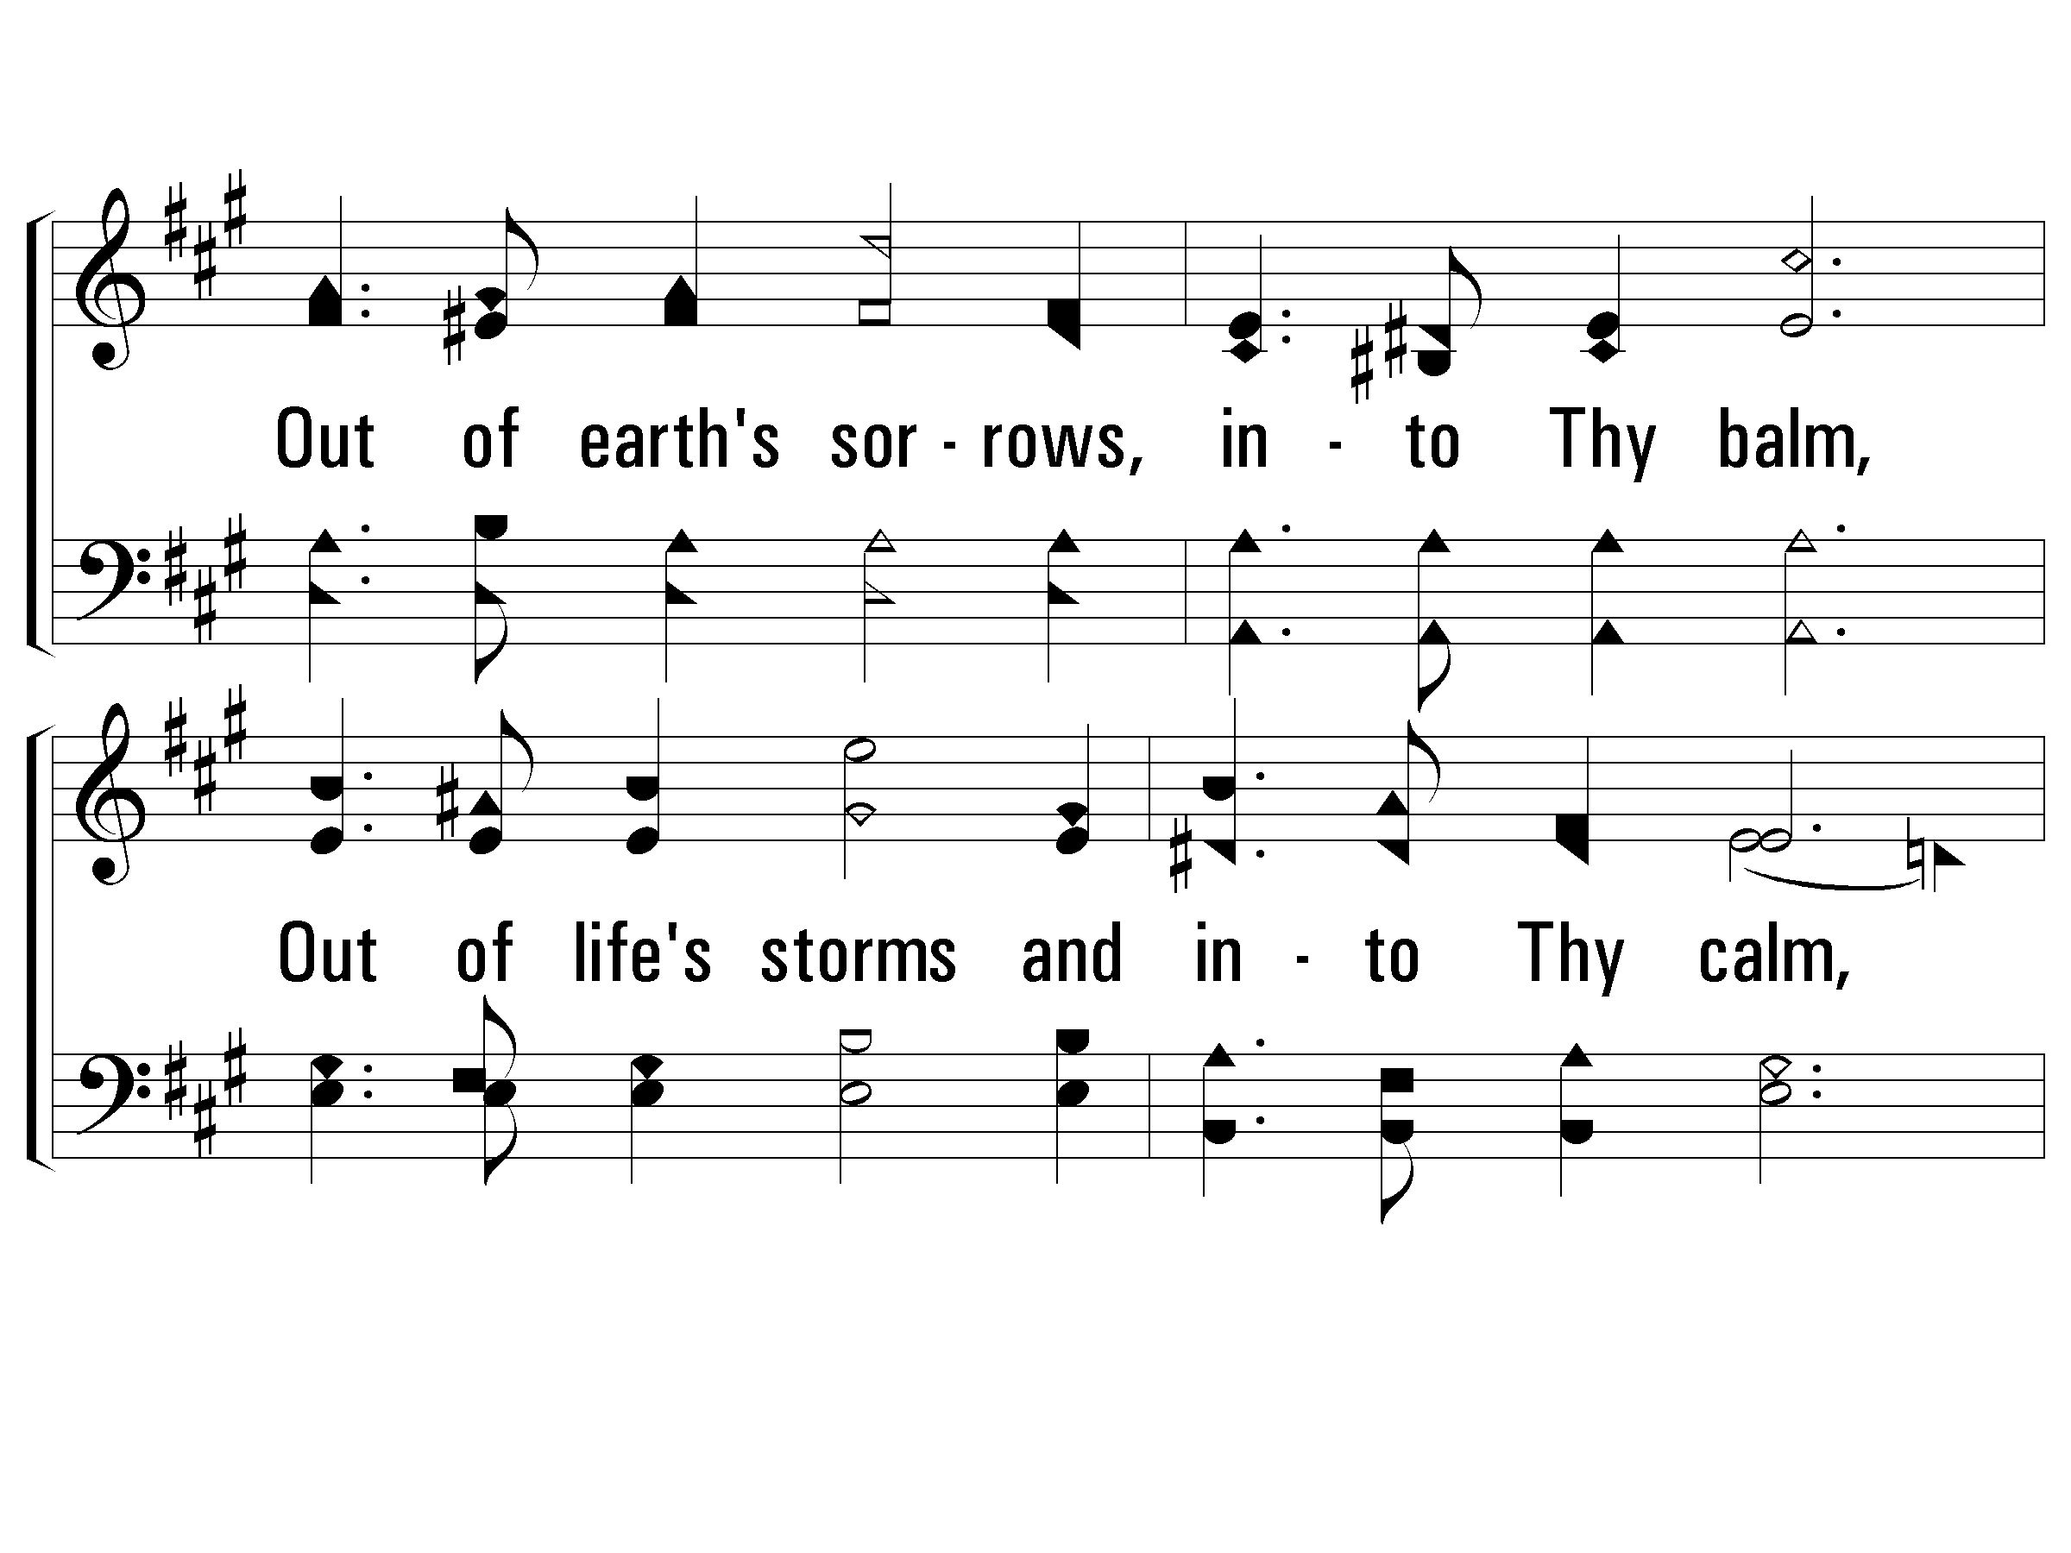
2 – Out of My Bondage
529
© 2003 The Paperless Hymnal™

Slide 72
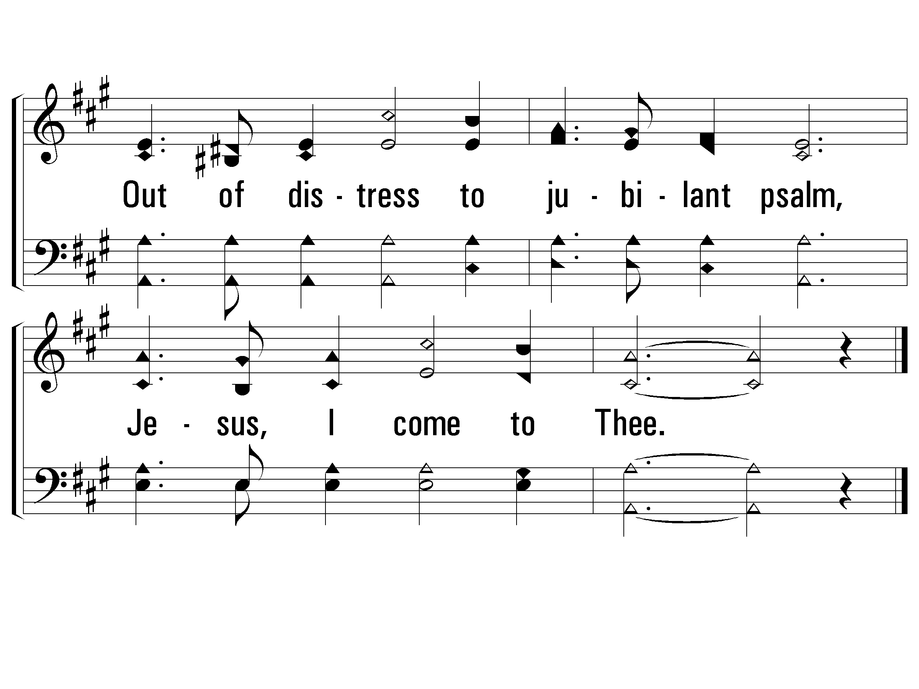
2 – Out of My Bondage
529
END
© 2003 The Paperless Hymnal™

Slide 73
Exploring Exodus

Slide 74
E. X. O. D. U. S.
E – X – O – D – U – S : Ex - o – dus. A book of great deliverance is Ex-o-dus. E – X – O – D – U – S : Ex - o – dus. A book of great deliverance is Ex-o-dus.
The sons of Israel were slaves in Egypt, Oppressed in Egypt by the Pharaoh. God heard their cry and, with His mighty hand, Sent Moses the man to lead them out of the land.

