Slide 1
Order of Evening Services
Prayer
Reading: I Samuel 16:1-23
Song 542 – Purer in Heart, O God
Reading: I Samuel 17:1-37
Song 134 – Faith is the Victory
Reading: 1 Samuel 17:38-58
Song 977 – The Battle Belongs to the Lord
Invitation
Inv. Song 163 – Is Thy Heart Right with God

Slide 2
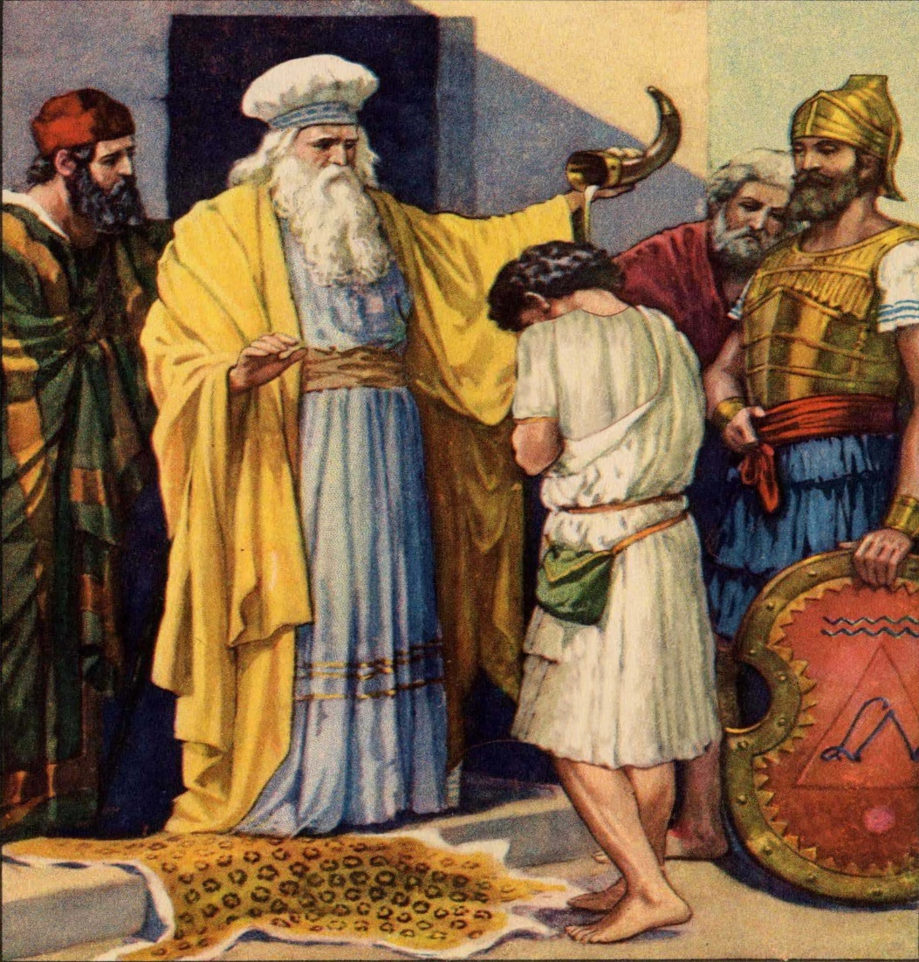

Slide 3
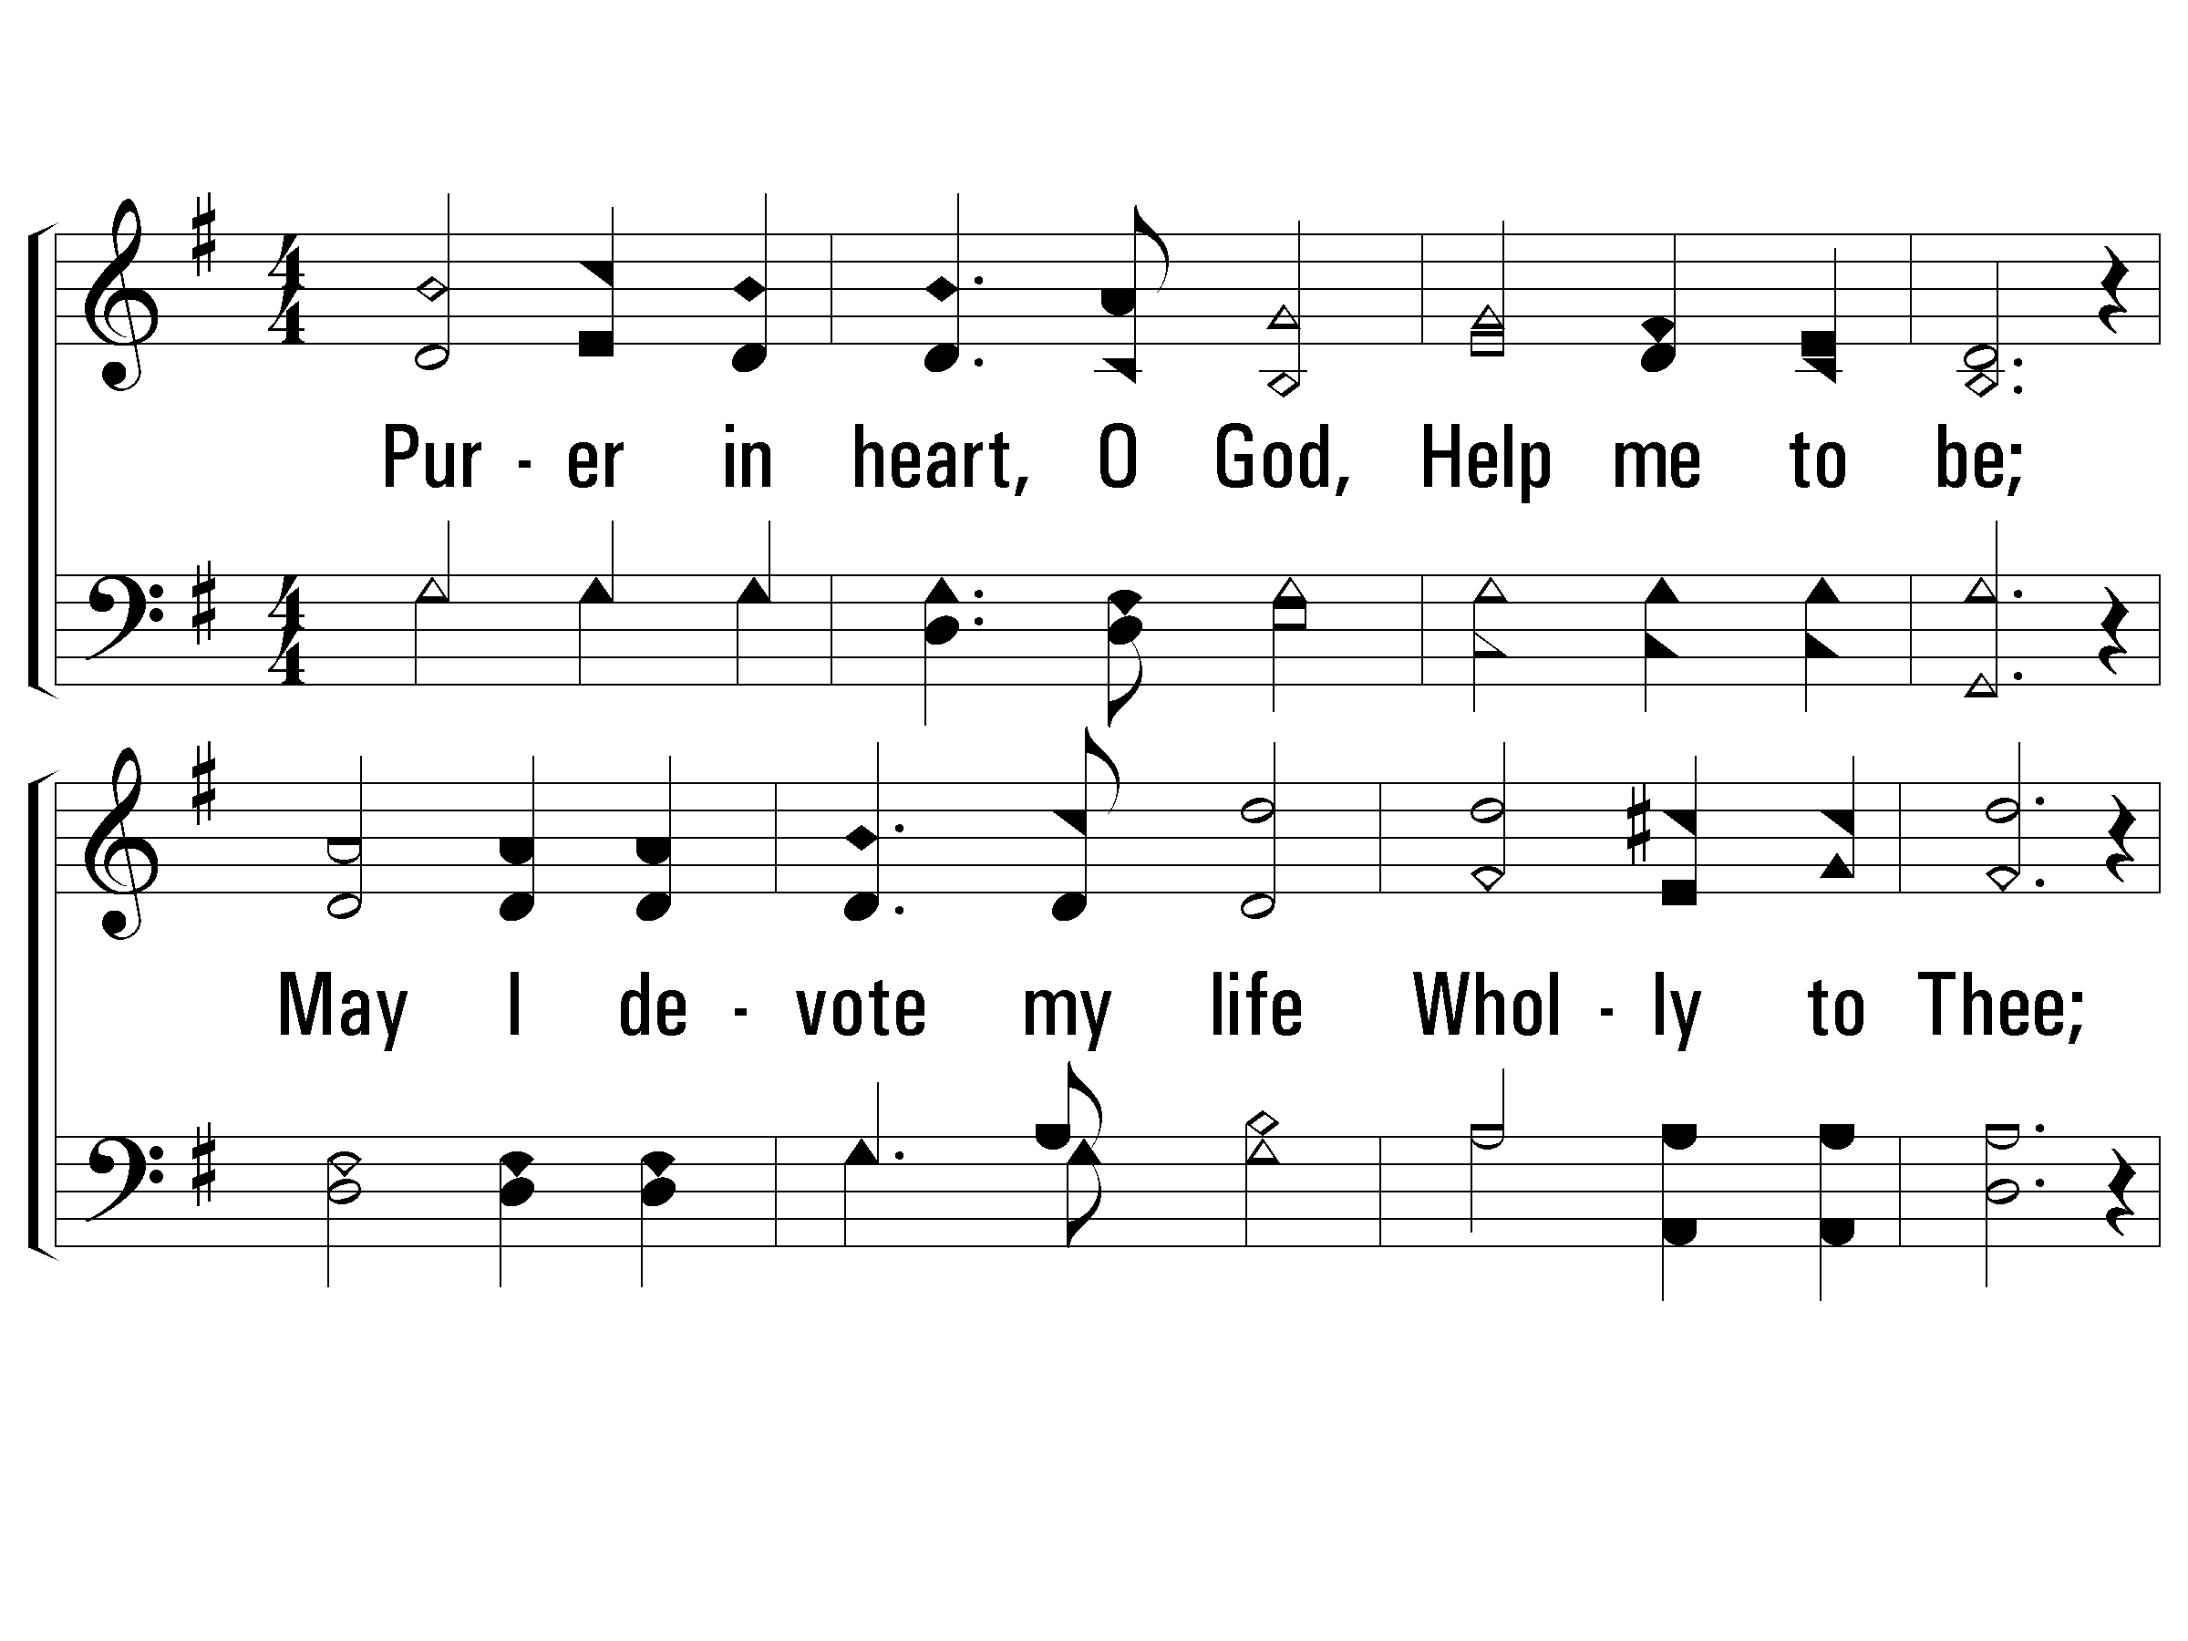
1 - Purer in Heart, O God
542
1.
Purer in heart, O God, Help me to be;
May I devote my life Wholly to Thee;
Watch Thou my wayward feet,
Guide me with counsel sweet;
Purer in heart, Help me to be.
Words by: Fannie E. C. Davison
Music by: James H. Fillmore
© 2001 The Paperless Hymnal™

Slide 4
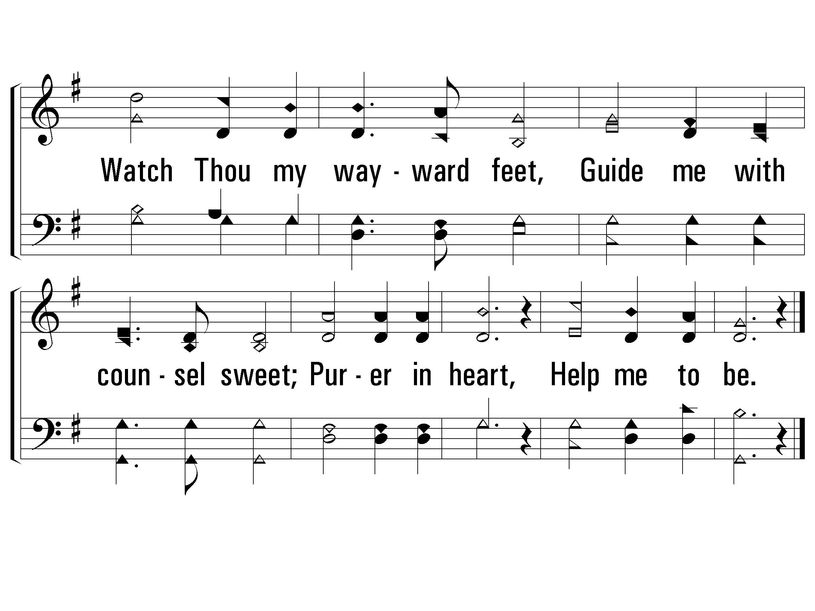
1 - Purer in Heart, O God
542
© 2001 The Paperless Hymnal™

Slide 5
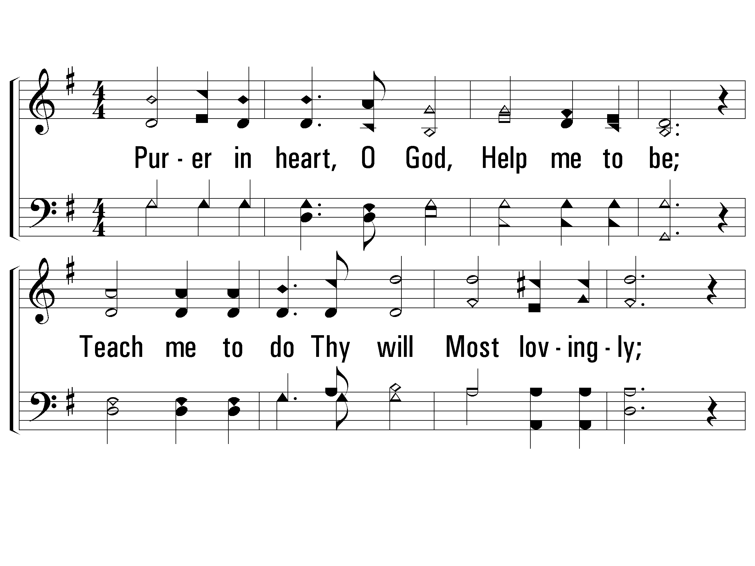
2 - Purer in Heart, O God
542
2.
Purer in heart, O God, Help me to be;
Teach me to do Thy will Most lovingly;
Be Thou my Friend and Guide.
Let me with Thee a-bide;
Purer in heart, Help me to be.
Words by: Fannie E. C. Davison
Music by: James H. Fillmore
© 2001 The Paperless Hymnal™

Slide 6
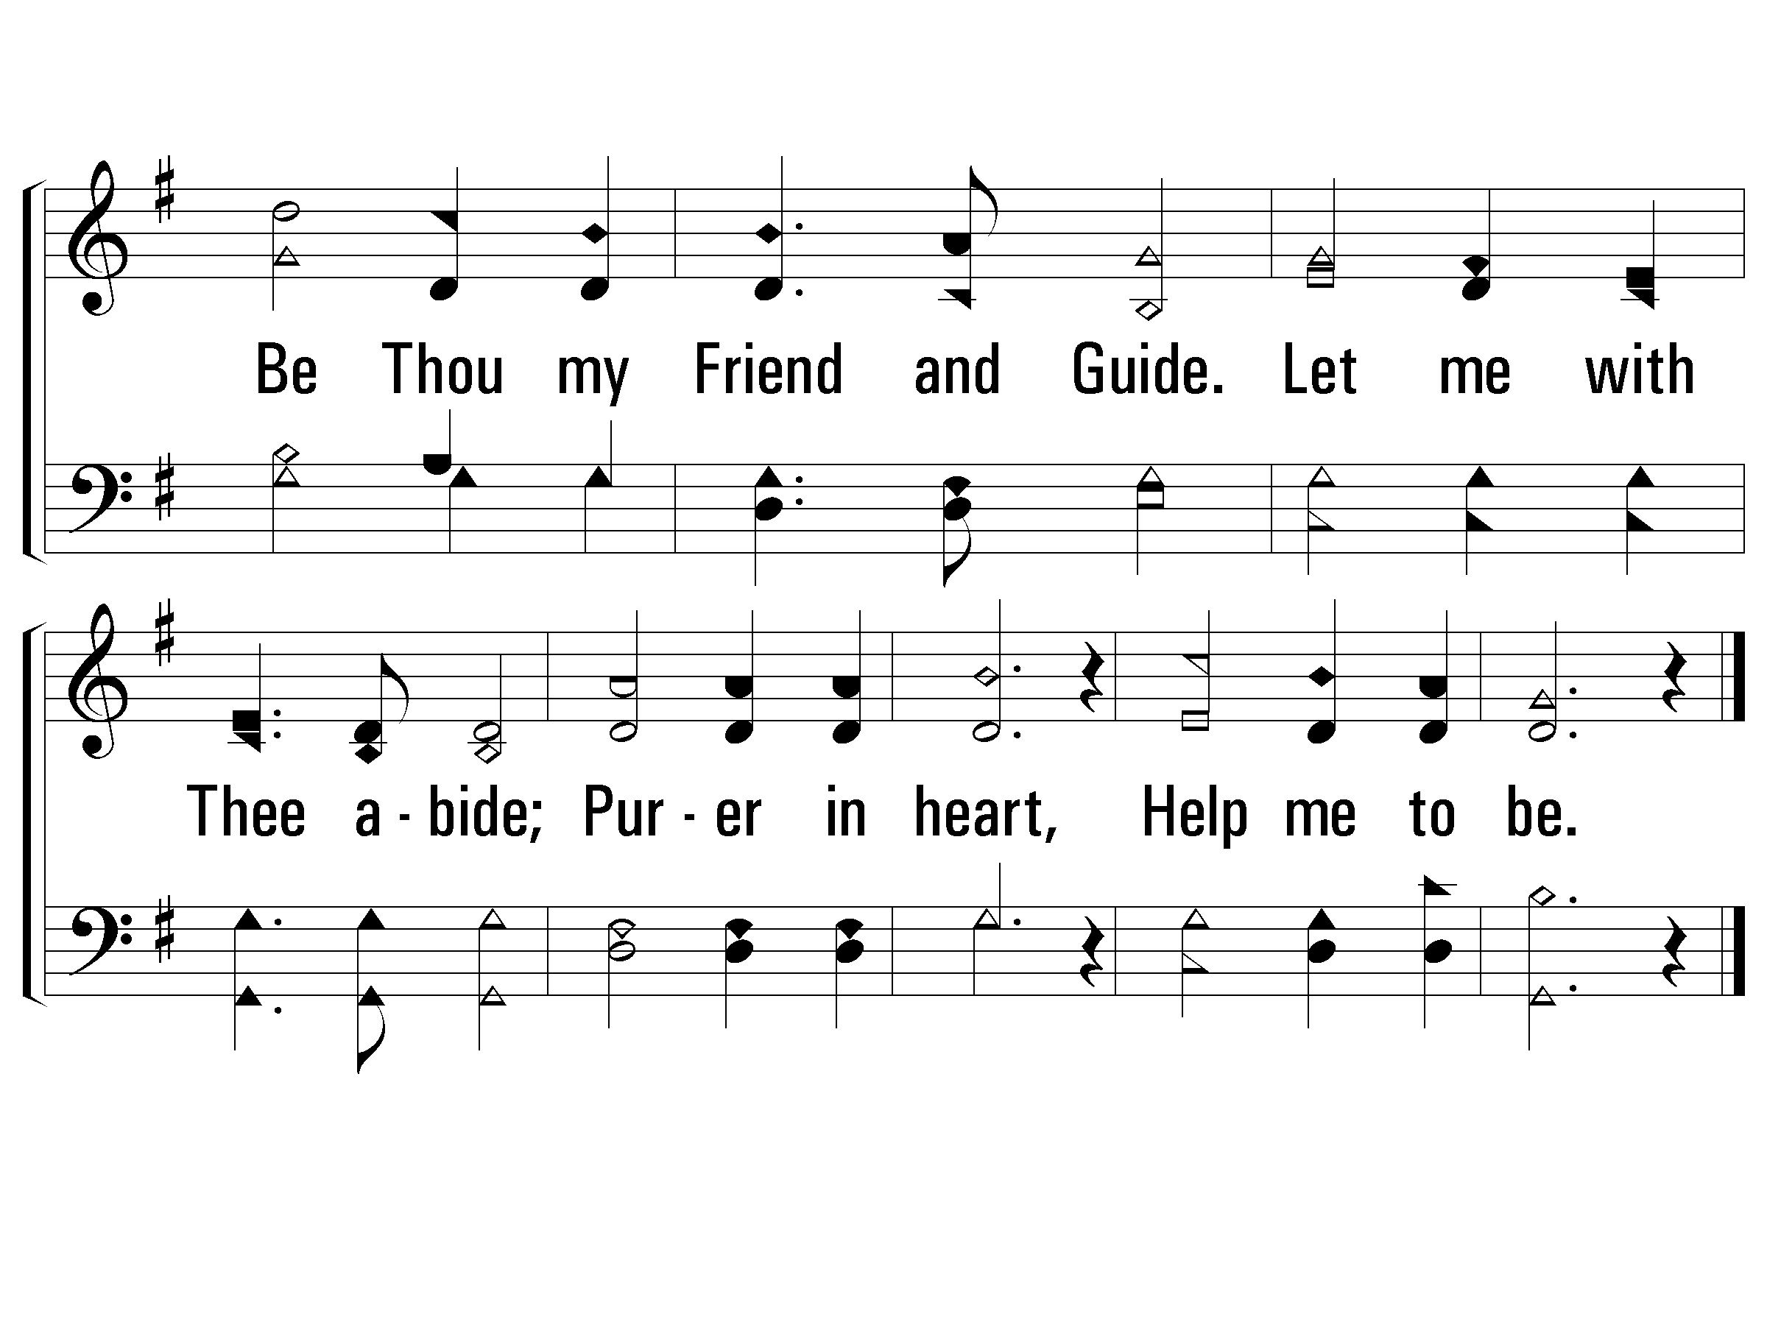
2 - Purer in Heart, O God
542
© 2001 The Paperless Hymnal™

Slide 7
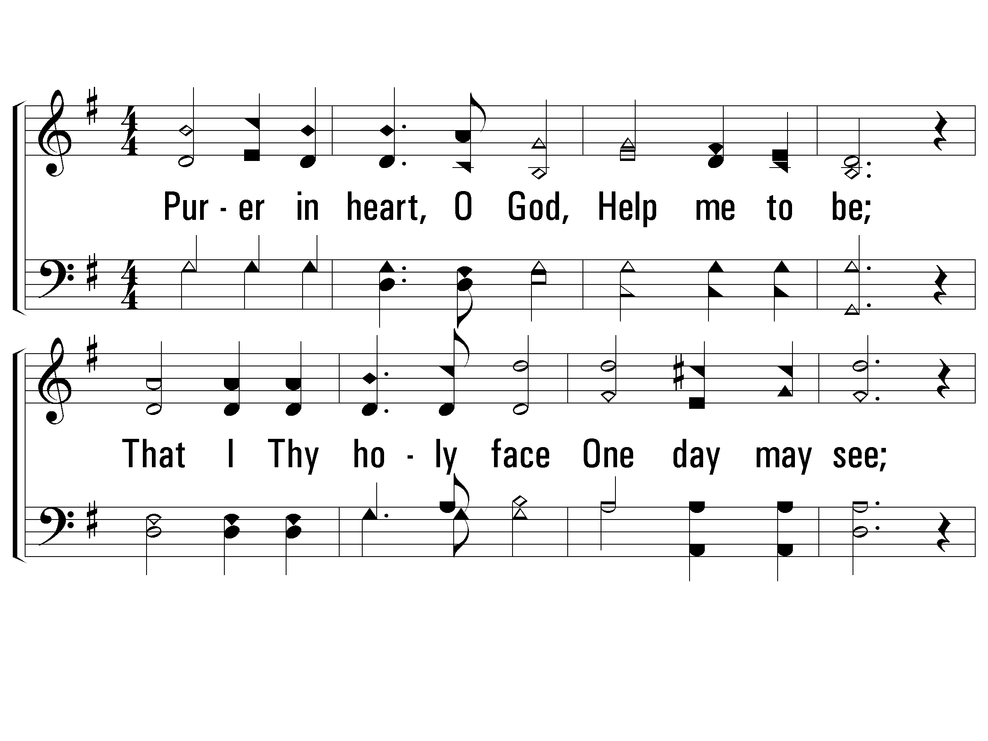
3 - Purer in Heart, O God
542
3.
Purer in heart, O God, Help me to be;
That I Thy holy face One day may see;
Keep me from secret sin,
Reign Thou my soul with-in;
Purer in heart, Help me to be.
Words by: Fannie E. C. Davison
Music by: James H. Fillmore
© 2001 The Paperless Hymnal™

Slide 8
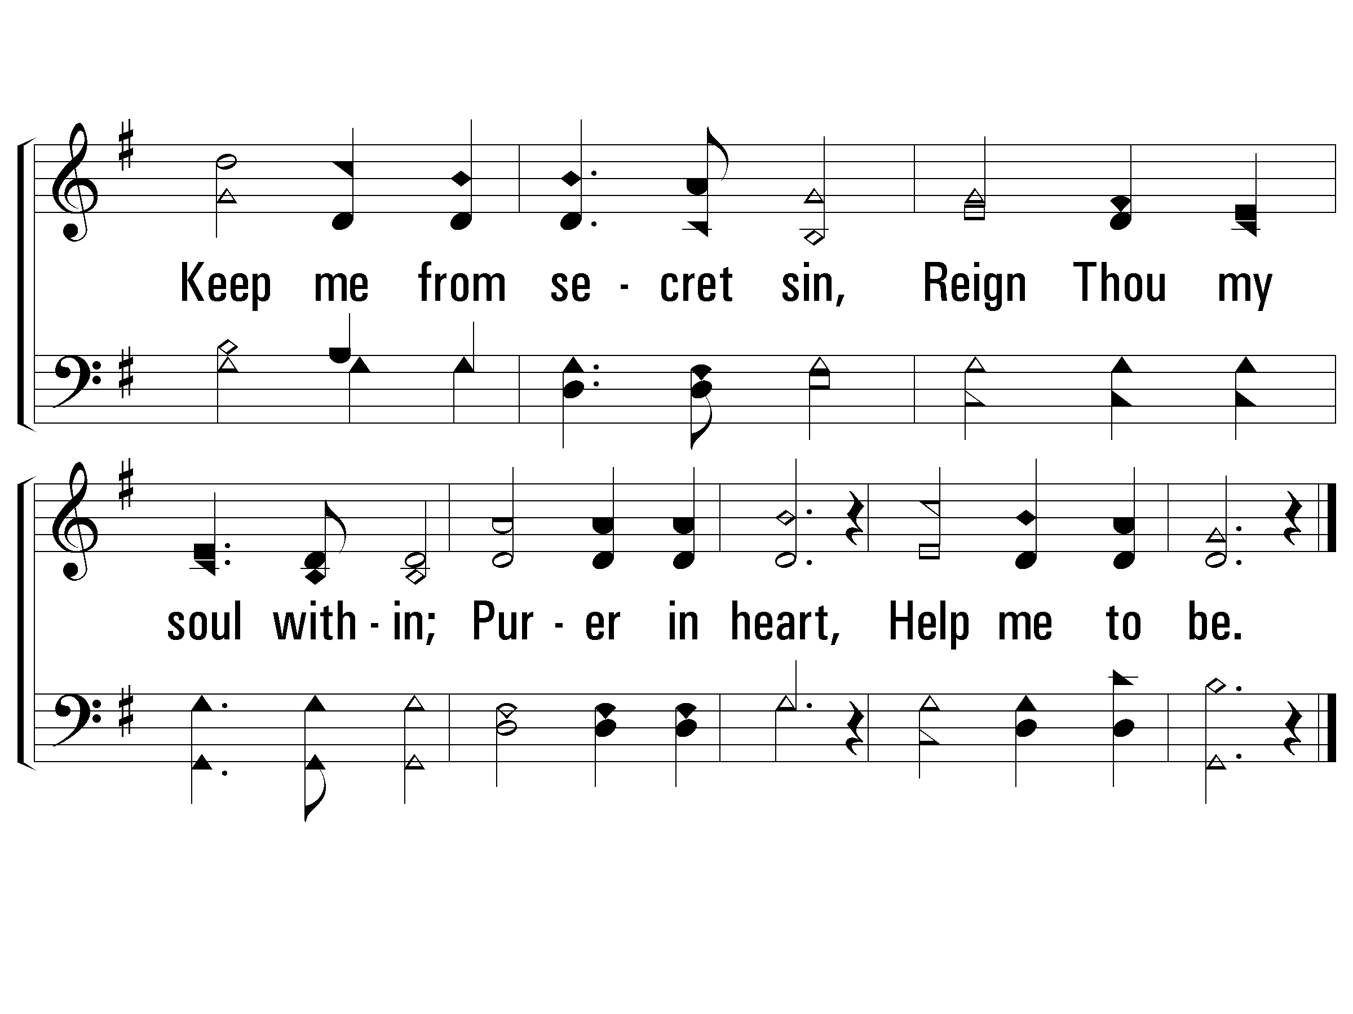
3 - Purer in Heart, O God
542
END
© 2001 The Paperless Hymnal™

Slide 9
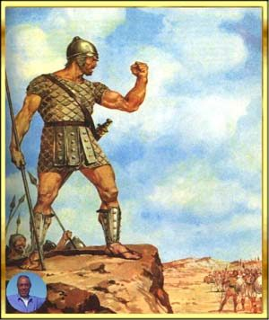

Slide 10
1 – Faith is the Victory
134
1.
Encamped along the hills of light,
Ye Christian soldiers, rise,
And press the battle ere the night
Shall veil the glowing skies.
Against the foe in vales below
Let all our strength be hurled;
Faith is the victory, we know,
That overcomes the world.
Words by: John H. Yates
Music by: Ira D. Sankey
© 2001 The Paperless Hymnal™

Slide 11
1 – Faith is the Victory
134
© 2001 The Paperless Hymnal™

Slide 12
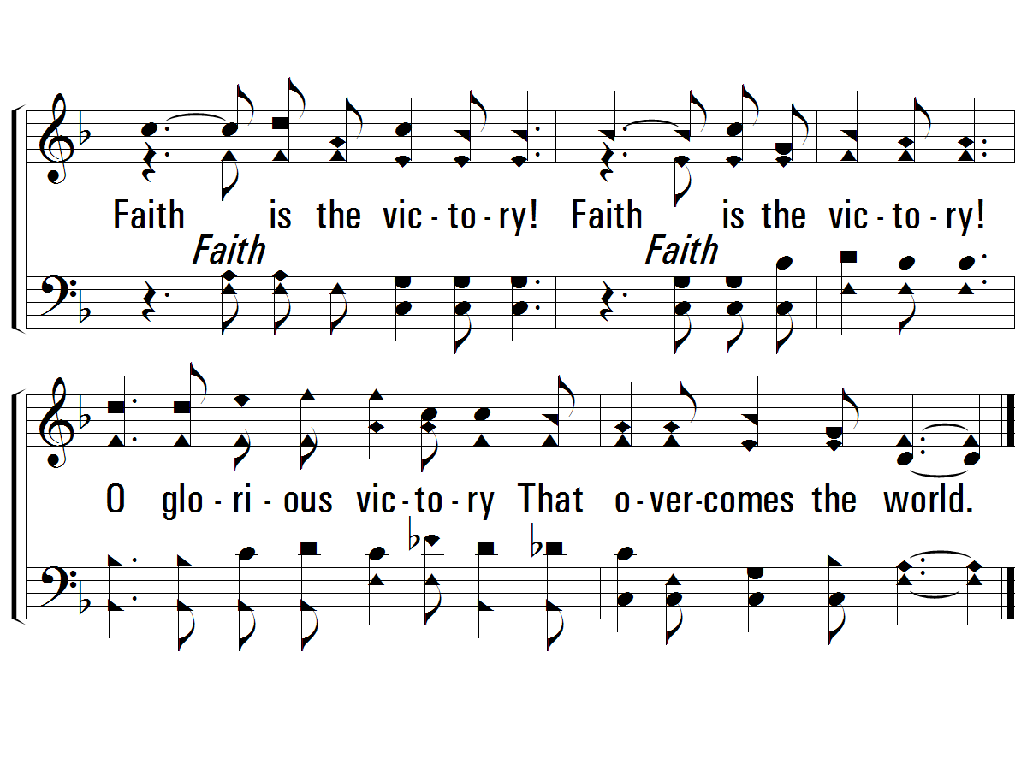
c – Faith is the Victory
134
Faith is the victory!
Faith is the victory!
O glorious victory
That overcomes the world.
© 2001 The Paperless Hymnal™

Slide 13
2 – Faith is the Victory
134
2.
His banner over us is love,
Our sword the Word of God;
We tread the road the saints above
With shouts of triumph trod.
By faith they, like a whirlwind's breath,
Swept on o'er every field;
The faith by which they conquered death
Is still our shining shield.
Words by: John H. Yates
Music by: Ira D. Sankey
© 2001 The Paperless Hymnal™

Slide 14
2 – Faith is the Victory
134
© 2001 The Paperless Hymnal™

Slide 15
c – Faith is the Victory
134
Faith is the victory!
Faith is the victory!
O glorious victory
That overcomes the world.
© 2001 The Paperless Hymnal™

Slide 16
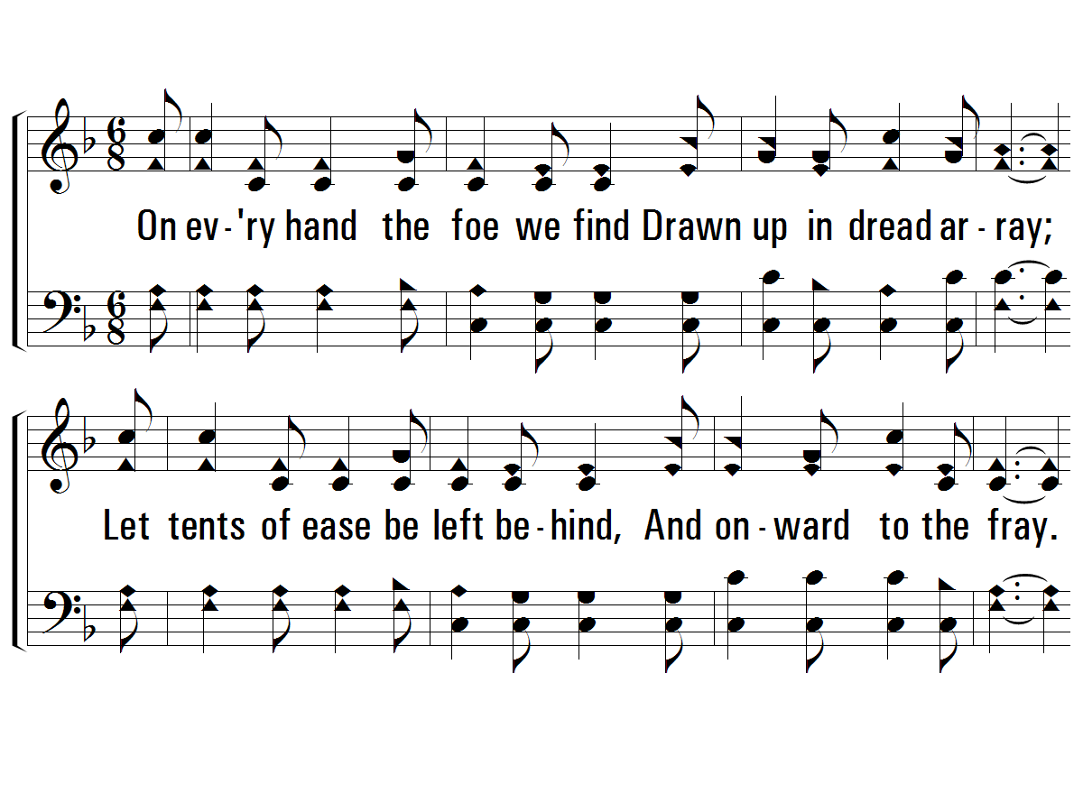
3 – Faith is the Victory
134
3.
On every hand the foe we find
Drawn up in dread array;
Let tents of ease be left behind,
And onward to the fray.
Salvation's helmet on each head,
With truth all girt about,
The earth shall tremble 'neath our tread,
And echo with our shout.
Words by: John H. Yates
Music by: Ira D. Sankey
© 2001 The Paperless Hymnal™

Slide 17
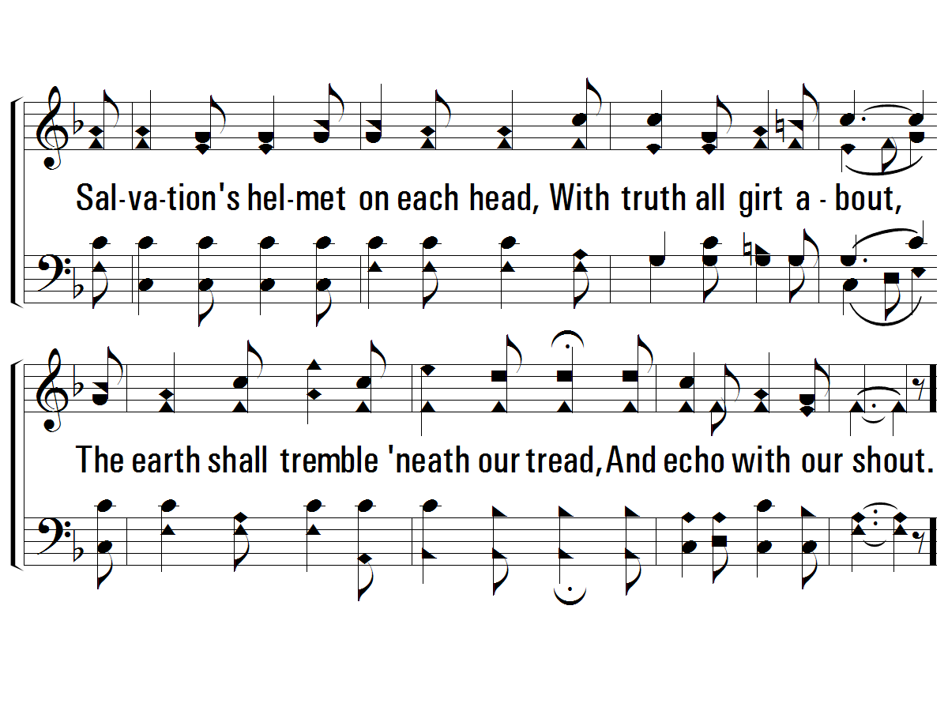
3 – Faith is the Victory
134
© 2001 The Paperless Hymnal™

Slide 18
c – Faith is the Victory
134
Faith is the victory!
Faith is the victory!
O glorious victory
That overcomes the world.
© 2001 The Paperless Hymnal™

Slide 19
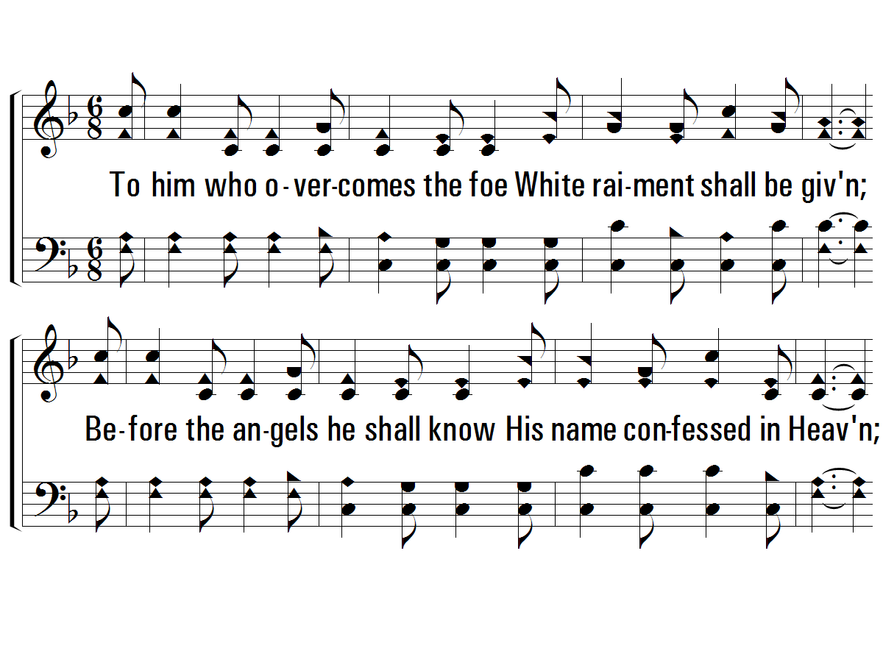
4 – Faith is the Victory
134
4.
To him who overcomes the foe
White raiment shall be given;
Be-fore the angels he shall know
His name confessed in Heaven;
Then onward from the hills of light,
Our hearts with love aflame;
We'll vanquish all the hosts of night,
In Jesus' conquering name.
Words by: John H. Yates
Music by: Ira D. Sankey
© 2001 The Paperless Hymnal™

Slide 20
4 – Faith is the Victory
134
© 2001 The Paperless Hymnal™

Slide 21
c – Faith is the Victory
134
Faith is the victory!
Faith is the victory!
O glorious victory
That overcomes the world.
END
© 2001 The Paperless Hymnal™

Slide 22
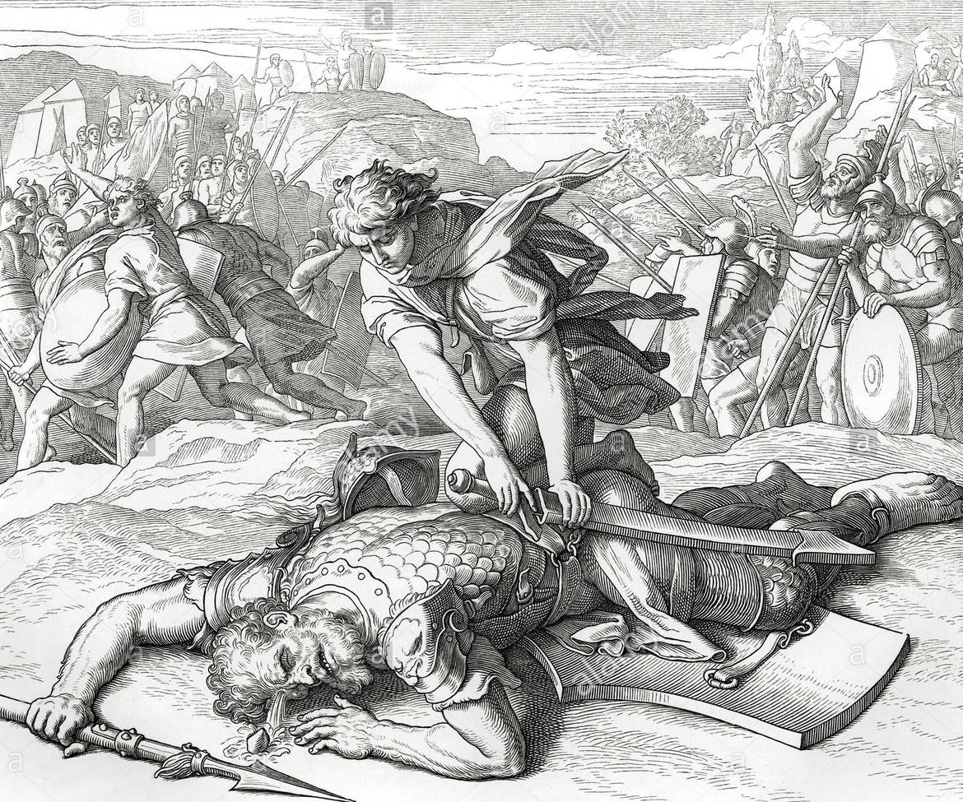

Slide 23
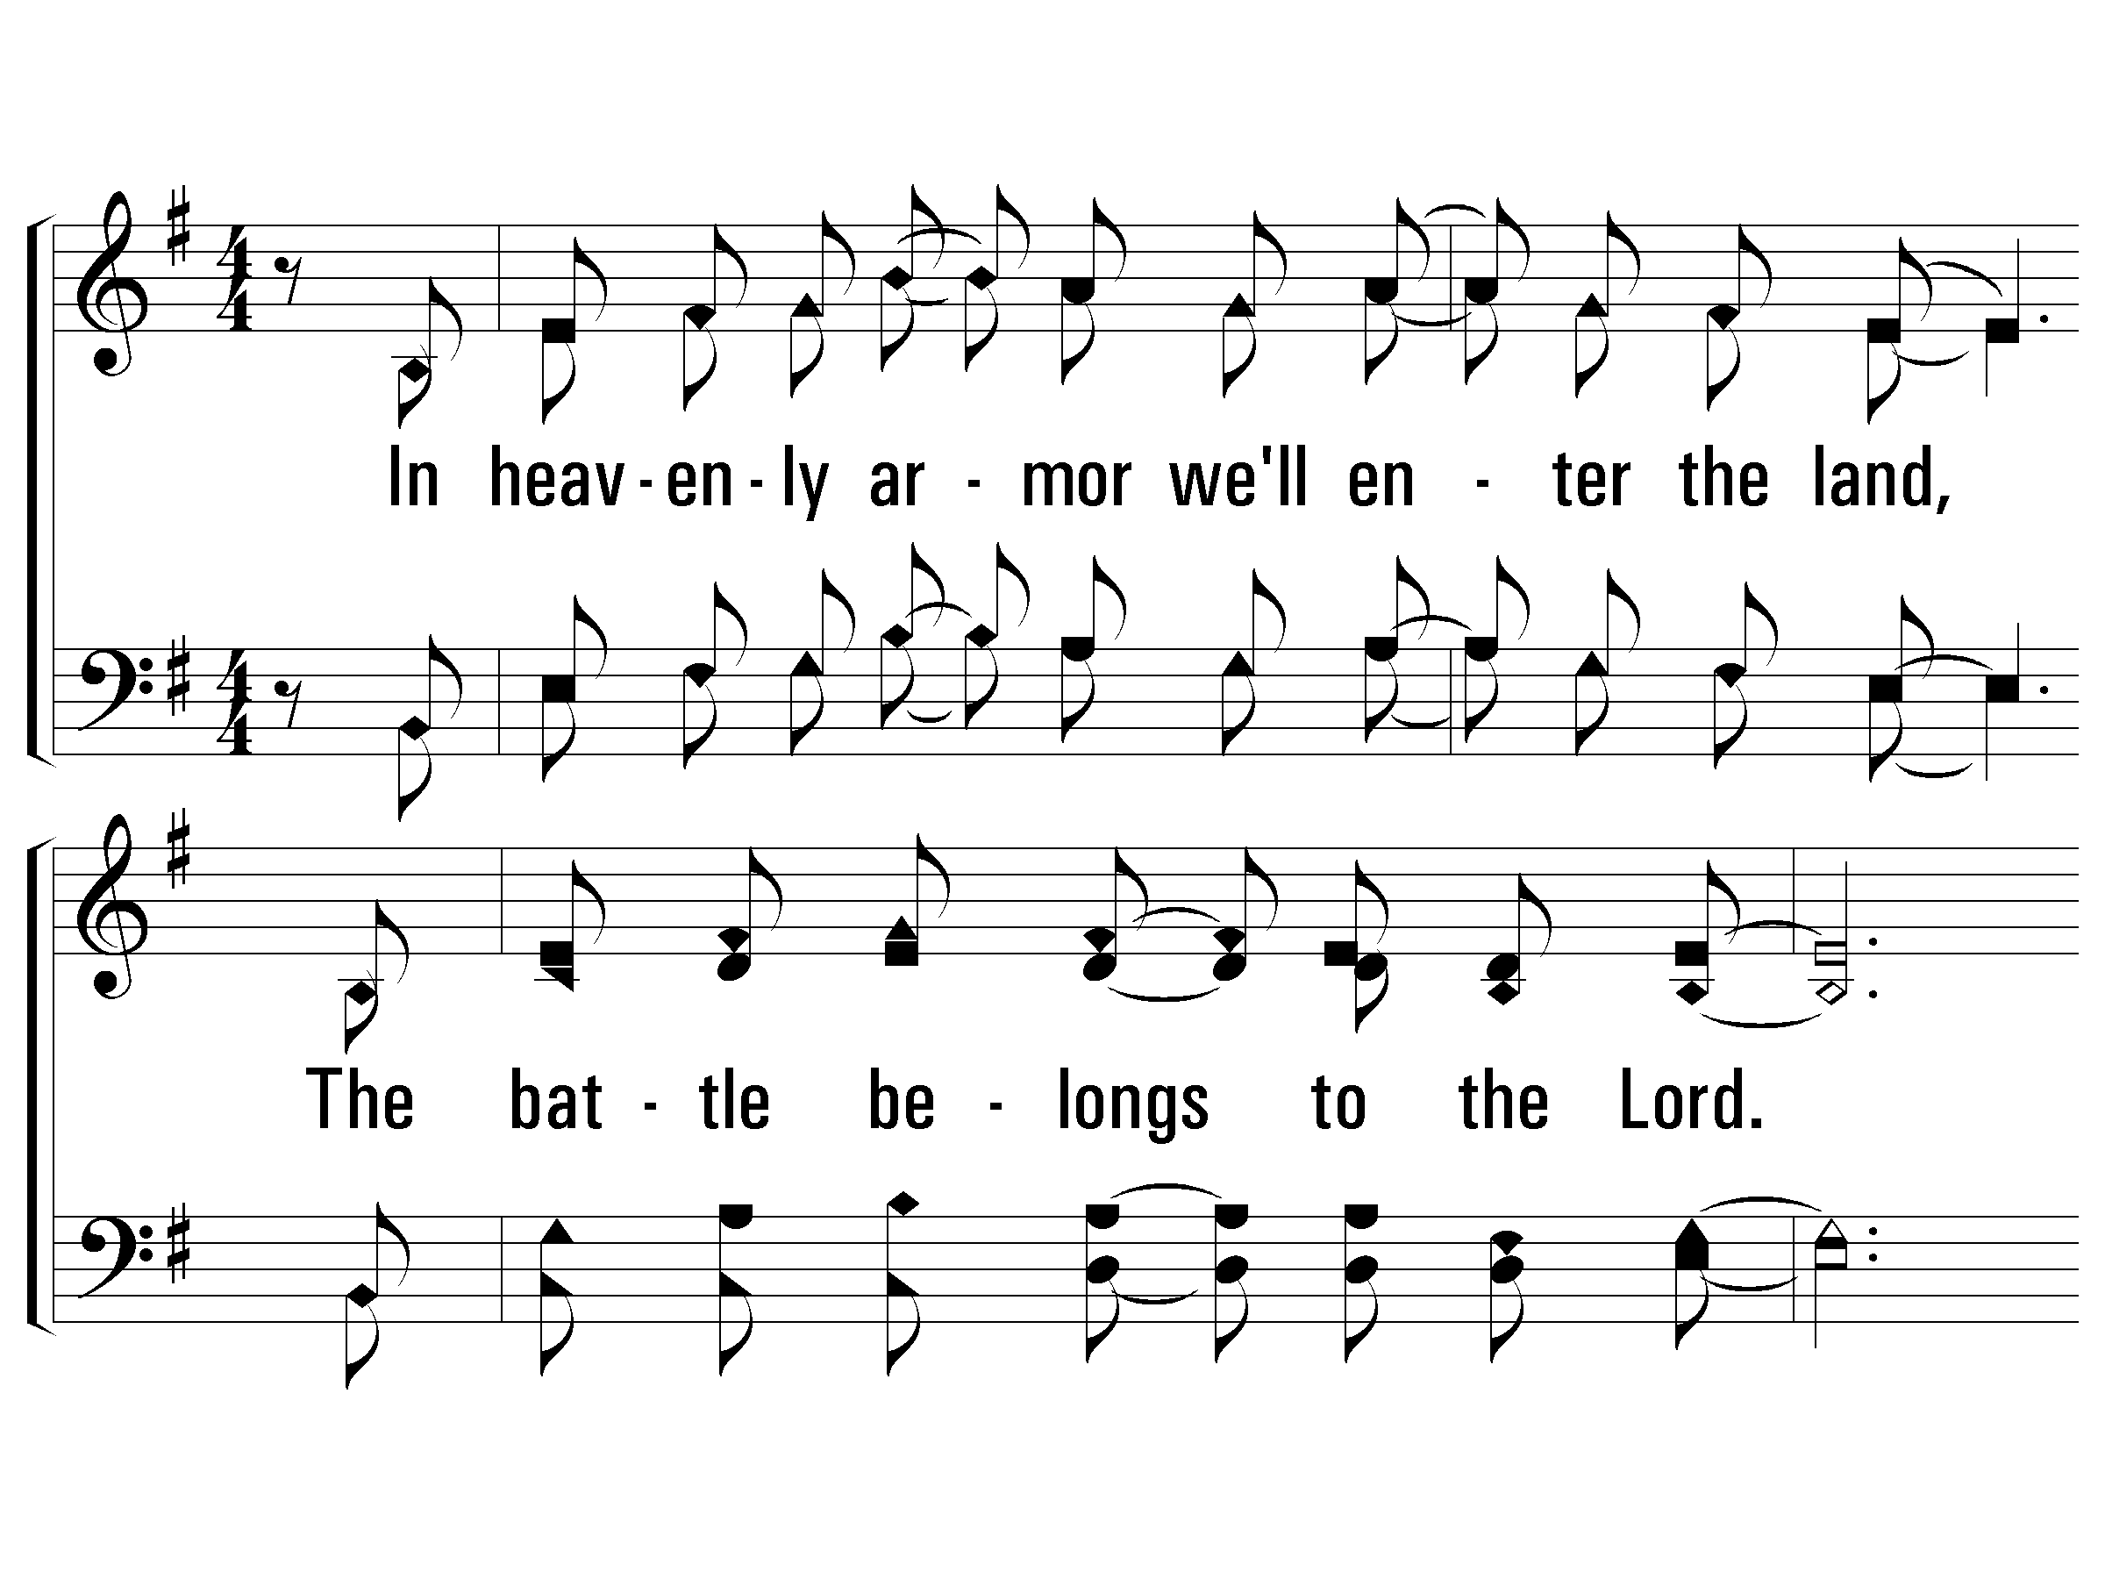
1 – The Battle Belongs to the Lord
977
1.
In heavenly armor we'll enter the land,
The battle belongs to the Lord.
No weapon that's fashioned against us will stand,
The battle belongs to the Lord.
Words & Music: Jamie Owens-Collins
Copyright © 1984 by Fairhill Music, Inc. (ASCAP)
© 2003 The Paperless Hymnal™

Slide 24
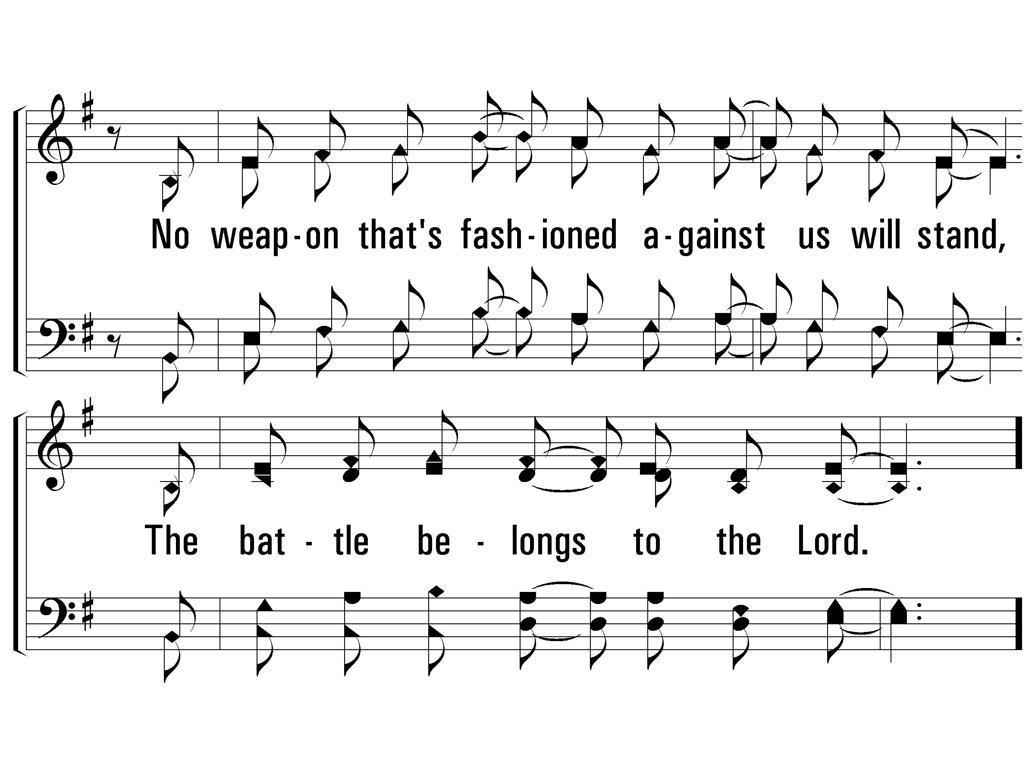
1 – The Battle Belongs to the Lord
977
© 2003 The Paperless Hymnal™

Slide 25
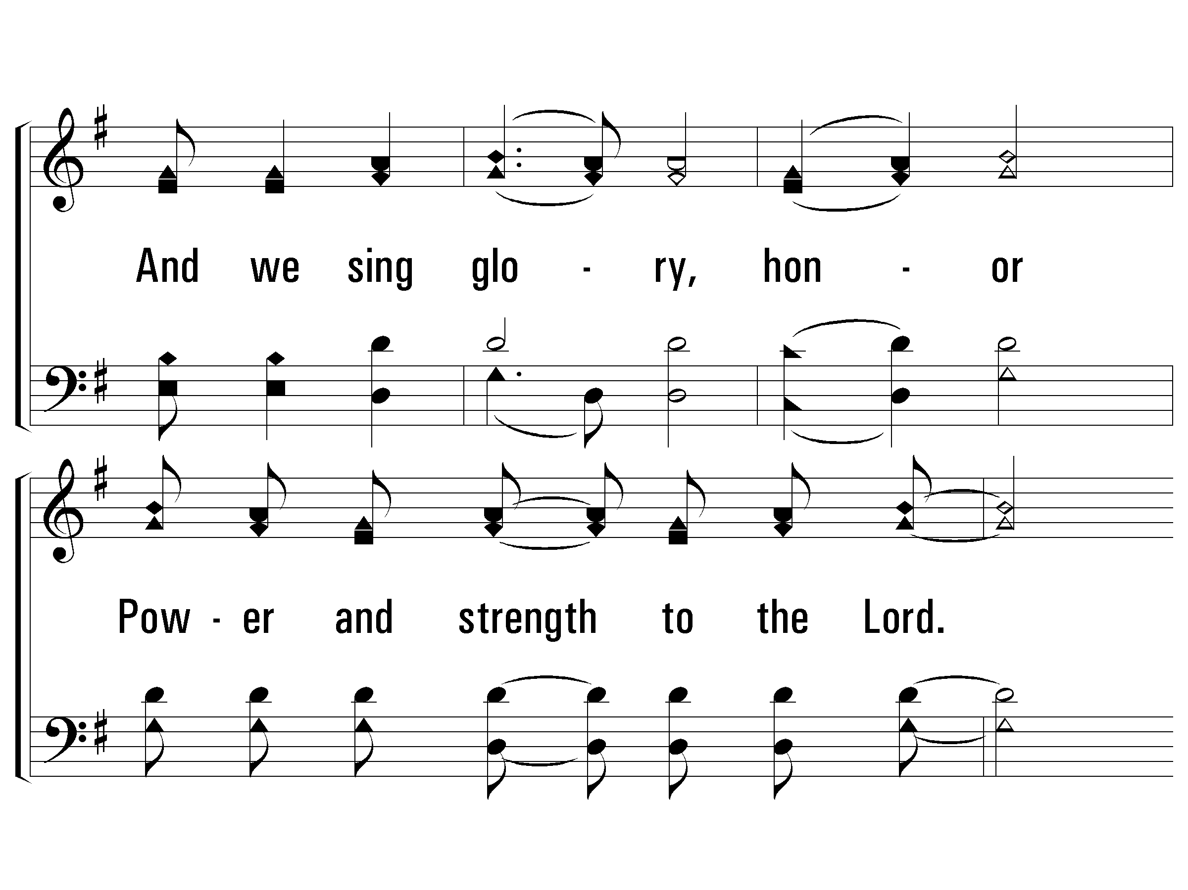
c – The Battle Belongs to the Lord
977
And we sing glory, honor
Power and strength to the Lord.
We sing glory, honor,
Power and strength to the Lord.
© 2003 The Paperless Hymnal™

Slide 26
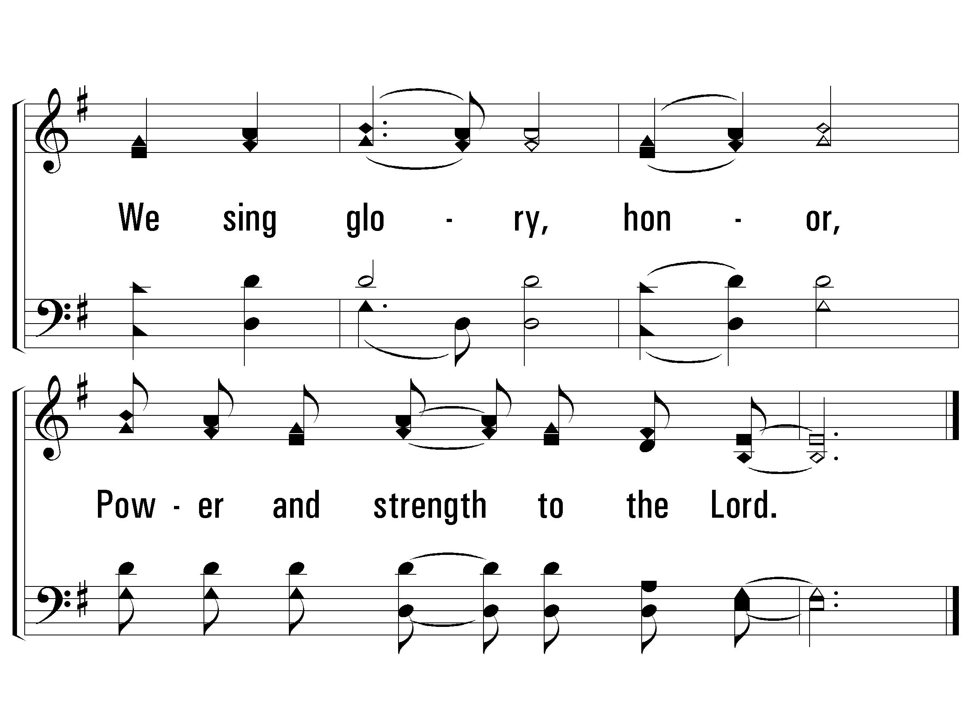
c – The Battle Belongs to the Lord
977
© 2003 The Paperless Hymnal™

Slide 27
2 – The Battle Belongs to the Lord
977
2.
When the power of darkness comes in like a flood,
The battle be-longs to the Lord.
He's raised up a standard, the power of His blood,
The battle belongs to the Lord.
Words & Music: Jamie Owens-Collins
Copyright © 1984 by Fairhill Music, Inc. (ASCAP)
© 2003 The Paperless Hymnal™

Slide 28
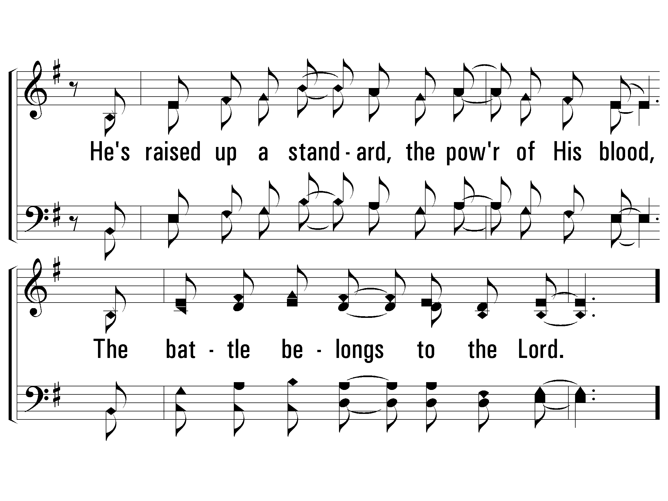
2 – The Battle Belongs to the Lord
977
© 2003 The Paperless Hymnal™

Slide 29
c – The Battle Belongs to the Lord
977
And we sing glory, honor
Power and strength to the Lord.
We sing glory, honor,
Power and strength to the Lord.
© 2003 The Paperless Hymnal™

Slide 30
c – The Battle Belongs to the Lord
977
© 2003 The Paperless Hymnal™

Slide 31
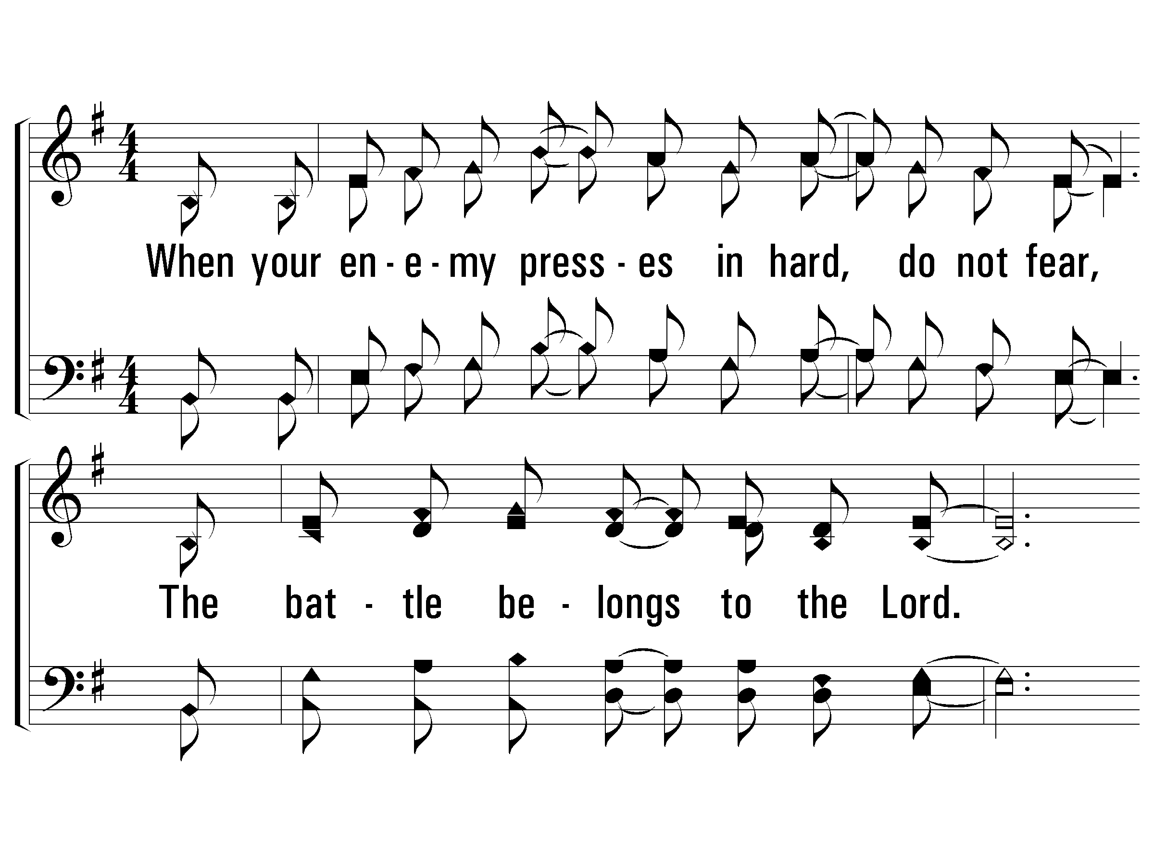
3 – The Battle Belongs to the Lord
977
3.
When your enemy presses in hard, do not fear,
The battle belongs to the Lord.
Take courage, my friend, your redemption is near,
The battle belongs to the Lord.
Words & Music: Jamie Owens-Collins
Copyright © 1984 by Fairhill Music, Inc. (ASCAP)
© 2003 The Paperless Hymnal™

Slide 32
3 – The Battle Belongs to the Lord
977
© 2003 The Paperless Hymnal™

Slide 33
c – The Battle Belongs to the Lord
977
And we sing glory, honor
Power and strength to the Lord.
We sing glory, honor,
Power and strength to the Lord.
© 2003 The Paperless Hymnal™

Slide 34
c – The Battle Belongs to the Lord
977
© 2003 The Paperless Hymnal™

Slide 36
David & Goliath

Slide 37
Humbling & Exalting
1 Samuel 2:1-10 – Hannah’s Prayer
“…raises up the poor from the dust” (vs. 8)
2 Samuel 1:19-27 – David’s Lament for Saul
“How the mighty have fallen” (vs. 19, 25, 27)
2 Samuel 22:1-51 – David Praises God (cf. Psalm 18)
“You save a humble people, but your eyes are on the haughty to bring them down” (vs. 28)

Slide 38
Foreshadowing Jesus
Defeated Strong Enemy
Used Enemies Weapon
Marriage
Received Praise

Slide 40
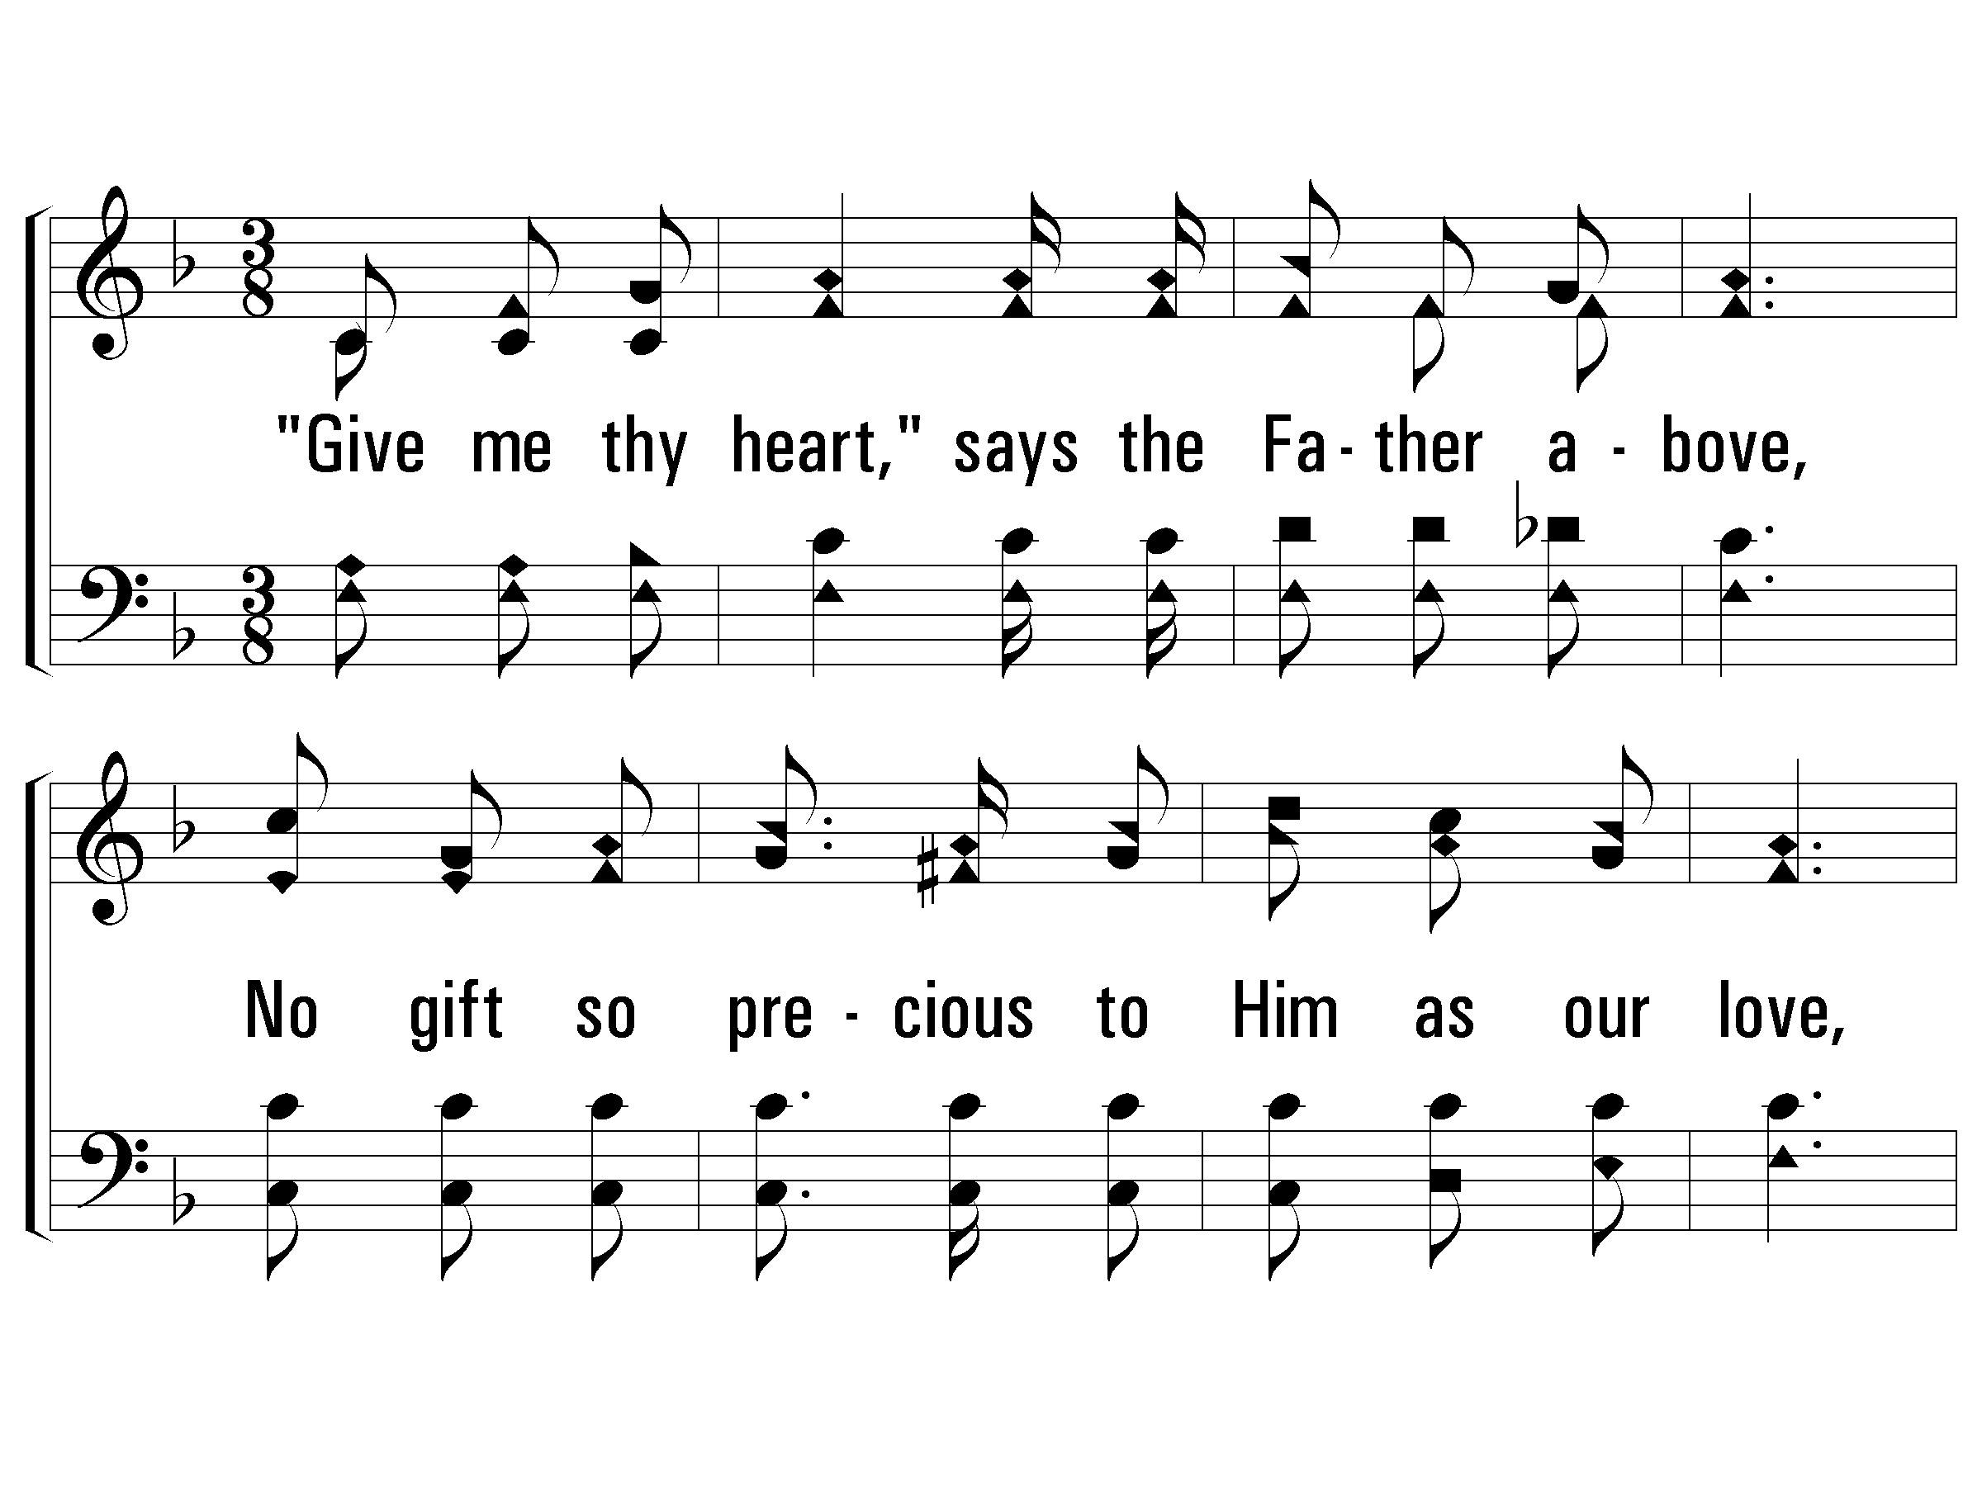
1 – Give Me Thy Heart
163
1.
"Give me thy heart," says the Father above,
No gift so precious to Him as our love,
Softly He whispers wherever thou art,
"Gratefully trust me, and give me thy heart."
Words: Eliza E. Hewitt
Music: William J. Kirkpatrick
© 2005 The Paperless Hymnal™

Slide 41
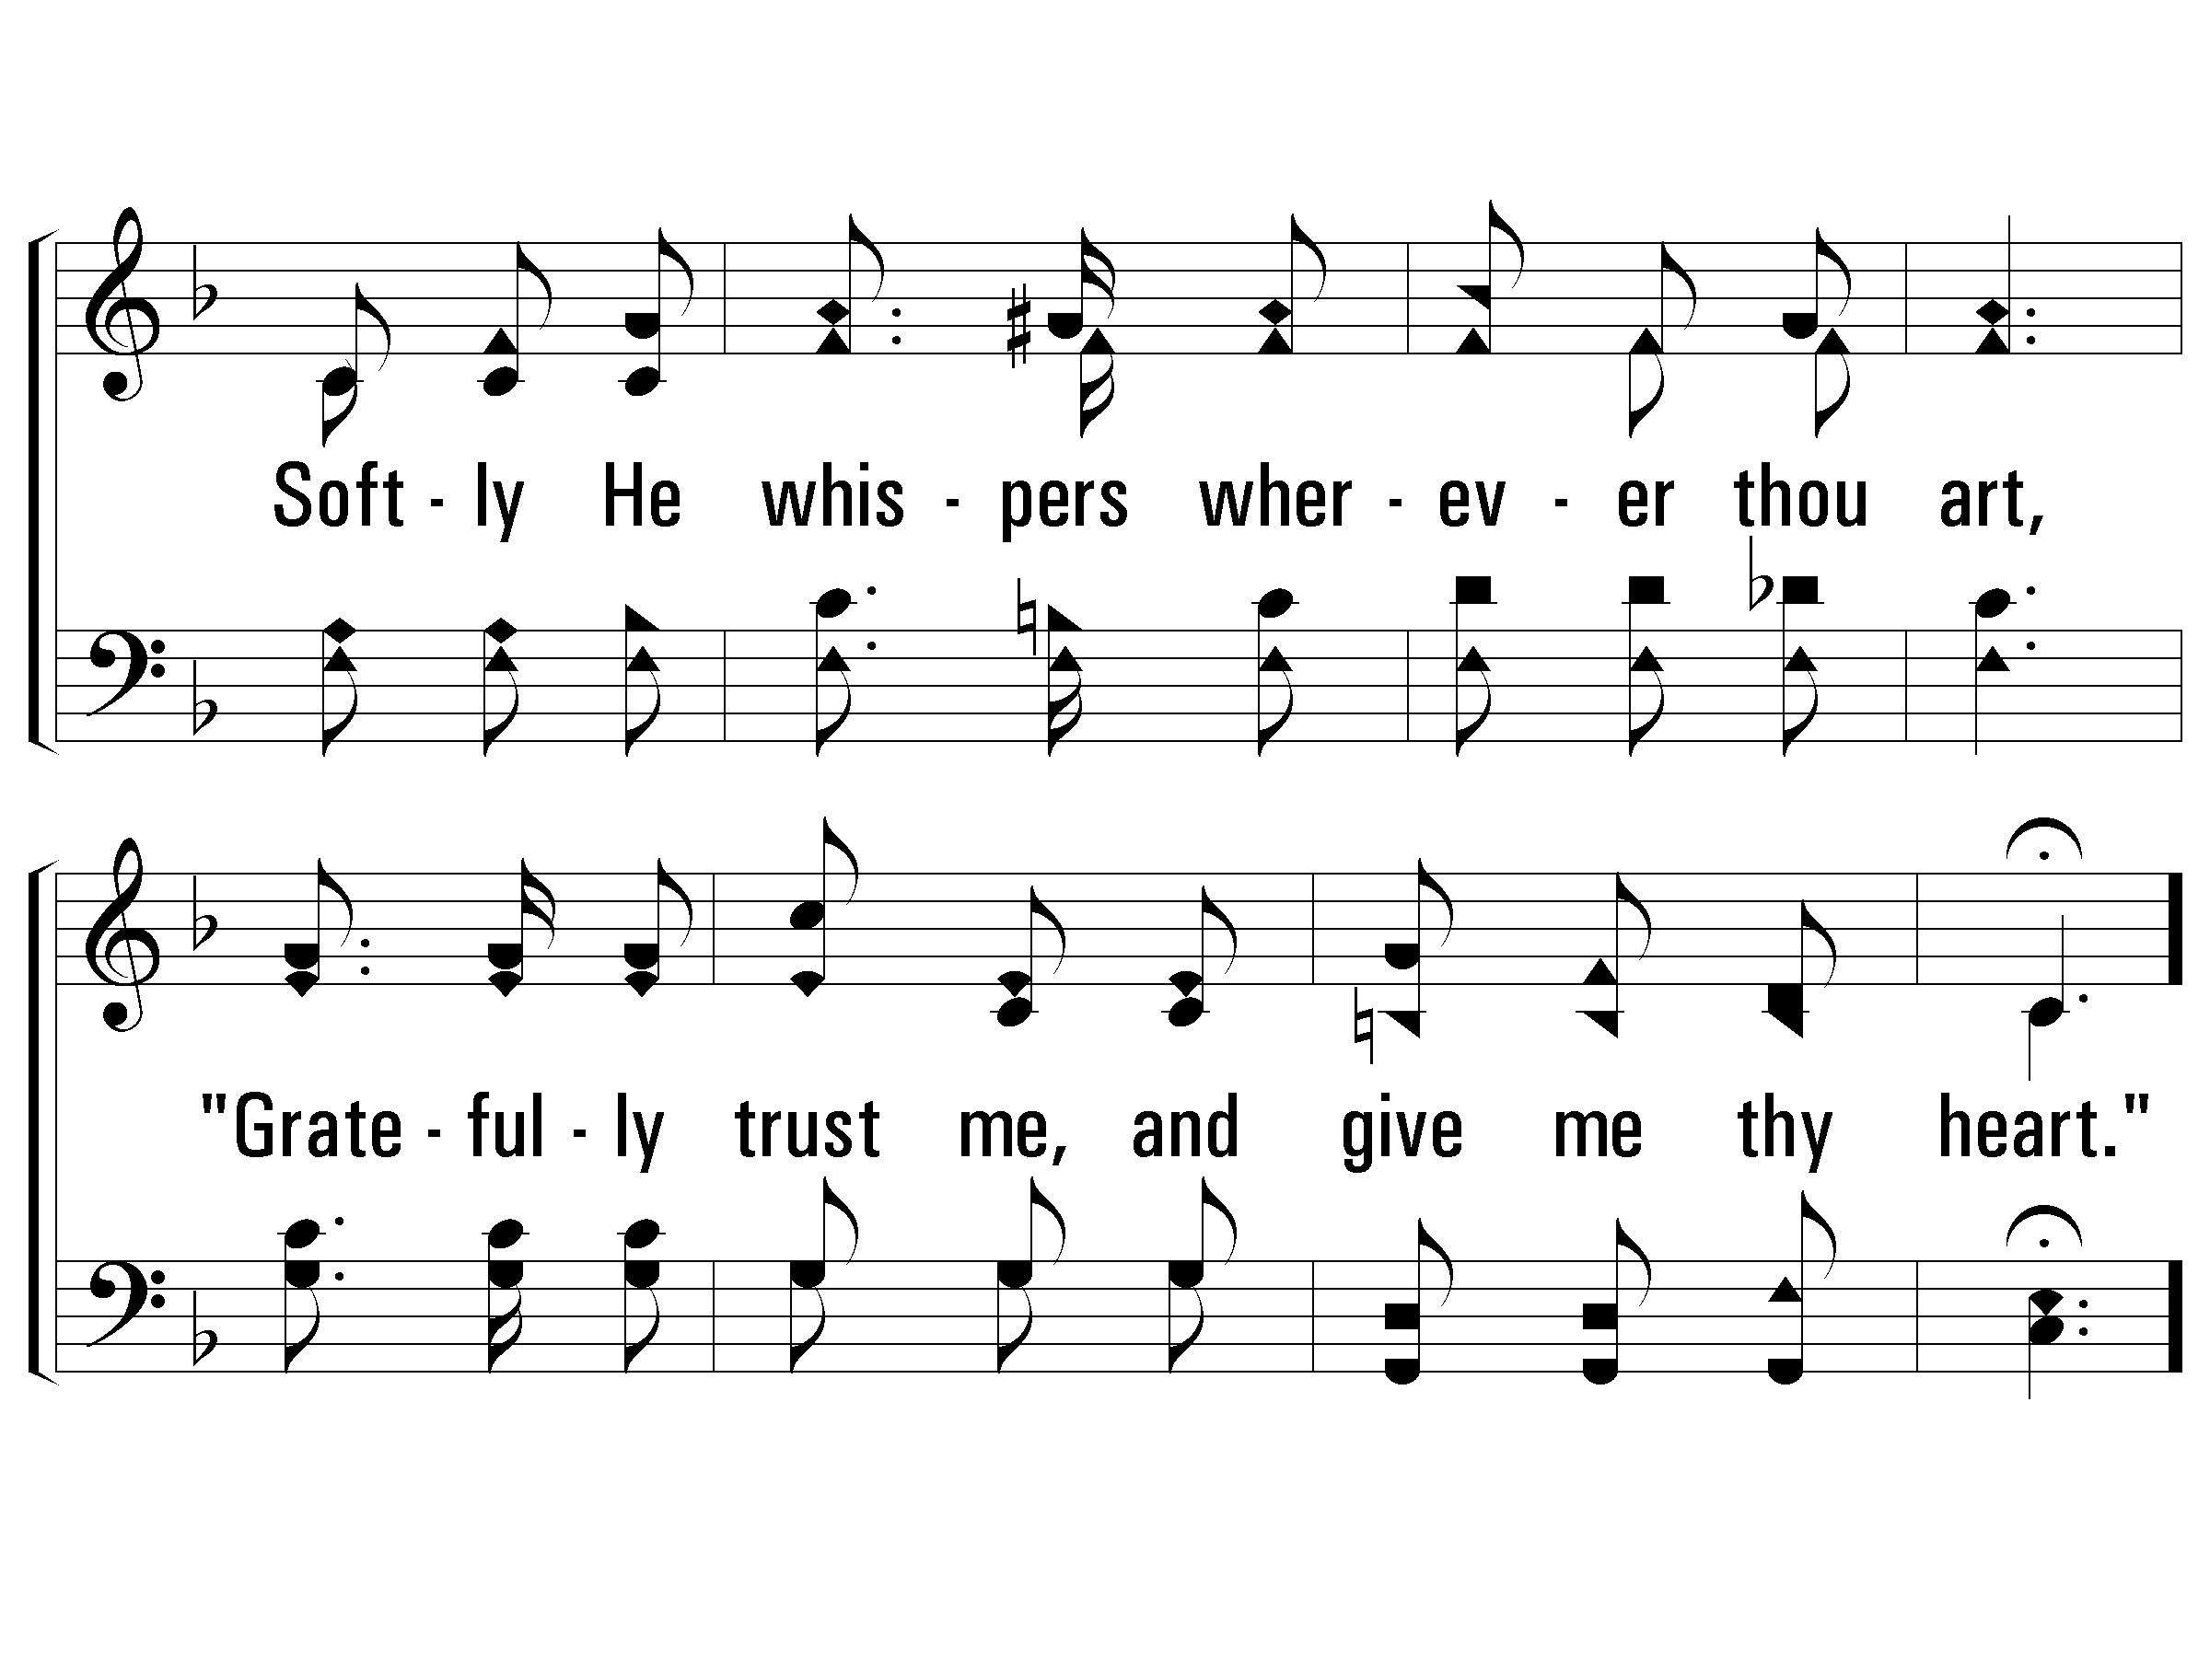
1 – Give Me Thy Heart
163
© 2005 The Paperless Hymnal™

Slide 42
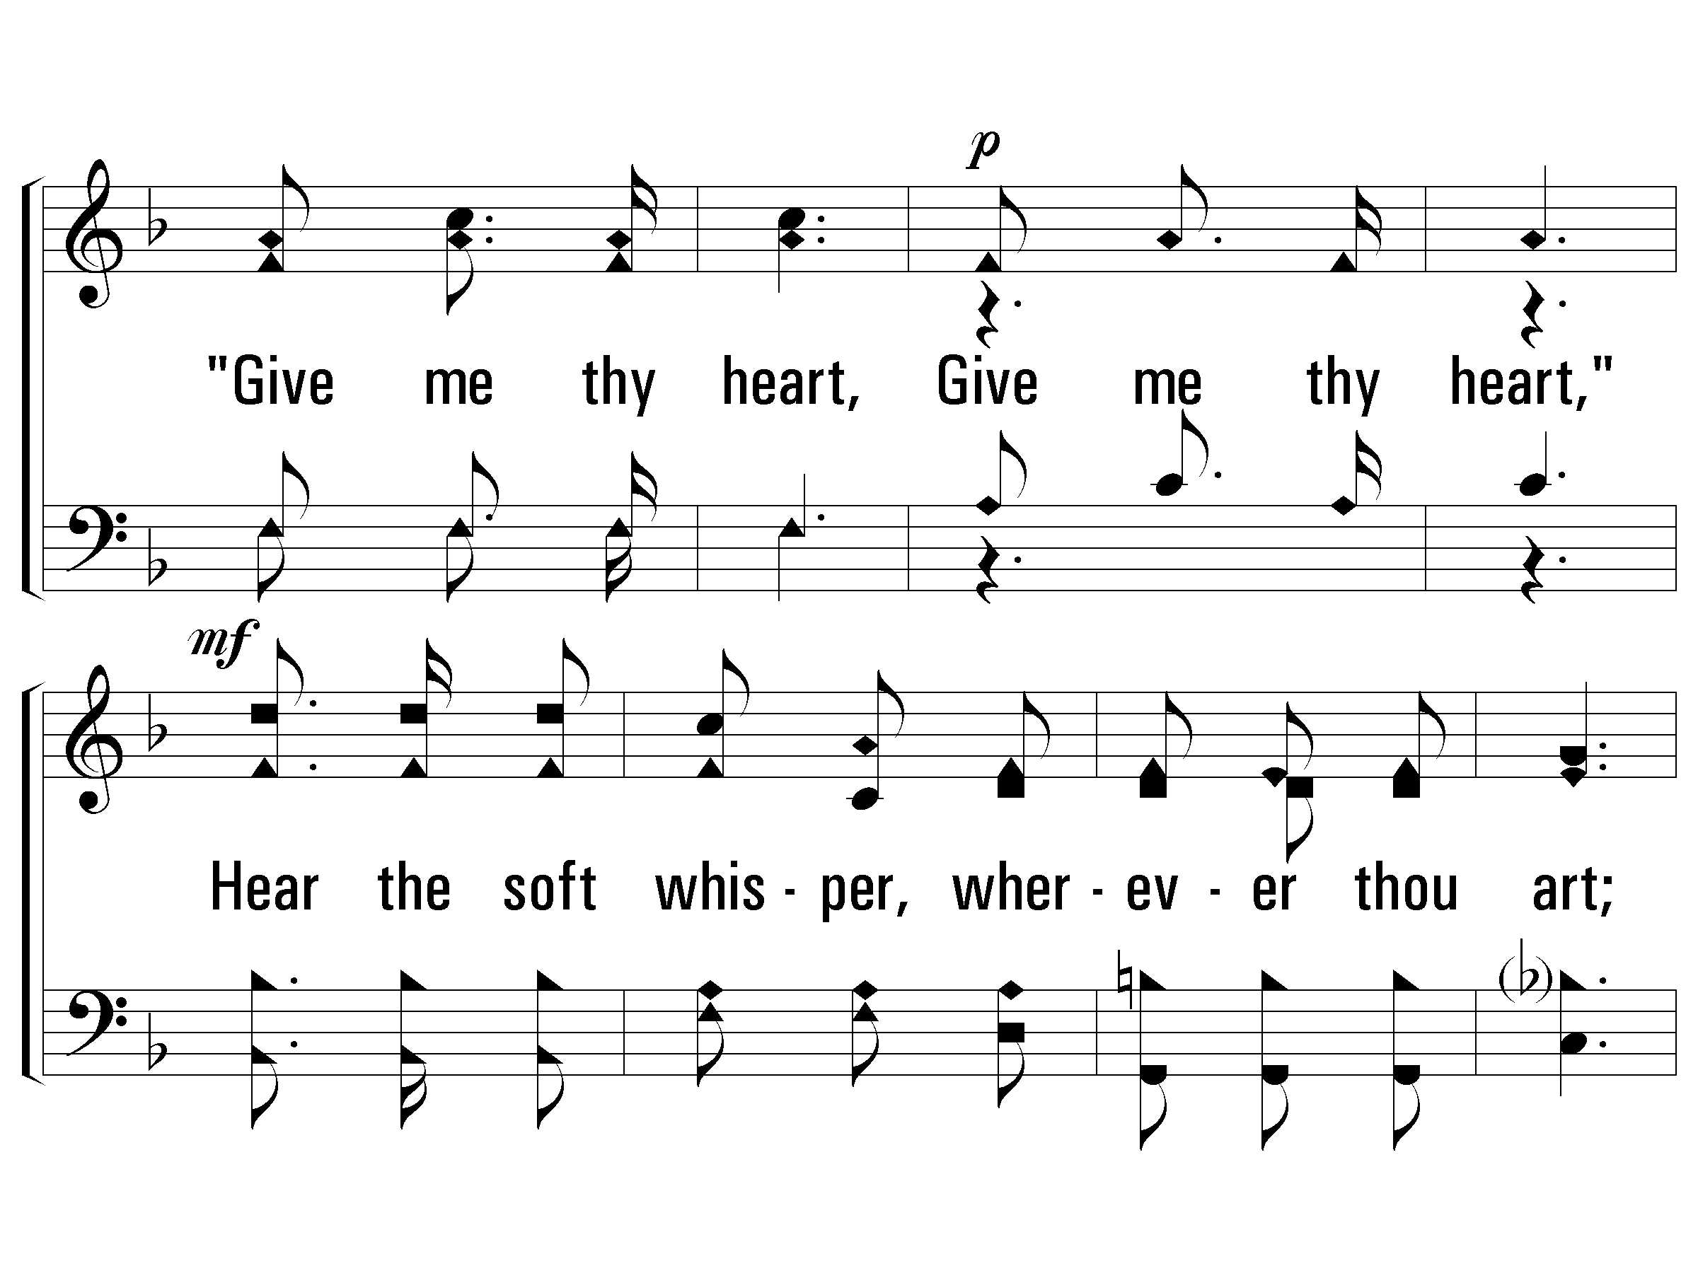
c – Give Me Thy Heart
163
"Give me thy heart, Give me thy heart,"
Hear the soft whisper, wherever thou art;
From this dark world, He would draw thee apart,
Speaking so tenderly, "Give me thy heart."
© 2005 The Paperless Hymnal™

Slide 43
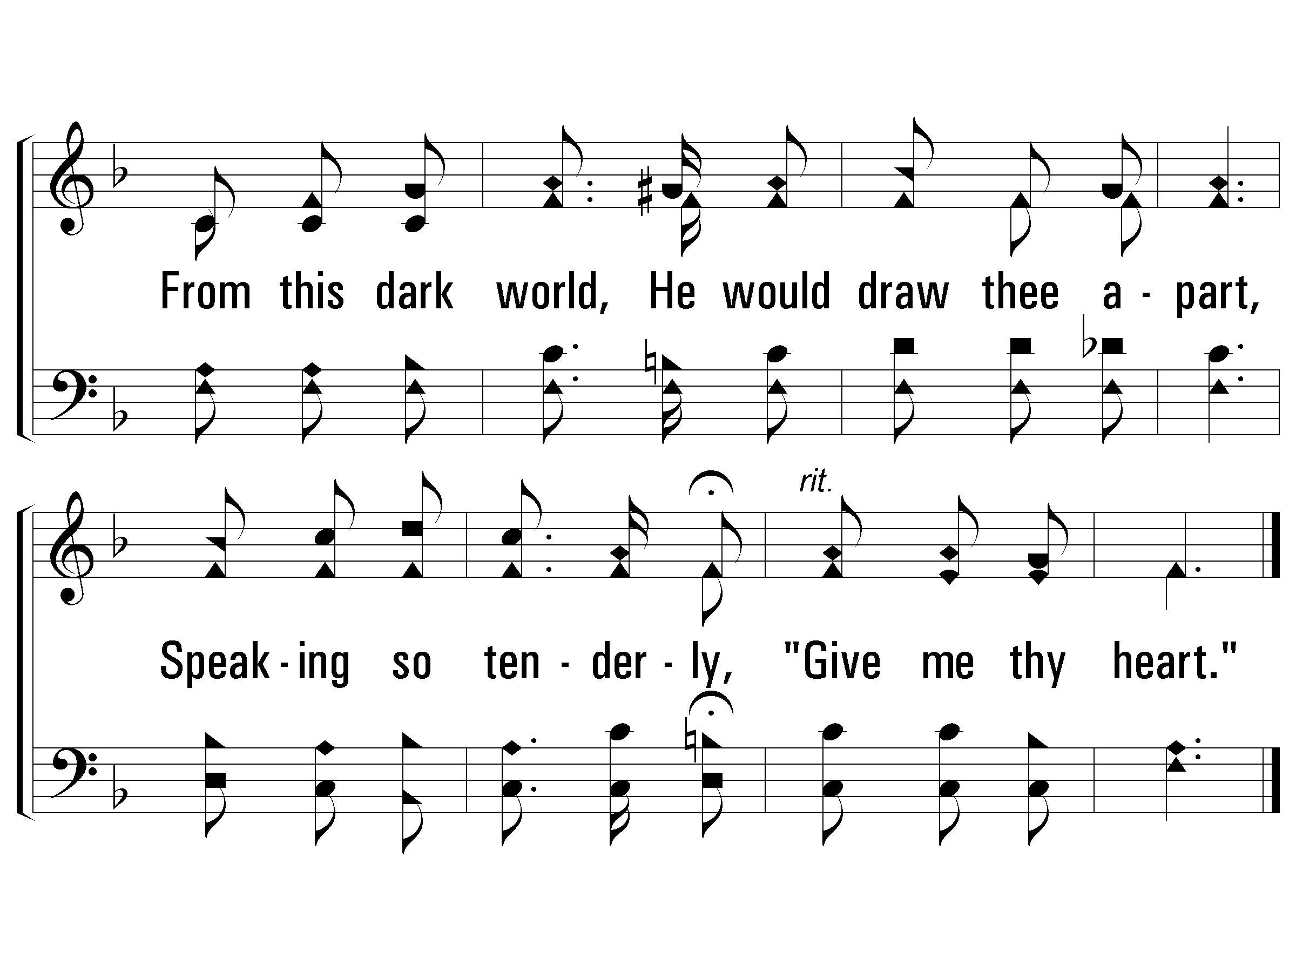
c – Give Me Thy Heart
163
© 2005 The Paperless Hymnal™

Slide 44
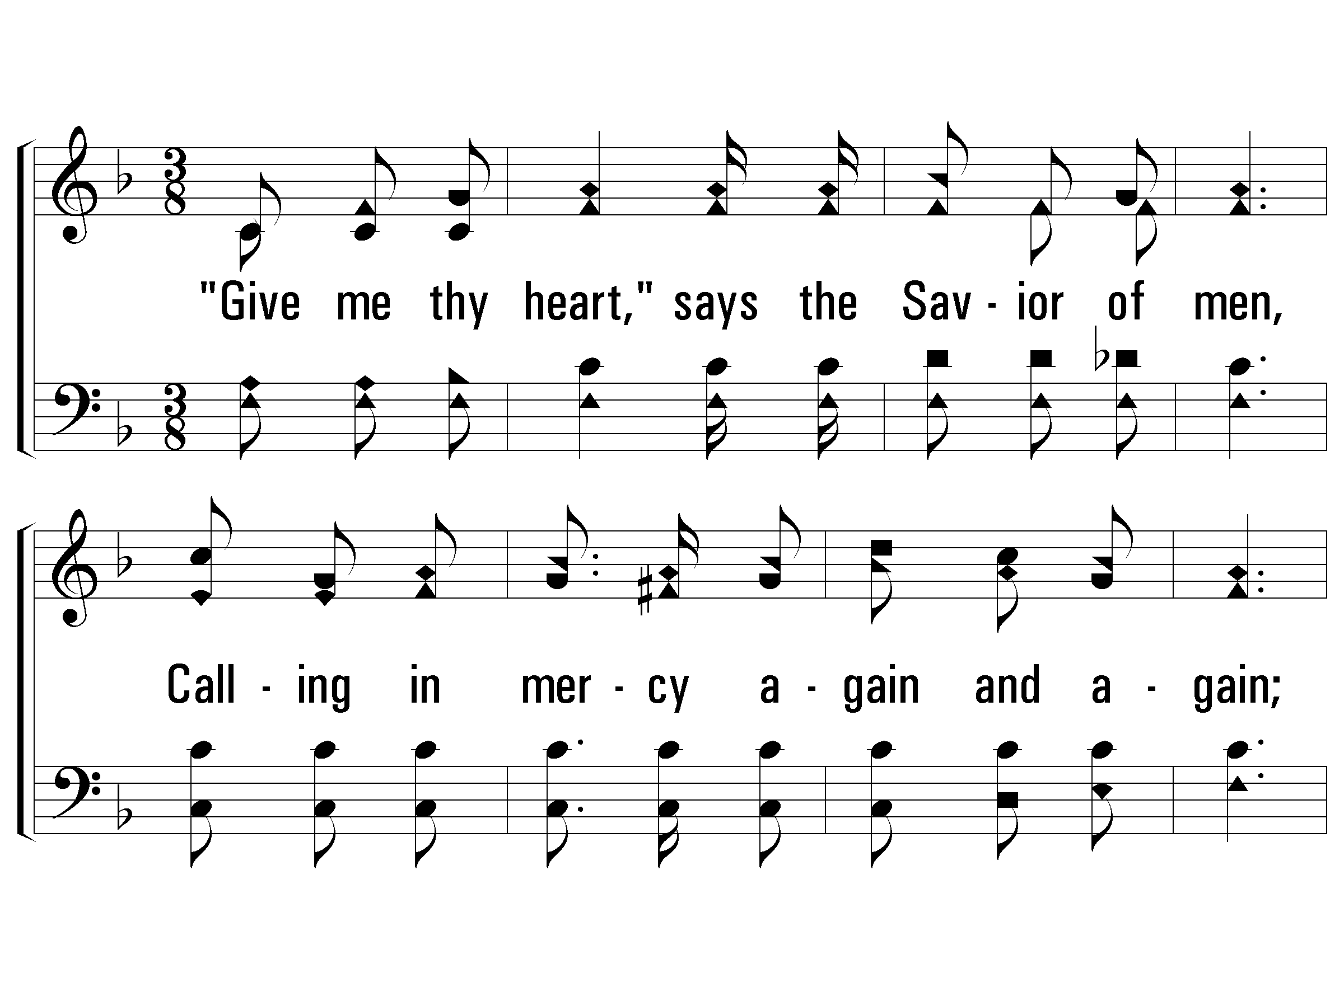
2 – Give Me Thy Heart
163
2.
"Give me thy heart," says the Savior of men,
Calling in mercy again and again;
"Turn now from sin, and from evil depart.
Have I not died for thee? Give me thy heart."
Words: Eliza E. Hewitt
Music: William J. Kirkpatrick
© 2005 The Paperless Hymnal™

Slide 45
2 – Give Me Thy Heart
163
© 2005 The Paperless Hymnal™

Slide 46
c – Give Me Thy Heart
163
"Give me thy heart, Give me thy heart,"
Hear the soft whisper, wherever thou art;
From this dark world, He would draw thee apart,
Speaking so tenderly, "Give me thy heart."
© 2005 The Paperless Hymnal™

Slide 47
c – Give Me Thy Heart
163
© 2005 The Paperless Hymnal™

Slide 48
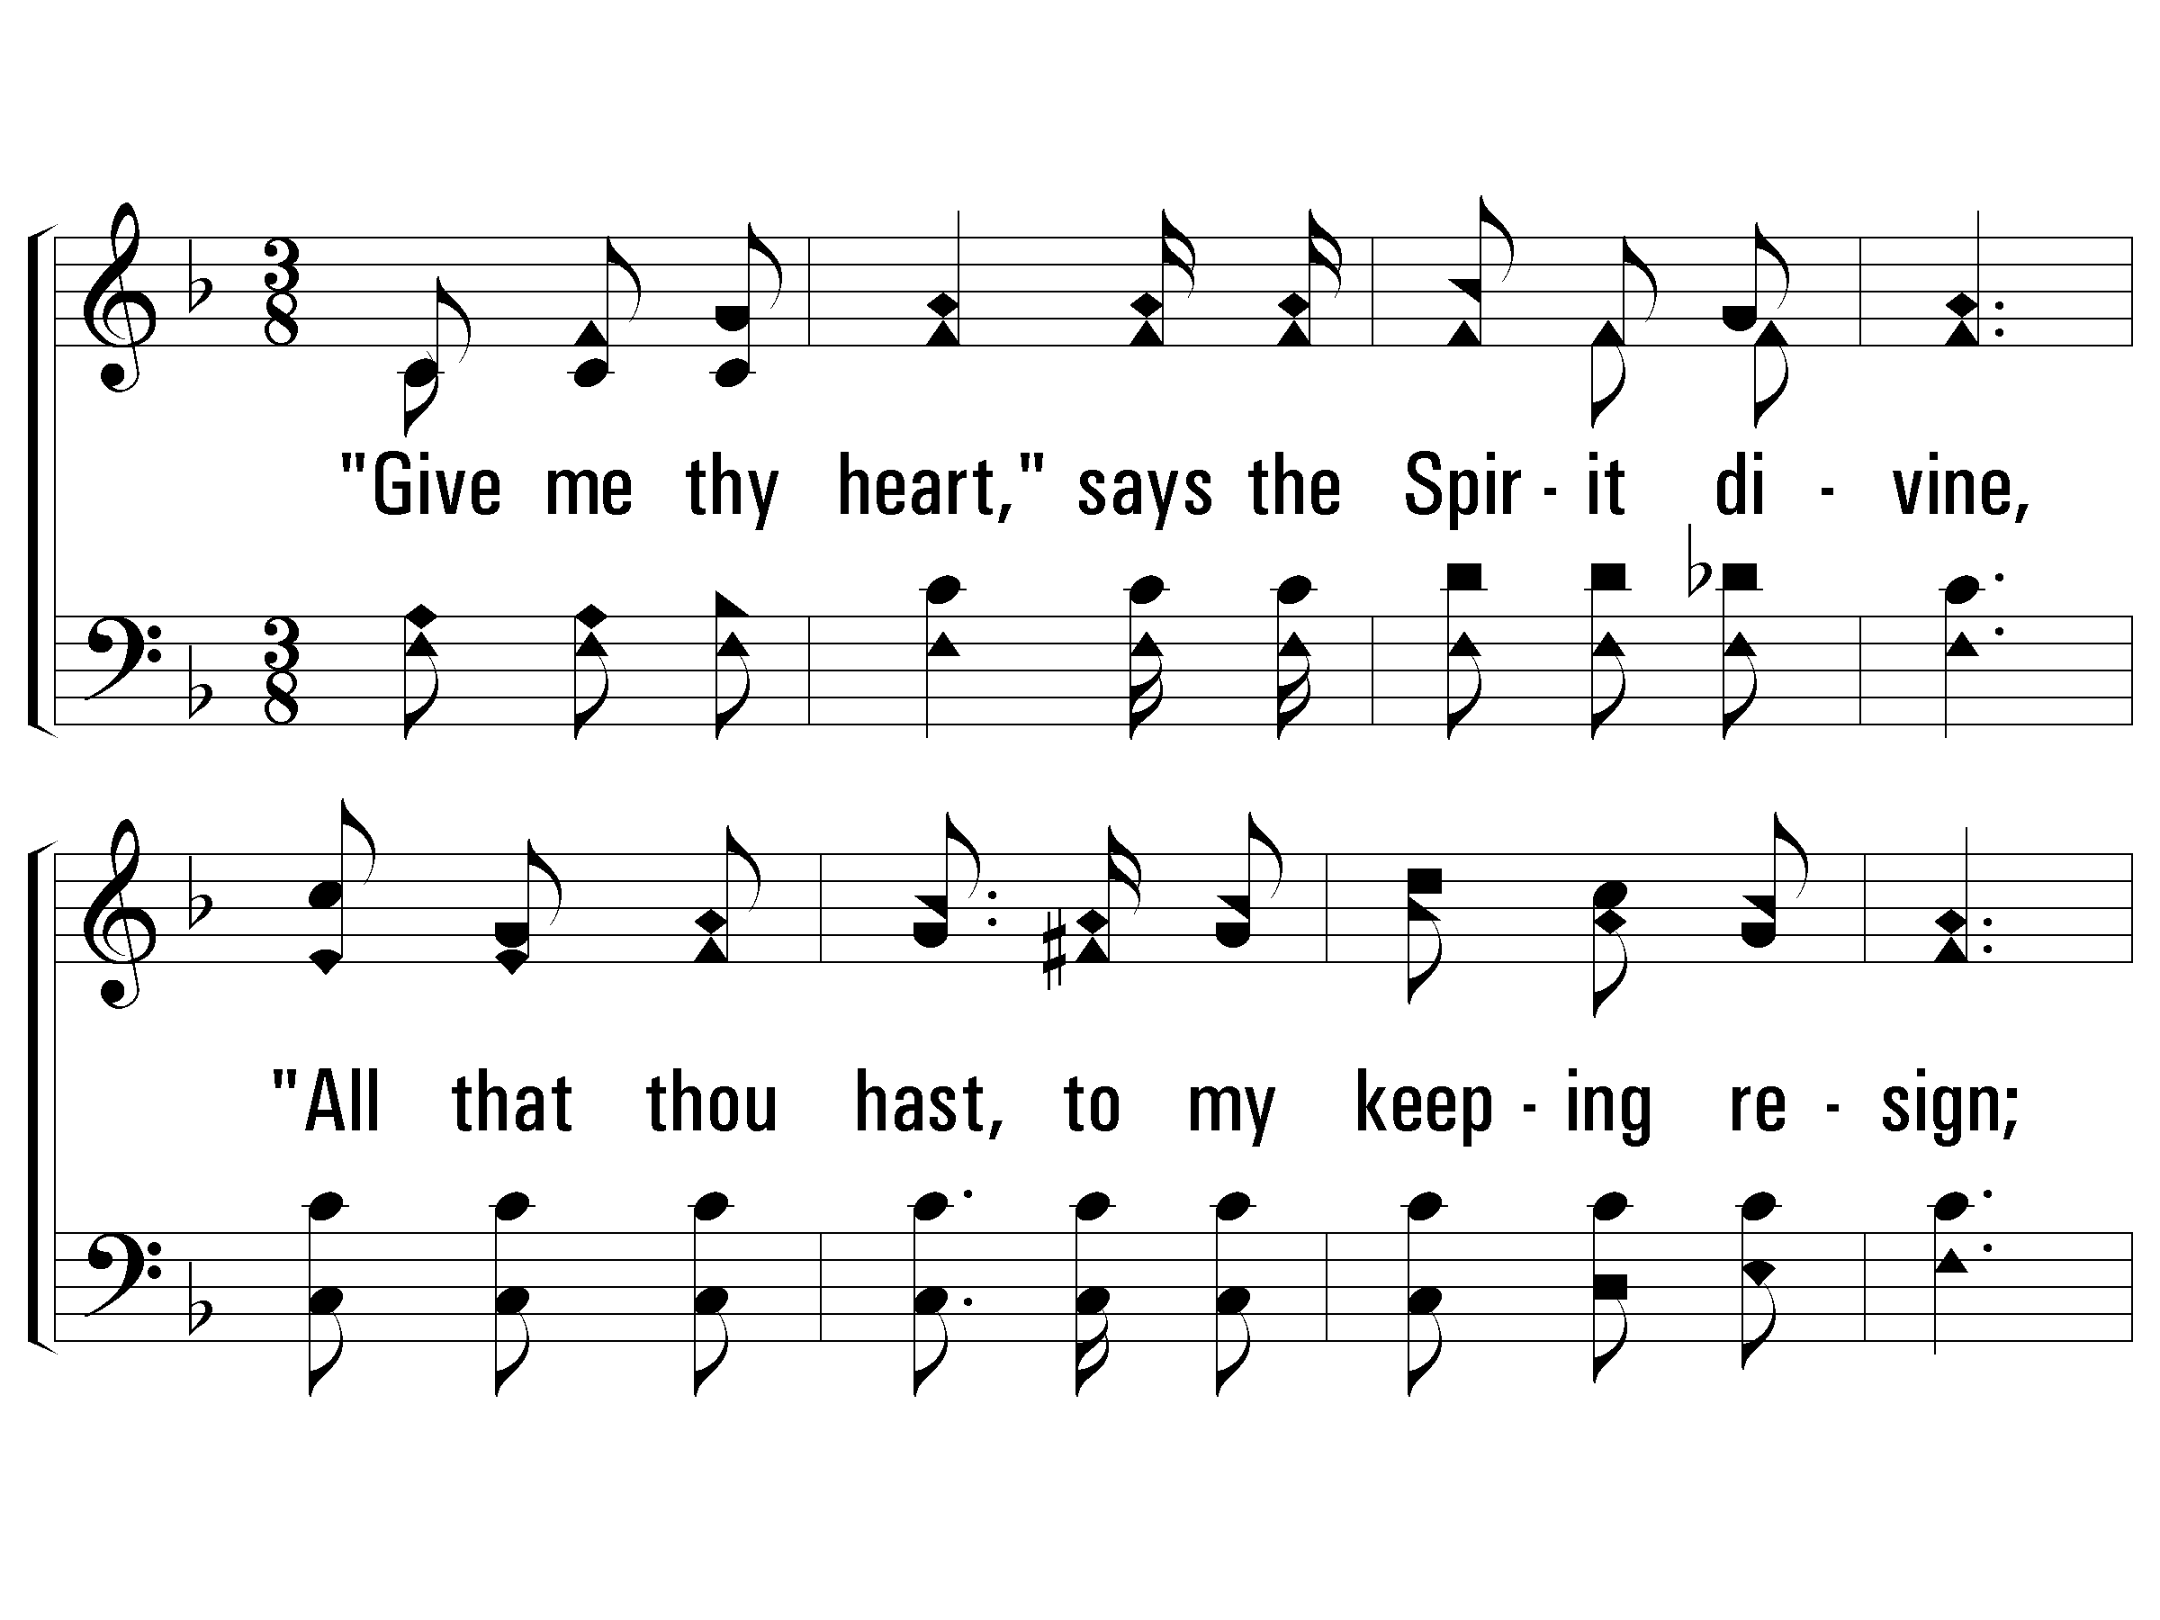
3 – Give Me Thy Heart
163
3.
"Give me thy heart," says the Spirit divine,
"All that thou hast, to my keeping resign;
Grace more abounding is mine to impart,
Make full surrender and give me thy heart."
Words: Eliza E. Hewitt
Music: William J. Kirkpatrick
© 2005 The Paperless Hymnal™

Slide 49
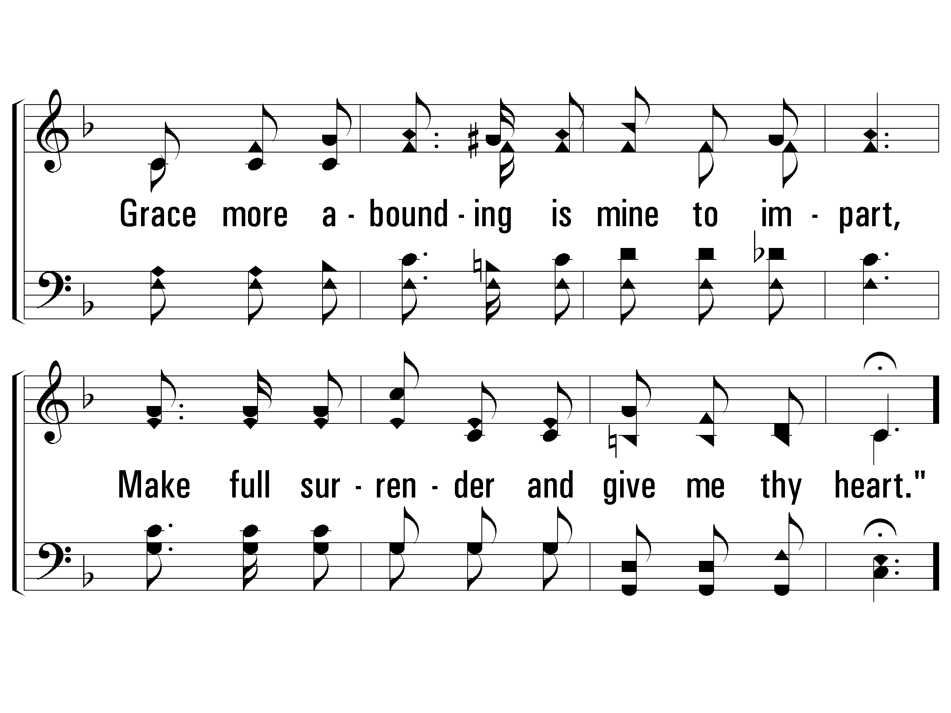
3 – Give Me Thy Heart
163
© 2005 The Paperless Hymnal™

Slide 50
c – Give Me Thy Heart
163
"Give me thy heart, Give me thy heart,"
Hear the soft whisper, wherever thou art;
From this dark world, He would draw thee apart,
Speaking so tenderly, "Give me thy heart."
© 2005 The Paperless Hymnal™

Slide 51
c – Give Me Thy Heart
163
© 2005 The Paperless Hymnal™

