Slide 1
Lesson 3: Working As A Team

Slide 2
Chapter 3 is not just the documentation of a Building Project
The work brought glory to God (currently the city was in shameful condition)
The work helped protect the people and make Jerusalem a viable place to live
The work helped bring the nation together as one working with a common purpose
The work helped accomplish God’s promise of restoration (Jeremiah 31)
The work is a story of the fruits of good leadership
The work is a story of the fruits of unity

Slide 3
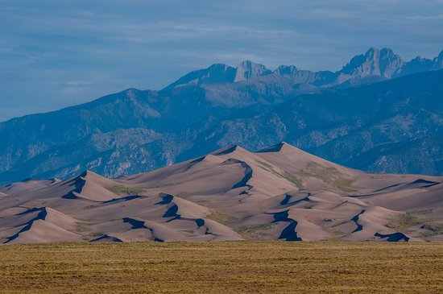
Context
Understand the significance of rebuilding the wall to the history of God’s people
Jerusalem falls to King Neb. and destroyed ~ 586 BC
Around this time Jeremiah quotes that the walls will be rebuilt (Jer 31:38)
The wall being built per prophecy should give us confidence in God’s promises today.

Slide 4
Context
538 BC
~538 BC - First wave of exiles return to Jerusalem under Zerubbabel, build the altar
458 BC
~458 BC – Second wave of exiles return led by Ezra, rebuild the temple
444 BC
~444 BC – Third wave of exiles return led by Nehemiah, rebuild the wall (about 142 years after walls destroyed and rebuild prophecy made). ~94 years after first wave of exiles returns.

Slide 5
The walls were destroyed, and the prophecy made that they would be built around 142 years ago. The people had been back in Jerusalem for around 94 years. Why did it take so long to begin to rebuild the wall?

Slide 6
All this time has elapsed…Why are these people so willing to rebuild the wall despite their position and occupation? Why are these people now so willing to work together to accomplish this rebuilding project?

Slide 7
Building the Wall

Slide 8
Who helped build the Wall?
High Priest (3:1)
Other Priests (3:1, 22, 28)
Men of Jericho (3:2)
Individuals, some repairing by their own house (3:2, 4, 6, 10, 11, 20, 21, 23, 24, 25, 29, 30)
Families, sons, daughters (3:3, 18)
Tekoites (minus their nobles…) (3:5) – Tekoites also repaired another section (3:27)
Men of Gideon and Mizpah (3:7)
Governors/rulers (3:7, 9, 12, 14, 15, 16, 17, 18, 19)
Goldsmith (3:8, 31, 32)
Perfumer (3:8)
Inhabitants of Zenoah (3:13)
Levites (3:17)
Temple servants (3:26)
Merchants (3:32)

Slide 9
Applications 1. Why is it important to work with and “next to” brethren (in unity)?

Slide 10
Why is it important to work with and “next to” brethren? 1. Accomplish more (Neh 3) 2. Jesus sent out disciples in groups of 2 (Luke 10:1) 3. Makes work easier (Ecc 4:9-10) 4. Not as easily broken (Ecc 4:12) 5. Encouragement/stir to good works (Heb 10:24) 6. We all need each other to function effectively (1 Cor 12:12-31)

