Slide 1

The Necessity of Holiness
Numbers 5-6

Slide 3
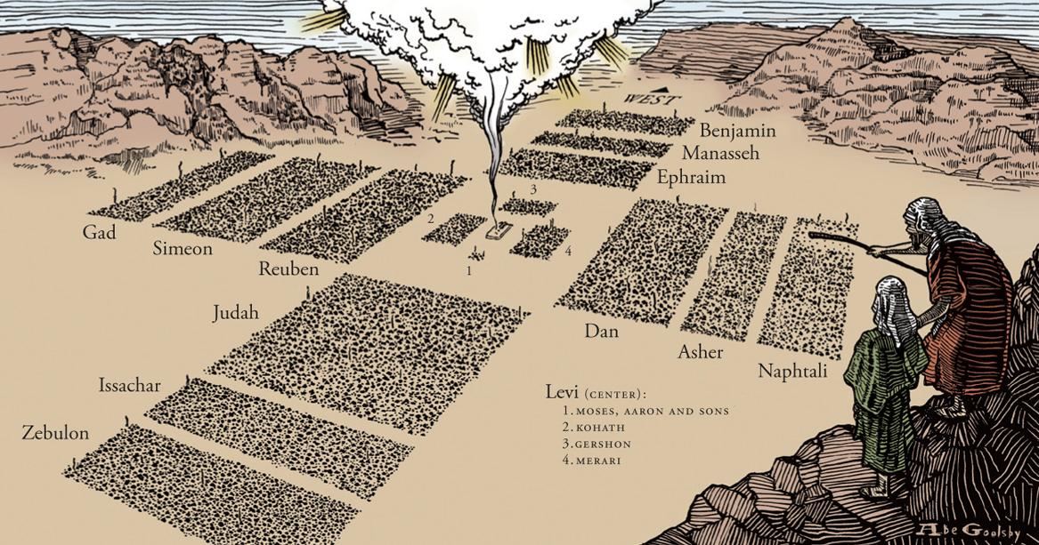

Slide 4

The Necessity of Holiness
Introductory Thoughts
  Priests Guarded Tabernacle (Numbers 1:51)
  Approaching God Requires Sober-Mindedness
  Numbers 5-6 Deal With Ethics in the Camp
Outline of Section
  Defilement (Numbers 5)
    Uncleanness (vs. 1-4)
    Defrauding (vs. 5-10)
    Adultery (vs. 11-32)
  Devotion (Numbers 6)
    Nazirite (vs. 1-21)
    Blessing (vs. 22-27)

Slide 5
Defilement (5:1-32)
Uncleanness (vs. 1-4)
  Conditions That Forced People “Outside the Camp”
    Skin Disease (cf. Leviticus 13:1-14:57)
    Bodily Discharge (cf. Leviticus 15:1-33)
    Touching Dead Body (cf. Leviticus 21:11)
  Unclean Is Not The Same as Sinfulness
    Unclean After Conceiving a Child (Leviticus 12:2)
    Unclean After Sex Within Marriage (Leviticus 15:18)
    Not All Uncleanness Required Being “Outside Camp” (Different Levels of Uncleanness)
  New Testament Parallels
    Jesus, the Temple, Healed the “Unclean” (Mark 1:40-45; 5:21-43)
    Metaphor for Sin: “But nothing unclean will ever enter it, nor anyone who does what is detestable or false, but only those who are written in the Lamb's book of life.” (Rev. 21:27; cf. Mark 7:14-23)
  The People Obeyed (vs. 4; cf. 2:34)
Defrauding (vs. 5-10; cf. Leviticus 6:1-7)
  Must Pay Price Plus Add Fifth of Cost; 120% Back (Lev. 22:14)
  Something Zacchaues Understood (Luke 19:8)
  If No Surviving Family, Restitution Goes to Support Priests

Slide 6
Defilement (5:1-32)
Adultery (vs. 11-32)
  Not Gender-Equal Instruction (Numbers 5:3, 6; 6:1)
  General Procedure
    Husband is Suspicious of Unfaithfulness (vs. 14)
    Brings Wife to Priest With Offering (vs. 15)
    She Hears Curses for Guilt & Agrees to Curses (vs. 16-23)
    She Drinks “Holy Water” With Dust Mixed In It (vs. 24)
  If Guilty
    Thigh Falls Away & Body/Womb Swells (Walks With Limp? Vs. 21, 27)
    Body Parts They Sinned With Are Punished
  How the Test Supports Women
    Other Cultures: Women Can Be Killed for Suspicion Alone
    Test Protects those Who Are Innocent
    Woman Who Was Innocent Would Gladly Take This Test
  Lessons From Adultery Test
    God Wants His People to Have Marital Fidelity
    God Wants His Bride (Israel) to be Faithful to Him
    God Knows Your Sins
    God Knows Your Innocence

Slide 7
Closer Fellowship With God (6:1-27)
Nazirite Vow (6:1-21)
  Men or Women Can Take This Vow (vs. 2)
  Rules for Nazirites (vs. 3-8)
    Nothing from the Grape (vs. 3-4; cf. Lev. 10:9-11)
    No Cutting Hair (vs. 5; Ex. 29:6, 39:30; Lev. 8:9)
    No Contact With Dead (vs. 6-8; cf. Lev. 21:11)
  If Rules Are Broken (vs. 9-12)
    Situation Where Someone Dies Next to Nazirite
    Must Begin All Over Again
  Completion of Vow (vs. 13-20)
    Hair is Cut (vs. 18; Acts 18:18)
    Many Sacrifices Offered
  Lessons From the Nazirite Vow
    Following Jesus Involves Denial of Self
    Making Vows to God Are Not Inherently Wrong
    God Takes Vows Seriously

Slide 8
Closer Fellowship With God (6:1-27)
Blessing From God (6:22-27)
  Meaning of Blessing
    To Delight in Something (Genesis 2:3)
    To Wish Well & Bestow Good on Someone (Genesis 49:1-27)
  What Aaron’s Sons Say to Israel (vs. 22-23)
    What Zechariah Couldn’t Say When Muted? (Luke 1:22)
    Priests Supposed to Have Genuine Concern for Israelites
    Priests Become Channels of God’s Blessings (Our Mission as Priests Today)
  Components of the Blessing (vs. 24-26)
    The Lord Bless You & Keep You (God is Committed to our Good)
    Make His Face to Shine on Them (Smile on You; Relational Presence; Light of Truth)
    Be Gracious (Help us See More of Your Grace; Granted Larger Measures of Grace
    Lift His Countenance Upon You (Look Cheerfully on His People)
    Give Them Peace (Shalom – Wholeness)
  Result – God’s Name Put Upon the People (vs. 27)
    Adopted Children Get the Family Name
    With God’s Name on You, You Represent God to the World

