Slide 1
Christian World View Lesson 02 Truth and Knowledge

Slide 10
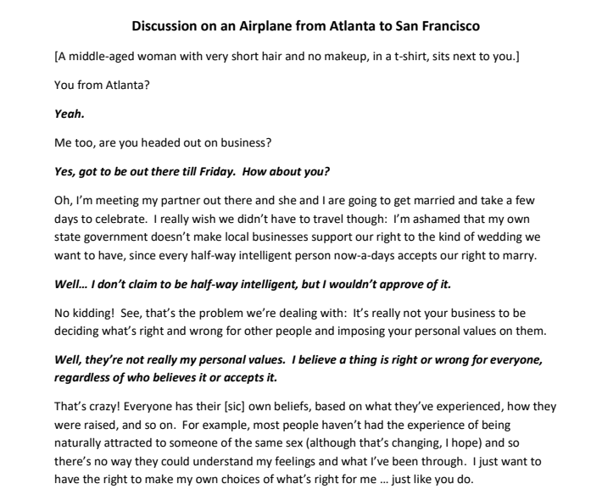
T-Shirt Lady Discussion on an Airplane from Atlanta to San Francisco

Slide 11
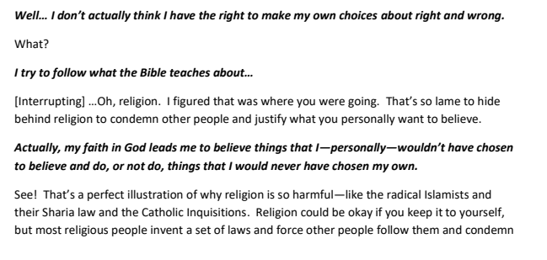
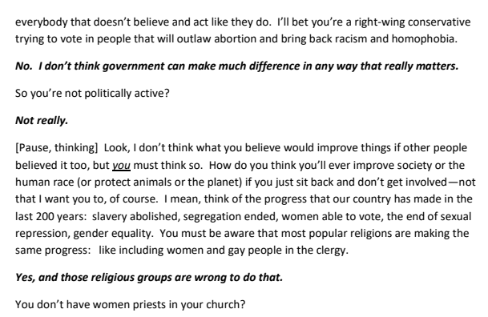
T-Shirt Lady Discussion on an Airplane from Atlanta to San Francisco

Slide 12
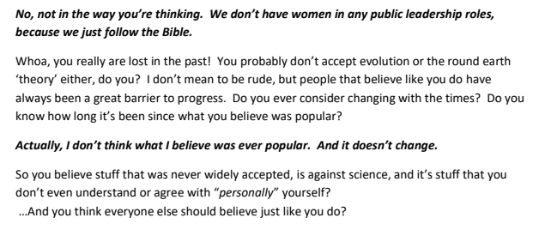
T-Shirt Lady Discussion on an Airplane from Atlanta to San Francisco

Slide 14
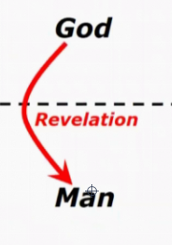

Slide 15
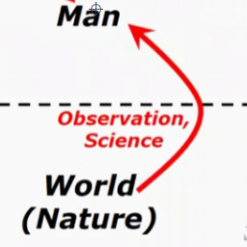

Slide 25
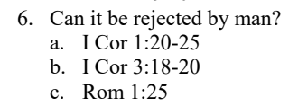

Slide 34
T-Shirt Lady World View

Slide 36
Christian World View
T-Shirt Lady World View

Slide 37
Lesson 2 Summary

Slide 38
Lesson 2 Summary

