Slide 1
“Let marriage be had in honor among all and let the bed be undefiled, for fornicators and adulterers God will judge.”
Heb.13:4

Slide 2
Josh. 24.15
Gen.
2:24

Slide 3
Putting more and more into the wedding & the house… and not enough into the marriage & the home
a common cultural problem today:

Slide 4

www.wf-lawyers.com/divorce-statistics-and-facts
Almost 50 percent of all marriages in the United States will end in divorce or separation.
Researchers estimate that 41 percent of all first marriages end in divorce.
60 percent of second marriages end in divorce.
73 percent of all third marriages end in divorce.
(U.S.): 6th highest divorce rate in the world

Slide 5
www.wf-lawyers.com/divorce-statistics-and-facts
In 2011, Facebook was cited as a major contributor to 1/3 of divorce petitions examined by one U.K. study.
Pornography addiction was cited as a factor in 56 percent of divorces according to a recent study.

Slide 6
“disposable-marriage” in a disposable culture
“I thought things would be different”
“I’m not in love anymore”
Luke 16.18; Mark 10; Matt. 19
1 Cor. 7; Malachi 2:13-16

Slide 7


an observation from cuban cars
By Zahav511 - Own work, CC BY-SA 3.0, https://commons.wikimedia.org/w/index.php?curid=23452995
CC BY-SA 3.0, https://commons.wikimedia.org/w/index.php?curid=1042507
By MiltonPoint - Own work, CC BY-SA 4.0, https://commons.wikimedia.org/w/index.php?curid=38351278

Slide 8
“Let marriage be had in honor among all and let the bed be undefiled, for fornicators
and
adulterers
God will judge.”
Heb.13:4

Slide 9
www.wf-lawyers.com/divorce-statistics-and-facts
living together prior to marriage can increase the chance of getting divorced by as much as 40 percent.
for both men and women, the loss of virginity before age 18 was correlated with a greater number of occurrences of divorce

Slide 10
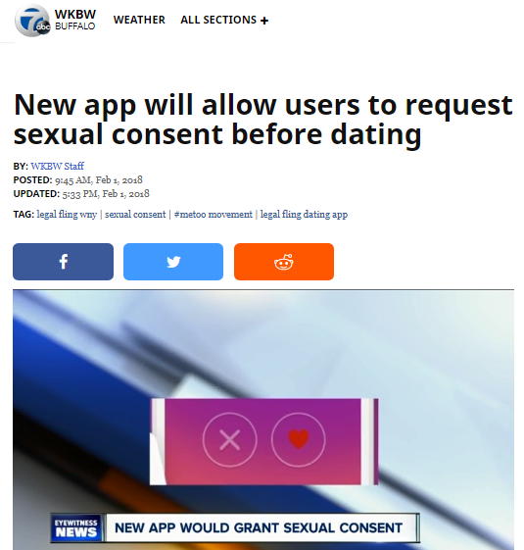
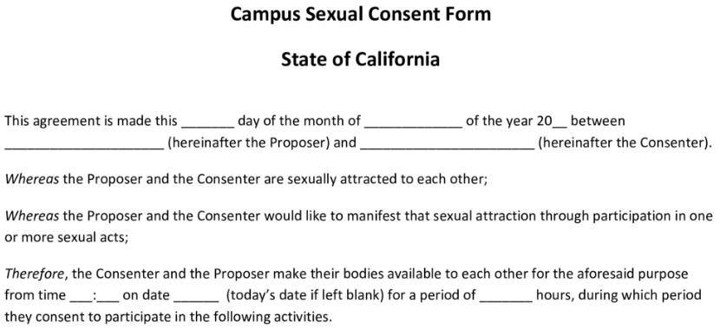
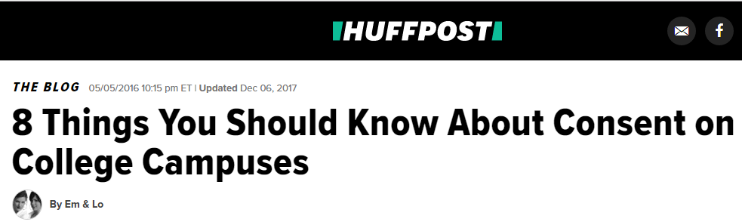
a recurring defense:
“consensual”

Slide 11
Here’s a much
better consensual
agreement:

Slide 12

Do you take this
woman / man
to be your lawfully wedded
wife /husband?
To have and to hold, and to keep yourself to
her/ him alone?
So long as you both shall live?
I do.
I do.

Slide 13
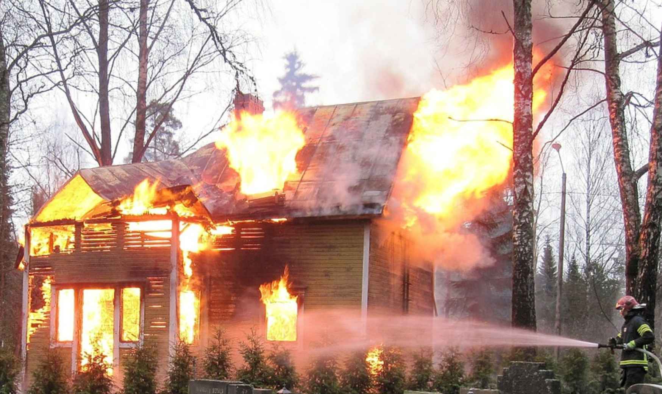
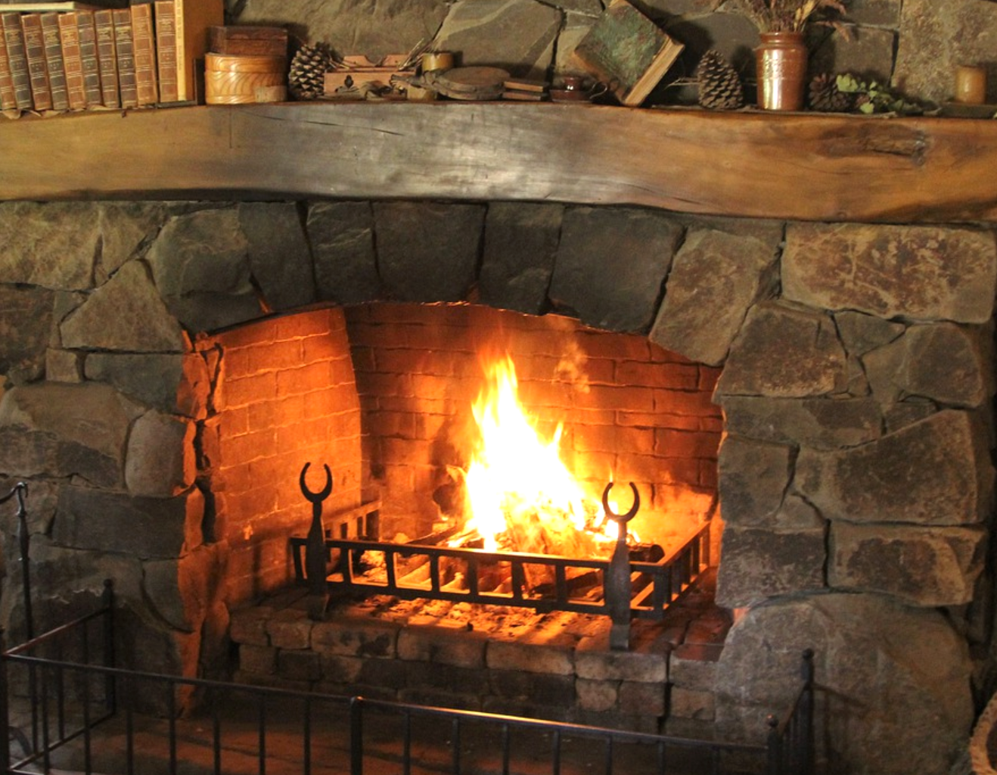

Slide 14
Thou shalt have no other gods before me.
Thou shalt not make
a graven image
Thou shalt not take the name of the LORD thy God in vain
Remember the sabbath
Honour thy father and thy mother
Thou shalt not
kill.
Thou shalt not commit adultery
Thou shalt not
steal.
Thou shalt not
bear false witness
Thou shalt not
covet
Thou shalt Not
coMMIT ADULTERy

Slide 15
Proverbs
5 & 7

Slide 16
REMEMBERING YOUR VOWS:
“love and cherish” Eph.5.28-29
“honor” 1Ptr.3.7
“to her and her alone” Job.31.1; Pr.5; Mt.5
husbands

Slide 17
the
prevention
of adultery

Slide 18

RESPECTING
BOUNDARIES

Slide 19
Thou shalt have no other gods before me.
Thou shalt not make
a graven image
Thou shalt not take the name of the LORD thy God in vain
Remember the sabbath
Honour thy father and thy mother
Thou shalt not
kill.
Thou shalt not commit adultery
Thou shalt not
steal.
Thou shalt not
bear false witness
Thou shalt not
covet
pornography
Matt. 5.27-30

Slide 20
a Healthy marriage:
involves so much much more than
“don’t commit Adultery”
a Healthy
body:
Involves so much more than
“don’t commit suicide”

Slide 21
Gen. 2.18, 24 -leave & cleave
Gen.3.13-19; 1 Tim. 5.8
  provide for physical needs
Deut.6.1-9; Eph.6.4
  provide spiritual leadership
Eph. 5.25, 28-29
  provide leadership generally
  a sacrificial & serving leader : Eph. 5.25
husbands

Slide 22
Eph 5:25, 28-31, 33 ESV
25 Husbands, love your wives, as Christ loved the church and gave himself up for her, ...
28-31 In the same way husbands should love their wives as their own bodies. He who loves his wife loves himself. For no one ever hated his own flesh, but nourishes and cherishes it, just as Christ does the church, because we are members of his body.
31 "Therefore a man shall leave his father and mother and hold fast to his wife, and the two shall become one flesh." ... 33 However, let each one of you love his wife as himself, and let the wife see that she respects her husband.
husbands

Slide 23
Homes
(like houses) need work
& maintenance

Slide 24
STRESS
STRAIN
&
STRIFE

Slide 25

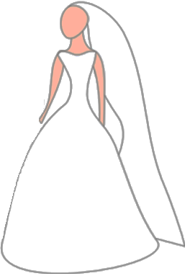

Slide 27

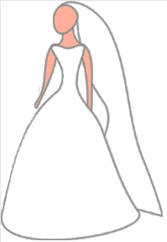


PhP.
2.1-8

Slide 30
a final thought on home maintenance…

Slide 31
a
Q for the dads

Slide 32
the relative importance of temporary threats & eternal threats…

Slide 33
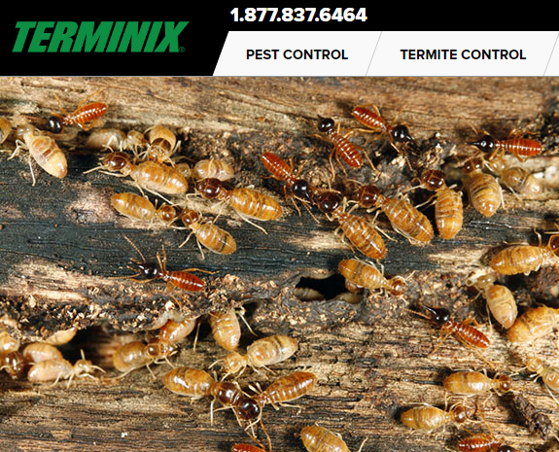
How seriously would you take finding this…?

Slide 34
on a spiritual & moral level…
…am I letting toxic filth infiltrate my home?

Slide 35

PROTECTING
OUR
FAMILIES

Slide 36
Godliness does not come from taking our cues from the world
Rm.12.1-2

