Slide 1
The
Sacrifice
Of Praise
Embry Hills • 2.26.23
Unless otherwise indicated, all Scripture quotations are from The ESV® Bible (The Holy Bible, English Standard Version®),
copyright © 2001 by Crossway, a publishing ministry of Good News Publishers. Used by permission. All rights reserved.

Slide 2
The Sacrifice of Praise
Do you offer sacrifices?
Heb 13:15-16 - New Covenant disciples offer sacrifices:
Praise - fruit of lips
Do good
Share what you have
Not every sacrifice is pleasing—what does God want?
Gen 4:3-5 - “the firstborn… fat portions…”
Ex 12:5, etc. - “without blemish…” (36x Ex-Num)
Mal 1:6-8 - We must not serve leftovers to a holy God!

Slide 3
For the Beauty of the Earth

Slide 4
Dimensions of Song Worship
Eph 5:18-21 & Col 3:16-17
Physical
Mental
Singing
Singing psalms, hymns, and spiritual songs
Addressing one another
Teaching and admonishing one another
Emotional
Spiritual
Making melody to the Lord with your heart
Giving thanks
With thankfulness in your heart
Be filled with the Spirit
Submitting to one another
Let the word of Christ dwell in you richly
All in the name of the Lord

Slide 5
And Can It Be?

Slide 6
Dimensions of Song Worship
Eph 5:18-21 & Col 3:16-17
Physical
Mental
Singing
Singing psalms, hymns, and spiritual songs
Addressing one another
Teaching and admonishing one another
Emotional
Spiritual
Making melody to the Lord with your heart
Giving thanks
With thankfulness in your heart
Be filled with the Spirit
Submitting to one another
Let the word of Christ dwell in you richly
All in the name of the Lord

Slide 7
This Is My Father’s World
Hymn: Maltbie D. Babcock (1901) Tune: TERRA BEATA • Franklin L. Sheppard (1915)

Slide 8
This is my Father's world, And to my listening ears
El mundo_entero es del Padre celestial;

Slide 9
All nature sings, and round me rings The music of the spheres.
Su alabanza_en la creación escucho resonar.

Slide 10
This is my Father's world: I rest me in the thought
¡De Dios el mundo es! ¡Qué grato_es recordar

Slide 11
Of rocks and trees, of skies and seas–His hand the wonders wrought.
Que_en el autor de tanto bien podemos descansar!

Slide 12
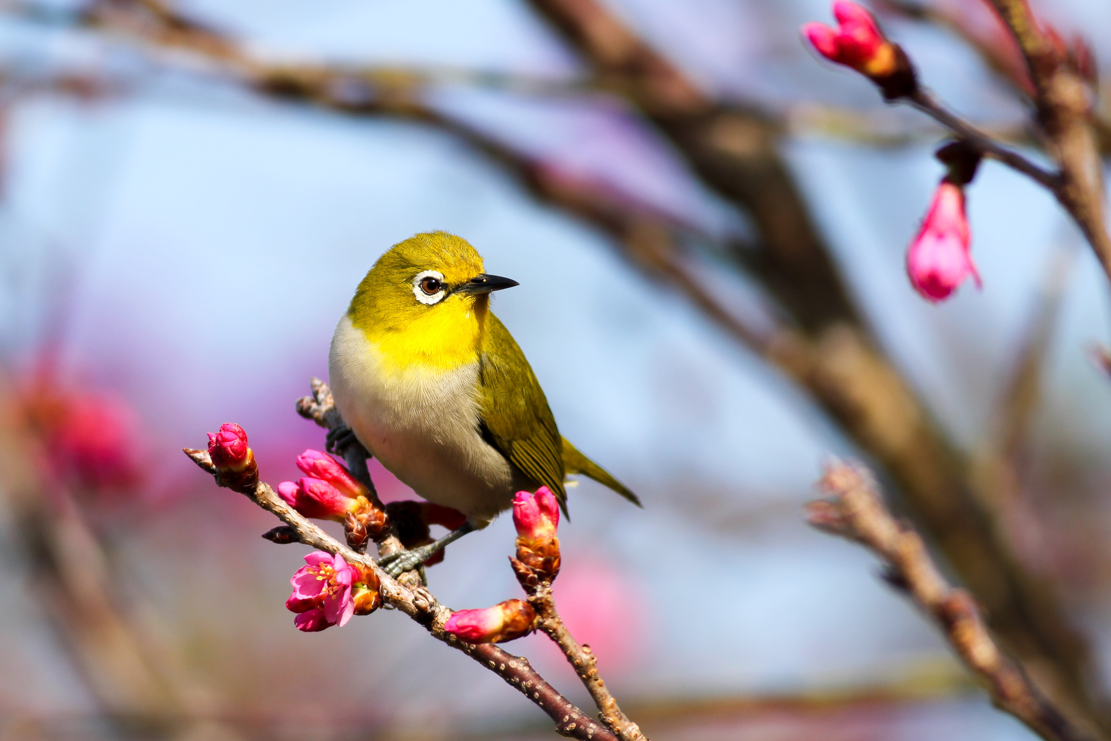
This is my Father's world: The birds their carols raise,
El mundo_entero es del Padre celestial;

Slide 13
The morning light, the lily white, Declare their Maker's praise.
El pájaro, la luz, la flor proclaman Su bondad.

Slide 14
This is my Father's world: He shines in all that's fair;
¡De Dios el mundo es! El fruto de Su_acción

Slide 15
In the rustling grass I hear Him pass, He speaks to me everywhere.
Se muestra con esplendidez en toda la_expansión.

Slide 16
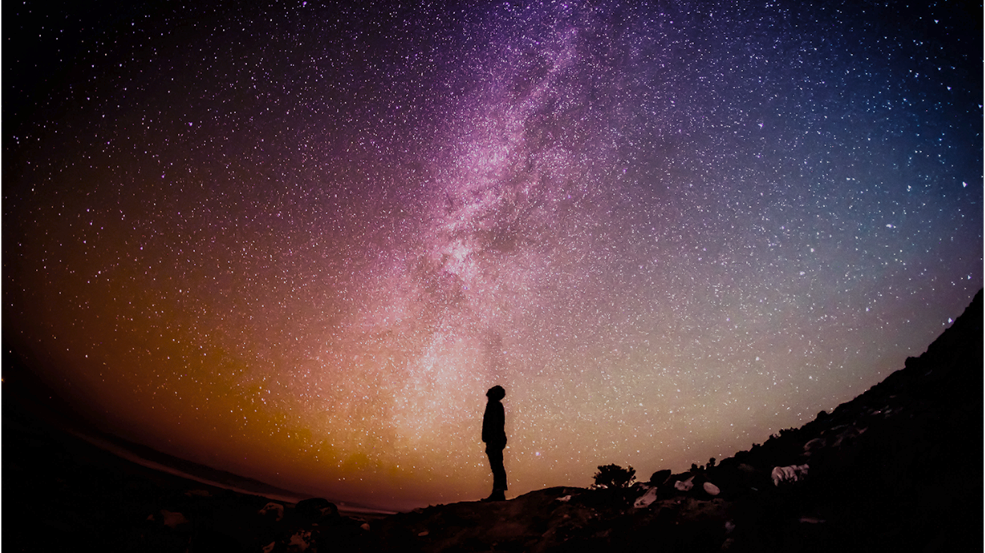
This is my Father’s world, O let me ne’er forget
El mundo_entero es del Padre celestial;

Slide 17
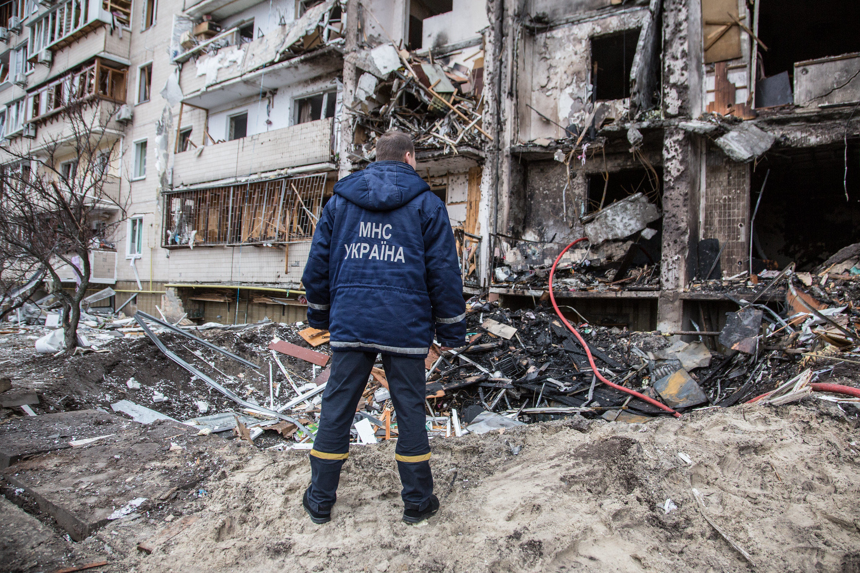
That though the wrong seems oft so strong, God is the ruler yet.
Y nada habrá de detener Su triunfo sobre el mal.

Slide 18
This is my Father's world: Why should my heart be sad?
¡De Dios el mundo es! Confiada mi_alma_está,

Slide 19
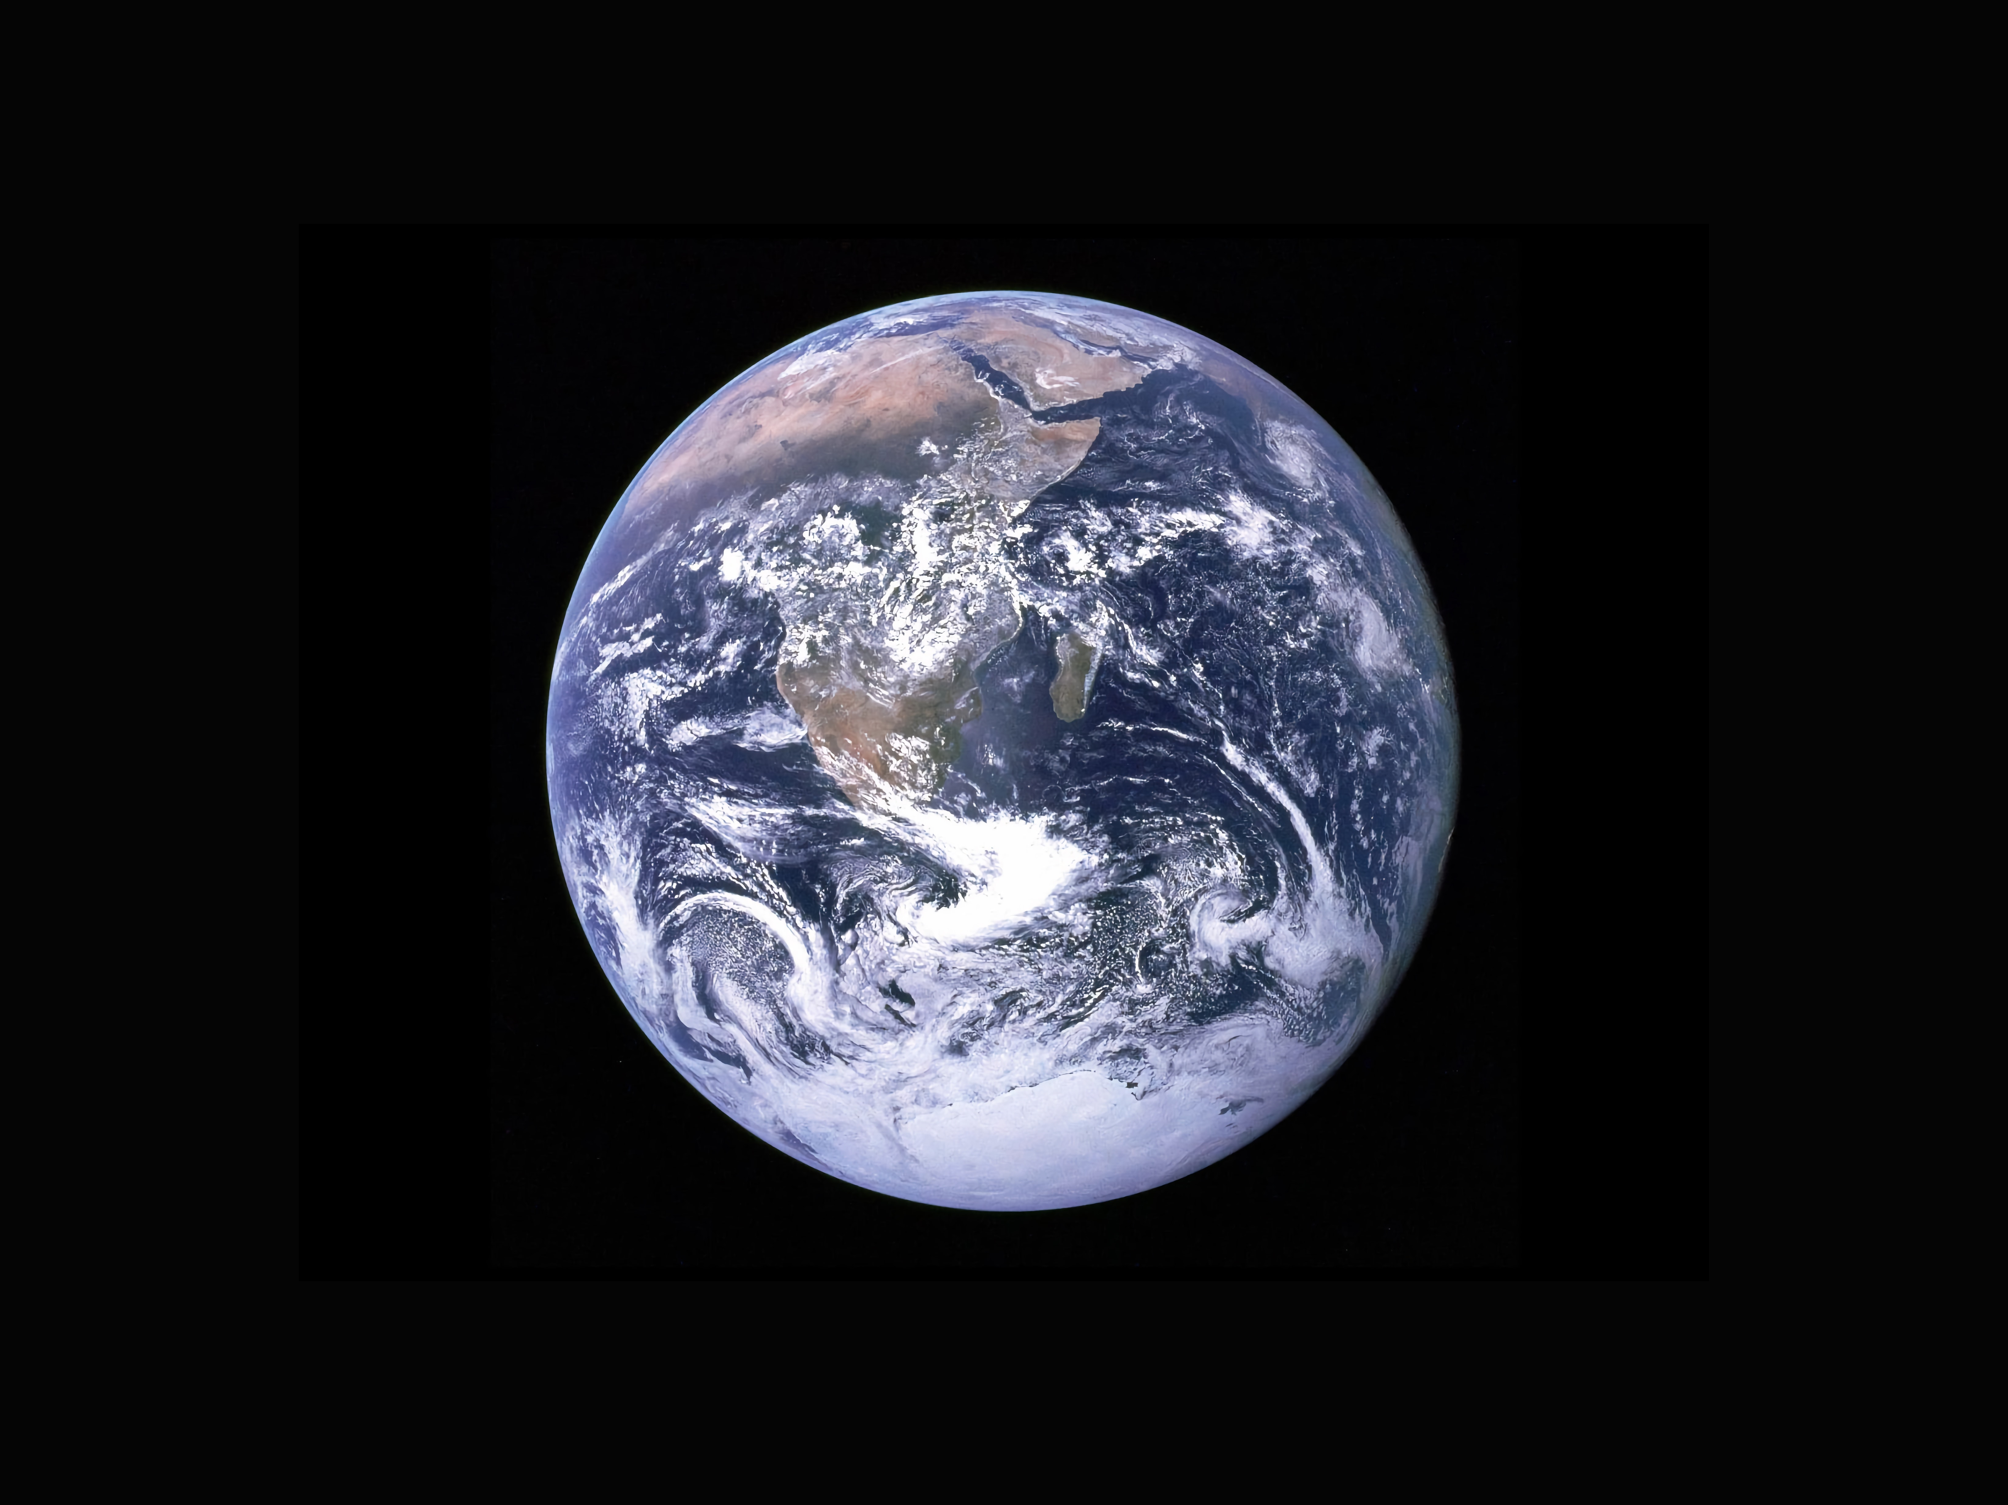
The Lord is King: let heaven ring! God reigns; let earth be glad!
Pues Dios en Cristo, nuestro Rey, por siempre reinará.

Slide 20
Dimensions of Song Worship
Eph 5:18-21 & Col 3:16-17
Physical
Mental
Singing
Singing psalms, hymns, and spiritual songs
Addressing one another
Teaching and admonishing one another
Emotional
Spiritual
Making melody to the Lord with your heart
Giving thanks
With thankfulness in your heart
Be filled with the Spirit
Submitting to one another
Let the word of Christ dwell in you richly
All in the name of the Lord

Slide 21
Reflect
the Heart
Direct
the Heart
Fear
Hope
Joy
3
27
98
Regret
Anger
51
GOD
55
Peace
23
45
Love
88
22
Despair
Doubt
8
34
Wonder
38
Gratitude
Grief

Slide 22
I Will Sing to the Lord (Psalm 146)

Slide 23
Dimensions of Song Worship
Eph 5:18-21 & Col 3:16-17
Physical
Mental
Singing
Singing psalms, hymns, and spiritual songs
Addressing one another
Teaching and admonishing one another
Emotional
Spiritual
Making melody to the Lord with your heart
Giving thanks
With thankfulness in your heart
Be filled with the Spirit
Submitting to one another
Let the word of Christ dwell in you richly
All in the name of the Lord

Slide 24
The Sacrifice of Praise
Heb 13:15 - How can I offer a better sacrifice?
Preparation: Get your heart ready
Perspective: Come into God’s presence
Participation: The more you put in, the more you and others benefit
Practice: Make hymns a habit, work at it

Slide 25
Jesus, Draw Me Ever Nearer

