Slide 2
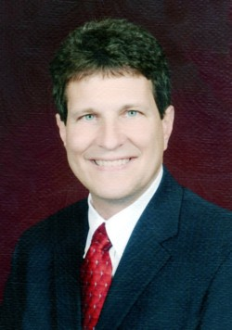

Slide 3
Expectations
Free Will
My Part
God’s Timetable
God’s Agenda
Big Picture

