Slide 1
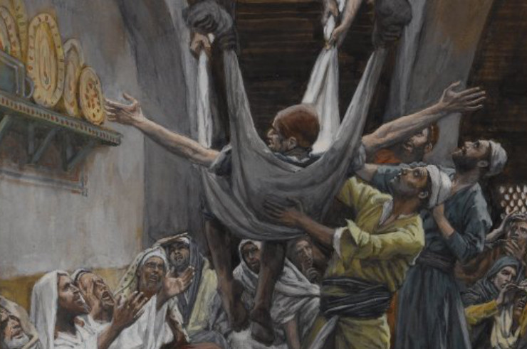
Lessons from a Break-in
MARK 2:1-12

Slide 2
And again He entered Capernaum after some days, and it was heard that He was in the house. ² Immediately many gathered together, so that there was no longer room to receive them, not even near the door. And He preached the word to them. ³ Then they came to Him, bringing a paralytic who was carried by four men. ⁴ And when they could not come near Him because of the crowd, they uncovered the roof where He was. So when they had broken through, they let down the bed on which the paralytic was lying.
Four Lessons from this Story.

Slide 3
Priority of Forgiveness

Slide 4
And again He entered Capernaum after some days, and it was heard that He was in the house. ² Immediately many gathered together, so that there was no longer room to receive them, not even near the door. And He preached the word to them. ³ Then they came to Him, bringing a paralytic who was carried by four men. ⁴ And when they could not come near Him because of the crowd, they uncovered the roof where He was. So when they had broken through, they let down the bed on which the paralytic was lying.
⁵ When Jesus saw their faith, He said to the paralytic, “Son, your sins are forgiven you.”

Slide 5
Common Approach for Jesus
Financial Dispute Luke 12:13-15
Government Atrocity
Luke 13:1-3
Natural Disaster Luke 13:4-5
Physical Malady
“Beware of Covetousness” Verse 15
“Unless you repent, you will all likewise perish. vs 3
“Unless you repent, you will all likewise perish. Vs.5
Not surprising that He would deal with sin first.
Sin is a greater curse than any disease or handicap!

Slide 6
Priority of Forgiveness
Necessity of Visible Faith

Slide 7
And again He entered Capernaum after some days, and it was heard that He was in the house. ² Immediately many gathered together, so that there was no longer room to receive them, not even near the door. And He preached the word to them. ³ Then they came to Him, bringing a paralytic who was carried by four men. ⁴ And when they could not come near Him because of the crowd, they uncovered the roof where He was. So when they had broken through, they let down the bed on which the paralytic was lying.
⁵ When Jesus saw their faith, He said to the paralytic, “Son, your sins are forgiven you.”

Slide 8
Faith has always been the requirement for forgiveness.
There are two kinds of Faith
Abraham… offered Isaac his son on the altar? ²² Do you see that faith was working together with his works, and by works faith was made perfect? (vs. 21-22)
For as the body without the spirit is dead, so faith without works is dead also. James 2:26
“ I will show you my faith by my works.” vs. 18

Slide 9
Priority of Forgiveness
Necessity of Visible Faith
Only God can Forgive Sins

Slide 10
⁶ And some of the scribes were sitting there and reasoning in their hearts, ⁷ “Why does this Man speak blasphemies like this? Who can forgive sins but God alone?”
⁸

Slide 11
Three Different Concepts
Offense
Crime
Sin
The act of causing anger, resentment, displeasure, or affront.
Not necessarily sin. (Mt. 15:12)
An act committed in violation of man-made law
Not necessarily sin (Acts 5:29)
Transgression of the law of God
“Only God can forgive sin.”

Slide 12
⁶ And some of the scribes were sitting there and reasoning in their hearts, ⁷ “Why does this Man speak blasphemies like this? Who can forgive sins but God alone?”
⁸ But immediately, when Jesus perceived in His spirit that they reasoned thus within themselves, He said to them, “Why do you reason about these things in your hearts?
The Question:
Was Jesus GOD or Merely a Man?

Slide 13
Jesus Proposed a Test
^{9 ”}Which is easier, to say to the paralytic,
“Your sins are forgiven you”
‘Arise, take up your bed and walk’?
OR
Any mere man could say this!
No mere man could say this and see it happen!

Slide 14
⁶ And some of the scribes were sitting there and reasoning in their hearts, ⁷ “Why does this Man speak blasphemies like this? Who can forgive sins but God alone?”
⁸ But immediately, when Jesus perceived in His spirit that they reasoned thus within themselves, He said to them, “Why do you reason about these things in your hearts? ⁹ Which is easier, to say to the paralytic, ‘Your sins are forgiven you,’ or to say, ‘Arise, take up your bed and walk’? ¹⁰ But that you may know that the Son of Man has power on earth to forgive sins”—He said to the paralytic, ¹¹ “I say to you, arise, take up your bed, and go to your house.” ¹² Immediately he arose, took up the bed, and went out in the presence of them all.
Now, what would happen?

Slide 15
Priority of Forgiveness
Necessity of Visible Faith
Only God can Forgive Sins
The Purpose of Miracles

Slide 16
Primary Purpose: To Provide Evidence for Faith
“ And truly Jesus did many other signs in the presence of His disciples, which are not written in this book; ³¹ but these are written that you may believe that Jesus is the Christ, the Son of God, and that believing you may have life in His name” (John 20:30-31).
“…so great a salvation, which at the first began to be spoken by the Lord, and was confirmed to us by those who heard Him, ⁴ God also bearing witness both with signs and wonders, with various miracles, and gifts of the Holy Spirit, according to His own will?” (Heb. 2:3-4).

Slide 17
“But I did not see those miracles!”
“Blessed are those who have not seen and yet have believed” (John 20:29).
There is more evidence for the resurrection of Jesus than for any other event in ancient history!
The Number of Witnesses
Their willingness to die for their testimony
The success of their testimony
Our gathering on the “1st Day of the week”

Slide 18
Can Your Faith be SEEN?
“I believe in the Resurrection!”
Colossians 2:12

Slide 19
Colossians 2:12
¹² buried with Him in baptism, in which you also were raised with Him through faith in the working of God, who raised Him from the dead. ¹³ And you, being dead in your trespasses and the uncircumcision of your flesh, He has made alive together with Him, having forgiven you all trespasses.

