Slide 1
2023 Theme
Notes:
Four Things I Want To Do in This Lesson…
1.) Hold Your Speech To The Highest Standards
2.) Speak To Transform (Not Just Sugar-Coat)
3.) Avoid Dangerous Discussions
4.) Use These Best Practices

Slide 2
Una frase con mucho significado
²¹ Por tanto, si alguien se limpia de estas cosas, será un vaso para honra, santificado, útil para el Señor, preparado para toda buena obra. 22 Huye, pues, de las pasiones juveniles y sigue la justicia, la fe, el amor y la paz, con los que invocan al Señor con un corazón puro.
Notes:
We take it upon ourselves to make some changes. I have determined and decided… I’m not going to be useless clutter in the Master’s house. I’m going to be His favorite vessel.

Slide 3
Título del sermón | Domingos a las 6:00pm
Introducción: Vasos para honra | 2 Timoteo 2:21
Sé fuerte en la gracia de Dios | 2 Timoteo 2:1
Atesorando las Escrituras | 2 Timoteo 2:15
Escapando de los enredos | 2 Timoteo 2:4
Evitando las influencias impías | 2 Timoteo 2:14-18
Refinando mi habla | 2 Timoteo 2:14-18
Invocando al Señor con un corazón puro | 2 Timoteo 2:22
Soportándolo todo | 2 Timoteo 2:3-13
Refrescándonos y animándonos unos a otros | 2 Timoteo 2:22
Pasando la fe a la próxima generación | 2 Timoteo 2:2
Reprendiendo tiernamente | 2 Timoteo 2:24-26
Conclusión: Persistiendo en las cosas que hemos aprendido | 2 Timoteo 3:14

Slide 4
Pablo está instruyendo a su pupilo.
Refinando mi habla
Debemos conformar nuestra forma de hablar a los estándares más altos. (2 Tim. 2:14-18, 1 Tim. 6:3-5, Tito 2:8)
“Ya sabes esto, que todos los que están en Asia me han vuelto la espalda…” (2 Tim. 1:15)
“…Te encargo solemnemente: Predica la palabra. Insiste a tiempo y fuera de tiempo. Amonesta, reprende, exhorta con mucha paciencia e instrucción”. (2 Tim. 4:1-2)
Notes:
We have pointed out in previous lessons that he is talking to “his son.” “To Timothy, my beloved son…” (2 Tim. 1:2)
But tonight, we need to remember another facet of the relationship. Timothy is also Paul’s protégé. He was hand-picked from Lystra & Derbe in Acts 16:3. Paul knows that his life is nearing its end, and he is writing with the greatest care and passion to help Timothy succeed.
He has a vital message to communicate in this letter. A message full of love, but also full of guidance for the future in his life and his work.
It’s a message that not only does Timothy need to learn, but that he needs to pass on to others.
What You Say Is Your Responsibility.
What You Say Is Powerful.
What You Say Determines Your Reputation & Your Effectiveness.
What You Say Is Your CHOICE. Don’t Enter Every Conversation.
Timothy: Hold yourself to the highest standard.
Be Diligent – thought, energy, and effort
Seek God’s Approval
Accurately Handle – no more and no less
Truth

Slide 5
Cómo hablar con el fin de transformar
Refinando mi habla
Punto A
Punto B
Recuerde: Lucas 10:29-37
Persona A
Persona B
Notes:
With people, the shortest distance from A to B is not a straight line.
As Paul gives his instructions, he is demonstrating well-refined speech. Each word well chosen, meaningful, and powerful.
We are not dealing with MATH, we are dealing with PEOPLE.
He has a vital message to communicate in this letter. A message full of love, but also full of guidance for the future in his life and his work.
It’s a message that not only does Timothy need to learn, but that he needs to pass on to others.
The Goal of our speech is not just to make a point or convey information. It is for TRANSFORMATION… (Remember 1 Tim. 1:3-5) Paul led with this concept!

Slide 6
Cómo hablar con el fin de transformar
Refinando mi habla
Razonable
Personal
Memorable
Persona A
Persona B
Notes:
He has a vital message to communicate in this letter. A message full of love, but also full of guidance for the future in his life and his work.
It’s a message that not only does Timothy need to learn, but that he needs to pass on to others.
Make Clear Requests For Specific Actions (vs 2)
Use Aspirational Comparisons (vs 3-7)
Weave In Relevant Personal Experiences (v 9)
Use Well Balanced Contrasts (vs 9)
Use Short Lists of Similar Statements. (11-13)
Use Dense & Memorable Metaphors (17, 20)

Slide 7
3 errores peligrosos que evitar
Refinando mi habla
Discusiones sobre palabras (2:14)
Palabrerías vacías y profanes (2:16)
Razonamientos necios e ignorantes (2:23)
Lleva a ruina
Impiedad
Rencillas
Notes:
I love the NKJV… “Shun” – Get Away, Like “Flee” in vs 22.
What I Say Will S P R E A D S (further than we may think.)
What I Say Leads (to further rightouesness or ungodliness)
What I Say Impacts The Faith of Others (Positively or Negatively)
Stop it! Friends – We need to run from this as much as we run from the youthful lusts in vs. 22!
Cut it out! Get away from it.
Don’t participate in this.
“It says what it means and it means what it says, and it’s time to move on.” - Great example is 1 Cor 5 “do not even eat with such a one.”
FOOLISH IGNORANT…
Conspiracy Theories (Flat Earth, etc….)
Click-Bait, Spam, Exaggerations, Sensationalism,

Slide 8
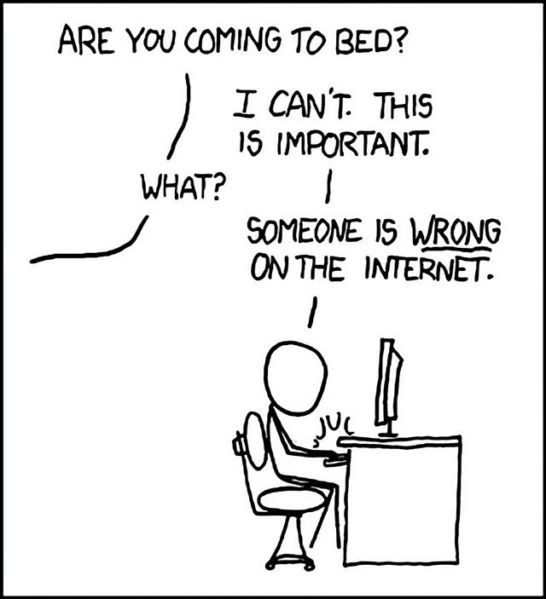
Cómo reconocer una discusión de la que es mejor salir
Refinando mi habla
¿Vienes a la cama?
La discusión no tiene ningún propósito.
La discusión se intensifica rápidamente.
La discusión pasa por alto la verdad.
La discusión desanima a los demás.
La discusión lleva a más pecado.
No puedo. Esto es importante.
¿Qué cosa?
Alguien en el internet está equivocado.
Notes:
Some people are just trying to appear unique and intelligent when they are neither.
Some people are only arguing from their experiences…not facts.
Some people are only arguing from pride…not learning.
Some people are only arguing from skepticism…no amount of evidence will ever satisfy, they aren’t looking for an answer, only more questions. (Evil generation asks for a sign.)
(They’ve ignored doctors, experts, Scripture, and family…but they might listen to me! Don’t be prideful (at worst) or delusional (at best.) )

Slide 9
Tenemos que elegir nuestras palabras con cuidado.
preocupaciones
Palabras fieles
Palabras de oración
Palabras que nutren
Notes:
We can’t just “edit” our speech depending on who we spend time with or where we are. We must put into the heart key desires…
Cherish the TRUTH over any exciting stories.
Bless the HEARER rather than extort or embarrass them.
Spread GODLINESS not sickness.
Correct & Lead the CAPTIVE, rather than prove our point or superiority.
Ch 3 – we are not trying to captivate an audience, but to convert a soul!
Ch 3:16 – Scripture is the well, we continue to drink from!
Timothy – you are too busy with…
Faithful Words
Saving Words
Prayerful Words
Nourishing Words
You can’t get pulled into fruitless and harmful discussions.
Just like the Master’s Golden Cups – aren’t mean for measuring out scoops of pig food. You aren’t meant for these conversations.

Slide 10
#1: Tener conversaciones personales en persona.
#2: Usar lenguaje bíblico para temas bíblicos.
#3: Construir y preservar la confianza.
#4: Siempre mostrar respeto en tono y gestos.
#5: Solamente contar chistes de acuerdo con sus valores.
⁸ con palabra sana e irreprochable, a fin de que el adversario se avergüence al no tener nada malo que decir de nosotros. (Tito 2:8)
Notes:
Godly Speech: Best Practices…
Give People The RICHES of God’s Word, Not The Momentary Ideas of our World.
Give Messages That CHANGE LIVES, Not purely Academic Observations.
Embrace The ROLE OF TEACHING, Not Entertaining
Be Examples of Real Highs & Lows, Not Impersonal Definitions
Social Media/Texting. (3 John 1:13, Mt 18 “go to him”)
Complaining Diminishes Everything Else We Say. (Do All Things Without…) (Phil. 2:14)
Earn this reputation and uphold it. (1 Tim. 4:9, 2:11)
Reputation: Proverbs 22:1 & Eccl. 7:1
To Everyone You Address (directly and indirectly). (1 Peter 2:17-18) Being insulting or uncaring will ruin your effectiveness.
(Don’t Make Jokes About Suffering or Lust. (Proverbs. 26:19, Eph 5:3-4)

Slide 11
2023 Theme

