Slide 1
2023 Theme
Notes:
Four Things I Want To Do in This Lesson…
1.) Hold Your Speech To The Highest Standards
2.) Speak To Transform (Not Just Sugar-Coat)
3.) Avoid Dangerous Discussions
4.) Use These Best Practices

Slide 2
A Phrase Rich In Meaning
²¹ Therefore, if anyone cleanses himself from these things, he will be a vessel for honor, sanctified, useful to the Master, prepared for every good work. ²² Now flee from youthful lusts and pursue righteousness, faith, love and peace, with those who call on the Lord from a pure heart.
Notes:
We take it upon ourselves to make some changes. I have determined and decided… I’m not going to be useless clutter in the Master’s house. I’m going to be His favorite vessel.

Slide 3
Sermon Title | Sundays at 6:00 P.M.
Intro: Vessels for Honor | 2 Timothy 2:21
Be Strong In God’s Grace | 2 Timothy 2:1
Treasuring Scripture | 2 Timothy 2:15
Escaping Entanglements | 2 Timothy 2:4
Avoiding Ungodly Influences | 2 Timothy 2:14-18
Refining My Speech | 2 Timothy 2:14-18
Calling On The Lord From A Pure Heart | 2 Timothy 2:22
Enduring All Things | 2 Timothy 2:3-13
Refreshing & Encouraging One Another | 2 Timothy 2:22
Passing The Faith To The Next Generation | 2 Timothy 2:2
Correcting With Gentleness | 2 Timothy 2:24-26
Conclusion: Continuing In The Things We’ve Learned | 2 Timothy 3:14
Notes:
Our travel for the funeral and Russ being under the weather – we are going to get back on Track…
Four Things I Want To Do in This Lesson…
1.) Hold Your Speech To The Highest Standards
2.) Speak To Transform (Not Just Sugar-Coat)
3.) Avoid Dangerous Discussions
4.) Use These Best Practices

Slide 4
Paul Is Instructing His Protégé.
Refining My Speech
We Must Hold Our Speech To The Highest Standards. (2 Timothy 2:14-18, 1 Timothy 6:3-5, Titus 2:8)
“You are aware of the fact that all who are in Asia turned away from me…” (2 Tim. 1:15)
“I solemnly charge you…preach the word; be ready in season and out of season; reprove, rebuke, exhort, with great patience and instruction.” (2 Tim 4:1-2)
Notes:
We have pointed out in previous lessons that he is talking to “his son.” “To Timothy, my beloved son…” (2 Tim. 1:2)
But tonight, we need to remember another facet of the relationship. Timothy is also Paul’s protégé. He was hand-picked from Lystra & Derbe in Acts 16:3. Paul knows that his life is nearing its end, and he is writing with the greatest care and passion to help Timothy succeed.
He has a vital message to communicate in this letter. A message full of love, but also full of guidance for the future in his life and his work.
It’s a message that not only does Timothy need to learn, but that he needs to pass on to others.
What You Say Is Your Responsibility.
What You Say Is Powerful.
What You Say Determines Your Reputation & Your Effectiveness.
What You Say Is Your CHOICE. Don’t Enter Every Conversation.
Timothy: Hold yourself to the highest standard.
Be Diligent – thought, energy, and effort
Seek God’s Approval
Accurately Handle – no more and no less
Truth

Slide 5
Speaking For Transformation
Refining My Speech
Point A
Point B
Remember: Luke 10:29-37
Person A
Person B
Notes:
With people, the shortest distance from A to B is not a straight line.
As Paul gives his instructions, he is demonstrating well-refined speech. Each word well chosen, meaningful, and powerful.
We are not dealing with MATH, we are dealing with PEOPLE.
He has a vital message to communicate in this letter. A message full of love, but also full of guidance for the future in his life and his work.
It’s a message that not only does Timothy need to learn, but that he needs to pass on to others.
The Goal of our speech is not just to make a point or convey information. It is for TRANSFORMATION… (Remember 1 Tim. 1:3-5) Paul led with this concept!

Slide 6
Speaking For Transformation
Refining My Speech
Reasonable
Personal
Memorable
Person A
Person B
Notes:
He has a vital message to communicate in this letter. A message full of love, but also full of guidance for the future in his life and his work.
It’s a message that not only does Timothy need to learn, but that he needs to pass on to others.
Make Clear Requests For Specific Actions (vs 2)
Use Aspirational Comparisons (vs 3-7)
Weave In Relevant Personal Experiences (v 9)
Use Well Balanced Contrasts (vs 9)
Use Short Lists of Similar Statements. (11-13)
Use Dense & Memorable Metaphors (17, 20)

Slide 7
3 Dangerous Errors To Avoid
Refining My Speech
Arguments About Words (2:14)
Worldly & Empty Chatter (2:16)
Foolish, Ignorant Speculations (2:23)
Ruin Hearers
Ungodliness
Quarrels
Notes:
I love the NKJV… “Shun” – Get Away, Like “Flee” in vs 22.
What I Say Will S P R E A D S (further than we may think.)
What I Say Leads (to further rightouesness or ungodliness)
What I Say Impacts The Faith of Others (Positively or Negatively)
Stop it! Friends – We need to run from this as much as we run from the youthful lusts in vs. 22!
Cut it out! Get away from it.
Don’t participate in this.
“It says what it means and it means what it says, and it’s time to move on.” - Great example is 1 Cor 5 “do not even eat with such a one.”
FOOLISH IGNORANT…
Conspiracy Theories (Flat Earth, etc….)
Click-Bait, Spam, Exaggerations, Sensationalism,

Slide 8
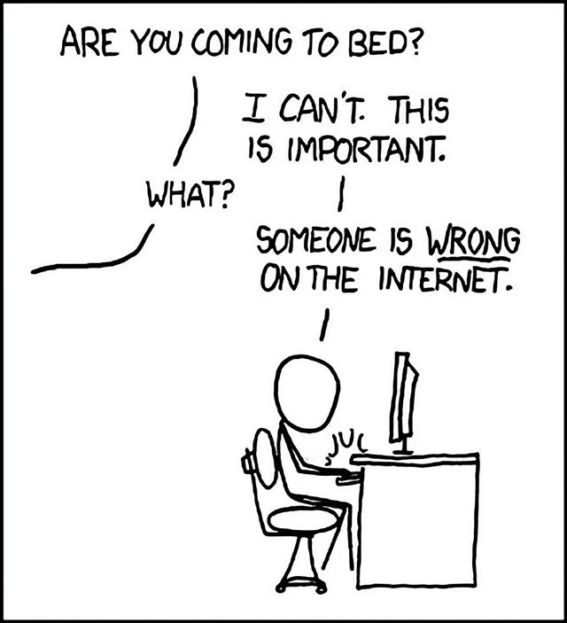
Recognizing A Discussion To Exit
Refining My Speech
The Discussion Is Pointless.
The Discussion Is Escalating Quickly.
The Discussion Ignores Truth.
The Discussion Discourages Others.
The Discussion Increases Sinfulness.
Notes:
Some people are just trying to appear unique and intelligent when they are neither.
Some people are only arguing from their experiences…not facts.
Some people are only arguing from pride…not learning.
Some people are only arguing from skepticism…no amount of evidence will ever satisfy, they aren’t looking for an answer, only more questions. (Evil generation asks for a sign.)
(They’ve ignored doctors, experts, Scripture, and family…but they might listen to me! Don’t be prideful (at worst) or delusional (at best.) )

Slide 9
We Need To Choose Our Words Carefully.
Concerns
Faithful Words
Prayerful Words
Nourishing Words
Notes:
We can’t just “edit” our speech depending on who we spend time with or where we are. We must put into the heart key desires…
Cherish the TRUTH over any exciting stories.
Bless the HEARER rather than extort or embarrass them.
Spread GODLINESS not sickness.
Correct & Lead the CAPTIVE, rather than prove our point or superiority.
Ch 3 – we are not trying to captivate an audience, but to convert a soul!
Ch 3:16 – Scripture is the well, we continue to drink from!
Timothy – you are too busy with…
Faithful Words
Saving Words
Prayerful Words
Nourishing Words
You can’t get pulled into fruitless and harmful discussions.
Just like the Master’s Golden Cups – aren’t mean for measuring out scoops of pig food. You aren’t meant for these conversations.

Slide 10
#1: Have Personal Conversations In Person.
#2: Use Biblical Language For Biblical Subjects.
#3: Build & Preserve Trust.
#4: Always Show Respect In Tone & Gestures.
#5: Only Tell Jokes That Match Your Values.
⁸ sound in speech which is beyond reproach, so that the opponent will be put to shame, having nothing bad to say about us. (Titus 2:8)
Notes:
Godly Speech: Best Practices…
Give People The RICHES of God’s Word, Not The Momentary Ideas of our World.
Give Messages That CHANGE LIVES, Not purely Academic Observations.
Embrace The ROLE OF TEACHING, Not Entertaining
Be Examples of Real Highs & Lows, Not Impersonal Definitions
Social Media/Texting. (3 John 1:13, Mt 18 “go to him”)
Complaining Diminishes Everything Else We Say. (Do All Things Without…) (Phil. 2:14)
Earn this reputation and uphold it. (1 Tim. 4:9, 2:11)
Reputation: Proverbs 22:1 & Eccl. 7:1
To Everyone You Address (directly and indirectly). (1 Peter 2:17-18) Being insulting or uncaring will ruin your effectiveness.
(Don’t Make Jokes About Suffering or Lust. (Proverbs. 26:19, Eph 5:3-4)

Slide 11
2023 Theme

