Slide 1
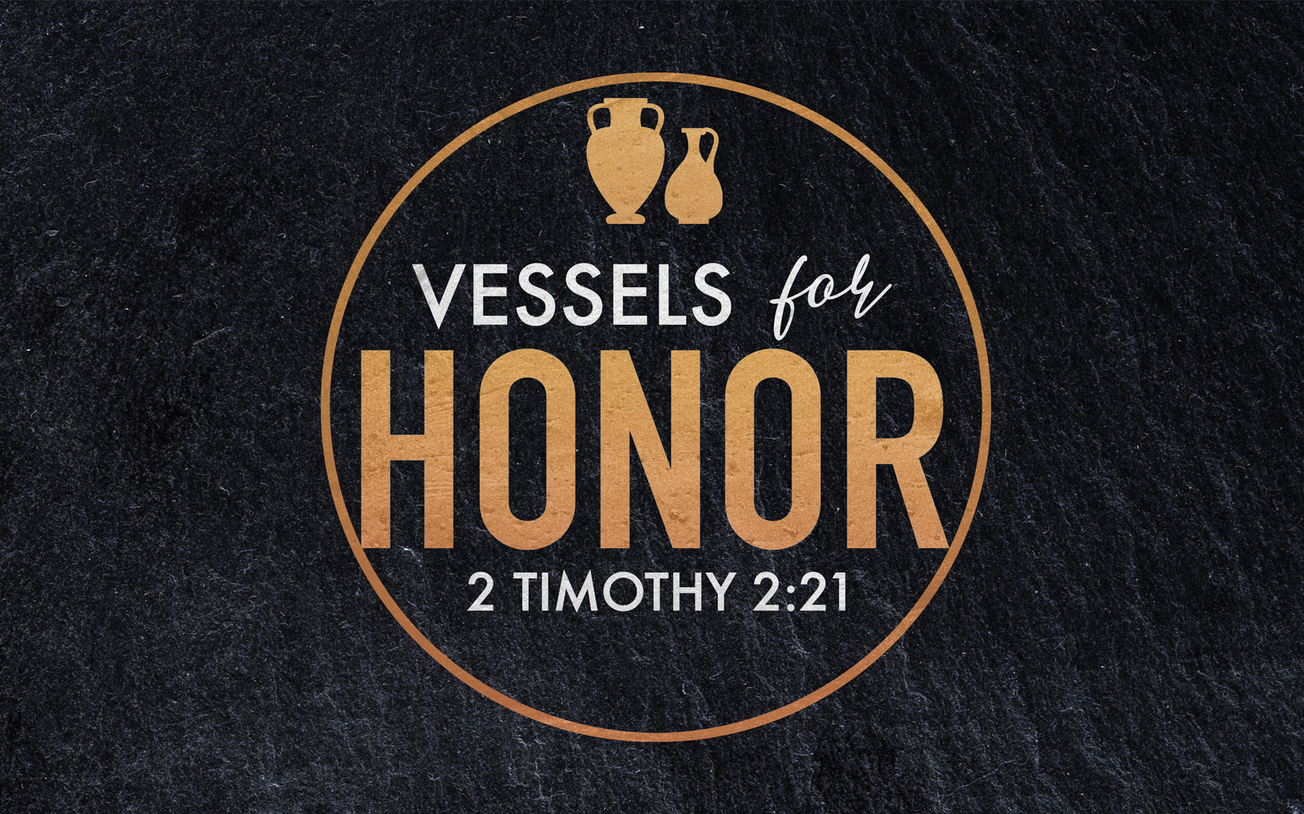
2023 Theme
Notes:
If we just jump into chapter 2, this phrase might seem a little intimidating… Let me show you why it is actually extremely inspiring…
It is clear from the verse beginning of the letter – that Paul Believes in Timothy. (1 Tim. 1:1-7)
… I’m just trying to hold things together, deal with the ups and downs in my family, and not yell at anyone…

Slide 2
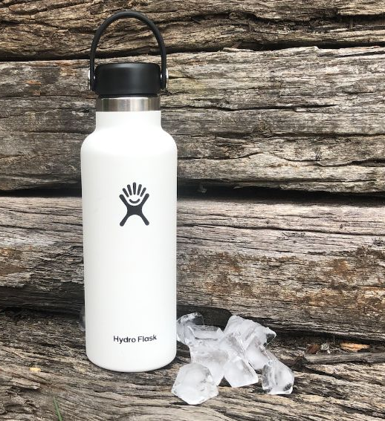
Known for…
A Phrase Rich In Meaning
Health
Usefulness
Values
Notes:
Not only is this an inspiring picture – it is a phrase rich in meaning.
You might be saying – Phillip, it’s hard for me to get excited about a “vessel” – I mean, I like my coffee cup – but even there, it’s mostly about the coffee.
So let me explain how rich this phrase actually is by talking about the metal water bottles you’ve seen tons of people with the last few years….
Hydro-Flask was started in 2008 by Travis Rosbach and Cindy Webber.
After selling their water bottles in Farmer’s Markets in Bend, Oregon, they exploded in popularity. By 2012 the founders couldn’t keep up with the high-demand, so they sold the company to a group of investors. These investors brought in an accomplished Tech Executive as CEO and things took off again, so that by 2016 the company was sold to a major consumer brand for $210 Million.
Success is attributed to 3 things. Wellness, Function, & Values…
Wellness – I’m drinking water instead of something artificial or sugary. I’m active. I’m staying hydrated.
Function – Hydro Flask ended up being the industry leader because the founder specifically wanted a wider mouth that was easier to add full ice-cubes into and was more comfortable to drink from. The function really mattered.
Values - They are designed to be carried, not just tucked into a backpack or pocket. (Virtue Signaling) Carrying one suggest – I don’t use plastic water bottles – this reusable container is better for the environment. And by the way, you probably noticed this great powder coating…I look pretty good doing it too. Marriage of Responsibility & Attractiveness
OVER TIME – these 3 qualities came to be associated with this these attractive containers.
We think – that’s a lot of psychology to assign to a water bottle…and I understand you… but the truth is, their success isn’t a result of only ONE of these factors – They were financially successful because all 3 came together.
And I think you’ll see as we study tonight that All 3 of these factors show up in 2 Timothy 2…

Slide 3
Known for…
A Phrase Rich In Meaning
²¹ Therefore, if anyone cleanses himself from these things, he will be a vessel for honor, sanctified, useful to the Master, prepared for every good work. ²² Now flee from youthful lusts and pursue righteousness, faith, love and peace, with those who call on the Lord from a pure heart.
Health
Usefulness
Values
Notes:
Not only is this an inspiring picture – it is a phrase rich in meaning.
You might be saying – Phillip, it’s hard for me to get excited about a “vessel” – I mean, I like my coffee cup – but even there, it’s mostly about the coffee.
So let me explain how rich this phrase actually is by talking about the metal water bottles you’ve seen tons of people with the last few years….
Hydro-Flask was started in 2008 by Travis Rosbach and Cindy Webber.
After selling their water bottles in Farmer’s Markets in Bend, Oregon, they exploded in popularity. By 2012 the founders couldn’t keep up with the high-demand, so they sold the company to a group of investors. These investors brought in an accomplished Tech Executive as CEO and things took off again, so that by 2016 the company was sold to a major consumer brand for $210 Million.
Success is attributed to 3 things. Wellness, Function, & Values…
Wellness – I’m drinking water instead of something artificial or sugary. I’m active. I’m staying hydrated.
Function – Hydro Flask ended up being the industry leader because the founder specifically wanted a wider mouth that was easier to add full ice-cubes into and was more comfortable to drink from. The function really mattered.
Values - They are designed to be carried, not just tucked into a backpack or pocket. (Virtue Signaling) Carrying one suggest – I don’t use plastic water bottles – this reusable container is better for the environment. And by the way, you probably noticed this great powder coating…I look pretty good doing it too. Marriage of Responsibility & Attractiveness
OVER TIME – these 3 qualities came to be associated with this these attractive containers.
We think – that’s a lot of psychology to assign to a water bottle…and I understand you… but the truth is, their success isn’t a result of only ONE of these factors – They were financially successful because all 3 came together.
And I think you’ll see as we study tonight that All 3 of these factors show up in 2 Timothy 2…
*** SO PART of what makes this series really RICH for the year ahead is that we get to dig into the chapter further and touch on a lot of subjects we don’t usually address in “theme lessons”

Slide 4
Sermon Title | Sundays at 6:00 P.M.
Intro: Vessels for Honor | 2 Timothy 2:21
Be Strong In God’s Grace | 2 Timothy 2:1
Treasuring Scripture | 2 Timothy 2:15
Escaping Entanglements | 2 Timothy 2:4
Avoiding Ungodly Influences | 2 Timothy 2:14-18
Refining My Speech | 2 Timothy 2:14-18
Calling On The Lord From A Pure Heart | 2 Timothy 2:22
Enduring All Things | 2 Timothy 2:3-13
Refreshing & Encouraging One Another | 2 Timothy 2:22
Passing The Faith To The Next Generation | 2 Timothy 2:2
Correcting With Gentleness | 2 Timothy 2:24-26
Conclusion: Continuing In The Things We’ve Learned | 2 Timothy 3:14
Notes:
The first 3 lessons all dealt with being a vessel that belongs to God.
The middle 5 lessons have focused on being a vessel that is cleansed “from these things” (vs. 21)
The final 4 lessons will take up being USEFUL in EVERY GOOD WORK.
- If we imagine being a gold or silver cup in the house of a king… Not only is this CLEAN – but it is also STURDY…

Slide 5
Gold & Silver Vessels
A Picture of Endurance
The Materials That Survive The Test.
Now if any man builds on the foundation with gold, silver, precious stones, wood, hay, straw, ¹³ each man’s work will become evident; for the day will show it because it is to be revealed with fire, and the fire itself will test the quality of each man’s work. (1 Corinthians 3:12-13)
The Faith That Endures.
⁶ In this you greatly rejoice, even though now for a little while, if necessary, you have been distressed by various trials, ⁷ so that the proof of your faith, being more precious than gold which is perishable, even though tested by fire, may be found to result in praise and glory and honor at the revelation of Jesus Christ; (1 Peter 1:6-7)
Notes:
We associate Gold & Silver with their financial value. But Bible writers uses them not only to speak of the vessels of kings, but to contrast them with the kind of fragile and weak vessels that crumble under pressure.
They Get Dents & Scratches But Do Not Crumble.
They CAN Handle The Heat.
They May Lose Their Shine, But Not Their Value! (Ps. 71, 17-18)
Gold Cups at the Temple… Ezra 5:13-16… They had been taken, but they had not been destroyed. They could be RESTORED!

Slide 6
3 Powerful Comparisons
Vessels That Endure
The Endurance of A Good Soldier (2:3-4)
The Endurance of An Elite Athlete (2:5)
The Endurance of A Hard-Working Farmer (2:6)
Notes:
Solider: Seeking to PLEASE God! No soldier expects things to be comfortable or easy. ON the battlefield your priorities become crystal clear. I want to LIVE. I want to ACCOMPLISH MY MISSION. I want to PROTECT my FRIENDS.
Athlete: We don’t break the rules just because things are difficult. We are pushing to WIN.
Farmer: Not only do our priorities become Clear, but also WHO WE ARE COUNTING ON.
You guys know much more about farming than me, but I know enough to believe that you are prayerful about this work! Praying for the rain, the sun, the time your crops need.
Endurance brings Proven Character. (Romans 5:1-5)
** We exult – we boast in the fact that when SATAN has done his worst!! He has kicked us, slandered us, injured us, and threatened us… the only thing these attacks accomplish is to make us more convinced than ever that THIS WORLD IS NOT OUR HOME!
** Christian, let me ask you, even plead with you, to view all the evil in the world as an abundance of evidence that our HOPE is in GOD!
Not in ”friendship with the world” as John puts it.

Slide 7
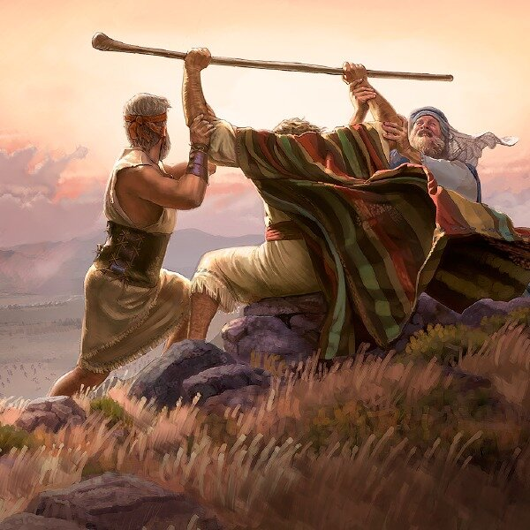
The Call To
ENDURE Is Not A Call
To Endure
Alone!
(2:22)
Notes:
Vessels for Honor will Not only remember WHY… But will Also remember we are not required to do it all ALONE!
You are not Fighting This Battle Alone.
You are not Running This Race Alone.
You are not Sowing The Good Seed Alone.
I want to speak to the hearts of everyone here – please, please – don’t listen to the random thoughts in your head that make you feel alone or isolated.
We are right here. There are good women and good men who have the hearts of Aaron & Hur… Exodus 17:12-14.
I want to tell everyone – if things are going well for you, and you want to be a blessing – then LIFT UP the hands of our elders! LIFT UP the hands of our deacons! They are doing all of this in addition to the many other job and family responsibilities they juggle!
They are agonizing over how to help - - come along side them and lift them up. Because they want to be there for you one day when you need it too!

Slide 8
Reflect on Godly Examples
Vessels That Endure
Hebrews 12:1-11
Helps Me More Accurately Estimate The Severity of My Suffering. (2 Cor. 11:23-28)
Reminds Me That Endurance Is An Expression of Love, Conviction, and Priorities. (2 Tim. 4:5)
Encourages Me To Hope In The Lord! (2 Tim 3:10-12)
Notes:
2 Tim. 1:8 – “join with me”
2 Tim. 1:12 – “I also suffer…”
2 Tim. 2:3 “suffer hardship with me”
Reflecting on Godly Examples Helps us Re-Callibrate our Thinking. It helps us see challenges in a whole new light.
Levels of Intensity…. Hebrews 12:1-11.
The Endurance of Jesus shows us what to expect.
The Endurance of Jesus reminds us not to exaggerate our own suffering out of propotion.
The Endurance of Jesus shows us that God we are not suffering because God is absent or unloving. But in fact, that God is allowing us to be perfected as His children!
The Endurance of Jesus reminds us that in hard times, our FAITH is actually made stronger.

Slide 9
Remember Why We Endure
Vessels That Endure
⁸ Remember Jesus Christ, risen from the dead, descendant of David, according to my gospel, ⁹ for which I suffer hardship even to imprisonment as a criminal; but the word of God is not imprisoned. ¹⁰ For this reason I endure all things for the sake of those who are chosen, so that they also may obtain the salvation which is in Christ Jesus and with it eternal glory. (2 Timothy 2:8-10)
Notes:
20 years ago, at the Anandale Lectures outside of DC. I remember an older preacher saying…
The phrase “I endure all things” is challenging enough when we think of the persecution we will face… but there is another level of endurance – when people gossip about our spouse, or unfairly criticize our children. When we have to bear under not just personal mistreatment, but attacks on those we love…. Paul wants us to understand the REAL and the DIFFICULT SCOPE of what we may face in this life. And knowing how it impacts us and those we love… why continue?
Because he remembers:
Remember JESUS.
Remember the RESURRECTION.
Remember the CHOSEN/ELECT. >>The Salvation we preach and proclaim to them!
Remember the GLORY.

Slide 10
Learn To Excel Under Pressure
Vessels That Endure
Like Timothy, Focus on God’s Approval. (2:15)
Like Timothy, Trust in God’s Power. (2:9)
Like Timothy, Hope In God’s Faithfulness. (2:12-13)
Like Timothy, Take Comfort in God’s Perspective. (2:19)
Like Timothy, Recognize Known Threats. (4:15)
Notes:
There are specific actions we can take when we are under great pressue to not only SURVIVE but actually SUCCEED!
- Paul is teaching Timothy that this is the world we live in. It is going to be hard. BUT even in that environment of difficulty – you can and will save souls because GOD is the TRUE STRENGTH working through you!

Slide 11
Poetry To Remember
Vessels That Endure
“For if we died with Him, we will also live with Him; If we endure, we will also reign with Him; If we deny Him, He also will deny us; If we are faithless, He remains faithful, for He cannot deny Himself.”
Notes:
*These verses – written or sung – help us remember the GLORY that comes after our suffering and the CERTAINTY of God’s unchanging promises if we abandon Him.
GLORY… These hardships are TRANSFORMED into BLESSINGS. The first two phrases are a reversal.
Death will be turned into Life.
Persecution will be turned into Victory.
Not only do they remind us of God’s faithfulness – but especially of the GLORY ahead!
*We can count on Him.
*We can look forward to victory.
Just as surely as HE WILL REVERSE these hardships. He will also JUDGE those who abandon their faith.
So we can be sure of 2 things… I can be sure that the rejection and persecution in this life will be radically reversed.
And I can be sure, that I do not want to quit, or give up, or get pulled away into the temptations of the world, because that is a DEAD END!
*He will judge with grace, and will punish exactly who He promises to punish.

Slide 12
I have fought the good fight, I have finished the course, I have kept the faith; in the future there is laid up for me the crown of righteousness, which the Lord, the righteous Judge, will award to me on that day; and not only to me, but also to all who have loved His appearing. (2 Timothy 4:7-8)
Notes:
Endure until the end…
But notice this awesome detail….
Paul called timothy to be a soldier, an athlete, a farmer. And he is saying:
I’ve been a solider who fought.
I’ve been an athlete who ran.
I’ve been a farmer who trusted in the Lord.

Slide 13
2023 Theme
Notes:
Are you determined to be a vessel for honor in the household of God? I pray that you are.
What kind of vessel will you be?
We learned tonight that part of being a vessel of honor is being “cleansed.” The only way for us to be fully cleansed is in the blood of Jesus.

