Slide 1
THE REAL ME

Slide 2
2 Timothy
2 Timothy 4:6-7
2 Timothy 4:18
⁶ For I am already being poured out as a drink offering, and the time of my departure is at hand. ⁷ I have fought the good fight, I have finished the race, I have kept the faith.
¹⁸ And the Lord will deliver me from every evil work and preserve me for His heavenly kingdom. To Him be glory forever and ever. Amen!
The Real Me

Slide 3
Romans 8:38-39
I am persuaded that neither death nor life, nor angels nor principalities nor powers, nor things present nor things to come, ³⁹ nor height nor depth, nor any other created thing, shall be able to separate us from the love of God which is in Christ Jesus our Lord.

Slide 4
The body is not the real Me!
“And the Lord God formed man of the dust of the ground, and breathed into his nostrils the breath of life; and man became a living being” (Genesis 2:7)
Then the dust will return to the earth as it was, And the spirit will return to God who gave it” (Ecclesiastes 12:7)
“ And do not fear those who kill the body but cannot kill the soul.” (Matthew 10:28)
“I am the resurrection and the life. He who believes in Me, though he may die, he shall live. ²⁶ And whoever lives and believes in Me shall never die” (John 11:25-26)

Slide 5
Paul called the body a tent.
”For we know that if our earthly house, this tent, is destroyed, we have a building from God, a house not made with hands, eternal in the heavens. ² For in this we groan, earnestly desiring to be clothed with our habitation which is from heaven” (2 Corinthians 5:1-3).
The outer man is perceived by our senses.
The inner man is perceived by faith.
“We walk by faith, not by sight” (Verse 7)

Slide 6
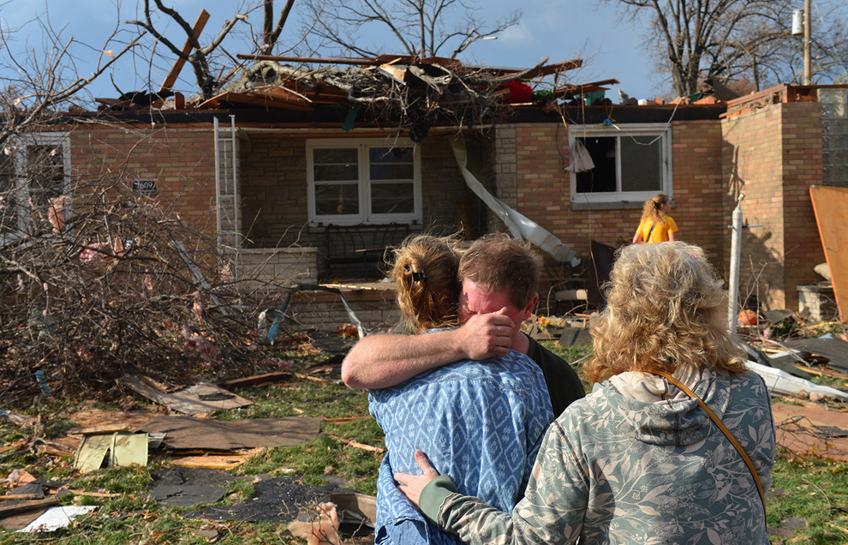
“At least, we’re still alive!”

Slide 7
The Body is Mortal, the Soul Eternal
“Even though our outward man is perishing, yet the inward man is being renewed day by day. ¹⁷ For our light affliction, which is but for a moment, is working for us a far more exceeding and eternal weight of glory, ¹⁸ while we do not look at the things which are seen, but at the things which are not seen. For the things which are seen are temporary, but the things which are not seen are eternal” (2 Corinthians 4:16-18).

Slide 8
If the Inner Man is “The Real Me”, it should be our first concern for –
Adornment
Nourishment
Preservation

Slide 9
1. Adornment
ADORNMENT = “Something added to make a person or thing more attractive” (Britannica Dictionary)
³ Do not let your adornment be merely outward—arranging the hair, wearing gold, or putting on of fine apparel— ⁴ rather let it be the hidden person of the heart, with the incorruptible beauty of a gentle and quiet spirit, which is very precious in the sight of God.
“ I desire…that the women adorn themselves in modest apparel, with propriety and moderation, not with braided hair or gold or pearls or costly clothing, ¹⁰ but, which is proper for women professing godliness, with good works. (1 Timothy 2:9-10)

Slide 10
2. Nourishment
²⁰ And He said, “What comes out of a man, that defiles a man. ²¹ For from within, out of the heart of men, proceed evil thoughts, adulteries, fornications,murders, ²² thefts, covetousness,wickedness, deceit, lewdness, an evil eye, blasphemy, pride, folishness ²³ All these evil things come from within and defile a man.” (Mark 7:20-23)
HOW DO THESE THINGS GET INTO THE HEART? G.I.G.O.
“Finally, brethren, whatever things are true, whatever things are noble, whatever things are just, whatever things are pure, whatever things are lovely, whatever things are of good report, if there is any virtue and if there is anything praiseworthy—meditate on these things.”

Slide 11
3. Preservation
^{24 ”}Then Jesus said to His disciples, “If anyone desires to come after Me, let him deny himself, and take up his cross, and follow Me. ²⁵ For whoever desires to save his life will lose it, but whoever loses his life for My sake will find it” (Mathew 16:24-25).
Amplified Bible: For whoever wishes to save his life [in this world] will [eventually] lose it [through death], but whoever loses his life [in this world] for My sake will find it [that is, life with Me for all eternity].
The time may be near when confession of Faith in God and Christ will mean death.

Slide 12
WARNING!
The inner man will always exist, but not necessarily with Jesus in heaven!
“The hour is coming in which all who are in the graves will hear His voice ²⁹ and come forth—those who have done good, to the resurrection of life, and those who have done evil, to the resurrection of condemnation” (John 5:28-29)
“Therefore whoever confesses Me before men, him I will also confess before My Father who is in heaven. ³³ But whoever denies Me before men, him I will also deny before My Father who is in heaven” (Matthew 10:32-33)

Slide 13
“HOW ARE YOU TONIGHT?”
”Beloved, I pray that you may prosper in all things and be in health, just as your soul prospers”.
3 John 2

