Slide 1
The Way of Balaam 2 Peter 2:15-16
Notes:
I won’t say everything that could be said about this – but I am 100% certain it is good for us to stop and remember this story! Peter , Jude, and John all thought it was a critical story to remember.
* Strong reminder – Scripture is not just speaking to the nation of Israel who would hear the story of their journey to the Promise Land. Or who needed to learn to fear the Lord in their day. Scripture is speaking to US. God is revealing Himself to US today and it is imperative that we learn the lessons our Father has preserved. For Peter particularly… it is a matter of life and death.

Slide 2
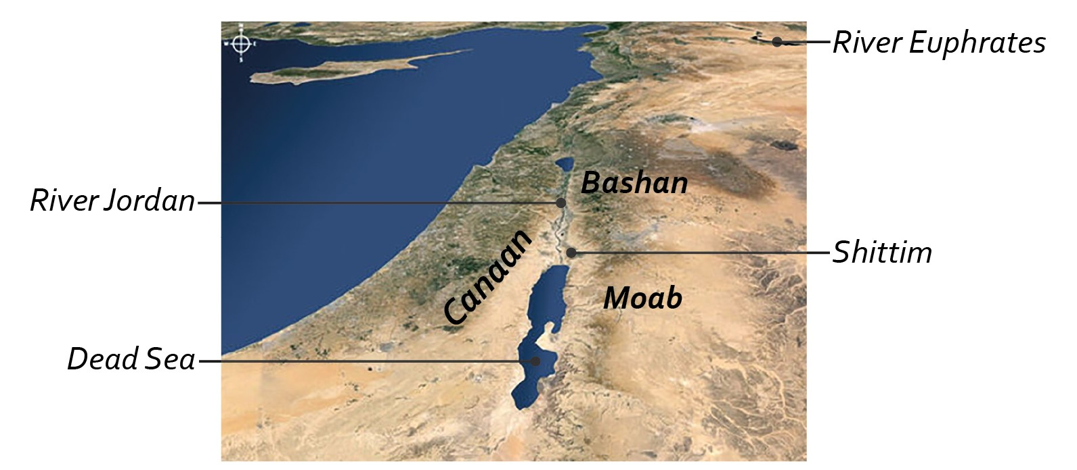
Numbers 22-24
Notes:
After Israel has traveled along the edges of Edom and Moab, they have had to battle two kings.
Balak is so full of fear – that he decides to launch a pre-emptive strike on Israel.
Deut. 23:4 – of Mesopotamia.

Slide 3
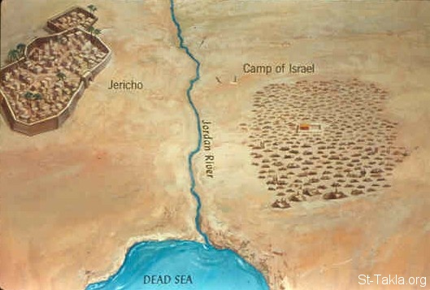
Numbers 22-24
Notes:
So they are not even in MOAB, and have no plan of attacking Moab, but as we see in the first few verses – the People are terrified because nearly 2 million strangers are camped out.

Slide 4
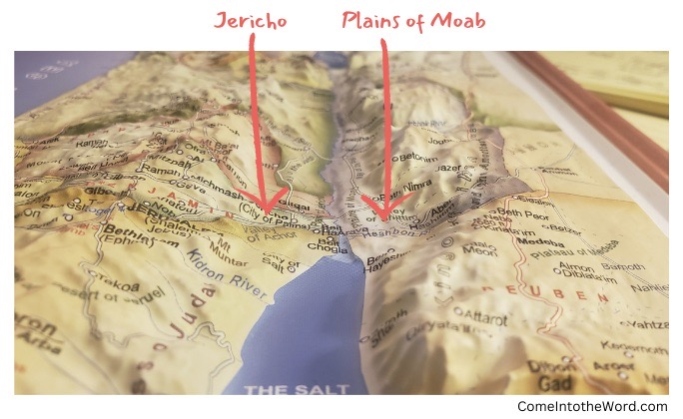
Numbers 22-24
Notes:
It is also beneficial to think about this being in the PLAINS of Moab, because it helps us understand how Balak selects several positions where from the higher ground he and Balaam can look down and see this mass of people camping in the plains below.

Slide 5
The Unexpected Story of Balak & Balaam
Balaam Declines Balak’s Invitation. (Numbers 22:6-14)
God Is Angry About Balaam’s Journey. (Numbers 22:22-35)
Notes:
The Narrative of Numbers doesn’t actually require these chapters. They could be taken out and you’d still get the message. But this unexpected prophet is given 3 whole chapters – because his life is treated by Scripture as an always relevant, always important warning.
This story unfolds masterfully. A big reason it is so memorable because it has so many Plot Twists… So many unexpected turns that grab our attention and make us wonder WHY these things are unfolding in such a unique way.
Don’t let knowing this story cause you to overlook how many twist and turns this narrative follows.
ODD juxtaposition – how can a prophet of God be wrapped up in superstition and heathenism?
BALAK – declined? The world is often confident in the attractiveness of it’s rewards. As peter wrote – they think it strange that we don’t run with them into excesses of sin any longer.
God Both Permits & Is Angry About Balaam’s Journey.

Slide 6
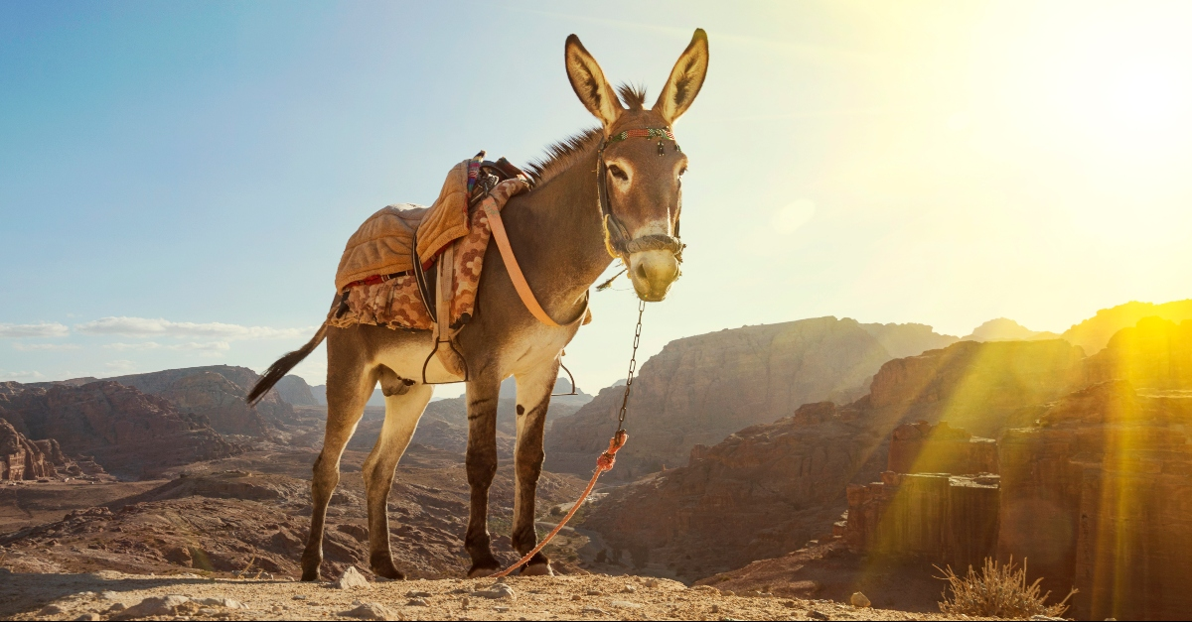
The Unexpected Story of Balak & Balaam
Notes:
22:23-35
The Angel and the Donkey are the only one who really honor God here.

Slide 7
The Unexpected Story of Balak & Balaam
Balaam Declines Balak’s Invitation. (Numbers 22:6-14)
God Is Angry About Balaam’s Journey. (Numbers 22:22-35)
Balaam’s Curse Is Turned Into A Blessing. (Numbers 23:8)
Balak Multiplies His Bad Decisions. (Num. 23:20,24, Num. 24:3-5, Num. 24:17)
Balaam Teaches Balak To Tempt Israel With Idolatry. (Numbers 24:14, Numbers 31:16)
Notes:
The Narrative of Numbers doesn’t actually require these chapters. They could be taken out and you’d still get the message. But this unexpected prophet is given 3 whole chapters – because his life is treated by Scripture as an always relevant, always important warning.
This story unfolds masterfully. A big reason it is so memorable because it has so many Plot Twists… So many unexpected turns that grab our attention and make us wonder WHY these things are unfolding in such a unique way.
Don’t let knowing this story cause you to overlook how many twist and turns this narrative follows.
ODD juxtaposition – how can a prophet of God be wrapped up in superstition and heathenism?
BALAK – declined? The world is often confident in the attractiveness of it’s rewards. As peter wrote – they think it strange that we don’t run with them into excesses of sin any longer.
God Both Permits & Is Angry About Balaam’s Journey.

Slide 8
The “Way of Balaam” Is A Permanent Warning For The People of God.
Triple-Problem: Extremely Enticing, Deceptively Evil, & Tragically Unprofitable.
2 Peter 2:15-16, Jude 11, Revelation 2:14
Please, Don’t Beg God For Something That Isn’t Good For You.
Please, Remember That Some False Prophets May Know God’s Word But They Aren’t Living By Them.
2 Peter 2:21-22
Notes:
We cannot underestimate how powerful these temptations are!
This is a textbook case of greed
We need to think of Balaam’s Character. Balaam’s Journey. And Balaam’s Fall.
Interesting Side Note: Part of our insight into Balaam’s heart is his cruelty towards animals. When people are cruel and hurtful to animals that are weak and helpless – their own hearts get darker.
Every adult here should be uncomfortable to realize how much we have in common with Balaam. He knew God. He was able to teach others about God. He had a reputation for his relationship with God. And people were patient with him.
Balaam Becomes His Own Worst Enemy! Satan will target the weak spots in our hearts.
Super Obvious, But Also The Downfall of Millions in Every Generation.
He is literally a lesson in a wasted life. In someone who had EVERY ADVANTAGE. Who had everything going for Him. And threw it all away.
False Prophets: He might as well have had a “For Sale” sign in his front yard. He sold his soul for a chance at fame and fortune.

Slide 9
The “Way of Balaam” Is A Permanent Warning For The People of God.
Balaam Is Self-Serving,
Fixated On Earthly Riches,
Easily Frustrated,
And A Dangerous Stumbling Block.
Jesus Lives To Serve Others,
Lay Up Treasure In Heaven,
Turn The Other Cheek,
And To Lift Up Others Who Have Fallen.
Notes:
We cannot underestimate how powerful these temptations are!
This is a textbook case of greed
We need to think of Balaam’s Character. Balaam’s Journey. And Balaam’s Fall.
Interesting Side Note: Part of our insight into Balaam’s heart is his cruelty towards animals. When people are cruel and hurtful to animals that are weak and helpless – their own hearts get darker.
Every adult here should be uncomfortable to realize how much we have in common with Balaam. He knew God. He was able to teach others about God. He had a reputation for his relationship with God. And people were patient with him.
Balaam Becomes His Own Worst Enemy! Satan will target the weak spots in our hearts.
Super Obvious, But Also The Downfall of Millions in Every Generation.
He is literally a lesson in a wasted life. In someone who had EVERY ADVANTAGE. Who had everything going for Him. And threw it all away.
False Prophets: He might as well have had a “For Sale” sign in his front yard. He sold his soul for a chance at fame and fortune.

Slide 10
When God Is For Us, We Have Nothing To Fear.
⁵ How fair are your tents, O Jacob, Your dwellings, O Israel! ⁶ “Like valleys that stretch out, Like gardens beside the river, Like aloes planted by the Lord, Like cedars beside the waters. ⁷ “Water will flow from his buckets, And his seed will be by many waters, And his king shall be higher than Agag, And his kingdom shall be exalted. (Numbers 24:5-7)
Notes:
God’s Words in Balaam’s prophecy shows us how God views HIS people – even after they have sinned in the past.
God’s words in Balaam’s prophecy even point towards the future Kingdom!

Slide 11
When God Is For Us, We Have Nothing To Fear.
¹⁶ The oracle of him who hears the words of God, And knows the knowledge of the Most High, Who sees the vision of the Almighty, Falling down, yet having his eyes uncovered. ¹⁷ “I see him, but not now; I behold him, but not near; A star shall come forth from Jacob, A scepter shall rise from Israel, And shall crush through the forehead of Moab, And tear down all the sons of Sheth. (Numbers 24:16-17)
Notes:
God’s Words in Balaam’s prophecy shows us how God views HIS people – even after they have sinned in the past.
God’s words in Balaam’s prophecy even point towards the future Kingdom!

Slide 12
Avoiding The Sins of Balaam
What Is My Reputation Today? (Num. 22:6, Prov. 22:1)
Who Do I Care About Impressing? (Gal. 1:10)
Do I Really Want To Hear God’s Message? (Gal. 4:16, Num. 24:10-11)
How Do I Treat Others Who See More Than Me?
Am I On Guard For The Stumbling Blocks Ahead? (Rom. 14:13)
Will My Advice Lead Others Closer To God? (James 5:19-20)
How Will I Be Remembered In The Future?
Notes:
Trying To Impress The Wrong People Is A Devastating Decision.
> Am I trying to impress people with clothing that is immodest? What a trainwreck.
> Am I trying to impress people who don’t even know God? What a misguided ambition!
Do I Want To Hear.
Regardless of the Messenger?
Regardless of the Message? (Num. 24:10-11)
Beware of flattery! (Proverbs 29:5 - A man who flatters his neighbor spreads a net for his feet.)
Please – DON’T GO – with people who want you to do what you KNOW you can’t do!
Who I want to impress will determine WHERE I want to be and what I want to have.
Num. 31:16 and Rev. 2:14
DO I WANT TO HEAR?
(23:25 – and 24:10-11. He gets so frustrated! He wants Balaam to stop in the middle of the blessings.)
TREAT OTHERS WHO SEE MORE… Humility to listen and accept that they are looking out for me!
Please don’t take that job.
Please don’t rush into that marriage.
Please don’t dwell on that failure.
Please don’t take this lightly.
STUMBLING BLOCKS…
HOW WILL I BE REMEMBERED… Not just that he fell – but that he had been moving that way over the course of many bad decisions, day after day. That he had ignored and rejected his conscience.
Numbers 23:10 – He wants to die the death of the righteous – but isn’t willing to LIVE the life of a TRUE servant of God.

Slide 13
The Way of Balaam 2 Peter 2:15-16
Notes:
Let’s talk for a moment about a FAITH that doesn’t save.
He knows who God is.
He knows what God commands.
He speaks God’s words.
But He is not loyal to God above all others.
He does not love God more than fame and fortune.
We are inviting you tonight to follow the WAY OF JESUS. The true King. The true Savior.

