Slide 2
Bringing The Ark Back to Jerusalem
David Encourages The People To Seek The Ark. (2 Samuel 6:1-4, 1 Samuel 7:1-2)
The Spiritual Significance of The Ark Is Described (2 Samuel 6:2, 1 Chronicles 13:6)

Slide 3
1 Chronicles 13:5 and 2 Samuel 6:2
Notes:
About 10 Miles Away…

Slide 4
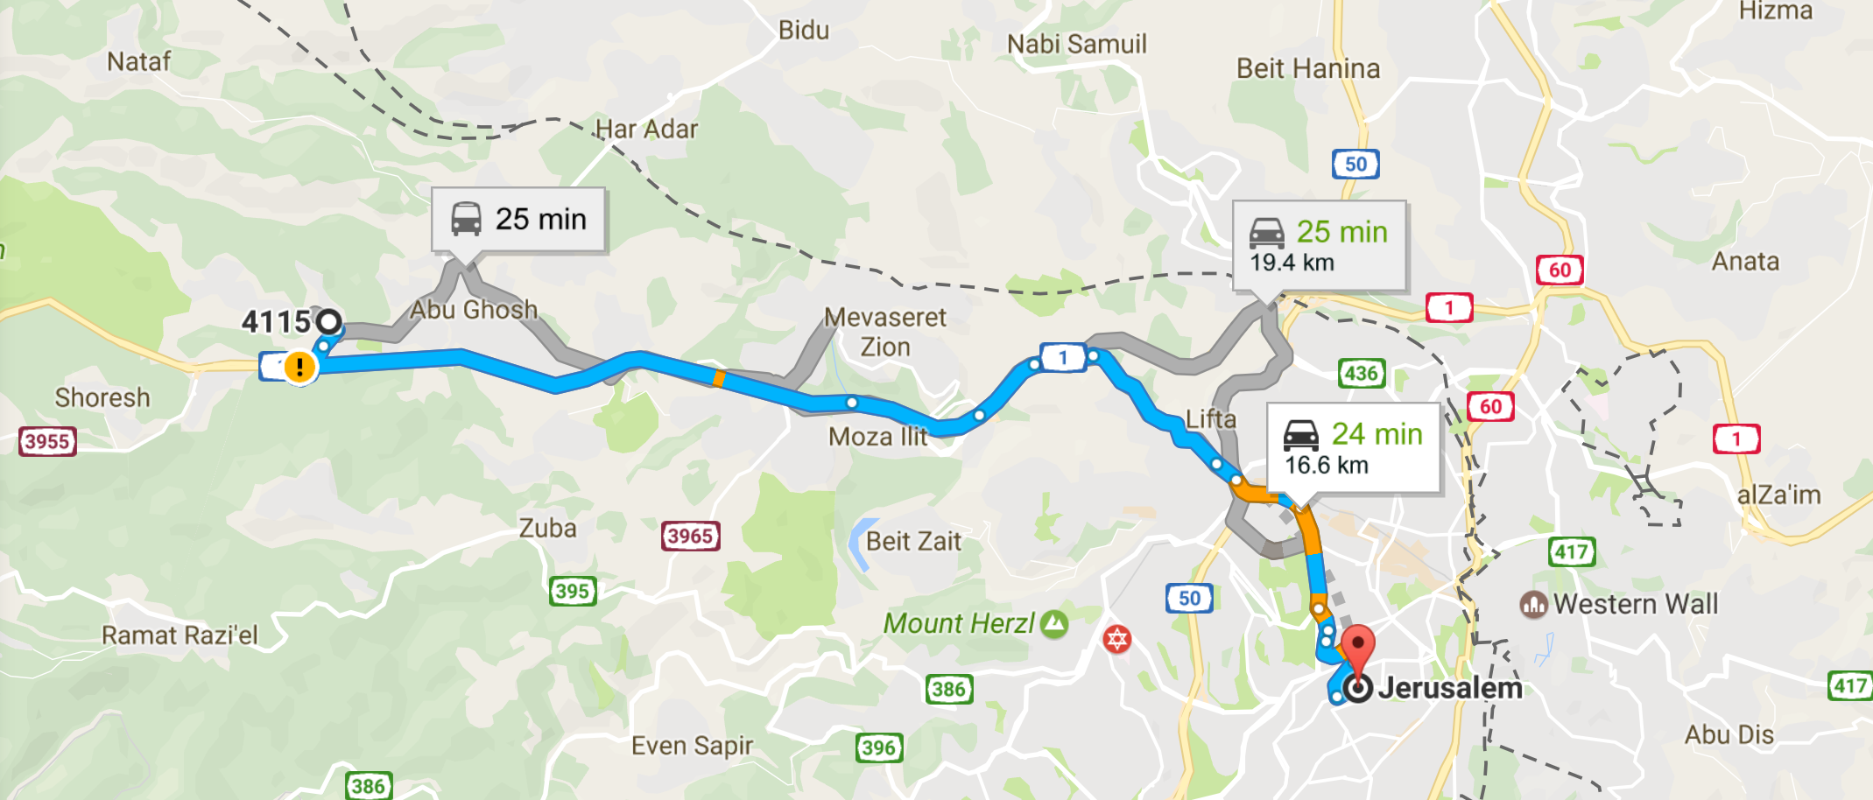
1 Chronicles 13:5 and 2 Samuel 6:2

Slide 5
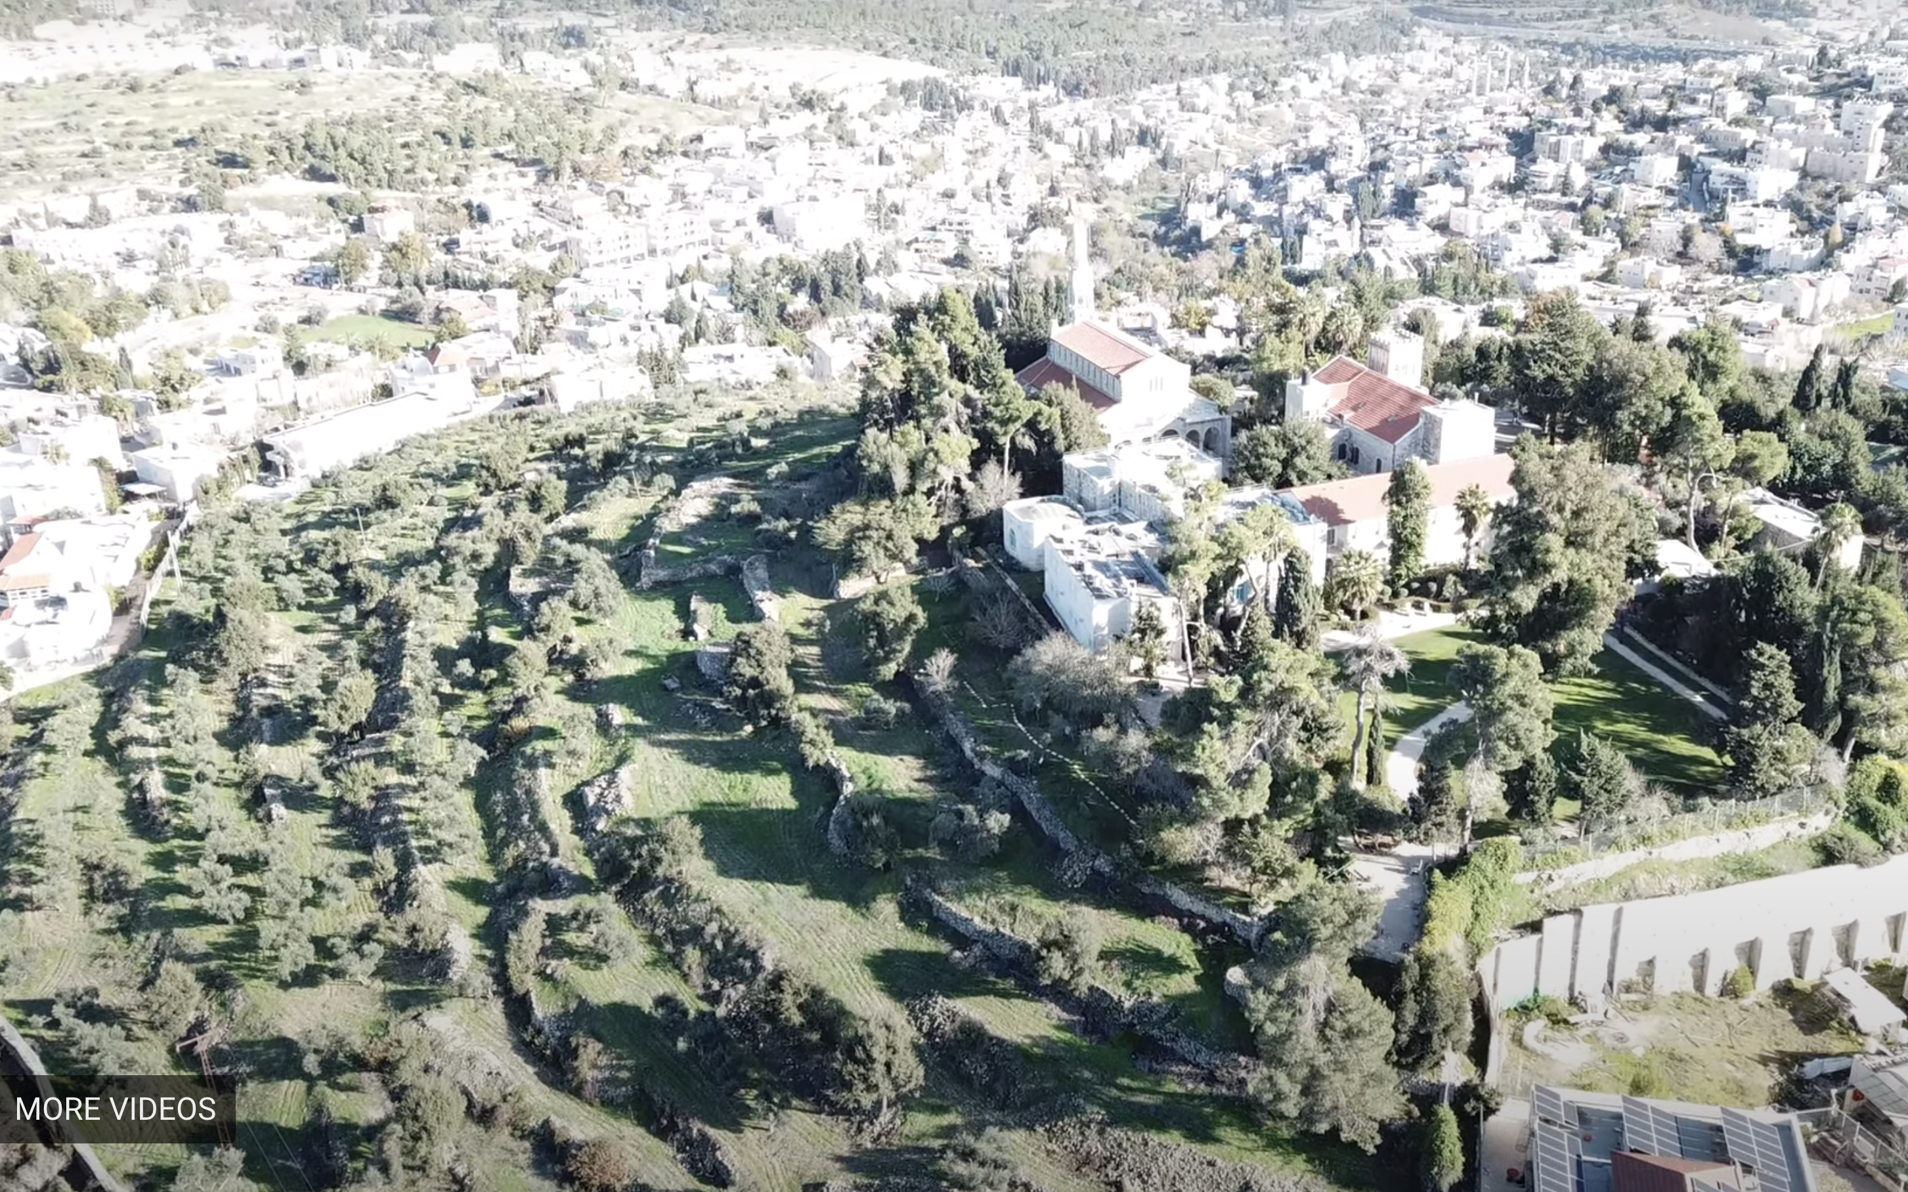

Slide 6
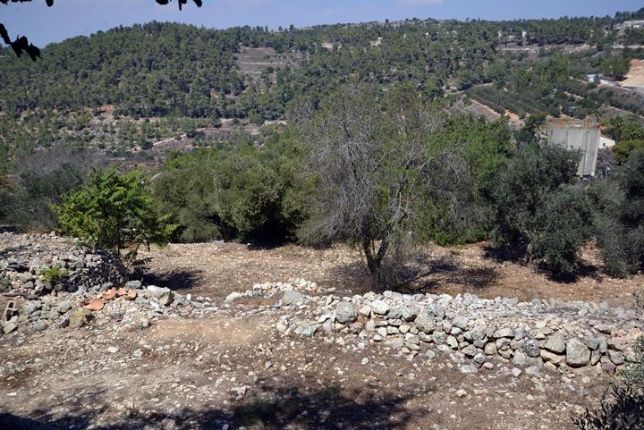

Slide 7
Bringing The Ark Back to Jerusalem
David Encourages The People To Seek The Ark. (2 Samuel 6:1-4, 1 Samuel 7:1-2)
The Spiritual Significance of The Ark Is Described (2 Samuel 6:2, 1 Chronicles 13:6)
We Meet The Family of Abinadab (2 Samuel 6:3, 1 Chronicles 13:7)
The People Rejoice As They Transport The Ark On A Cart (2 Samuel 6:5, 1 Chronicles 13:8, 1 Samuel 6:8-13)

Slide 8
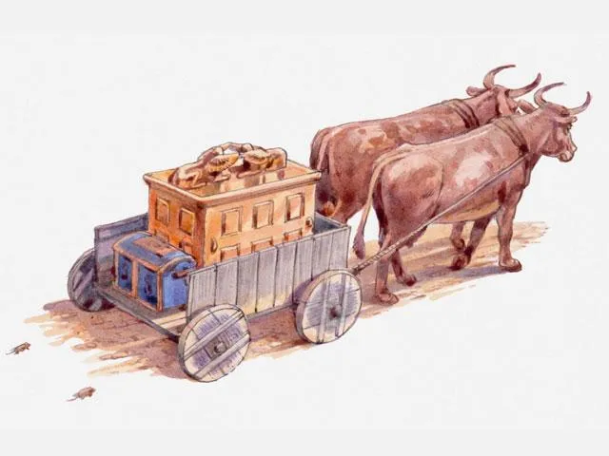

Slide 9
Bringing The Ark Back to Jerusalem
David Encourages The People To Seek The Ark. (2 Samuel 6:1-4, 1 Samuel 7:1-2)
The Spiritual Significance of The Ark Is Described (2 Samuel 6:2, 1 Chronicles 13:6)
We Meet The Family of Abinadab (2 Samuel 6:3, 1 Chronicles 13:7)
The People Rejoice As They Transport The Ark On A Cart (2 Samuel 6:5, 1 Chronicles 13:8, 1 Samuel 6:8-13)
Uzzah Does The Unthinkable: He Touches The Ark (1 Samuel 6:19-21, 2 Samuel 6:6-7, 1 Chronicles 13:9-10 )

Slide 10
WE CAN NEVER LOSE SIGHT OF
THE HOLINESS
GOD.
OF

Slide 11
Learning To Act with Respect & Resolve
David Becomes Both Angry with God & Afraid. (2 Samuel 6:8-10, 1 Chronicles 13:11-12)
God Blesses The Household of Obed-Edom the Gittite. (2 Samuel 6:11, 1 Chronicles 13:13-14)
David Completes The Journey With Renewed Reverence. (2 Samuel 6:12-15, 1 Chronicles 15:1-2, 11-15)
Notes:
A Defining Moment for David
It’s common to feel angry with God or be afraid of God when we think about this.
It’s important that we handle those feelings with maturity and respect instead of making rash decisions.
With a little time, David comes to realize that God didn’t ruin the celebration – Uzzah did – Uzzah violated an extremely well known command.
Despite knowing about Uzzah’s fate, Obed-Edom welcomed the ark and seemed to have no misgivings. Indeed, as a godly man, Obed-Edom had nothing to fear: “The righteous are as bold as a lion” (Proverbs 28:1). It could be that he viewed having the ark in his home as a high honor rather than a nuisance, and God rewarded his attitude.
COMPLETES….
Don’t Stop Doing What Was Right…

Slide 12
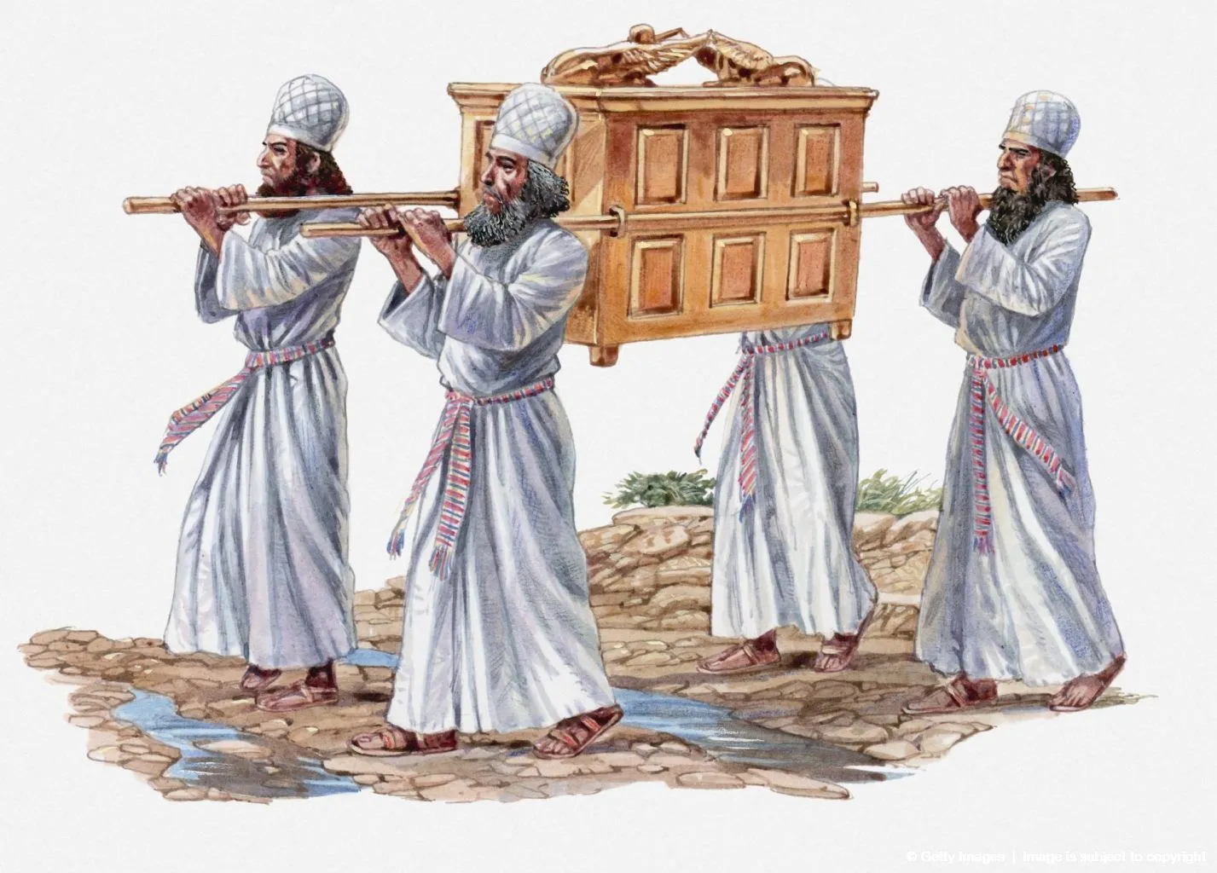
Notes:
Numbers 7:9

Slide 13
WE MUST PAY CLOSE
ATTENTION TO THE
INSTRUCTIONS
FOUND IN THE BIBLE.
Notes:
1.) This means we need to study and know the word of God. WE need to know his commands for how we worship, for how we run our homes, for how we..
We Must Know God’s Word WELL To Carry Out His Commands
He is In Our Midst…
Draw from the springs of salvation, Give thanks to His great and holy name; Make known His deeds among the people, Make known His exalted way. Call on His name with thanksgiving, Yes, joyously praise His name in song; Through love He authored our salvation, Through love He did give His son. Chorus: Praise the Lord and shout and cry for joy, For the Holy One is in our midst, Praise the Lord and shout and cry for joy, For He is in our midst.

Slide 14
Notes:
1 Chron. 16
Oh give thanks to the Lord, call upon His name; Make known His deeds among the peoples. ⁹ Sing to Him, sing praises to Him; ^{[d]}Speak of all His ^{[e]}wonders. ^{10 [f]}Glory in His holy name; Let the heart of those who seek the Lord be glad. ¹¹ Seek the Lord and His strength; Seek His face continually. ¹² Remember His wonderful deeds which He has done, His marvels and the judgments from His mouth,

