Slide 1
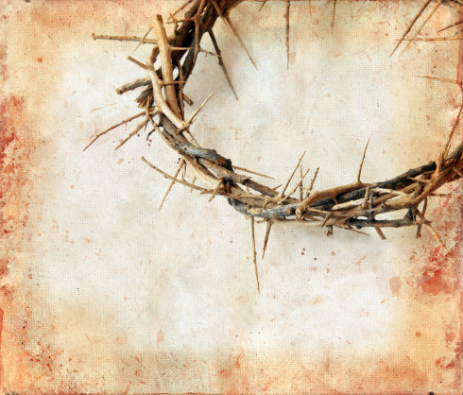
SO, JESUS CAME OUT
WEARING THE CROWN OF THORNS
AND THE PURPLE ROBE. PILATE SAID TO THEM
“BEHOLD THE MAN!”
John 19:5

Slide 2
Deity in the Flesh
“And the Word became flesh and dwelt among us, and we have seen his glory, glory as of the only Son from the Father, full of grace and truth”
John 1:14

Slide 3
Goals of this Lesson
To recognize His humanity
To see Him as flesh and blood
To see how He can sympathize with us and be a Friend to us
To see Him as He is/was so our love for Him will be magnified greatly!

Slide 4
A Man of Compassion
The unclean (Mk 1:41)
The sick and disabled (Mt 14:14)
The lost seeking leadership (Mt 9:36; 6:34)
The hungry (Mk 8:2)
The widows and grieving (Lk 7:13)
The blind and forgotten (Mt 20:34)

Slide 5
A Man Filled with Emotion
Jesus was hungry (Luke 4:2; Matt 21:18)
Jesus was thirsty (John 4:7; 19:28)
Jesus was tired (John 4:6)
Jesus was sleepy – (Matt 8:24; Luke 8:23; Mark 4:38)

Slide 6
A Man Filled with Emotion
Jesus had strong desires (Luke 22:15)
Jesus was surprised (Luke 7:9)
Jesus wondered (Mark 6:6)
Jesus was angry (Mark 3:5)
Jesus grieved (Mark 3:5)

Slide 7
A Man Filled with Emotion
Jesus was indignant (Mark 10:14)
Jesus sighed (Mark 7:34)
Jesus “groaned in the spirit” (John 11:33-38)
Jesus was in agony (Luke 22:44)
Jesus cried (John 11:35; Luke 19:41)

Slide 8
A Man of Sorrow
Luke 12:49-50
“I came to cast fire on the earth, and would that it were already kindled! I have a baptism to be baptized with, and how great is my distress until it is accomplished!”

Slide 9
A Man of Sorrow
John 12:27
“Now is my soul troubled. And what shall I say? ‘Father, save me from this hour’? But for this purpose I have come to this hour.”

Slide 10
A Man of Sorrow
Matt 26:38
“Then he said to them, ‘My soul is very sorrowful, even to death; remain here, and watch with me.’”

Slide 11
A Man of Sorrow
Luke 22:44
“And being in an agony he prayed more earnestly; and his sweat became like great drops of blood falling down to the ground.”

Slide 12
A Man of Sorrow
Hebrews 5:7
“In the days of his flesh, Jesus offered up prayers and supplications, with loud cries and tears, to him who was able to save him from death, and he was heard because of his reverence.”

Slide 13
This is God Living Our Life
1. God entered in an ordinary home with an ordinary family
2. God was not ashamed to do a man's work
3. God knows what it is to be tempted
4. God shared love and judgment
5. God was nailed to a Cross
(William Barclay)

Slide 14
“…looking to JESUS
the founder and perfecter of our FAITH, who for the JOY …set before him ENDURED the cross, despising the shame, and is SEATED at the right hand of the throne of God”
Hebrews 12:2

Slide 15
Take Home
1. Our Lord sympathizes with our weaknesses
2. Our Lord understands our struggles
3. Our Lord motivates us with His love
4. Our Lord inspires us to lead as he led
5. Our Lord wants us to excel in Faith

