Slide 1
RESPETO Y
RESOLUCIÓN
LECCIONES DE DAVID Y UZA – 2 SAMUEL 6

Slide 2
Trayendo el arca de vuelta a Jerusalén
David anima al pueblo a buscar el arca. (2 Samuel 6:1-4, 1 Samuel 7:1-2)
Se describe la importancia espiritual del arca (2 Samuel 6:2, 1 Crónicas 13:6)

Slide 3
1 Crónicas 13:5 y 2 Samuel 6:2
Quiriat Jearim
Pérez Uza
Jerusalén
Notes:
About 10 Miles Away…

Slide 4
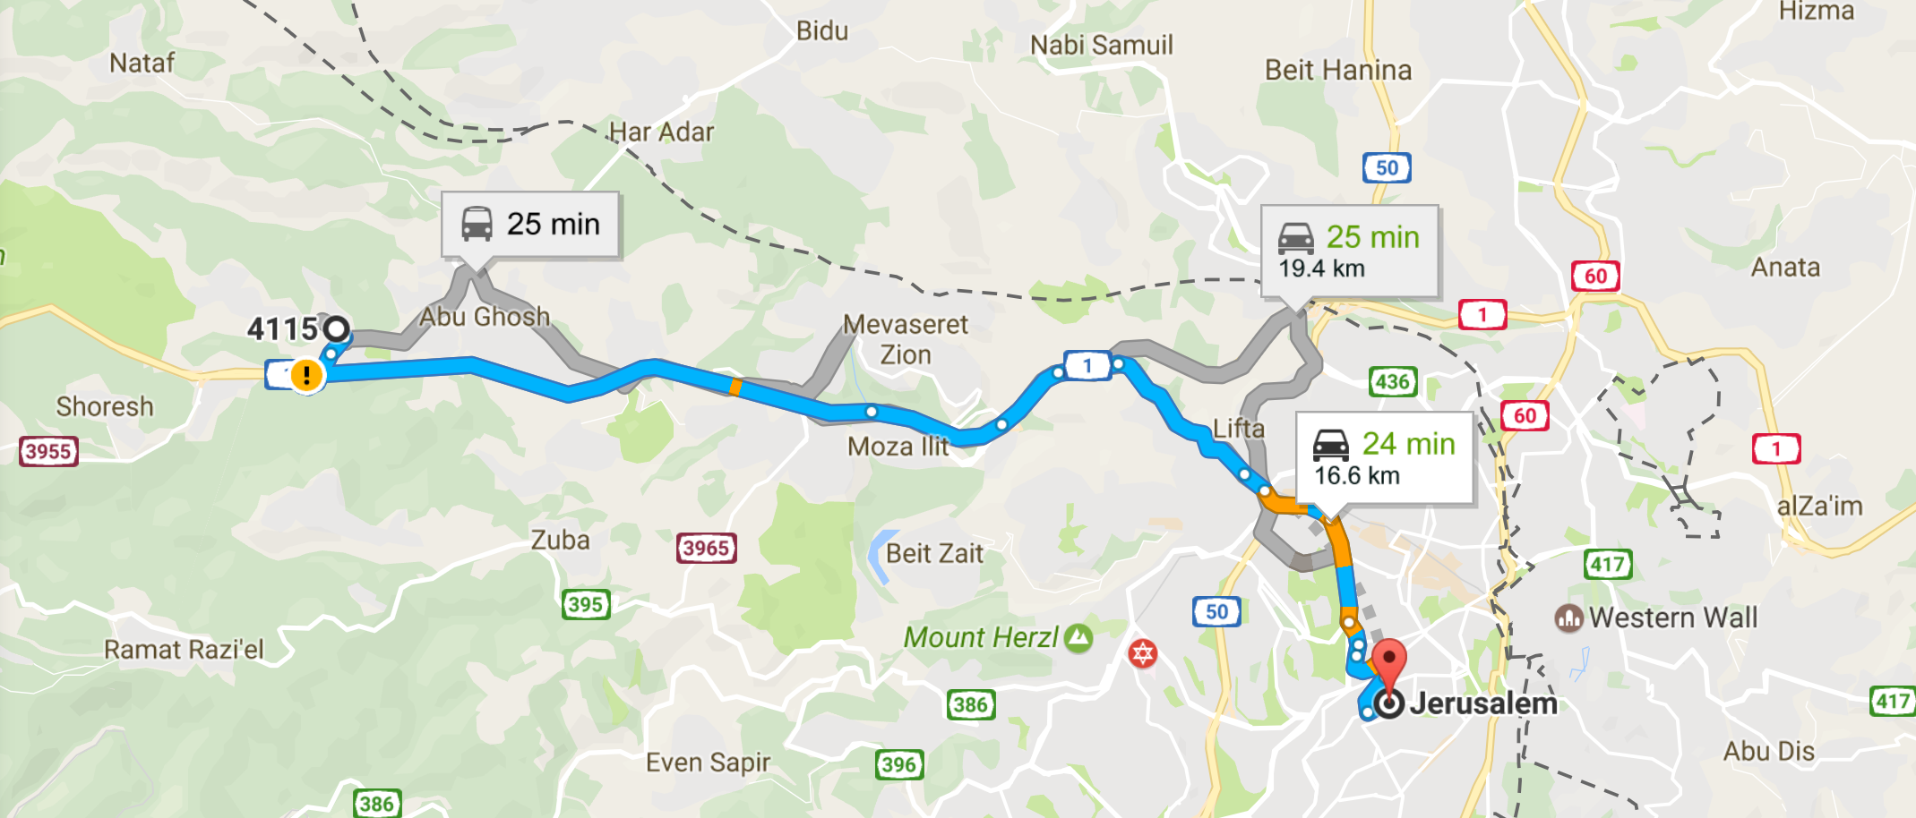
1 Crónicas 13:5 y 2 Samuel 6:2

Slide 5
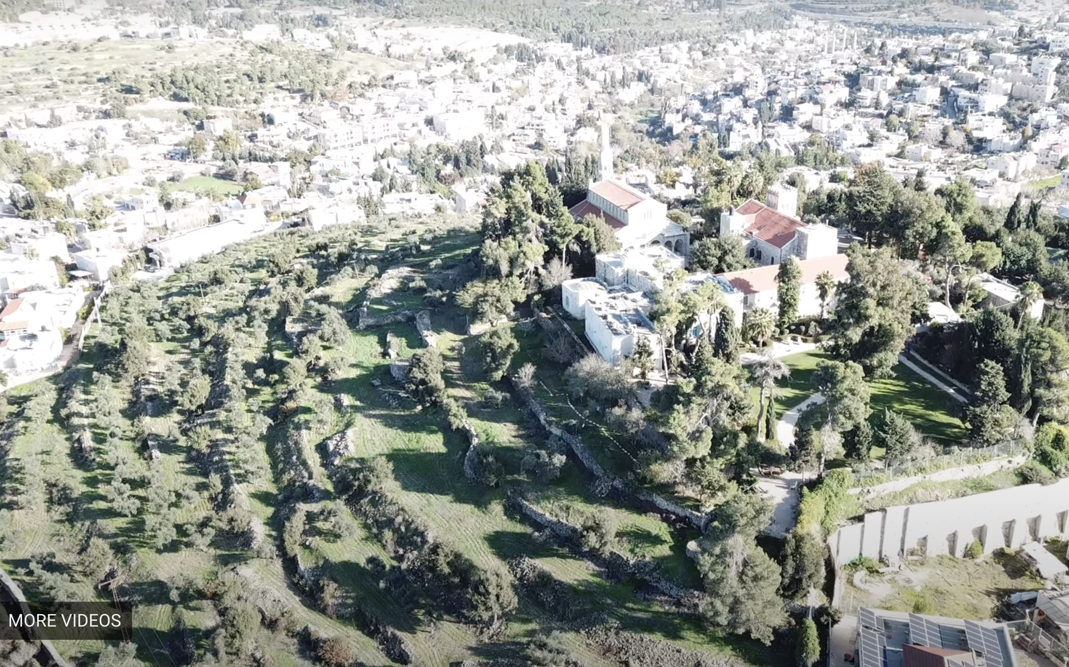

Slide 6
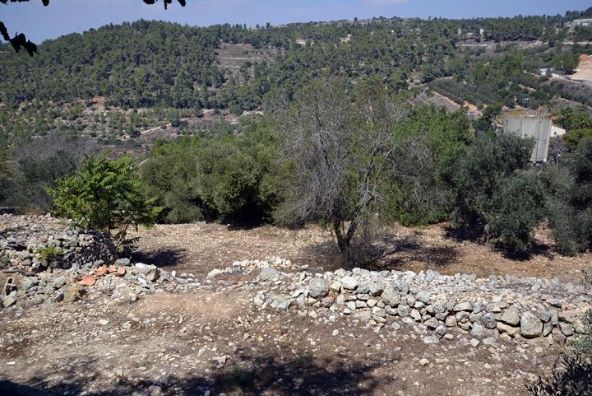

Slide 7
Trayendo el arca de vuelta a Jerusalén
David anima al pueblo a buscar el arca. (2 Samuel 6:1-4, 1 Samuel 7:1-2)
Se describe la importancia espiritual del arca (2 Samuel 6:2, 1 Crónicas 13:6)
Conocemos a la familia de Abinadab (2 Samuel 6:3, 1 Crónicas 13:7)
El pueblo se regocija mientras se transportaba el arca sobre un carro. (2 Samuel 6:5, 1 Crónicas 13:8, 1 Samuel 6:8-13)

Slide 8
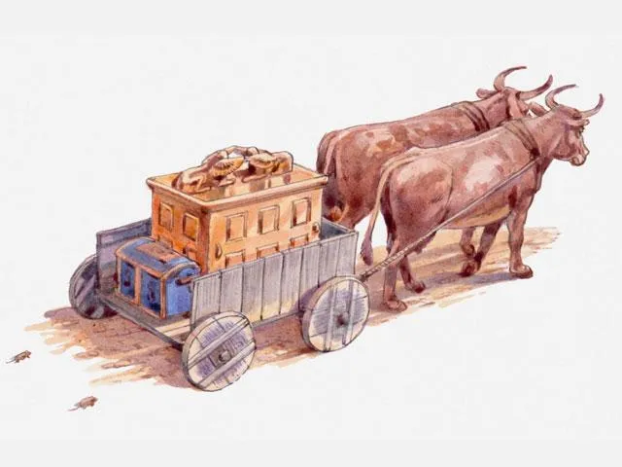

Slide 9
Trayendo el arca de vuelta a Jerusalén
David anima al pueblo a buscar el arca. (2 Samuel 6:1-4, 1 Samuel 7:1-2)
Se describe la importancia espiritual del arca (2 Samuel 6:2, 1 Crónicas 13:6)
Conocemos a la familia de Abinadab (2 Samuel 6:3, 1 Crónicas 13:7)
El pueblo se regocija mientras se transportaba el arca sobre un carro. (2 Samuel 6:5, 1 Crónicas 13:8, 1 Samuel 6:8-13)
Uza hace lo impensable: toca el arca (1 Samuel 6:19-21, 2 Samuel 6:6-7, 1 Crónicas 13:9-10 )

Slide 10
NUNCA PODEMOS PERDER DE VISTA
LA SANTIDAD
DIOS.
DE

Slide 11
Aprendiendo a actuar con respeto y resolución
David se enojó y también tuvo miedo de Dios. (2 Samuel 6:8-10, 1 Crónicas 13:11-12)
Dios bendijo a la casa de Obed Edom el geteo. (2 Samuel 6:11, 1 Crónicas 13:13-14)
David complete el viaje con reverencia renovada. (2 Samuel 6:12-15, 1 Crónicas 15:1-2, 11-15)
Notes:
A Defining Moment for David
It’s common to feel angry with God or be afraid of God when we think about this.
It’s important that we handle those feelings with maturity and respect instead of making rash decisions.
With a little time, David comes to realize that God didn’t ruin the celebration – Uzzah did – Uzzah violated an extremely well known command.
Despite knowing about Uzzah’s fate, Obed-Edom welcomed the ark and seemed to have no misgivings. Indeed, as a godly man, Obed-Edom had nothing to fear: “The righteous are as bold as a lion” (Proverbs 28:1). It could be that he viewed having the ark in his home as a high honor rather than a nuisance, and God rewarded his attitude.
COMPLETES….
Don’t Stop Doing What Was Right…

Slide 12
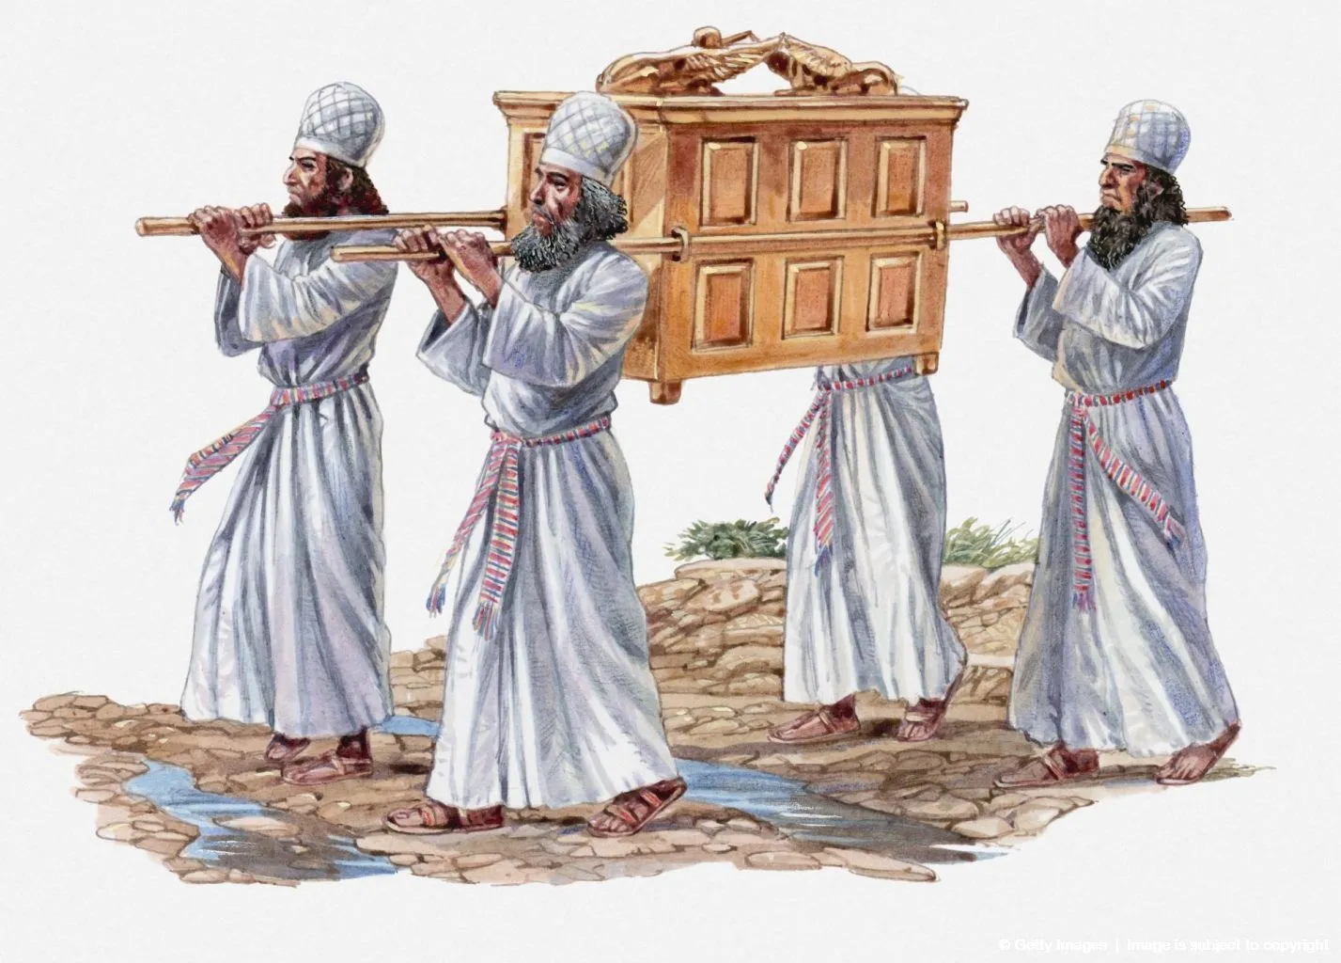
Notes:
Numbers 7:9

Slide 13
HAY QUE PONER MUCHA
ATENCIÓN A LAS
INSTRUCCIONES
QUE ENCONTRAMOS EN LA BIBLIA.
Notes:
1.) This means we need to study and know the word of God. WE need to know his commands for how we worship, for how we run our homes, for how we..
We Must Know God’s Word WELL To Carry Out His Commands
He is In Our Midst…
Draw from the springs of salvation, Give thanks to His great and holy name; Make known His deeds among the people, Make known His exalted way. Call on His name with thanksgiving, Yes, joyously praise His name in song; Through love He authored our salvation, Through love He did give His son. Chorus: Praise the Lord and shout and cry for joy, For the Holy One is in our midst, Praise the Lord and shout and cry for joy, For He is in our midst.

Slide 14
RESPETO Y
RESOLUCIÓN
LECCIONES DE DAVID Y UZA – 2 SAMUEL 6

