Slide 1
Therefore, since we have so great a cloud of witnesses surrounding us, let us also lay aside every encumbrance and the sin which so easily entangles us, and let us run with endurance the race that is set before us, 2 fixing our eyes on Jesus, the author and perfecter of faith, who for the joy set before Him endured the cross, despising the shame, and has sat down at the right hand of the throne of God.

Slide 2
Therefore, since we have so great a cloud of witnesses surrounding us, let us also lay aside every encumbrance and the sin which so easily entangles us, and let us run with endurance the race that is set before us, 2 fixing our eyes on Jesus, the author and perfecter of faith, who for the joy set before Him endured the cross, despising the shame, and has sat down at the right hand of the throne of God.

Slide 3
Therefore, since we have so great a cloud of witnesses surrounding us, let us also lay aside every encumbrance and the sin which so easily entangles us, and let us run with endurance the race that is set before us, 2 fixing our eyes on Jesus, the author and perfecter of faith, who for the joy set before Him endured the cross, despising the shame, and has sat down at the right hand of the throne of God.

Slide 4
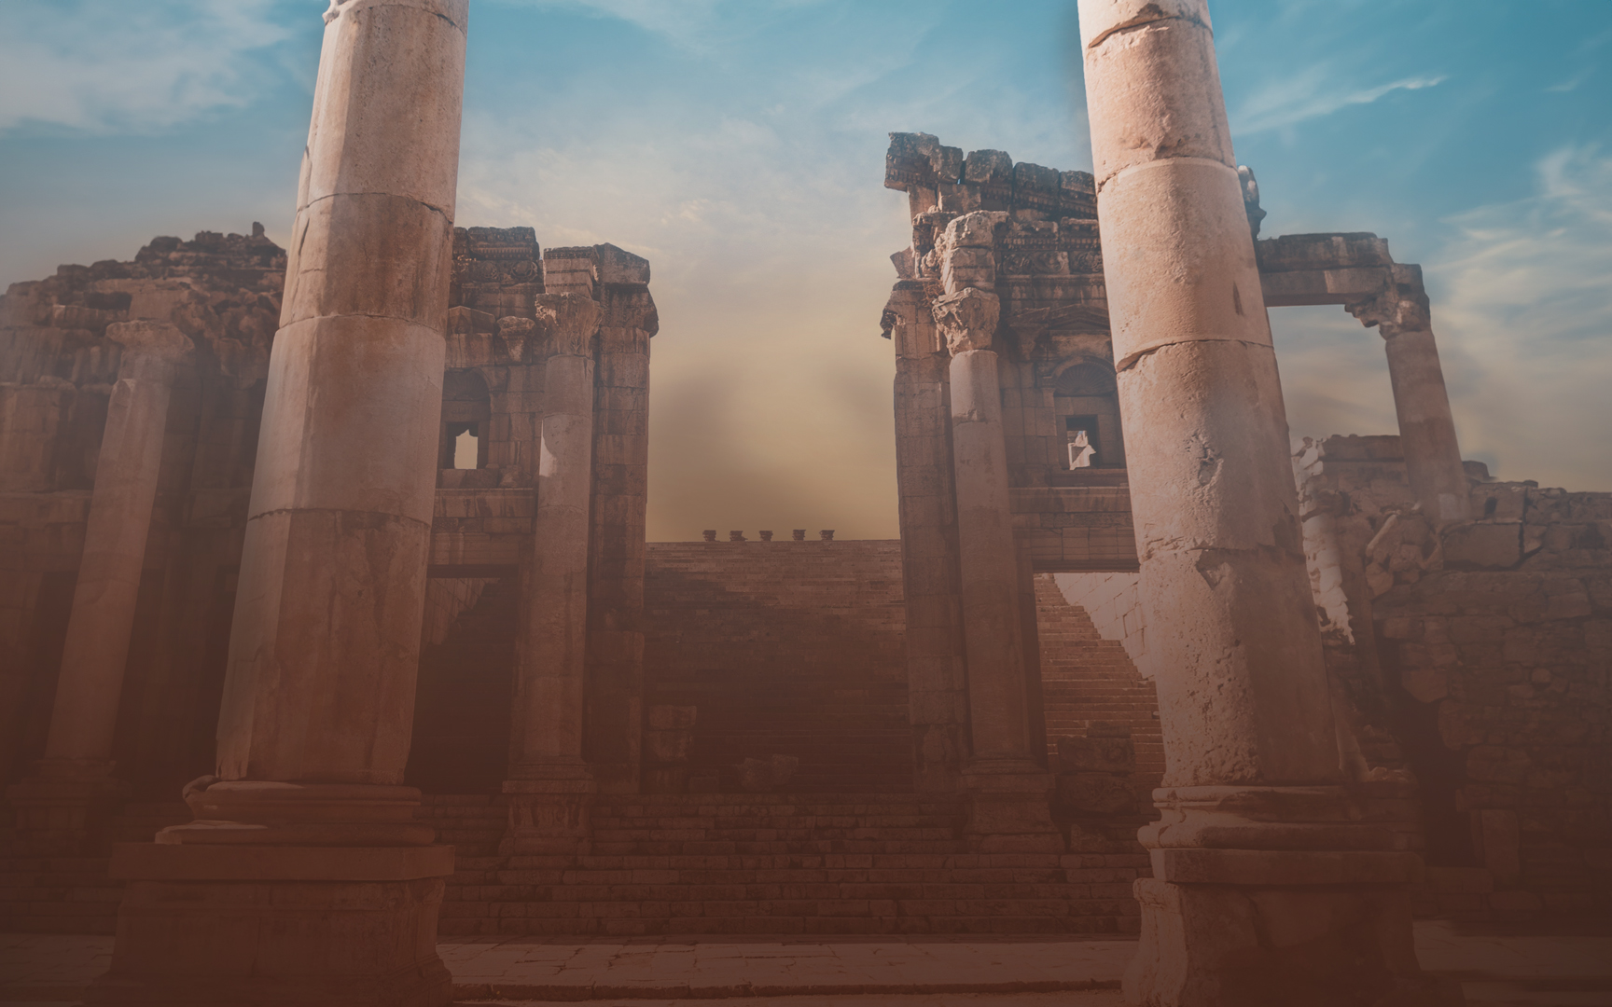

Slide 5
Activities with Our Theme
Children’s classes – Gospels
Public Readings – Sunday am and pm
Annual Reading Plan – embryhills.com/podcast
End of the Year Studies – Parables of Jesus
Song – “Looking to Thee”

Slide 6
10-15 Minute Podcasts
Related to the Annual Reading
Available on Spotify
Look for an email with a link
QR codes

Slide 7
Title | Sundays at 6 PM
Intro: Fixing Our Eyes on Jesus | September 17, 2023
Focusing Our Eyes on Jesus:
The Author and Perfector of Faith | October 15, 2023
The Joy Set Before Him | November 19, 2023
Enduring the Cross, Despising the Shame | December 17, 2023
Sitting at the Right Hand of God’s Throne | January 21, 2024
The Same Yesterday, Today, and Tomorrow | February 18, 2024
Living Like Jesus:
Laying Aside Every Weight and Sin | March 17, 2024
Sharing in His Holiness | April 21, 2024
Seeking the City to Come | May 19, 2024
Loving Sacrificially | June 16, 2024
Rejecting Strange Teaching | July 21, 2024
Jesus Working in Us | August 18, 2024

Slide 8
Title | Sundays at 6 PM
Intro: Fixing Our Eyes on Jesus | September 17, 2023
Focusing Our Eyes on Jesus:
The Author and Perfector of Faith | October 15, 2023
The Joy Set Before Him | November 19, 2023
Enduring the Cross, Despising the Shame | December 17, 2023
Sitting at the Right Hand of God’s Throne | January 21, 2024
The Same Yesterday, Today, and Tomorrow | February 18, 2024
Living Like Jesus:
Laying Aside Every Weight and Sin | March 17, 2024
Sharing in His Holiness | April 21, 2024
Seeking the City to Come | May 19, 2024
Loving Sacrificially | June 16, 2024
Rejecting Strange Teaching | July 21, 2024
Jesus Working in Us | August 18, 2024

Slide 9
Jesus, the Faithful
“Faith is the conviction of the truth of anything.”
[Heb 11:1, 6 NASB95] 1 Now faith is the assurance of [things] hoped for, the conviction of things not seen. ... 6 And without faith it is impossible to please [Him,] for he who comes to God must believe that He is and [that] He is a rewarder of those who seek Him.

Slide 10
Jesus, the Faithful
“Faith is the conviction of the truth of anything.”
Jesus is the author of faith.
Jesus is the perfector of faith.

Slide 11
Jesus, the Faithful
The convictions that Jesus had.
Seeing Jesus’ faith.
Fixing our eyes on the faith of Jesus.

Slide 12
The convictions of Jesus of Nazareth
John 5:19 Therefore Jesus answered and was saying to them, "Truly, truly, I say to you, the Son can do nothing of Himself, unless [it is] something He sees the Father doing; for whatever the Father does, these things the Son also does in like manner. 20 "For the Father loves the Son, and shows Him all things that He Himself is doing; and [the Father] will show Him greater works than these, so that you will marvel. 21 "For just as the Father raises the dead and gives them life, even so the Son also gives life to whom He wishes. 22 "For not even the Father judges anyone, but He has given all judgment to the Son, 23 so that all will honor the Son even as they honor the Father. He who does not honor the Son does not honor the Father who sent Him.

Slide 13
The convictions of Jesus of Nazareth
24 "Truly, truly, I say to you, he who hears My word, and believes Him who sent Me, has eternal life, and does not come into judgment, but has passed out of death into life. 25 "Truly, truly, I say to you, an hour is coming and now is, when the dead will hear the voice of the Son of God, and those who hear will live. 26 "For just as the Father has life in Himself, even so He gave to the Son also to have life in Himself; 27 and He gave Him authority to execute judgment, because He is [the] Son of Man.

Slide 14
Jesus of Nazareth was convicted and convinced of…
the love that the Father had for Him.
the Father’s will being lived out in His life.
the right He had to judge and give life.
the notion that He came from the Father.
that this was the way to honoring the Son and Father.
that He and the Father are One.

Slide 15
Seeing the faith of God the Son
John 1:1 In the beginning was the Word, and the Word was with God, and the Word was God. 2 He was in the beginning with God. 3 All things came into being through Him, and apart from Him nothing came into being that has come into being… 14 And the Word became flesh, and dwelt among us, and we saw His glory, glory as of the only begotten from the Father, full of grace and truth.
Faith in surrendering Heaven to
redeem man.

Slide 16
Seeing the faith of God the Son
Hebrews 1:2 His Son, whom He appointed heir of all things, through whom also He made the world. 3 And He is the radiance of His glory and the exact representation of His nature, and upholds all things by the word of His power. When He had made purification of sins, He sat down at the right hand of the Majesty on high…
1 Pet. 2:21-24 “Christ suffered, ‘WHO COMMITTED NO SIN, NOR WAS ANY DECEIT FOUND IN HIS MOUTH’” and then while living like this He was “reviled, suffered, and died” and “did not revile in return, did not utter threats, but entrusted Himself to God.
Faith to submit to the point of humiliation.

Slide 17
Seeing the faith of God the Son
Luke 22:41 And He withdrew from them about a stone's throw, and He knelt down and [began] to pray, 42 saying, "Father, if You are willing, remove this cup from Me; yet not My will, but Yours be done."
Luke 23:43 And He said to him, "Truly I say to you, today you shall be with Me in Paradise." 44 It was now about the sixth hour, and darkness fell over the whole land until the ninth hour, 45 because the sun was obscured; and the veil of the temple was torn in two. 46 And Jesus, crying out with a loud voice, said, "Father, INTO YOUR HANDS I COMMIT MY SPIRIT." Having said this, He breathed His last.
Faith to die in hopes of receiving and giving life.

Slide 18
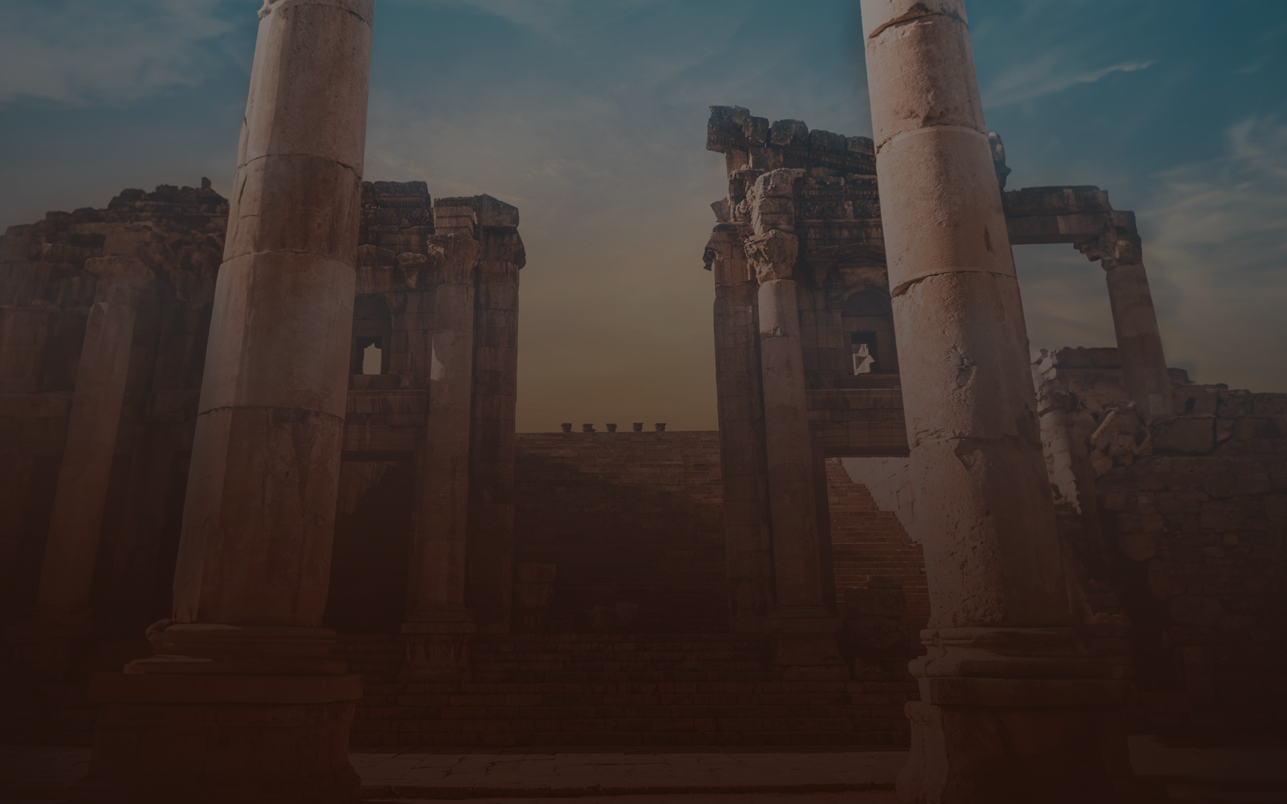
Fixing our eyes on Jesus’ faith
Look at Jesus’ faith and learn of sacrifice.
Look at Jesus’ faith and see God’s faithfulness.
Look at Jesus’ faith and set an example to those looking at you.
Look at Jesus’ faith and see that faith doesn’t take the easy way out.

