Slide 1
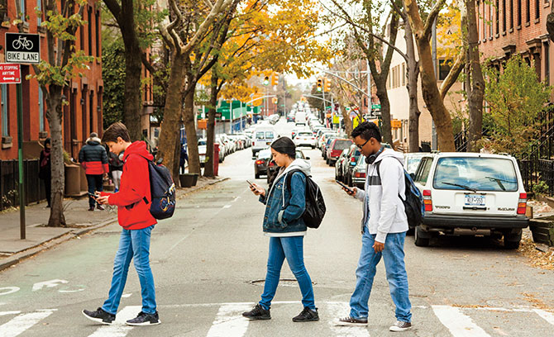
mindlessness?

Slide 2
Faith & Our Digital World
Embry Hills church
November 11-12, 2023

Slide 3
Eden vs. Babel
Two Visions of Technology
Genesis 1-11

Slide 4
Two Visions of Technology
Garden of Eden
(Genesis 1-2)
Man was made to rule (cultivate, protect), filling the earth with God’s glory.
We are made in God’s image, with intellect & ingenuity.
God intended for man to build, create, invent to fulfill his God-given purpose.

Slide 6
Two Visions of Technology
Garden of Eden
(Genesis 1-2)
City of Babel
(Genesis 11)
Man was made to rule (cultivate, protect), filling the earth with God’s glory.
We are made in God’s image, with intellect & ingenuity.
God intended for man to build, create, invent to fulfill his God-given purpose.
Man is intelligent & capable, human potential is unlimited. If we can, we should (& will).
We are better off seeking our own purposes (w/o God).
We can overcome our limitations and make our world what we want it to be.

Slide 7
My Vision of Tech/Devices
Can I redeem my view in Christ?
Have I bought into Babylon’s view?
Can I use my device in submission to God?
Can I use tech & media to produce good fruit in myself and others?
Does my use of tech give glory to God?
Am I operating under the “If I can…I will” mentality?
Is personal pleasure / fulfillment the end goal of my technology use?
Does technology / media leave me empty & isolated?

Slide 8
Faith & Our Digital World
Be self-critical
Start a conversation
Seek wisdom & fruitfulness

