Slide 1
Through His Eyes

Slide 2
Jesus Wants Us To Learn How To See Things Differently.
³⁹ And Jesus said, “For judgment I came into this world, so that those who do not see may see, and that those who see may become blind.” ⁴⁰ Those of the Pharisees who were with Him heard these things and said to Him, “We are not blind too, are we?” ⁴¹ Jesus said to them, “If you were blind, you would have no sin; but since you say, ‘We see,’ your sin remains.
Notes:
They are BLINDED by their BIAS.

Slide 3
Jesus Points Out Why We Are Blind… Matthew 23:16-19, 23-24, 25-26
...When we overlook what is spiritually important.
…When we emphasize the details, but neglect the values.
…When we only clean the appearance, instead of the heart.
Notes:
They are BLINDED by their BIAS.

Slide 4
“It’s a skill you can cultivate – just like flipping a pancake.”
The first to plead his case seems right, Until another comes and examines him.
- Proverbs 18:17
Notes:
One clinical psychologist who helps people understand where the other person is coming from called this “flipping the pancake.”
Remembering that there are always TWO sides to the story, there is always another point of view.
Jesus sees more than the Pharisees of His day – and he is training us – to flip the pancake – not just see from a worldly perspective, but to look from a Godly perspective!

Slide 5
Jesus Sees More Because of What He Believes, Values, & Hopes.
Luke 13:10-17
He Believes: The Pharisees Have Hypocritical Limits.
He Values: Her Healing > Official Approval.
He Hopes: We See That He Releases Us From Satan.
Notes:
ankylosing spondylitis – an inflamitory condition that causes the bones in the spine to fuse.
An – Co – Low – Sing )
“Folded Man” in China who did not receive care for 20 years.
Leads to the medical condition: Kyphosis: an excessive outward curvature of the spine.
Seeing things from Jesus point of view takes real work…
He Believes: The Pharisees Have Adopted Artificial & Hypocritical Limits.
Oxen reduce the strain on THEIR BACKS.
Mules reduce the strain on THEIR BACKS!
What about hers!!!!
(They were perfectly willing to enrich themselves on the Sabbath – they just wouldn’t help this poor woman!)

Slide 6
Jesus Sees The Faith & The Humility, Not Just The Title or Heritage.
Matthew 8:5-13
What distractions do I need to look beyond?
Am I really listening to the message?
What is praiseworthy, and how can I best help?
Notes:
He Believes: The Pharisees Have Adopted Artificial & Hypocritical Limits.
Only when we really listen – can we respond with the 2 things Jesus does. Jesus responds by commending what is praiseworthy and by providing the right kind of help.

Slide 7
Jesus Sees People Who Don’t Want His Help.
Matthew 15:10-14
He presents His message and gives them a choice.
His help is still available if they change their mind.
He moves forward to teach those who want to learn.
Notes:
He Believes: The Pharisees Have Adopted Artificial & Hypocritical Limits.
Only when we really listen – can we respond with the 2 things Jesus does. Jesus responds by commending what is praiseworthy and by providing the right kind of help.

Slide 8
Jesus Sees The Changes We Need To Make…Right Now.
Matthew 21:28-32
³² For John came to you in the way of righteousness and you did not believe him; but the tax collectors and prostitutes did believe him; and you, seeing this, did not even feel remorse afterward so as to believe him.
Notes:
Jesus sees the loss – if people reject Him.
He presents His points, makes His case, and will not force people to follow Him.
Sometimes Jesus sees people that don’t want His help.

Slide 9
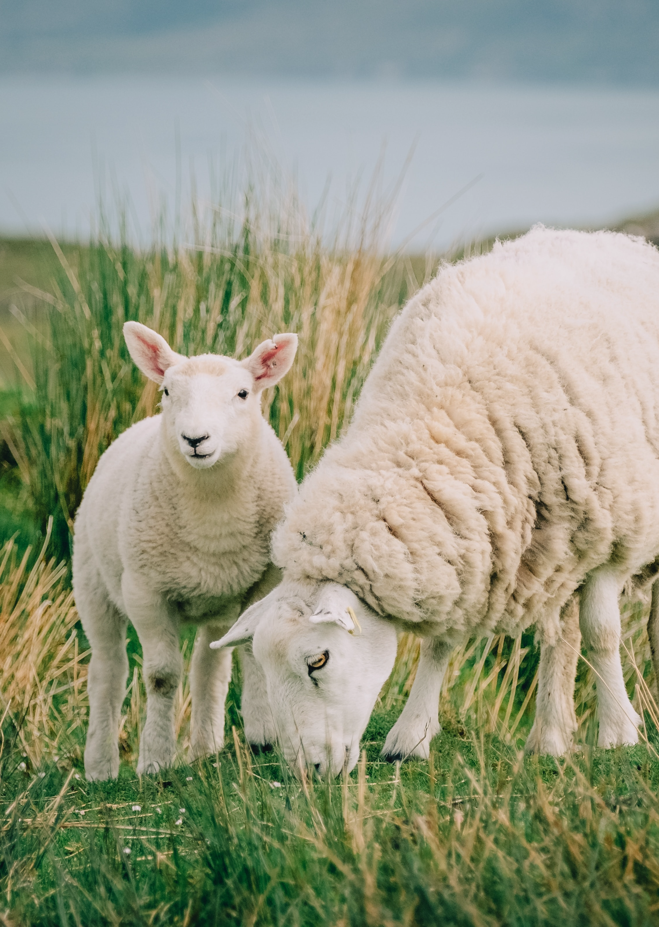
I Will Look Beyond The Surface.
I Will Look Beyond My Own Concerns.
I Will Look For The True Need of The Moment.
Notes:
MATTHEW 9:36
³⁵ Jesus was going through all the cities and villages, teaching in their synagogues and proclaiming the gospel of the kingdom, and healing every kind of disease and every kind of sickness.
³⁶ Seeing the ^{[ab]}people, He felt compassion for them, because they were ^{[ac]}distressed and ^{[ad]}dispirited like sheep ^{[ae]}without a shepherd. ³⁷ Then He *said to His disciples, “The harvest is plentiful, but the workers are few. ³⁸ Therefore beseech the Lord of the harvest to send out workers into His harvest.”
I Want To See The Truth, So I Can Respond With Humility, Patience, Justice, & Compassion.
I Want To See The Importance of Every Soul.
Maybe the TRUE NEED of the moment – is for me to admit that my bias has been wrong. For me to make a change.
Maybe the TRUE NEED of the moment – is to help others achieve their potential.
But I’m not just looking at it with old assumptions. I’m looking through HIS EYES.

Slide 10
Through His Eyes
Notes:
Invitation: Seeing Myself Through Jesus Eyes…
>. In Need…
>. I Don’t Know As Much As I think…
Jesus Sees You – and Love YOU!
He Sees You As Worth Dying For!
He Sees You Totally Washed, Purified, Forgiven…

