Slide 1
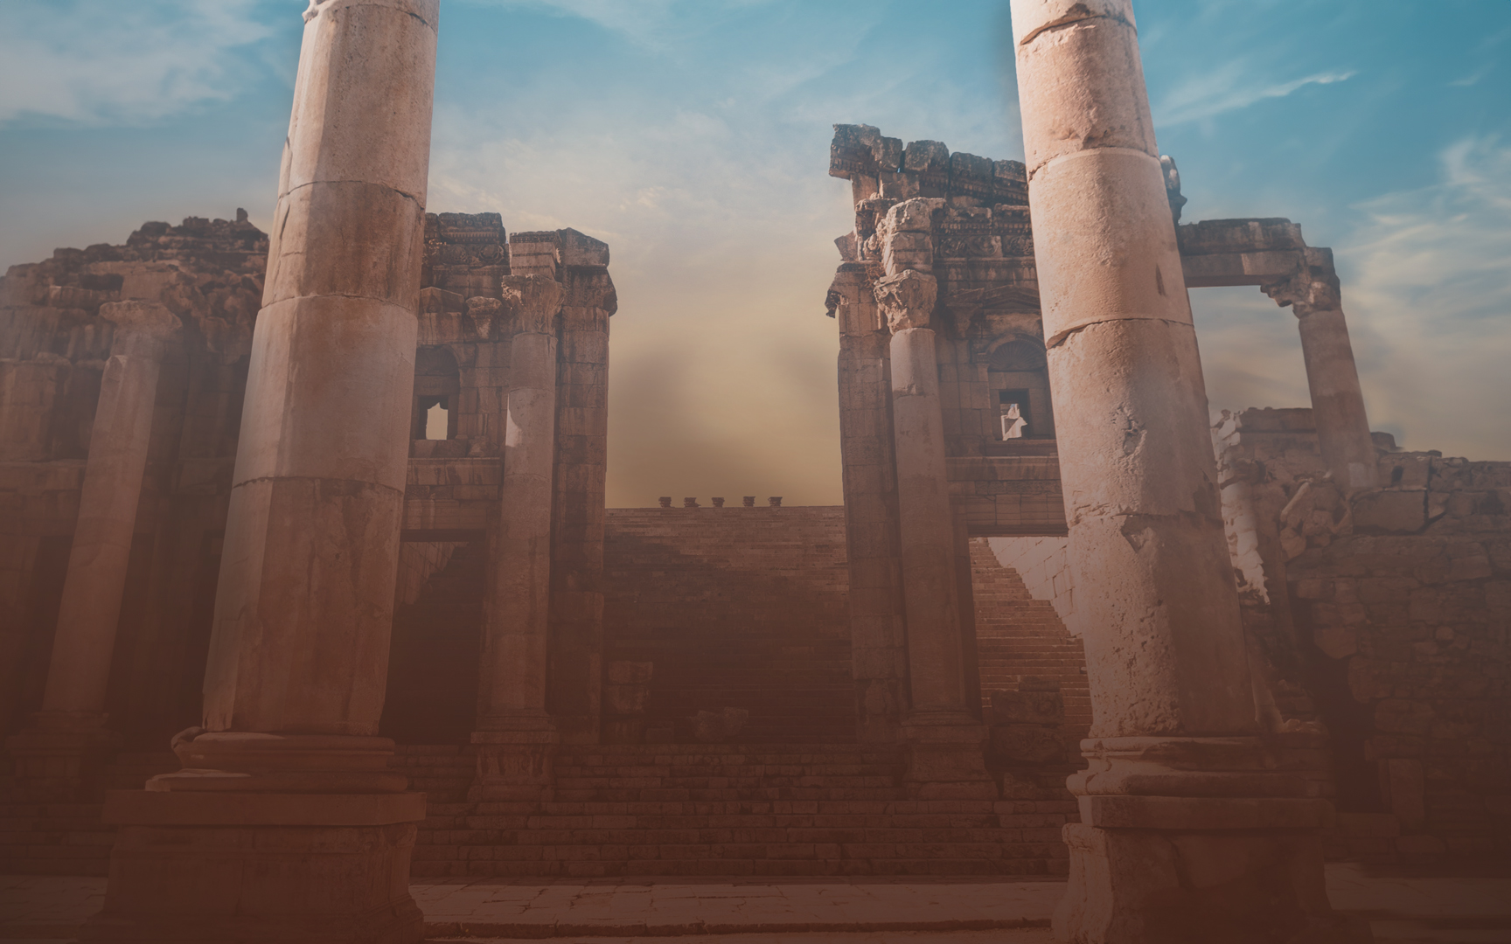

Slide 2
Key Verse
“¹ Therefore, since we have so great a cloud of witnesses surrounding us, let us also lay aside every encumbrance and the sin which so easily entangles us, and let us run with endurance the race that is set before us,
² fixing our eyes on Jesus, the author and perfecter of faith, who for the joy set before Him endured the cross, despising the shame, and has sat down at the right hand of the throne of God.”

Slide 3
Lesson Titles | Sundays at 6 PM
Intro: Fixing Our Eyes on Jesus | September 17, 2023
Focusing Our Eyes on Jesus:
The Author and Perfector of Faith | October 15, 2023
The Joy Set Before Him | November 19, 2023
Enduring the Cross, Despising the Shame | December 17, 2023
Sitting at the Right Hand of God’s Throne | January 21, 2024
The Same Yesterday, Today, and Tomorrow | February 18, 2024
Living Like Jesus:
Laying Aside Every Weight and Sin | March 17, 2024
Sharing in His Holiness | April 21, 2024.
Seeking the City to Come | May 19, 2024
Loving Sacrificially | June 16, 2024
Rejecting Strange Teaching | July 21, 2024
Conclusion: Jesus Working in Us | August 18, 2024

Slide 4
Assigned Text Hebrews 13:8
⁸ Jesus Christ is the same yesterday and today and forever.

Slide 5
Topics covered in Hebrews 13:1-7
Brotherly Love – vs 1
Hospitality to Strangers – vs. 2
Christians in Prison – vs. 3
Marriage – vs. 4
Proper and Improper Sexual Conduct – vs. 4
Love of Money – vs. 5
Contentment – vs. 5
Presence and help of God – vs. 5b-6
Faith and example of Leaders – vs. 7
Notes:
Matthew 25:21, 23 – Joy is the outcome of doing what is RIGHT.
“…enter into the joy of your master.”
First, the master is Joyful.
Second, sharing in His joy is a blessing.
Matt 25 describes 7 qualities that lead to joy.
Responsible Actions – “Well done”
Godly Character – “Good & Faithful”
Humble Service - “Slave”
Faithful Stewardship – “Faithful in a Few Things”
Meaningful Compliments
Increased Trust & Tasks – “Many Things”
Closer/Shared Relationship – Enter Into The Joy of…
Joy over the Outcome
Joy from fulfilling our Purpose
Joy from using out talents in this EPIC Mission

Slide 6
The Bigger Context
⁸ Jesus Christ is the same yesterday and today and forever – Hebrews 13:8
“You, Lord, laid the foundation of the earth in the beginning, and the heavens are the work of your hands; ¹¹ they will perish, but you remain; they will all wear out like a garment, ¹² like a robe you will roll them up, like a garment they will be changed. But you are the same, and your years will have no end.” – Hebrews 1:10-12

Slide 7
The Bigger Context – Hebrews 12:18-29
⁸ Jesus Christ is the same yesterday and today and forever – Hebrews 13:8
¹⁸ For you have not come to what may be touched, a blazing fire and darkness and gloom and a tempest ¹⁹ and the sound of a trumpet and a voice whose words made the hearers beg that no further messages be spoken to them. ²⁰ For they could not endure the order that was given, “If even a beast touches the mountain, it shall be stoned.” ²¹ Indeed, so terrifying was the sight that Moses said, “I tremble with fear.” –
Hebrews 12:18-21

Slide 8
The Bigger Context – Hebrews 12:18-29
⁸ Jesus Christ is the same yesterday and today and forever – Hebrews 13:8
²² But you have come to Mount Zion and to the city of the living God, the heavenly Jerusalem, and to innumerable angels in festal gathering, ²³ and to the assembly of the firstborn who are enrolled in heaven, and to God, the judge of all, and to the spirits of the righteous made perfect, ²⁴ and to Jesus, the mediator of a new covenant, and to the sprinkled blood that speaks a better word than the blood of Abel. –
Hebrews 12:22-24

Slide 9
The Bigger Context – Hebrews 12:18-29
⁸ Jesus Christ is the same yesterday and today and forever – Hebrews 13:8
now he has promised, “Yet once more I will shake not only the earth but also the heavens.” ²⁷ This phrase, “Yet once more,” indicates the removal of things that are shaken—that is, things that have been made—in order that the things that cannot be shaken may remain. ²⁸ Therefore let us be grateful for receiving a kingdom that cannot be shaken, and thus let us offer to God acceptable worship, with reverence and awe, - Hebrews 12:26b-28

Slide 10
The Need for Endurance
For you have need of endurance, so that when you have done the will of God you may receive what is promised – Hebrews 10:36
let us run with endurance the race that is set before us – Hebrews 12:1
Therefore lift your drooping hands and strengthen your weak knees, ¹³ and make straight paths for your feet, so that what is lame may not be put out of joint but rather be healed – Hebrews 12:12-13
If nothing in life lasts, how can we endure?

Slide 11
Help That Never Ends
⁸ Jesus Christ is the same yesterday and today and forever – Hebrews 13:8
A God and Savior who never changes
An unchanging message from God
The constant presence of God
A place with God’s people

