Slide 1
Psalm 63

Slide 2
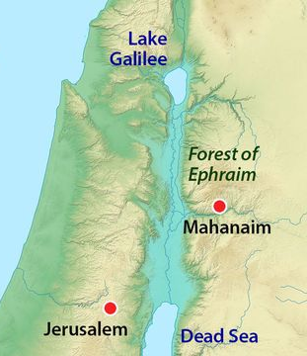
Place In
HISTORY
• “THE KING WILL REJOICE IN GOD” (11)
• DAVID FLEES FROM ABSALOM (2 SAM 15-17)
• DAVID JOURNEYS TO MAHANAIM (17:24)
Notes:
About 40 miles…

Slide 3
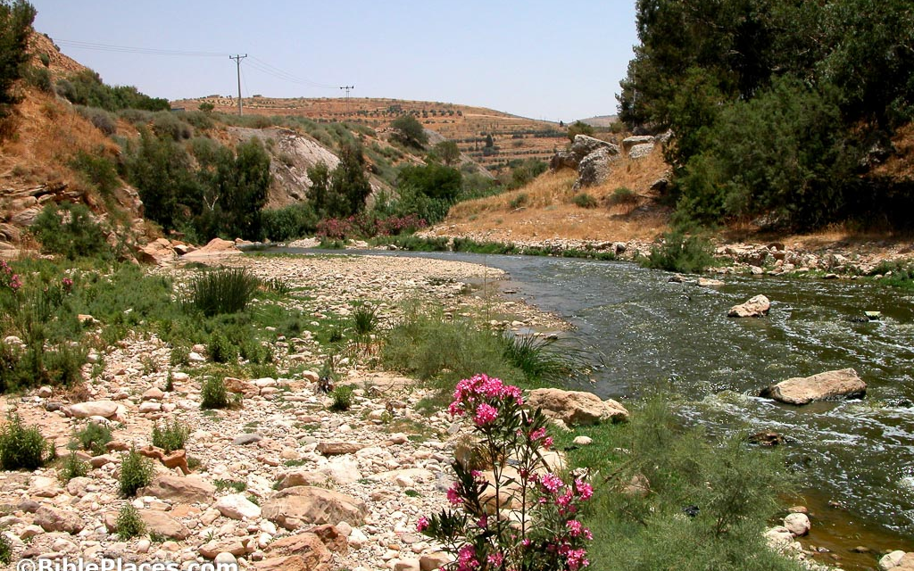

Slide 4
Place In
Place In
HISTORY
HEARTS
• “THE KING WILL REJOICE IN GOD” (11)
• “NO DAY SHOULD PASS WITHOUT THE SINGING OF THIS PSALM”
• DAVID FLEES FROM ABSALOM (2 SAM 15-17)
• “THE SPIRIT AND SOUL OF THE WHOLE BOOK OF PSALMS”
• DAVID JOURNEYS TO MAHANAIM (17:24)

Slide 5
GOD MY
DESIRE
PSALM 63:1-4
GOD MY
DELIGHT
PSALM 63:5-8
GOD MY
DEFENSE
PSALM 63:9-11

Slide 6
GOD MY
DESIRE
PSALM 63:1-4
1 O God, You are my God; I shall seek You earnestly; My soul thirsts for You, my flesh yearns for You,
In a dry and weary land where there is no water.
2 Thus I have seen You in the sanctuary,
To see Your power and Your glory.
3 Because Your lovingkindness is better than life,
My lips will praise You.
4 So I will bless You as long as I live;
I will lift up my hands in Your name.
>
Tabernacle
>

Slide 7
GOD MY
DELIGHT
PSALM 63:5-8
5 My soul is satisfied as with marrow and fatness, And my mouth offers praises with joyful lips.
6 When I remember You on my bed, I meditate on You in the night watches, 7 For You have been my help, And in the shadow of Your wings I sing for joy. 8 My soul clings to You; Your right hand upholds me.
Late Night Fears & Sadness Are Overcome In Gratitude & Prayer

Slide 8
GOD MY
DEFENSE
PSALM 63:9-11
9 But those who seek my life to destroy it, Will go into the depths of the earth. 10 They will be delivered over to the power of the sword; They will be a prey for foxes. 11 But the king will rejoice in God; Everyone who swears by Him will glory, For the mouths of those who speak lies will be stopped.
Oath/Loyalty
Notes:
He’s gone from looking to the past – to looking towards the future…

Slide 9
Walking with
Peace with
GOD
GOD
• Our Personal Love For God
• Inner Satisfaction (vs 5)
“my soul is satisfied”
• Our Reflections On His Past Faithfulness
• Inner Stability (vs 7-8)
“upholds me”
• Our Confidence In His Justice
• Inner Perspective (vs 11)
“they will be”

Slide 10
Psalm 63

