Slide 1
Hebrews
Lesson Ten: Draw Near & Endure

Slide 3
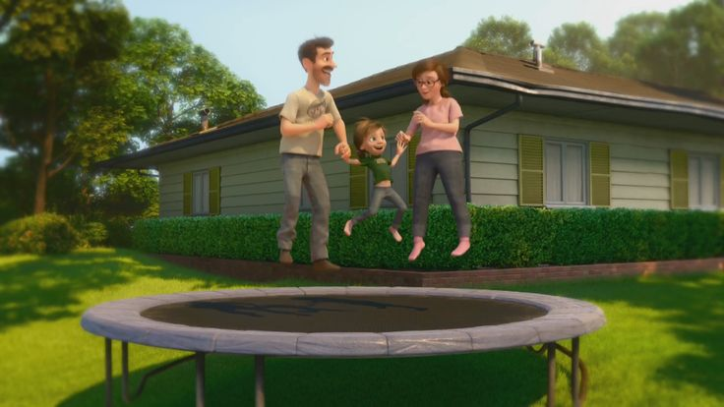
Great Family
Great House
Great Yard
Great Friends
Great Hockey Team
Happy
Life

Slide 4
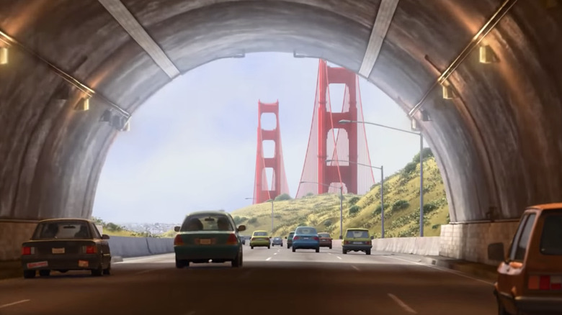
Hopeful
Change
Happy
Life

Slide 5
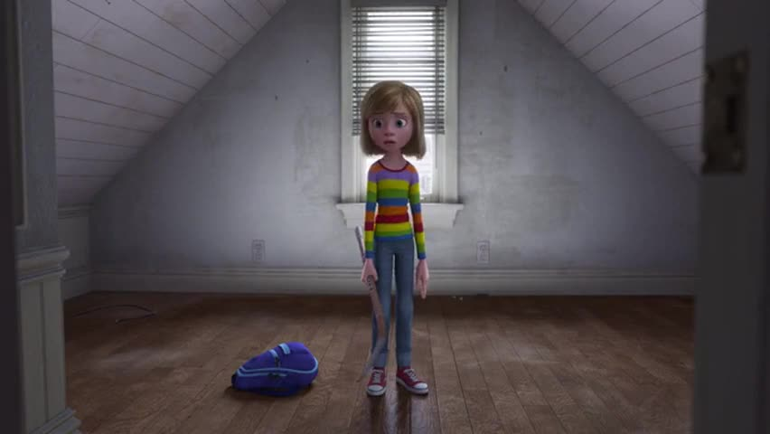
Ugly House
Nasty Room
Stressed
Parents
Broccoli Pizza!
Fails Hockey Tryouts
Hard
Struggles
Hopeful
Change
Happy
Life

Slide 6
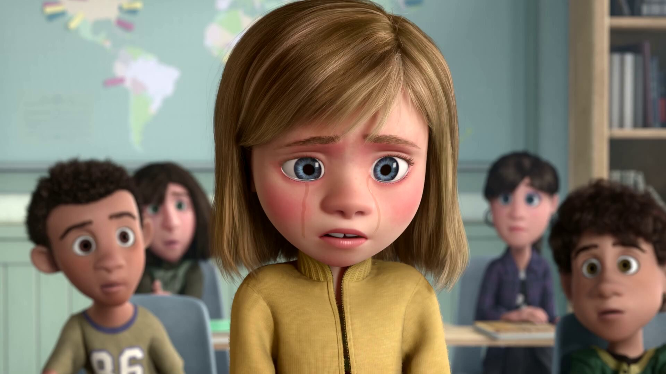
Emotional
Crisis
Hard
Struggles
Hopeful
Change
Happy
Life

Slide 7
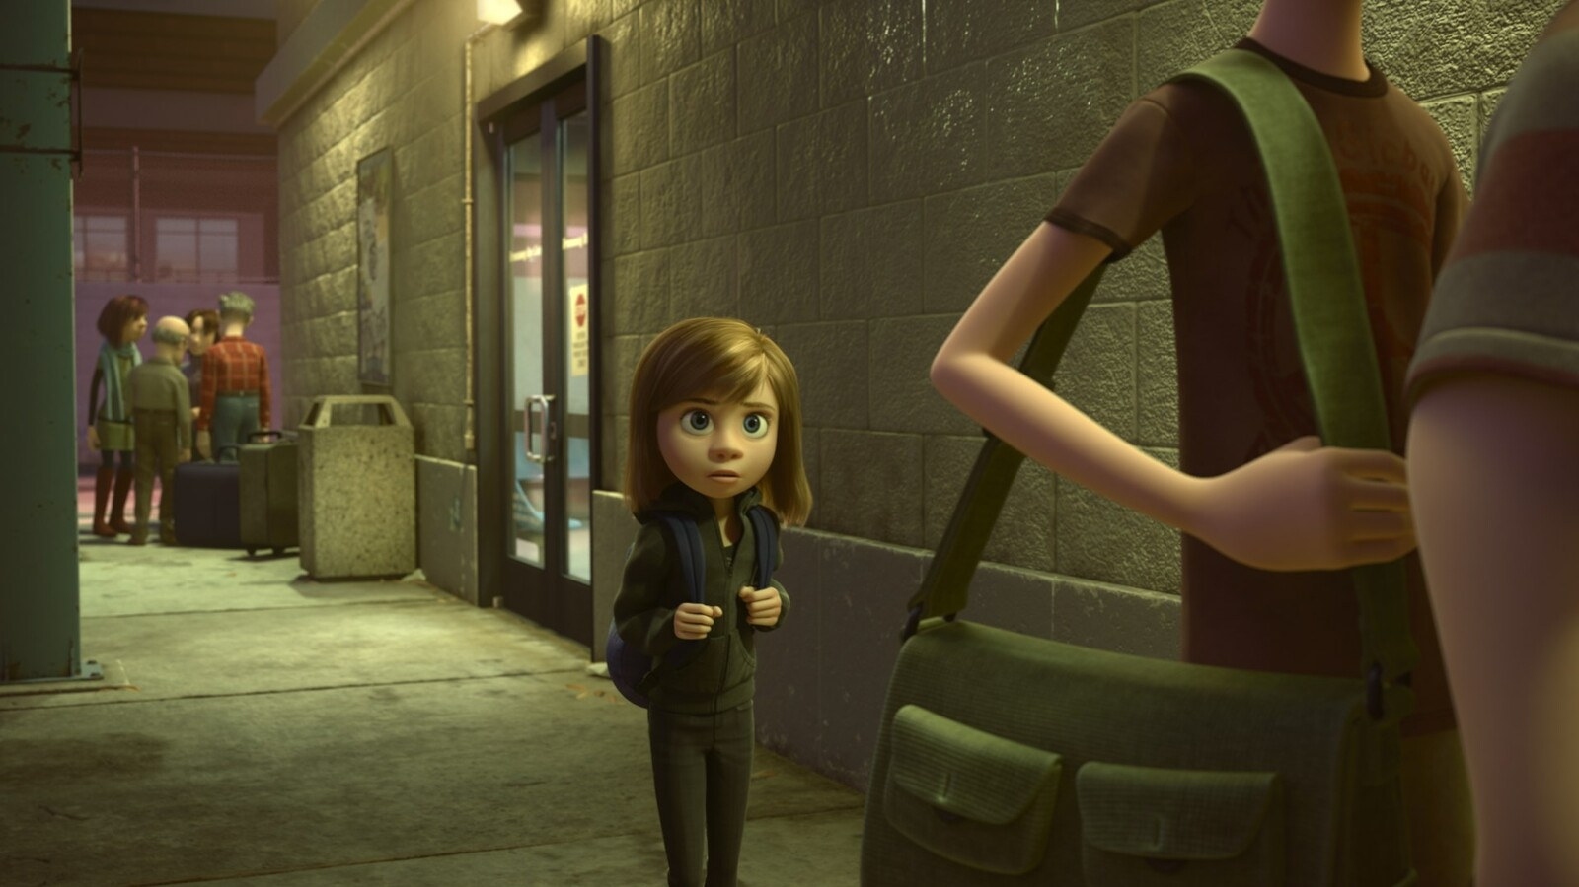
Emotional
Crisis
Hard
Struggles
Hopeful
Change
Happy
Life
Go Back!

Slide 8
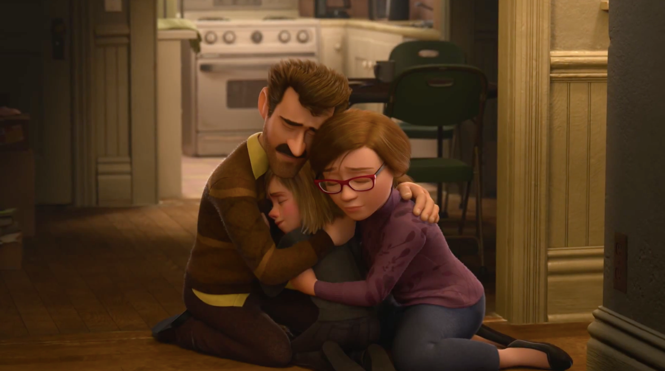
Seek
Help
Emotional
Crisis
Hard
Struggles
Hopeful
Change
Happy
Life
Go Back!

Slide 9
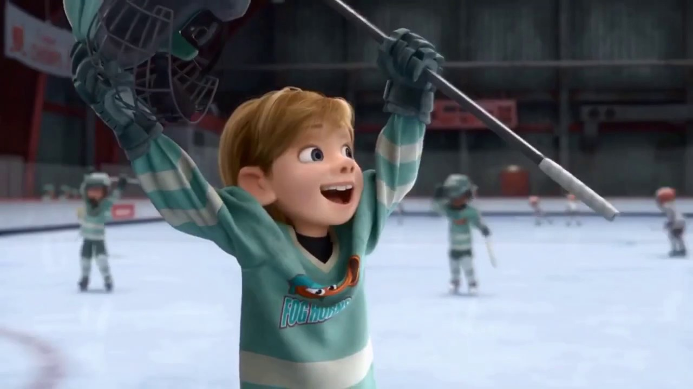
Better
Life
Seek
Help
Emotional
Crisis
Hard
Struggles
Hopeful
Change
Happy
Life
Go Back!

Slide 10
10:32-34
Hebrews
Better
Life
Seizure of Property
Moses, Law, Traditions
Public Ridicule
Became Christians
Secure Community
Sent to Prison
Seek
Help
Emotional
Crisis
Temple & Feasts
Hard
Struggles
Hopeful
Change
Happy
Life
Harden your hearts
Throw away your confidence
Shrink back
Grow weary
Lose heart
Go Back!
DO NOT

Slide 11
JESUS IS OUR
7-10:18
GREAT HIGH PRIEST
Better
Life
Seek
Help
Emotional
Crisis
Hard
Struggles
Hopeful
Change
Happy
Life
Harden your hearts
Throw away your confidence
Shrink back
Grow weary
Lose heart
Go Back!
DO NOT

Slide 12
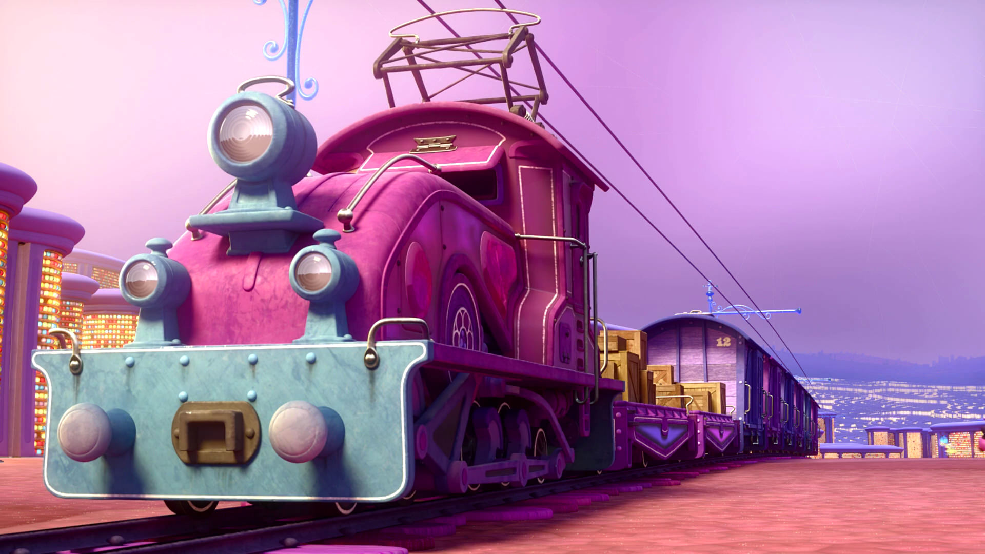
Train of Thought

Slide 13
Train of Thought

Slide 14
TABERNACLE
COVENANT
ORDER & OATH
JESUS IS OUR
7-10:18
GREAT HIGH PRIEST
SACRIFICE
promises
MINISTRY
Train of Thought

Slide 15
Sorrowful
Straighten
Lest we drift
Enduring foR
12:4-11
Discipline
Pay Attention
Joy set before Him
Angels
1:4-2:16
God has spoken
1:1-3
In his son
Strengthen
Pursue Peace
Why Lower?
Right Hand
Righteousness
Prepare
12:12-17
to Endure
Endured Cross
Right Hand
Short of Grace
Purification
Despising Shame
Bitterness
Encourage
Suffering
FIXING OUR
12:2-3
Eyes On Jesus
Esau
Hold Firm
Faithful
Run with Endurance
2:17-18
Merciful
No Evil Hearts
Able to Help
Moses
Joshua
3-4
Be Diligent
MINISTRY
Have Faith
promises
SACRIFICE
COVENANT
TABERNACLE
ORDER & OATH
JESUS IS OUR
7-10:18
GREAT HIGH PRIEST
Miss Rest
God’s Word
THE CLOUD
10:32-12:1
OF witnesses
Shaking
Hold Fast
Throw Away
Need Endurance
Time of Need
4:14-16
Gratitude & Service
Reveremce & Awe
Grace to Help
Sinai
12:18-29
AND Zion
Draw Near
Consuming Fire
Immaturity
Suffering of Christ
Falling Away
Aaron
5:1-10
Melchi
zEdek
Judgment
Draw Near
Vengeance
Hold Fast
SINCE Therefore
10:19-25
LET US
For if we go
10:26-31
on sinning
Stir Up
Faith & Patience
Anchor of Hope
Encourage
Fury of Fire
Terrifying
5:11-6:20
Closing
13
exhortations
Train of Thought

Slide 16
HEBREWS 7
GOD
GOD
THE OATH
HOLY
SPIRIT
GOD
MELCHIZEDEK
PRIEST
AARON
Priesthood
SON
Physical Requirement
Power of an Indestructible Life
SON
SON
SON
SON
TITHE
BLESSING
TABERNACLE
Many Priests who keep dying
One Who holds His priesthood permanently
ABRAHAM
LEVI
LEVI
LEVI
LEVI
MAN
MAN
MAN
MAN
Repeated sacrifices for people & priests
Sacrificed Himself Once for All
ISAAC
BULL
SON
LAND
NATION
SEED
Without an Oath
With an Oath
COVENANT
COVENANT
MAN
MAN
MAN
Weak Men
Perfect Son
SON
MAN
MAN
MAN

Slide 17
HEBREWS 7
GOD
GOD
THE OATH
HOLY
SPIRIT
GOD
MELCHIZEDEK
PRIEST
AARON
Priesthood
SON
For when the priesthood is changed, of necessity there takes place a change of law also.
SON
SON
SON
SON
TITHE
BLESSING
TABERNACLE
ABRAHAM
LEVI
LEVI
LEVI
LEVI
MAN
MAN
MAN
MAN
Weakness
Uselessness
Makes Nothing Perfect
Better Hope
Better Covenant
ISAAC
BULL
SON
LAND
NATION
SEED
COVENANT
COVENANT
MAN
MAN
MAN
SON
MAN
MAN
MAN

Slide 18
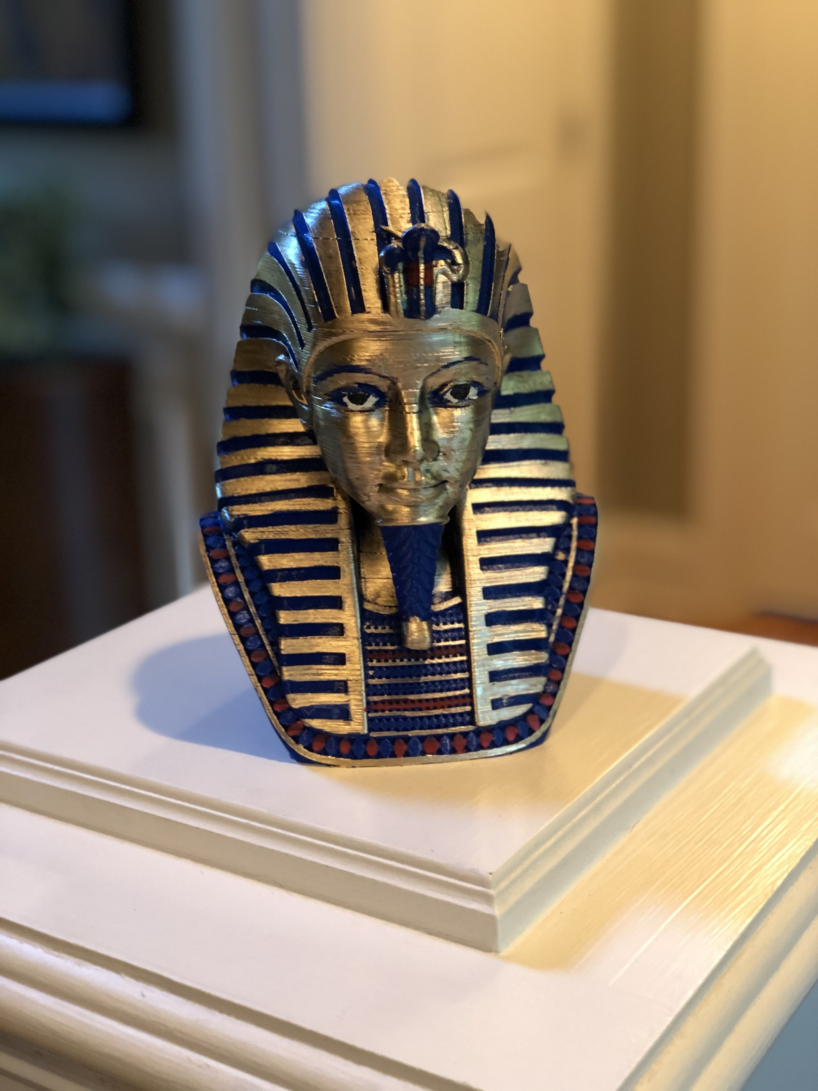
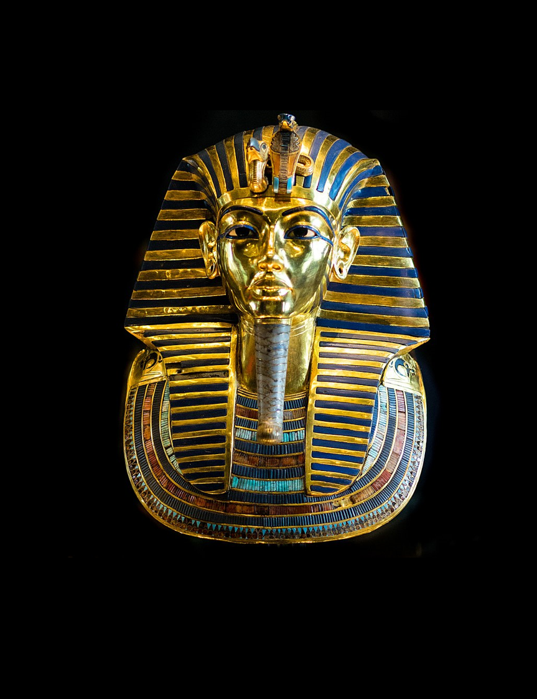
HEBREWS 8
GOD
GOD
THE OATH
HOLY
SPIRIT
GOD
MELCHIZEDEK
PRIEST
AARON
TABERNACLE
SON
SON
SON
SON
SON
TITHE
BLESSING
TABERNACLE
Earthly
Heavenly
ABRAHAM
LEVI
LEVI
LEVI
LEVI
MAN
MAN
MAN
MAN
Shadow
True
Man Pitched
Lord pitched
ISAAC
BULL
SON
Copy
Pattern
LAND
NATION
SEED
COVENANT
COVENANT
MAN
MAN
MAN
SON
MAN
MAN
MAN

Slide 19
HEBREWS 8
GOD
THE OATH
HOLY
SPIRIT
GOD
AARON
SON
⁷ For if that first covenant had been faultless, there would have been no occasion sought for a second.
Not like the covenant which I made with their fathers
SON
SON
SON
SON
(Stone)
Hearts & Minds
⁸ For finding fault with them, He says,
“Behold, days are coming, says the Lord, When I will effect a new covenant…
TABERNACLE
(Broken)
God & People
LEVI
LEVI
LEVI
MAN
MAN
MAN
MAN
(Ignorance)
All will know Me
¹³ When He said, “A new covenant,” He has made the first obsolete. But whatever is becoming obsolete and growing old is ready to disappear.
(No Forgiveness)
Forgiveness of Sin
BULL
SON
COVENANT
COVENANT
COVENANT
MAN
MAN
MAN
SON
MAN
MAN
MAN

Slide 20
HEBREWS 9
GOD
THE OATH
HOLY
SPIRIT
GOD
¹¹ But when Christ appeared as a high priest of the good things to come…
SON
AARON
MINISTRY
SON
SON
SON
SON
Outer Tabernacle
True Tabernacle
TABERNACLE
Blood of Animals
His Own Blood
LEVI
LEVI
LEVI
MAN
MAN
MAN
MAN
⁸ The Holy Spirit is signifying this, that the way into the holy place has not yet been disclosed while the outer tabernacle is still standing, ⁹ which is a symbol for the present time.
Continually Enter
Once For All
BULL
Cleanse Flesh
Cleanse Conscience
SON
Until time of reformation
Eternal Redemption
COVENANT
COVENANT
MAN
MAN
MAN
¹⁴ …to serve the living God?
SON
MAN
MAN
MAN

Slide 21
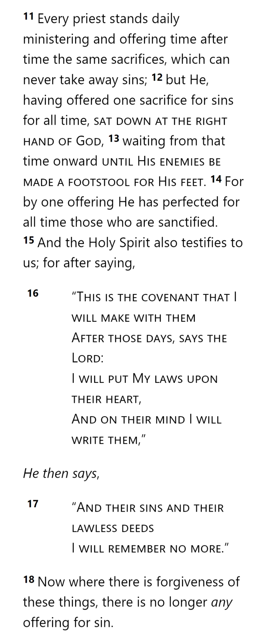
GOD
THE OATH
HOLY
SPIRIT
GOD
AARON
SON
SON
SON
SON
SON
TABERNACLE
LEVI
LEVI
LEVI
MAN
MAN
MAN
MAN
BULL
SON
COVENANT
COVENANT
MAN
MAN
MAN
SON
MAN
MAN
MAN
Hebrews 10

Slide 22
Sorrowful
Straighten
Lest we drift
Enduring foR
12:4-11
Discipline
Pay Attention
Joy set before Him
Angels
1:4-2:16
God has spoken
1:1-3
In his son
Strengthen
Pursue Peace
Why Lower?
Right Hand
Righteousness
Prepare
12:12-17
to Endure
Endured Cross
Right Hand
Short of Grace
Purification
Despising Shame
Bitterness
Encourage
Suffering
FIXING OUR
12:2-3
Eyes On Jesus
Esau
Hold Firm
Faithful
Run with Endurance
2:17-18
Merciful
No Evil Hearts
Able to Help
Moses
Joshua
3-4
Be Diligent
MINISTRY
Have Faith
promises
SACRIFICE
COVENANT
TABERNACLE
ORDER & OATH
JESUS IS OUR
7-10:18
GREAT HIGH PRIEST
Miss Rest
God’s Word
THE CLOUD
10:32-12:1
OF witnesses
Shaking
Hold Fast
Throw Away
Need Endurance
Time of Need
4:14-16
Gratitude & Service
Reveremce & Awe
Grace to Help
Sinai
12:18-29
AND Zion
Draw Near
Consuming Fire
Immaturity
Suffering of Christ
Falling Away
Aaron
5:1-10
Melchi
zEdek
Judgment
Draw Near
Vengeance
Hold Fast
SINCE Therefore
10:19-25
LET US
For if we go
10:26-31
on sinning
Stir Up
Faith & Patience
Anchor of Hope
Encourage
Fury of Fire
Terrifying
5:11-6:20
Closing
13
exhortations
Train of Thought

Slide 23
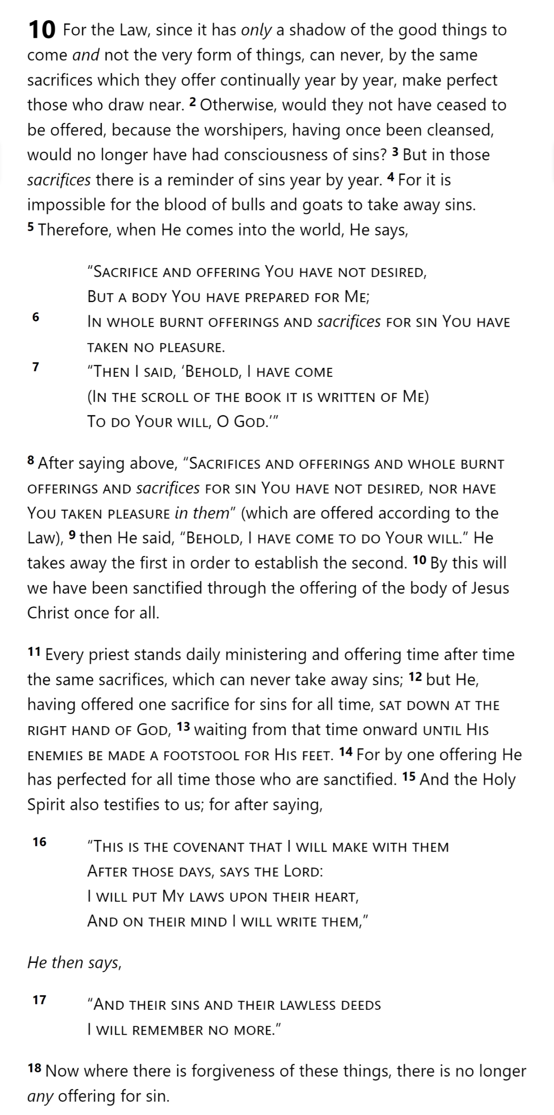
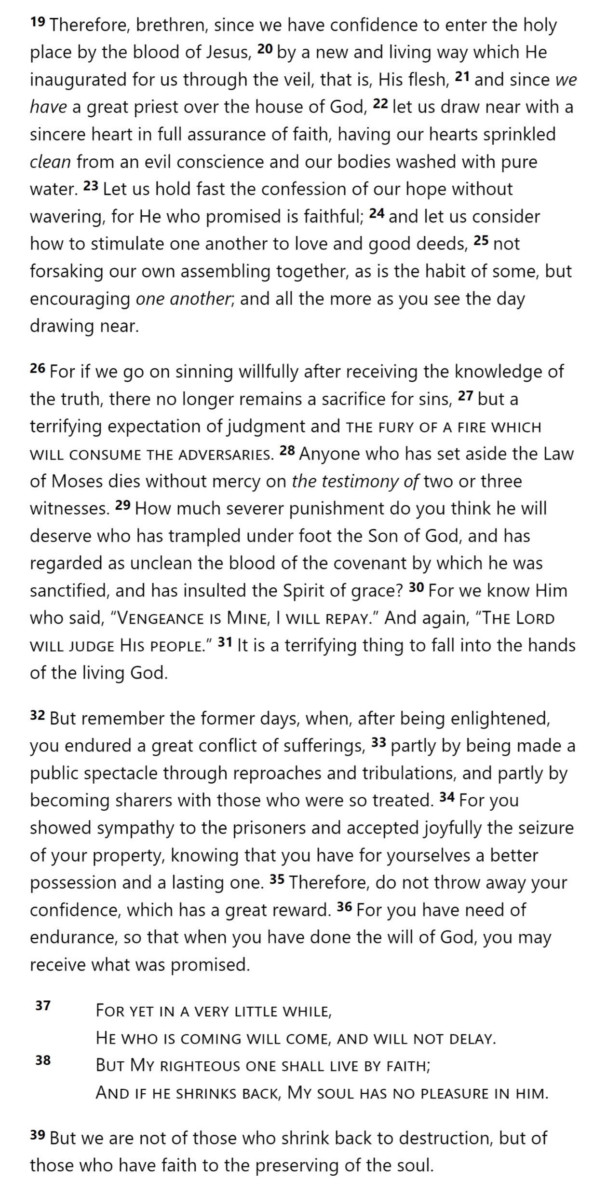
THE OATH
HOLY
SPIRIT
GOD
¹¹ But when Christ appeared as a high priest of the good things to come…
SON
SON
SON
SON
SON
MAN
MAN
MAN
MAN
⁸ The Holy Spirit is signifying this, that the way into the holy place has not yet been disclosed while the outer tabernacle is still standing, ⁹ which is a symbol for the present time.
SON
COVENANT
MAN
¹⁴ …to serve the living God?
SON
Hebrews 10

Slide 24
THE OATH
HOLY
SPIRIT
GOD
¹¹ But when Christ appeared as a high priest of the good things to come…
SON
SON
SON
SON
SON
MAN
MAN
MAN
MAN
⁸ The Holy Spirit is signifying this, that the way into the holy place has not yet been disclosed while the outer tabernacle is still standing, ⁹ which is a symbol for the present time.
SON
COVENANT
MAN
¹⁴ …to serve the living God?
SON
Hebrews 10

Slide 25
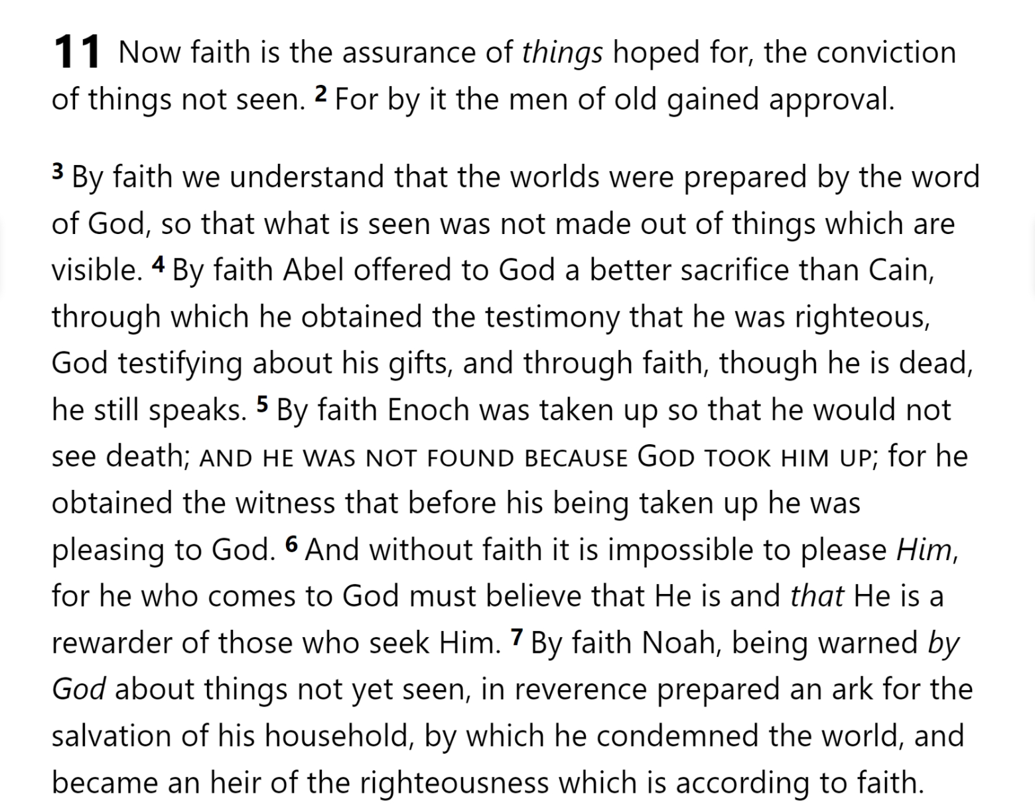
THE OATH
HOLY
SPIRIT
GOD
¹¹ But when Christ appeared as a high priest of the good things to come…
SON
SON
SON
SON
SON
MAN
MAN
MAN
MAN
⁸ The Holy Spirit is signifying this, that the way into the holy place has not yet been disclosed while the outer tabernacle is still standing, ⁹ which is a symbol for the present time.
SON
COVENANT
MAN
¹⁴ …to serve the living God?
SON
Hebrews 10

Slide 26
THE OATH
HOLY
SPIRIT
GOD
¹¹ But when Christ appeared as a high priest of the good things to come…
SON
SON
SON
SON
SON
MAN
MAN
MAN
MAN
⁸ The Holy Spirit is signifying this, that the way into the holy place has not yet been disclosed while the outer tabernacle is still standing, ⁹ which is a symbol for the present time.
SON
COVENANT
MAN
¹⁴ …to serve the living God?
SON
Hebrews 10

Slide 27
THE OATH
HOLY
SPIRIT
GOD
¹¹ But when Christ appeared as a high priest of the good things to come…
SON
SON
SON
SON
SON
MAN
MAN
MAN
MAN
⁸ The Holy Spirit is signifying this, that the way into the holy place has not yet been disclosed while the outer tabernacle is still standing, ⁹ which is a symbol for the present time.
SON
COVENANT
MAN
¹⁴ …to serve the living God?
SON
Hebrews 11

Slide 28
Hebrews

