Slide 1
Hebrews
Lesson Twelve: Looking to Jesus

Slide 3
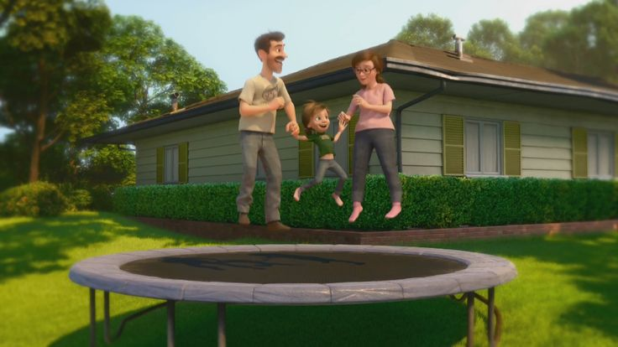
Great Family
Great House
Great Yard
Great Friends
Great Hockey Team
Happy
Life

Slide 4
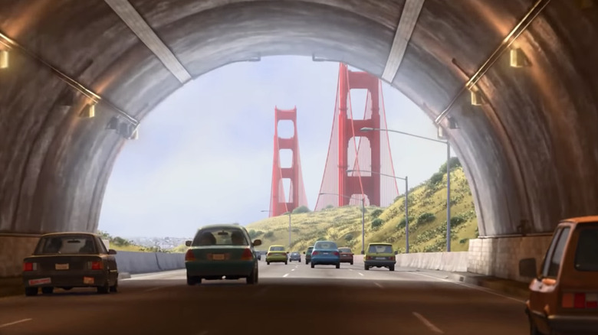
Hopeful
Change
Happy
Life

Slide 5
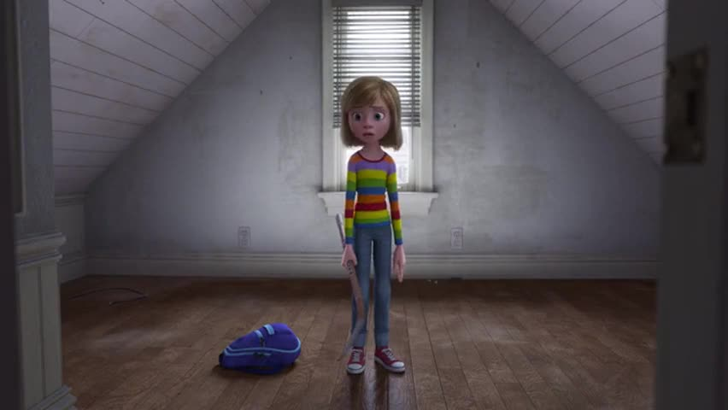
Ugly House
Nasty Room
Stressed
Parents
Broccoli Pizza!
Fails Hockey Tryouts
Hard
Struggles
Hopeful
Change
Happy
Life

Slide 6
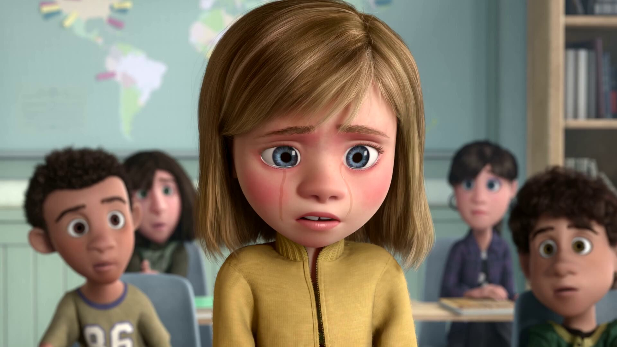
Emotional
Crisis
Hard
Struggles
Hopeful
Change
Happy
Life

Slide 7
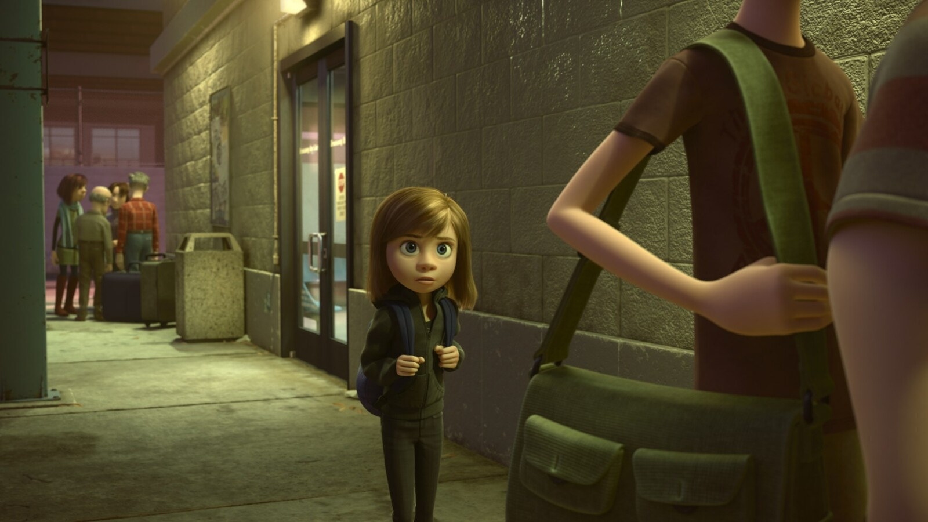
Emotional
Crisis
Hard
Struggles
Hopeful
Change
Happy
Life
Go Back!

Slide 8
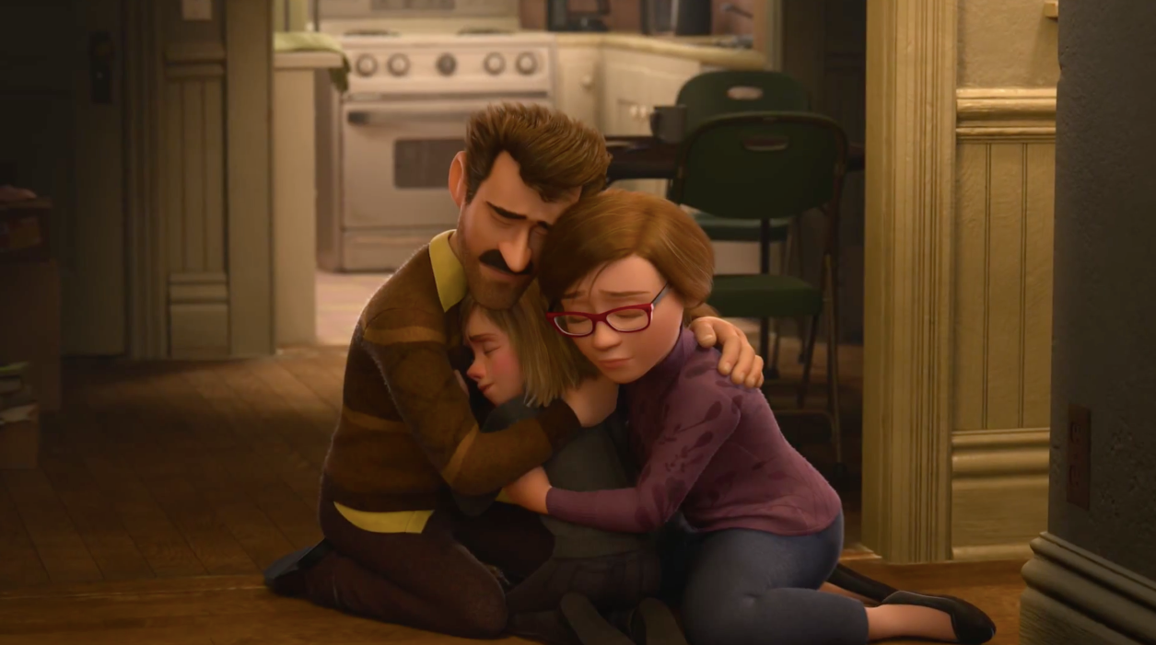
Seek
Help
Emotional
Crisis
Hard
Struggles
Hopeful
Change
Happy
Life
Go Back!

Slide 9
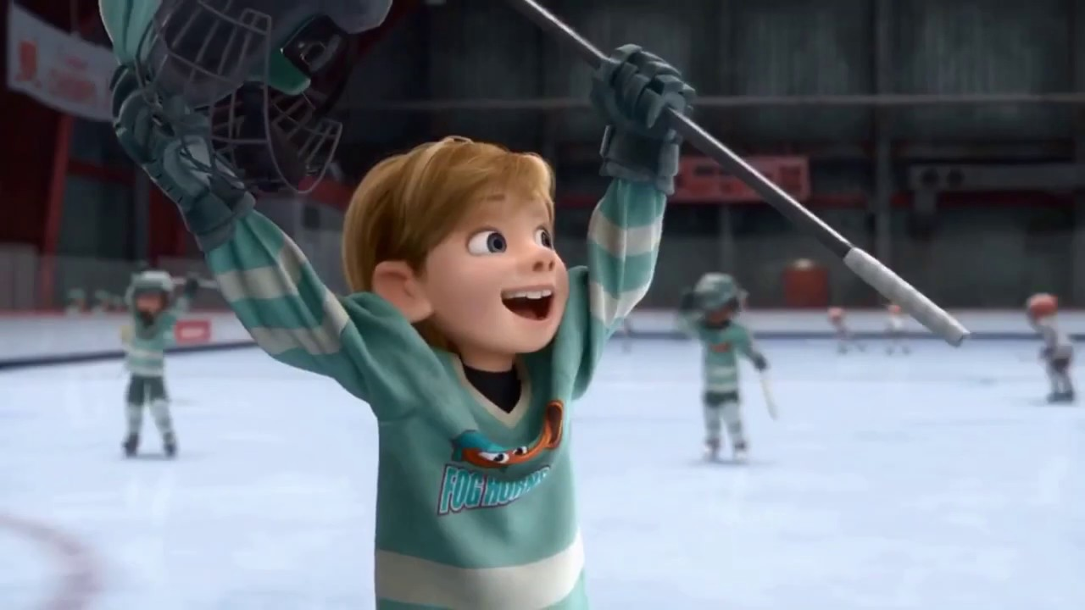
Better
Life
Seek
Help
Emotional
Crisis
Hard
Struggles
Hopeful
Change
Happy
Life
Go Back!

Slide 10
10:32-34
Hebrews
Better
Life
Seizure of Property
Moses, Law, Traditions
Public Ridicule
Became Christians
Secure Community
Sent to Prison
Seek
Help
Emotional
Crisis
Temple & Feasts
Hard
Struggles
Hopeful
Change
Happy
Life
Harden your hearts
Throw away your confidence
Shrink back
Grow weary
Lose heart
Go Back!
DO NOT

Slide 11
JESUS IS OUR
7-10:18
GREAT HIGH PRIEST
Better
Life
Seek
Help
Emotional
Crisis
Hard
Struggles
Hopeful
Change
Happy
Life
Harden your hearts
Throw away your confidence
Shrink back
Grow weary
Lose heart
Go Back!
DO NOT

Slide 12
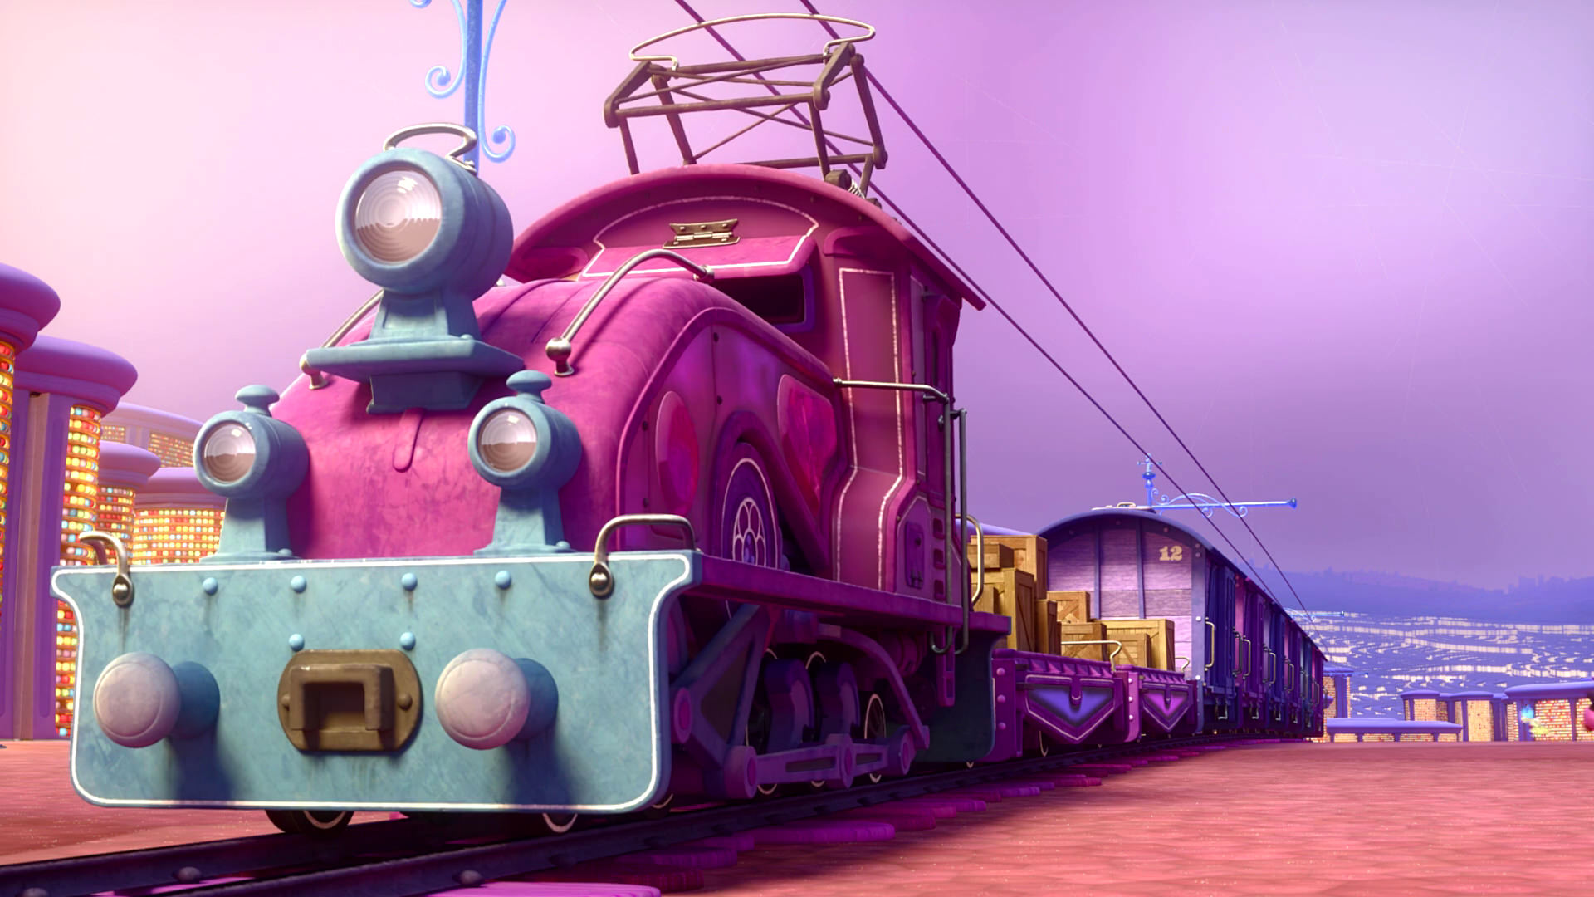
Train of Thought

Slide 13
Train of Thought

Slide 14
TABERNACLE
COVENANT
ORDER & OATH
JESUS IS OUR
7-10:18
GREAT HIGH PRIEST
SACRIFICE
promises
MINISTRY
Train of Thought

Slide 15
Sorrowful
Straighten
Lest we drift
Enduring foR
12:4-11
Discipline
Pay Attention
Joy set before Him
Angels
1:4-2:16
God has spoken
1:1-3
In his son
Strengthen
Pursue Peace
Why Lower?
Right Hand
Righteousness
Prepare
12:12-17
to Endure
Endured Cross
Right Hand
Short of Grace
Purification
Despising Shame
Bitterness
Encourage
Suffering
FIXING OUR
12:2-3
Eyes On Jesus
Esau
Hold Firm
Faithful
Run with Endurance
2:17-18
Merciful
No Evil Hearts
Able to Help
Moses
Joshua
3-4
Be Diligent
MINISTRY
Have Faith
promises
SACRIFICE
COVENANT
TABERNACLE
ORDER & OATH
JESUS IS OUR
7-10:18
GREAT HIGH PRIEST
Miss Rest
God’s Word
THE CLOUD
10:32-12:1
OF witnesses
Shaking
Hold Fast
Throw Away
Need Endurance
Time of Need
4:14-16
Gratitude & Service
Reveremce & Awe
Grace to Help
Sinai
12:18-29
AND Zion
Draw Near
Consuming Fire
Immaturity
Suffering of Christ
Falling Away
Aaron
5:1-10
Melchi
zEdek
Judgment
Draw Near
Vengeance
Hold Fast
SINCE Therefore
10:19-25
LET US
For if we go
10:26-31
on sinning
Stir Up
Faith & Patience
Anchor of Hope
Encourage
Fury of Fire
Terrifying
5:11-6:20
Closing
13
exhortations
Train of Thought

Slide 16
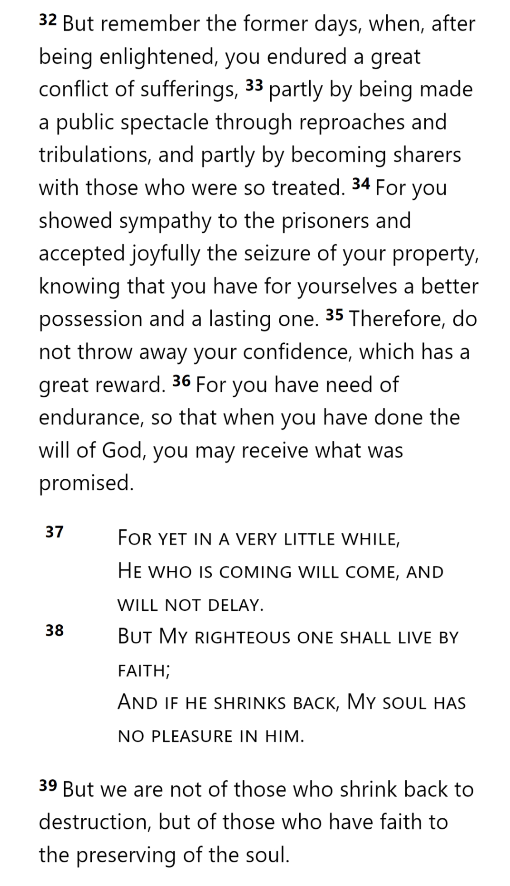
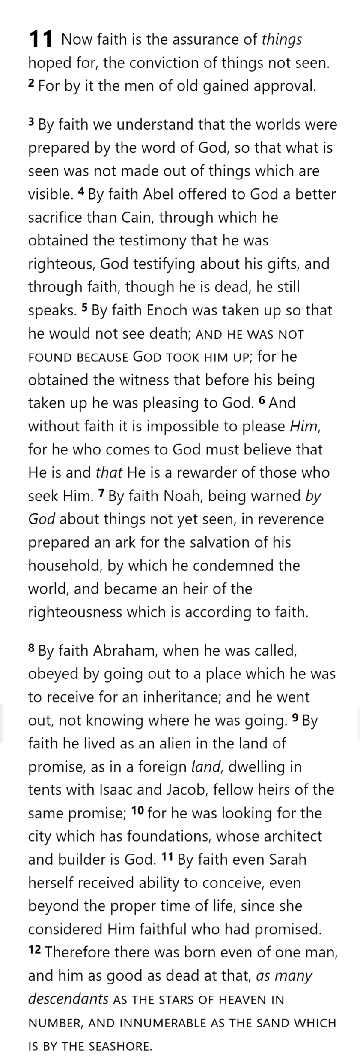
THE OATH
HEBREWS 10
CITY
MAN
SUFFERING

Slide 17
THE OATH
THINGS NOT SEEN
HEBREWS 10
GOD
CITY
REWARD
WILL OF GOD
MAN
FAITH
THINGS HOPED FOR
OBEY
SUFFERING
DESTRUCTION
THAT WHICH IS SEEN

Slide 18
THE OATH
THINGS NOT SEEN
HEBREWS 10
GOD
CITY
REWARD
WILL OF GOD
MAN
FAITH
THINGS HOPED FOR
OBEY
SUFFERING
DESTRUCTION
THAT WHICH IS SEEN

Slide 19
THE OATH
THINGS NOT SEEN
HEBREWS 11
GOD
CITY
REWARD
APPROVAL
MAN
FAITH
THINGS HOPED FOR
SUFFERING
DESTRUCTION
THAT WHICH IS SEEN

Slide 20
THE OATH
THINGS NOT SEEN
HEBREWS 11
GOD
CITY
REWARD
APPROVAL
MAN
FAITH
THINGS HOPED FOR
SUFFERING
DESTRUCTION
THAT WHICH IS SEEN

Slide 21
THE OATH
THINGS NOT SEEN
HE WHO COMES TO GOD
GOD
CITY
REWARD
MAN
FAITH
THINGS HOPED FOR
SUFFERING
DESTRUCTION
THAT WHICH IS SEEN

Slide 22
THE OATH
THINGS NOT SEEN
NOAH
GOD
HEIR OF RIGHTEOUSNESS
CITY
WARNED
SALVATION
MAN
FAITH
THINGS HOPED FOR
BUILT ARK
(FLOOD)
WORLD?
SUFFERING
DESTRUCTION
THAT WHICH IS SEEN

Slide 23
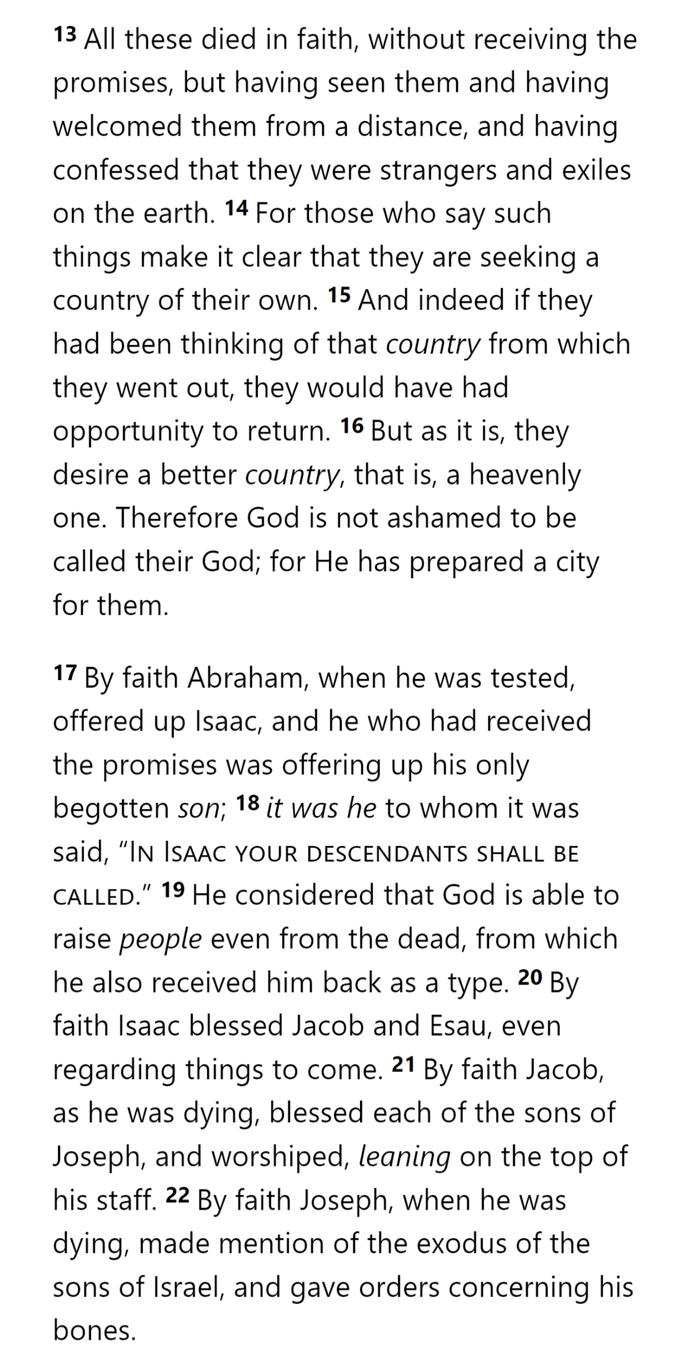
THE OATH
THINGS NOT SEEN
ABRAHAM
GOD
CITY
CALLED
MAN
FAITH
INHERITANCE
THINGS HOPED FOR
WENT OUT
TENTS
SUFFERING
DESTRUCTION
THAT WHICH IS SEEN

Slide 24
THE OATH
THINGS NOT SEEN
SARAH
GOD
CITY
PROMISED
ISAAC
MAN
FAITH
THINGS HOPED FOR
NATIONS
CONSIDERED HIM FAITHFUL
SUFFERING
DESTRUCTION
THAT WHICH IS SEEN

Slide 25
THE OATH
THINGS NOT SEEN
PATRIARCHS
GOD
CITY
MAN
FAITH
PROMISES
THINGS HOPED FOR
STRANGERS & EXILES
RETURN
SUFFERING
DESTRUCTION
THAT WHICH IS SEEN

Slide 26
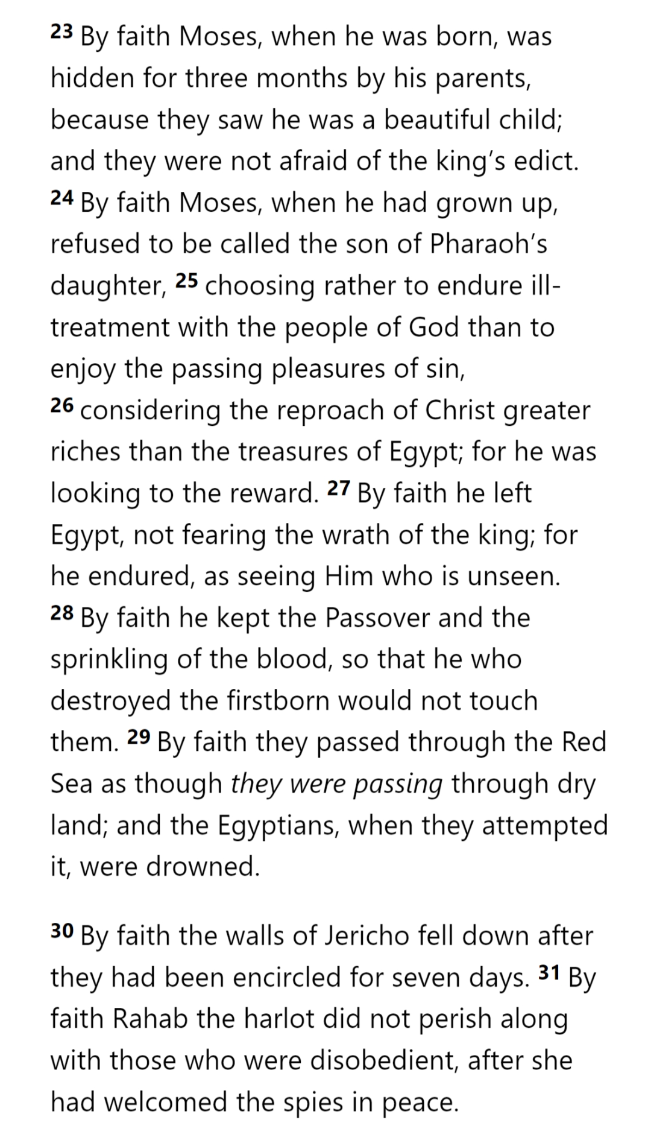
THE OATH
THINGS NOT SEEN
ABRAHAM & ISAAC
GOD
CITY
TESTED
RESURRECTION
MAN
FAITH
THINGS HOPED FOR
CONSIDERED
OFFERED ISAAC
SUFFERING
DESTRUCTION
THAT WHICH IS SEEN

Slide 27
THE OATH
THINGS NOT SEEN
MOSES IN EGYPT
GOD
CITY
REWARD
MAN
FAITH
THINGS HOPED FOR
ILL-TREATMENT
PLEASURES
CHOOSING
SUFFERING
DESTRUCTION
THAT WHICH IS SEEN

Slide 28
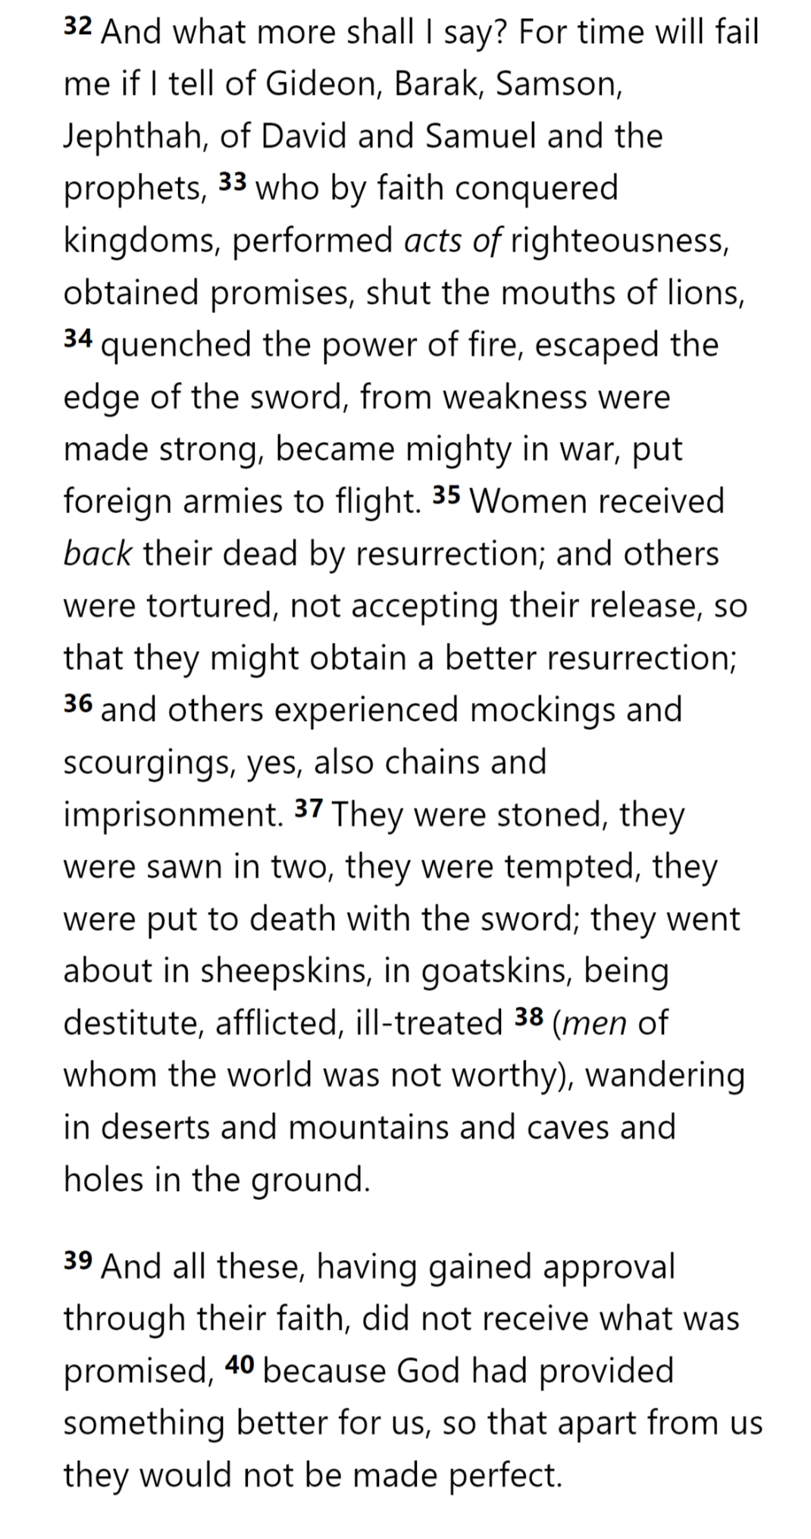
THE OATH
THINGS NOT SEEN
MIGHTY DEEDS
GOD
CITY
MIGHTY DEEDS
MAN
FAITH
THINGS HOPED FOR
OBEY
SUFFERING
DESTRUCTION
THAT WHICH IS SEEN

Slide 29
THE OATH
THINGS NOT SEEN
GREAT SUFFERING
GOD
CITY
MIGHTY DEEDS
MAN
FAITH
THINGS HOPED FOR
OBEY
GREAT SUFFERING
SUFFERING
DESTRUCTION
THAT WHICH IS SEEN

Slide 30
THE OATH
THINGS NOT SEEN
BETTER FOR US
GOD
CITY
APPROVAL
MIGHTY DEEDS
MAN
FAITH
THINGS HOPED FOR
OBEY
GREAT SUFFERING
SUFFERING
DESTRUCTION
THAT WHICH IS SEEN

Slide 31
THE OATH
THINGS NOT SEEN
LESSER TO GREATER
GOD
CITY
We have a greater Spokesman
We have a greater promise to come
We have a greater promise now
We risk a greater destruction
We should have greater faith, obedience, and endurance
IN HIS SON
OUR GREAT HIGH PRIEST
MAN
FAITH
THINGS HOPED FOR
OBEY
TERRIFYING
ENDURE
SUFFERING
DESTRUCTION
THAT WHICH IS SEEN

Slide 32
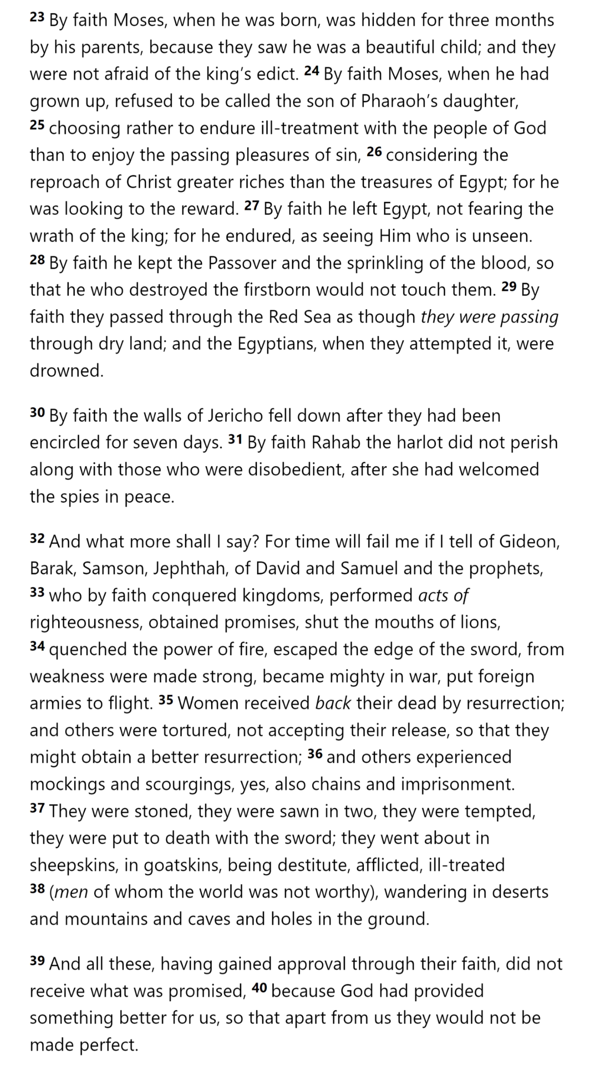
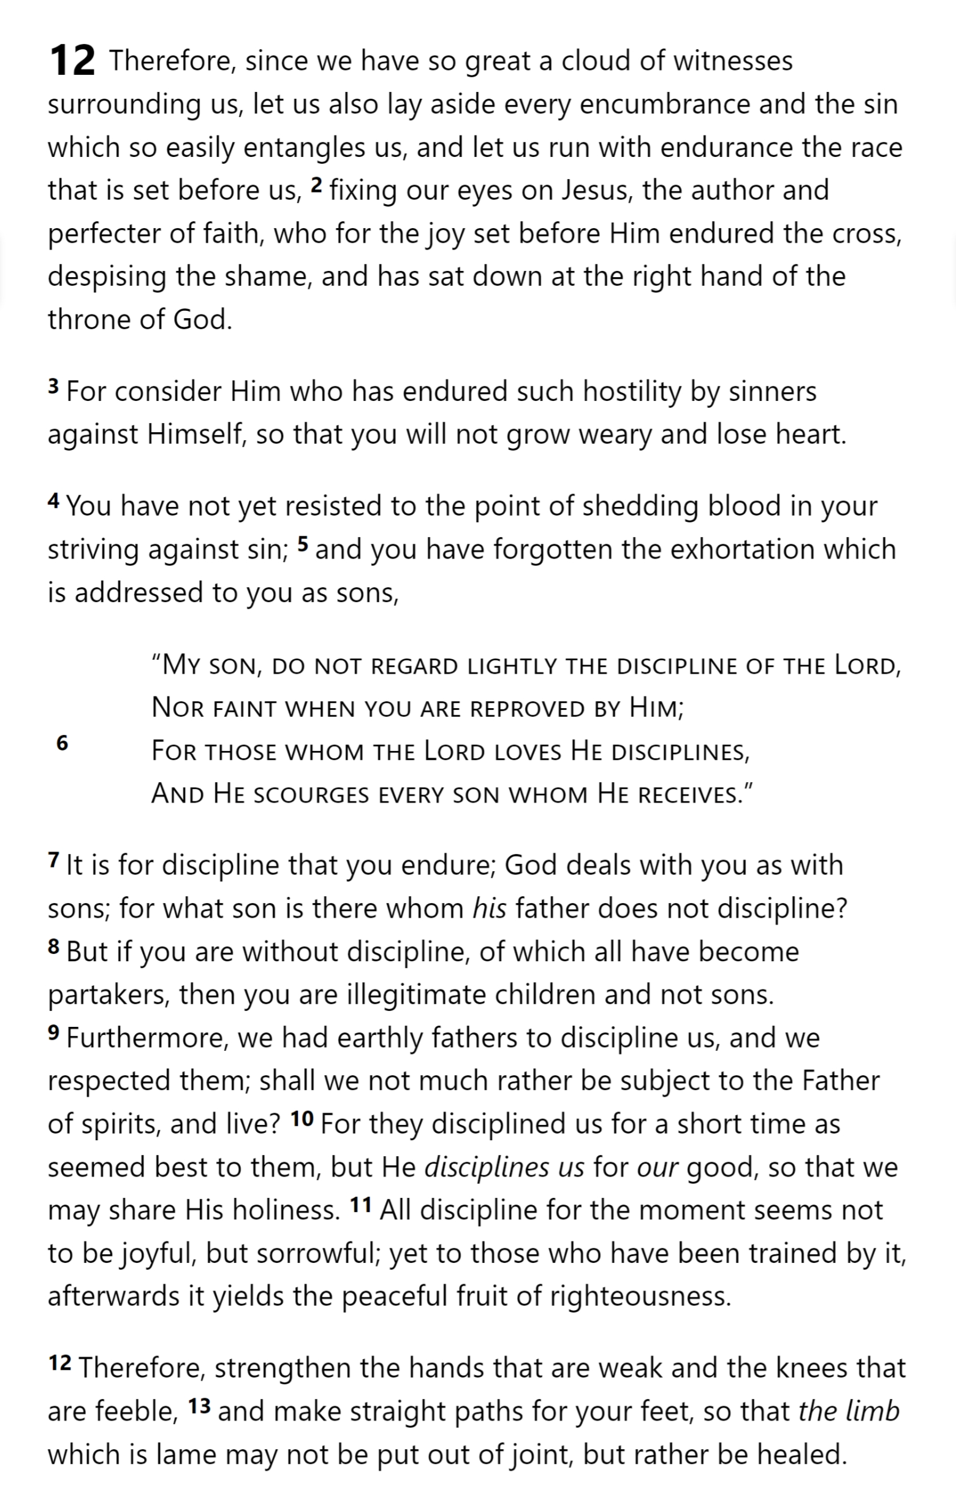
Hebrews 12

Slide 33
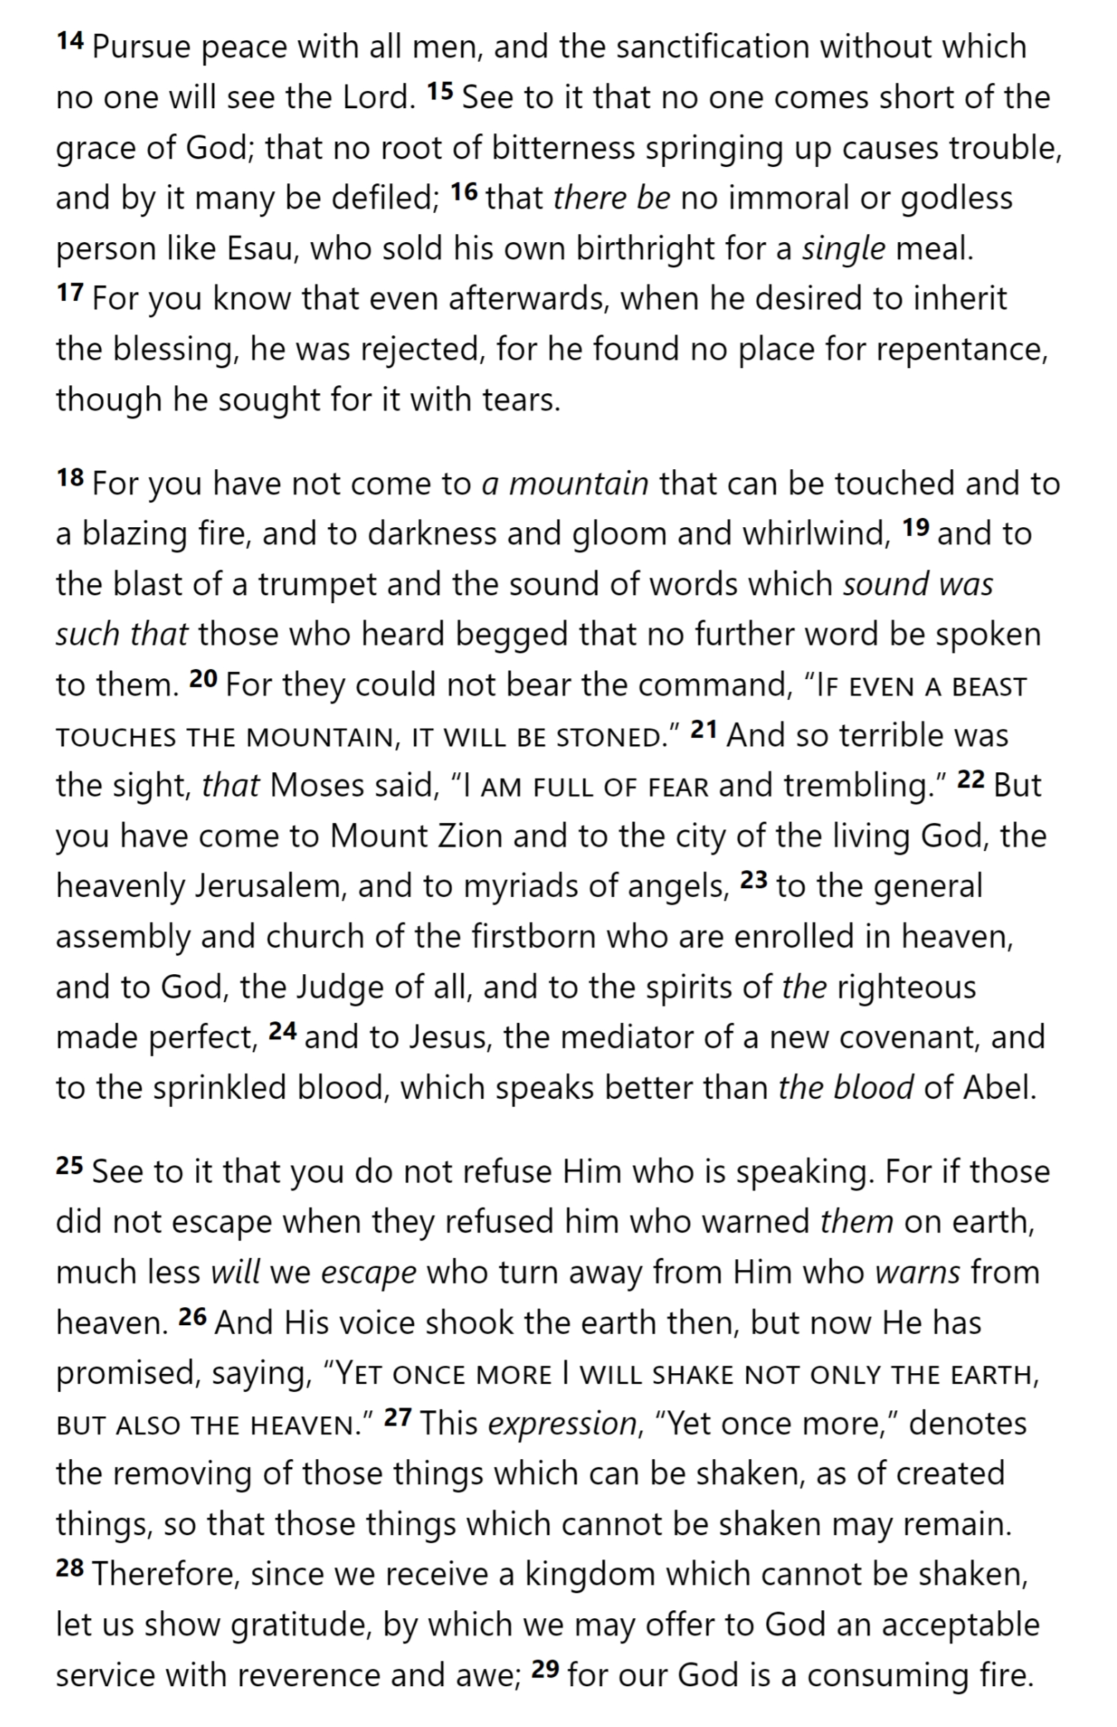
Hebrews 12

Slide 34
Hebrews 12

Slide 35
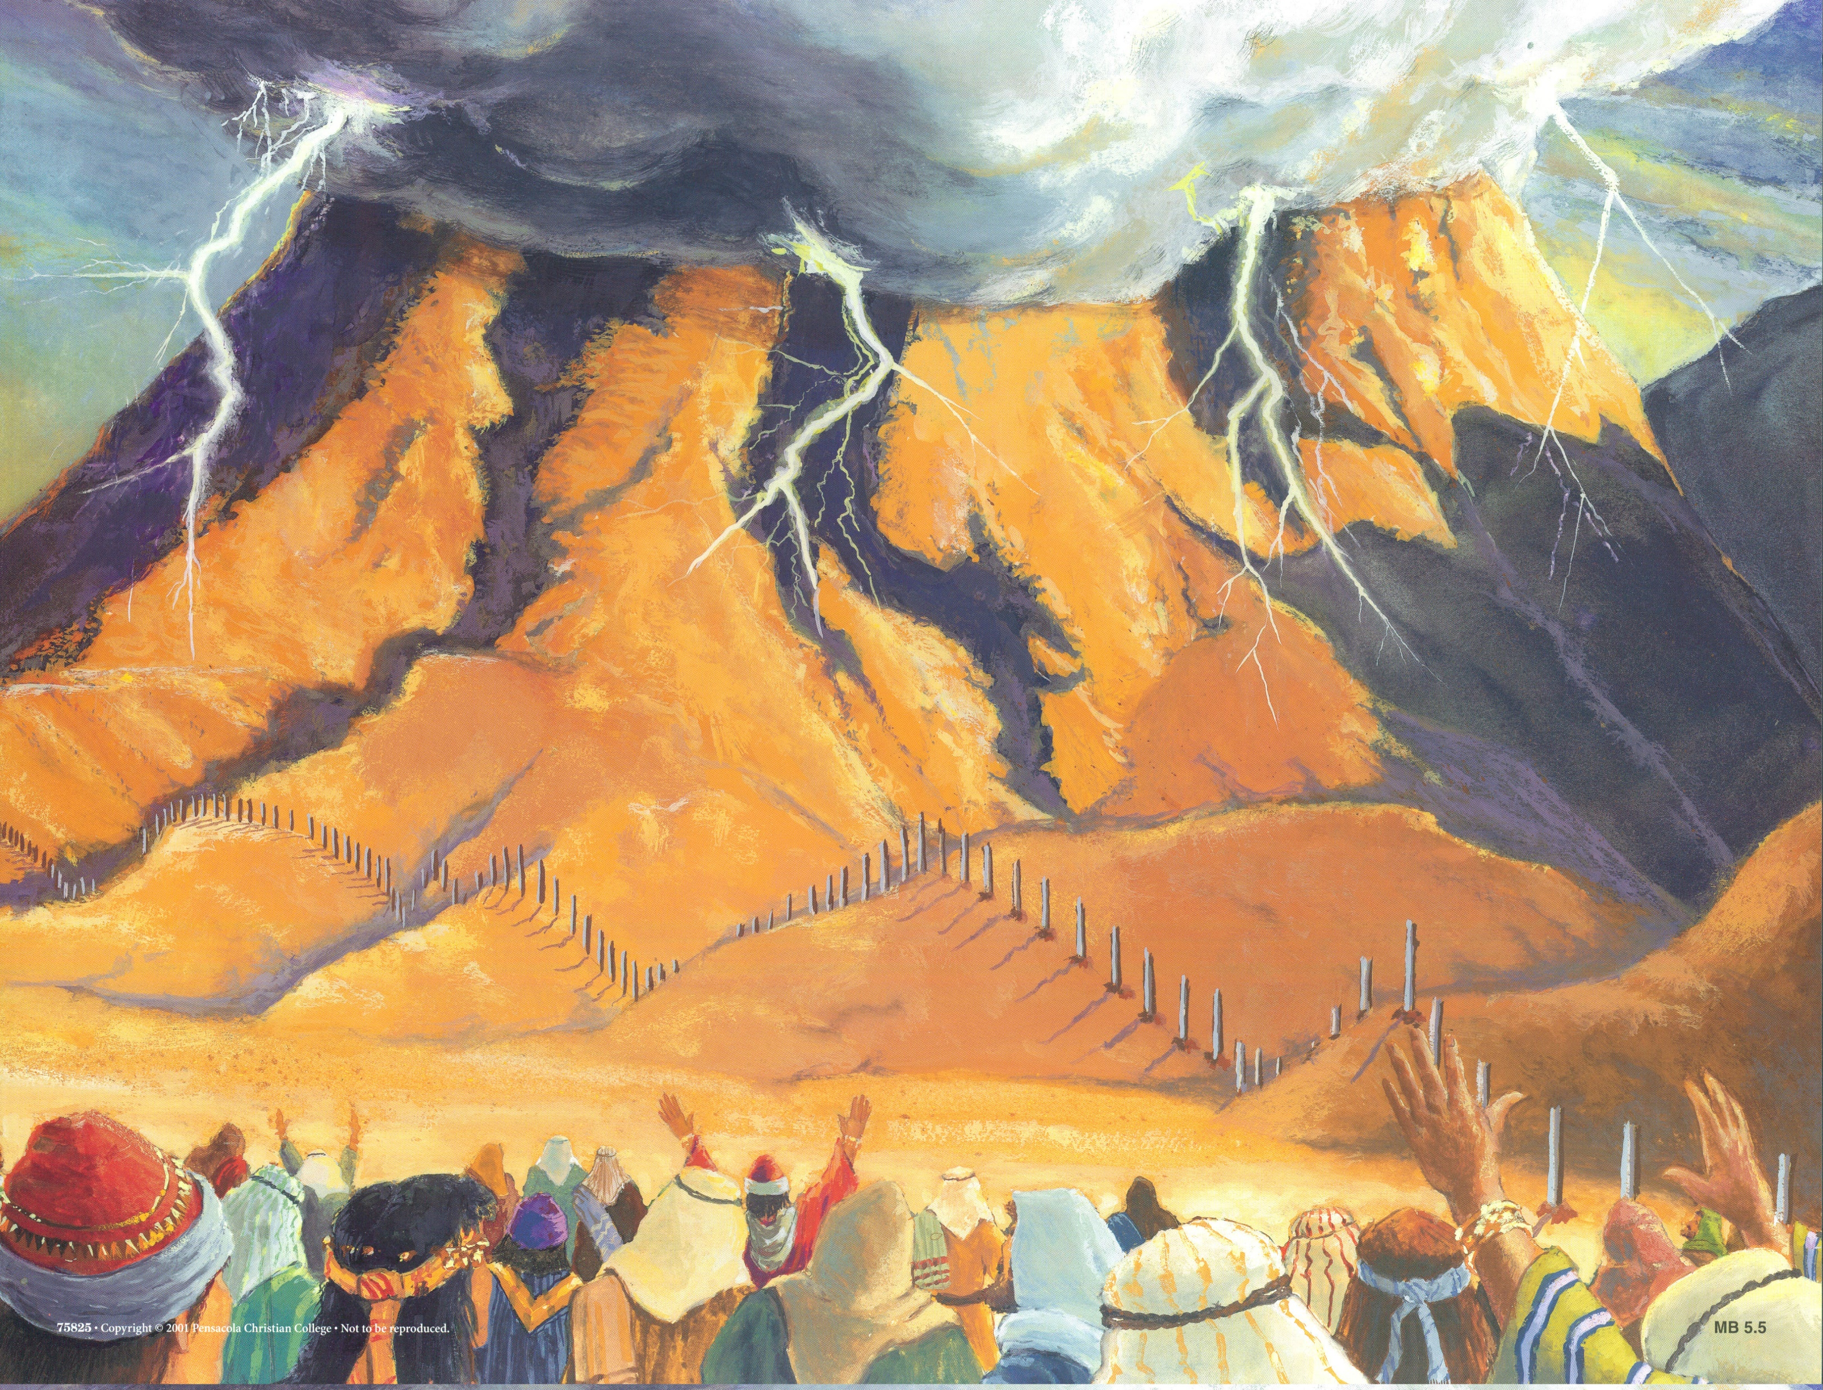
HOLY
SPIRIT
GOD
SON
SON
SON
SON
SON
MAN
MAN
MAN
MAN
SON
COVENANT
MAN
SON
Hebrews 12

Slide 36
HOLY
SPIRIT
GOD
SON
SON
SON
SON
SON
MAN
MAN
MAN
MAN
SON
COVENANT
MAN
SON
Hebrews 12

Slide 37
Hebrews

