Slide 2


Slide 3
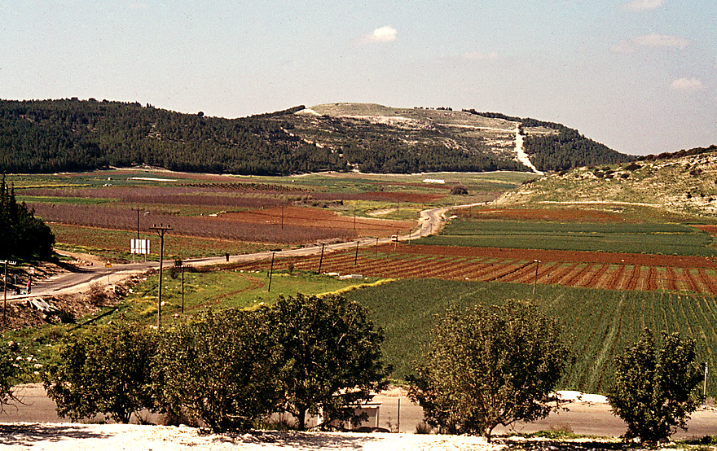
Courtesy of Ferrell Jenkins

Slide 4
FEAR
Israel’s response to the Philistine champion
DOUBT
how Israel felt about David
COURAGE
the result of David’s confidence in the Lord

Slide 5
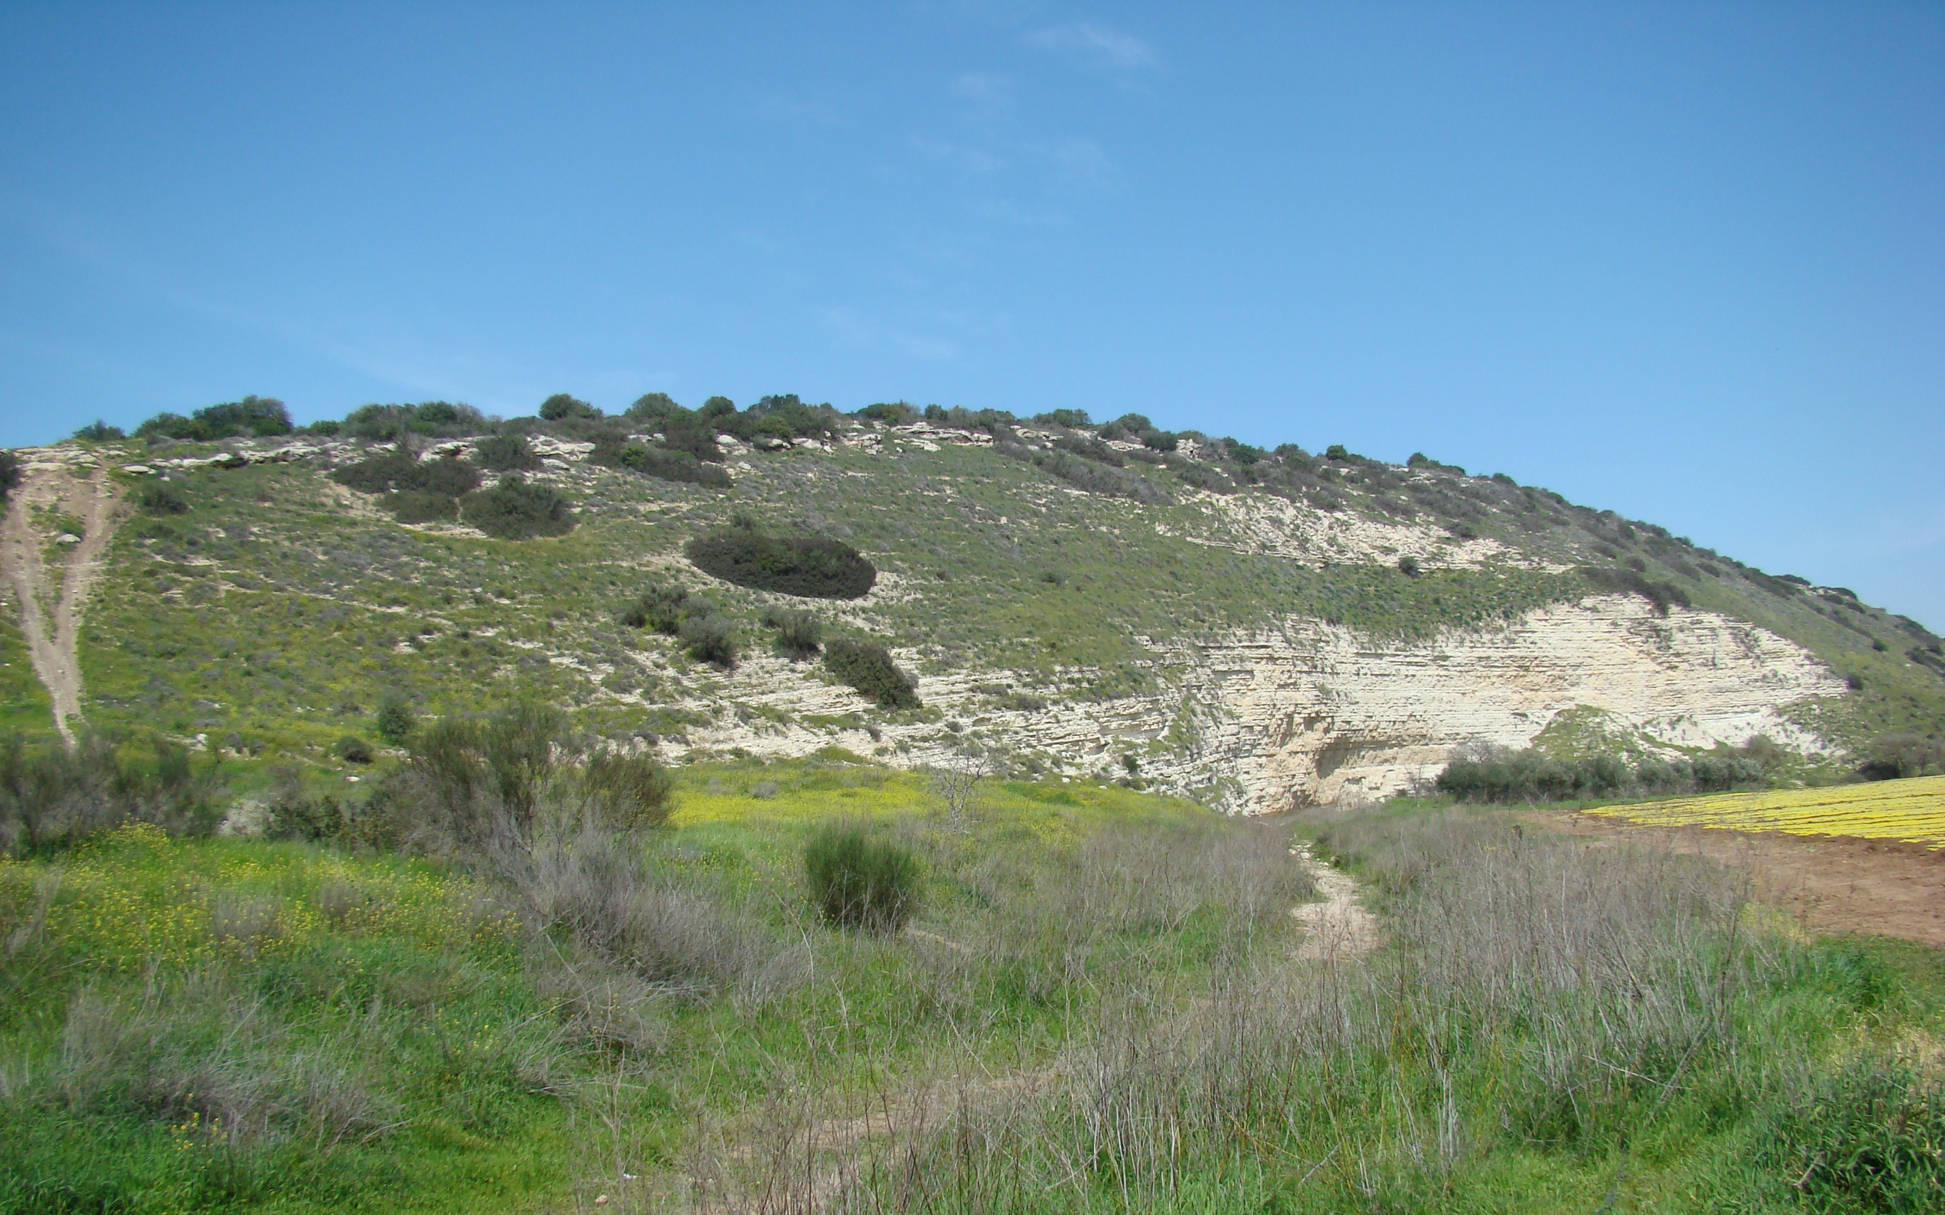
Courtesy of Leon Mauldin

Slide 6
FEAR
remains a problem
COURAGE
comes from knowing WHO is with us
SO WE STAND & FIGHT…

