Slide 1
WARM UP
Complete: But I received _______ for this reason, that in me, as the _________, Jesus Christ might display his ________ patience as an _________ to those who were to believe in him for eternal life. (1 _________ 1:16)
Name the place:
Paul’s birth
Paul’s rebirth
Name some events following Stephen’s stoning that led to the door to the Gentiles being opened

Slide 2
*Took 15+ years
PREACHER TO THE GENTILES
Jesus’ mission (Acts 1:8) and prophecy (Acts 2:17)
There are Hellenists (Acts 2:5) and proselytes from beginning (Acts 6:5)
Stephen’s stoning (Acts 7:51-53) and Paul’s persecution (Acts 8:4)
Samaritans
Acts 8
Saul’s conversion
Acts 9
Cornelius
Acts 10
Antioch
Acts 11
Jerusalem visits
Acts 22:21; Gal. 2?
Saul’s journeys
Acts 13:1; 14:27
Continuing controversy
Acts 15

Slide 3
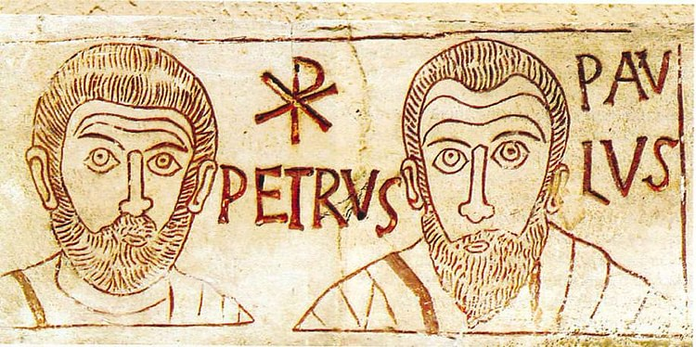
LIFE and epistles OF PAUL
Embry Hills
Feb – April, 2024
LESSONS 3-4
1st preaching tour, controversy over Gentile converts
Engraving in Catacombs
Anonymous

Slide 4
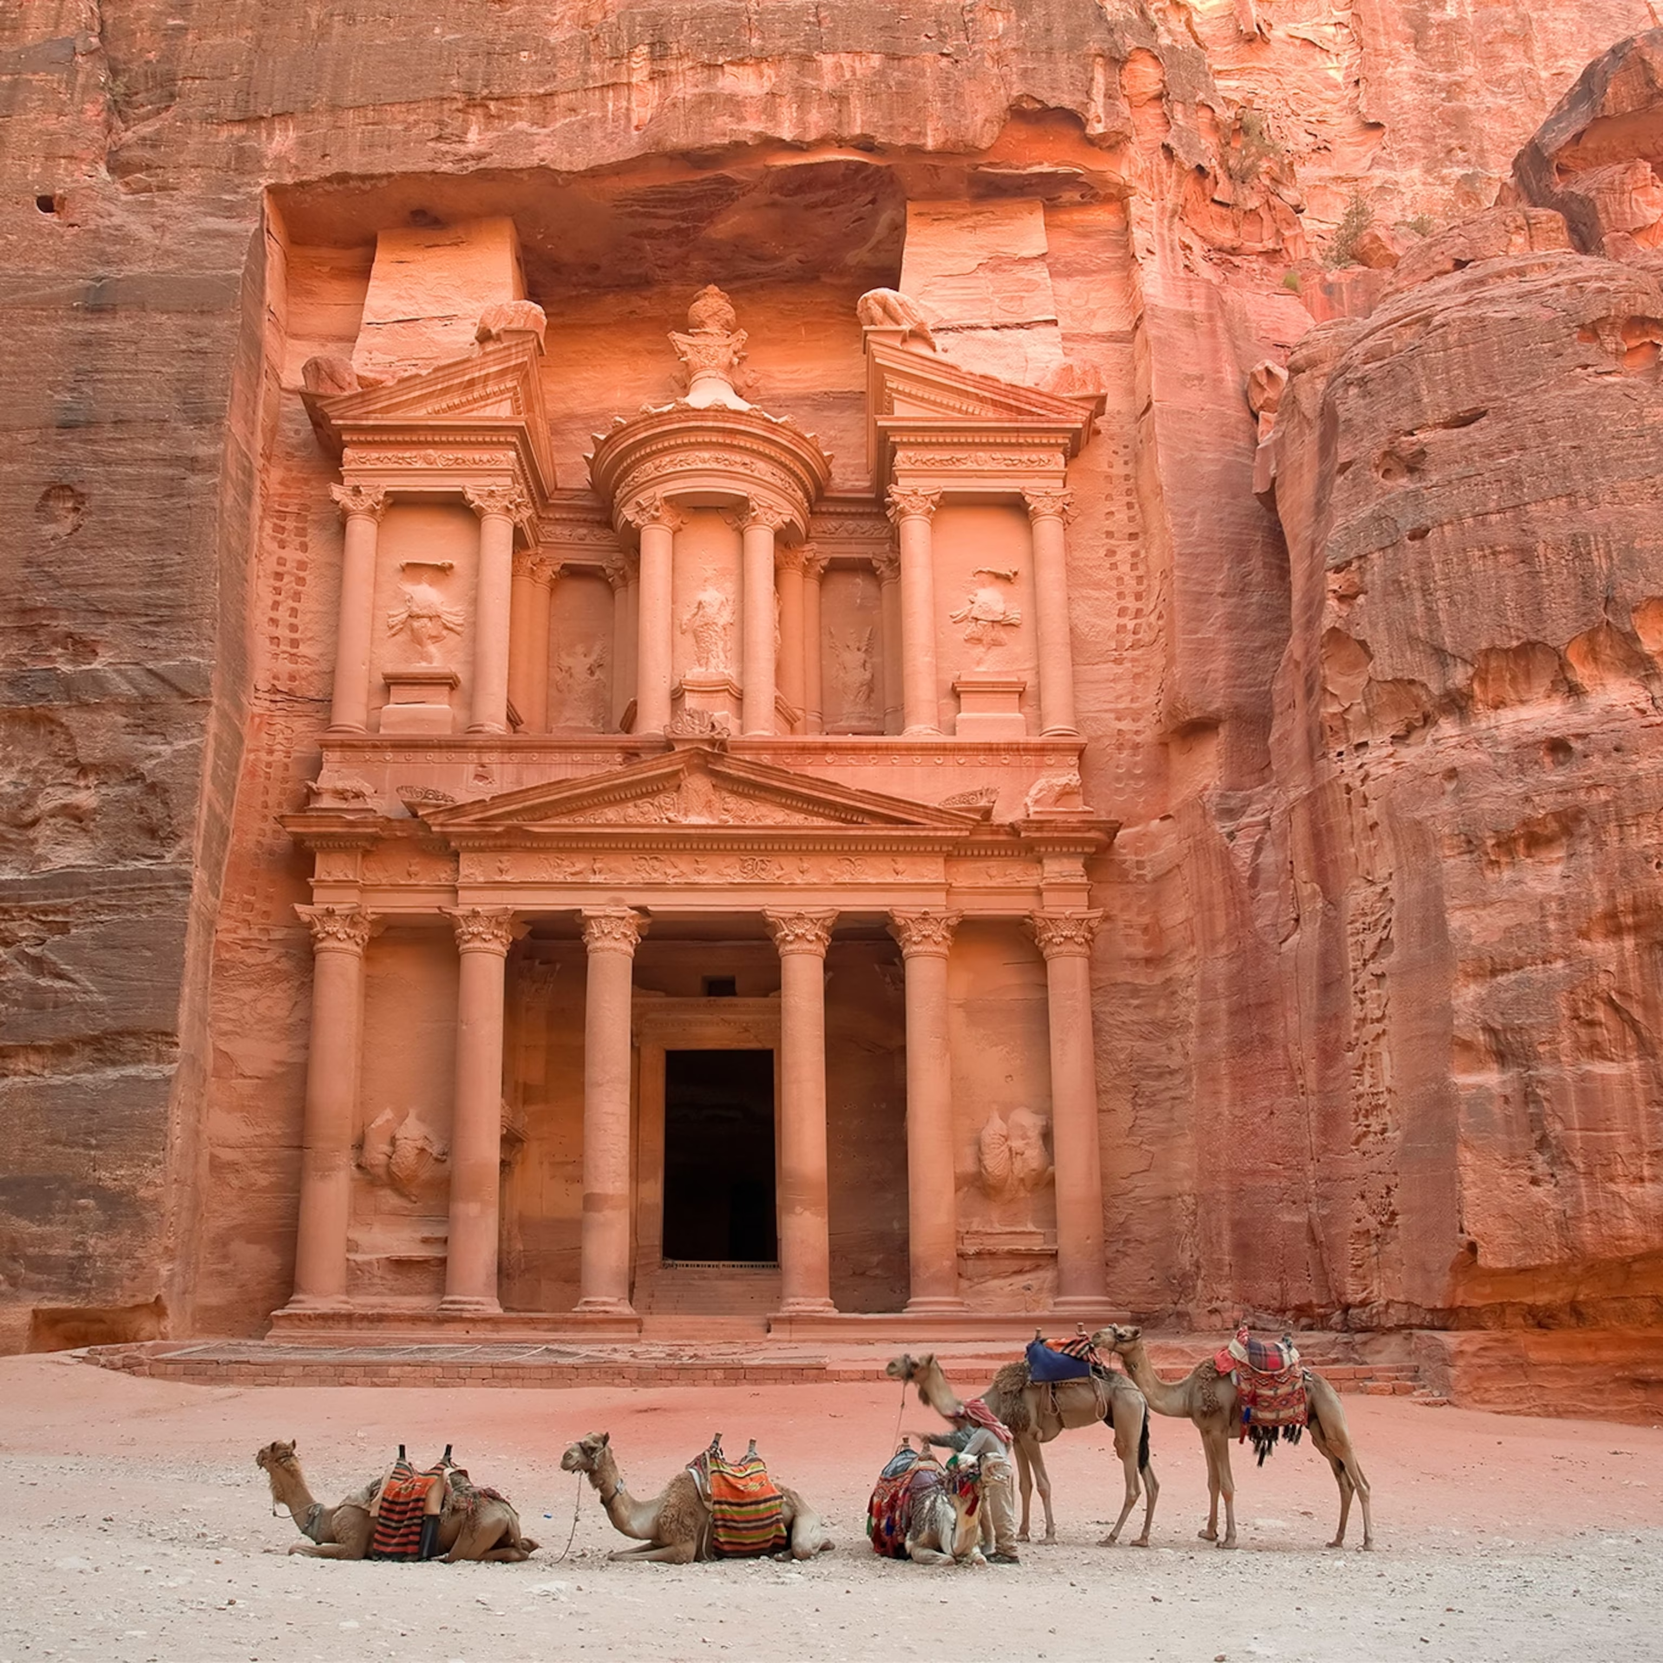
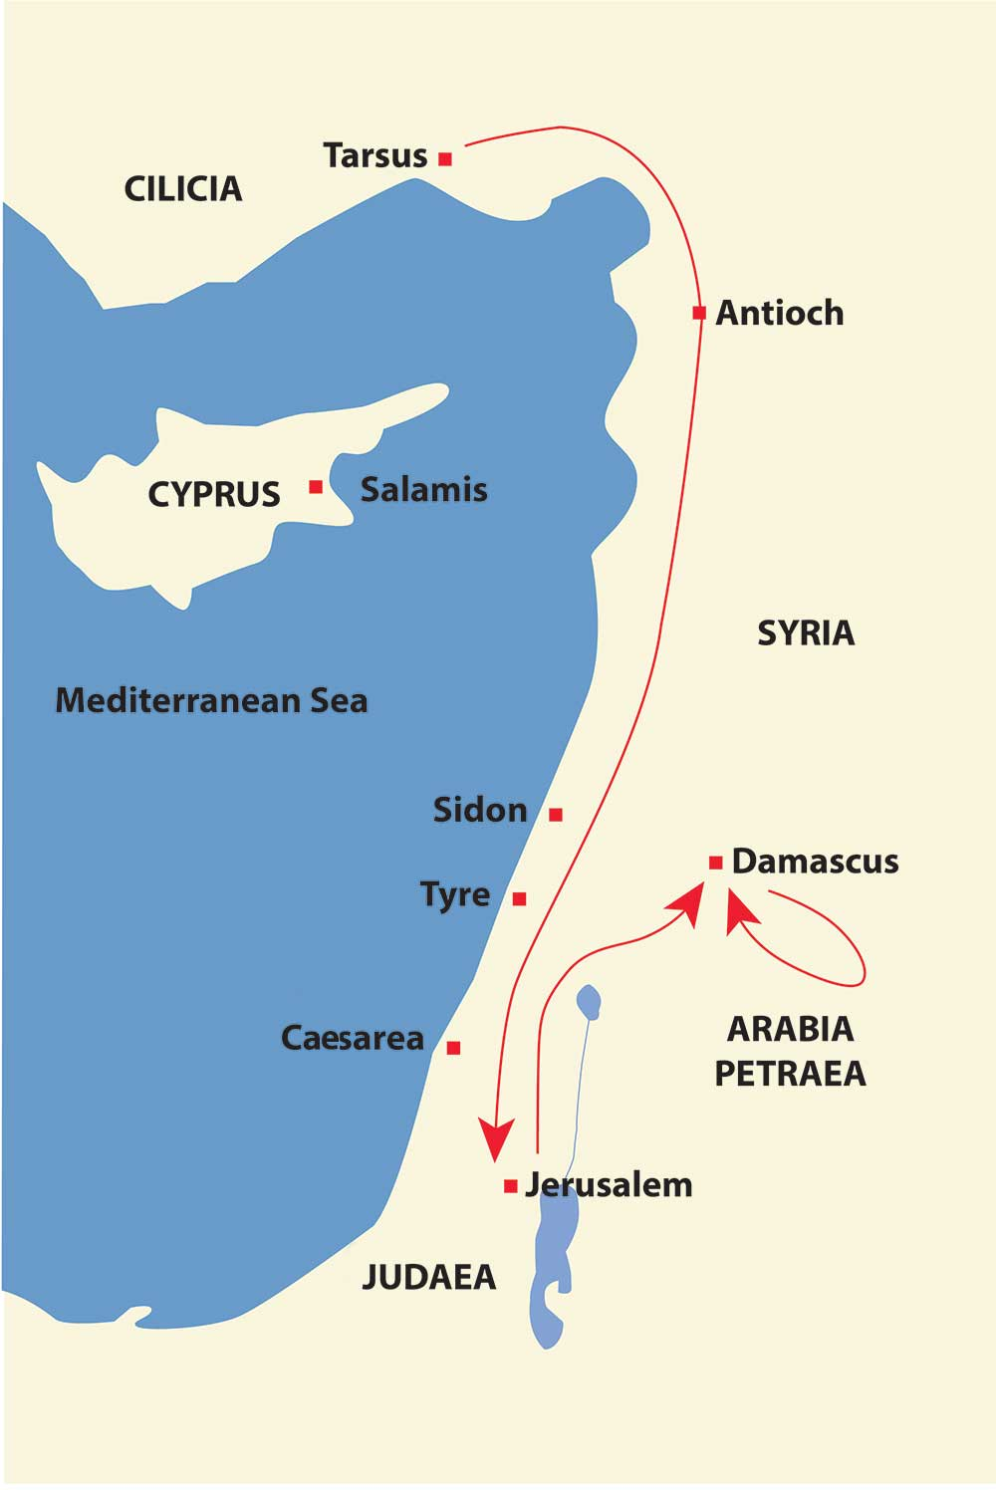
CONVERSION TO 1st journey (1/2)
Several days in Damascus, 9:20
“Immediately” began to proclaim – synagogues (Gal. 1:11-12)
Amazed, cf. John 9:8, Acts 3:10; Mark 5:15; Gal. 1:24
Confounding, proving – cf. 6:9,10; 9:29
“Many days” elapse, 9:23.
Arabia? 3 years, Gal. 1:18.
Bruce: preaching to Nabatean kingdom, p. 86, based on 2 Cor. 11:32,33 referring to Nabatean king Aretas.
Greeks? Only in synagogues? (Acts 22:21?; 26:20? Note esp. Acts 15:23, 41)

Slide 5
CONVERSION TO 1st journey (2/2)
“When he came to Jerusalem” 9:26
Fear, Barnabas intercedes
Stays with Peter 2 weeks and only sees him and James (Gal. 1:18-19)
Moving freely, speaking boldly (reasoning: Acts 22:19-20)
Hellenists. Want to kill. Vision from Jesus, Acts 22:17-21
Sent to Tarsus, Gal. 1:21. How long was he there? (Gal. 1:18; 2:1; Acts 11:26)
What are some events that might have taken place in this period? (2 Cor. 11:23 – 12:10)
Why no information on Arabia or Tarsus? We are limited to what the point of Luke and Paul’s narrative is! (Acts 1:8)
Church in peace – cf. 2:46f, 4:32ff 6:7 – bookend statements indicating resolution. This ends the Stephen episode. 12:24 contrast method.

Slide 6
ANTIOCH (1/2)
11:19 is a lengthy period
Movement to Phoenicia, Cyprus, Antioch
Greeks (contrast to “Jews alone”). Hellenists (ESV) would not be noteworthy
Yet must be after Cornelius (Acts 15:7)
11:22 Bros. in Jerusalem support (similar to 8:14; maybe 9:31,32,36)
Barnabas is Cyprian
Tarsus not far – Barnabas knew value (9:27,28; knew Paul’s commission?)

Slide 7
ANTIOCH (2/2)
Spent 1 year teaching
Agabus, famine, contribution to Judea. Show of relationship
Paul went to Judea with contribution. Must be the second visit to Jerusalem (Gal. 2:1-10), assuming Paul doesn’t skip over it (which would be contrary to his purpose)
Goes up upon revelation
Barnabas and Titus accompany
Controversy from false brethren
Took the occasion for private meeting – Peter, James, John – laid out gospel to Gentiles. Right hand of fellowship
Just remember the poor (Acts 11:29,30)
Peter comes to Antioch and Paul has to condemn him.
Acting hypocritically, not in accordance with gospel

Slide 8
Course calendar
L | Date | Subject | Texts | Dates
1 | 25-Feb-24 | Background, youth and persecution | Acts 7-8 | 0 – 33
2 | 28-Feb-24 | Conversion until Antioch | Acts 9-11,22,26; Gal. 1-2 | 33 – 46
3 | 3-Mar-24 | 1st preaching tour; controversy over Gentile converts | Acts 13:1 – 15:35; Gal. 4-6 | 47 – 49
4 | 6-Mar-24 | 1st preaching tour; controversy over Gentile converts | Acts 13:1 – 15:35; Gal. 4-6 | 47 – 49
5 | 10-Mar-24 | 2nd preaching tour; epistles from 2nd tour | Acts 15:36 – 18:22; 1&2 Thess. | 50 – 54
6 | 13-Mar-24 | 2nd preaching tour; epistles from 2nd tour | Acts 15:36 – 18:22; 1&2 Thess. | 50 – 54
7 | 17-Mar-24 | 3rd preaching tour; epistles from 3rd tour | Acts 18:23 – 20:38; Romans, 1&2 Cor. | 54 – 58
 | 20-Mar-24 | (No class)
8 | 24-Mar-24 | 3rd preaching tour; epistles from 3rd tour | Acts 18:23 – 20:38; Romans, 1&2 Cor. | 54 – 58
9 | 27-Mar-24 | Imprisonment in Caesarea | Acts 21-26 | 58 – 59
10 | 31-Mar-24 | Journey to Rome; prison epistles | Acts 27-28; Eph., Phi., Col., Phlm. | 60 – 61
11 | 3-Apr-24 | Journey to Rome; prison epistles | Acts 27-28; Eph., Phi., Col., Phlm. | 60 – 61
12 | 7-Apr-24 | Life after Acts; preacher epistles | 1&2 Timothy, Titus | 62 – 68
13 | 10-Apr-24 | Overflow and review

Slide 9
APPROX. TIMELINE – PAUL’S LIFE
Tarsus, Gamaliel, zealous, persecutor
Damascus/Arabia (3 years),
Visit to Jerusalem,
Syria/Cilicia,
Antioch (1 year)
1st preach trip
30
40
50
60
70 AD
Cross
Galatians?
1st visit to Jerusalem
2nd visit to Jerusalem
Stephen
Peter visits Antioch
Jerus. conference

Slide 10
(attempted) timeline of Paul’s life
S. Hall
Blue Letter Bible
Conybeare & Howson
BEE
Stalker
Bruce
30
33
35
35-46
46
47-48
48?
49
c. 4 BC Jesus born
c. 0 AD Paul born
30 Jesus died, Pentecost
31 Stoning of Stephen
33-34 Paul converted in Damascus
Paul goes to Arabia
35 Paul returns to Damascus
36 Paul goes to Jerusalem – 2 weeks
Paul goes to Tarsus
45 Paul brought to Antioch
46-47 2nd visit to Jerusalem. Acts 11, Gal. 2?
Peter’s visit to Antioch
Peter imprisoned, James martyred
47-48 1st journey
? Letter to Galatians?
49 Visit Jerusalem – conference. Gal. 2?
50 Paul in Antioch, 15:36
34
34
36
36
39
40-42
43
44
44
46-49
57
50
c. 5
32
34
34-37
37
37
37-46
47
47
48-49
51
49
30
36
37
38
39-43
44
45
48-49
50
30
35
35-37
38-43
44
46-47
51
50

Slide 11
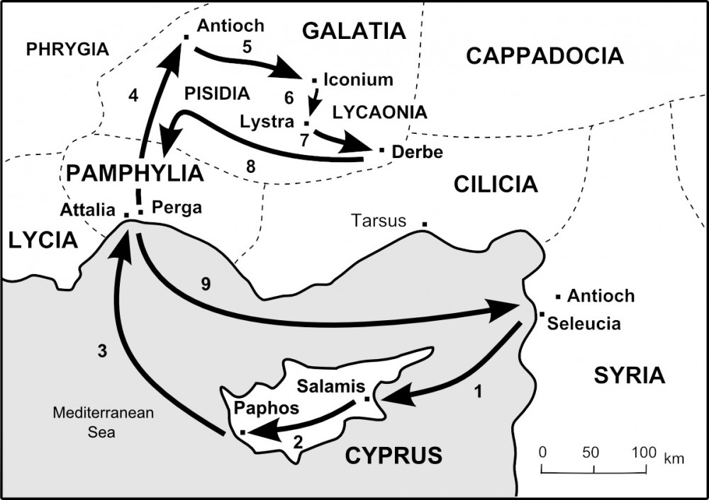
1st journey
Synagogue sermon, persecution
Sending out
Company
Why Cyprus?
Why synagogues?
Why Paul?
Antioch sermon and Jewish reaction
2 Cor. 11:25; 2 Tim. 3:10-11
Final report?
Long time, plot
Lame man, sacrifices, stoned
Strengthen, elders
John leaves
Long time
Holy Spirit sends out
Sergius Paulus, Elymas

Slide 12
THE SIGNS OF AN APOSTLE Rom 15:18-19; 2 Cor. 11:30
CONVERSION EPISODE: Men – hear voice, Paul blinded, Ananias – vision, restoration of sight
IN JERUSALEM: Vision (Acts 22:21)
IN TARSUS: Vision (2 Cor. 12)
1st JOURNEY: Blinds Elymas, signs and wonders (14:3), heals lame man, gets up after stoning; imparted Spirit to Galatians (3:5)
2nd JOURNEY: Imparts gift to Timothy (2 Tim. 1:6; cf. Rom. 1:11); guidance through dream; exorcism and miraculously freed from prison in Phillippi; “power” among Thessalonians (1 The. 1:5); tongues, signs in Corinth (1 Cor. 14:18; 2 Cor. 12:12)
3rd JOURNEY: Imparts gifts to 12 disciples (19:6); extraordinary miracles in Ephesus (Acts 19:11); resurrection of Eutychus (20:10); revelation by Spirit (20:23)
JOURNEY TO ROME: Vision and prophecy (27:23ff); snakebite on Malta (28:3ff), healing of Publius father and the sick of the island (8ff)

Slide 13
Warm up - MATCH
Home base; where Holy Spirit sends out
Sergius Paulus and Elymas
John Mark leaves
Synagogue sermon
Healing of lame man; Paul stoned
Perga of Pamphylia
Antioch of Pisidia
Lystra of Lycaonia/Galatia
Antioch of Syria
Paphos of Cyprus

Slide 14
JERUSALEM CONFERENCE – THE ISSUE
Men from Judea – teaching (not from apostles), v. 24 (cf. Gal. 2:12; 1 Jn 2:19)
Their position stated (2, 5)
Their theology: Judaism + Jesus
Great debate
Determination: go to Jerusalem. Is this a church council?
Members of church A teach a problematic doctrine in church B. Church B sends representative members to church A (the source) to address the issue.
Paul and Barnabas knew the truth.
There are apostles – source of authority.
Paul (in my view of chronology) had no doubt what the other apostles would say

Slide 15
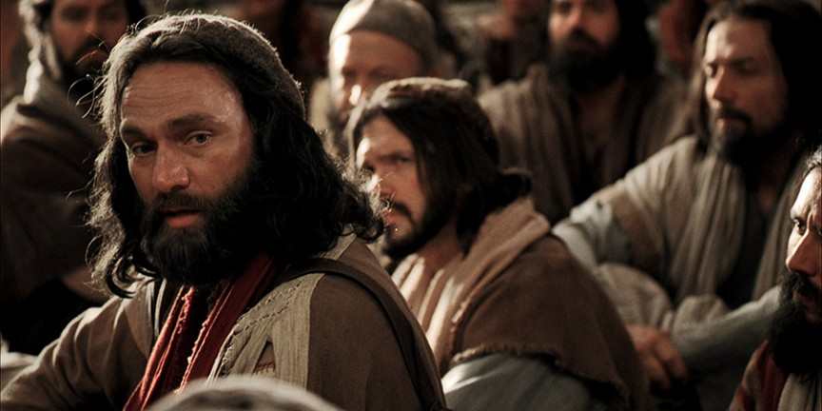
JERUSALEM CONFERENCE - DEBATE
Phoenicia/Samaria – describing – joy
Jerusalem – rec’d – church, apostles, elders
Much debate. No opposing arguments mentioned here, but implicit in many places in polemic sections of Paul’s epistles (e.g. Rom. 3:31; 6:1; 7:7; 9:19; 11:1; Gal. 3:19, 21)
Peter:
God’s choice (15:7)
God’s witness (8). Approved example
God’s attitude (9). Cf. Gal. 3:28
Imposing the yoke of the law = opposing (cf. Gal. 5:1-4)
Salvation is by grace…for Jews also
Barnabas (name first) and Paul
Signs and wonders – necessary conclusion
James (Gal. 2:12)
Prophets (Amos 9:11,12). Direct statement
Write: No trouble, but holy people (Lev. 17-18)
If they want to follow law, they can

Slide 16
JERUSALEM CONFERENCE - LETTER
Who made the decision? (22,28)
Why send Judas and Silas?
V. 23 – same status
Result – v. 31
Who got this letter? (v. 23). Who else needs it? (v. 36; 16:4)

Slide 17
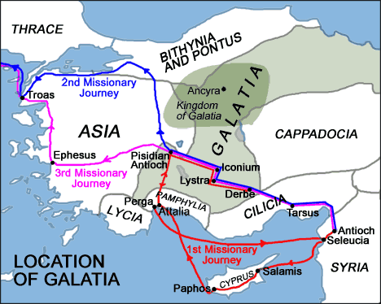
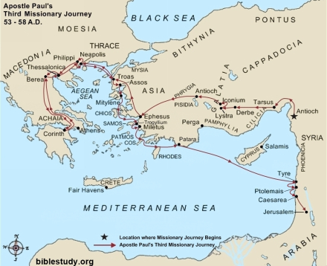
GALATIANS
When written? And to whom?
Paul preached to them (1:8). They were Gentiles (4:8). Some Jews were trying to circumcise them (6:12ff)
Galatia is a region. There were important cities in the north and in the south. Paul visited the south on the first journey. He “went through” Galatia on second journey (16:6). He “went from one place to the next through the region of Galatia” on the 3rd journey. Given the lack of particular indicators in the book, the book could fit in any of these contexts.
However, the theme dovetails with the situation of Acts 15, so we will study it here.

Slide 18
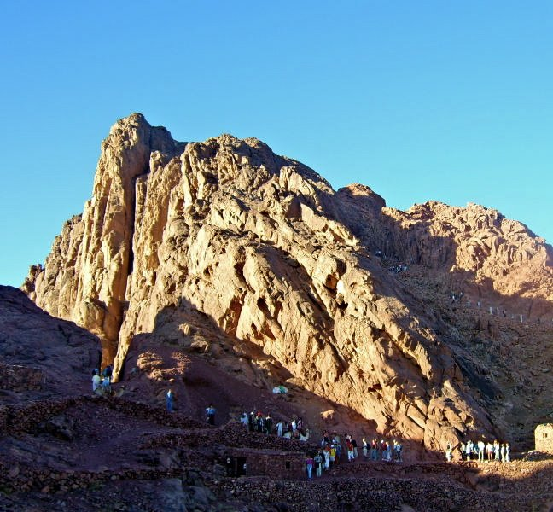
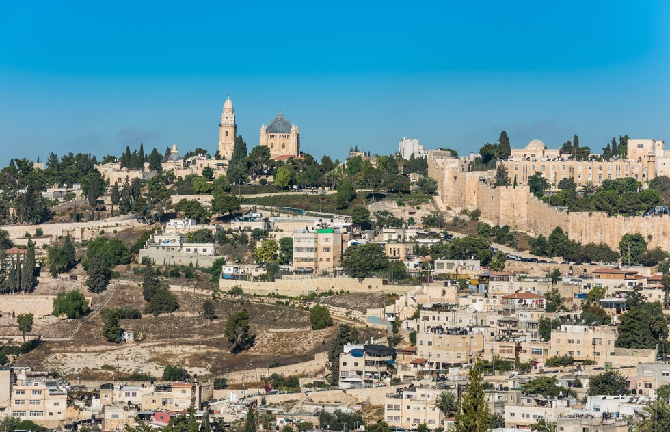
GALATIANS
Defense of apostleship
“1:11 For I would have you know, brothers, that the gospel that was preached by me is not man's gospel. 12 For I did not receive it from any man, nor was I taught it, but I received it through a revelation of Jesus Christ.”
Justification by faith, not law
3:10-14. Law doesn’t justify; it curses. Jesus became the curse, and our faith in Him saves us.
Why the law then? History and the Bible summed up in 3:21ff.
Exhortations to godliness
“5:16 But I say, walk by the Spirit, and you will not gratify the desires of the flesh.”

